Slide 1
Zimbabwe
Author
Institutional Affiliation
Course Code
Date of submission

Slide 2
Introduction
Zimbabwe, formerly known as Rhodesia, is a landlocked country in the southern part of the African continent located between the two major rivers of Zambezi and Limpopo.
The country’s capital is located at Harare. Occupying a total area of 390, 757 square kilometers, the country is home to 14 million people with a population density of 95.2 persons per square kilometer (UN, 2020).
However, the country’s projected population is expected to reach 19 million by the end of 2030.

Slide 3
Economic Issues
Cumulatively, the country’s GDP currently stands at 42.5 billion US dollars. Zimbabwe enjoyed a positive GDP for a better part of the 1980s and early 1990s until its involvement in the War in the DRC in the 2000s that saw a fall in its GDP by approximately 20% (ADBG, 2020).
Due to the drain imposed on the country’s economy by this war, the average purchasing power declined considerably, however the government had pointed accusing fingers at the foreign governments and imposed sanctions as the main causes for the failing economy

Slide 4
Cont.…
The country’s economy rebounded in 2009 after the formation of a unity government and adoption of the Zimbabwean dollar.
The 2020 GDP of Zimbabwe stands at 42.5 billion US dollars in a country whose 60% of the population falls below the poverty line.
Minerals and gold represents the country’s major foreign exports. Similarly, tourism plays an important in the country’s economy (Kararach & Otieno, 2016).

Slide 5
Cont..
The country’s mining sector has continued to play pivotal roles in enhancing the country’s economy. For instance, some of the country’s largest reserves being mined currently include the Marange diamond fields(Kararach & Otieno, 2016).
The economy was majorly contributed by the tertiary industry that made up its 60% GDP in 2017.
A large number of the population in Zimbabwe stills depends on farming while there is also a considerable number who depend on formal employment. Zimbabwe depends hugely on the agricultural sector and mining.

Slide 6
In Zimbabwe, it was estimated that the levels of poverty had risen significantly from 29% in 2018 to 34% in 2019 which is quite a high percentage considering the population in Zimbabwe (IMF, 2020).
Unemployment is still a big issue in in most African states, and in Zimbabwe, the current unemployment rate stands at 4.95% , a slightly higher number in 2019 considered to 2018.
According to evidence obtained from the African Development Bank, state corporations and enterprises enjoy highly subsidized taxes as opposed to their private counterparts.

Slide 7
Although tourism has been considered a major source of income to the Zimbabwean economy, earnings from this sector have continued to dwindle over the past owing to the fact that a good portion of the country’s wildlife have been lost due to poaching and deforestation.
Agriculture has as well remained a key contributor to the country’s economy. The country produces wheat, and maize which accounts for over half of the country’s gross domestic product.

Slide 8
Social Organization
Home to approximately 14 million people, Zimbabwe is socially structured society. About 40% of this population is dominated by the youth while the rest of the population is comprised of the rest of the population (UN, 2020).
The country’s total population currently stands at 14 million, with the life expectancy ranging between 56 years and 60 years for men and women respectively.
UNESCO observed that the country’s HIV infection rates stands at 14% particularly for people aged 15 and 49 years.

Slide 9
However, the organization has also noted a decline in the rates of new infections among pregnant women.
In terms of religion, the country is religiously diverse consisting of Christians, Islam and traditional worshipers. It is important to note that 85% of the total population are Christians. Observably, Islam accounts for only 1% of the total population (UNESCO, 2016).
Ethnically defined, the country is made up of a majority Bantu speaking group comprising of 70% of the total population. the minority ethnic groups make up the remaining percentage.

Slide 10
As observed during the last census report, it was noted that 97% of the country’s population is of African origin (UN, 2020).
Due to the serious economic crisis in the country and the oppressive political regimes, most of the country’s nationals have fled the country as refugees to the neighboring countries of South Africa and Botswana.
Currently, close to 4 million Zimbabweans have left the country as refugees.

Slide 11
Although English is considered the main language that is used in the education and judicial systems, the country recognizes other 16 official languages drawn from the major ethnic divisions.
A good portion of the Zimbabwean people are bantus and therefore speak their native languages. Though the country has 16 official languages, Shona, due to its rich oral tradition has gained huge popularity in the nation (Learning Factory, 2018).
It is noted that English mostly spoken in cities, has as well been incorporated in schools as a teaching language alongside Shona and Ndebele.
In Zimbabwe, most of the radio and televisions broadcast their news in Shona, Sindebele and English.

Slide 12
Cont.…
Education in Zimbabwe falls under the country’s ministry for primary and secondary education and the ministry for higher and tertiary education.
It is noted that the country’s education system would require 13 years to cover both primary and secondary education.
Declared a basic human right by the former president, Education in Zimbabwe is free and compulsory for all the children of school-going age. The government in Zimbabwe has focused on ensuring universal coverage of education in the country to achieve the millennium development goals (UNESCO, 2016).
The government’s specific objective is to enhance its literacy programs to all the children in the country by the year 2030.

Slide 13
Political Issues
Zimbabwe is purely a presidential republic headed by a president who is the head of government.
It is a democratic state guided by the rule of law under the constitution, although many could argue that the constitution has failed to offer good governance and provide the blue print of the running of both the society and government business (Chitiyo & Rupia, 2005).
There are three arms of government namely; the executive headed by the president, the legislature headed by the prime minister and then the Judiciary headed by the chief justice.

Slide 14
Several attempts had been made by the country to change the constitution by the former dictatorial president Robert Mugabe consequently killing the previously existing democratic space in the country.
Due to the imperial leadership by the former president, and the consequent dictatorship, there has never been transparency in election for such a long time leading up to the removal of Robert Mugabe.
With the rule of law being suspended in Zimbabwe in the years preceding to the resignation of the former president, there has been a common culture of manipulating the outcome of justice processes by the political and elite class, making the public trust of the judiciary decline.

Slide 15
It has been a common practice for the avoidance of the rule of law in Zimbabwe and especially by the political class (Herbst & Herbst, 1990).
The powerful and highly connected have misused power while going around government and personal business.
The leaders of opposition have risen over the years to defend the rule of law while struggling amidst difficult political conditions to defend the constitution (Harare, 1998).

Slide 16
Cultural Issues
The culture forms the major part of a people’s society; it is by definition who a people are. Zimbabwe is quite diverse culturally and in the same length very rich.
Zimbabwe as a country boasts of several cultures including beliefs and ceremonies practiced by the people of Zimbabwe (UNESCO, 2016).
There are over 16 official languages in the country and a number of other local ethnic languages.
There are various ethnic groups with the common ones being the Shona, Ndebele, Tonga, Venda and shangaan.

Slide 17
The African art practiced in Zimbabwe has to a larger extent been influenced by the Europeans who for a long time inhabited the southern parts of Africa.
Among the distinctive aspects of culture in Zimbabwe include arts, food and languages.
Traditional arts such as basketry, pottery, textiles and carvings have for a long time been part of the country’s traditions and people culture.
A good portion of the Zimbabwean people are bantus and therefore speak their native languages.

Slide 18
Cont.…
Just like many other African nations, a good majority of the people of Zimbabwe depend on staple foods for survival.
The food in Zimbabwe is majorly grain, vegetable with some foods being seasonal like groundnuts fruits, termites milk and caterpillars (Ndhlovu, 2020). There are however practices of food taboos, for instance foods like eggs were believed to cause infertility.
One of the areas that culture has manifested itself is in traditional ways of treating of ailments. Before the arrival of scientific interventions of treating of conditions, Zimbabwe had traditional interventions to address most illness.

Slide 19
Cont.…
Used in the preparation of thick porridge, cornmeal is eaten during breakfast. However, it can as well be used to prepare Sadza eaten during super and lunch.
Rice and chicken are also served as main meals during graduation ceremonies and weddings.
Having been a former British colony, most of the eating habits in Zimbabwe have been adopted from the colonial master.
It is possible to find most people taking porridge for breakfast, and still serve tea at midday.

Slide 20
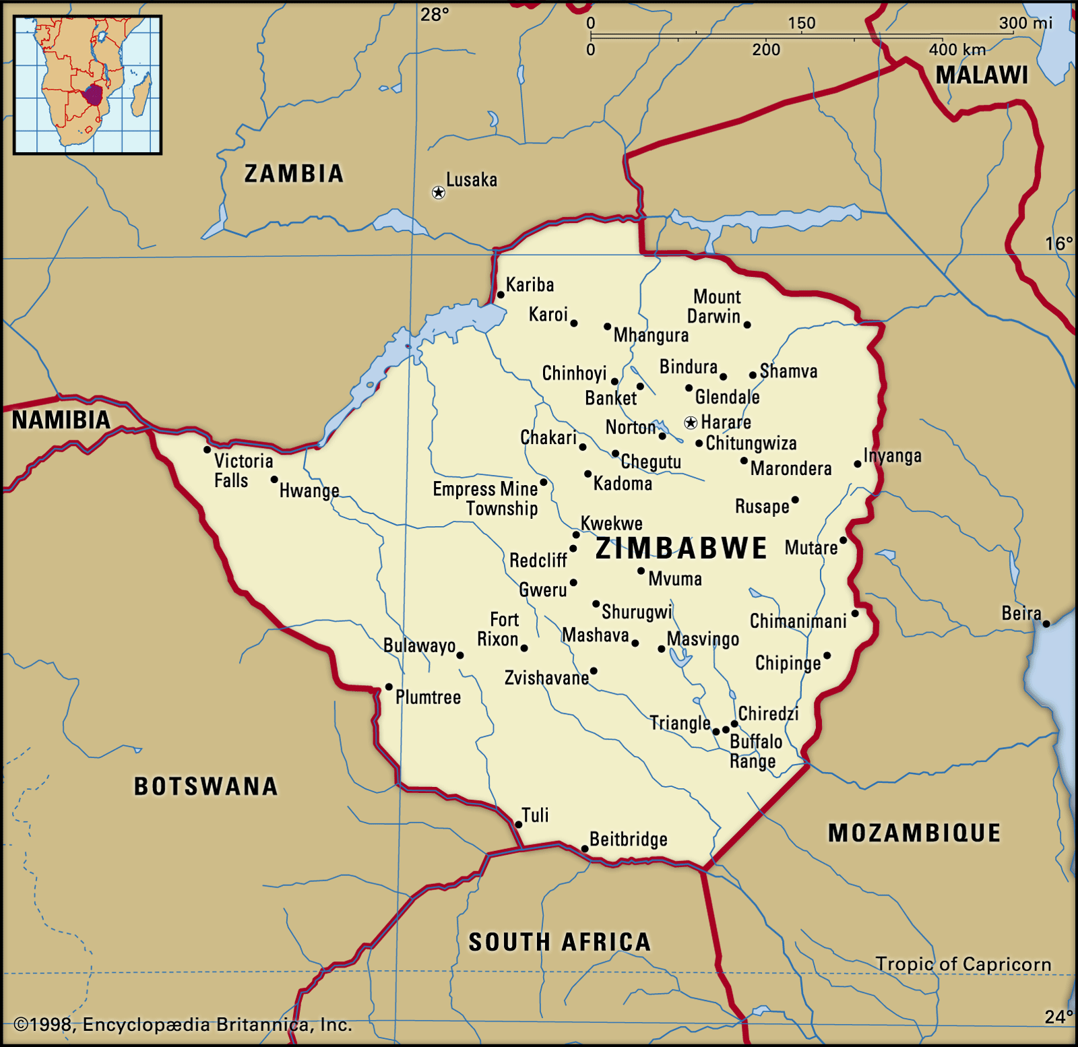
An image showing the map of Zimbabwe

Slide 21
References
Kararach, G., & Otieno, R. O. (Eds.). (2016). Economic Management in a Hyperinflationary Environment: The Political Economy of Zimbabwe, 1980-2008. Oxford University Press.
Makochekanwa, A. (2012). Measuring the second economy in Zimbabwe. Botswana Journal of Economics, 10(14), 27-58.
Herbst, J. I., & Herbst, J. (1990). State politics in Zimbabwe (Vol. 45). Univ of California Press.
Chitiyo, K., & Rupiya, M. (2005). Tracking Zimbabwe’s political history: The Zimbabwe defense force from 1980-2005. Evolutions and Revolutions: A Contemporary History of Militaries in Southern Africa. Pretoria: Institute of Security Studies, 331-363.

Slide 22
Learning Factory. (2018). Great Zimbabwe: Political and Social Organization. Retrieved from: https://www.youtube.com/watch?v=mwv8DWlOVpw
UNESCO. (2016). Diversity of cultural Expressions, Zimbabwe. Retrieved from: https://en.unesco.org/creativity/monitoreo-e-informes/informes-periodicos/informes-19
IMF. (2020). Zimbabwe at a glance. Retrieved from: https://www.imf.org/en/Countries/ZWE

Slide 23
ADBG. (2020). Zimbabwe economic outlook. Retrieved: https://www.afdb.org/en/countries/southern-africa/zimbabwe
Harare, V. F. (1998). Zimbabwe.
Ndhlovu, E. (2020). Socio-Economic Characterization of Resettled Smallholders in Rural Zimbabwe.
United Nations. (2020). Population Division. Retrieved from: https://population.un.org/wpp/

