Slide 1
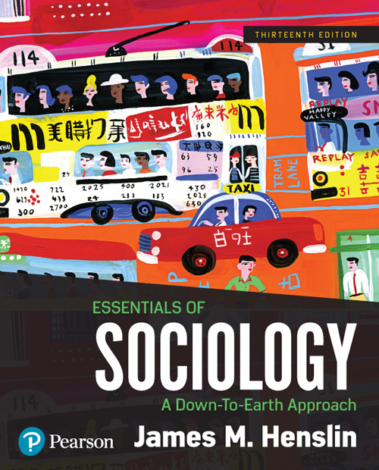
Essentials of Sociology
Thirteenth Edition
Chapter 15
Social Change and the
Environment

Slide 2
Learning Objectives (1 of 2)
15.1 Summarize how social change transforms society: include the four social revolutions, Gemeinschaft and Gesellschaft, capitalism, social movements, and global politics.
15.2 Summarize theories of social change: social evolution, natural cycles, conflict over power and resources, and Ogburn’s theory.

Slide 3
Learning Objectives (2 of 2)
15.3 Use the examples of the automobile and the microchip to illustrate the sociological significance of technology; include changes in ideology, norms, human relationships, education, work, business, war, and social inequality.
15.4 Explain how industrialization is related to environmental problems; contrast the environmental movement and environmental sociology; discuss the goal of harmony.

Slide 4
How Social Change Transforms Social Life
15.1 Summarize how social change transforms society: include the four social revolutions, Gemeinschaft and Gesellschaft, capitalism, social movements, and global politics.
The Four Social Revolutions
From Gemeinschaft to Gesellschaft
The Industrial Revolution and Capitalism
Social Movements
Conflict, Power, and Global Politics

Slide 5
The Four Social Revolutions
From hunting and gathering societies to domestication: horticultural or pastoral
The plow: agricultural
The steam engine: industrial
The Microchip: postindustrial, then
Pushing into another revolution with genome mapping and biotechnology

Slide 6
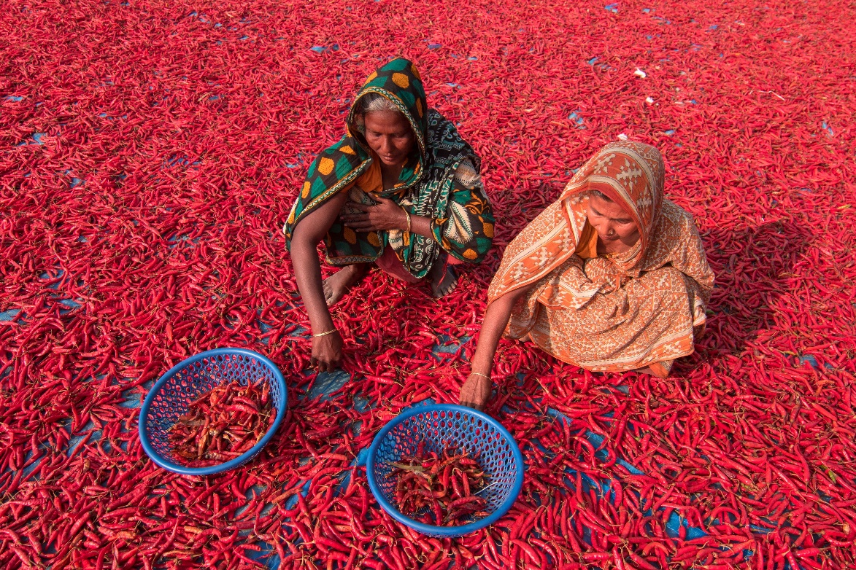
From Gemeinschaft to Gesellschaft
Women working at the chilli pepper harvest in Bangladesh. The evolution of societies has been so thorough that scenes like this have become strange, exotic. Our type of society, too, will be replaced by some new type yet to appear.

Slide 7
The Industrial Revolution and Capitalism (1 of 4)
Table 15.1 Comparing Traditional and Industrialized (and Information) Societies
Characteristics | Traditional Societies | Industrialized (and Information) Societies
General Characteristics
Social change | Slow | Rapid
Size of group | Small | Large
Demographic transition | First stage | Third stage (or Fourth)
Religious orientation | More | Less
Education | Informal | Formal
Place of residence | Rural | Urban
Family size | Larger | Smaller

Slide 8
The Industrial Revolution and Capitalism (2 of 4)
Table 15.1 Comparing Traditional and Industrialized (and Information) Societies
Characteristics | Traditional Societies | Industrialized (and Information) Societies
General Characteristics
Infant mortality | High | Low
Life expectancy | Short | Long
Health care | Home | Doctor’s office
Severe illnesses | Home | Hospital
Temporal orientation | Past | Future
Expectation of the Future | More of the same | Change

Slide 9
The Industrial Revolution and Capitalism (3 of 4)
Table 15.1 Comparing Traditional and Industrialized (and Information) Societies
Characteristics | Traditional Societies | Industrialized (and Information) Societies
Material Relations
Industrialized | No | Yes
Technology | Simple | Complex
Division of labor | Little | Extensive
Income | Low | High
Material possessions | Few | Many
Social Relationships
Basic organization | Gemeinschaft | Gesellschaft
Families | Extended | Nuclear
Respect for elders | More | Less

Slide 10
The Industrial Revolution and Capitalism (4 of 4)
Table 15.1 Comparing Traditional and Industrialized (and Information) Societies
Characteristics | Traditional Societies | Industrialized (and Information) Societies
Social Relationships
Social stratification | Rigid | More open
Social mobility | Little | Much
Statuses | More ascribed | More achieved
Gender equality | Less | More
Norms
View of morals | Absolute | Relativistic
Social control | Informal | Formal
Tolerance of difference | Less | More
Source: By the author.

Slide 11
Social Movements
The cutting edge of social change
People banding together to demand change

Slide 12
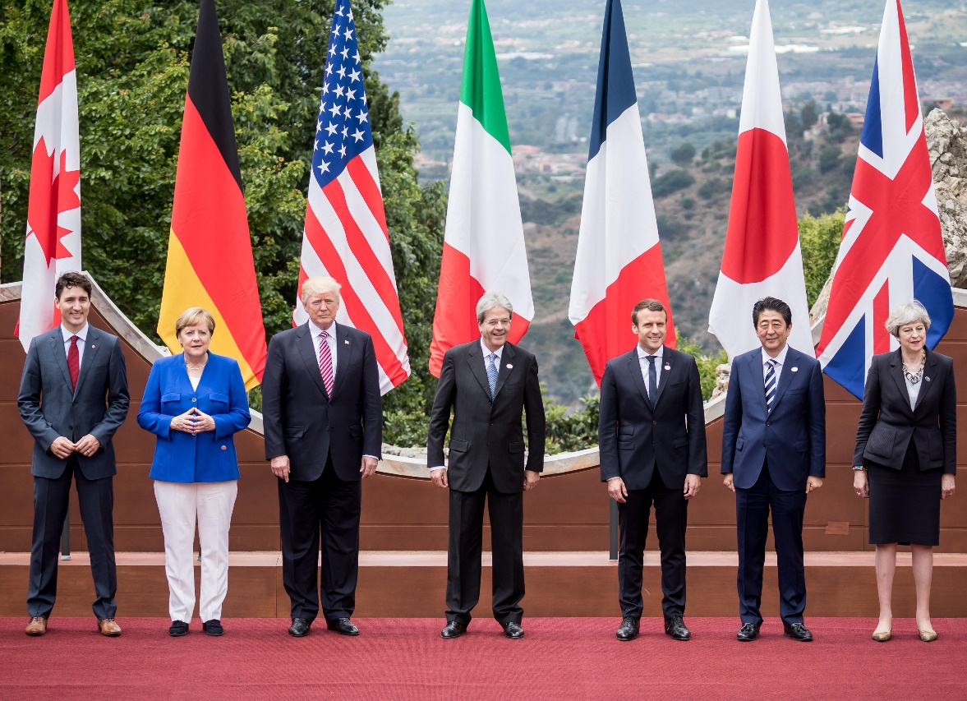
Conflict, Power, and Global Politics (1 of 2)
Each year, the leaders of the most powerful nations meet in a secluded, secure place to make world-controlling decisions. This photo was taken at their 2017 meeting in Taormina, Sicily, Italy. With the striking absence of Russia, G8 has shrunk back to G7.

Slide 13

Conflict, Power, and Global Politics (2 of 2)
To maintain global power requires the continuous development of weapons. Shown here is the F-35 Lightning II, as it is refueled off the coast of Florida. The United States spent more to develop and deploy this plane than it did to land a man on the moon.

Slide 14
Theories and Processes of Social Change
15.2 Summarize theories of social change: social evolution, natural cycles, conflict over power and resources, and Ogburn’s theory.
Evolution from Lower to Higher
Natural Cycles
Conflict over Power and Resources
Ogburn’s Theory

Slide 15
Evolution from Lower to Higher
Unilinear
Multilinear

Slide 16
Natural Cycles
Cyclical theories assume that civilizations are like organisms: They are born, enjoy an exuberant youth, come to maturity, and then decline as they reach old age. Finally, they die.

Slide 17
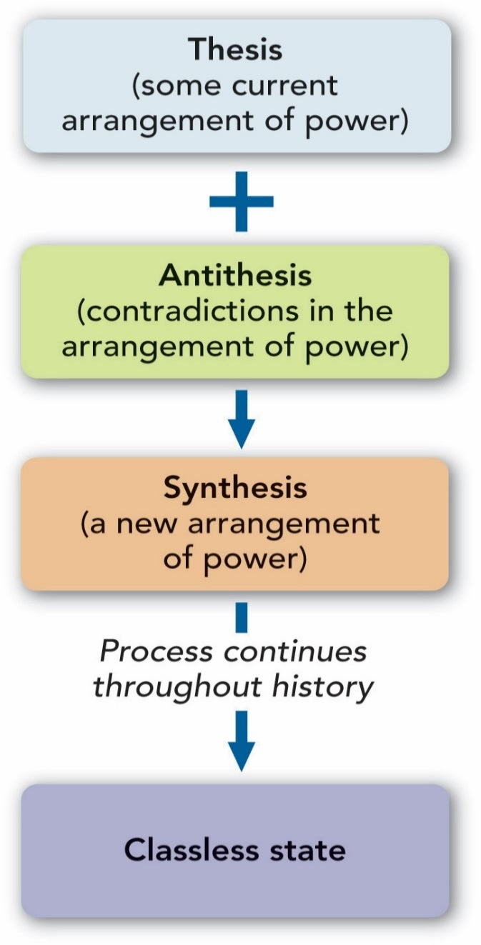
Figure 15.1 Marx’s Model of Historical Change
Source: By the author.

Slide 18
Ogburn’s Theory (1 of 2)
Table 15.2 Ogburn’s Processes of Social Change
Process of Change | What It Is | Examples | Social Change
Invention | Combination of existing elements to form new ones | 1. Cars 2. Microchip 3. Graphite composites | 1. Urban sprawl and long commutes to work 2. Telecommuting and cyber warfare 3. New types of building construction
Discovery | New way of seeing some aspect of the world | 1. Columbus—North America 2. Gold in California 3. DNA | 1. Realignment of global power 2. Westward expansion of the United States 3. Positive identification of criminals
Diffusion | Spread of an invention or discovery | 1. Airplanes 2. Money 3. Condom | 1. Global tourism 2. Global trade 3. Smaller families
NOTE: For each example, there are many changes, such as those discussed in this chapter ushered in by the automobile and microchip. You can also see that any particular change, such as global trade, depends not just on one item but also on several preceding changes.
Source: By the author.

Slide 19
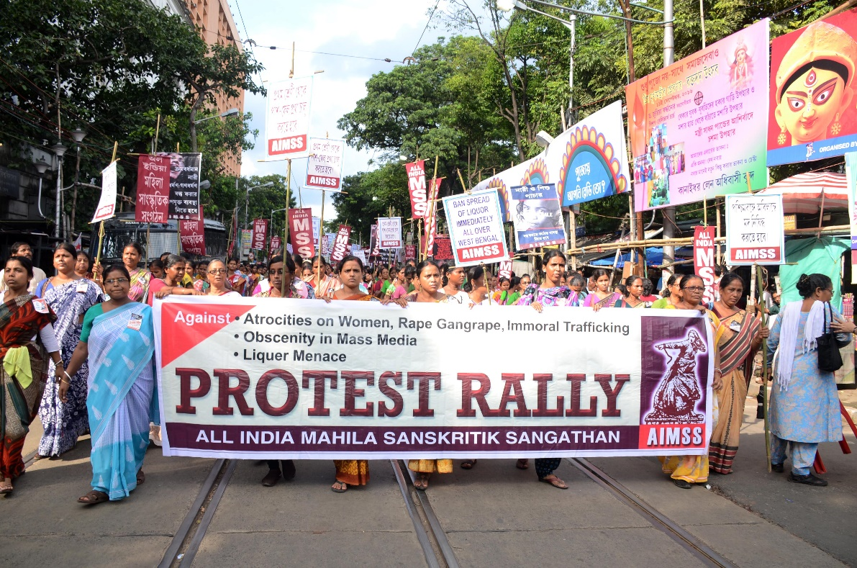
Ogburn’s Theory (2 of 2)
Diffusion refers not only to technology spreading from one group to another but also to the cultural diffusion of ideas. Women’s rights, for example, taken for granted in the West, is a new idea in some parts of the world. This protest rally in India indicates that this new idea is reshaping views of the world. That women have the right to organize to defend themselves is a powerful transformation.

Slide 20
How Technology Is Changing Our Lives
15.3 Use the examples of the automobile and the microchip to illustrate the sociological significance of technology; include changes in ideology, norms, human relationships, education, work, business, war, and social inequality.
Extending Human Abilities
The Sociological Significance of Technology: How Technology Changes Social Life
When Old Technology Was New: The Impact of the Automobile
The New Technology: The Microchip and Social Life
Cyberspace and Social Inequality

Slide 21
Extending Human Abilities
Communication
Travel
Retrieval and analysis of information

Slide 22
The Sociological Significance of Technology: How Technology Changes Social Life
Production
Worker-owner relations
Ideology
Conspicuous consumption
Family relationships

Slide 23
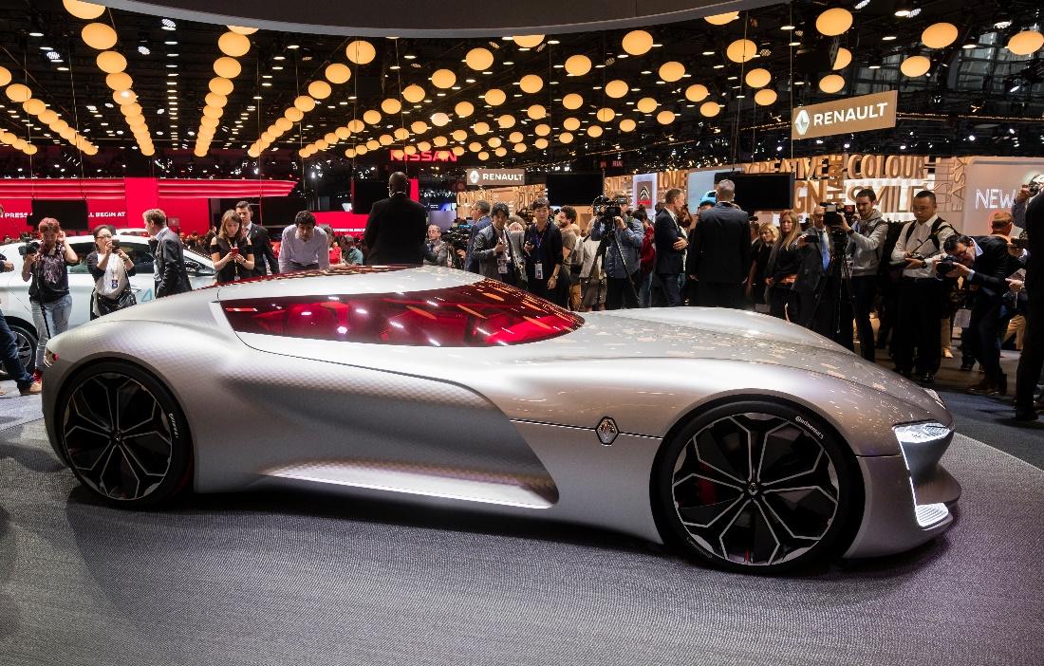
When Old Technology Was New: The Impact of the Automobile (1 of 2)
New technology builds on existing technology, as you can see by looking at this electric car by Renault.

Slide 24
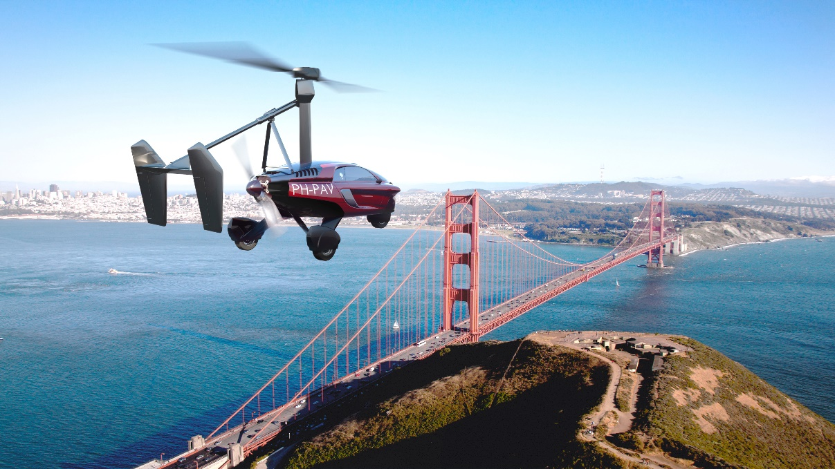
When Old Technology Was New: The Impact of the Automobile (2 of 2)
Long the dream of many is the flying car, and here is one. Soon to be offered to the public, this car can fly over traffic jams, as well as rivers, lakes, and even mountains. Changing technology changes not only the way we do things, such as travel, but also the way we think about life and the self and the way we relate to others.

Slide 25
The New Technology: The Microchip and Social Life
Education
Business and finance
International conflict

Slide 26
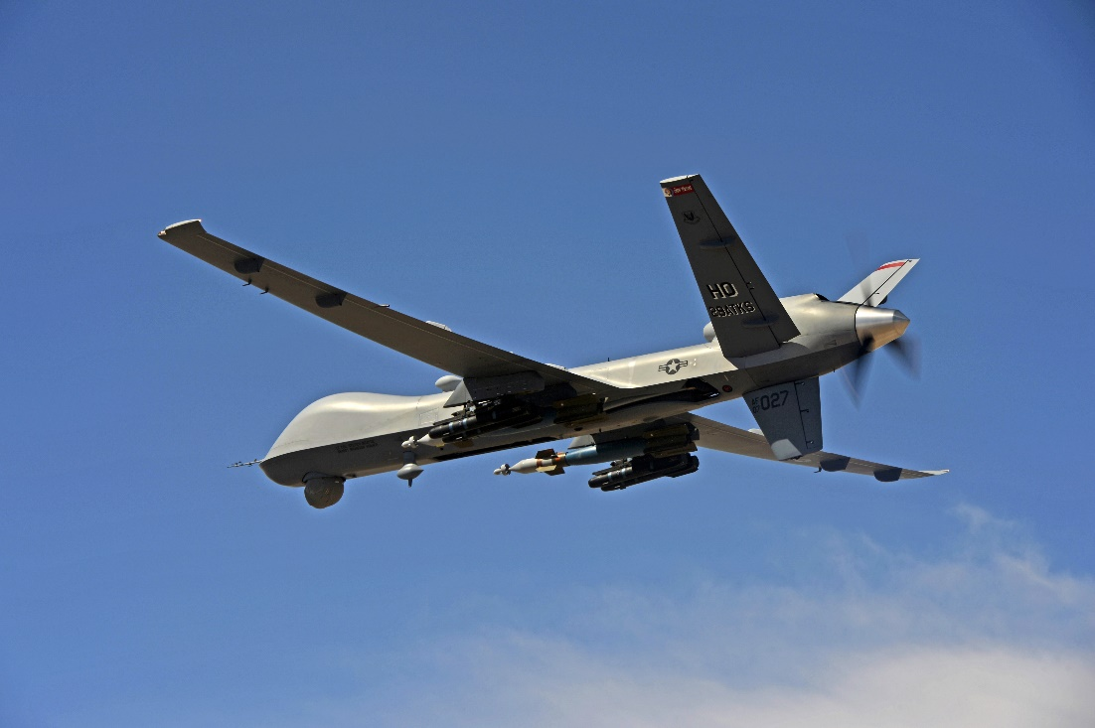
Sociology and Technology: The Shifting Landscape Weaponizing Space: The Coming Star Wars
This pilotless drone, an MQ-9 Reaper, streams live video to an operator at a remote, safe base. When the operator gives the signal, the Reaper reaps, unleashing the missiles you see here. Technological killing that one day might come home, with operators in another country doing the same to us.

Slide 27
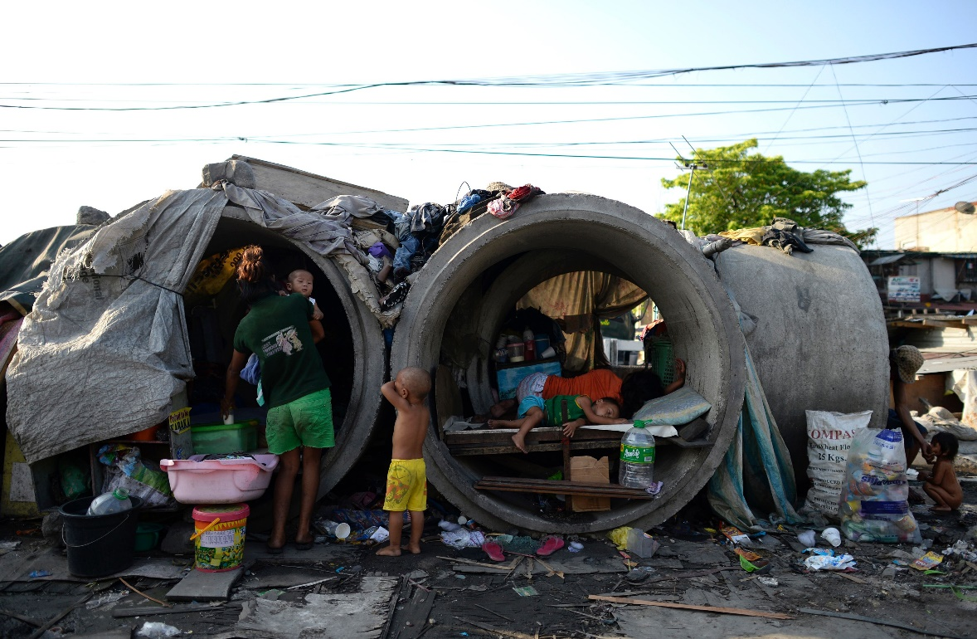
Cyberspace and Social Inequality
The offspring of the microchip—from computers to cell phones—offer access to vast information and efficiency of communication, manufacturing, and transportation. Will this fundamental change bring greater equality to the world’s nations? These concrete pipes are home to some residents of Manila, the capital of the Philippines.

Slide 28
The Growth Machine versus the Earth
15.4 Explain how industrialization is related to environmental problems; contrast the environmental movement and environmental sociology; discuss the goal of harmony.
The Globalization of Capitalism and the Race for Economic Growth
Environmental Problems and Industrialization
The Environmental Movement
Environmental Sociology
Technology and the Environment: The Goal of Harmony

Slide 29
The Globalization of Capitalism and the Race for Economic Growth
The race for economic growth is on!
A sustainable environment

Slide 30
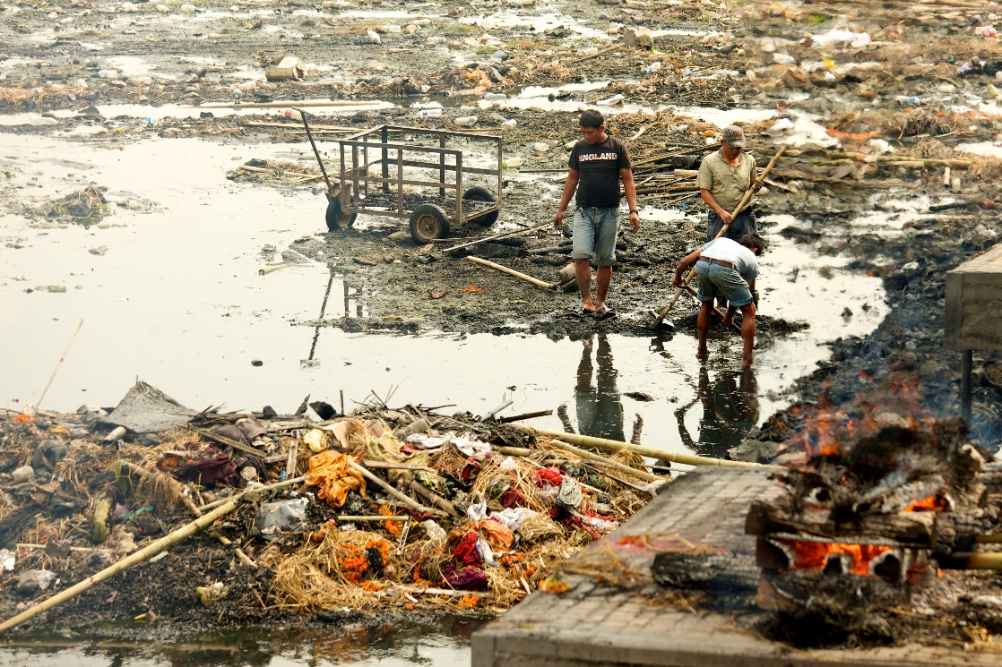
Environmental Problems and Industrialization
Pollution poses a risk to health around the world. This photo of garbage collectors was taken on the Bagmati River in Nepal.

Slide 31
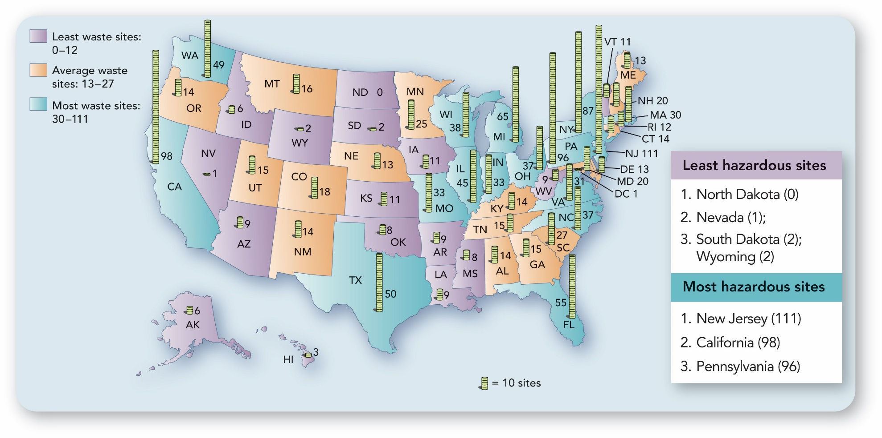
Figure 15.2 The Worst Hazardous Waste Sites
U. S. map showing the number of hazardous waste sites per state.
Source: By the author. Based on Environmental Protection Agency 2013.

Slide 32
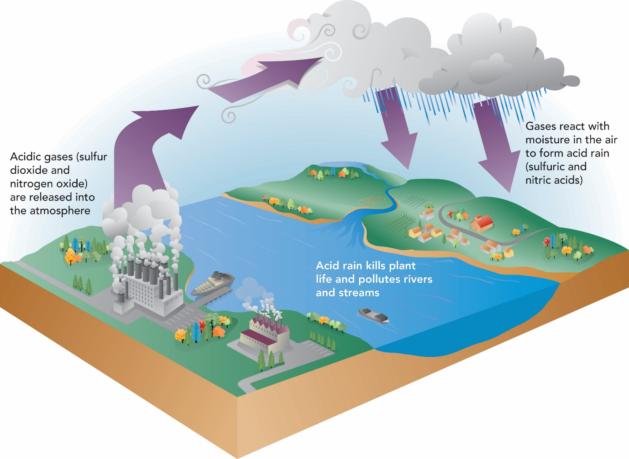
Figure 15.3 Acid Rain
Diagram showing how acid rain is created.
Source: By the author.

Slide 33

Thinking Critically about Social Life: Climate Controversy, the Island Nations, and You
Ocean pollution has become a threat to the world's coral reefs, such as this one off the coast of Egypt.

Slide 34
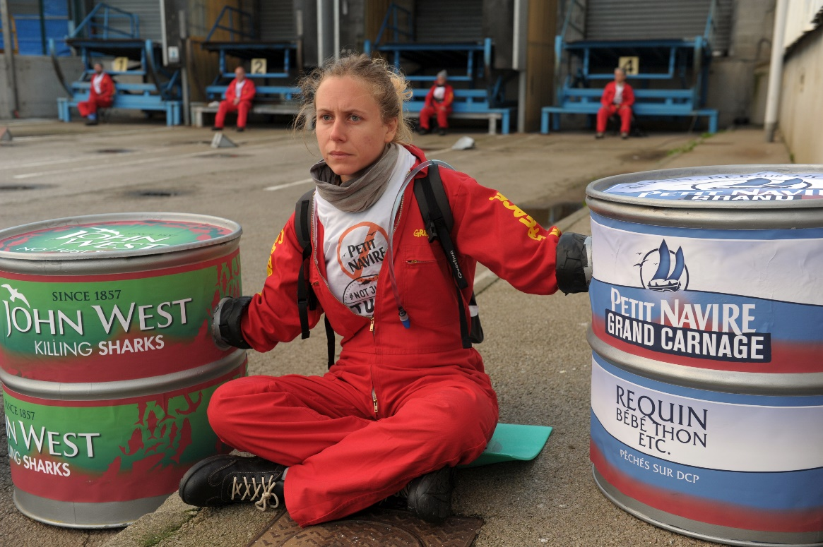
Thinking Critically about Social Life Eco-sabotage
Environmental activism is a global social movement, an example of transnational social movements in Chapter 21. These members of Greenpeace in France are protesting the fishing methods of a major canner.

Slide 35
Environmental Sociology
Goal is not to stop pollution or nuclear power, but rather to study the interactions of people with their environments
  How humans (their cultures, values, and behavior) affect the physical environment
  How the physical environment affects human activities

Slide 36
Technology and the Environment: The Goal of Harmony
Reaching the middle ground
Toward a sustainable future

Slide 37
Photo Credits
Chapter 15 CO Ikon Images/Getty Images; KIM JAE-HWAN/AFP/Getty Images; 002: Based on Chase, Arlen F., Diane Z. Chase, and John F. Weishampel. “Lasers in the Jungle.” Archeology, 63, 4, July/August 2010; Handwerk, Brian. “Maya City in 3-D.” National Geographic Daily News, May 20, 2010; Wilford, John Noble. “Mapping Ancient Civilization, in a Matter of Days.” New York Times, May 10, 2010; Preston 2017.; 031: Flink, James J., The Automobile Age. Cambridge, Mass.: MIT Press, 1990.; 033: Laura Pappano, “The Boy Genius of Ulan Bator,” New York Times, September 13, 2013.; 036: Sanger, David E. “Obama Order Sped Up Waves of Cyberattacks against Iran.” New York Times, June 1, 2012.; 041: Boudreaux, Richard. “Putin Move Stirs Russian Environmentalist Row.” New York Times, January 20, 2010.; 044: Based on Environmental Protection Agency. “Final National Priorities List.” Washington, D.C.: Environmental Protection Agency, March 29, 2013.; 048: Based on Durning, Alan. “Cradles of Life.” In Social Problems 90/91, LeRoy W. Barnes, ed. Guilford, Conn.: Dushkin, 1990:231–241; Gorman, Peter. “A People at Risk: Vanishing Tribes of South America.” The World & I, December 1991:678–689; Linden, Eugene. “Lost Tribes, Lost Knowledge.” Time, September 23, 1991:46, 48, 50, 52, 54, 56; Stipp, David. “Himalayan Tree Could Serve as Source of Anti-Cancer Drug Taxol, Team Says.” Wall Street Journal, April 20, 1992:B4; Nabhan, Gary Paul. Cultures in Habitat: On Nature, Culture, and Story. New York: Counterpoint, 1998; Simons, Marlise. “Social Change and Amazon Indians.” In Exploring Social Life: Readings to Accompany Essentials of Sociology: A Down-to-Earth Approach, Sixth Edition, 2nd edition, James M. Henslin, ed. Boston: Allyn and Bacon, 2006:157–165; Okpiliya 2014.; 052: Based on Eder, Klaus. “The Rise of Counter-Culture Movements against Modernity: Nature as a New Field of Class Struggle.” Theory, Culture & Society, 7, 1990:21–47.; Foote, Jennifer. “Trying to Take Back the Planet.” Newsweek, 115, 6, February 5, 1990:24–25.; Parfit, Michael, “Earth Firsters Wield a Mean Monkey Wrench.” Smithsonian, 21, 1, April 1990:184–204; Reed, Susan, and Lorenzo Benet. “Ecowarrior Dave Foreman Will Do Whatever It Takes in His Fight to Save Mother Earth.” People Weekly, 33, 15, April 16, 1990:113–116; Knickerbocker, Brad. “Firebrands of ‘Ecoterrorism’ Set Sights on Urban Sprawl.” Christian Science Monitor, August 6, 2003; Gunther, Marc. “The Mosquito in the Tent.” Fortune, 149, 11, May 31, 2004:158; Fattig, Paul. “Good Intentions Gone Bad.” Mail Tribune, June 6, 2007; Grigoriadis, Vanessa. “The Rise and Fall of the Eco-Radical Underground.” Rolling Stone, June 21, 2011; Oxalis 2014.; Amelie-Benoist/BSIP/Superstock; Bettmann/Getty Images; BRUNO DOMINGOS/REUTERS/Newscom; Byrdyak/Fotolia; Capt. Hope R. Cronin/age fotostock; Corbis Historical/Getty Images; dpa picture alliance/Alamy Stock Photo; FRED TANNEAU/AFP/Getty Images; Gabriela/Fotolia; H. Armstrong Roberts/ClassicStock/The Image Works; Iain Masterton/Alamy Stock Photo; Ikon Images/Getty Images; Jan Wlodarczyk/Alamy Stock Photo; Leo Sad/Fotolia; Loren McIntyre/Newscom; Mlorenz/Shutterstock; Newscom; NOEL CELIS/AFP/Getty Images; NurPhoto/Getty Images; PAL-V/Cover Images/Newscom; Rex Features/AP Images; Rob Wilson/Shutterstock; Sirko Hartmann/Newscom; Ssg Matthew B. Fredericks/ZUMA Press/Newscom; The Zetland Collection; Tose/Shutterstock; Transit/Sovfoto; Wildlywise/Shutterstock

Slide 38
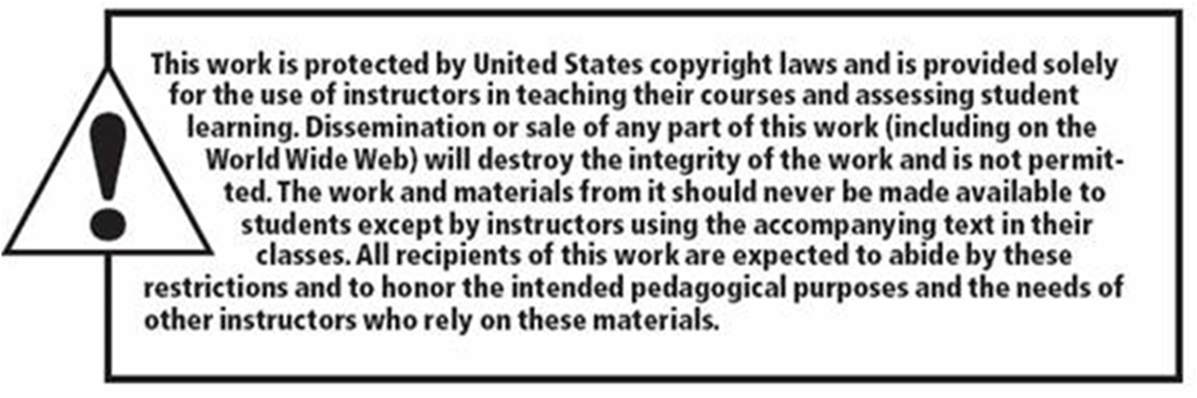
Copyright

