Slide 1
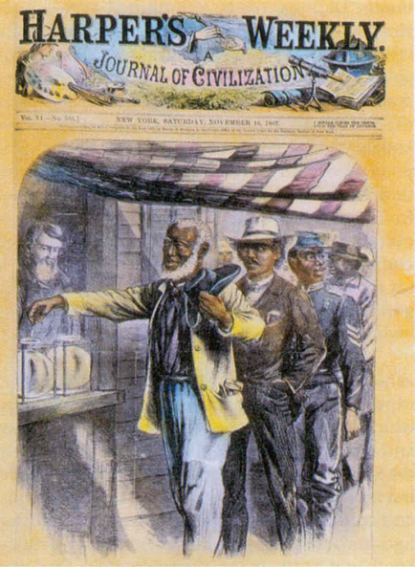
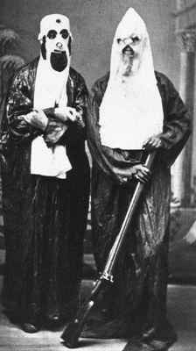
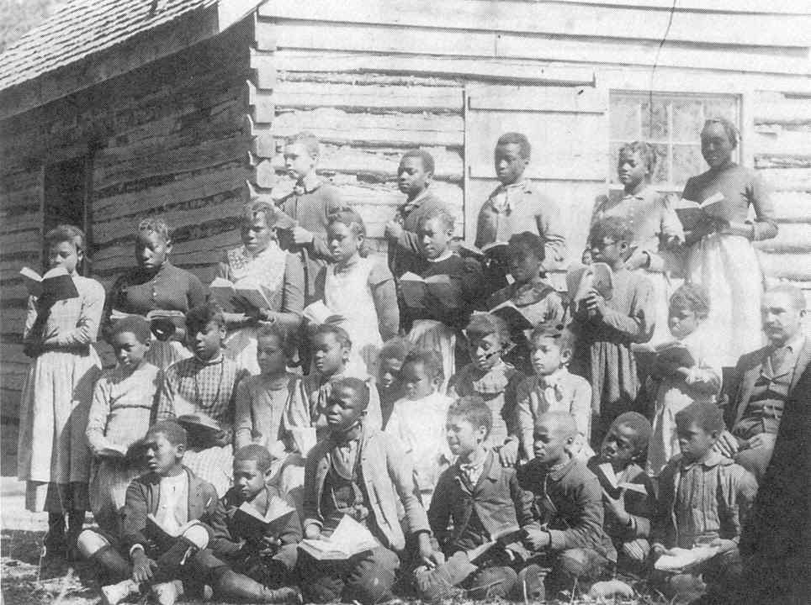
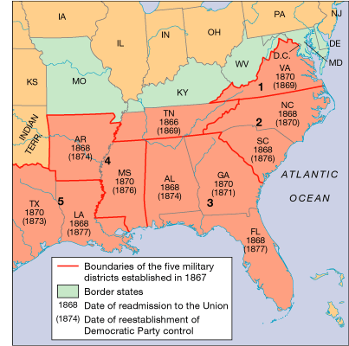
The Second Industrial System Moves South

Slide 2
The South
Meanwhile, in the South…
Reconstruction:
  Era after the Civil War – 1877, when Republicans were influential in the South
  The fate of African Americans in the South hung in the balance. Former southern elites wanted to reinstitute a version of slavery.
  The issues of modernizing and industrializing the South were significant.

Slide 3
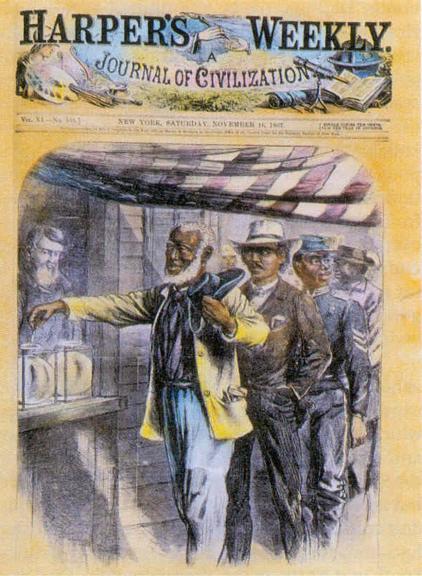
Reconstruction: Politics
4 million freed slaves
* 13th Amendment: ended slavery
* 14th Amendment: defined national citizenship to include “all persons born or naturalized in the United States” but excluded Native Americans
* 15th Amendment: extended the vote to black men
The federal government made promises to African Americans. Would it keep them?
Freed male slaves voted: ??

Slide 4
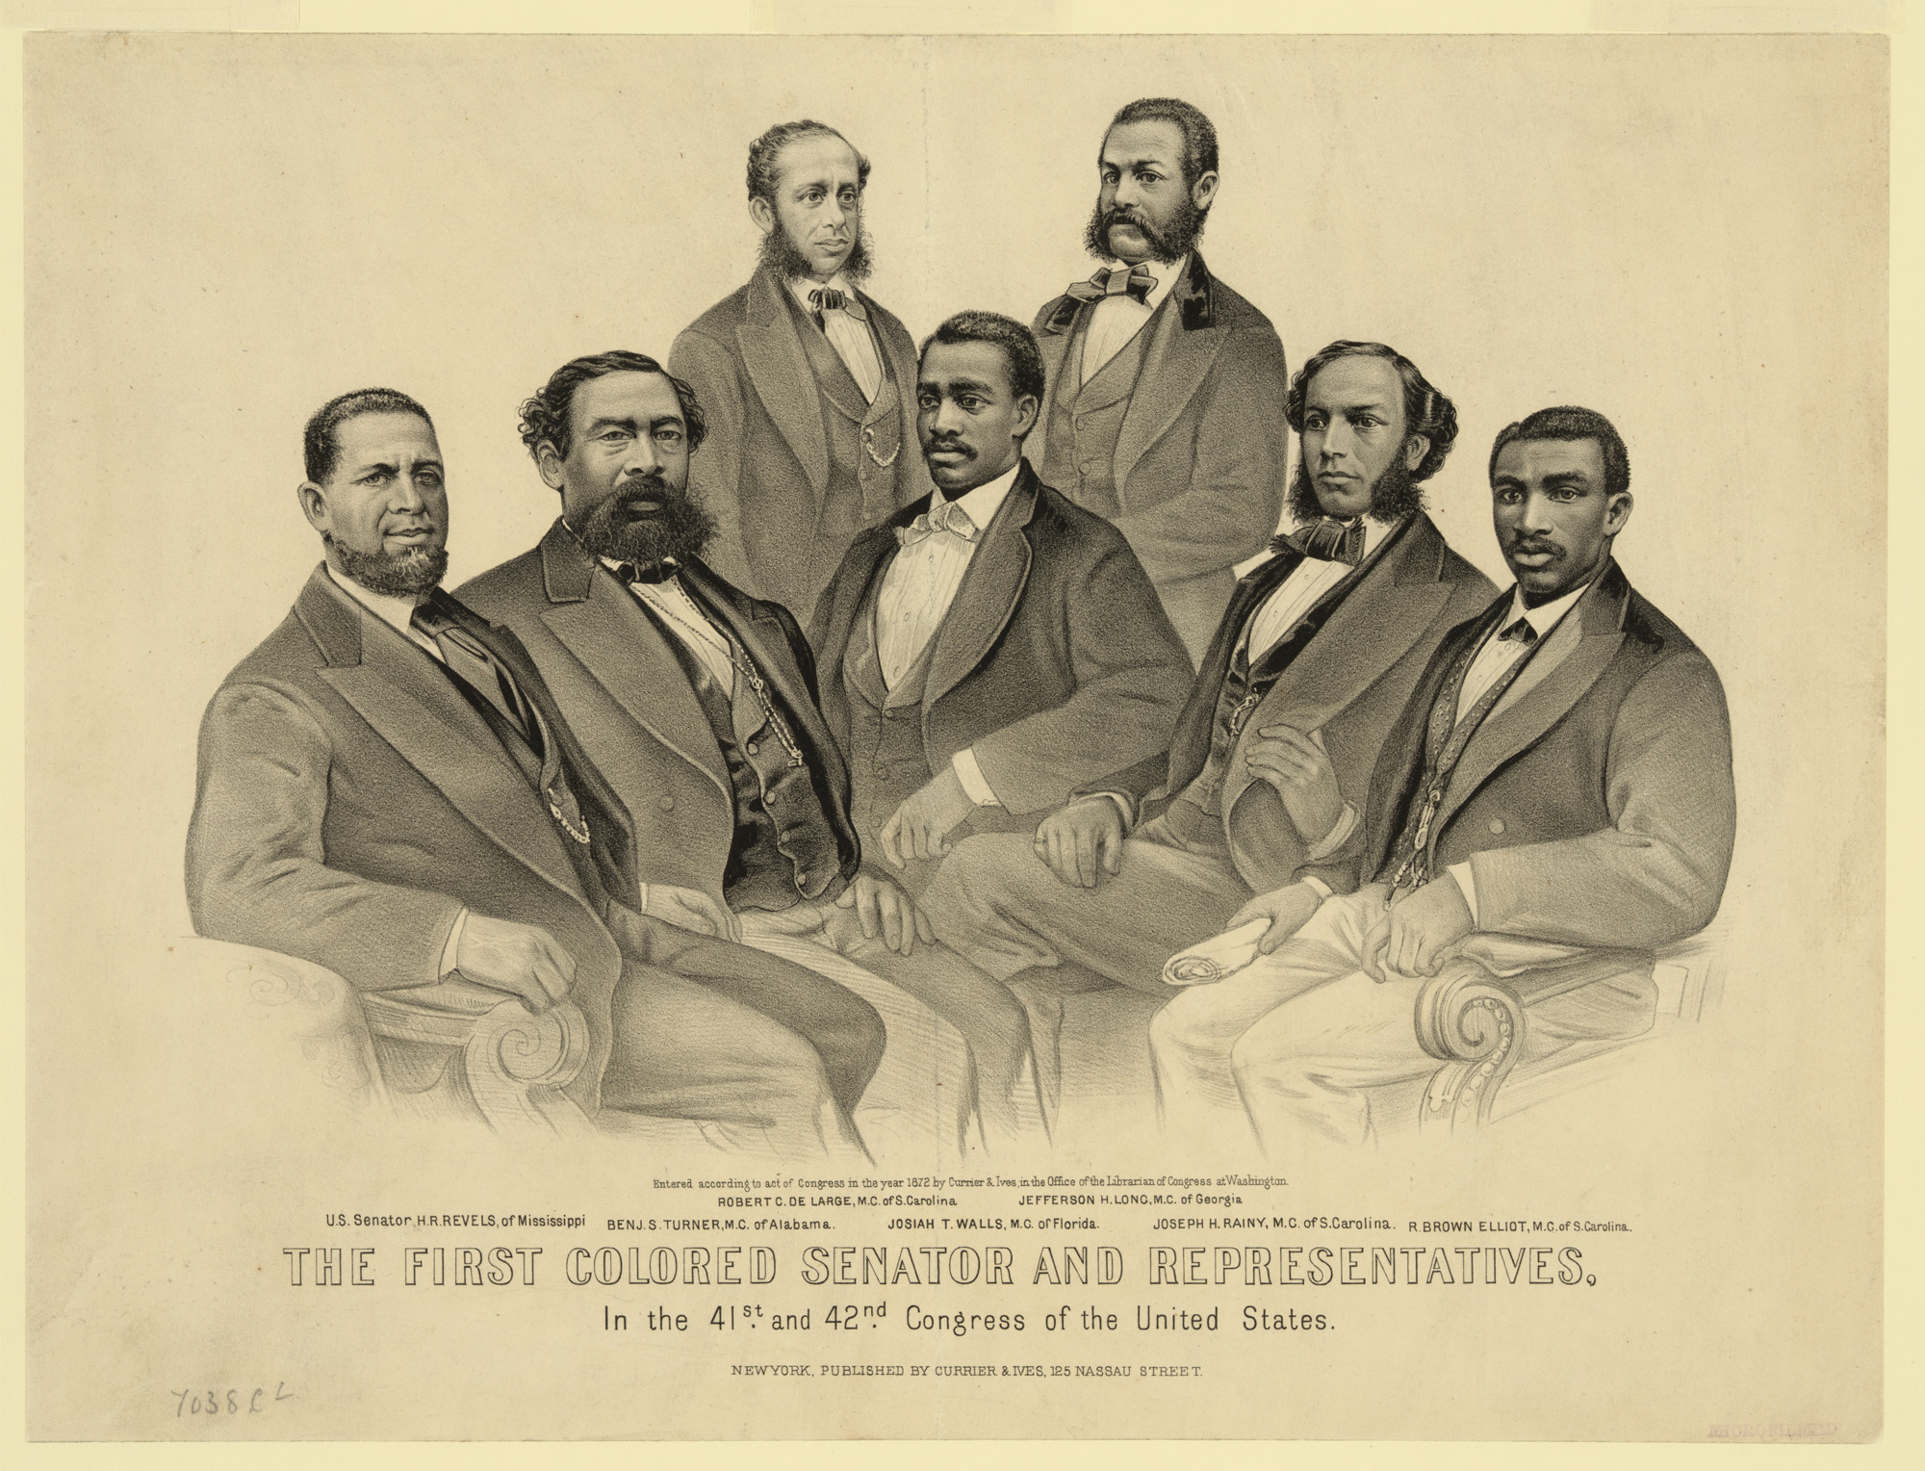
Black, Southern Elected Officials
Racist image coming next..

Slide 5
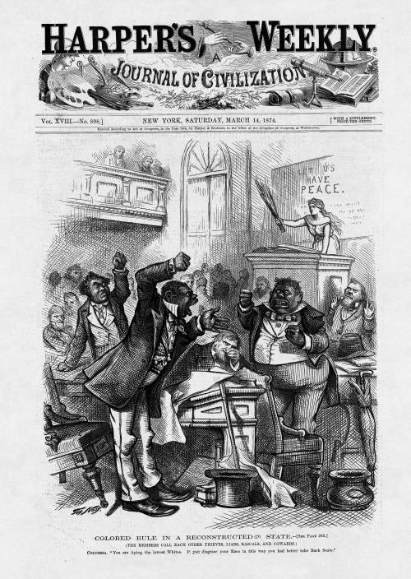

Slide 6
The Meaning of Freedom: Education
African Americans from the North traveled south to help.
First state-funded systems of education in the South
1865-1880
* African American school attendance: from 5 to 40%
* White school attendance:
from 20 to 60%
What else did African Americans do after the Civil War that suggests what they thought freedom meant?
Another racist image coming.

Slide 7
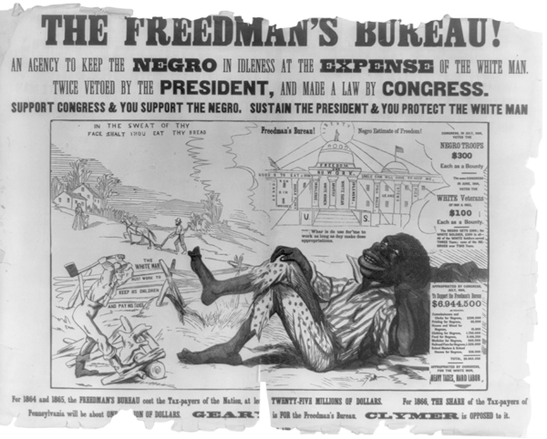
Southern White Elites Wanted To Reassert Their Power

Slide 8
Republicans: Federal Grants to Companies to move South
Railroads
Timber
Mining

Slide 9
The Republicans encounter an obstacle:
Poor blacks and whites often did not want to work in factories.
Freed slaves wanted land.
The Republicans wouldn’t give them land:
PRIVATE PROPERTY

Slide 10
The Dilemma
Sharecropping
Freed slaves want land and freedom.
Former slave owners want to recreate the conditions of slavery.

Slide 11
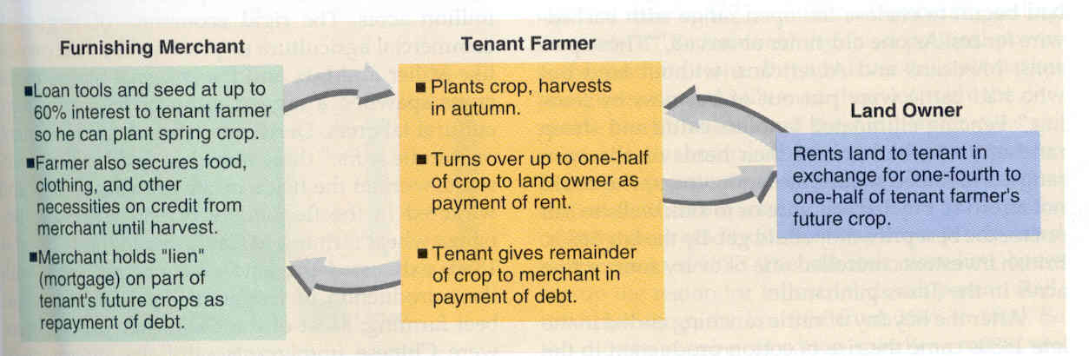
Sharecropping as an Unfair “Compromise”
The sharecropping system emerged by the mid-1870s.
Sharecropping kept most black people desperately poor and was not that different than slavery.
http://www.pbs.org/tpt/slavery-by-another-name/themes/sharecropping/

Slide 12
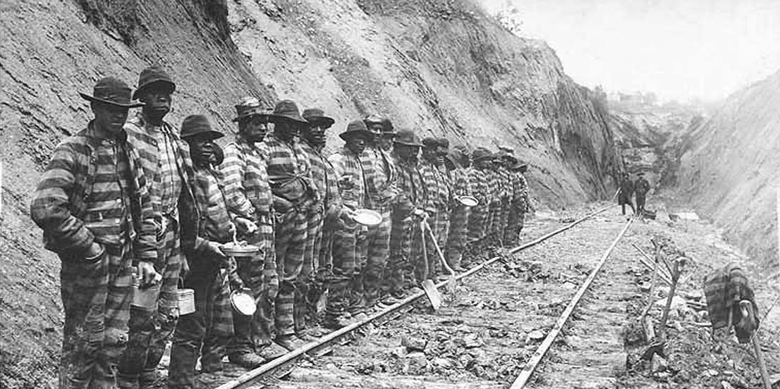
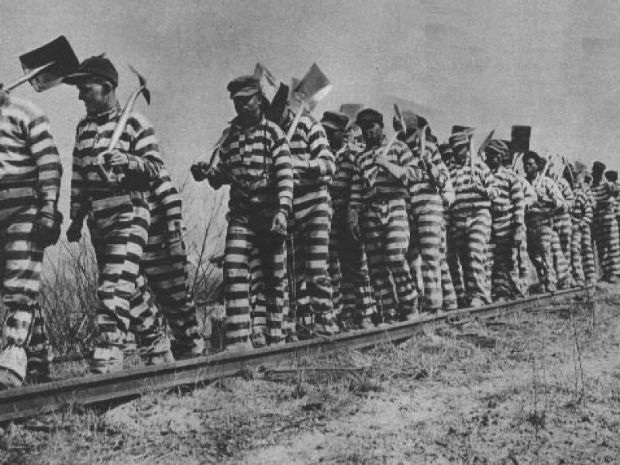
Vagrancy Laws and Chain Gangs

Slide 13
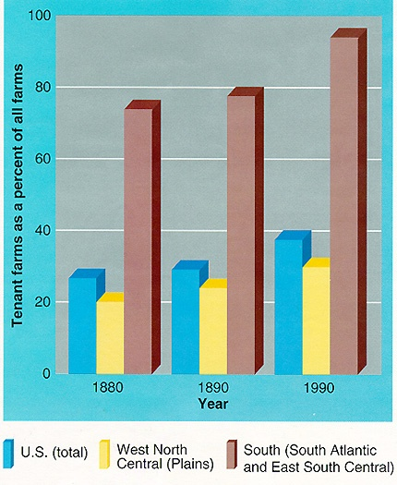
High tenancy and turnover rates
By 1880, nearly 75% of all Southern farms were operated by tenants and sharecroppers.
1/3 of white farmers were tenants/ sharecroppers.
Almost ¾ African American farmers were tenants/ sharecroppers.

Slide 14
Southern Democrats Vie to Regain Authority
Land owners threatened African American tenants who voted.
The Ku Klux Klan was founded in 1866 and existed to terrorize African Americans into subordination. Lynching was one technique.
Federal troops remained in the South.
Democrats advised poor whites that the Republican party was the party of African Americans.
End of Reconstruction; former slave holders were back in charge.

Slide 15
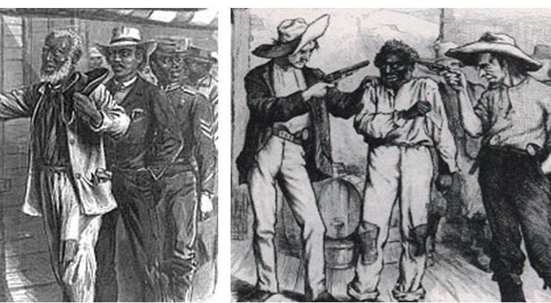
The Failure of Reconstruction

Slide 16
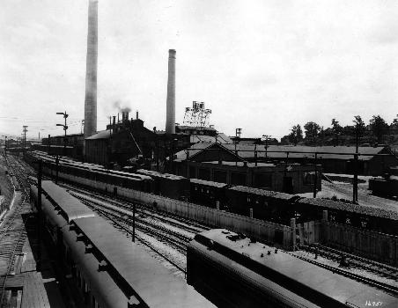
Southern Industrialization
Government grants to railroads.
Southerners encounter consumer goods.
The quest for cash.
Subsistence to cash-crop farming.
Cotton prices drop.

Slide 17
Formerly Poor but
Independent White Land Owners
Sharecropping
DEBT
(foreclosures)
Factory Work

Slide 18
The Dilemma for Poor Whites By the 1890s:
Race?
Class?

Slide 19
The Second Industrial System in the South
A more spatially unified nation.
The spread of technology: transportation and communication links.
Opportunities for upward mobility.
Segregation,
violence, and disenfranchisement
Many white farmers’ debt, despair and mounting anger

Slide 20
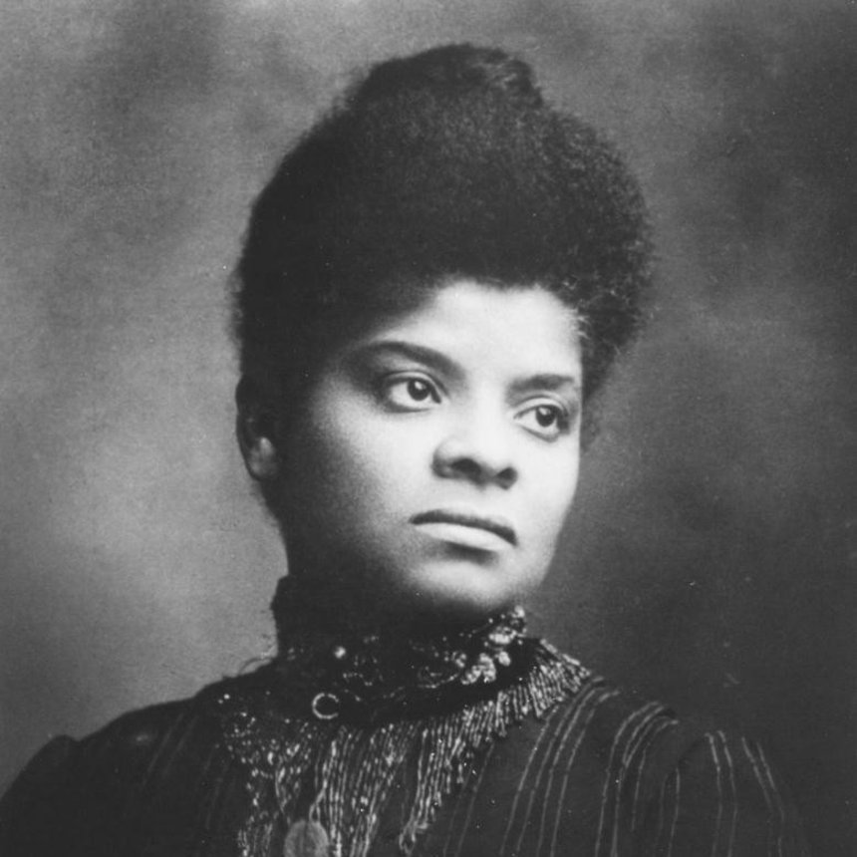
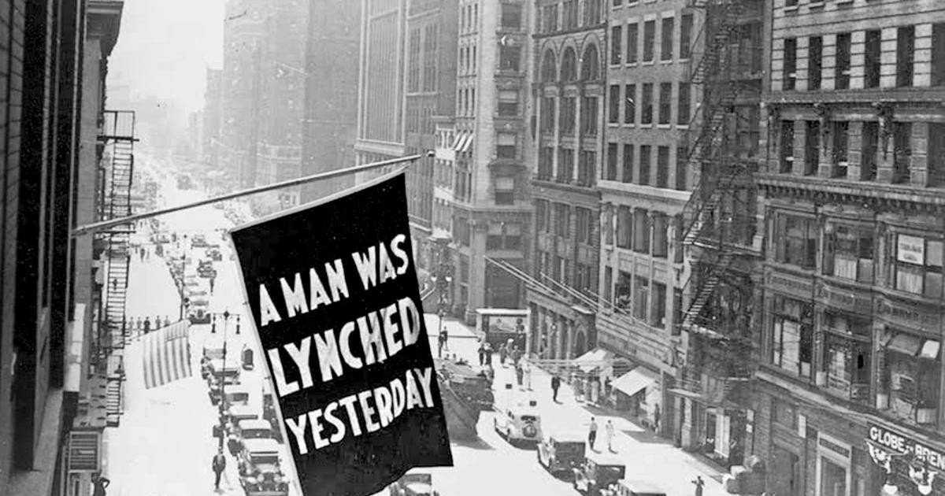
Ida B. Wells
1862 – 1931
Born into slavery.
Freed by the Emancipation Proclamation.
Became a journalist who documented lynching (extrajudicial murders).
https://www.youtube.com/watch?v=nvG0K5AdKiM

