Slide 1
02.06 Introduction to Photosynthesis
Madelyn Webb

Slide 2
The Assignment
Your presentation should include the following:
Detailed descriptions of what happens to the carbon atom:
  during photosynthesis (the light-dependent reactions and the light-independent reactions)
  transitioning between photosynthesis and respiration
  during cellular respiration or fermentation
An explanation of how the carbon atom is transferred between molecules. Please include descriptions of the molecules involved in each of the processes above and be sure to mention the movement of electrons and energy as the carbon atom moves from one reaction to another.
Complete sentences should be used in all written descriptions and explanations
Illustrations, diagrams, or images that help explain the carbon atom’s journey.
  You can create your own images, or use images from websites or other sources.
  If you use premade images, you will need to give a reference of the source of that image and create your own unique caption to describe the image.
Your presentation should be detailed and organized.

Slide 3
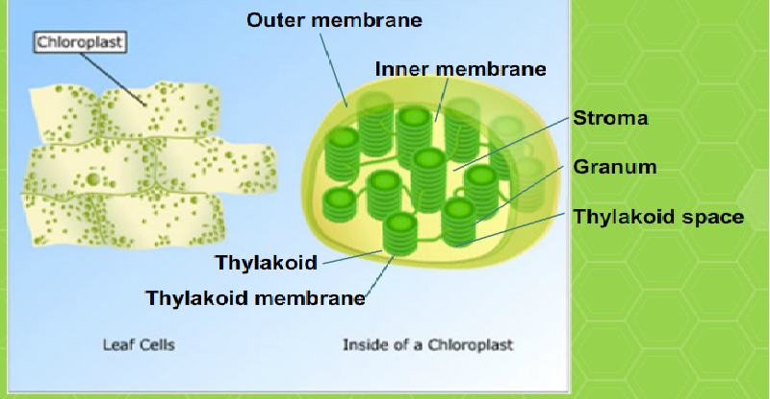
What is photosynthesis?
Photosynthesis is a chemical process in which plants use light energy to convert carbon dioxide and water into carbohydrates and stored chemical energy.
Photosynthesis occurs in the chloroplasts.
Inside the chloroplasts, membrane sacs called thylakoids are stacked in interconnected piles called grana. Within these stacks, photosynthesis takes place.
This picture is from the FLVS lesson, 02.06.

Slide 4
The Light dependent Reactions
Light dependent reactions occur inside the thylakoids. Chlorophyll molecules absorb sunlight and then give off high energy electrons. These high energy electrons move through a series of electron carrier proteins, called the electron transport chains, within the thylakoid membrane. NADP+ molecules accept high-energy electrons to form NADPH. NADPH carries the electrons and their energy to the next phase. Oxygen gas is released and ATP molecules are formed. ATP transfers to the light-independent reactions to provide energy for the next phase.
The carbon molecule is not part of this process, but the step is crucial for the process.
1

Slide 5
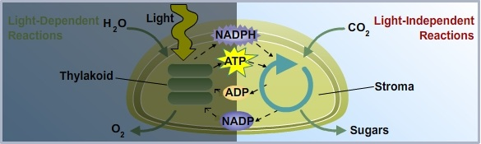
The Light Independent Reactions
2
The light independent reaction is often referred to as the Calvin cycle. Light independent reactions use the energy that was converted from light in the first stage of photosynthesis and can be completed without a light source. This cycle uses six molecules of carbon dioxide to produce a single six-carbon glucose molecule. ATP and NADPH provide the energy needed for the light-independent reactions to occur.

Slide 6
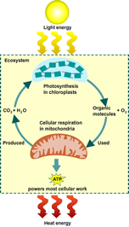
The Transition between photosynthesis and respiration
3
Photosynthesis: 6 CO₂ + 6 H₂O + Energy (Solar) → C₆H₁₂O6 + 6 O₂
Cellular Respiration: C₆H₁₂O₆ + 6 O₂ → 6 CO₂ + 6 H₂O + Energy (ATP and Heat)
The carbon atom is split into two pyruvate molecules during glycolysis in glucose. The pyruvate is processed into Acetyl CoA. The Acetyl Coa is then oxidized in the citric acid cycle to make two molecules of CO2 per cycle.

Slide 7
Cellular Respiration
4
Cellular respiration is a three part process.
Glycolysis: Glycolysis takes place in the cytoplasm of the cell. It splits glucose, a 6-carbon compound, into 3-carbon pyruvate molecules.
The Krebs Cycle: The Krebs Cycle sends energy-rich NADH and FADH2 molecules to the electron transport chain.
Electron Transport Chain: The ETC uses the high-energy electrons stored in NADH and FADH2. It then reforms NAD+ and FAD, which are sent back to participate in earlier stages of respiration

