Slide 1
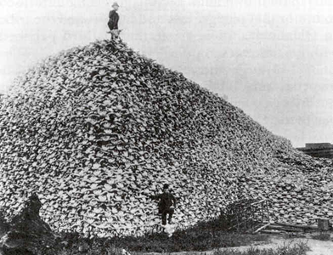
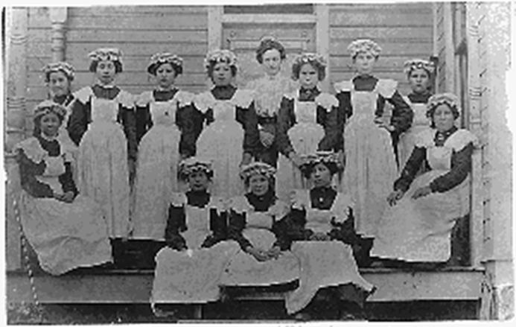
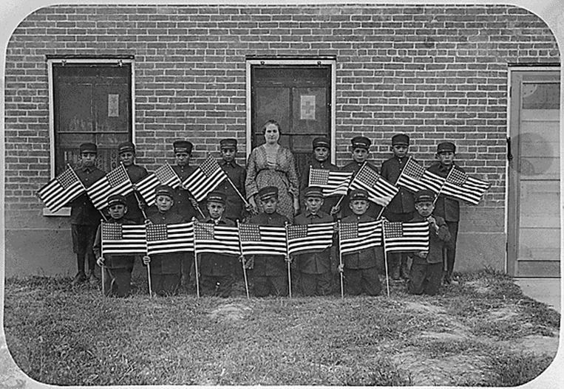
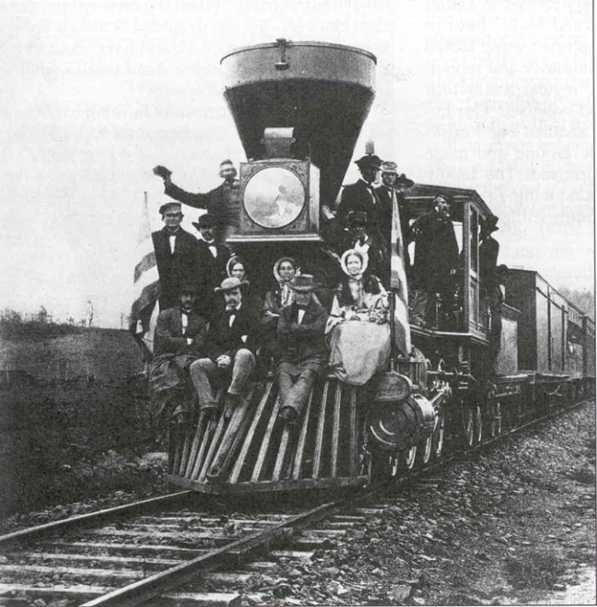
The Industrial System in the West

Slide 2
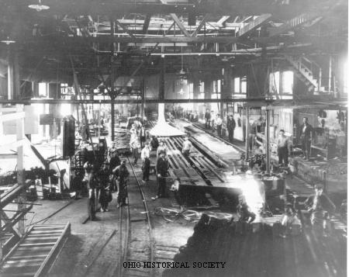
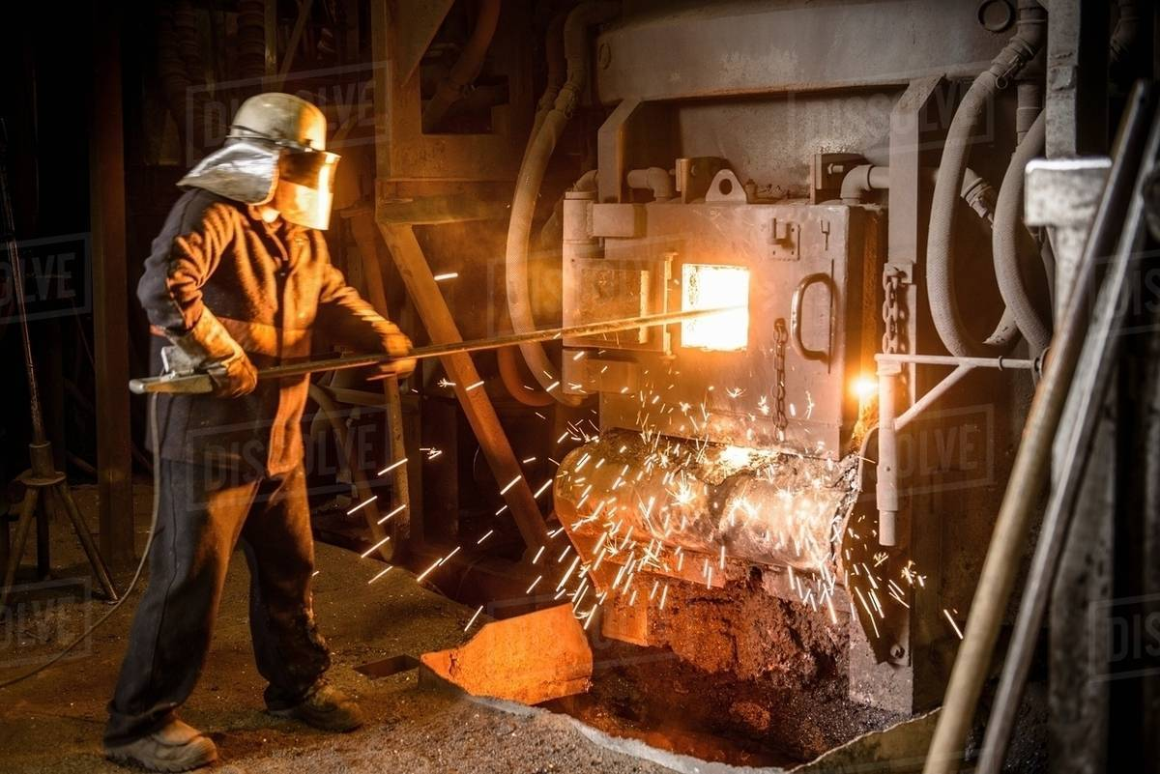
Labor Songs Presentations
“Title: “Men of Steel”
Lyric: “We struggle and toil to fill hungry mouths.”
Weak analysis: The workers worked hard to feed their families.
Strong analysis: The song’s title in combination with the lyric line suggest men felt a gendered pressure to provide for their families.
Use historical rather than contemporary photos.

Slide 3
Review
Second industrial system
  Pros and cons
The South: Reconstruction
  Continuation of white supremacy
  Industrialization

Slide 4
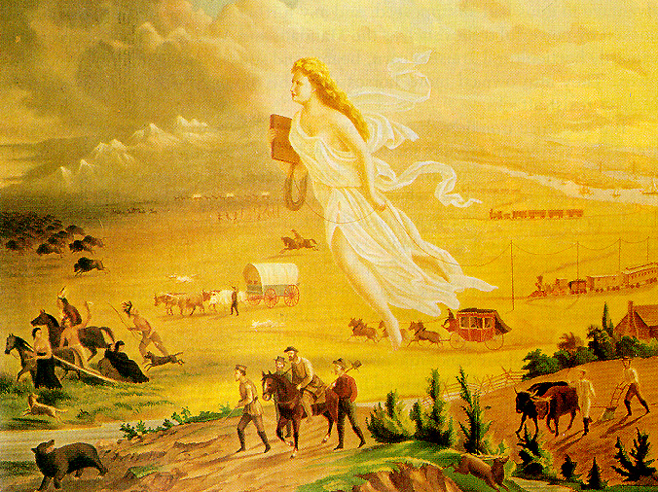
Manifest Destiny

Slide 5
The West
Lincoln’s plans: The Homestead Act (1862):
* 160 acres of public domain free to any settler who lived on the land and improved it for at least 5 years
* settler could purchase the land for $1.25 per acre after 6 months’ residence
* 605 million acres available
* land given to male heads of households and single or widowed women
What future did Lincoln foresee for the nation if his “solution” was the Homestead Act?
What were potential problems associated with westward expansion?

Slide 6
“Barriers” to Westward Expansion
People already lived there.
Transportation

Slide 7
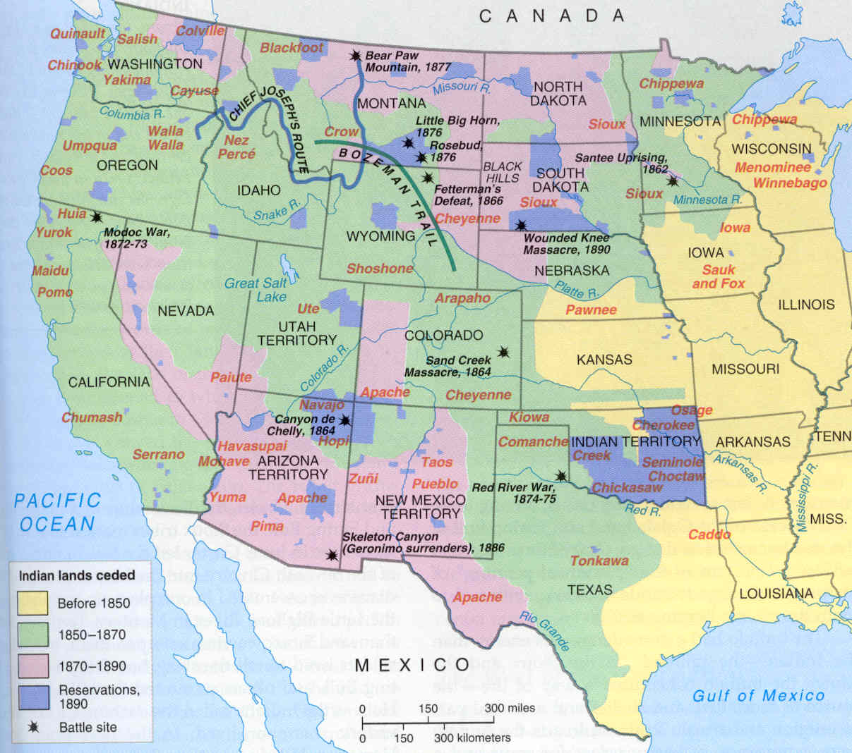
Westward Expansion and Native Americans
1865- 360,000 Native Americans lived on the Great Plains
1900- 70,000 Native Americans lived on the Great Plains

Slide 8
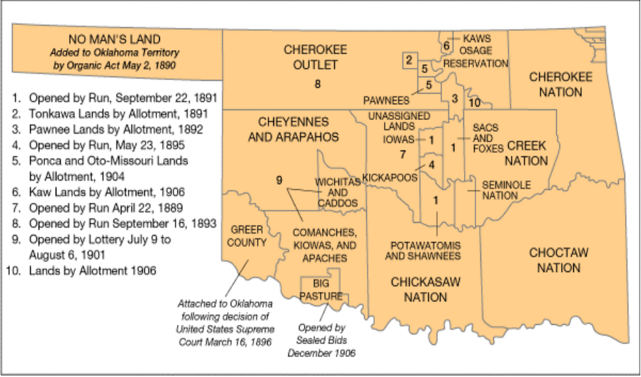
Federal Policies towards
Native Americans
Autonomous dependent nations
Segregation
  Indian Removal Act (1830) - relocate all eastern tribes by force if necessary

Slide 9
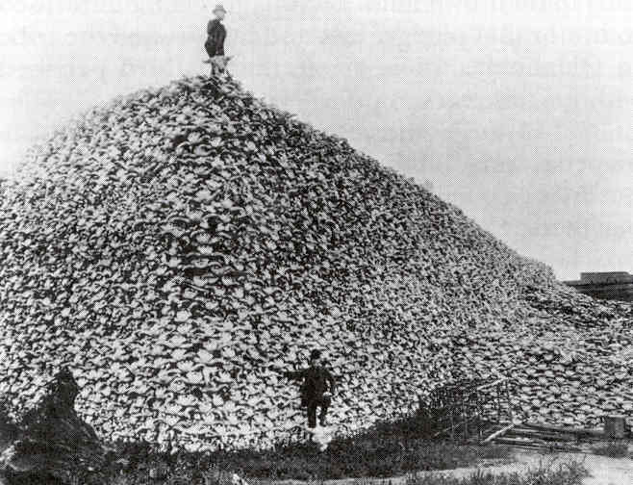
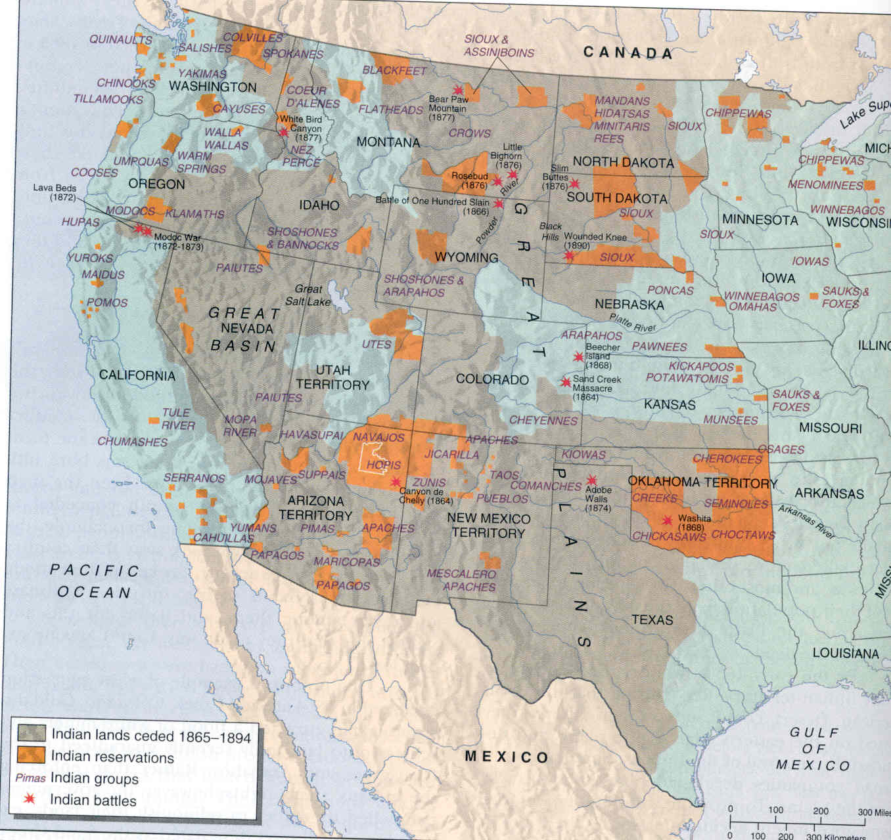
Conflict on the Plains
White settlement
* land claim disputes
* disease
Mining
Disappearance of the buffalo
Anger, mistrust and warfare. Indian Wars 1860s-1890s
What are potential solutions to the problems westward expansion created?

Slide 10
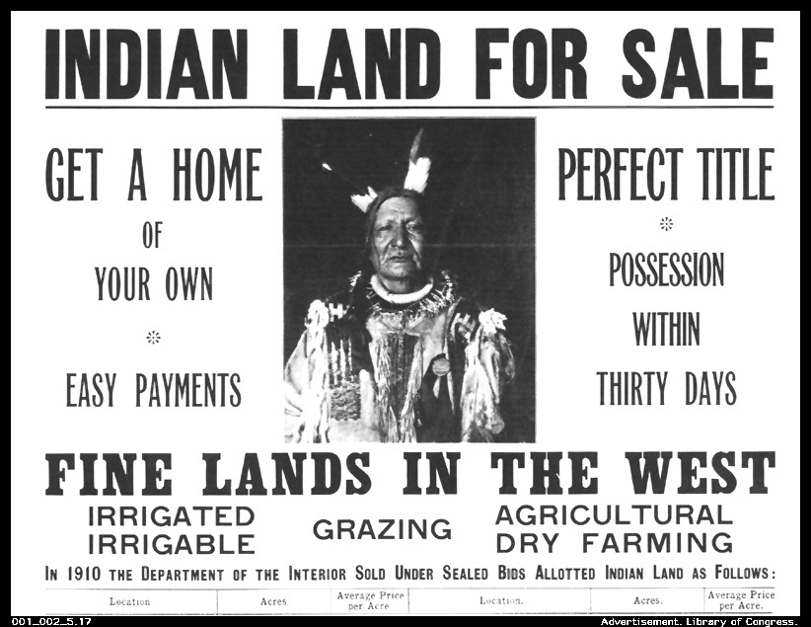
A Solution? Assimilation and Citizenship
Dawes Severalty Act (1887)
* 160 acres per male head of family
* individuals could petition for U.S. citizenship
Assimilation efforts
60% of reservation lands lost
66% of allotted lands eventually lost
Indian boarding schools

Slide 11
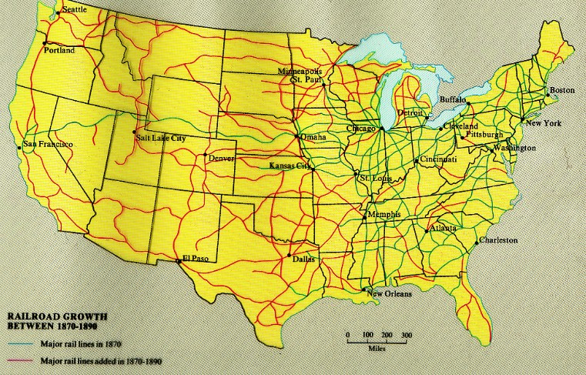
The Transportation “Barrier”
Free land for Railroad companies
Between 1862 and 1872, Congress awarded 100 million acres of public lands to railroad companies.
In 1880s, 40,000 miles of track laid west of Mississippi.

Slide 12

Railroads and Land Promotion
Only 10% of western settlers (400,000 families) received their land under the Homestead Act.
Land adjacent to railroads most valuable.
By 1870, railroads charged $6-$8/acre.

Slide 13
Farmers’ Debt
Land
Seeds
Equipment
DEBT

Slide 14
Transportation and Storage Costs
DEBT
Railroad monopolies
1870s- Railroads paid farmers 50 cents for a bushel of corn and sold it in cities for $1.25.

Slide 15
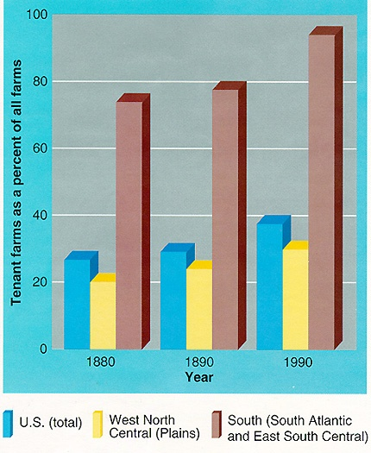
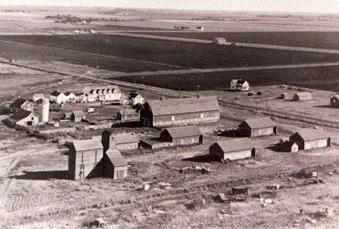
High tenancy and turnover rates
1900- more than 1/3 of all farmers on the Plains were tenants
1/3 to 1/2 moved within a decade
Farm corporations and hired laborers

Slide 16
The Second Industrial System in the West
On the one hand:
A more spatially unified nation.
The spread of technology: transportation and communication links.
Opportunities for upward mobility.
On the other hand:
Violence, warfare and the destruction of cultures
Farmers’ debt, despair and mounting anger

Slide 17
Group Activity
Analyze the photographs for the insights they provide about Indian boarding schools. Based on the photographs, what was involved in assimilation? What were educators supposed to do to assimilate native children?
Imagine you have to write a paper on the topic of the assimilation of American Indians in boarding schools. Your primary sources are the historical photographs. How would you organize your paper? Write an outline for the paper that includes a thesis, the topics for your paragraphs, and the evidence you would use in each paragraph. Write the thesis last.
Along the spectrum of views on Indian/American relations that the documents in the Document Project represent, where would you put assimilation efforts such as boarding schools?

