Slide 1
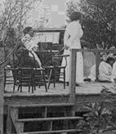
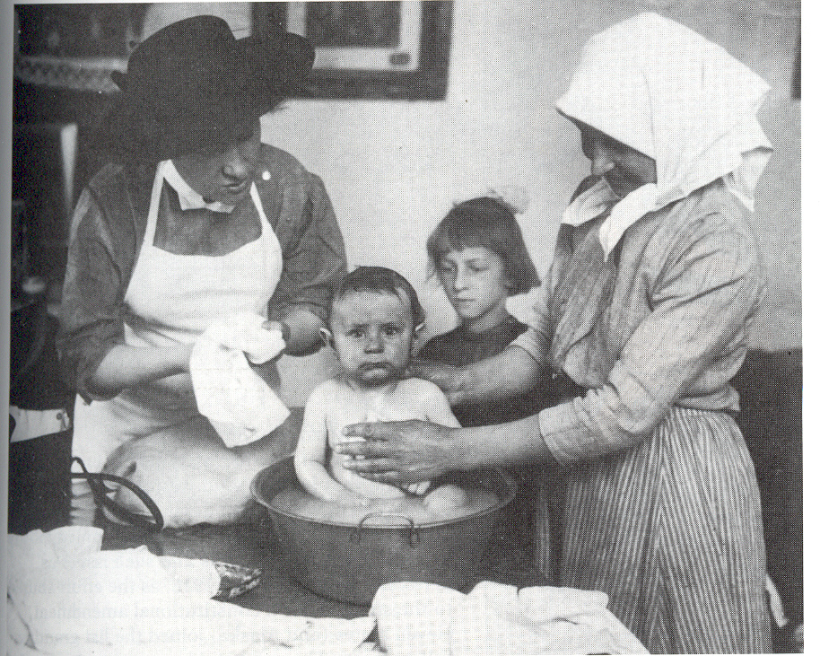
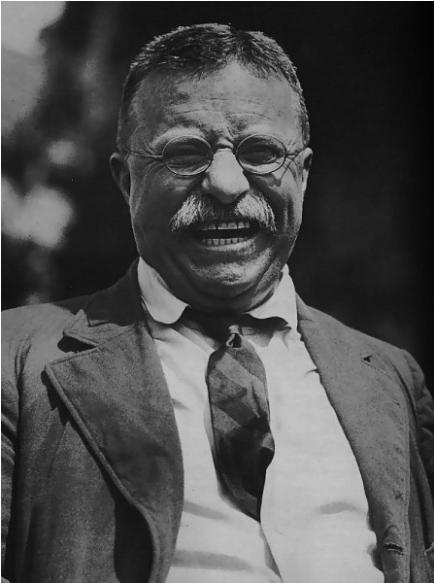
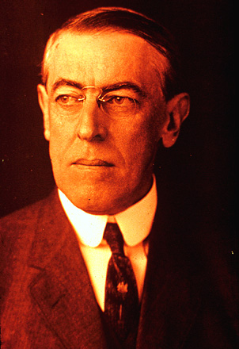
Progressivism:
Reforming the
Second Industrial
System

Slide 2
Review
What is laissez-faire capitalism?
Who defended it and why?
Who wanted to see it entirely replaced and why?
Why did some workers want to organize labor unions?
Can you have labor unions in a laissez-faire system?
How would you characterize workers’ views when it comes to laissez-faire based on what you’ve learned so far?

Slide 3
Progressives
Progressives were not:
Members of a single political party.
Progressives generally were:
Members of the middle class
Products of the second industrial system.
Concerned that businessmen were corrupting the system.

Slide 4
Progressives Diagnose the Problem
1.) Corruption in Politics
2.) Monopolies
3.) Mistreatment

Slide 5
The Middle Class had to fix the system by finding the middle ground, middle-class Progressives believed.
Business men would just leave things as they were, many progressives believed.
Poor people were too easily swayed by radical and other “half-baked” ideas.

Slide 6
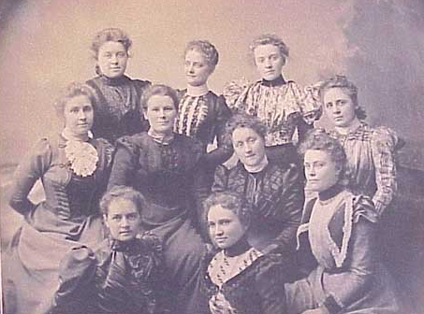
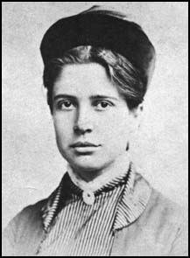
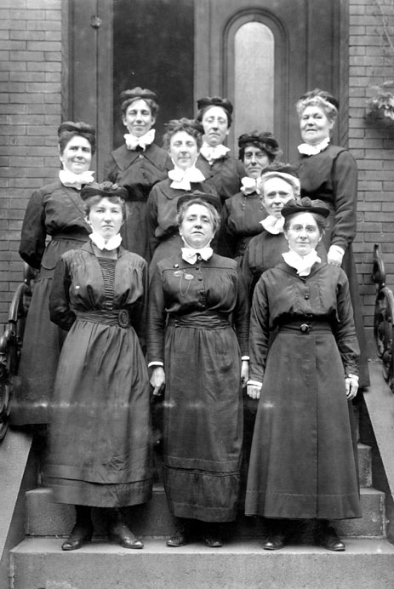
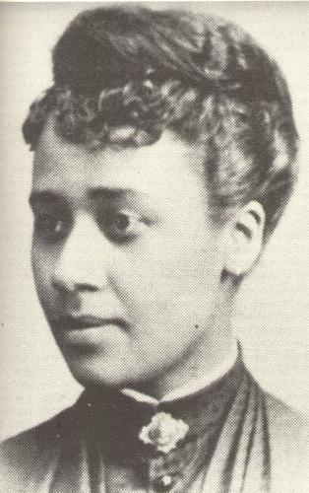
Middle and Upper-Class Women and Higher Education

Slide 7
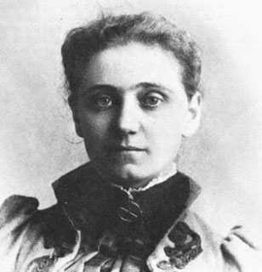
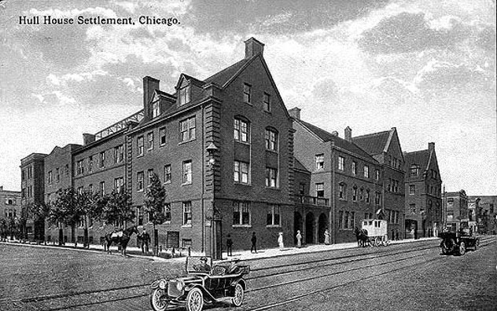
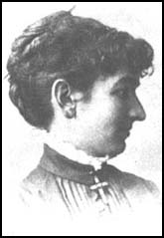
Jane Addams
Middle (and not working) class women lived in the settlement houses.

Slide 8
“Social Housecleaning”
From cleaning up the kitchen to cleaning up the neighborhood.
* sanitation
* day care, playgrounds
* child labor
* child and public health and safety
* protective labor legislation

Slide 9

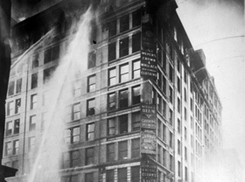
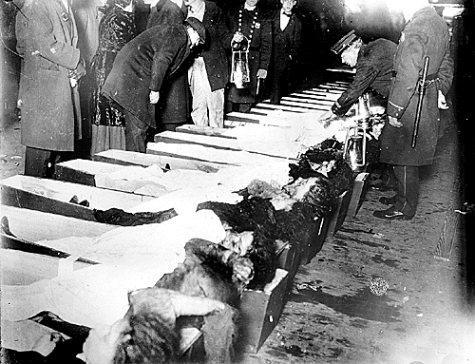
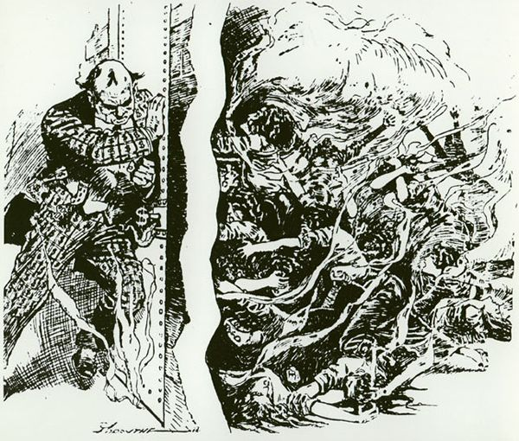
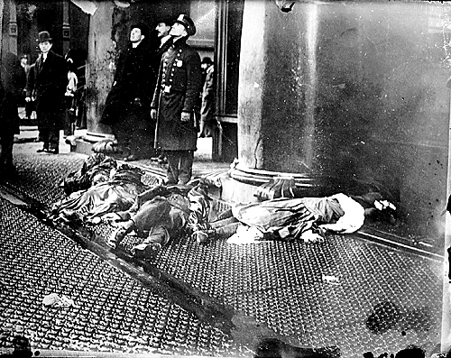
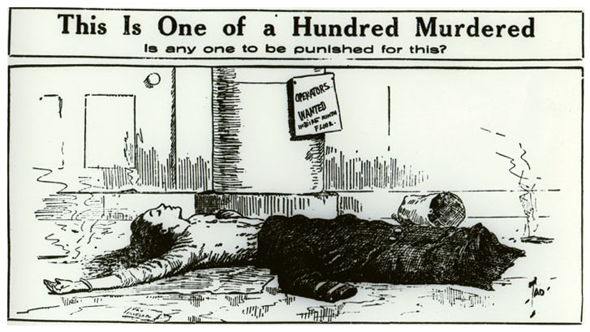
Triangle Shirtwaist Factory Fire (1911)
Notes:
146 deaths; sweatshop; subcontracting; had walked out to protest unsafe working conditions;
Recent studies conducted by the U.S. Department of Labor found that 67% of Los Angeles garment factories and 63% of New York garment factories violate minimum wage and overtime laws. Ninety-eight percent of Los Angeles garment factories have workplace health and safety problems serious enough to lead to severe injuries or death.

Slide 10
The Key to Progressives’ Solutions
The second industrial system has great potential.
But the system is susceptible to abuse.
The system isn’t providing the opportunities it could.
The Government Has to Take Action!

Slide 11
A Greater Role for Government:
1.) Services
2.) Regulation

Slide 12
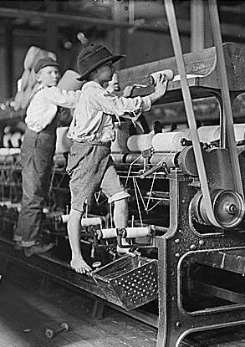
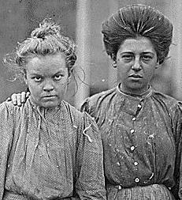
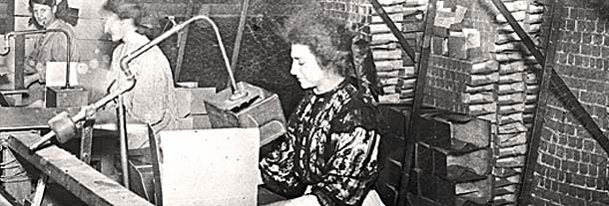
Progressivism and Labor: State Level
Anti-child labor legislation
Ten-hour day for women: Muller v. Oregon (1908)
Ten-hour day for women and men: Bunting v. Oregon (1917)
Workmen’s compensation laws
Workplace safety laws

Slide 13
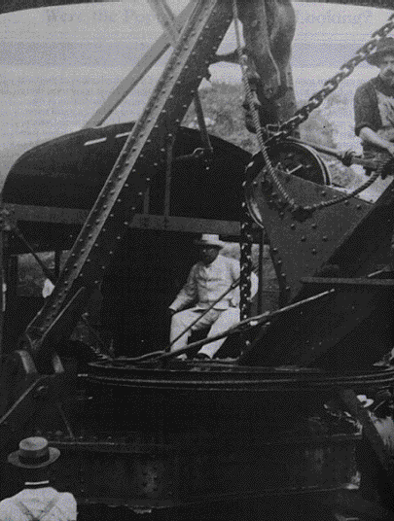
Progressive Presidents
Teddy Roosevelt
Loved the limelight and good political fights.
Woodrow Wilson
Righteous and rather humorless.

Slide 14
“That Damned Cowboy”
Teddy Roosevelt was:
Concerned with monopolies.
Felt Americans needed an institution on their side as strong and powerful as monopolies and big corporations.
Created the modern presidency.
Tried to balance corporate power with presidential power.

Slide 15
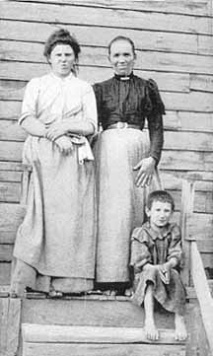
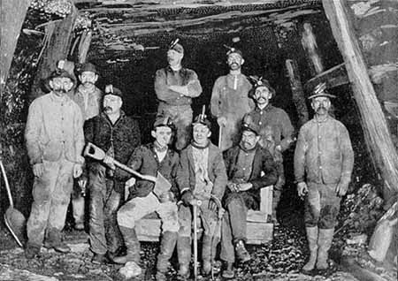
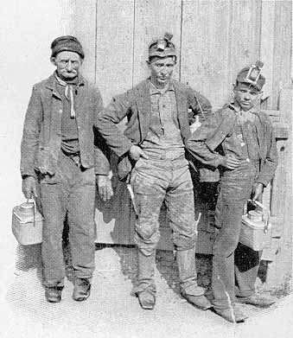
1902 Coal-Miners’ Strike

Slide 16
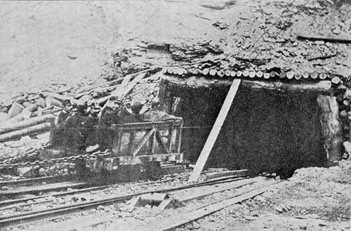
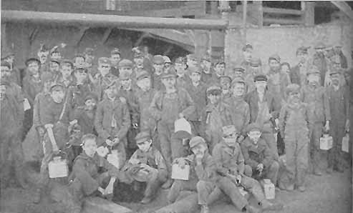
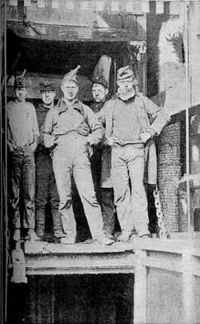
1902 Coal-Miners’ Strike

Slide 17
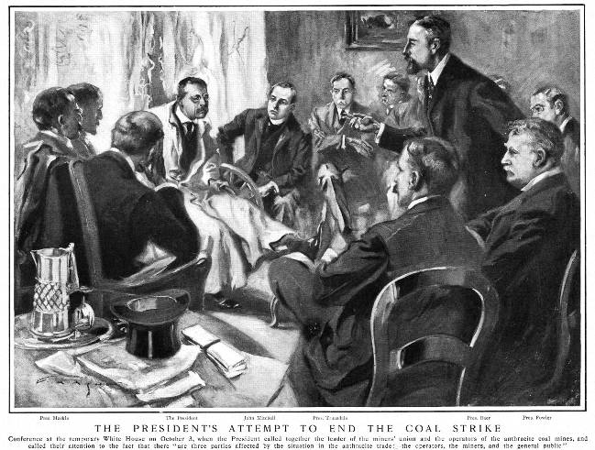
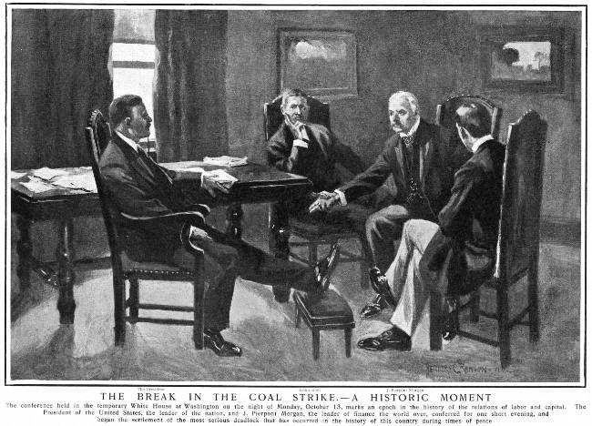

Slide 18
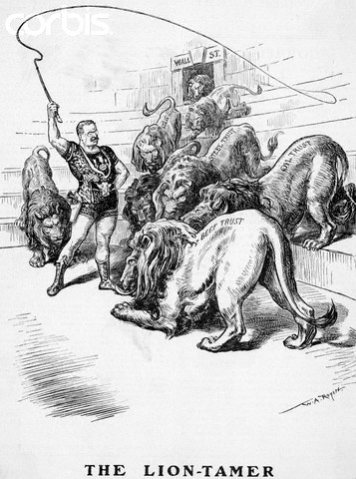
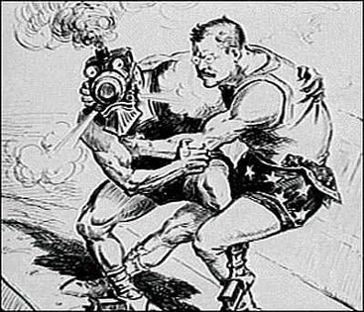
Trust Busting:
A Square Deal
1903: Bureau of Corporations
1906: Hepburn Act (maximum freight rates)
1906: Meat Inspection Act and the Pure Food and Drug Act
Trust Buster

Slide 19
Using the law to keep things fair
Wilson’s Domestic Progressivism
The Federal Trade Commission
The Federal Reserve System

Slide 20
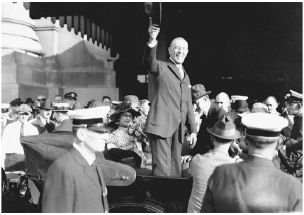
Wilson, Farmers and Workers
Federal Farm Loan Act (1916)
Keating-Owen Child Labor Act (overturned by the Supreme Court)
Adamson Act (1916): 8-hour workday for interstate railroad workers

Slide 21
Progressives
There were advantages to the second industrial system,
But laissez-faire was too extreme because the system concentrated wealth and power at the top,
So the government had to play a role in making things more fair for the average people.

