Slide 1
Equality, or equality before the law:
“All are equal before the law and are entitled without any discrimination to equal protection of the law. All are entitled to equal protection against any discrimination in violation of this Declaration and against any incitement to such discrimination.”
Article 7, The United Nations’ Universal Declaration of Human Rights (1948)
https://www.un.org/en/universal-declaration-human-rights/

Slide 2
Equality before the law:
Equality before the law, also known as equality under the law, equality in the eyes of the law, legal equality, or legal egalitarianism, is the principle that each independent being must be treated equally by the law (principle of isonomy) and that all are subject to the same laws of justice (due process).
Therefore, the law must guarantee that no individual nor group of individuals be privileged or discriminated against by the government.

Slide 3
Civil Rights and Civil Liberties
People often confuse civil rights and civil liberties. Civil rights refer to legal provisions that stem from notions of equality.
Civil rights are not in the Bill of Rights; they deal with legal protections. For example, the right to vote is a civil right. A civil liberty, on the other hand, refers to personal freedoms protected by the Bill of Rights. For example, the First Amendment's right to free speech is a civil liberty.
https://www.law.cornell.edu/wex/civil_rights

Slide 5
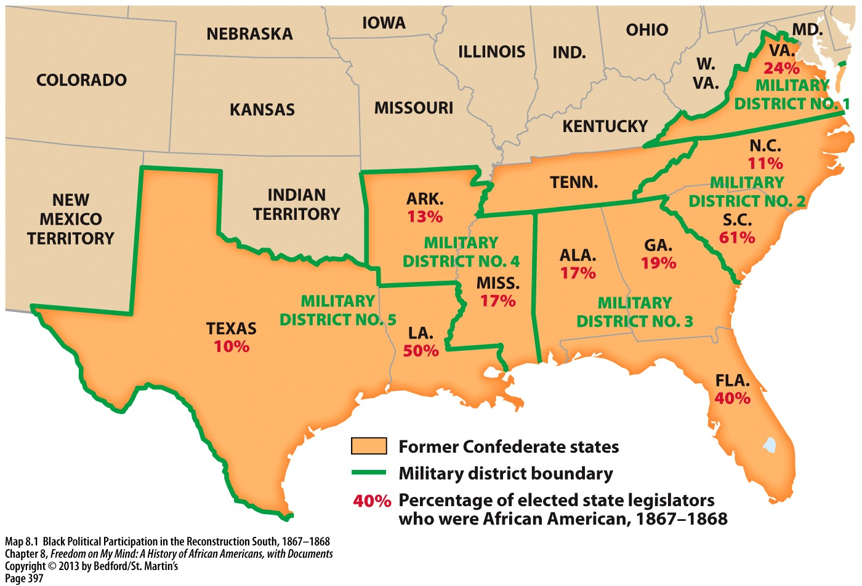

Slide 6
Major Questions After the Civil War
How should the South be rebuilt?
How should the states that seceded be brought back into the Union?
How should former slaves be incorporated into the country as freed men and women?

Slide 7
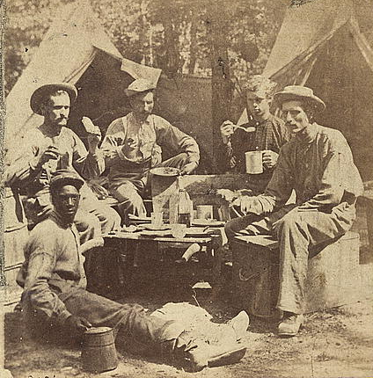
Reconstructing a Nation
After 4 years of war and over 200 years of slavery, could Northerners and Southerners rebuild the South together?
Could they unify as citizens of the same country?
Photograph of a Union soldier camp taken between 1861 and 1865
Notes:
Image retrieved from http://www.loc.gov/pictures/item/2005683189/

Slide 8
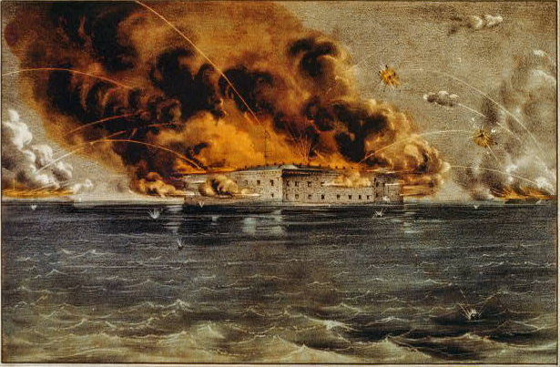
Punishment for the Confederate States?
Should people who fought against the United States be recognized as citizens? Should they be punished?
Illustration of the Attack on Fort Sumter from 1861
What should be done to the Southern state governments that fought against the United States?
Notes:
Image retrieved from http://www.loc.gov/pictures/item/90711987/

Slide 9
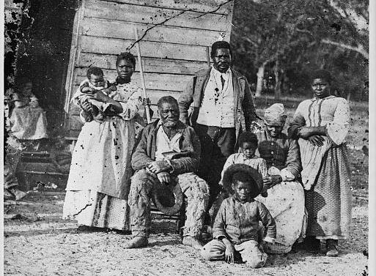
African Americans in the South
How would freed men and women be treated in the Southern states?
How would Northerners address the issue of including former slaves as citizens in society?
Photograph of an enslaved family in South Carolina taken in 1862
What were some major challenges that former
slaves faced?
Notes:
Image retrieved from http://www.loc.gov/pictures/item/98504449/

Slide 10
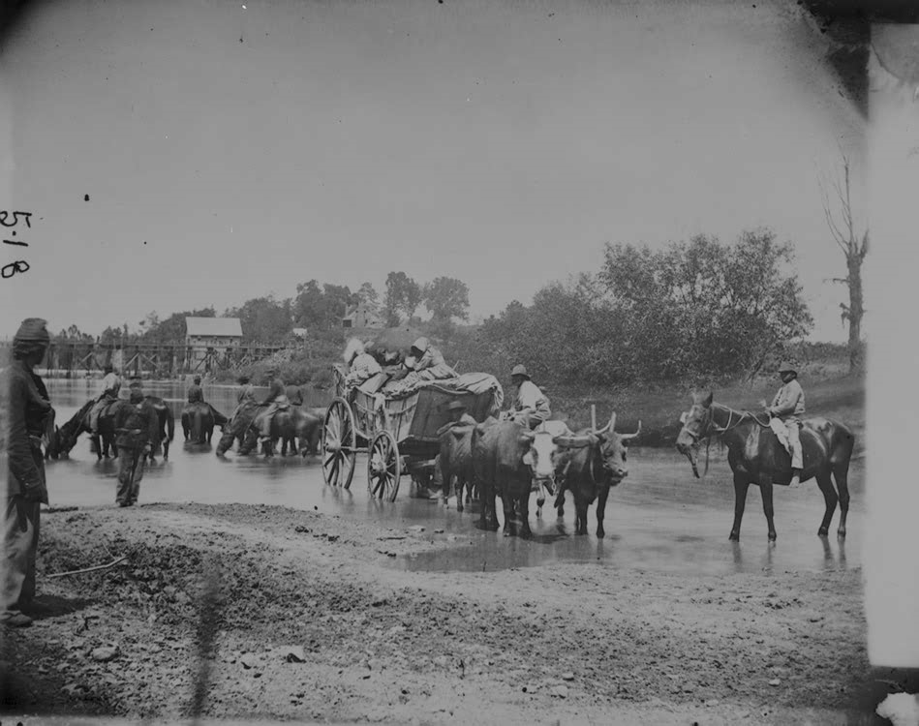
Fleeing Enslaved People

Slide 12
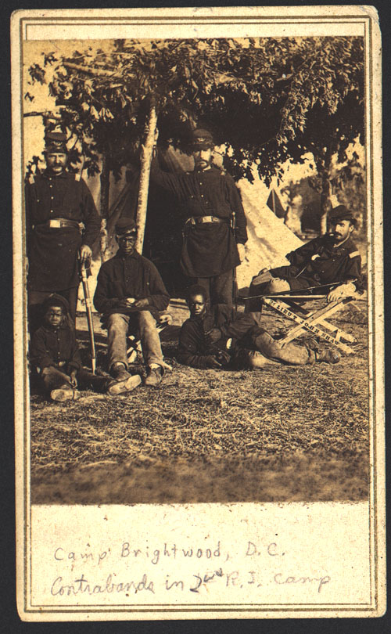
Runaway slaves who’ve joined the Union army, i.e. “contrabands”

Slide 14
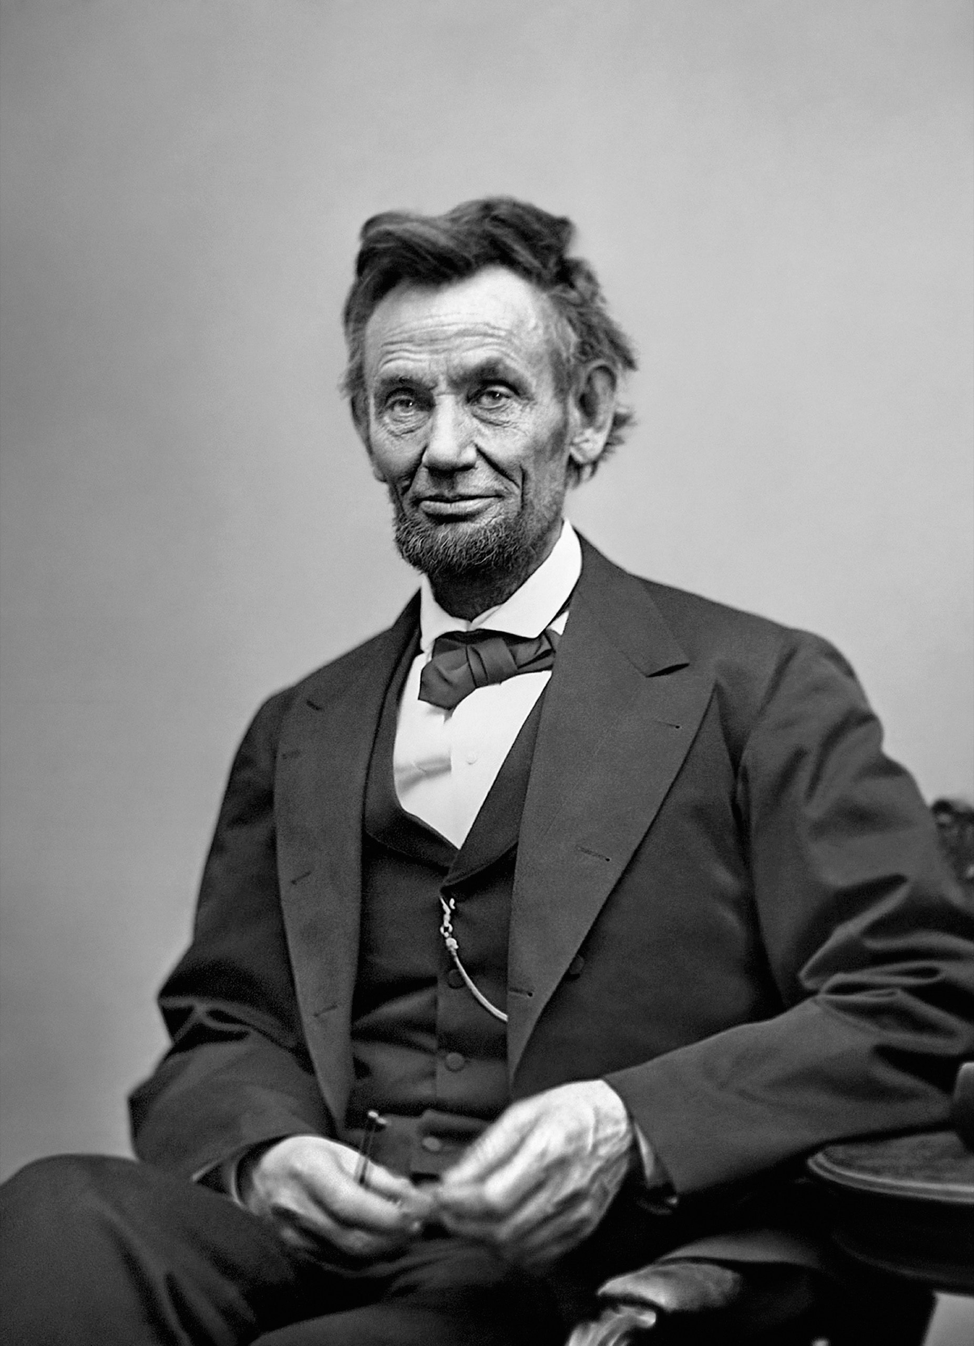

Slide 15
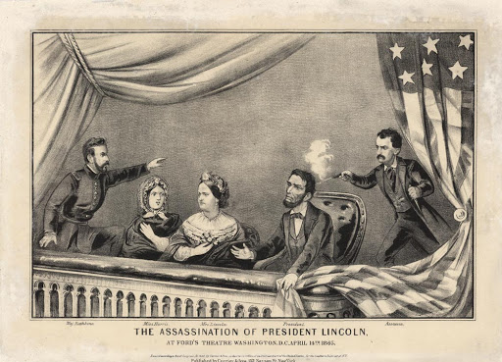

Slide 16
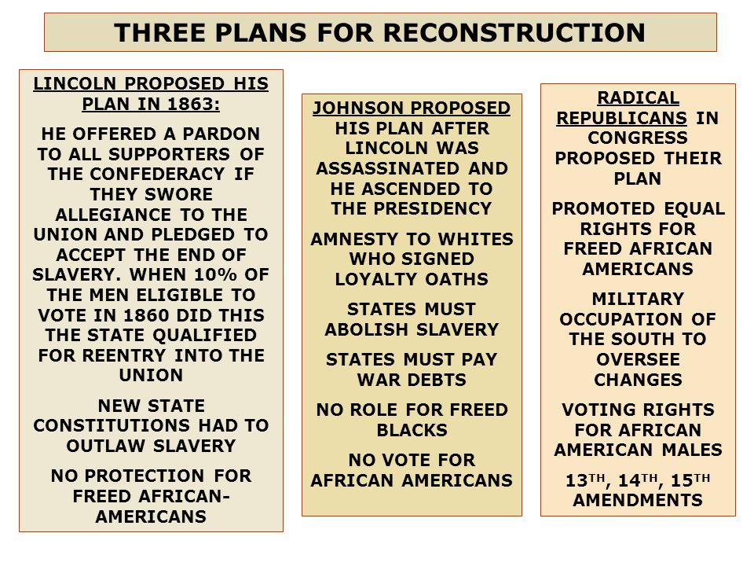

Slide 17
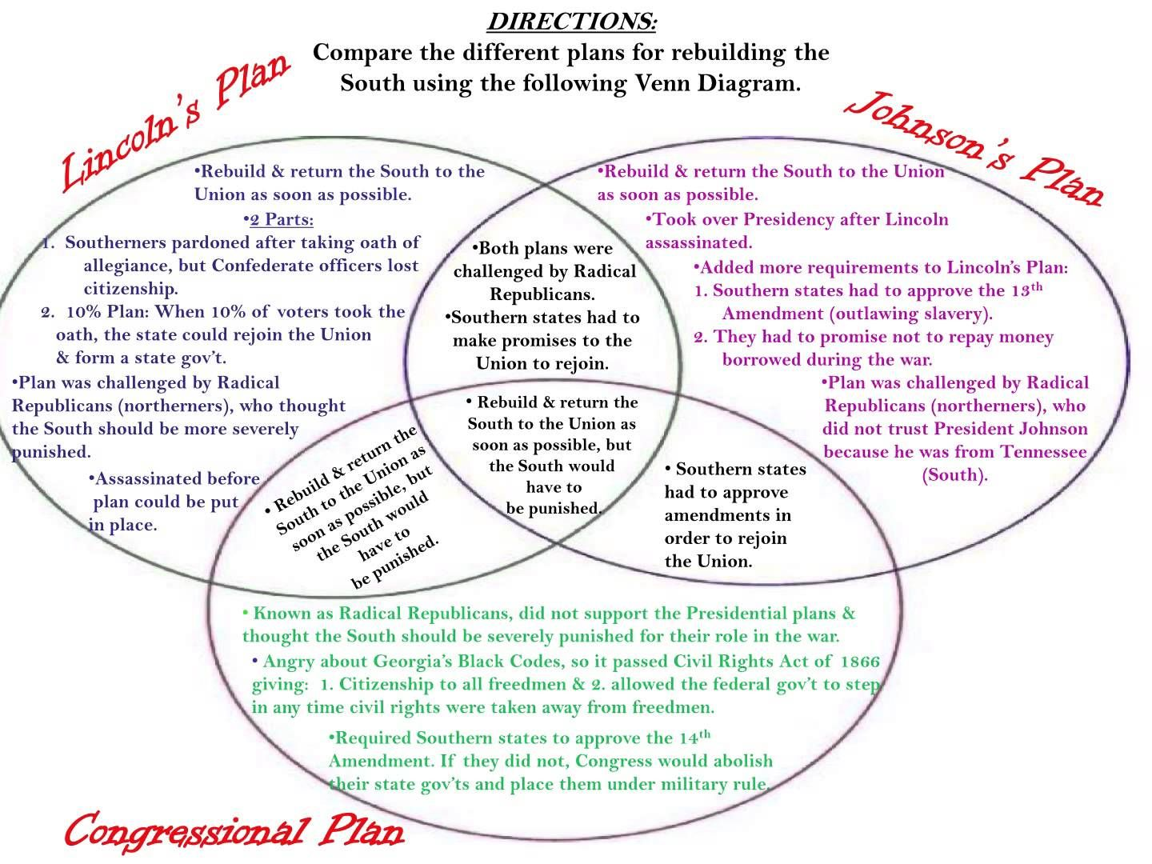

Slide 20
The Civil Rights Act of 1866 (14 Stat. 27–30, enacted April 9, 1866, but not ratified until 1870) was the first United States federal law to define citizenship and affirm that all citizens are equally protected by the law.^{[1]} It was mainly intended, in the wake of the American Civil War, to protect the civil rights of persons of African descent born in or brought to the United States.
The Act was passed by Congress in 1865 and vetoed by United States President Andrew Johnson. In April 1866 Congress again passed the bill to support the Thirteenth Amendment, and Johnson again vetoed it, but a two-thirds majority in each chamber overrode the veto to allow it to become law without presidential signature.

Slide 21
The Enforcement Act of 1870, also known as the Civil Rights Act of 1870 or First Ku Klux Klan Act, or Force Act was a United States federal law that empowered the President to enforce the first section of the Fifteenth Amendment throughout the United States. The act was the first of three Enforcement Acts passed by the United States Congress in 1870 and 1871, during the Reconstruction Era, to combat attacks on the voting rights of African Americans from state officials or violent groups like the Ku Klux Klan.
The Enforcement Act of 1870 prohibited discrimination by state officials in voter registration on the basis of race, color, or previous condition of servitude. It established penalties for interfering with a person's right to vote and gave federal courts the power to enforce the act. The act banned the use of terror, force or bribery to prevent people from voting because of their race.

Slide 22
The Enforcement Acts were three bills passed by the United States Congress between 1870 and 1871. They were criminal codes that protected African-Americans’ right to vote, to hold office, to serve on juries, and receive equal protection of laws.
Passed under the presidency of Ulysses S. Grant, the laws also allowed the federal government to intervene when states did not act to protect these rights. The acts passed following the ratification of the Fourteenth Amendment to the US Constitution, which gave full citizenship to anyone born in the United States or freed slaves, and the Fifteenth Amendment, which banned racial discrimination in voting.

Slide 24
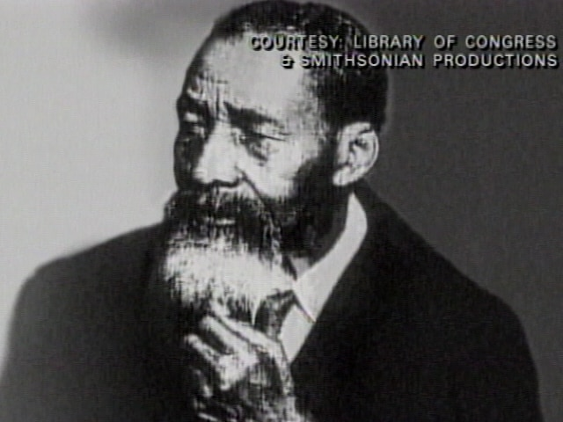

Fountain Hughes, 1949,
t.ly/ovSG

Slide 25
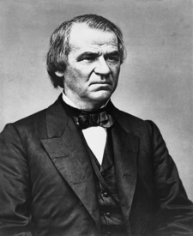
Andrew Johnson, seventeenth President of the United States, 1865-1869

Slide 26
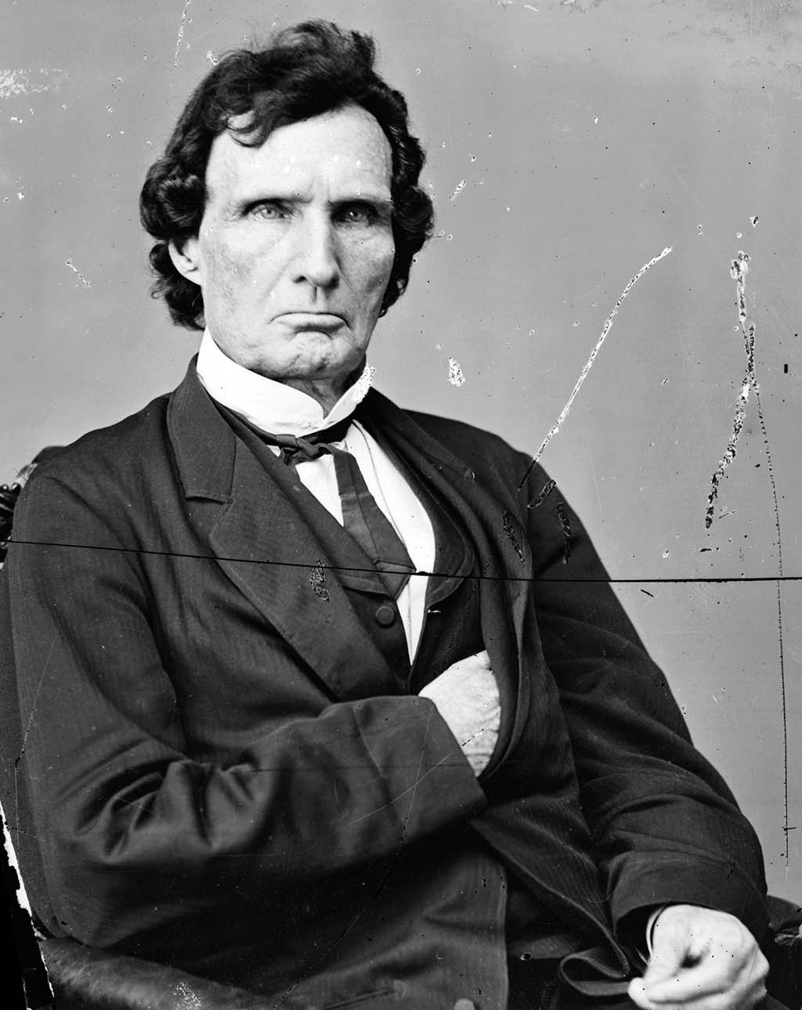
Thaddeus Stevens, Radical Republican leader

Slide 27
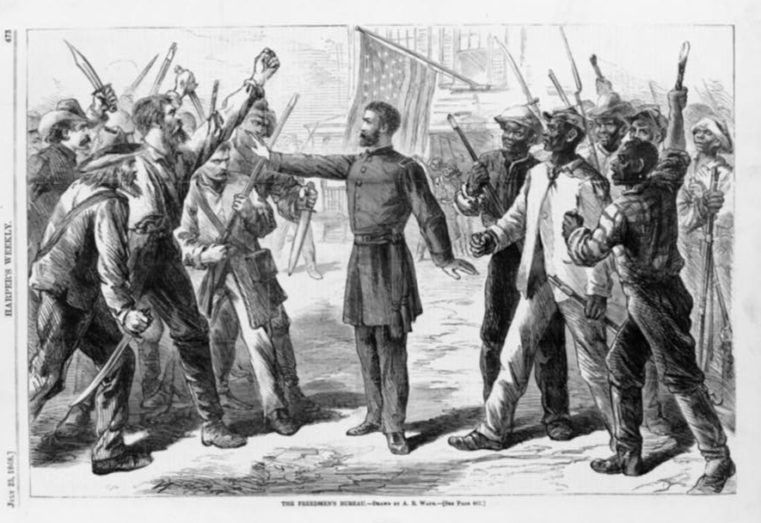
The Freedmen’s Bureau

Slide 28
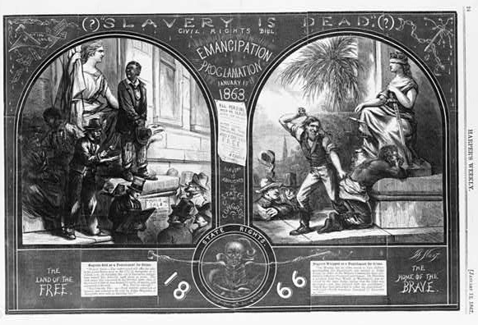
“Slavery is Dead?” cartoon from Harper’s, 1867

Slide 29
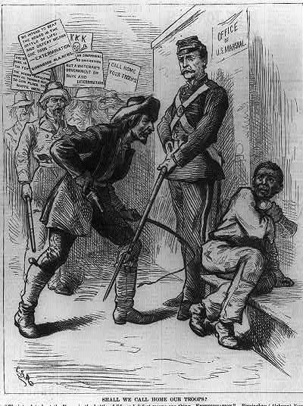

Slide 30
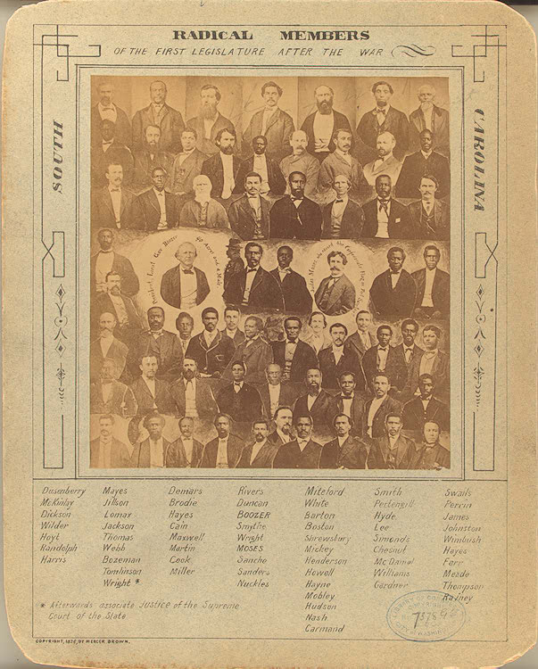
Radical Members of the First Legislature after the War, South Carolina.
Photograph 1878.
From the Library of Congress

Slide 31
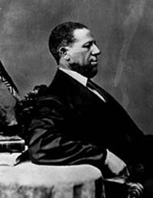
Hiram Revels, U.S. Senate (Mississippi, Republican)
Photo: Library of Congress

Slide 32
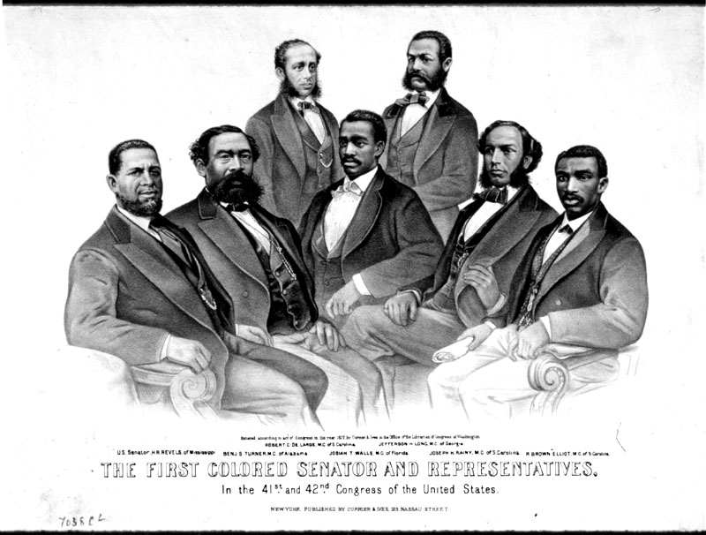
The First Colored Senator and Representatives, in the 41st and 42nd Congress of the United States.
Washington: Currier & Ives, 1872. Color lithograph.
From the Library of Congress

Slide 33
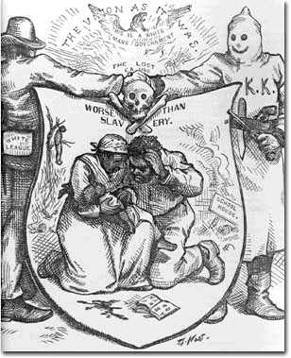
Thomas Nash, Political Cartoon, c. 1868
Harper’s Weekly
From the State Historical Society of Wisconsin

Slide 34
Emancipation and Reconstruction
Main Questions: What does the phrase Reconstruction mean? What was the U.S. trying to reconstruct, and why did it need to reconstruct? In what ways did it succeed, in what ways did it fail? What did freedom for African Americans mean—from both black and white perspectives?
I. Meanings of Freedom
--How did the freed people define freedom?--
  A. Education
  B. Land
  C. Religious Independence
  D. Economic and Political Equality
II. Political Struggles over Freedom
  A. Black Codes
  B. Black Reconstruction
  C. Constitutional Amendments
  D. Redemption
Key Terms
Ten-Percent Plan Black Codes
Military Reconstruction Acts 13th Amendment (1865)
14th Amendment (1868) 15th Amendment (1870)
Redemption Freedmen’s Bureau
Compromise of 1877 Ku Klux Klan
Andrew Johnson Radical Republicans
Black elected officials Radical Reconstruction

Slide 35
How to Read Primary and Secondary Documents
Don’t skip the introductions. Read the introductions to the chapter and the document. Get a sense of where this document came from.
2. Read the discussion questions on the syllabus
3. Decide what to look for. Based on your preliminary knowledge of the document, or subject matter what should you look for? What topics, keywords, or ideas do you think will be the most important?
3. Jot down the main idea of each section in just a few words in the margins or in a notebook. This will help you recall information at a glance.
4. Try to sum up the main point or the most important thing from the document in just a sentence or two.
5. Read the “Questions for Reading and Discussion” if there are any. Think about them, and then post your own question on the blackboard discussion board.
Pre-Reading
Notetaking
Discuss

