Slide 1
Case Study #2

Slide 2
Case Study Report
Sammy is a 20 year old female tennis athlete. She comes to the athletic training room after seeing her physician who diagnosed her with lateral epicondylitis and orders to begin rehabilitation as soon as possible. Sammy complains of constant moderate to severe pain at her right lateral elbow that prevents her from playing tennis. The pain started about 1 month ago, the morning after she spent pulling weeds in her mother’s garden, and remained unchanged in severity or frequency until 3 days ago. She reports a slight decrease in pain severity over the last 3 days, which she associates with starting to take an NSAID prescribed by her physician. She has had similar symptoms previously, after playing tennis, but these have always resolved within a couple of days without any medical intervention. Objective examination reveals tenderness and mild swelling at the right lateral epicondyle and pain without weakness with resisted wrist extension. All other tests, including upper extremity sensation, range of motion, and strength, are within normal limits.

Slide 3
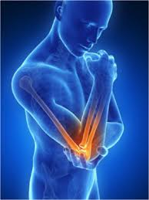
Lateral Epicondylitis
Commonly known as tennis elbow and is an injury dealing with the tendons that attach to the outside of the elbow (lateral aspect)
The tendons attaching to the lateral part start to degenerate at the attachment point and can become very painful with activity; for example in this case it is tennis
Occurs in all ages and in both men and women either due to overuse or a traumatic event like a direct blow to the elbow or tendon

Slide 4
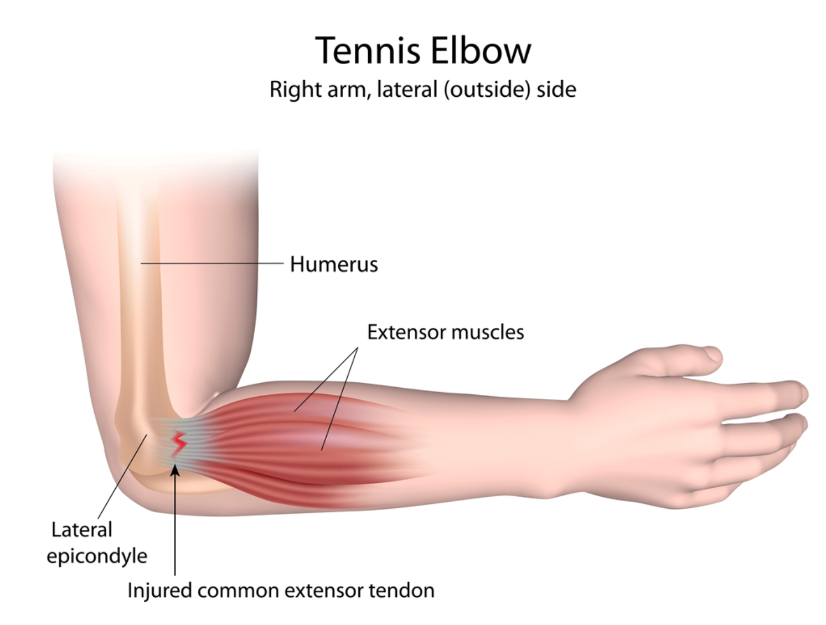

Slide 5
Patient Signs and Symptoms
Mild swelling and inflammation on the lateral epicondyle of her right elbow
Constant to severe pain has been occurring for about a month, but has decreased in the last 3 days due to oral NSAID’s
Patient has had pain like symptoms in the past, but nothing that has lasted this long

Slide 6
Prioritization of Problems
Moderate to severe pain on right lateral elbow preventing her from playing tennis
Pain without weakness with resisted wrist extension
Tenderness and mild swelling at right lateral epicondyle
ROM, extreme sensation and strength are within normal limits

Slide 7
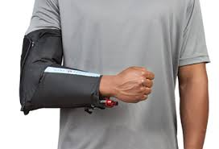
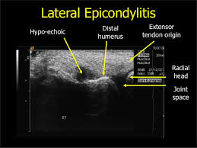
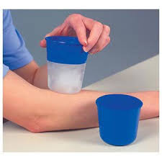
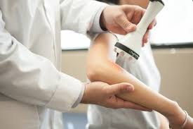
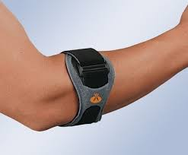
Modality Definitions
Game Ready- a compression device or sleeve that fills with ice cold water to ice an injured area on the body; usual set time is approximately 20 minutes
Ultrasound- can be set on 3 MHz for a superficial injury or 1 MHz for a deeper injury and can be placed on the patient directly with a gel medium or can use an immersion technique with the patient’s extremity placed in water with the ultrasound head approximately 0.5 cm away while keeping in mind the possibility of having to raise the intensity
Ice cup massage- Ice on a popsicle stick or in a Dixie cup used as a massage technique to ice and massage at the same time; approximately 5 to 10 minute application
Laser- a type of light therapy (aka phototherapy) is an application of light from a variety of devices for a variety of therapeutic purposes; specific wavelengths of the laser light can cause specific physiological responses within the patient depending on the injury being assessed
Iontophoresis-

Slide 8
Modalities and Treatment Plan
Start the patient with ultrasound on a pulsed 3 MHz setting, maybe start at 50 % pulsed or another number that the patient feels completely comfortable at; most likely use immersion technique
Then move to an effleurage massage to allow all of the swelling to start to move away from the area; patient has to drink water to help with this process otherwise it does not work. Patient could also have a myofascial release treatment done to help with the fascial tissue and pain
Laser treatment to help stimulate tissues to help with mild inflammation
Then work with the patient on physical therapy rehab exercises
Finally, finish with the Game Ready machine to ice down the area eliminating pain by numbing the area that was just worked on
*Patient should continue her NSAID’s for at least a 10 day period to also help with the mild inflammation

Slide 9
Long Term and Short Term Goals
Short Term:
  Patient will reduce swelling from 3 cm to 2 cm
  Patient will limit pain from a 8 out 10 to a 5 out of 10 by 12 days
Long term:
  Patient will have no swelling by 4 weeks after injury
  Patient will be pain free by 5 weeks after injury and will be back to playing tennis full time granted she rests in that time period

