Slide 1
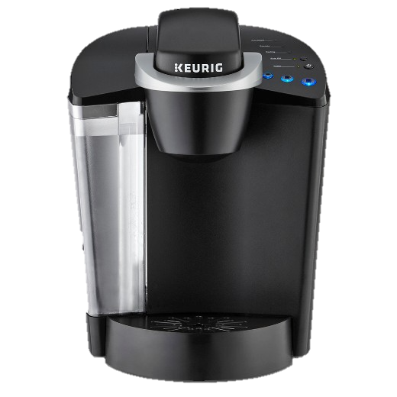
Keurig coffee maker

Slide 2
INTRODUCTION
Not brewing.
Noise.

Slide 3
OBJECTIVE
Not brewing
https://www.youtube.com/watch?v=YBruZzE3y84
Noise
https://www.youtube.com/watch?v=ZrqI0u7vvY4

Slide 4
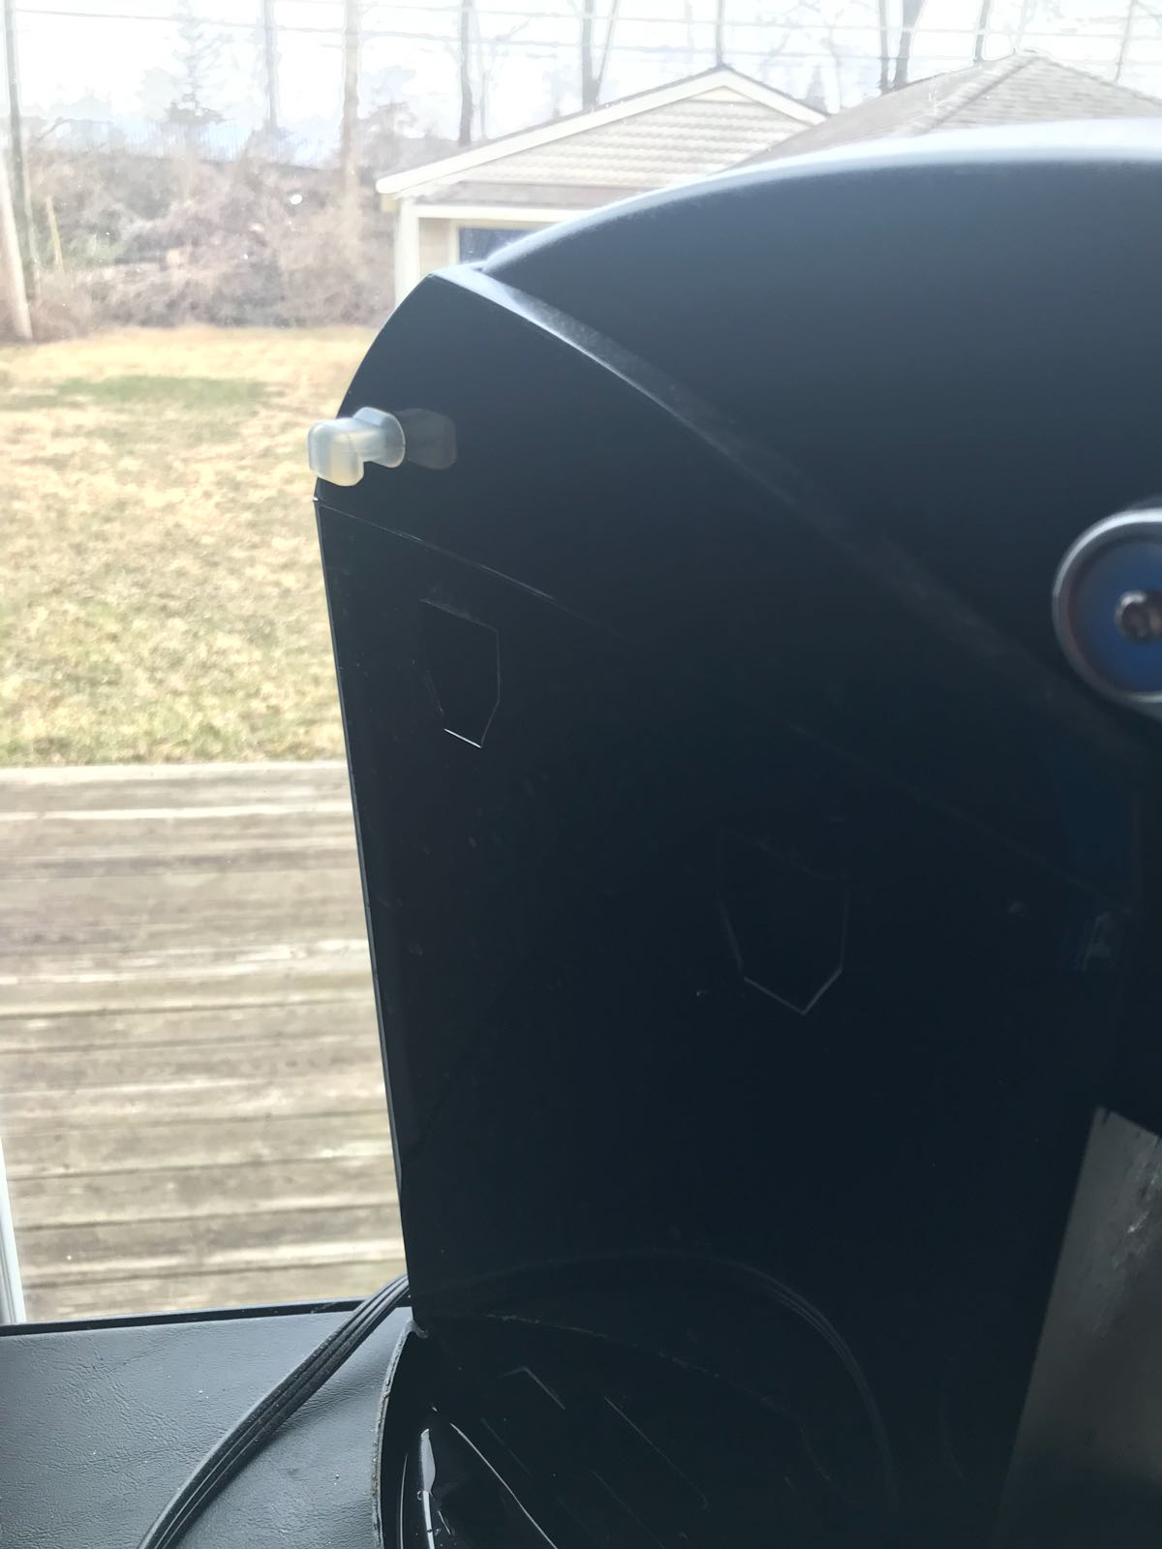
SOLUTION

Slide 5
DMAIC
Define: not brewing coffee and loud noise.
Measure: filter is not tighten and not clean.
Analyze: too much usage without cleaning it and checking the filter.
Improve: cleaning and tighten the filter.
Control: testing it and listen to the sound if it decrease or not, and see if it starts brewing or not.

Slide 6
CONCLUSION
Tight the filter with a screwdriver.
Clean the filter.

