Slide 1
Student’s Name
Institutional Affiliation
.

Slide 2
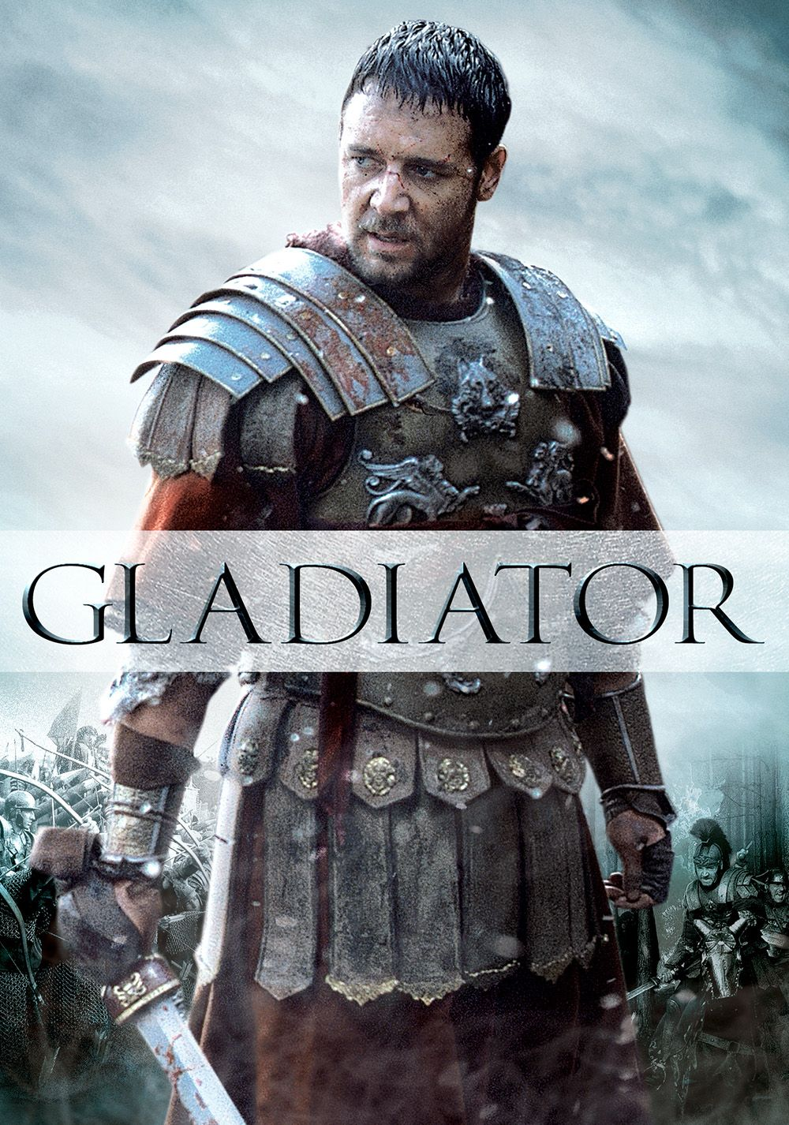
General Maximus
Gladiator,2000

Slide 3
Introduction
Gladiator is an historical film based on real events that happened in the roman empire.
It features Maximus a powerful roman soldier who exact revenge against an empire that murdered his family and sent him into slavery.
In the beginning Commodus is angered by his father who chooses Maximus to be his heir.

Slide 4
Continuation….
He kills his father and order death of Maximus's family.
His popularity in the gladiator arena is a threat to the reigning emperor.
In my view the film lacks accuracy and does not exhibit real event that occurred in the Roman empire.

Slide 5
Continuation….
There is no evidence that emperor’s son had any political differences with his father.
Besides, it was not common for an emperor to choose a roman soldier as his successor as indicated in the film.
The roman emperor had appointed his son as successor long before he died,(Greenberg et al,101).

Slide 6
Continuation….
The roman emperor died in Vienna while the film indicate that he died in Germania during a political campaign.
The film indicate that the emperor was killed by his son which may not be true based on historical documents.
It is difficult to know what exactly occurred in this era as some books indicate that Romans suffered under Commodus reign.

Slide 7
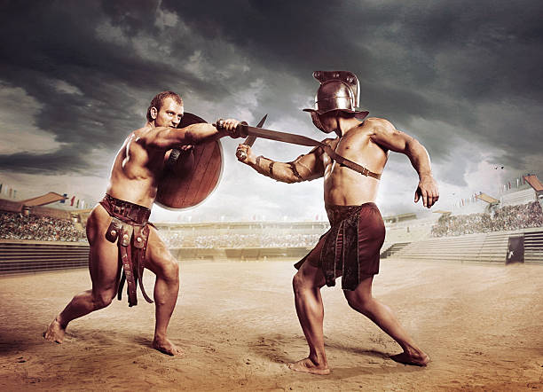
Gradiator Fight.
Gladiator,2000.

Slide 8
Continuation…
In the historical roman empire contest in the gladiator arena did not lead to death as indicated in the film ,(Capes,66).
As witnessed in the sports event today, gladiator games generated a lot of money thus mass killings of gladiator may not have happened regularly.
The film does not show that gladiators were also used to sponsor products in the stadium during contest.

Slide 9
Continuation…..
The film also shows the emperor’s son fighting Maximus on a one on one contest which may not be true for various reasons.
Firstly, the emperor’s did not die at the hand of Maximus as indicated in the film.
Secondly, Commodus did not participate in fights organized in the gladiator arena as shown in the film.

Slide 10
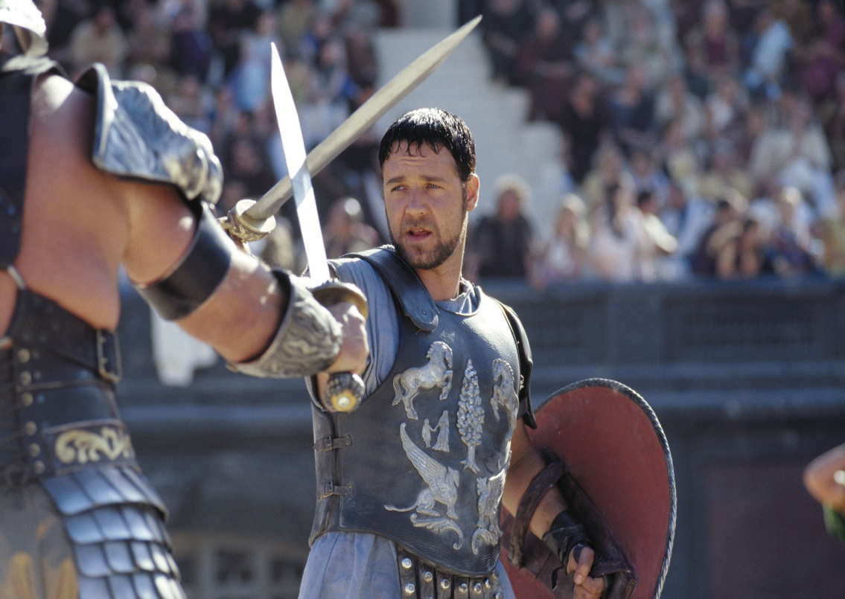
Maximus fighting Commodus
Gladiator,2000.

Slide 11
Continuation….
The emperor’s son only fought with animals and crippled captives where he was assured of victory.
The character of Maximus is based on powerful soldier in the Aurelius' reign who declared himself the ruler shortly after thinking his boss was dead indicating a power struggle,(Macgill& Sara,181).
He was eventually killed, besides Maximus was a general in late roman empire.

Slide 12
Continuation…
In real life ,Commodus ruled the roman emperor for 12 years.
During his reign he held naked gladiator contests which earned him a bad reputation in the society hence his downfall.
He killed large number of disabled people in the stadium which eventually led to his assassination.

Slide 13
Continuation…..
The producer of the film did not show how gladiator were used to sponsor products in the ancient roman because he thought the audience would not believe it due to its similarity with our modern sports.
The producer also wanted to show a more democratic roman empire by indicating that the roman emperor choose a roman soldier as his heir over his son.
The film also portray the Aurelius' as a wiser ruler who always acted in the best interest of the roman people.

Slide 14
Conclusion
There are many historical inaccuracies which can be easily noticed in the film although its more of entertainment than historical narrative.
The outrageous character of the emperor’s son indicated in the film is true, his reign is among the worst in the roman history.
lastly it is important to view this film as creative perspective of the roman history rather than accurate historical picture of the mentioned era.

Slide 15
Work Cited
"Gladiator (2000) - Imdb". Imdb, 2020, https://www.imdb.com/title/tt0172495/.
Capes, W. W. Roman History. Longmans, Green, And Co., 1927, pp. 56-79.
Greenberg, Imogen, and Isabel Greenberg. The Roman Empire. 2002,pp.88-105.
"Greek Drama Vs. Modern Movies". Our Pastimes, 2020, https://ourpastimes.com/greek-drama-vs-modern-movies-12531250.html.
McGill, Sara Ann. Ancient Roman Government. 2000, pp. 179-201.

