Slide 1
Executive Summary
Author name
Institutional affiliation

Slide 2
Sportstar store, NC
Sportstar store will be located in Durham, NC.
Mission
To provide extraordinary customer experience through our best designed quality sporting products.
Sportstar store will be a partnership business.
We aim at targeting at a large market segment.
Sportstar business aims at incorporating technology
Notes:
Durham has a growing need of sporting equipment due to high numbers of sporting activities carried out. Our mission is to ensure customer needs are met and fulfilled through provision of high quality products. A form of limited liability partnership will ensure success of the business. Our sporting goods will be used by people of all age groups. We also aim to market our products using the latest technology models. Technology will also enhance security of the store through installation of surveillance cameras to ensure that our customers are protected.

Slide 3
Initial investment cost
Sportstar initial investment cost is estimated to be $ 500,000-800,000.
The cost will cater for;
Rent of the retail space
Obtaining a business insurance and licence
Purchase of sporting products
Payment of employees
Paying for internet
Notes:
Initial investment cost will cater for all the expenses required to start and run the business. For security of the retail space, we will pay for the first three months. Following government policies and regulations, a business licence and insurance will be obtained. Out of the investment cost, $380,000 will be used in purchasing the inventory. High speed internet connection will also be required for research of new products.

Slide 4
Our products and services
Sportstar store will retail the most popular sporting goods.
The following products will be initially offered;
Sporting uniforms including shoes
Bags
Baseball, football, basketball and volleyball equipment's
Sports team logo
Cheerleading equipment
Notes:
Our store will have a wide range of products that will cater for the needs of sporting in Durhan and other cities in North Carolina. Our sporting equipment are of high quality purchased from top manufacturers. When our customers will be purchasing the equipment, they will be advised on type, size, and design required. We will also offer services such as putting sports team logo if required by our clients.

Slide 5
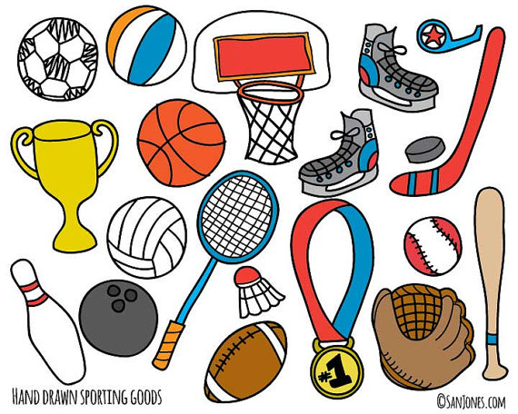
Products
A drawing showing some sporting equipment

Slide 6
Target market and demand for the products
There is a high demand for sporting equipment.
Sportstar store will cater for all the demands in sporting equipment.
Our target market will include
Sports coaches and directors
Sports teams
individual sports person
Parents
Notes:
In the metropolitan area of Durham, there is a growing demand in the need of sporting equipment. Due to this gap, sportstar store will fill the gap. Our store will mainly target sports coaches and directors who will purchase our products in bulk for their teams. Individual persons and parents are also our main target.

Slide 7
Return on investment (ROI)
The business targets to have a high ROI.
The targeted ROI is 30% over the first year of operation.
Sportstar store is projected to have a growth rate of 3.6% per month.
Early years into the business will be profitable
Notes:
Due to the nature of the business, we expect the business to operate in profits during the first years of operation. To get the ROI, we assumed that the store will make a profit of $250,000 for the first year.

Slide 8
Conclusion
Investing in Sportstar will lead to high profits.
We intend to offer sales at reasonable prices that will attract our customers.
Depending on the success of the business, future plans will involve:
Opening new stores
Hiring more employees
Adding more sporting equipment.
Notes:
Investing in sportstar store will be the best decision ever. We believe that the business will grow and thus we have future plans of opening more stores. Due to increasing numbers of customers in our store, more trained personnel will be hired. Sportstar is a prospective business with great future plans.

