Slide 1
Better Vaccination Policies
Instructor:
Student Name:
Student id:

Slide 2
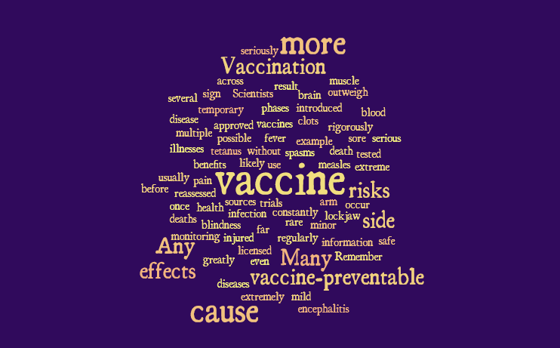
Notes:
Vaccination is a simple, safe and effective way of protecting individuals against bacterial, and viral diseases, before they get infected. A vaccine makes use of human beings' natural defenses to provide resistance against specific infections and upon administration, it makes the immune system stronger by training the immune system to produce antibodies and fight diseases.

Slide 3
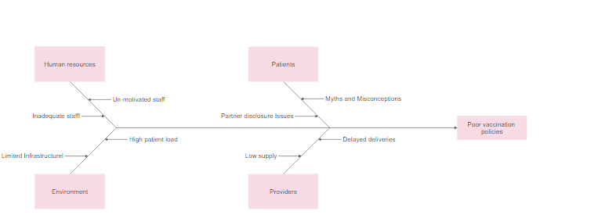
Notes:
Vaccination policies are facing a lot of hostility from the general public—this has made it difficult for the governing bodies to effectively administer vaccines to the citizens. This bottleneck can be attributed to improper public emancipation and education. The opposing parties have had an easy time spreading fake news and mobilizing the public against governmental vaccination campaigns

Slide 4
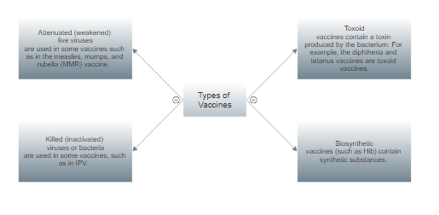
Notes:
Better vaccination policies will go a long way in influencing the general public to accept the vaccines being administered and water down the false news that has been feed to the public through the media and other communication channels.

Slide 5
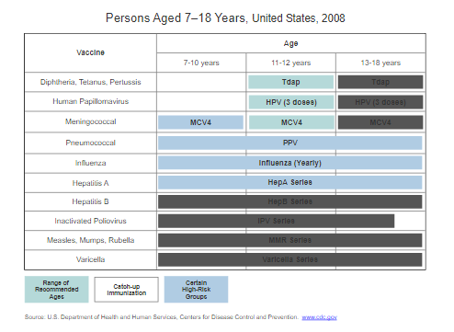
Notes:
Implementation of the new vaccination policies can only be successful if the general public is involved in decision-making and policymaking since they are the consumers of the vaccines. The governing body should make the public feel incorporated in the decision process, and the implementation process too.

Slide 6
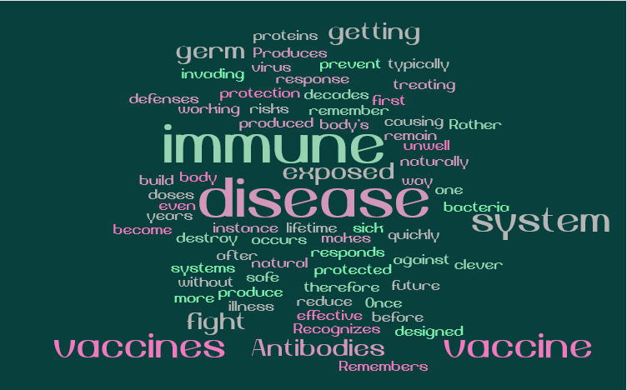
Notes:
Better vaccination policies will go a long way in influencing the general public to accept the vaccines being administered and water down the false news that has been feed to the public through the media and other communication channels.

Slide 7

Notes:
Vaccines have played a major role in the prevention of diseases as, currently, there are more than 20 diseases against which a human being can be vaccinated against. With the insurgence of Covid-19, a global pandemic, vaccination has emerged to be the only dependable solution to solve this quagmire; however, the vaccination process has been marred with challenges ranging from; spread of wrongful information, inadequate supply of vaccines, shortage of experts/professionals and an unwilling population to be vaccinated.

Slide 8
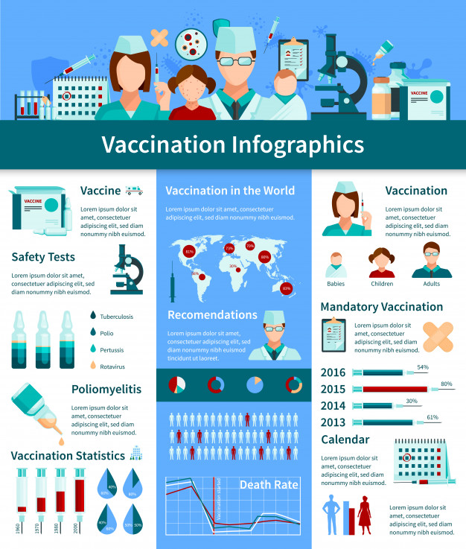
Notes:
Better vaccination policies are crucial in maintaining a healthy and disease-free population. If the governing bodies invest in developing and implementing better vaccination policies, it will be easier to control most communicable, and immunizable diseases that pose a threat to the general public.

