Slide 1
The Fundamental Principles of Care Coordination
Community Resources, Ethical, And Policy Issues That Affect the Continuity of Care
Designed by: (Name)
September 30, 2024

Slide 2
Introduction
Today, we will be discussing the fundamental principles of care coordination.
We will also cover how staff nurses play an expanded role in helping to manage the care continuity process.
This presentation will also touch on community resources, as well as ethical and policy issues that affect the continuity of care.
Notes:
Hello, everyone. Today, I have the privilege to present on a critical subject that influences the quality of care we provide patient outcomes, and care coordination.
This presentation will address care coordination basics and discuss how I and other staff nurses play an expanded role in helping to manage the care continuity process.
The basic principles of care coordination refer to the core beliefs undergirding the process of organizing patient care activities and sharing patient data between multiple healthcare providers to foster positive patient outcomes and high-quality care.
I will address the fundamental principles of care coordination and community resources, as well as ethical and policy issues that affect the continuity of care.

Slide 3
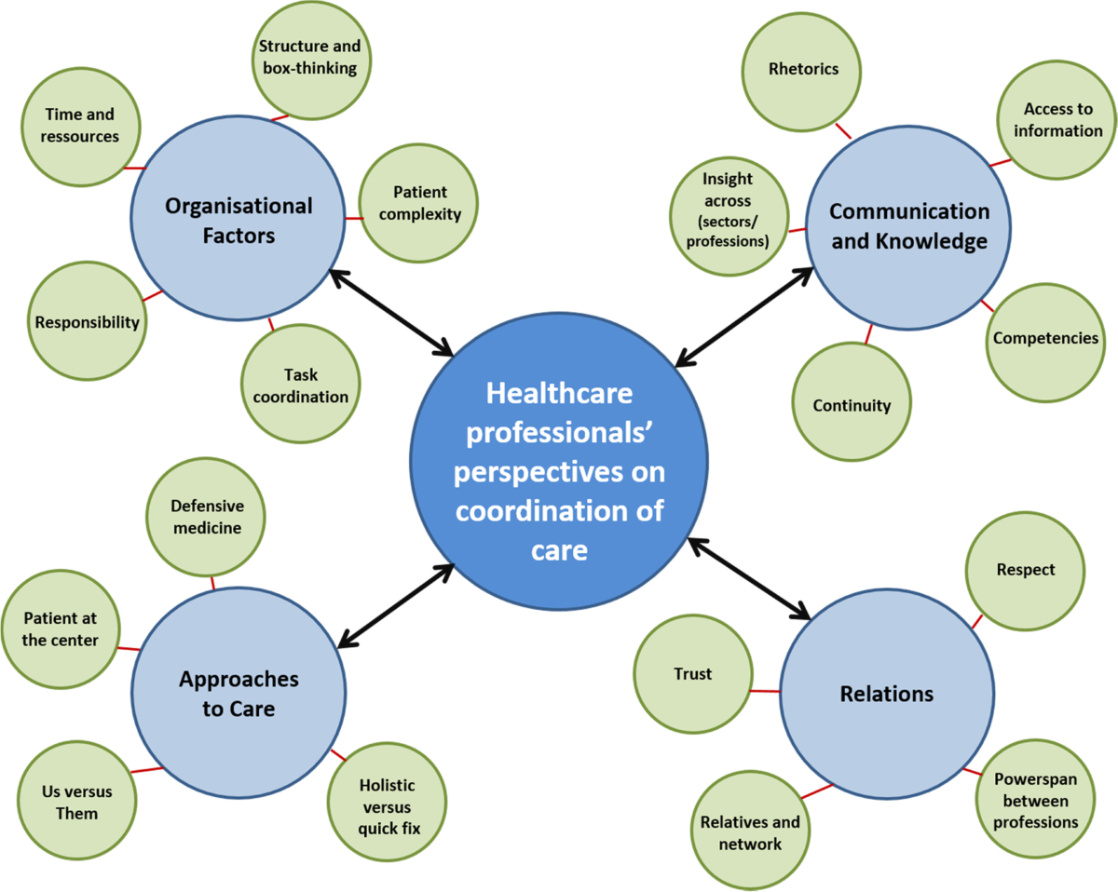
(Persson et al., 2022)

Slide 4
The Fundamental Principles of Care Coordination: Teamwork
All healthcare professionals involved in a patient’s care must cultivate a collaborative mindset and a commitment to their roles.
Teamwork means that all healthcare team members understand the main goals and have clear expectations of themselves and other clinicians (Anderson et al., 2020).
Effective teamwork also requires acknowledging the contributions of other members and a solid commitment to relationship building.
Notes:
In this presentation, we will discuss the first fundamental principle of care coordination: teamwork.
The basic principle of teamwork involves creating formal structures to support care continuity. All healthcare professionals involved in a patient’s care must cultivate a collaborative mindset and a commitment to their roles.
Teamwork means that all healthcare team members understand the main goals of care coordination and have clear expectations of themselves and other clinicians (Anderson et al., 2020).
Effective teamwork also requires a cooperative mindset that acknowledges the contributions of other members, including patients and their families, and a solid commitment to relationship building.
Recognizing that effective care coordination necessitates collaboration, effective relationships, and clear roles will help improve teamwork, positively influencing patient outcomes.

Slide 5
The Fundamental Principles of Care Coordination: Shared Goals
Shared goals allow healthcare professionals to develop interprofessional competencies and inclusive identities.
Common treatment goals provide the basis for coordinated healthcare plans, mitigating the risk of adverse reactions from unwanted or unwarranted treatments.
Shared goals help overcome healthcare fragmentation and information silos in multidisciplinary teams, fostering relational teamwork (Spitzer et al., 2023).
Notes:
In this presentation, we will discuss the second fundamental principle of care coordination: shared goals.
The second principle of shared goals is crucial to care coordination, particularly in managing cardiovascular diseases involving complex decision-making relating to medical treatment, treatment objectives, and self-care behaviors.
Shared goals facilitate teamwork by allowing healthcare professionals to develop interprofessional competencies and inclusive identities.
Common treatment goals provide the basis for coordinated healthcare plans, mitigating the risk of adverse reactions from unwanted or unwarranted treatments. For instance, healthcare systems are often fragmented, and healthcare processes may differ between primary care sites and specialty sites.
Shared goals help overcome healthcare fragmentation and information silos in multidisciplinary teams, promoting learning about healthcare services, processes, and decision-making of all participating healthcare providers (Spitzer et al., 2023).
Additionally, having the same treatment goals fosters relational teamwork, which is particularly relevant for coordinating cardiovascular care that is highly interdependent, uncertain, and time-constrained.

Slide 6
The Fundamental Principles of Care Coordination: Communication
Communication ensures all healthcare team members understand their roles and can efficiently follow treatment protocols and procedures (Hempel et al., 2023).
Effective communication is crucial to improving patients’ survival rates during critical events, allowing for prompt coordination across departments.
Moreover, it is essential to consider the health literacy needs of the patient and their families as they are also part of the healthcare team.
Notes:
In this presentation, we will discuss the third fundamental principle of care coordination: communication.
The third principle of communication is also integral to continuity of care, especially for effective operations, quality healthcare delivery, and patient outcomes.
Effective communication between healthcare team members is crucial for shared decision-making, treatment plan development, and resource allocation, ultimately enhancing operational efficiency and benefiting patient care.
It streamlines patient care activities by ensuring that all healthcare team members understand their roles and can efficiently follow treatment protocols and procedures (Hempel et al., 2023).
Effective communication is crucial to improving patients’ survival rates during critical heart disease and stroke events, allowing for prompt coordination between the administration, clinicians, and across departments like cardiology, radiology, and emergency services. Proper communication may include standardized processes like the SBAR tool or EHR systems.
Moreover, it is essential to consider the health literacy needs of the patient and their families as they are also part of the healthcare team: checking for understanding and communicating with kindness improves patient-clinician relationships and ensures treatment adherence.

Slide 7
Effective Strategies for Collaborating with Patients and Their Families
The AHA community organization recommends patient involvement in cardiovascular care decisions to ensure high-quality, value-based care (Himmelfarb et al., 2023).
Another strategy is empowering patients by providing education on diagnostics, medication use, and community resources (Bhattad & Pacifico, 2022).
Additionally, it is integral to demonstrate cultural competency by respecting and responding to patients' preferences, needs, and values (Stubbe, 2020).
Notes:
In this presentation, we will discuss effective strategies for collaborating with patients and their families.
Some effective strategies for collaborating with patients and their families to achieve desired health outcomes include shared decision-making, patient education, and culturally competent care.
The AHA community organization recommends patient involvement in cardiovascular care decisions, endorsing it as an essential feature of high-quality, value-based care (Himmelfarb et al., 2023).
An effective way of soliciting the input of patients and their families to achieve desired health outcomes is adopting a patient-centered model of care delivery that is not just focused on the clinical perspective but also integrates patients’ emotional, mental, social, and financial perspectives.
Additionally, it is essential to empower patients by providing accurate and accessible education on diagnostics, medication use, and community resources (Bhattad & Pacifico, 2022).
Healthcare professionals must ensure patients have a thorough understanding of healthcare plans before discharge and enough health literacy to facilitate self-management and positive health outcomes, particularly for patients with chronic cardiovascular issues.
The teach-back method is suitable for evaluating patients’ comprehension and adjusting teaching to improve medication adherence and motivate better health behavior and outcomes. Additionally, it is integral to demonstrate cultural competency when providing care and during patient education (Stubbe, 2020).
Healthcare professionals can partner with patients and their families to attain shared health outcomes by respecting and responding to patients' preferences, needs, and values.

Slide 8
Creating A Satisfying Patient Experience
Patient engagement refers to the active participation of patients, families, and carers in their healthcare decisions, treatment plans, and overall health.
Patient engagement is increasingly destined to play a central part in cardiovascular disease management and the development of guideline recommendations (Will & Mascherbauer, 2021).
Health IT, EHR, and digital patient outreach technologies can also foster positive patient-clinician relationships outside the office (Pawelek et al., 2022).
Notes:
In this presentation, we will discuss the aspects of change management that directly affect patient experience and quality of care.
Patient engagement and healthcare technologies like EHR and telehealth are the main entities of change management that deeply influence patient experience and patient-centered care.
Patient engagement refers to the active participation of patients, families, and carers in their healthcare decisions, treatment plans, and overall health.
It includes all activities and behaviors that empower patients to take charge of their healthcare and wellness: patient engagement is increasingly destined to play a central part in cardiovascular disease management and the development of guideline recommendations (Will & Mascherbauer, 2021).
Engaging patients has the potential to ensure that evidence-based cardiovascular treatments and guidelines are adopted in real-world practice to enhance patient outcomes.
Another aspect of change management affecting patient experience concerns healthcare technologies like EHR and telehealth. Health IT, EHR, and digital patient outreach technologies can foster positive patient-clinician relationships outside the office (Pawelek et al., 2022).
These tools allow healthcare providers and patients to coordinate real-time healthcare and mitigate health concerns through tailored outreach messages.

Slide 9
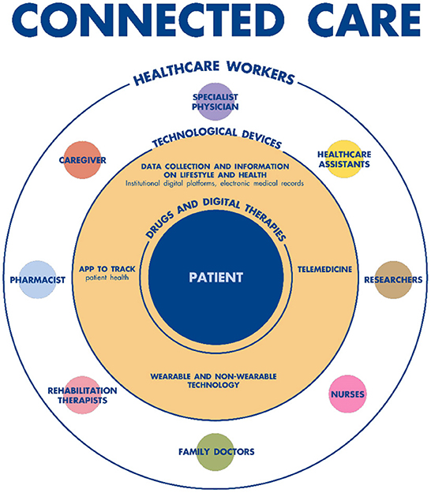
(Cingolani et al., 2023)

Slide 10
Coordinated Care Plans Based On Ethical Decision Making
The rationale for coordinated care plans based on ethical decision-making relates to the following principles:
  Patient autonomy
  Non-maleficence
  Beneficence
  Justice
Notes:
In this presentation, we will discuss the rationale for coordinated care plans based on ethical decision making.
The rationale for coordinated care plans based on ethical decision-making relates to the principles of patient autonomy, non-maleficence, beneficence, and justice.
As was covered in the previous presentation, nurses must recognize their duty to each of the four principles when coordinating patient care.
Respecting patients’ decision-making capacity, minimizing adverse reactions, acting as patient advocates, and promoting health equity ensures that coordinated care plans are patient-centered and enhance patient outcomes.

Slide 11
How Health Care Policies Affect Patient-Centered Care
Three policies that share similar provisions to expand healthcare services to low-income families and individuals, increasing care coordination for underserved populations are:
  ACA (at the national level)
  California’s Medi-Cal Program (at the state level)
  New York City community health programs (at the local level)
Notes:
In this presentation, we will discuss how health care policies affect patient-centered care.
Similarly, the healthcare policies addressed in the previous presentation, including ACA (at the national level), California’s Medi-Cal Program (at the state level), and New York City community health programs (at the local level), have a positive impact on patient outcomes and experiences.
All three policies share similar provisions to expand healthcare screening and prevention services to low-income families and individuals, increasing care coordination for underserved populations like minority groups and immigrants.

Slide 12
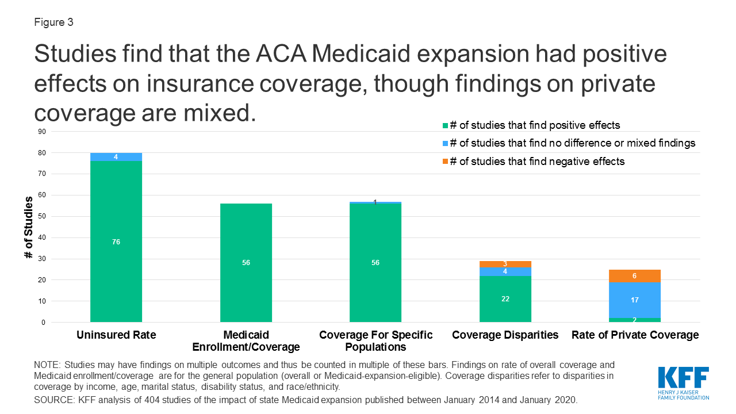
(Guth et al., 2020)

Slide 13
How Health Care Policies Affect Patient-Centered Care
Jiang et al. (2023) showed that ACA increased insurance coverage of cardiac treatments and improved cardiac outcomes through prevention services.
The California Health Care Foundation (2024) showed that California’s Medi-Cal Program improves health outcomes for patients with complex medical conditions like congenital heart disorders.
Bales et al. (2023) demonstrated that New York City community health programs reduce cardiovascular disease risk factors in underserved communities, particularly uninsured adults.
Notes:
In this presentation, we will discuss study findings supporting the positive impact of the three identified health policies on patient outcomes and experiences.
For instance, the study by Jiang et al. (2023), which AHA Journals published, showed that ACA’s Medicaid expansion resulted in a general increase in insurance coverage of cardiac treatments and improved cardiac outcomes and cardiac-tailored prevention and screening.
On the other hand, the publication by the California Health Care Foundation (2024) explains why integrating California’s Medi-Cal Program with other social services improves health outcomes, especially for patients with complex medical conditions like congenital heart disorders.
Similarly, the study by Bales et al. (2023) indicates the importance of New York City community health programs in screening for cardiovascular disease risk factors in underserved communities, particularly uninsured adults.

Slide 14
Conclusion
In conclusion, staff nurses play an expanded role in helping to manage the care continuity process.
Three principles critical to ensuring that patient’s needs and preferences are teamwork, shared goals, and effective communication.
By upholding the three basic principles, nurses ensure care coordination across the healthcare continuum from acute care settings to home care.
Notes:
In this presentation, we will summarize the major concepts covered in the presentation.
Nurses are the linchpin of cardiovascular care coordination.
Our role goes beyond helping physicians in direct patient care and includes acting as patient educators, advocates, and communicators.
By upholding the fundamental principles of teamwork, shared goals, and effective communication, we ensure care coordination across the healthcare continuum from acute care settings to home care.

Slide 15
References
Anderson, J. E., Lavelle, M., & Reedy, G. (2020). Understanding Adaptive Teamwork in Health care: Progress and Future Directions. Journal of Health Services Research & Policy, 26(3), 208–214. https://doi.org/10.1177/1355819620978436
Bales, M. E., Zhu, J., Ganzer, C. A., Aboharb, F., Keeler, A., Ryon, K., Ehrmann, B. J., & Imperato-McGinley, J. (2023). A Retrospective Case Study of Successful Translational Research: Cardiovascular Disease Risk Assessment, Experiences in Community Engagement. MedRxiv (Cold Spring Harbor Laboratory). https://doi.org/10.1101/2023.09.26.23296161
Bhattad, P. B., & Pacifico, L. (2022). Empowering patients: Promoting Patient Education and Health Literacy. Cureus, 14(7). https://doi.org/10.7759/cureus.27336
California Health Care Foundation. (2024, May 6). CalAIM Explained: A Five-Year Plan to Transform Medi-Cal - California Health Care Foundation. California Health Care Foundation. https://www.chcf.org/publication/calaim-explained-five-year-plan-transform-medi-cal/#related-links-and-downloads
Cingolani, M., Scendoni, R., Fedeli, P., & Cembrani, F. (2023). Artificial intelligence and digital medicine for integrated home care services in Italy: Opportunities and limits. Frontiers in Public Health, 10. https://doi.org/10.3389/fpubh.2022.1095001
Guth, M., Garfield, R., & Rudowitz, R. (2020, March 17). The Effects of Medicaid Expansion under the ACA: Updated Findings from a Literature Review - Report. KFF. https://www.kff.org/report-section/the-effects-of-medicaid-expansion-under-the-aca-updated-findings-from-a-literature-review-report/
Hempel, S., Ganz, D., Saluja, S., Bolshakova, M., Kim, T., Turvey, C., Cordasco, K., Basu, A., Page, T., Mahmood, R., Motala, A., Barnard, J., Wong, M., Fu, N., & Miake-Lye, I. M. (2023). Care coordination across healthcare systems: development of a research agenda, implications for practice, and recommendations for policy based on a modified Delphi panel. BMJ Open, 13(5), e060232. https://doi.org/10.1136/bmjopen-2021-060232
Himmelfarb, C. D., Beckie, T. M., Allen, L. A., Commodore-Mensah, Y., Davidson, P. M., Lin, G. A., Lutz, B., & Spatz, E. S. (2023). Shared Decision-Making and Cardiovascular Health: A Scientific Statement From the American Heart Association. Circulation, 148(11), 912–931. https://doi.org/10.1161/cir.0000000000001162
Jiang, G. Y., Urwin, J. W., & Wasfy, J. H. (2023). Medicaid Expansion Under the Affordable Care Act and Association With Cardiac Care: A Systematic Review. Circulation: Cardiovascular Quality and Outcomes, 16(6). https://doi.org/10.1161/circoutcomes.122.009753
Pawelek, J., Baca-Motes, K., Pandit, J. A., Berk, B. B., & Ramos, E. (2022). The Power of Patient Engagement with Electronic Health Records as Research Participants (Preprint). JMIR Medical Informatics, 10(7). https://doi.org/10.2196/39145
Persson, M. H., Søndergaard, J., Mogensen, C. B., Skjøt-Arkil, H., & Andersen, P. T. (2022). Healthcare professionals’ experiences and attitudes to care coordination across health sectors: an interview study. BMC Geriatrics, 22(1). https://doi.org/10.1186/s12877-022-03200-6
Spitzer, E. G., Kaitz, J., Fix, G. M., Harvey, K. L. L., Stadnick, N. A., Sullivan, J. L., Williamson, A. K., & Miller, C. J. (2023). Developing Relational Coordination: A Qualitative Study of Outpatient Mental Health Teams. Administration and Policy in Mental Health and Mental Health Services Research, 50(4). https://doi.org/10.1007/s10488-023-01261-2
Stubbe, D. E. (2020). Practicing cultural competence and cultural humility in the care of diverse patients. Focus, 18(1), 49–51. https://doi.org/10.1176/appi.focus.20190041
Will, M., & Mascherbauer, J. (2021). Patient engagement in cardiology—nice or necessary? Wiener Klinische Wochenschrift, 133(15-16), 747–749. https://doi.org/10.1007/s00508-021-01929-5

