Slide 1

Bitcoin Loans
Earvin Phillip Eugene

Slide 2

We Help Crypto Investors Avoid Scams & Unfair Lending Practices
Value Proposition: People want and are in scarcity of proper loans to access their bitcoin money. They require referrals and information (newsletters) to focus on these issues. They must learn about bitcoin loans and find the right ones with less scams and spam.

Slide 3
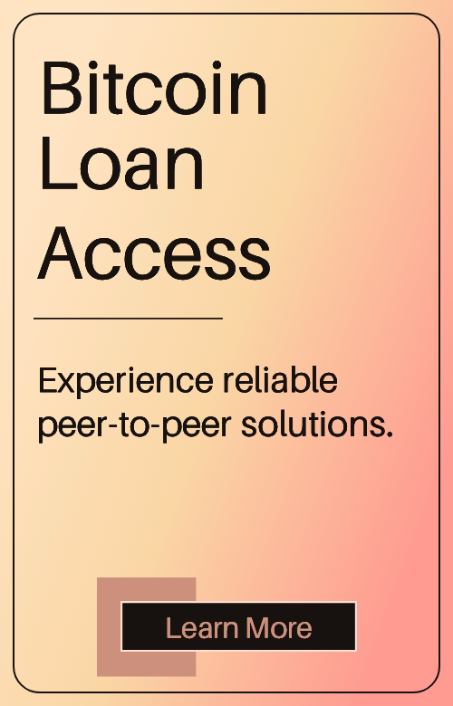
We started as a Bitcoin-Backed Lending Program
Goal: support secure loans as BTC assets
Target market: retail & HNW crypto holders needing money

Slide 4
Barriers Emerged
Money Access: Difficulty partnering to be suitable lender at appropriate terms
User Consistency as members: Borrowers are inhibited to participate for new programs due to prior scams, hidden fees, lack of transparency
“Everyone that used our product wanted access to money – no one wanted the risk of losing their crypto in escrow”

Slide 5
This wasn’t just a lending problem – it was a consistency problem
The real pain: Crypto investors don’t know who to use.
Lenders differ in rates, terms, and fees
Scams, hidden practices, and opaque (nefarious) programs dominate the space

Slide 6
We Pivoted to Solve the Issue
“People cannot pick and choose the right lender… So we fixed that”
New model: Curated, protected list of supportive lenders
We standardize and publish:
Loan terms
Rates
Fees
Security Practices

Slide 7
We Tested Both Models – and the Market made a decision
Ran A/B Tests with websites
BTC lending services
Curated comparison program
* Acquisition channels tested:
Direct email
Paid digital ads
Organic social
Result: Better Engagement & More Conversions for curated guide

Slide 8
A Transparency Layer for the Crypto Lending Program
Product format: Web-based comparison
Criteria: Required lenders only, consistent practices
Monetization: affiliate/partner model, premium listings, possibly white-label referrals

Slide 9
How it works for the user
Simple UX: Enter loan amount – get side by side options
Compare by:
APR
Assets requirements
Fees
Program risk profile

Slide 10
A Consistent Layer is Urgently Needed in a Messy, Risky Market
* Borrowing demand is increasing for market recovery
*Institutional entering, transparency issue
*Regulations occurring
“We’re building the resources we wish we had when we began”

Slide 11
Our Experiment Loop
*Q3: Expand lender listings, integrate review data, improve UX
*Q4: Require ratings, allow monetization
Early 2026: Expand of markets and institutions

Slide 12
Let’s build safer crypto together
*Advisors for lending or DeFi
*No hype, investors improving actual pain points
*Partners who are featured as honest options

