Slide 1
Chapter 9:
Performance Management

Slide 2
Learning Objectives
Define performance management and describe the key components of a performance management system
Discuss the reasons that organizations engage in performance management
Identify the characteristics of good rating criteria for performance appraisal
Enumerate sources of information about job performance and discuss the strengths and shortcomings of each
Conduct a performance appraisal interview with an employee, taking into consideration the techniques that make such an interview successful
Describe the types of performance information that may be used and the rationale for each type of information
Identify the multiple motivations for managers to distort performance appraisal information

Slide 3
Human Resources Management Responsibilities
Setting specific performance goals with the employee and ensuring mutual understanding of these goals
Developing performance criteria and continually reinforcing these criteria to the employee
Establishing development plans with the employee
Monitoring and measuring employee progress toward performance goals
Providing continual coaching, training, and education as necessary

Slide 4
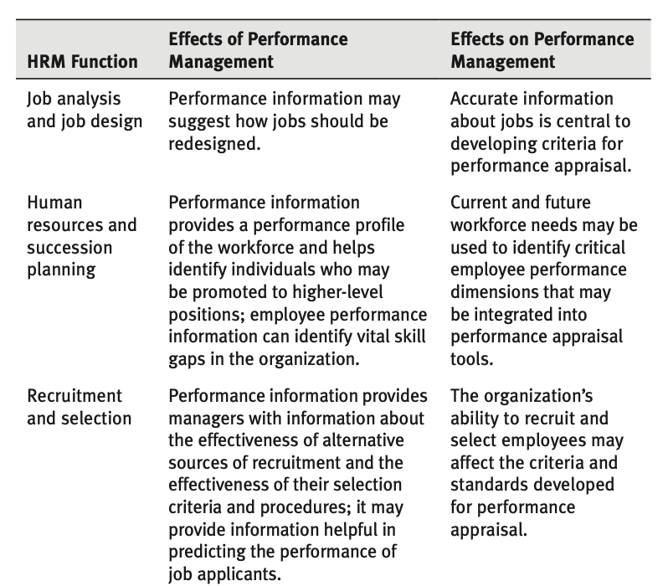
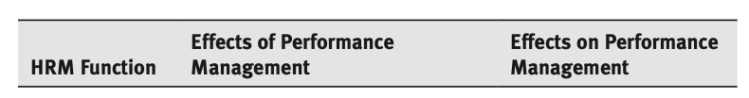
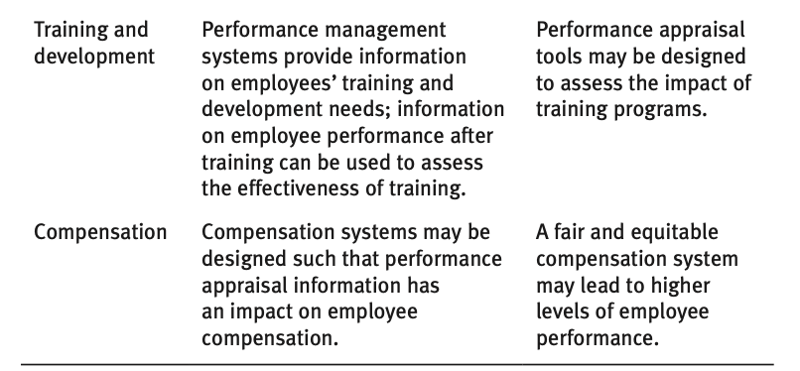
Relationship of Performance Management to Other HRM Functions
Exhibit 9.1 Relationship of Performance Management to Other Human Resources Management Functions

Slide 5
The Role of Performance Management
Can provide insight into effectiveness of other human resources management functions
Are our employee selection procedures selecting the right people?
Are our training programs showing improvement in individual performance?
Is our compensation system rewarding the right behaviors?

Slide 6
The Role of Performance Reviews
The performance review should be reserved for the following:
Giving employees the opportunity to discuss performance and performance standards
Addressing employee strengths and weaknesses
Identifying and recommending strategies for improving employee performance
Discussing personnel decisions, such as compensation, promotion, and termination
Defining a variety of regulatory requirements that deal with employee performance and discussing compliance methods

Slide 7
Errors in Performance Management
There are numerous opportunities for managers to inaccurately rate employees. Regardless of the type of data used in performance appraisal, what persists are “rating errors.”
Distributional:
Lenient
Strict
Central
Halo effect
Personal bias
Similar-to-me error
Temporal errors

Slide 8
How to Avoid Rating Errors
Most important strategy for overcoming these rating errors is manager training.
Ultimate objective is to increase each manager’s consistency in rating employees and to improve interrater reliability among managers.
At a minimum, managers need to be aware of potential rating errors in performance appraisal.
Performance should be assessed using objective criteria.
Improved performance may be recognized and discussed during a performance review session; managers should stick with the criteria when rating an employee’s performance.

Slide 9
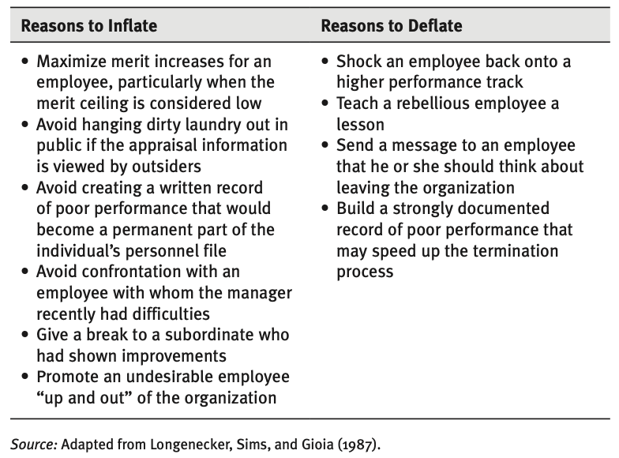
Reasons Managers Inflate or Deflate Performance Appraisal
Exhibit 9.2 Reasons Managers Inflate or Deflate a Performance Appraisal

Slide 10
Establishing Job Standards and Appraisal Criteria
Criteria should:
Have strategic relevance to the organization as a whole. Criteria for individual performance appraisal are an extension of criteria to evaluate organizational performance and consistent with a management by objectives approach.
Be comprehensive and take into consideration the full range of an employee’s major functions as defined in the job description.
Be reliable and valid.

Slide 11
Collecting Job Performance Data
Self-appraisal is very effective when a manager is seeking to obtain the involvement of the employee in the appraisal process, which is desirable under virtually all circumstances.
Team-based appraisals can evaluate both an individual’s performance in contributing to a group’s outcomes or the performance of the whole group. This type of appraisal is beneficial in that it explicitly reinforces the importance of teamwork.
Subordinate appraisal presents many benefits, among which are providing managers with a vital information about their performance. The risk of retaliation may discourage subordinate appraisal.
Multisource appraisal acknowledges that for many jobs, relying on one source of performance information is incomplete and inadequate.

Slide 12
Multisource Appraisal
Advantages:
Emphasizes aspects of performance valued by the organization
Recognizes explicitly the importance of customer focus
Reinforces the value of teams and team development
Contributes to employee involvement and development
Reduces bias because it incorporates multiple perspectives
Limitations:
Employees must have a high level of trust in the organization.
Anonymity is critical, which may limit the use of multisource appraisal in a small organization.
Employees may use the process for purposes of retribution.
Multiple sources of information may be difficult to integrate or combine.
The method of feedback must be done by a trained individual in a manner that encourages insight and growth.

Slide 13
Collecting Performance Data
Individual traits refer to individual characteristics, such as aptitude, interpersonal abilities, and personality characteristics. Behaviors are more likely than traits to develop through experience.
Results or outcomes refer to the outputs of an individual: what is actually produced. Results are varied and may include financial goals, patient satisfaction, and clinical outcomes. As evaluation criteria, outcomes should, of course, be under the control of the individual.
Competencies may be thought of as the core capabilities required to successfully perform a job.

Slide 14
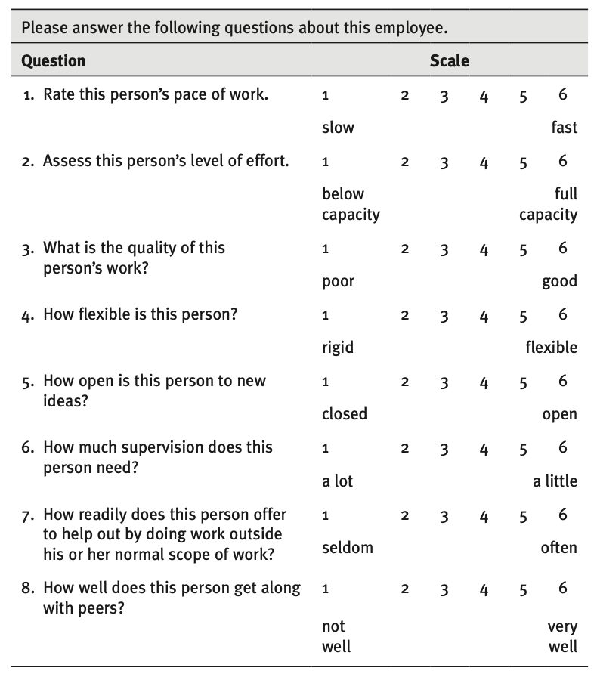
Graphic Rating Scale
Exhibit 9.3 Example of a Graphic Rating Scale

Slide 15
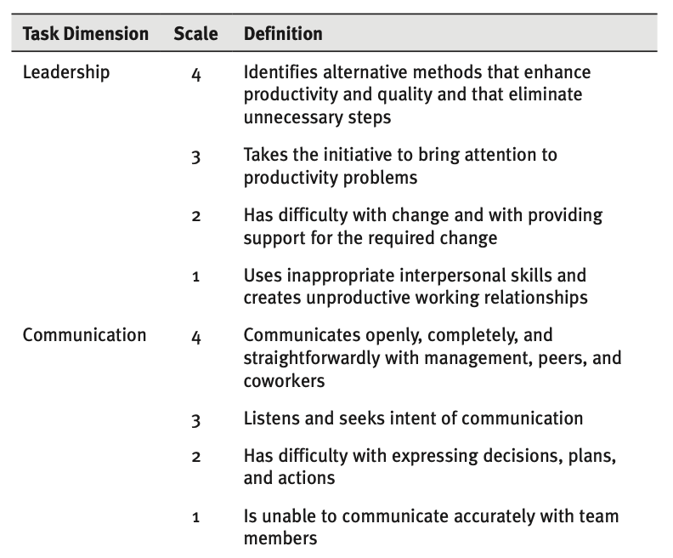
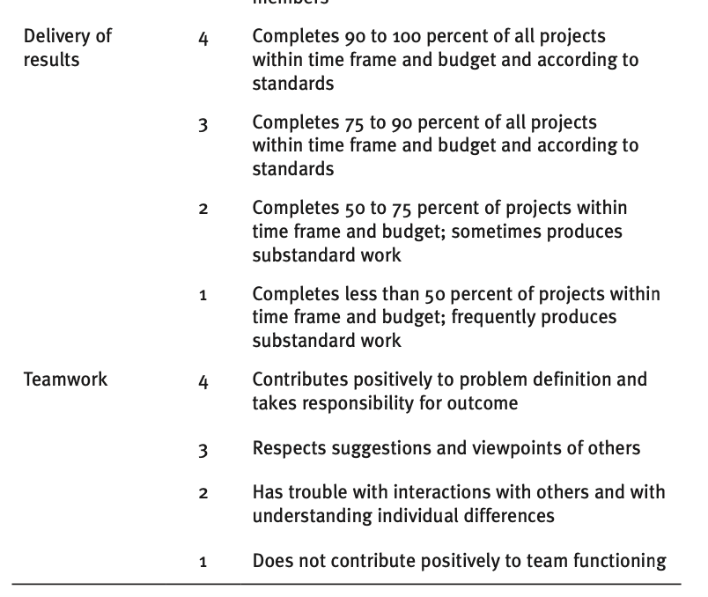
Behavioral Anchored Rating Scale
Exhibit 9.4 Behavioral Anchored Rating Scale for a Clinical Trials Coordinator

Slide 16
SMART Goals
SMART Goals: Critical to achieving performance improvement is the setting of effective goals. A useful approach is to use the SMART acronym as a guide. Goals should be
Specific
Measurable
Achievable
Relevant
Time-bound

Slide 17
Managing Bullies and Toxic Managers
Intervene early as warning signs appear.
Set limits and avoid personal martyrdom to accommodate the bully.
Speak to coworkers to assess how widespread the bullying is and to get advice on coping strategies.
Use positive reinforcement with the bully, rewarding positive and civilized behavior.
Be a good role model by serving as an example of good behavior for the bully.
Consult with the HR department.
Where abusiveness is out of control, seek assistance from coworkers, other managers, or outside counsel.

Slide 18
Eliminating and Preventing Bullying Behavior
Conduct thorough background checks on job applicants and be sure that treatment of others is part of the selection process.
Include treatment of others in performance appraisal and reward systems; this process may include the use of multisource appraisals.
Assess whether the bullying behavior is a result of a treatable physical condition, such as drug dependence, anxiety, depression, or attention deficit hyperactivity disorder.
Coach abusive employees.
Be prepared to terminate employees whose bullying behavior is not changeable.

Slide 19
Summary
Organizations are taking a more enlightened and helpful approach to performance management, focusing on improvement, coaching, and aligning organization and individual goals.
Performance management implies an improvement-focused process in which efforts are made to assess performance and develop specific collaborative improvement strategies.
Recognizing that employee performance results from an employee’s skills, motivation, and facilitative factors in the work environment, improvement strategies include training, work process redesign, and other changes internal and external to the employee.
An important aspect of performance management is the development of relevant appraisal criteria for the employee’s position and the expectations of the organization.

