Slide 1
Conflict Management and Negotiation Skills
Chapter 15

Slide 2
Learning Outcomes
After completing this chapter, the student should understand:
The definition of conflict
The four basic types of conflict
The five levels of conflict
The five conflict-handling modes
The three major negotiation models

Slide 3
Conflict
Occurs when an individual or group feels negatively affected by another individual or group
Three components:
Perceived incompatibility of interests
Some interdependence of the parties
Some form of interaction

Slide 4
Types of Conflict
Goal
Cognitive
Affective
Procedural

Slide 5
Levels of Conflict
Intrapersonal
Interpersonal
Intragroup
Intergroup
Interorganizational

Slide 6
Intrapersonal Conflict (1 of 2)
Occurs within an individual and may involve some form of goal, cognitive, or affective conflict
Three types of cognitive dissonance:
Approach/Approach
Avoidance/Avoidance
Approach/Avoidance

Slide 7
Intrapersonal Conflict (2 of 2)
Three types of role conflict
Person-role conflict
Intrarole conflict
Interrole conflict

Slide 8
Interpersonal Conflict
Involves two or more individuals who believe that their attitudes, behaviors, or preferred goals are in opposition
Personal characteristics and issues
Interactional difficulties
Differences around perspectives and perceptions of the issues

Slide 9
Intragroup Conflict
Involves clashes among some or all of a group’s members, which often affect the group’s processes and effectiveness
Relationship
Task
Process

Slide 10
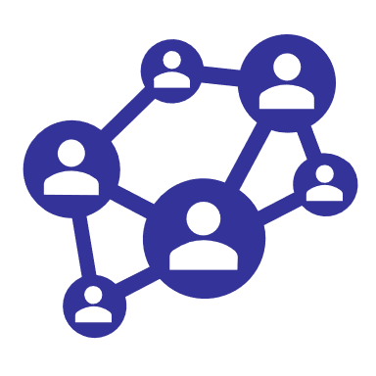
Intergroup Conflict
Involves opposition and clashes between groups
Vertical
Horizontal
Line-staff
Diversity-based

Slide 11


Interorganizational Conflict
Occurs between organizations due to interdependence on membership and divisional or system-wide success

Slide 12
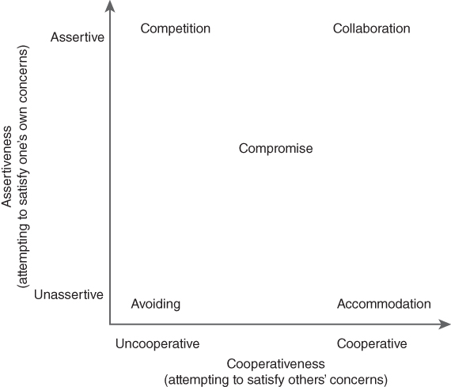
Conflict-Handling Modes
Figure 15-1 Thomas and Kilmann’s Two-Dimensional Taxonomy of Conflict-Handling Modes

Slide 13
Conflict Negotiation Models
Negotiation is the process by which two or more parties decide what each will give and take in an exchange.
Three major negotiation models
Distributive (win–loss approach)
Integrative (win–win approach)
Interactive (joint problem-solving approach)

