Slide 1
Conflict and Conflict Management
Chapter 14

Slide 2
Learning Outcomes (1 of 2)
After completing this chapter, the student should be able to understand:
The difference between the rational and the bounded rationality approach to decision making
The limitations of using intuitive decision making and the heuristics or biases approach

Slide 3
Learning Outcomes (2 of 2)
How framing heuristics affects escalation of commitment
The four basic styles of decision making
The Vroom-Yetton Decision-Making Method and the relating factors

Slide 4
Decision-Making Models (1 of 5)
Rational Approach
A systemic analysis of the problem followed by the choice and implementation of a solution in a logical, step-by-step sequence (Daft, 2004)

Slide 5
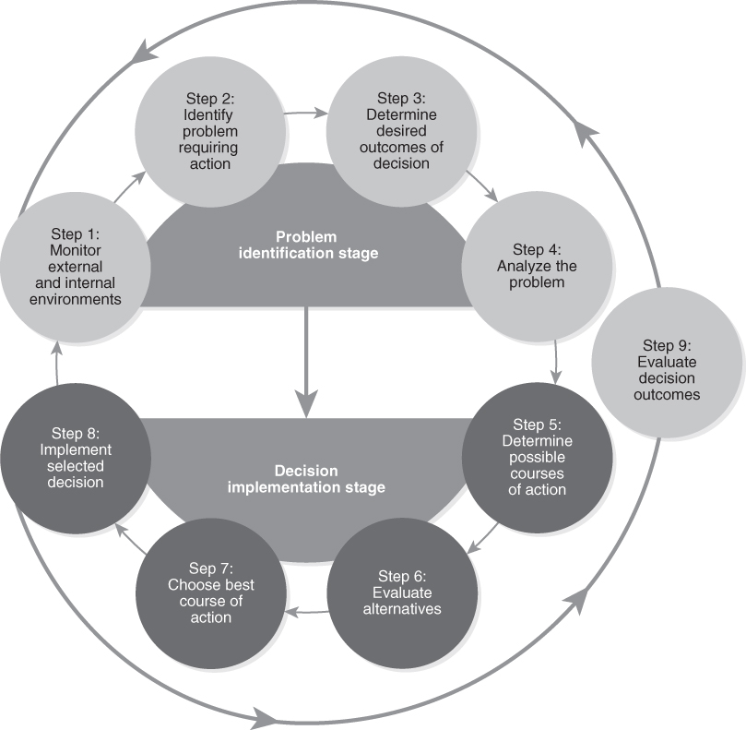
Decision-Making Models (2 of 5)
Figure 14-1 Steps in the Rational Approach to Decision Making

Slide 6


Decision-Making Models (3 of 5)
Bounded Rationality Approach
Due to cognitive limitations, an individual will limit his or her search for information prior to decision making.
Shielded from other sources
Own knowledge
Decision
Using only what they know without extra information

Slide 7
Decision-Making Models (4 of 5)
Intuition
Decision making using one’s professional judgment based on past experiences rather than sequential logic or explicit reasoning (Daft, 2004)

Slide 8
Decision-Making Models (5 of 5)
Heuristics or Biases Approach
Individuals use judgmental heuristics or “rules of thumb” to simplify their decision making.
Commonly used:
Availability bias
Representativeness bias
Anchoring/adjustment bias

Slide 9
Escalation of Commitment
When an individual continues to allocate more resources to a losing proposition due to:
Inability to admit to a mistake
Framing heuristic

Slide 10
Avoid Escalation of Commitment
Recognize that they may be biased toward escalation
See escalation for what it is (i.e., an overcommitment to a strategy by defining failure ambiguously, or by ignoring others’ concerns)
Avoid overcommitment by looking at the strategy from an outsider’s perspective

Slide 11
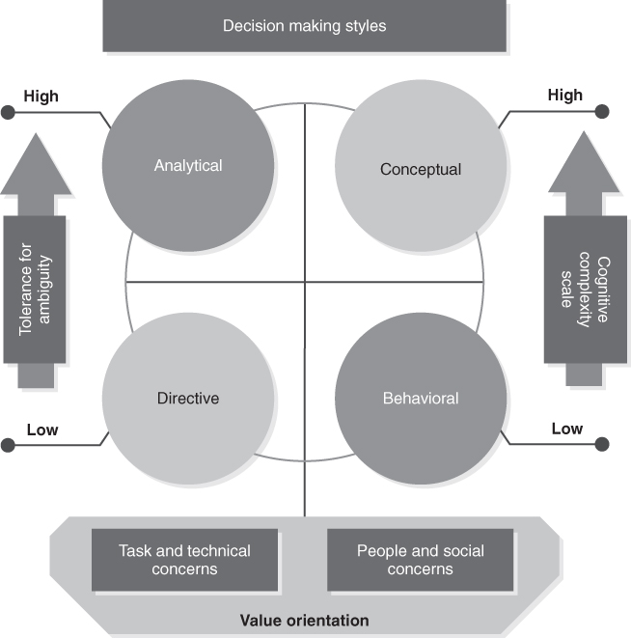
Decision-Style Model
Figure 14-2 Decision-Making Styles
Reproduced from Rowe, A. J., & Boulgarides, J. D. (1983). Decision styles: A perspective. Leadership & Organization Development Journal, 4(4), 3–9.

Slide 12
Vroom-Yetton Decision-Making Model
The five types of decision processes are:
Autocratic I(AI): Completely autocratic
Autocratic II(AII): Request specific information
Consultative I(CI): One-on-one discussion
Consultative II(CII): Group discussion
Group (GII): Consensual group decision-making

