Slide 1
Stress in the Workplace and Stress Management
Chapter 13

Slide 2
Learning Outcomes (1 of 3)
After completing this chapter, the student should understand:
The definition of stress
The process model of stress and coping
How stress can negatively affect individuals and organizations

Slide 3
Learning Outcomes (2 of 3)
The various forms of stress
The three stages of the General Adaptation Syndrome
How personalities, race, and gender affect an individual’s level of stress
The definition and phases of burnout
The four categories of stress in the workplace

Slide 4
Learning Outcomes (3 of 3)
The various coping strategies available to organizations and individuals
The concepts of learned optimism and hardiness training
The definition of stress management and the various programs used by organizations

Slide 5
What Is Stress?
“A particular relationship between the person and the environment that is appraised by the person as taxing or exceeding his or her resources and endangering his or her well being” (Schwarzer, 2004)

Slide 6
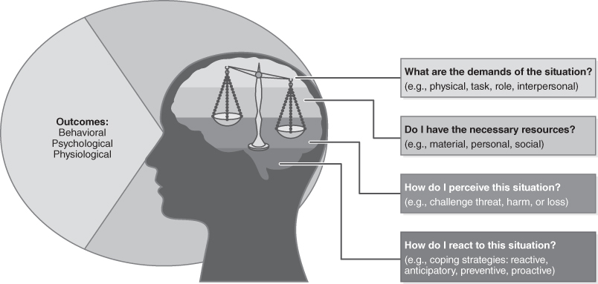
Process Model of Stress and Coping
Figure 13-1 The Process Model of Stress and Coping

Slide 7



Individual Distress Consequences
Behavioral
Psychological
Physiological

Slide 8
Work-Related Stress (1 of 2)
Job stress costs American businesses approximately $300 billion annually
Accidents
Absenteeism
Presenteeism
Employee turnover

Slide 9
Work-Related Stress (2 of 2)
Loss of productivity
Direct medical, legal, and insurance costs, workers’ compensation awards
Tort and Federal Employers’ Liability Act (FELA) judgments (Smith, 2012; American Institute of Stress, 2004)

Slide 10
Workplace Violence
Health care workers 20% more likely to experience workplace violence
Health care and social services workers are over four times more likely to experience intentional injuries caused by another person than are workers in all other private sector jobs combined.
One nurse reports, “I’ve been bitten, kicked, punched, pushed, pinched, shoved, scratched, and spat upon. I have been bullied and called very ugly names. I’ve had my life, the life of my unborn child, and of my other family members threatened, requiring security escort to my car.” (The Joint Commission, 2018)

Slide 11
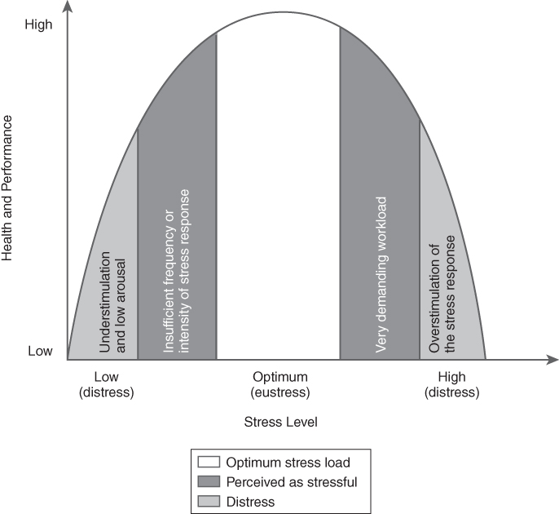
Distress–Eustress
Figure 13-2 Distress–Eustress (an Expanded Yerkes–Dodson Curve)
Quick, J. C., Quick, J. D., Nelson, D. L., & Hurrell, J. J. (1997). Preventive stress management in organizations. Washington, DC: American Psychological Association.

Slide 12





Stressors
Positive or negative
External or internal
Short-term (acute) or long-term (chronic)

Slide 13

Individuals and Stress
Personalities
Ethnic and Racial Identities
Gender
Disabilities
This Photo by Unknown Author is licensed under CC BY-SA-NC
Notes:
Ari: I added disabilities and I specified “minorities” into ethnic and racial identities.

Slide 14
Burnout
Three dimensions associated with burnout:
Emotional exhaustion
Depersonalization
Diminished personal accomplishment

Slide 15
Burnout in Health Care
78% of physicians reported experiencing symptoms of burnout (Hawkins, 2018).
33% of new nurses seek another job within a year (Lucian Leap Institute, 2013).
Suicide rates have been found to be 1.4 times and 2.27 times higher among physicians than in the general population for males and females, respectively (Schernhammer & Colditz, 2014).

Slide 16
Causes of Workplace Stress
Individual task demands
Individual role demands
Group demands
Organizational demands

Slide 17
Stress Management (1 of 2)
Stress is inevitable, but the degree of experienced stress can be modified in two ways:
By changing the environment
By changing the individual

Slide 18
Stress Management (2 of 2)
A narrow set of individual-level interventions or a broader meaning that includes any type of stress intervention
For stress management interventions to be successful, they need to target characteristics of the individual worker, the job, and the organization.

Slide 19
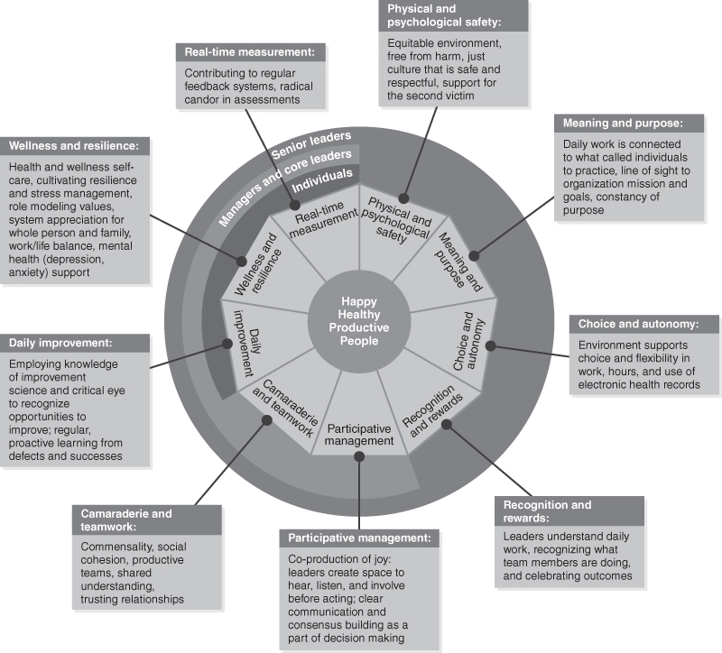
Joy in Work Framework
Figure 13-4 Components for Improving Joy in Work
Perlo, J., Balik, B., Swensen, S., Kabcenell, A., Landsman, J., & Feeley, D. (2017). IHI framework for improving joy in work. IHI White Paper. Cambridge, MA: Institute for Healthcare Improvement. Available from ihi.org

Slide 20
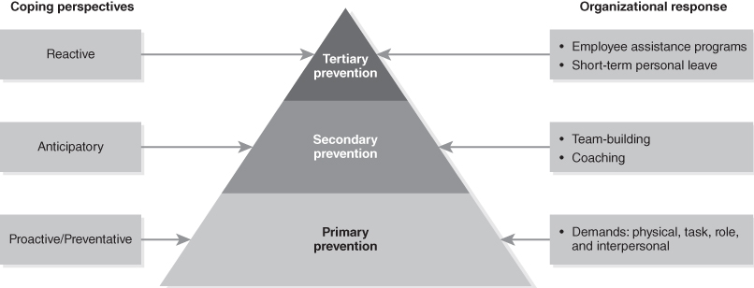
Coping with Stress
Figure 13-3 Four Coping Perspectives

Slide 21
Individual Coping Strategies
Relaxation
Learned optimism
Stress management programs

