Slide 1
Introduction to Rap Back
A Continuous Vetting Product
Customer & Stakeholder Engagements

Slide 2
Agenda
Overview
DCSA CV Overview
Advantages of CV via DCSA
Rap Back
Prerequisites and Requirements for Subscribing into Rap Back
Enrolling Subjects
CE Results
Viewing the Rap Sheet
CE Adjudication
CVS Batch File Submission Procedures
Rap Back Continuous Vetting (CV) Flat File Layout
Assistance

Slide 3
Continuous Vetting (CV) Overview

Slide 4
CE vs CV
CE-Continuous Evaluation-Process used to mitigate risk between PR’s. It includes 7 automated record checks per the SecEA.
CV-Continuous Vetting-Process used to ultimately replace PR’s and CE. Currently there are two transitional states of TW 1.25 and TW 1.5. TW 2.0 will be the final product. CV includes three things: automated record checks, time or event-driven investigative activity and agency-specified information.
Notes:
The enterprise is moving towards CV for both national security and public trust population.
For national security population, the enterprise has been given a target to get 100% of their population into a minimum of TW 1.25 by 30SEPT2021. When enrolled in a compliant TW 1.25 continuous vetting capability, those enrolled will no longer be subject to a PR. Upgrades to a TW 1.5 solution is required by 30SEPT2022. PR’s and CE are going away and CV is the wave of the future.
The public trust population has not been given a target date but has been notified of the upcoming changes.

Slide 5
Policy Background
UNCLASSIFIED//FOR OFFICIAL USE ONLY
Executive Order 13467 –
- Continuous Vetting applies to any individual in a covered position.
15 JAN 2021: Joint OPM/ODNI Memo –
- Rap Back is one of the services that can be used to be compliant with Trusted Workforce 1.5.
Notes:
In of June 2018, the Defense Counterintelligence and Security Agency’s (DCSA’s) predecessor, the National Background Investigations Bureau (NBIB), began to offer subscriptions to the Federal Bureau of Investigation’s Next Generation Identification (NGI) Rap Back program, which provides a continuous vetting model and an ongoing ability to gather real-time information about an individual’s behavior. Rap Back supports CV efforts as defined in Executive Order (E.O.) 13467, as amended, and Trusted Workforce 1.5 .
Additional CE guidelines can be found in the following documents:
2012 Federal Investigative Standards
Title 5, United States Code, Part 11001
ODNI Memo: ES 2016-00828, “Continuous Evaluation Phased Implementation and Options for Automated Record Checks”; 22 December 2016
Security Executive Agent Directive (SEAD) 6, “Continuous Evaluation”; 12 January 2018
Joint OPM and ODNI Memo, “Transforming Workforce Vetting: Measures to Reduce the Federal Government’s Background Investigation Inventory in Fiscal Year 2018”; 5 June 2018
Joint OPM and ODNI Memo, “Transforming Workforce Vetting: Measures to Expedite Reform and Further Reduce the Federal Government’s Background Investigation Inventory”; 3 February 2020
Joint OPM and ODNI Memo, “Transforming Workforce Vetting: Continuous Vetting and Other Measures to Expedite Reform and Transition to Trusted Workforce 2.0,” 15 January 2021

Slide 6
DCSA CV Product Overview
Continuous Evaluation Special Agreement Check (SAC)
- Snapshot in time of credit, criminal history and
Suitability and Security Index (SII)
FBI’s Next Generation Identification (NGI) Rap Back program
- Real time notification of changes in criminal history and civil records.
Notes:
National Background Investigations Bureau (NBIB), the Defense Counterintelligence and Security Agency’s (DCSA’s) predecessor, began to offer the Periodic Assessment (PA) Special Agreement Check (SAC) in August of 2010. This is now known as the Continuous Evaluation (CE) SAC. The CE SAC collects information from certain repositories in order to create a snapshot in time of an individual’s credit worthiness, criminal history, and OPM’s Suitability and Security Index (SII). For more information concerning the CE SAC please see Federal Investigations Notice 17-03, Continuous Evaluation Special Agreement Check. In June of 2018, NBIB began to offer subscriptions to the Federal Bureau of Investigation’s Next Generation Identification (NGI) Rap Back program, which provides a continuous vetting model and an ongoing ability to gather real-time information about an individual’s behavior.
When an agency enrolls (subscribes) an individual in Rap Back, the FBI’s Rap Back program uses a set of classifiable fingerprints provided by the subscribing agency and continuously compares those fingerprints with new criminal history and civil records, provided to the FBI by State Identification Bureaus (SIBs). If the FBI receives information on the enrolled individual, the FBI provides DCSA with the rap sheet. DCSA then immediately notifies the subscribed agency(ies) via email, while also making the new Identity History Summary (IdHS) immediately available within the CVS to the subscribed agency(ies).
The agency is responsible for the protection of the data as contained in FBI guidelines.
As of June 2018, the CE product does not include issue expansion or resolution. If agencies are not able to resolve issues present in a product result (in accordance with the requirements of the Expandable Focused Investigation Model of the Federal Investigative Standards) and would like to request additional investigative work, Reimbursable Suitability/Security Investigations (RSI) are available for order from DCSA.

Slide 7
Advantages of CV via DCSA
DCSA offers Rap Back
Handles Privacy Act requests related to CV information.
Supports Reciprocity
Storage of CV files for file request purposes
Provides a place to record CE adjudications
Supports ability to defer submission of reinvestigations if standard form has no issues and subject is enrolled in CE
Notes:
DCSA will provide Privacy Act request services for future Rap Back products that may come through this subscription process.
Use of DCSA for this product automatically means that record of the CV hit and associated adjudication will be present in an authorized system for Government-wide reciprocity of investigations and adjudications.
The Rap Back product can help support and agency’s reinvestigation deferral process, set forth in the “Transforming Workforce Vetting: Measures to Reduce the Federal Government’s Background Investigation Inventory in Fiscal Year 2018”.

Slide 8
Rap Back

Slide 9
Prerequisites for Rap Back
Executed MOU
Provide DCSA with SOI structure
SOI provided group email address for notifications
Agency staff requested access to Continuous Evaluation function in CVS
Notes:
MOU-To enroll in Rap Back, your agency must execute an MOU, which can be coordinated with your agency liaison and the MOU staff. To initiate the MOU process, your agency will be asked for agency name/address, MOU point of contact, phone number, email address and the MOU signatory. A draft will be provided specific to your agency for your review.
As part of the MOU, your agency will be required to complete the MOU appendix, providing your group email address to where your agency wishes Rap Back notifications be sent. The correct agency structure, which lists all of the SOIs, you wish to participate in Rap Back, will also need identified, including individuals having access to perform this function.
When enrolling individuals, the users associated Security Office Identifier (SOI) will receive the investigative materials.
The agency must have at least one CVS user with the add adjudication and continuous vetting functions. The CVS user must be associated with the SOI group. If an additional CVS user is required, please complete an INV70B and send it via the NP2 portal to (S) CVS Help.

Slide 10
Requirements for Enrolling into Rap Back
Classifiable fingerprints on file with DCSA
Enrollee has conditional offer of employment per 5 CFR, part 731.103(d)
Enrollee was notified of enrollment
- Ensuring collection/retention of a current Standard Form release (SF86, SF85, SF85P), signed by the subject.
- Presenting subject with verbal/written notification making subj aware of the present and potential future use of their fingerprints, including they will remain in NGI (Next Generation Identification) which can cause notices of future criminal/other activity.
Enrollee was notified of the requirement to self-report 120 days prior to enrolling.
Notes:
Requirements for enrolling a subject in CE start with a set of classifiable fingerprints on file with DCSA. In addition, there are a few technical fields associated with the fingerprint that are required in order to subscribe with the FBI, which DCSA has only begun to collect these fields, starting May 6, 2018. DCSA will work with the agency to help determine which subjects need new fingerprints.
- given a conditional offer of employment, per 5 CFR 731.103(d),
- has been notified that they have been enrolled in Rap Back (this is satisfied by the subject signing the release of the SF86, SF85, and SF85P). The subject also must be presented with verbal/written notification making the subject aware of the present and potential future use of their fingerprints, including they will remain in NGI which can cause notices of future criminal/other activity.
- the enrollee has been notified or the requirement to self‐report in accordance with 5 U.S.C., section 11001 for national security positions.

Slide 11
Requirements for Subscribing into Rap Back
Enrollee was presented with FBI Privacy Act Notices
Agency revalidates every 30 days
Notes:
The individual being enrolled, will be presented with the FBI Privacy Act Notices. The agency will record the presentation of these notices for FBI audit purposes.
The website for FBI Privacy Act Notice: https://www.fbi.gov/services/cjis/compact-council/privacy-act-statement
The website for Noncriminal Justice Applicant’s Privacy Rights: https://www.fbi.gov/services/cjis/compact-council/guiding-principles-noncriminal-justice-applicants-privacy-rights

Slide 12
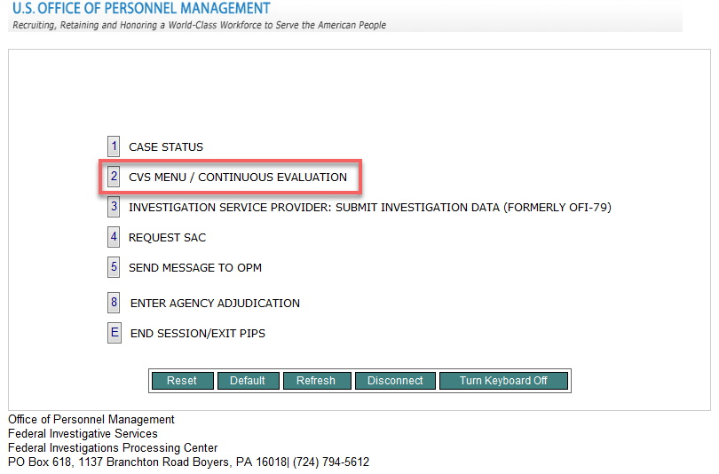
Enrolling a Subject
Notes:
To enroll a subject someone in your agency must have the Continuous Evaluation Enrollment role within CVS. This can be accomplished by the appropriate personnel requesting the access via the INV 70B Form, Request for CVS/User ID Access.
Once logged in the CVS user would click function 2 on the Agency Menu.

Slide 13
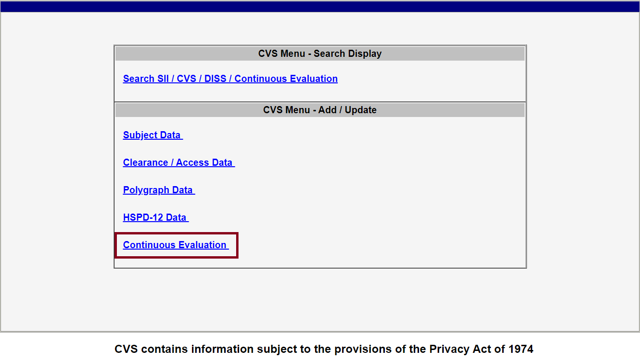
Enrolling a Subject
Notes:
Then the user would click the “Continuous Evaluation” link on the CVS menu.

Slide 14
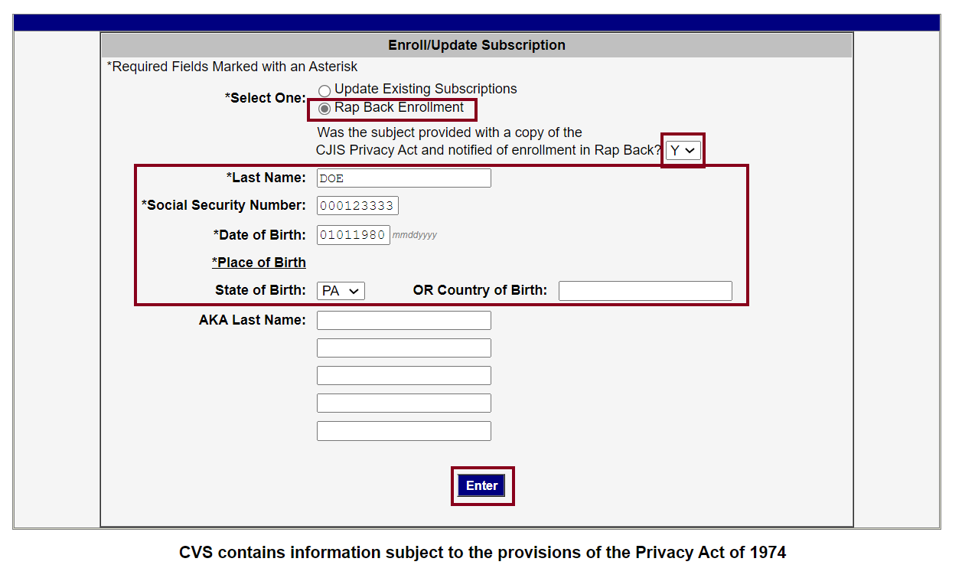
Enrolling a Subject
Notes:
1. Click the radio button next to the Rap Back Enrollment option
2. After confirming the subject was notified of Rap Back enrollment, choose “Y” from the drop-down menu next to “Was the subject provided with a copy of the CJIS Privacy Act and notified of enrollment in Rap Back?”
3. Enter the subject’s Last Name, SSN, Date of Birth and State of Birth or country of birth if foreign born.
4. Press “Enter” on the keyboard or click the “Enter” button on the screen.
To cancel Rap Back subscriptions- This must be done within 5 days of an enrollee no longer being affiliated with agency. No longer affiliated with means that the enrollee is no longer employed by the agency or the agency is no longer sponsoring their eligibility or access to facilities or classified information.

Slide 15
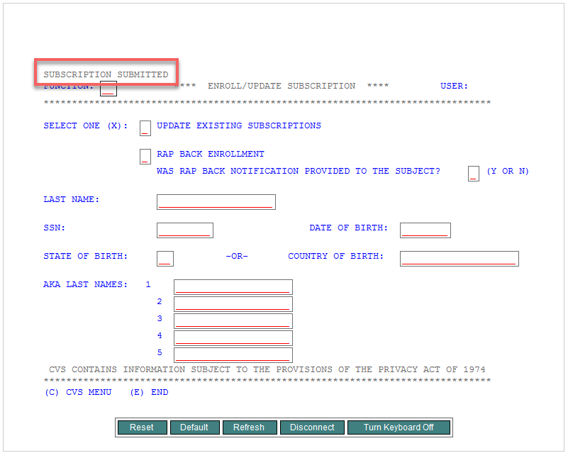
Enrolling a Subject
Notes:
When enrollment is successful, a notification stating “Subscription Submitted” will display in the top-left corner of the screen. DCSA will work with the agency when there is a data discrepancy with the subject information that does not correlate with subject information in CVS.
*Please note if there are any red lines in PIPS/CVS, they must be deleted first prior to entering required information.*

Slide 16
CE Results
Agency will receive an email notification if a result is received
Results will be sent to agency as a closed case (case type 94)
Agency users with appropriate adjudication access will have immediate access to view the rap sheet in CVS
The Agency is responsible for adjudicating initial enrollments.

Slide 17
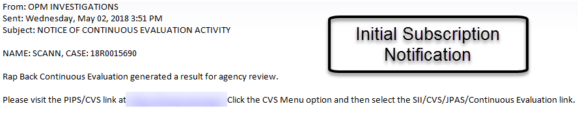
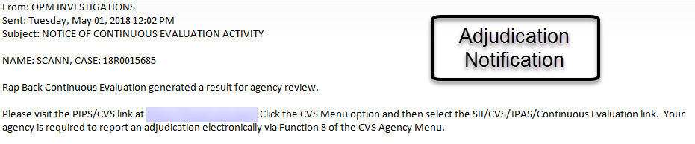
CE Results
Notes:
Agencies will receive an email notification for the initial Continuous Vetting Rap Back subscription along with subsequent notifications for adjudication, if applicable. The email will contain the verbiage Continuous Evaluation but as presented earlier DCSA is moving towards using Continuous Vetting.

Slide 18
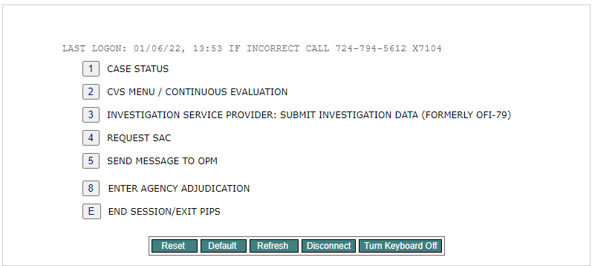
Viewing a Rap Sheet
Notes:
After receiving a notification, navigate to the PIPS/CVS application in NP2. Click “2 - CVS Menu/Continuous Vetting”.

Slide 19
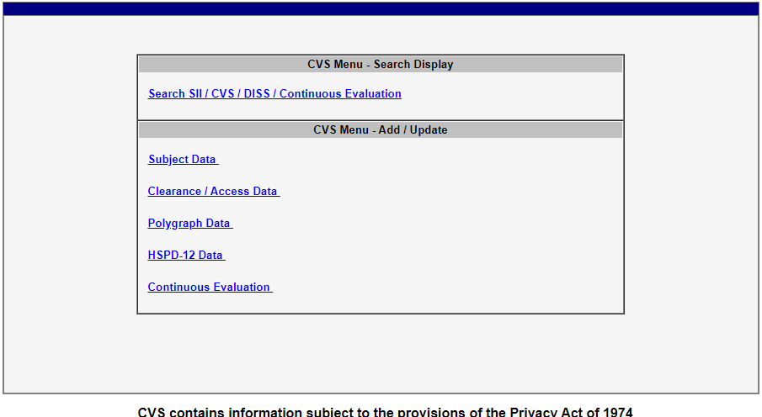
Viewing a Rap Sheet
Notes:
Click the “Search SII/CVS/Continuous Evaluation” link on the CVS Menu.

Slide 20
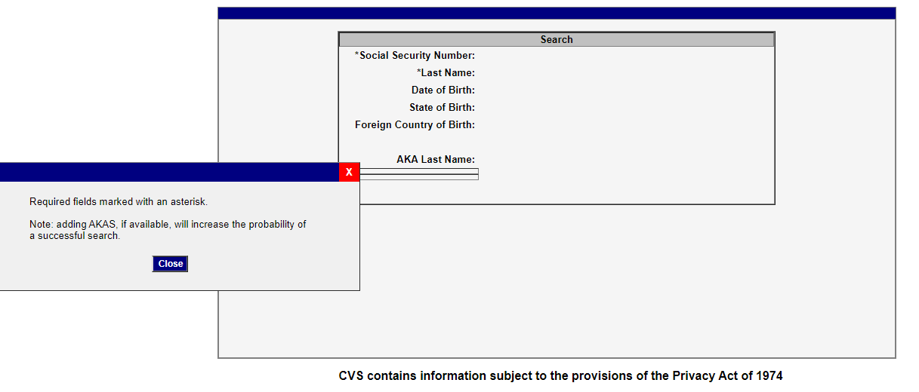
Viewing a Rap Sheet
Notes:
Read the message in the pop-up and then click “close”.

Slide 21
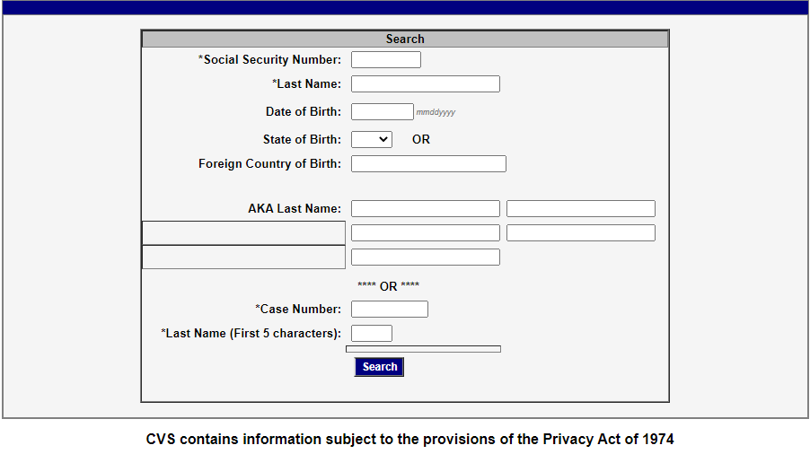
Viewing a Rap Sheet
Notes:
Enter the SSN and Last Name or the Case Number and Last Name (first 5 characters), then click “Search”.

Slide 22
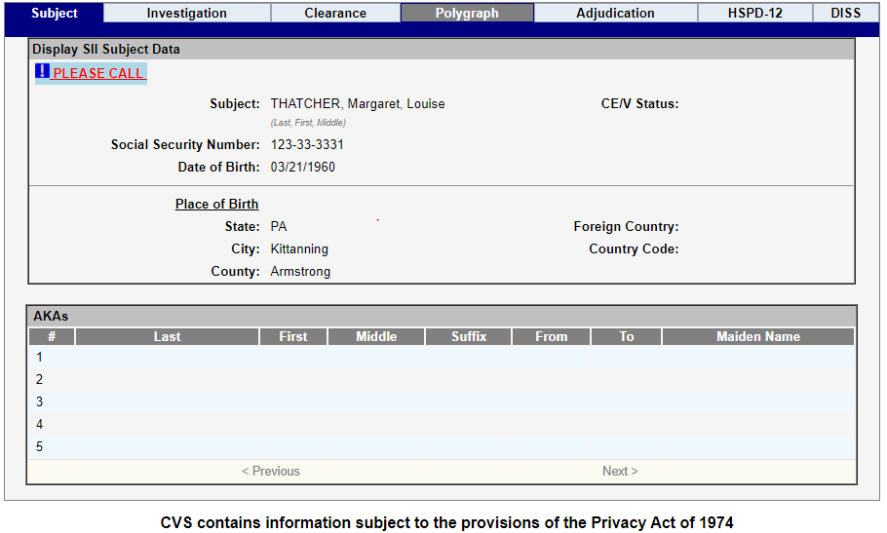
Viewing a Rap Sheet
Notes:
Click on the Investigation tab. Here the agency should see the subject record of the individual for whom the agency is searching.

Slide 23
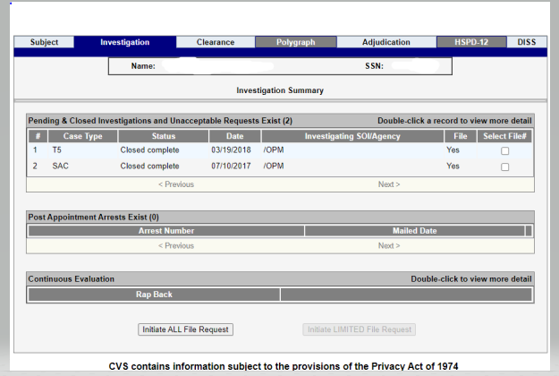
Viewing a Rap Sheet
Notes:
Agencies will see a section at the bottom of the screen with a result labeled “RAP BACK”. Double-click on the RAP BACK line to open to the Rap Back subscription details.

Slide 24
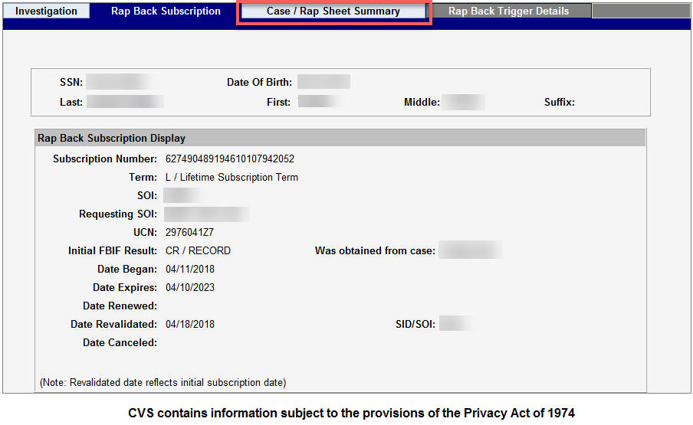
Viewing a Rap Sheet
Notes:
The Rap Back Subscription information will display to include the date it began, the date it expires and the date it was last revalidated. Click the “Case/Rap Sheet Summary” tab.
*Please note that no real PII was used.

Slide 25
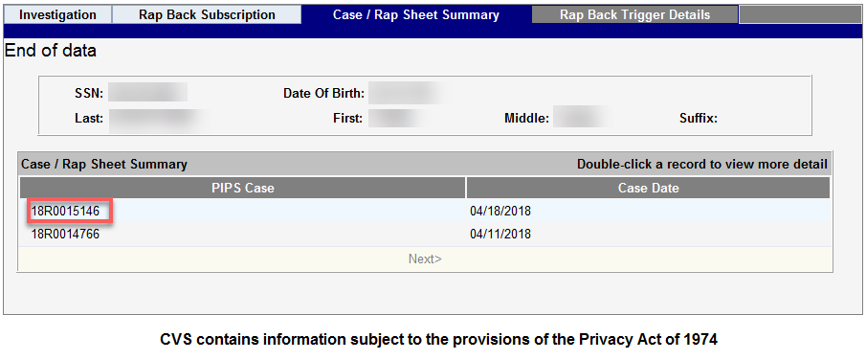
Viewing a Rap Sheet
Notes:
When you reach the Case / Rap Sheet Summary page, you will see the summary of cases / rap sheets for the subject. Double-click each case number for more information.
*Please note that no real PII was used.

Slide 26
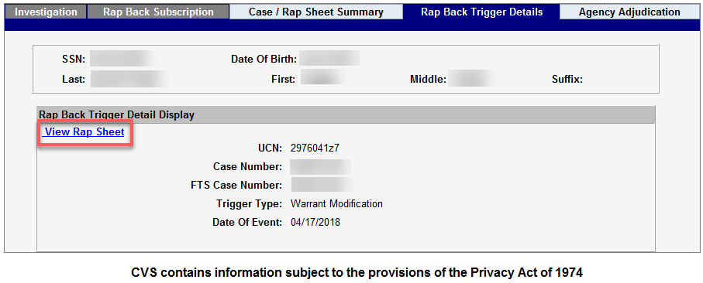
Viewing a Rap Sheet
Notes:
When you reach the Rap Back Trigger Details page, you can view summary information for the selected case. Click “View Rap Sheet”.
*Please note that no real PII was used.

Slide 27
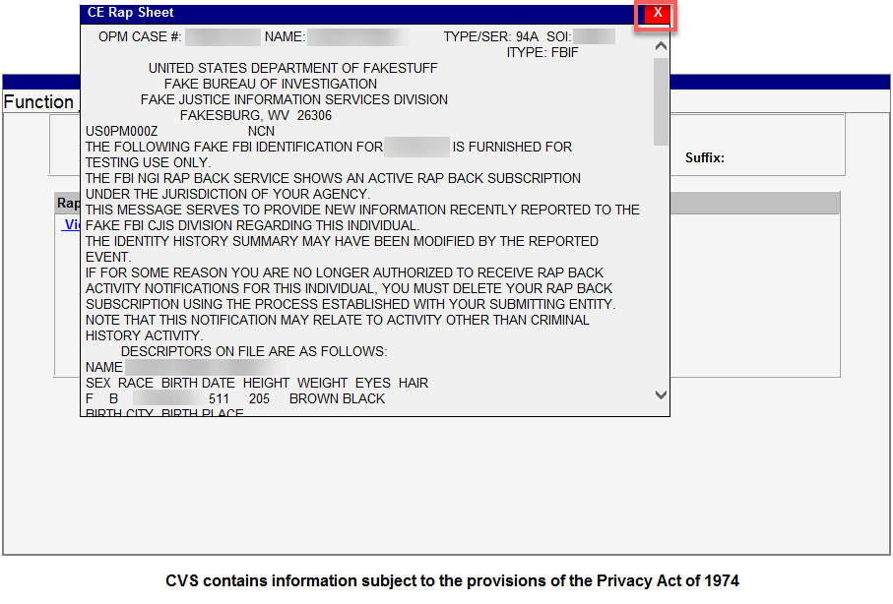
Viewing a Rap Sheet
Notes:
You can view the Rap Sheet in the pop-up box using the scroll bar. If you would like to print the Rap Sheet, you can Select “ALL” by right clicking in the pop-up box, copy the information and paste it in a Word document or Notepad. Click “Close” at the bottom of the document or you may click the “X” in the top right corner to return to the Rap Back Trigger Details page

Slide 28
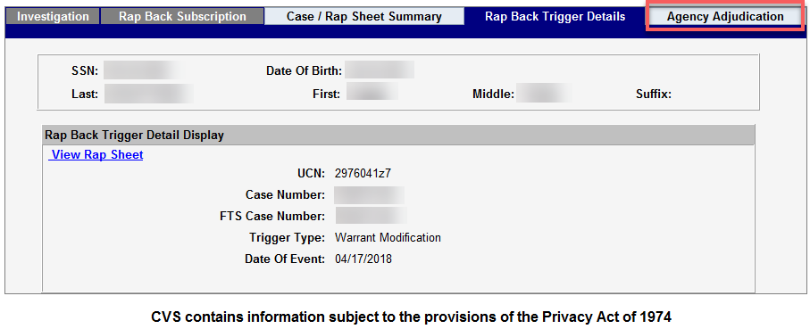
Viewing Previous Adjudication
Notes:
You may view adjudication information for the associated record by clicking the “Agency Adjudication” tab.
*Please note that no real PII was used.

Slide 29
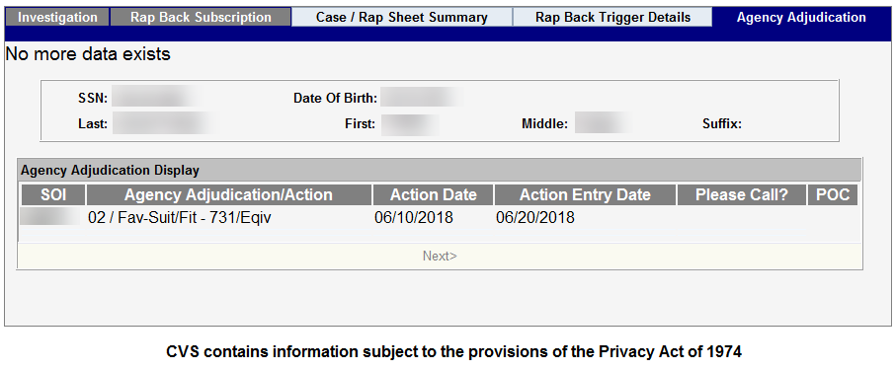
Viewing Previous Adjudication
Notes:
The Agency Adjudication tab displays the adjudication code for the record along with the date of action and any applicable Please Call notifications.

Slide 30
CV Adjudication
Adjudication of CE results must be reported electronically via CVS
- INV 79A hardcopies are no longer provided
- Users will need “Enter Agency Adjudication” function in CVS to enter adjudications as they do now
Agencies should not use adjudication code 10 and should only provide a final adjudication determination.
Bulk reporting of adjudications is possible by utilizing the 79A flat file format. This file layout can be found in the NP2 public library under the file CVS Batch File Documents.
Notes:
-If you wish to submit mass/bulk adjudication via the 79A flat file, please contact the CVS team for further guidance as programming may be required.

Slide 31
CV Adjudication
Notes:
When the FBI returns a result to DCSA, an email notification is sent to the subscribing agency requesting the required adjudication. The agency will not receive a hardcopy INV-79A form and is required to report the adjudication electronically.

Slide 32
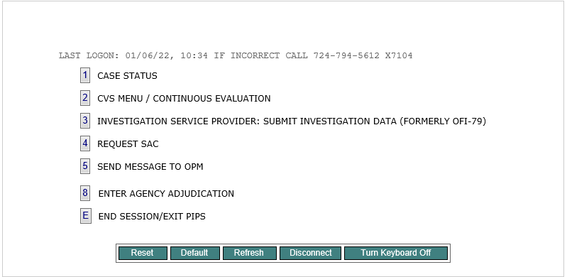
CV Adjudication
Notes:
After receiving a notification, navigate to the PIPS/CVS application in NP2. Click “8 - Enter Agency Adjudication”.

Slide 33
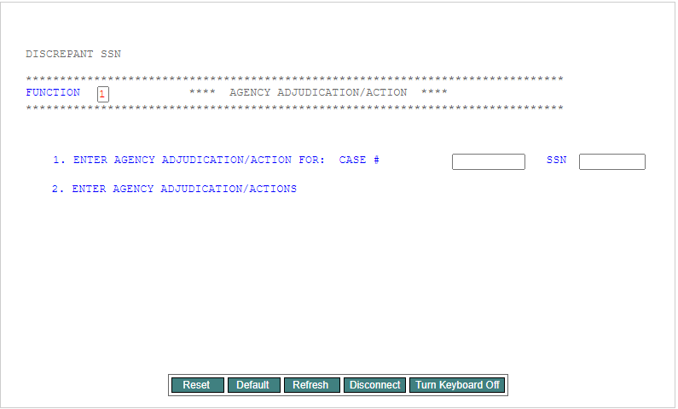
CV Adjudication
Notes:
If you would like to report a single adjudication, type a “1” in the box, provide the subject’s case number and SSN, and press Enter on your keyboard.
**If there are red lines in the field, delete and then add the information required.**

Slide 34
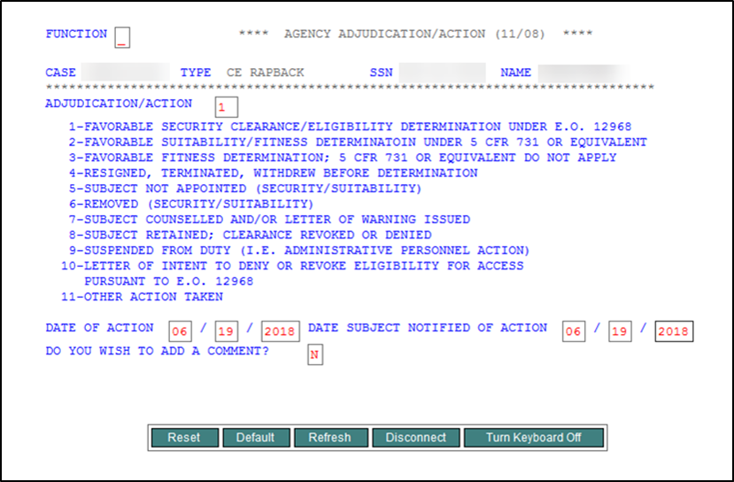
CV Adjudication
Notes:
Leave the Function box blank. Provide the adjudication code in the field next to Adjudication/Action and the Date of Action. You may also provide the Date Subject was Notified and/or a comment, if applicable. Press Enter on your keyboard. Re-enter the data for verification and press Enter. You will receive a confirmation message in the top left corner when the adjudication is added.
**If there are red lines in the field, delete and then add the information required.**

Slide 35
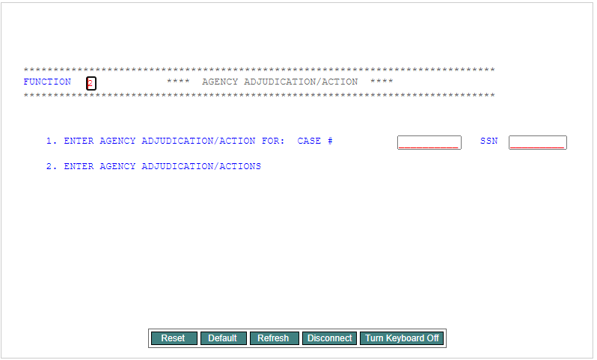
CV Adjudication
Notes:
If you would like to report multiple adjudications, type a “2” next to Function and press Enter on your keyboard. Please note that if a comment is needed for an adjudication, add that adjudication individually as there is no option to add a comment when adding multiple adjudications.
**If there are red lines in the field, delete and then add the information required.**

Slide 36
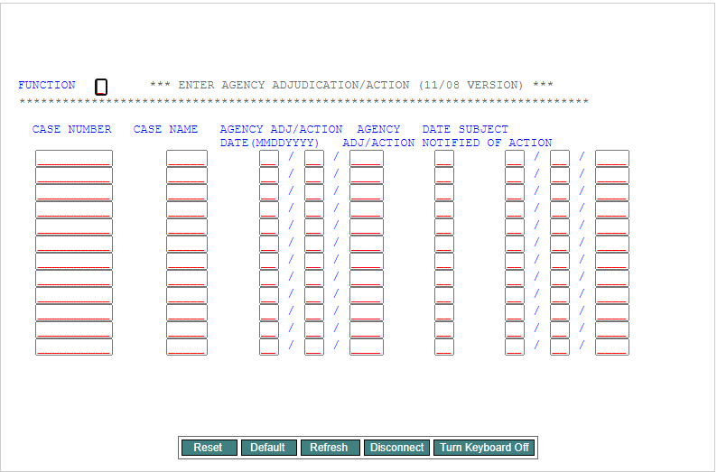
CV Adjudication
Notes:
Provide the Case Number, the first 5 characters of the Case Name, the Date of Action, the Agency Adjudication Action Code, and the Date Subject Notified of Action, if applicable. Press Enter on your keyboard. Re-enter the data and press Enter. You will receive a confirmation message in the top left corner when the adjudications are added.
**If there are red lines in the field, delete and then add the information required.**

Slide 37
CVS Batch File Submission Procedures
Please refer to the CVS Batch File Submission Procedures document, located in the NP2 public library for detailed instructions.
Notes:
This document is located in the public library within the NP2 portal system under the file name CVS Batch File Documents/Training.

Slide 38
Rap Back Continuous Vetting (CV) Flat File Layout
Position Field Length |  |  | Mandatory | Description
01-09 |  | 9 | Yes | SSN of the Subject
10-13 |  | 4 | Yes | SOI of the Agency Requesting the Subscription
14-20 |  | 7 | Yes | Type of Transaction Valid values are: RBSCVL = Request New Subscription for your SOI RBMNT = Update Existing Subscription SBVAL = Validate need for continuing current subscription
 | 21-21 | 1 | Yes | Action Code If Type of Transaction is RBSCVL, valid values are: Leave Blank If Type of Transaction is RBMNT, valid values are: C = Cancel U = Un-cancel If Type of Transaction is SBVAL, valid values are: V = Validation
 | 22-25 | 4 | No | Leave Blank
 | 26-45 | 20 | Yes | Subject’s Last Name
 | 46-53 | 8 | Yes | Subject’s Date of Birth Format YYYYMMDD
 | 54-55 | 2 | Yes, if born in U.S. or U.S. Territory | Subject’s Place of Birth U.S. State or U.S. Territory
 | 56-75 | 20 | Yes, if foreign born | Subject’s Place of Birth – Foreign Country Must be left blank if born in the U.S.
Notes:
The following is the layout of the Rap Back Continuous Vetting Flat File for agency use when subscribing, revalidating or canceling multiple individuals’ Rap Back subscriptions. (Note: These same functions are also available within CVS if you wish to update one individual at a time.)

Slide 39
Frequently Asked Questions
Q: How does Rap Back differ from Continuous Vetting Trusted Workforce 1.25 through 2.0?
A: Continuous Vetting is a process of reviewing the background of a “covered individual” at any time to determine whether that individual continues to meet applicable requirements to be eligible for access to classified information or to hold a sensitive position. Continuous Vetting products serve to support the vetting process. Rap Back is one of the products used for the purpose of Continuous Vetting.
Continuous Vetting - Trusted Workforce 1.25 – 2.0 includes:
Continuous automated record checks against terrorism, criminal and eligibility data sources on a daily basis.
Alert management/validation (identity resolution)
Threat analysis and reporting
Alert Notification/information sharing
Rap Back is a separate feature within Continuous Vetting- Trusted Workforce 1.25 -2.0. Rap Back enrollment is an optional data source for personnel with classifiable fingerprints as of 5/6/2018.

Slide 40
Frequently Asked Questions
Q: Is there a fee for Rap Back?
A: There is no additional fee for participating in the Rap Back enrollment program option; however, there is a Monthly Subscription Fee per each Active Enrollee in TW 1.25-2.0 billed separately from invoices issued for other BI services. There are no current or future expenses expected to participate in Rap Back; however, if they occur, this will be documented in and executed by DCSA and your agency through an FMS 7600A General Terms and Conditions, and associated FMS 7600B Order Requirements and Funding Information (Order) Section documents.
Notes:
.

Slide 41
Frequently Asked Questions
Q: Who does the agency contact to obtain more information on the requirements for the Rap Back program? How does an agency initiate steps to set up Rap Back?
A: Your DCSA Agency Liaison may be contacted to address any questions you have regarding the Rap Back program and how to initiate the process.

Slide 42
Frequently Asked Questions
Q: What Systems do the Users need access to?
A: NP2 Secure Portal and PIPS/CVS with the Adjudication and Continuous Evaluation functions. Ensure Users have access to these functions. Submit INV 70B to request required access to these functions, including current accesses.

Slide 43
Frequently Asked Questions
Q: Is an MOU and ISA required to participate in the Rap Back program?
A: An MOU is required to participate in the Rap Back program. Questions regarding MOU processing and requirements may be directed to your Agency Liaison and dcsamous@mail.mil .
No ISA is required. Rap Back processing is through PIPS/CVS accessed through the web via the NP2 Secure Portal. No individual VPN connection is required.

Slide 44
Frequently Asked Questions
Q: Can an Agency begin enrolling individuals in Rap Back upon receipt of the final MOU?
A: No. Additional programming in PIPS/CVS is required to be completed by DCSA. When the MOU is completed, the DCSA CVS Team will contact the agency and initiate steps to set up necessary PIPS/CVS programming.

Slide 45
Frequently Asked Questions
Q: Is an MOU required to participate in TW 1.25-2.0?
A: No MOU is required; however, a separate 7600B will be required for TW 1.25. One 7600A may be used for both TW 1.25 services along with the traditional Background Investigations. The 7600B, however, cannot cover both TW 1.25 and BI services.

Slide 46
Frequently Asked Questions
Q: Does the subject need to complete an e-QIP to be enrolled in Rap Back?
A: The agency must
ensure that the individual enrolled in Rap Back has been given a conditional offer of employment
notify individuals enrolled of their enrollment by:
Ensuring collection and retention of a current Standard Form release (SF86, SF85P, SF85) signed by the subject; or,
Presenting subject with verbal or written notification that makes the subject aware of the present and potential future uses of his or her fingerprints, including that they will remain in NGI and cause notices of future criminal or other activity.

Slide 47
Frequently Asked Questions
Q: Can more than one agency or SOI enroll the same subject in Rap Back?
A: Dual enrollment is available. Each agency/SOI that enrolled the subject would be notified of any results.
Notes:
Nothing different needs done for dual enrollments. DCSA would identify any "dups" and keep track of them internally. If more than one SOI has an interest in a subject and an activity occurs, DCSA would notify both (or more) SOIs as needed.

Slide 48
Assistance
For Policy related question/issues
- Contact your DCSA Agency Liaison
For technical questions/issues
- Contact DCSA System Liaison-CVS Team
- 724-794-5612 x4600 option 2, option 4
- Via NP2 message to CVS Help
- DCSACVSTeam@mail.mil

