Slide 1

TOUR710 TOURISM HOSPITALITY AND EVENTS IN THE DIGITAL AGE
Social Media Campaign Proposal
TUTORIAL: The 5s Strategy

Slide 2
What we will cover today:
Slide 1 – Organisation Overview
Business introduction
Market positioning / relevance
Slide 2 – Campaign Objective (5S Framework)
Selected objective (Serve / Speak / Sizzle)
Justification (refer to Situation Analysis findings)
Slide 3 – Target Audience
Audience profile
Data-supported justification
Slide 4 – Platform Strategy
Selected platforms
Strategic rationale
Slide 5-6 – Campaign Concept
Value proposition
Key campaign message

Slide 3
Group Assessments
Group Work and Statement of Contribution
Since team-based work contributes significantly toward your course grade, the full name of the student responsible for each section should be included at the end of each section.
In addition to this, a ‘statement of contribution’ (as outlined below), will also be required.
Group Members & Student ID | Contribution & Responsible Sections
Chloe Kim 152435 | Final proofreading, Objectives & OVPs

Slide 4
Group Assessments
Group Work and Statement of Contribution
There are two elements to ensure that fair contribution will be made. Both of these elements will need to be completed by all group members before grades will be released.
Collaboration and meeting records
Peer Evaluation/Group Member Evaluation

Slide 5
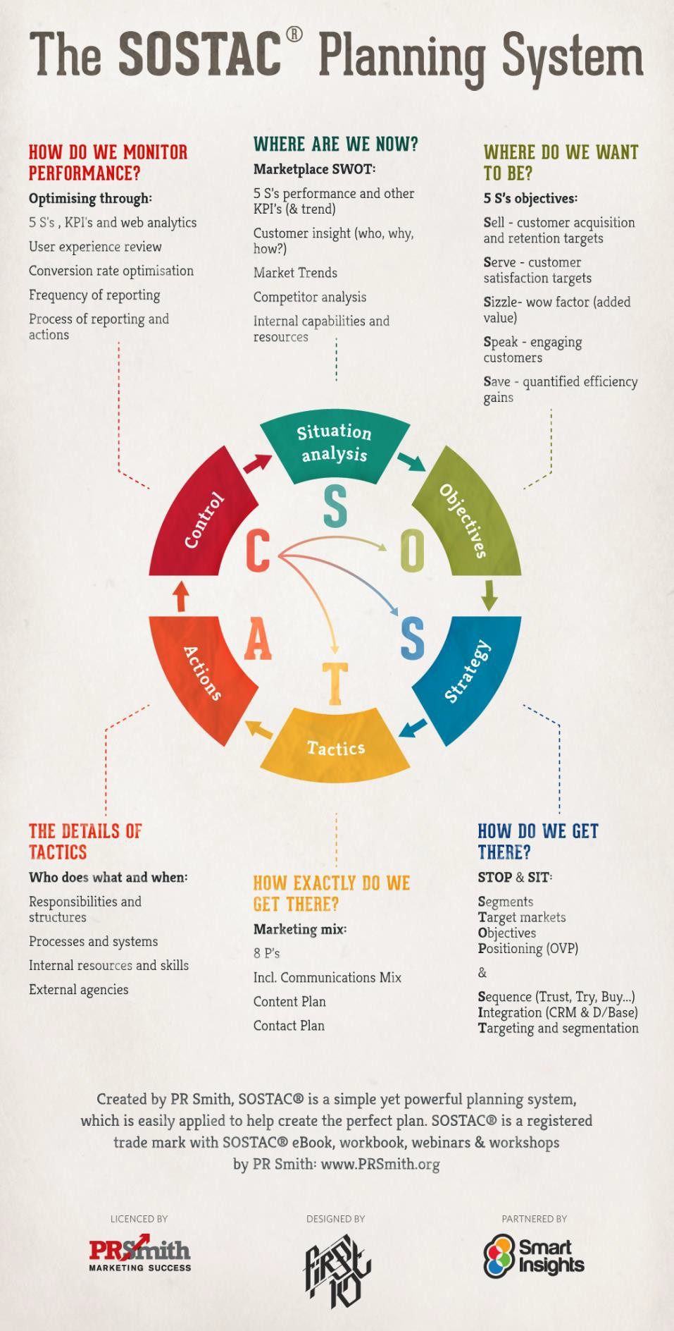
SOSTAC Framework
Using the SOSTAC planning framework you will carry out a ‘digital marketing/social media evaluation’ of the organisation’s current digital marketing/social media activity, considering the ways in which they position their product/service/experience and campaign their brand/message in a market/industry. Based on your ‘evaluation’, you will then offer recommendations to the organisation, by way of crafting a revised ‘digital/social media marketing plan’.

Slide 6
SOSTAC Framework
Using the SOSTAC planning framework you will carry out a ‘digital marketing/social media evaluation’ of the organisation’s current digital marketing/social media activity, considering the ways in which they position their product/service/experience and campaign their brand/message in a market/industry. Based on your ‘evaluation’, you will then offer recommendations to the organisation, by way of crafting a revised ‘digital/social media marketing plan’.

Slide 7
Five S’s
Chaffey and Smith, 2017
(first introduced in 2001)
  Sell – Grow sales.
  customer acquisition and retention targets
  Serve – Add value.
  customer satisfaction targets
  Speak – Get closer to customers.
  trialogue; number of engaged customers
Five S’s
Chaffey and Smith, 2017
p. 232-233
  Save – Save costs.
  quantified efficiency gains
  Sizzle – Extend the brand online.
  site stickiness, visit duration

Slide 8
Objectives
*For your assessment you’ll need to select a single objective from the following 3 s options below and you’ll need to discuss what ROI, (from the choices below), would be expected.
SPEAK
SERVE
SIZZLE
Non-financial ROI:
Brand satisfaction
Brand loyalty
Purchase consideration
Objectives are more like goals, while your tactics are the specific tools or the approach you’ll use to achieve the objectives.

Slide 9


  “speak”
    Write down your broad aims in these five areas:
    1) Encouraging ongoing engagement (this should come before company messages so that the ‘sell– inform– entertain’ balance is right).
    2) Communicating brand perception and key brand messages.
    3) Communicating updates about new products and offers.
    4) Encouraging dialogue to find out more about products.
Five S’s
Chaffey and Smith, 2017
p. 232-233, and also 23-42

Slide 10
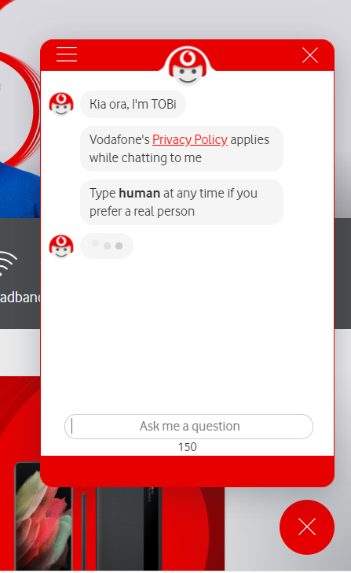
  “serve”
    Define how social media will be used to deliver customer-service goals:
    To provide information to resolve customer-service issues.
    To identify discussed customer issues and resolve them.
    To encourage web self-service including collaborative self-service.
Five S’s
Chaffey and Smith, 2017
p. 232-233, and also 23-42

Slide 11


  “sizzle”
    These are closely related to the speak goals; to add extra value (or ‘added value’), extend the experience and enhance the image.
    This can include adding to the experience of the brand through interactive facilities.
    Sometimes brand imagery and perceptions is the only real differentiator between products.
    The brand is affected by both reality and perception: the reality of the actual experience enjoyed (or suffered) when using the brand; the perception , or image, associated with the particular product.
Five S’s
Chaffey and Smith, 2017
p. 232-233, and also 23-42

Slide 12
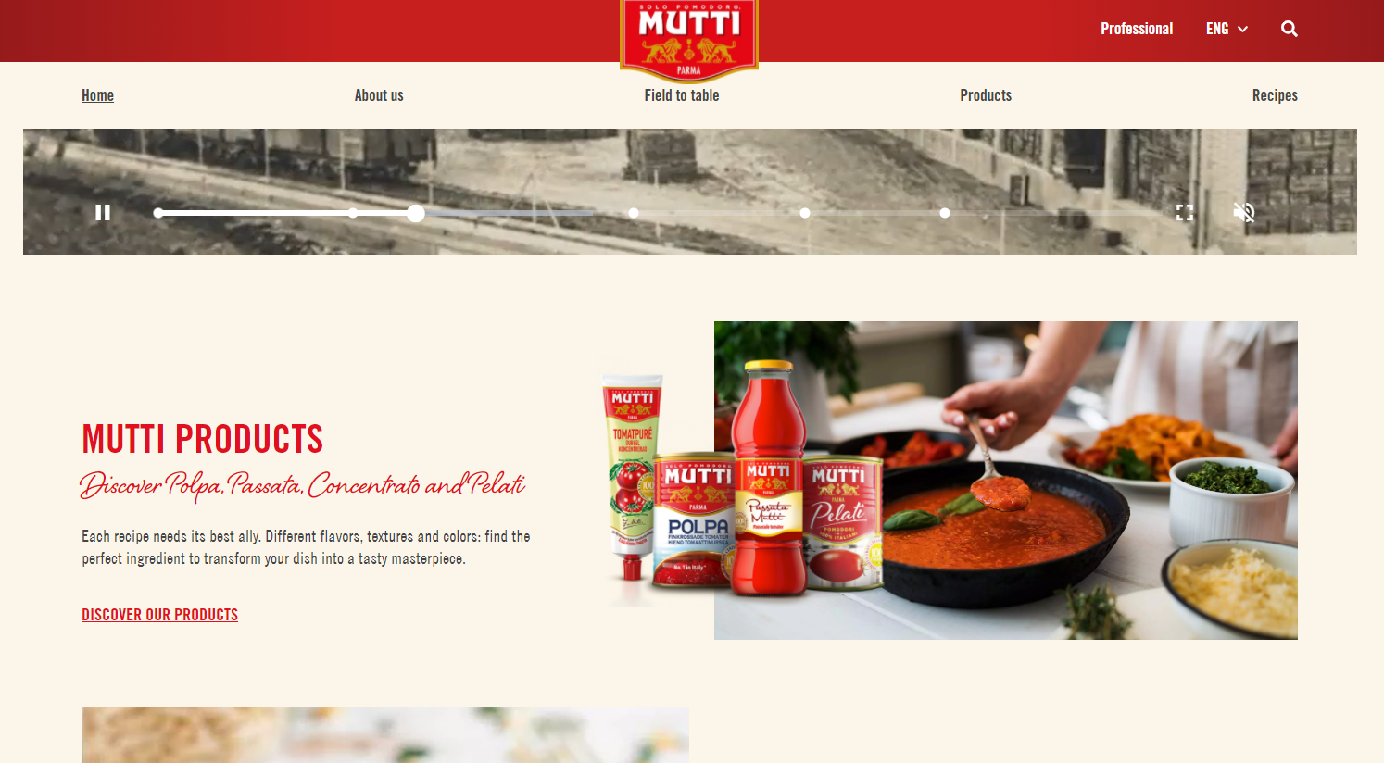
    Sizzle
    Examples:
    Mutti
    Bacardi
    Flash rich media
    High quality imagery
    Video clips
    Recipes
    Music/sound

Slide 13

ONLINE VALUE PROPOSITION [OVP]
What is it?
The OVP is similar to the traditional unique selling proposition (USP) used in advertising.
Ideally, you need to try to find a proposition that explains what your organisation or site is offering that:
Is different from your competitors
Is not available in the real world
Makes a difference to your customers’ lives
(Section 6.3, pg. 314, Chaffey & Smith, 2017)

Slide 14

ONLINE VALUE PROPOSITION [OVP]
Why is it important?
The web gives the ultimate in customer choice. There are millions of sites to choose from and thousands of new domain names are still added every day. How will you stand out?
What defines a “good site?”
Good content, are regularly updated, easy to use and fast to download.
In addition to all of these, your site must have a clear and strong proposition. A proposition to your visitor. A unique proposition. An online value proposition (OVP).
(pg. 313, Chaffey & Smith, 2017)

Slide 15

ONLINE VALUE PROPOSITION [OVP]
Defining it:
Why should a customer visit, stay and even revisit your site?
What does your site propose to visitors?
Can you summarize the proposition for your site?
Try to identify the proposition as you visit other web sites. Can you summarize their OVPs?
(Section 6.3, pg. 313, Chaffey & Smith, 2017)

Slide 16
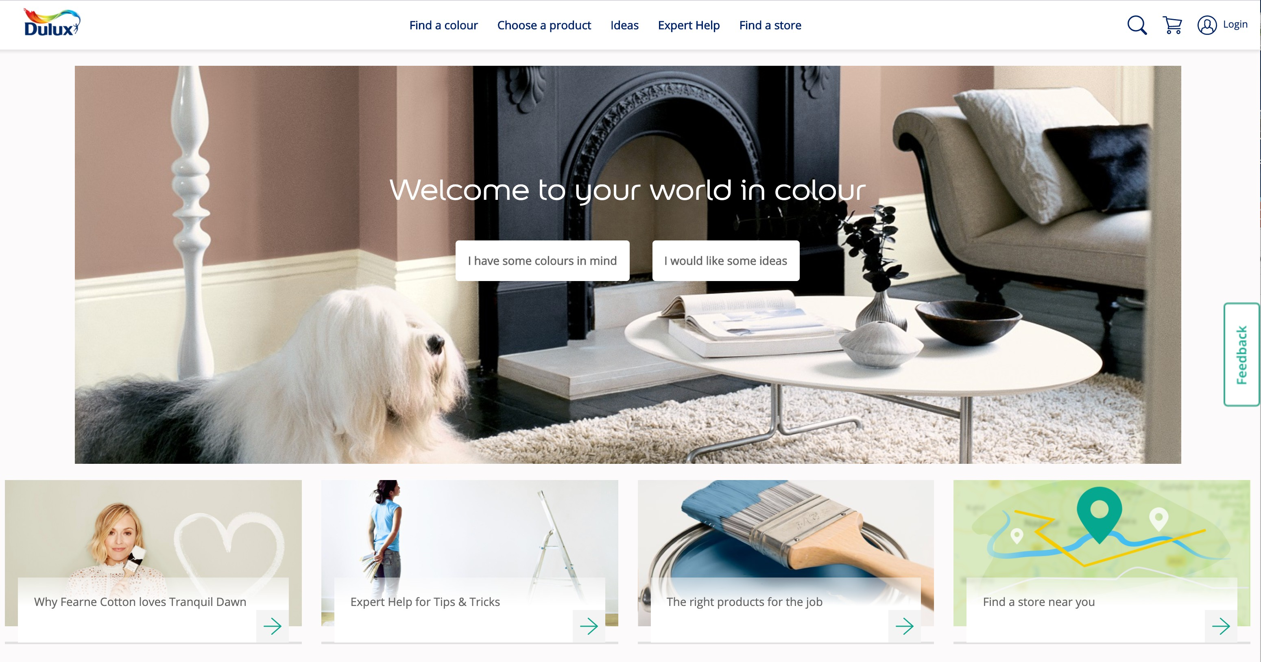
Site OVP example: www.dulux.co.uk
(pg. 313, Chaffey & Smith, 2017)

Slide 17
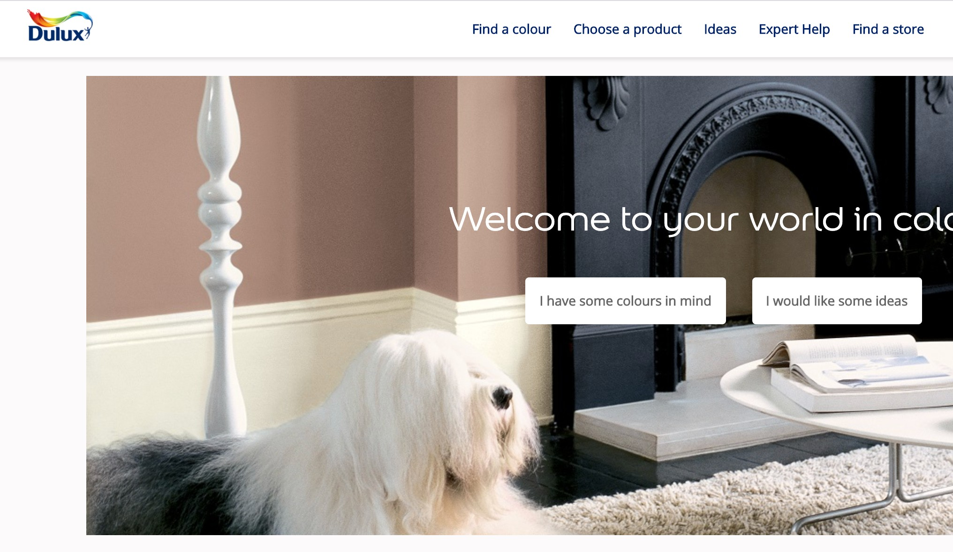
Site OVP example: www.dulux.co.uk
You also need to develop different OVPs for different audiences – the Dulux site does this well through use of four key characteristics. E-retailers need to think of their OVPs for different types of buyers from hunters and trackers through to explorers (see Section 4.6 in Chapter 4).

Slide 18
Group Assessments
The collective decisions that need to be made together as a group:
Organisation choice
Single 5s objective (serve/speak/sizzle)
Choice of social platform/s
Key campaign message
Expected outcomes

