Slide 1
TOUR710 TOURISM HOSPITALITY AND EVENTS IN THE DIGITAL AGE
From CRM to Social CRM
How can brands engage customers in social media?

Slide 2
Session Flow
Today's Agenda
What is Social CRM?
Why Social CRM?
Online value proposition
Campaign concepts
TOUR710

Slide 3
Sharing is the new buying
The CRM to Social CRM shift
MANAGEMENT
ENGAGEMENT
SOCIAL CRM
CRM =
Customer Relationship Management
TOUR710

Slide 4
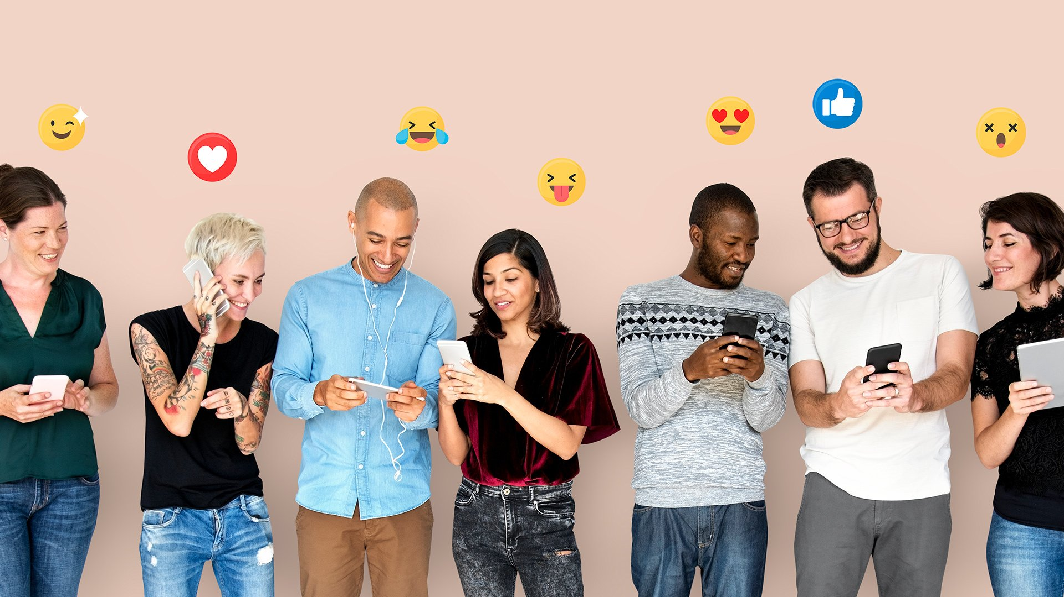
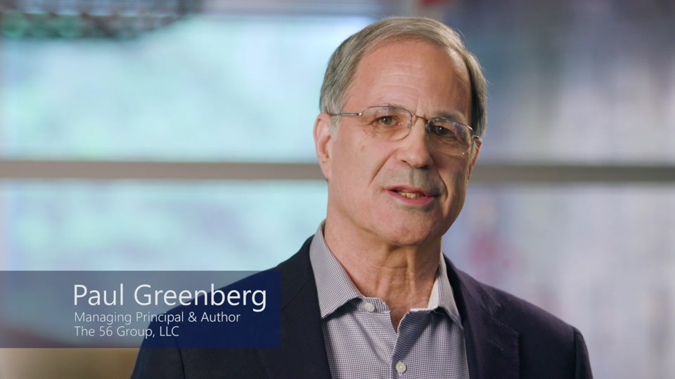
Social CRM
“a company’s response to the customer’s control of the conversation”
social CRM thought leader,
Paul Greenberg, 2010
“…entails a shift from a transactional and automational solution to a customer experience management philosophy, reflecting high levels of customer empowerment.”
Sigala, 2018

Slide 5
Why Social CRM?
Losing voice
Markets are conversations. The community of discourse is the market. Companies that do not belong to a community of discourse will die.
(Levine, Locke, Searls, & Weinberger, 2000)
Managing customers Managing the dialogue
.
(IBM Institute for Business Value, 2011)
TOUR710

Slide 6
Why Social CRM?
Losing control
The vast range of multi-directional and instantaneous communication channels in Web 2.0, has left marketers unable to control the reachability, frequency or content of their marketing initiatives, resulting in the organisation no longer being in complete control of the message.
(Mangold & Faulds, 2009; Powell, Groves, & Dimos, 2011)
TOUR710

Slide 7
Why Social CRM?
Collaborative experiences
Experiential-focused philosophies have replaced what was known to be the more transactional or automated solutions (Sigala, 2018).
Co-creative approach (value co-creation)
The need to actively engage customers in relationship building and value co-creation and considering customers as collaborative partners has been found as common to social CRM definitions.
(Brodie, Ilić, Jurić, & Hollebeek, 2013; Choudhury & Harrigan, 2014; Dutot, 2013; Greenberg, 2009; Lipiäinen, 2015).
Customer management Customer engagement
TOUR710

Slide 8

THE SOCIAL CUSTOMER
“someone like me”
They are customers who feel compelled to share information with peers they might have never met but who are
“someone like them”
Greenberg, 2010
Notes:
Greenberg, P. (2010). The impact of CRM 2.0 on customer insight. Journal of Business & Industrial Marketing, 25(6), 410-419.
They are customers who feel compelled to share information with peers they might never have met but who are “someone like them”.

Slide 9
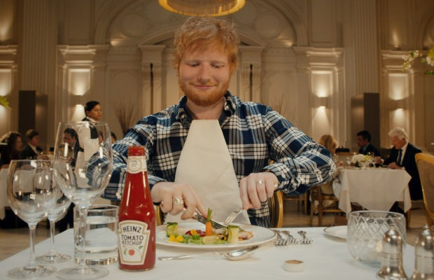

Collaborative projects:
Professional + UGC
Telling authentic stories
Fan – Brand Advocate
We will look at this story in more detail in Week 11 – ‘Social media marketing: Influencer marketing’
Heinz
Ketchup Ad

Slide 10

ONLINE VALUE PROPOSITION [OVP]
What is it?
The OVP is similar to the traditional unique selling proposition (USP) used in advertising.
Ideally, you need to try to find a proposition that explains what your organisation or site is offering that:
Is different from your competitors
Is not available in the real world
Makes a difference to your customers’ lives
(Section 6.3, pg. 314, Chaffey & Smith, 2017)

Slide 11

ONLINE VALUE PROPOSITION [OVP]
Why is it important?
The web gives the ultimate in customer choice. There are millions of sites to choose from and thousands of new domain names are still added every day. How will you stand out?
What defines a “good site?”
Good content, are regularly updated, easy to use and fast to download.
In addition to all of these, your site must have a clear and strong proposition. A proposition to your visitor. A unique proposition. An online value proposition (OVP).
(pg. 313, Chaffey & Smith, 2017)

Slide 12

ONLINE VALUE PROPOSITION [OVP]
Defining it:
Why should a customer visit, stay and even revisit your site?
What does your site propose to visitors?
Can you summarize the proposition for your site?
Try to identify the proposition as you visit other web sites. Can you summarize their OVPs?
(Section 6.3, pg. 313, Chaffey & Smith, 2017)

Slide 13
https://create.kahoot.it/details/tour710-pop-quiz/821216c8-50f2-460a-b4f8-8f9fb5582a22?drawer=
TOUR710 Pop Quiz

Slide 14
Make collective decisions for your Social Media Campaign Proposal including: 1. Choice of organisation 2. Choice of platform 3. Choice of Chaffey and Smith 's' strategy (refer to last week’s slides)
Slide 1 – Organisation Overview
Business introduction
Market positioning / relevance
Slide 2 – Campaign Objective (5S Framework)
Selected objective (Serve / Speak / Sizzle)
Justification (refer to Situation Analysis findings, Week 5 slides)
Slide 3 – Target Audience
Audience profile – what segment/s will be targeted? Define the segment/s.
Data-supported justification
Slide 4 – Platform Strategy
Selected platforms
Strategic rationale

Slide 15

Make collective decisions for your Social Media Campaign Proposal including: 4. Key campaign message 5. Key campaign dates/duration 6. Proposed engagement outcomes and measures
Select a campaign concept from the next two slides
Slide 5-6 – Campaign Concept
Value proposition
Key campaign message
Slide 6-7 – Content Strategy
Themes / formats
Engagement mechanisms
Slide 8 – Expected Outcomes
Engagement outcomes
Sales / behavioural outcomes
Slide 9 – Measurement & Evaluation
Metrics / KPIs
Tools & analytics
Slide 10 – Closing Statement
Strategic summary / persuasion
This should include the duration of the campaign and when it will be launched
What type of content would be launched for the campaign? Think back to the examples of campaigns from Week 5 lecture.

Slide 16
CAMPAIGN CONCEPT: TYPES
Types of Social Media Marketing Campaign Plan:
1) Competition/Draw
(Terms & Conditions – T&Cs: follow, like, share, tag a friend in comment, leave a comment etc. – guaranteed engagement, results, depending on the T&C’s UGC could be generated)
2) Influencer Marketing
(See Lecture content and Course Resources on Influencer Marketing)
3) Story-telling (theme) (establish stronger brand presence, increase brand awareness, could be a series of content that tells a story about the brand such as a “behind-the-scenes,” introducing staff, video marketing etc)
Choose from the suggestions, remember you can combine different tactics

Slide 17
CAMPAIGN TYPES
Types of Social Media Marketing Campaign Plan:
4) UGC – user-generated content
5) Event (could be an online event OR one that connects to an offline event)
**Bear in mind the above are just a few examples. You could select one or combine two different types for your campaign plan. For each of these campaign types you will need to provide details that include points you will be actioning. (i.e., the how and what it will look like for the company as added in side notes above).
Choose from the suggestions, remember you can combine different tactics

Slide 18
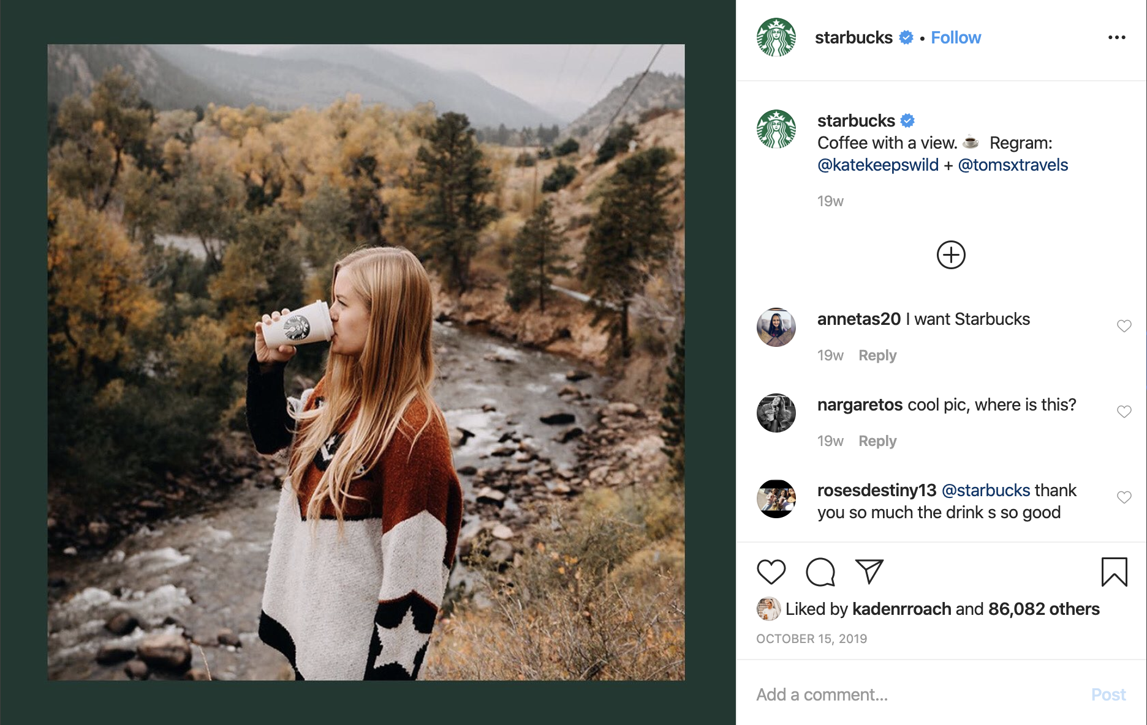
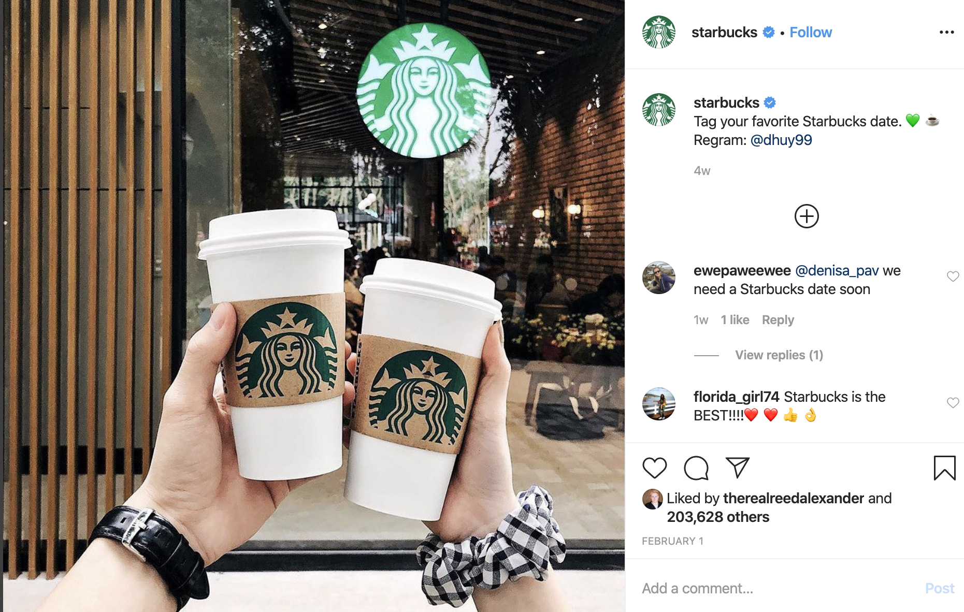
How Starbucks co-creates with customers:
1) Regram/repost

Slide 19
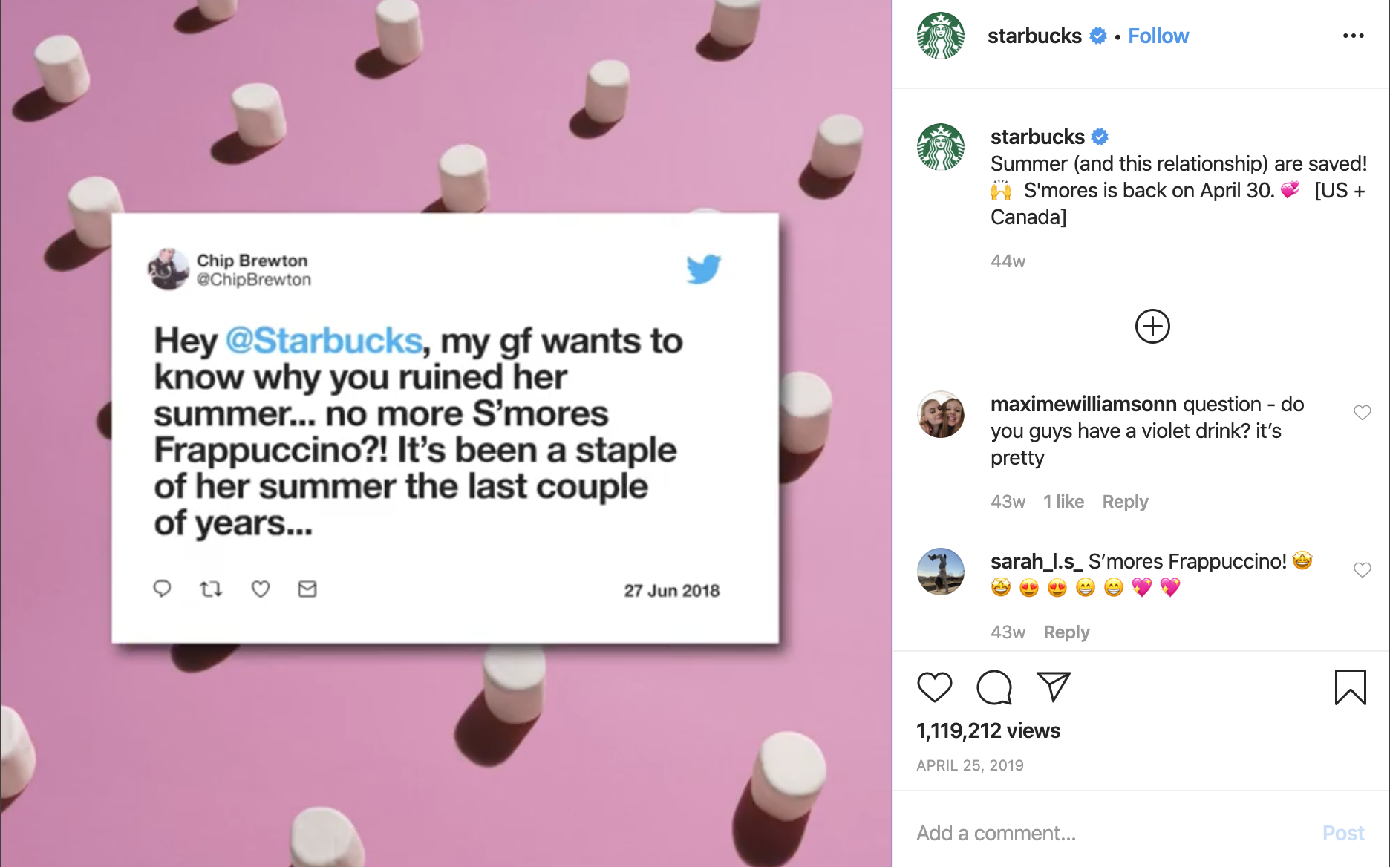
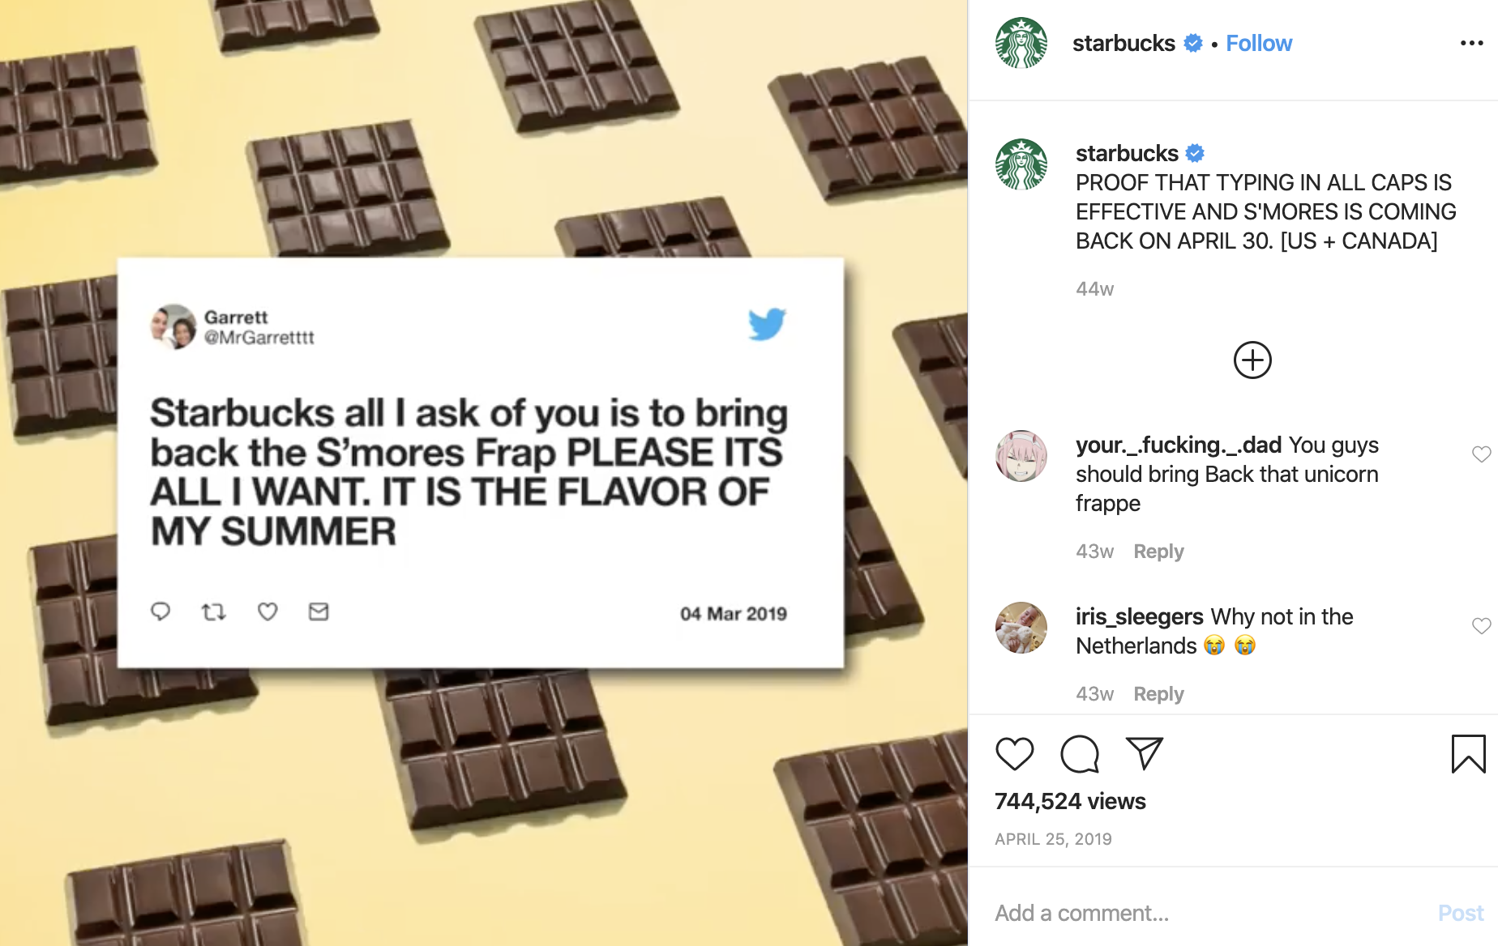
How Starbucks co-creates with customers:
2) Customer feedback: listens and responds (implements)

Slide 20
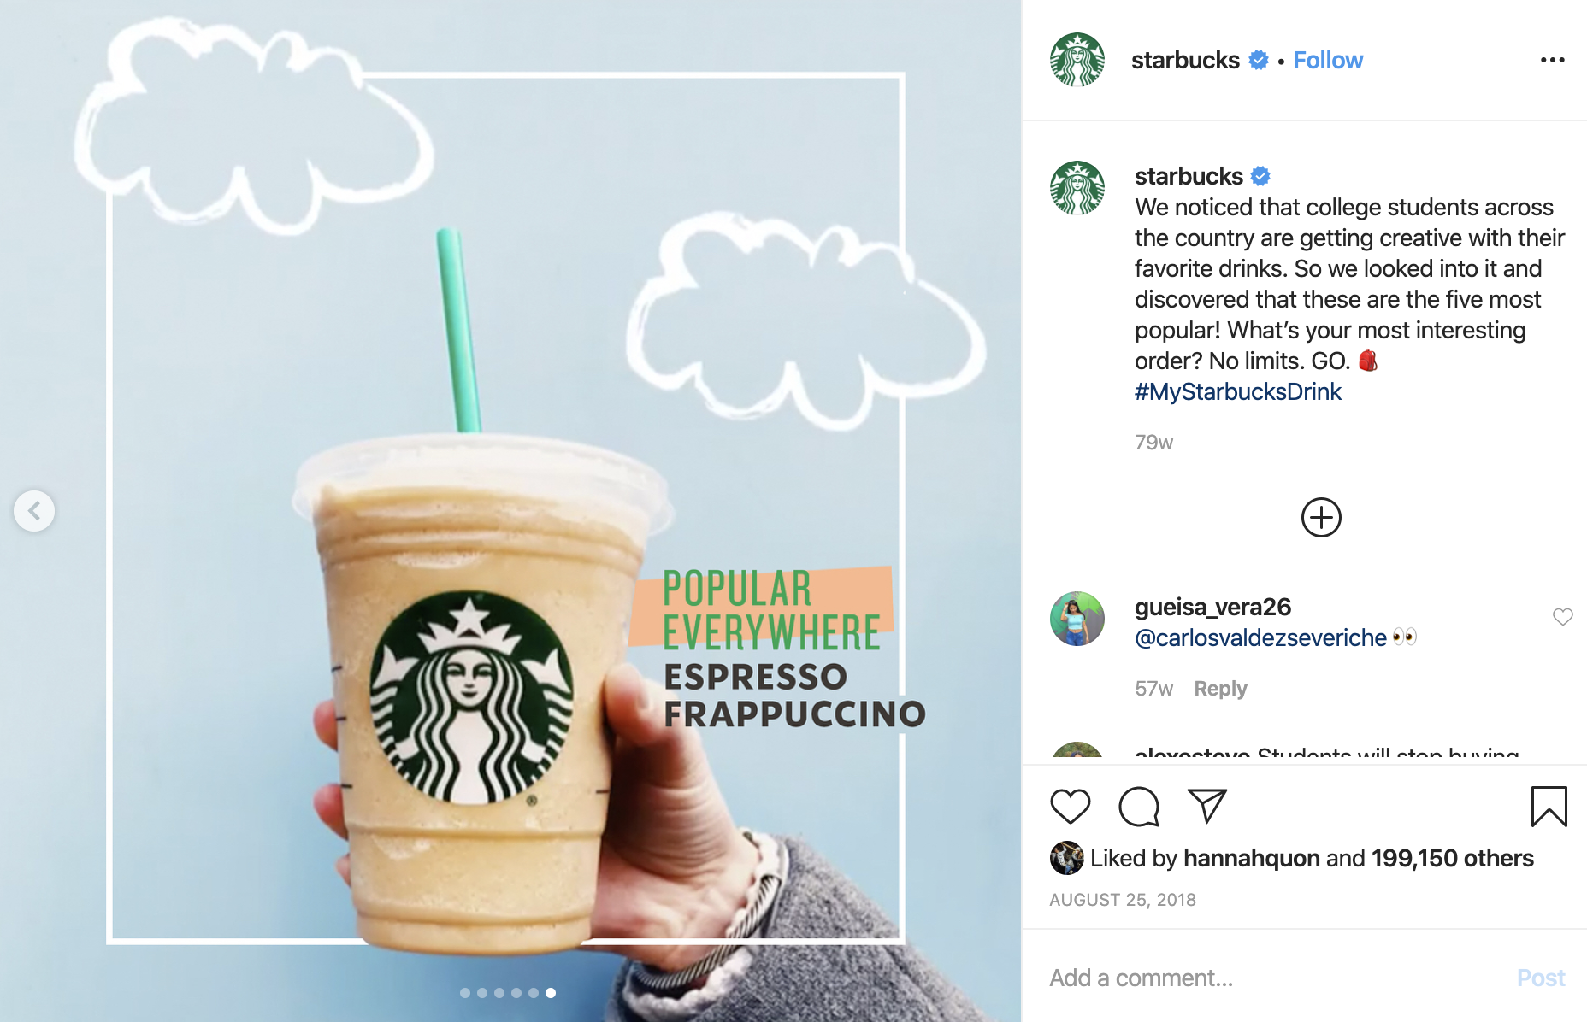
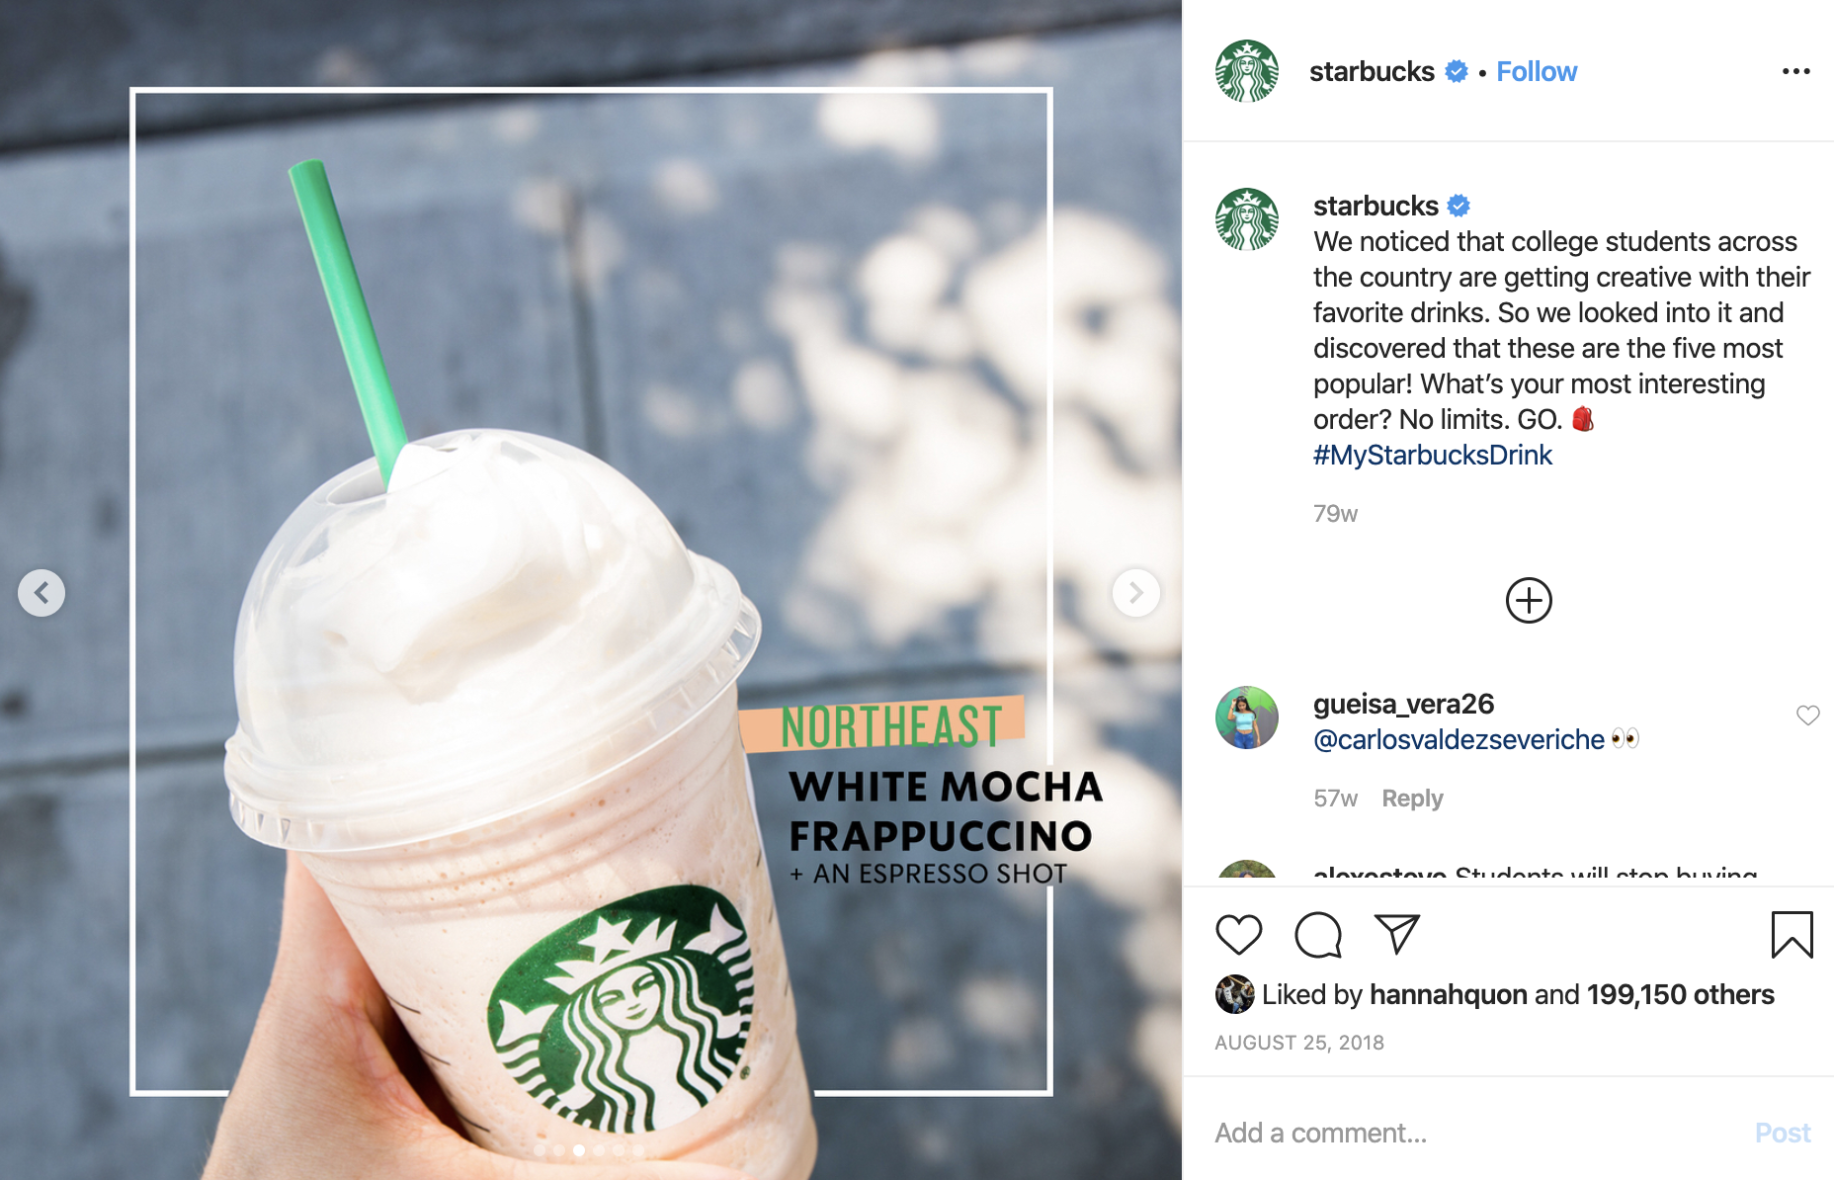
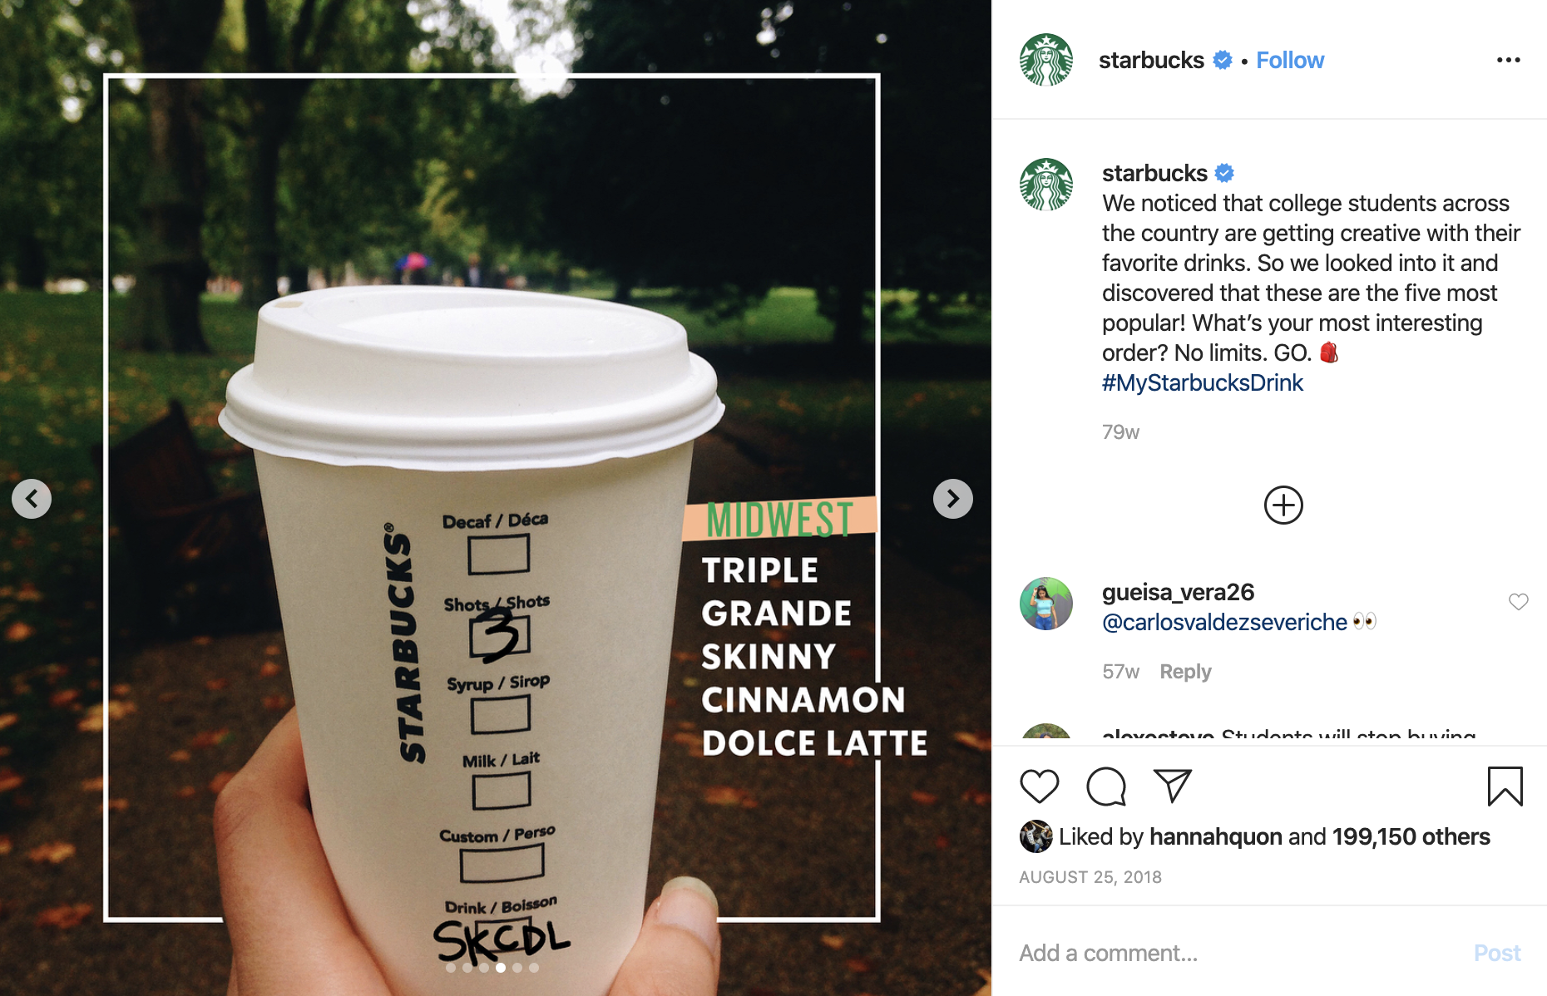
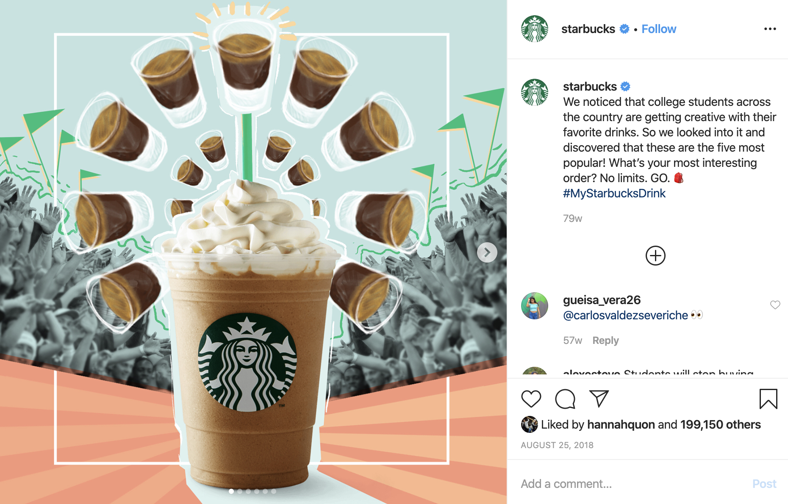
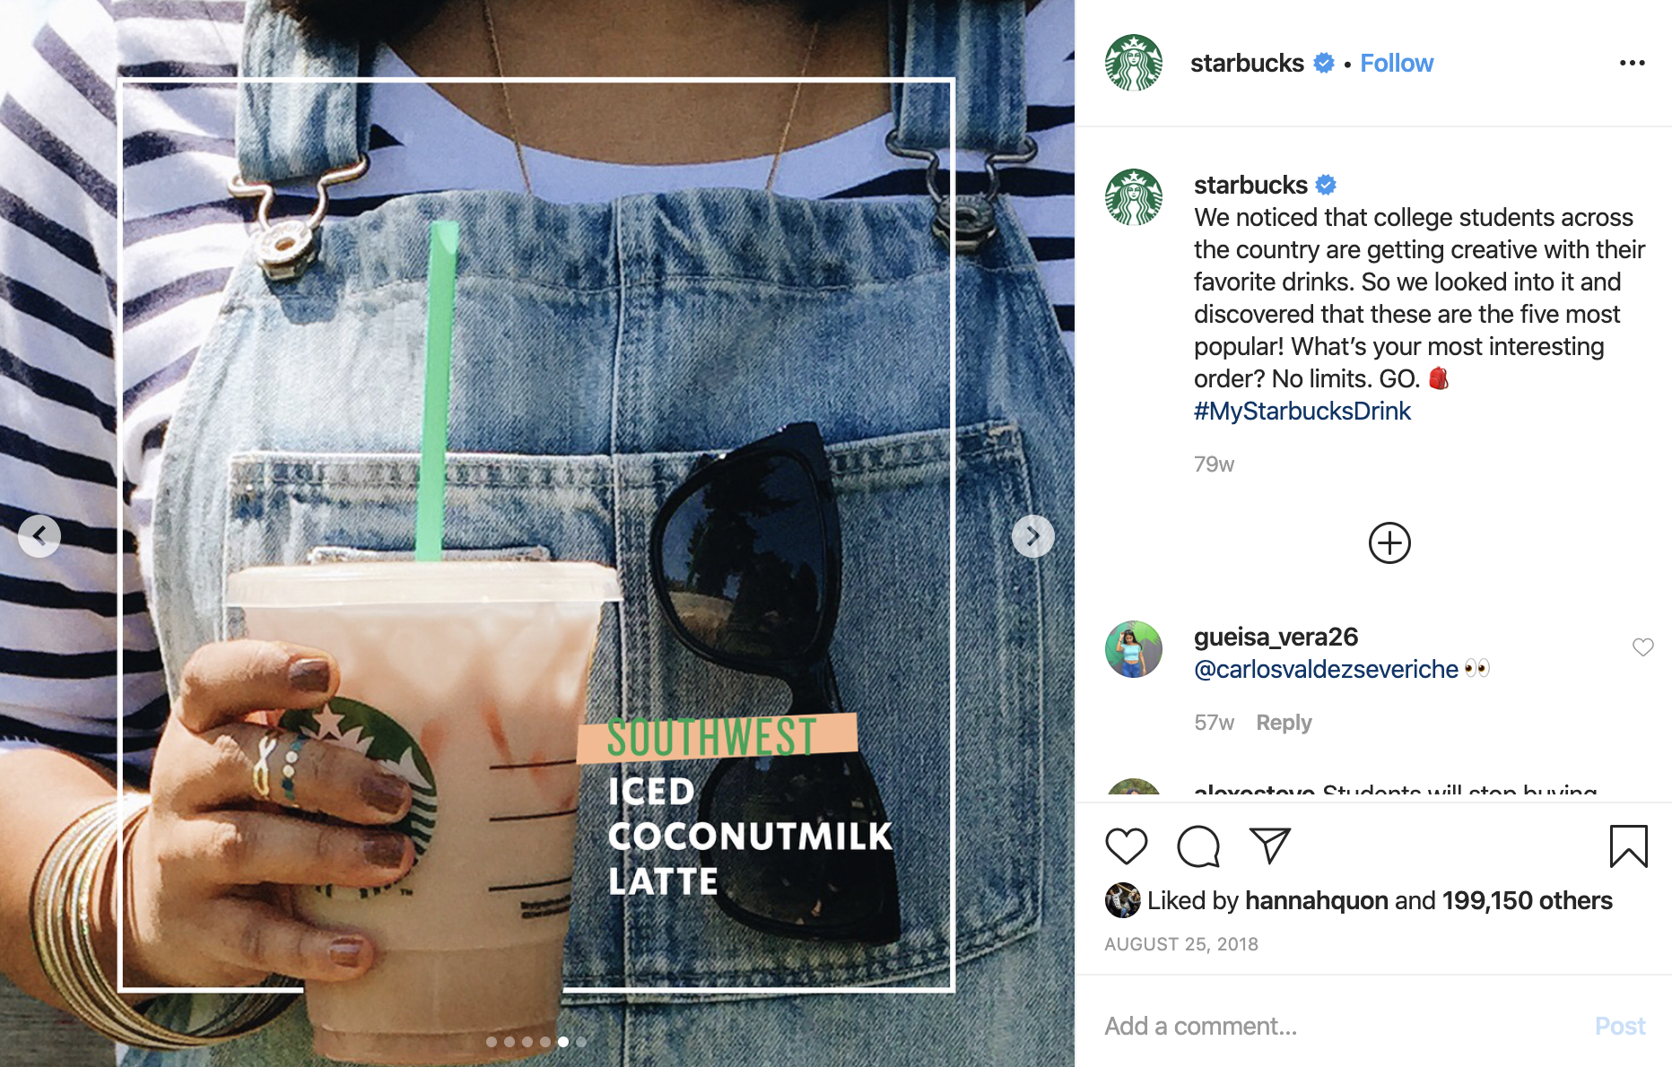
How Starbucks co-creates with customers:
3) Observes and reciprocates (data-driven marketing)

