Slide 1
Organisation and Human Behaviour Perspectives CLSY513 Semester 1, 2026
Week 10 Lecture:
Conflict Management in Organisations
Notes:
Welcome to Week 11.

Slide 2
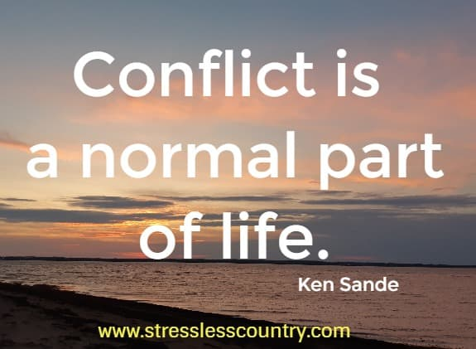

Slide 3
Lecture covers ...
Definitions of Conflict
Types of Conflict
Organisational Conflict post COVID-19
Common Roots of Conflict; Costs..
Conflict Resolution
Section 10, Portfolio: Conflict Resolution Style
Reminders; Last Word(s)

Slide 4
What is Conflict?
Some definitions:
... a struggle between parties, interdependent, over incompatible goals, interests or resources (Broome, 1990).
… intercultural exchanges context, conflict is defined as the perceived and/or actual incompatibility of values, expectations, practices between two or more parties from different cultures (Ting-Toomey, 1994).
... where one party perceives its interests are being opposed or negatively affected by another party (Wall & Callister, 1995).
… ‘a feeling, a disagreement, a real or perceived incompatibility of interests, inconsistent worldviews, or a set of behaviours’ (Mayer, 2003, p. 3).

Slide 5
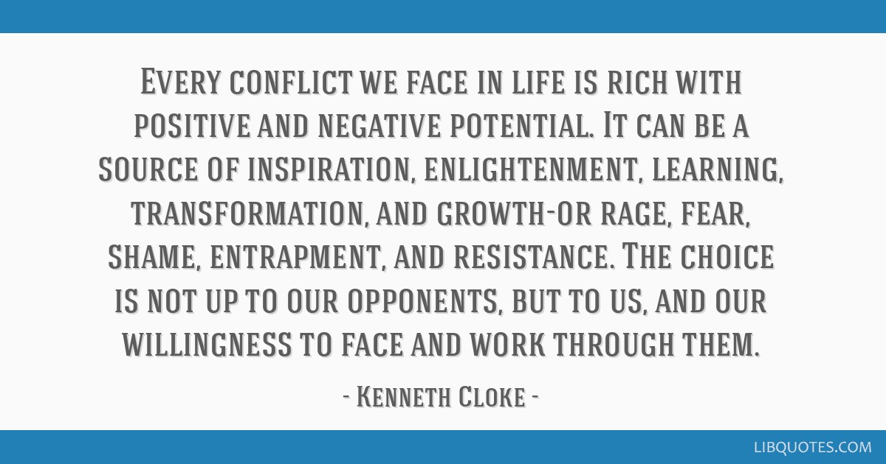
Notes:
Kenneth Cloke is a mediator, consultant, and trainer specialising in communication, negotiation, and workplace disputes.
Mediated conflicts and taught conflict resolution for decades in over 20 countries.
His quote reveals how every conflict has the potential to turn out well, or poorly.
It also emphasizes how every person must take responsibility for the outcome and not hand it off to others.

Slide 6

Types of Conflict
Good
Bad
Ugly
Notes:
Good: Resolved conflict in a positive and constructive manner. Growth, improvement(s), positive change, understanding, appreciation.
Bad: Negative and destructive behaviour, makes things worse.
Ugly: Harmful, highly destructive, personal attacks, extreme behaviours. Legal implications.

Slide 7

Conflict: Good
Resolved in a positive and constructive manner, leading to growth, improvement, and positive change.
Differences in opinions and ideas
Open communication and mutual respect

Slide 8
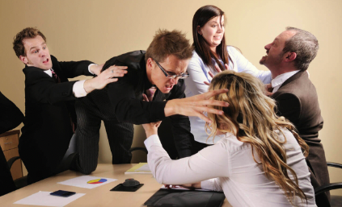
Conflict: Bad
Involving negative and destructive behaviour which can make things worse.

Slide 9
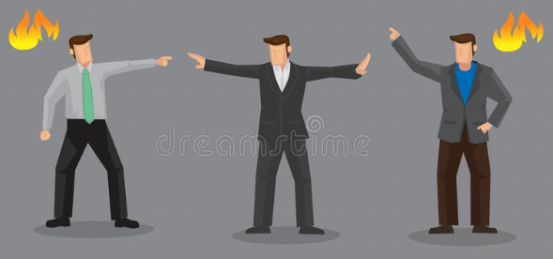
Conflict: Ugly
Particularly intense and harmful in nature, may involve personal attacks, or extreme behaviours.

Slide 10

Common Roots of Conflict
Ineffective communication
Values clashes
Culture and language clashes
Work policies and practices
Adversarial management
Noncompliance
Competition for scarce resources
Personality clashes

Slide 11

Costs of Conflict
Loss of productivity
Financial costs
Employee turnover
Emotional cost
Reputation damage

Slide 12

Dealing with Conflict
Three basic approaches to negotiations:
Win/Lose
Lose/Lose
Win/Win

Slide 13
The Win/Lose Strategy
Achieve your goals at expense of others.
Short-term solution.
Underlying problem remains.
Loser frustrated, seeds another conflict.

Slide 14
The Lose/Lose Strategy
Both parties give up something; feel frustrated.
Can be applied when
there is little time to find a solution.
negotiations at a standstill.
conflict needs to be removed completely.

Slide 15

The Win/Win Strategy
Process should be
flexible
sensitive
patient
calm
Most vital skill is listening.
Notes:
EQ
SQ
Communication skills

Slide 16
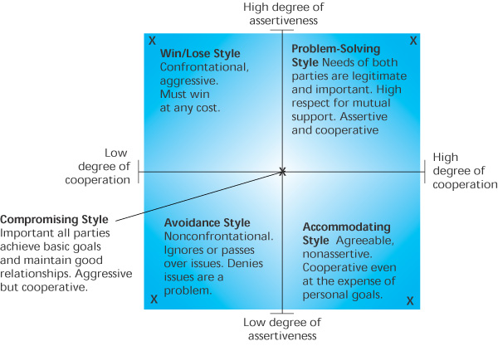
Figure 8.1
Behavioral Styles
For Conflict Situations
Source: Adapted from Robert B. Maddux, Team Building: An Exercise in Leadership, Crisp Publications Inc. Menlo, CA, 1986, p. 53. Reprinted by permission of the publisher.

Slide 17

Conflict Management/Resolution Considerations
Listen to the other party.
Avoid overarching statements.
Finding the interests of all involved.
Avoid judgment.
Share your strong feelings respectfully.

Slide 18
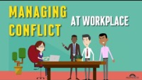
Notes:
3:08m long
Managing Conflict at the Workplace

Slide 19
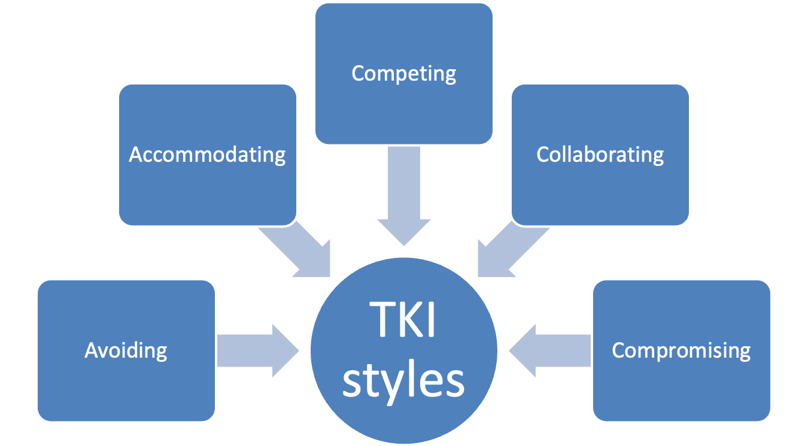
Section 10, Reflective Portfolio: Conflict Resolution Style
Notes:
Explored and explained in tutorials this week.

Slide 20
Reflective Portfolio: Section 10 Conflict Resolution Style
Complete the self-assessment based on Thomas-Kilmann conflict theory.
Conflict Management Styles Quiz | MTD Training
https://canvas.aut.ac.nz/courses/19923/files/6309432/download?download_frd=1
Self-assessment on Canvas, Week 10 Lecture page.
Reflective Questions:
What is my conflict resolution style?
How do I deal with conflict? (Briefly describe an example of conflict you have experienced and how you dealt with it and how you could have dealt with it better)
How can my conflict resolution style benefit an organisation? Name and describe three benefits.
Notes:
Conflict Management Styles Quiz | MTD Training – students who’ve already started using this (new) link.
https://canvas.aut.ac.nz/courses/19923/files/6309432/download?download_frd=1 – students have the option of either, but this link is the same as posted onto Canvas for Week 11.

Slide 21
Reflective Portfolio Part B: Final Section
Who Am I?
Who am I? A written personal statement that captures the essence of who you think you are, summing up all ten self-assessments.
300 words + 10%; 1+ academic reference.

Slide 22
Next Two Weeks Weeks 11 and 12
Lecture
No lecture in Weeks 11 and 12.
Tutorials/Drop-in Sessions
Week 11 Tutorials, ie students’ regular/assigned tutorial.
Lecturer will stay for the first 10-15 minutes and if no one turns up, lecturer will leave the classroom.
No tutorials in Week 12.
Assessment 2 Reflective Portfolio Part B – due 11:59 pm, Sunday 31 May 2026.

Slide 23
Last Word(s) Organisation and Human Behaviour Perspectives (CLSY513)
Insight(s) into oneself, and others.
Improved communication skills.
Improved self-awareness and personal ability(ies).
Significance of knowledge gained on resilience, and team roles.
Appreciation of the impact of perception, personality, values.
The value of diversity and its importance in organisations.
Understand role of leadership; conflict management.
Best Wishes from the CLSY513 Teaching Team
(Dan Zhu and Nancy McIntyre)

