Slide 1
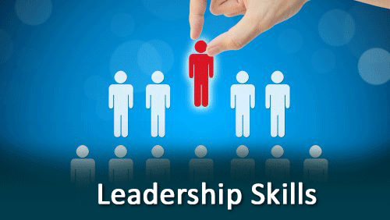

Organisation and Human Behaviour Perspectives
CLSY513
Semester 1, 2026
Week 9 Lecture:
Leadership Principles, and Power

Slide 2
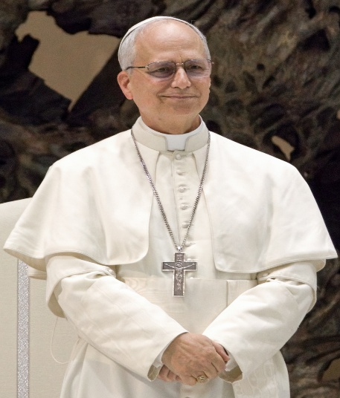
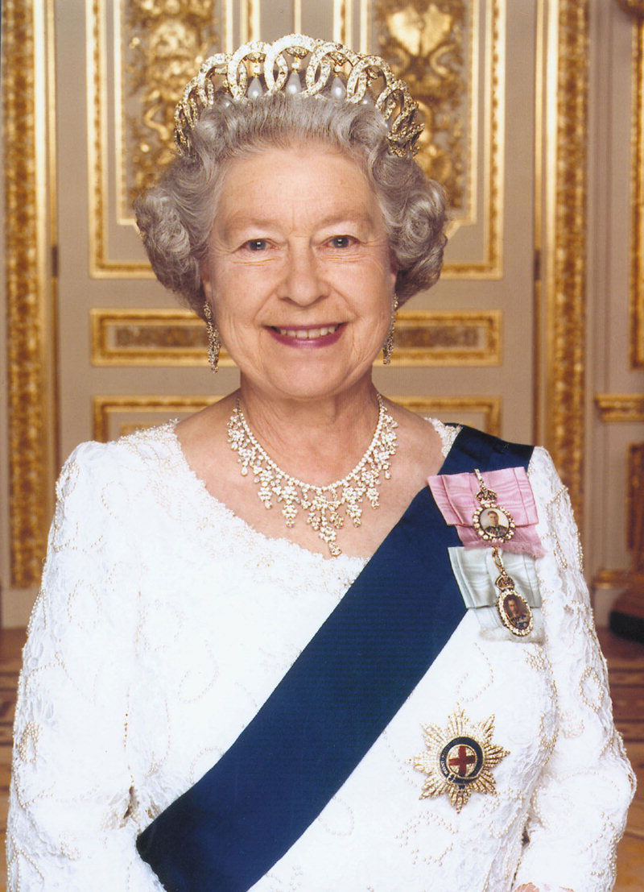
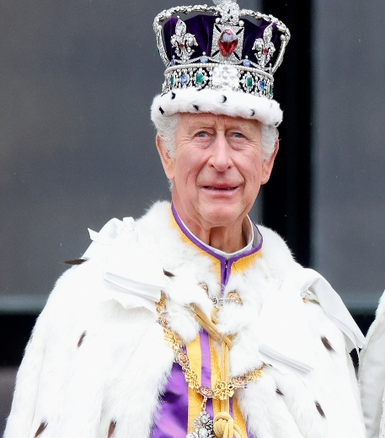



Are Leaders Born or Made?

Slide 3
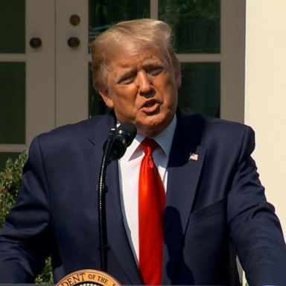
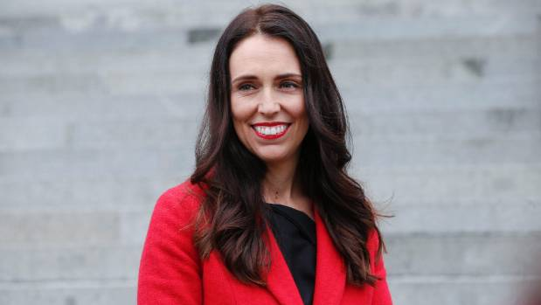
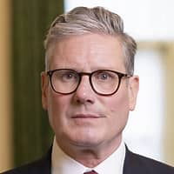
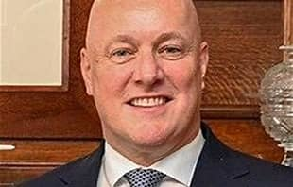
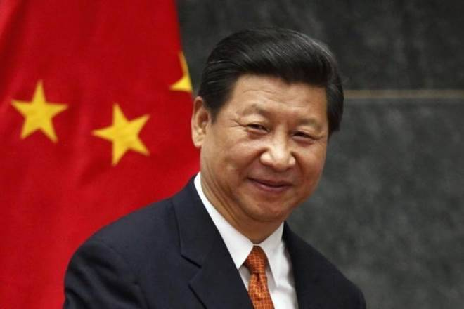
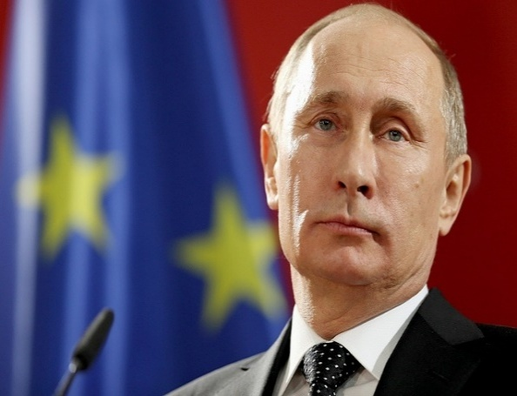
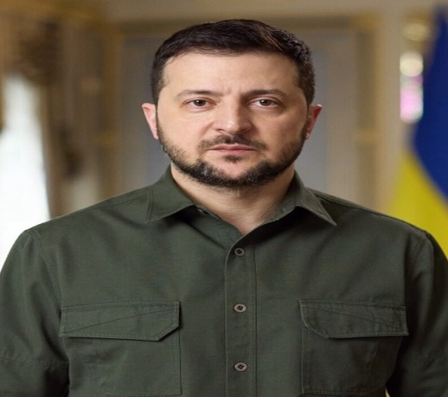
Is Leadership about Power and Influence?

Slide 4
Leadership Definitions
“…. is the process of inspiring, influencing, and guiding employees to participate in a common effort.” (Kreitner, 2009, p. 402)
“…. inducing followers to act for certain goals that represent the values and the motivations – the wants and the needs, the aspirations and expectations – of both leaders and followers who intend real changes that reflect their mutual purposes.” (Burns, 1978, p. 19)
“…. strategic leadership (is) the process of forming a vision for the future, communicating it to subordinates, stimulating and motivating followers, and engaging in strategy-supportive exchanges with peers and subordinates” (Elenkov, et al., 2005, p. 666)

Slide 5
Defining Leadership
Dominant Individual
Getting things done through people
Challenging the norm

Slide 6

What is Leadership?
“…. is the process of inspiring, influencing, and guiding employees to participate in a common effort.” (Kreitner, R, 2009:p402)

Slide 7
Evolution of Leadership Theory
1940s
1950s
1960s
1970s
1980s
1990s
Present
Transactional
Theory
Behavioural Theory
Transformational
Alternative
Theory
Contingency Theory
Trait Theory

Slide 8
What do Leaders do?
Provide inspiration
Create opportunities
Coach and motivate
Apply effective interpersonal skills

Slide 9
Leadership Qualities
Leadership qualities
Character – honesty, integrity, moral strength
Consideration and structure skills
Emotional Intelligence
Self Awareness
Flexibility

Slide 10
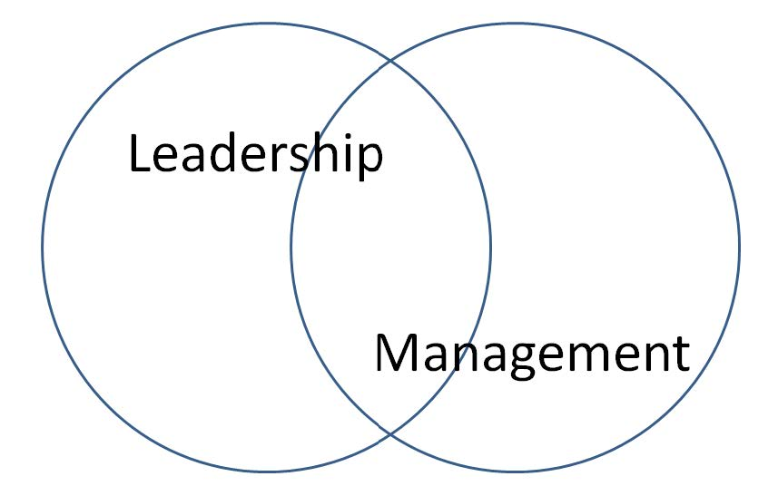
Leading or Managing?

Slide 11
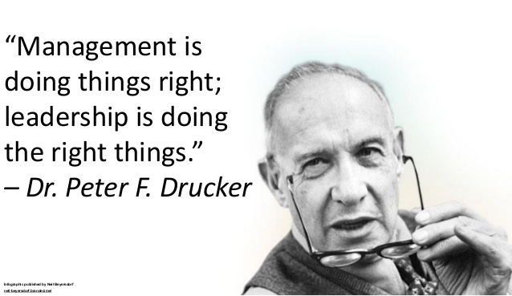

Slide 12
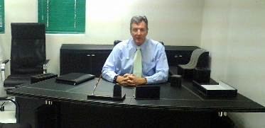
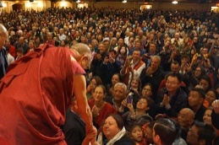
Leadership vs. Management
  Managers
  Plan, organise, lead and control
  Are appointed
  Have legitimate power to reward and punish
  Rely on influence based on formal authority inherent in their positions
  Develop detailed steps and timetables and allocate resources
  Leaders
  May be appointed or emerge
  Can influence others to perform beyond actions dictated by formal authority
  Establish direction, develop future vision and change strategies
  Exercise influence through special skills or resources that meet the needs of other people
See Simpson (2012)

Slide 13
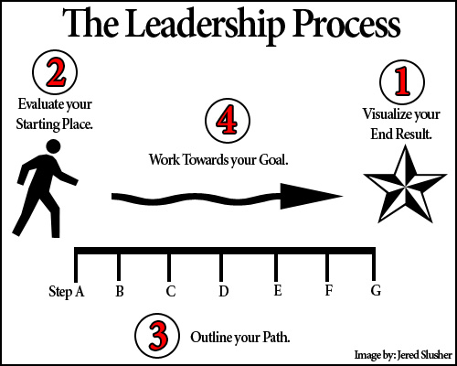
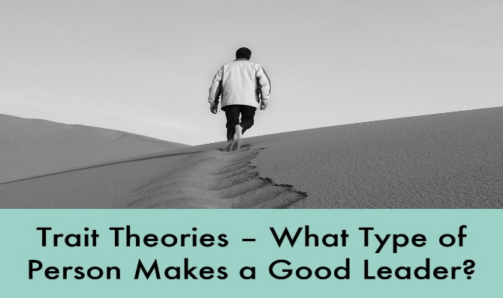
Common Concepts of Leadership
Process Leadership (Jago, 1982)
  Application of leadership knowledge and skills
Trait Leadership (Jago, 1982)
  The influence of attributes such as beliefs, values, ethics and character

Slide 14
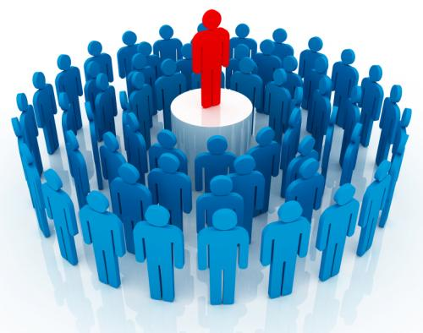
Traditional Leadership Models
Charismatic – the leader exerts influence through seduction of followers. Inspires through vision, actions, imagery, oratory.

Slide 15
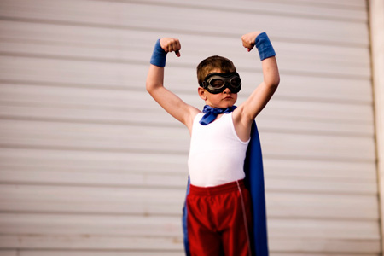
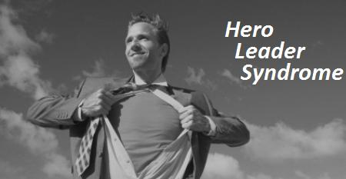
Another Traditional Leadership Model
Hero leader – the leader who is admired (worshipped) for courage, risk taking, individualism, decisiveness, determination. Often has a high, popular profile.

Slide 16
Transformational
Transactional

Slide 17
Transformational and Transactional Styles
Transformational leaders:
  inspire people to transcend their personal interests for the group
  broaden and elevate goals to give confidence to go beyond expectations
Transactional leaders:
  guide people so they can achieve pre-set goals
  exert influence with little emotion

Slide 18
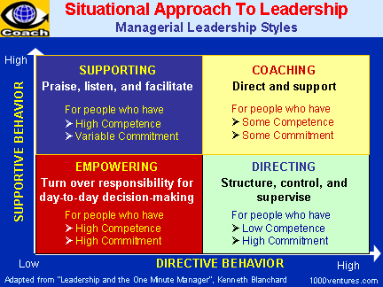
Situational Leadership

Slide 19
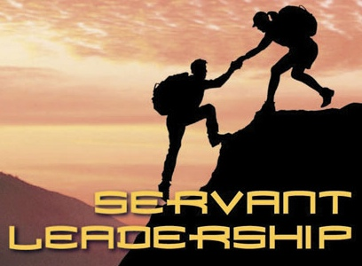
Servant Leadership

Slide 20
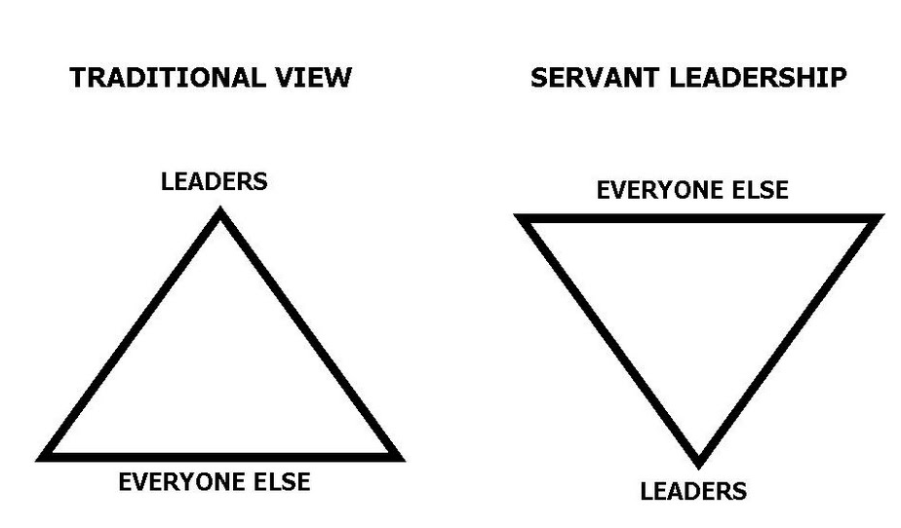
Servant Leadership
“the servant leader is servant first” (Greenleaf, 1991, p13)

Slide 21
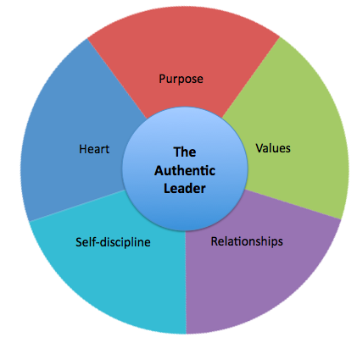
Authentic Leadership

Slide 22
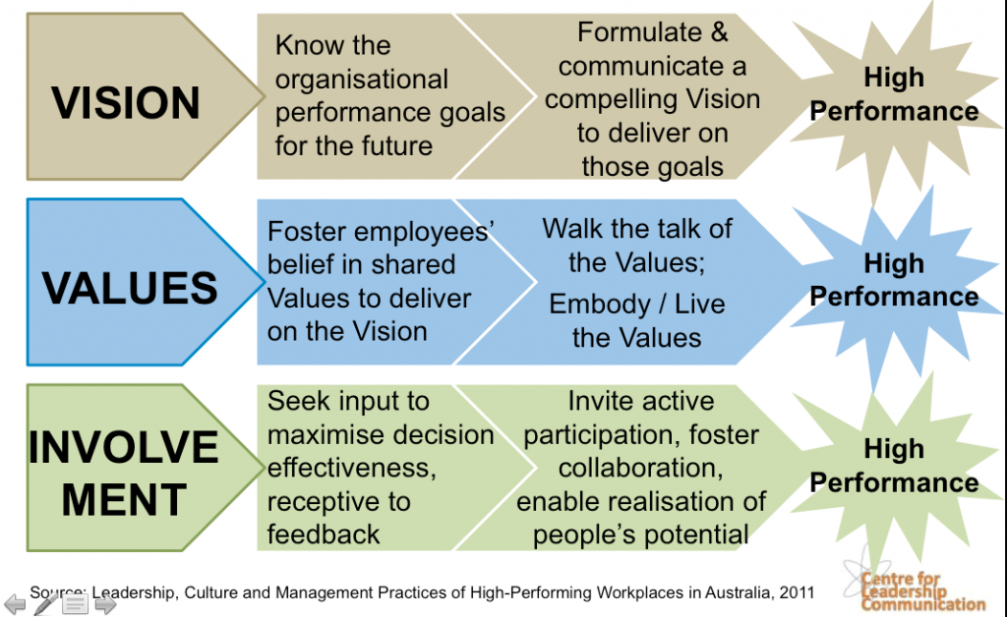
Authentic Leadership

Slide 23
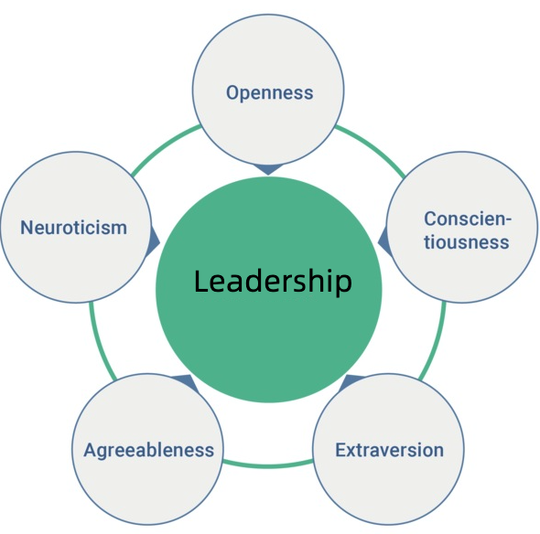
Trait Theories of Leadership

Slide 24
Trait Theories of Leadership
One trait often comes to mind:
Extraversion:
Outgoing, assertive, optimistic, energetic.
Comfortable in social situations.
Good predictor of leadership emergence rather than leadership effectiveness.

Slide 25
Trait Theories of Leadership
Conscientiousness:
Responsible, organized, dependable.
Achievement oriented.
Good planner; tasks completer.
Open to Experience:
Curious, imaginative, creative, think outside the box, receptive to novel situations, tolerant.
Ability to handle uncertainty; adjust well.

Slide 26
Trait Theories of Leadership
Neuroticism:
Extent to which a person (leader) experiences distress, worry, fear, sadness, anxiety, insecurities (Costa & McCrae, 1992)
Individuals high on neuroticism likely to be ineffective through displays of irrational behavior, easily stressed, inability to master emotions.
Agreeableness:
Sympathetic, altruistic, cooperative, trusting, caring, warm.
Assist others.

Slide 27
Trait Theories of Leadership
Conclusions:
Traits can predict leadership.
Traits do a better job predicting the emergence of leaders than they do at distinguishing between effective and ineffective leaders.
Extraversion, Conscientiousness and Openness to Experience positively related to leadership emergence and effectiveness.
Neuroticism negatively correlated with leadership.
Agreeableness has smallest relationship with leadership.

Slide 28
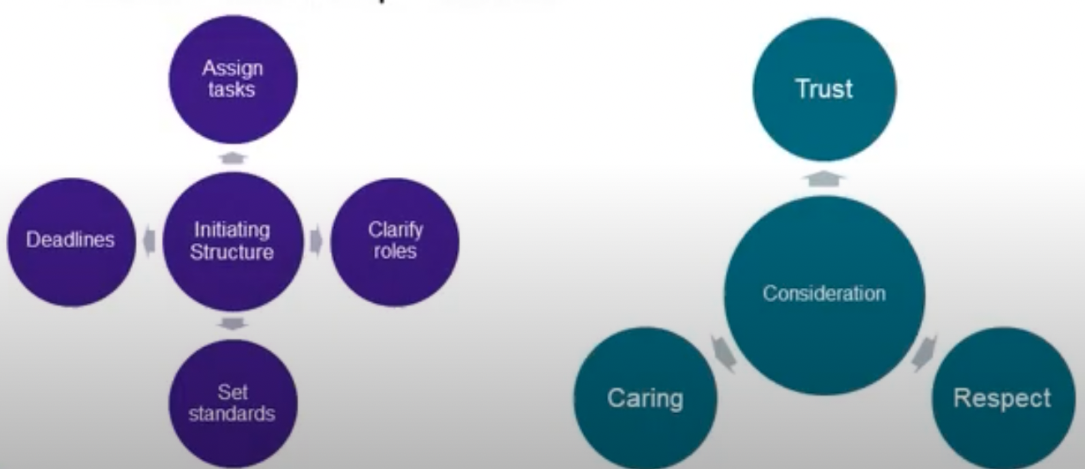
Behavioural Theories of Leadership
Behavioural theories of leadership imply leaders can be made (trained).
Ohio State studies found two leadership behaviours:

Slide 29
Summary
Summary of trait theories and behavioural theories:
Leaders who have certain traits and who display culturally appropriate consideration and structuring behaviours do appear to be more effective.
Traits and behaviours do not guarantee success.
Context, leadership skills, leadership styles matter too.

Slide 30
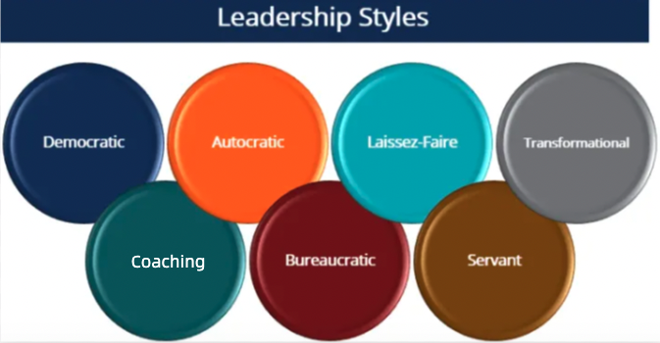

Slide 31
Leadership Styles
Autocratic leadership style
  Leader holds most, if not all, of the decision-making power and authority.
  No input from their team members in decision-making.
  Eg Generals in the military; dictatorship.
Bureaucratic leadership style
  Leaders follow established rules, procedures, and policies closely, inflexibly.
  Eg Employees asking for time off – form/s completion and authorisation processes.

Slide 32
Leadership Styles
Democratic leadership style
  Decisions made through participatory, inclusive process, input and feedback from team members.
  Opinions, ideas and contributions of team members sought, highly valued.
Coaching leadership style
  Focus on developing and empowering team members through guidance, support, and mentorship.
  Act as a coach, giving feedback, setting goals, and supporting growth.

Slide 33
Leadership Styles
Transformational leadership style
  Leader inspires and motivates their followers to achieve their best potential by creating a vision, setting high standards, and promoting personal growth.
  Strengths, weaknesses.
Servant leadership style
  Leader prioritises serving and supporting their team members, as opposed to giving orders.
  Prioritising the needs of their team members over their own.
Laissez-faire leadership style
  leader takes a hands-off approach; allows team members high degree of autonomy and decision-making authority.

Slide 34
Week 9 Tutorial:
What kind of leader are you?
What is my leadership style….
https://www.atlassian.com/blog/leadership/find-your-leadership-style-examples

Slide 35
What is Power?
Power is broadly defined as the capacity to bring about change,
The potential to control or influence the behaviour of others,
Notes:
The Pope, Head of Roman Catholic Church, weilds immense spiritual authority; most influential religious figures in the world, leading global faith of over 1.3 billion Catholics. Touted as Most Powerful Man in History.
Jacinda Ardern, former PM NZ: xxxxxxxxxxxxxxxxxx
Steve Jobs “Changed the World!” claim: developed groundbreaking products eg iPhone, iPads; influential for his accomplishments in technology, innovation, and product development.
Tim Cook, CEO of Apple: resilient leadership; role model for aspiring leaders worldwide. Continuing legacy of Steve Jobs. Under TimC’s watch, developed new product lines; Apple (Mac) …..
Bill Gates, Co-founder of Microsoft: Visionary computer programmer; revolutionised the technology industry with his innovations and became one of the world’s most influential philanthropists.

Slide 36
Sources of Power
Power
Position based
Person based
Reward
Coercive
Legitimate
Organisation based
Expert
Referent
Resource
Elected

Slide 37
Position Power
Reward
  Extrinsic and intrinsic rewards to control people
  Relies on ability to provide something of value to others
  Pros and cons will be covered in tutorials

Slide 38
Position Power
Coercive
  Denying or administering rewards or punishment to control
  Relies on ability to punish or withhold something of value
  Pros and cons will be covered in tutorials

Slide 39
Position Power
Legitimate
  Belief of a subordinate that the boss had the right to control
  relies on the power of role and expectations
  Used assertively can be very effective
  Police, officials, border staff
  Pros and cons will be covered in tutorials

Slide 40

Person Power
Expert
  Uses the power of personal expertise and knowledge to exert power
  Does not necessarily rely of status or position
  Pros and cons will be covered in
  tutorials

Slide 41
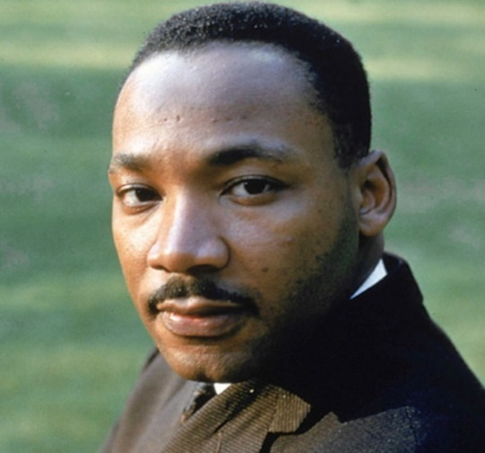
Person Power
Referent
  Uses the power of personal qualities, image and command of respect
  Does not rely of status or position
  It's based on the charisma and interpersonal skills of the power holder.
  Pros and cons will be covered
  in tutorials

Slide 42
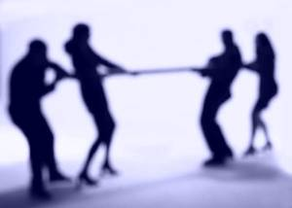
Organisational Power
Resource
  Based on ability to control tangible items or assets of an organisation (finance, property)
  Pros and cons will be covered in tutorials

Slide 43
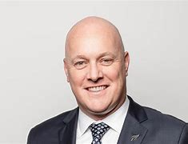
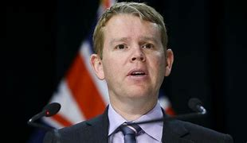
Organisational Power
Elected
  Power through democratic process or delegated authority
  Pros and cons will be covered in tutorials

Slide 44
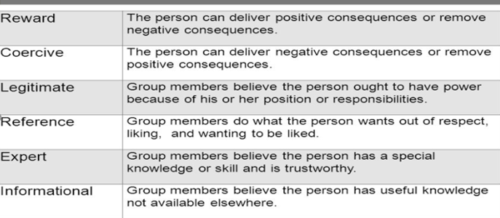
Sources of Power in an Organizational Context
(French & Raven, 1959)

Slide 45
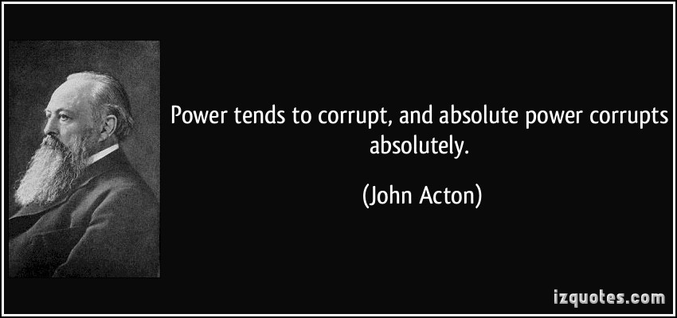
Using Power Properly

Slide 46
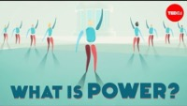
Power in a civic context

Slide 47
What Next?
Week 10:
Conflict and Conflict Management

