Slide 1
Organisation and Human Behaviour Perspectives
CLSY513
Semester 1, 2026
Week 8 Lecture:
Diversity and Inclusion
Intercultural Competence

Slide 2
Week 8 Lecture Content
Diversity in NZ Context
Diversity; Discrimination
Diversity and Inclusion
Cultural Intelligence (CQ)
Cross/Intercultural Competence
Diversity Management
Section 8 (Reflective Portfolio Part B): Diversity Statement
Guest Speakers:
Andrew Emery, Senior Lecturer
Dr Warren Goodsir, Head of School

Slide 3
Diversity in NZ Context
NZ’s population is diverse.
NZ Statistics/Information:
  Last Census 7 March 2023; NZ population recorded at 5,269,939; grew by about 300K from 2018 Census.
  Estimated Resident Population as at 31 December ‘25: 5,342,000
  Auckland population projected to reach 2 m by 2033; 2 in 5 Aucklanders born overseas. International migration driving population growth.
  Continues to diversify: Six major groups.
    Europeans largest 3.4 million; Asian and Maori largest increases between 2018 and 2023 Censuses.
  Official languages: English, Maori and Xxxx Xxxxxxxx
Notes:
Six major ethnic groups in NZ: European, Maori, Pacific peoples, Asian, MELAA. Middle Eastern, Latin American, African.
European ethnicities remain the largest at close to 3.4 million (3,383,742) people.
The Asian and Maori ethnic groups had the largest numeric increases between the 2018 and 2023 Censuses, up 153,978 people and 111,657 people respectively.
887,493 (17.8%) Maori; 861,576 (17.3%) Asian; 442,632 (8.9% Pacific peoples; 92,760 (1.9%) MELAA.
Official languages: English, Māori, and Sign Language.
Ethnic group populations overlap because people are allowed to self-identify with multiple ethnicities.
Refugee Quota 1,500 pa.

Slide 4
Diversity in NZ Context
NZ Migrant-receiving country
  Rich migration history: East Polynesians to reach NZ first, followed by early European explorers.
  Following ToW in 1840, British colony, immigrants predominantly from Britain, Ireland, and Australia. Exercised restrictive policies; limitations on non-European immigrants.
  Chinese arrived in 1866, gold rush period (1858-1880s).
  Immigration laws over the last three decades, since 1980s.
  Over 200 ethnicities; 170+ languages.
Notes:
Six major ethnic groups in NZ: European, Maori, Pacific peoples, Asian, MELAA. Middle Eastern, Latin American, African.
European ethnicities remain the largest at close to 3.4 million (3,383,742) people.
The Asian and Maori ethnic groups had the largest numeric increases between the 2018 and 2023 Censuses, up 153,978 people and 111,657 people respectively.
887,493 (17.8%) Maori; 861,576 (17.3%) Asian; 442,632 (8.9% Pacific peoples; 92,760 (1.9%) MELAA.
Official languages: English, Māori, and Sign Language.
Ethnic group populations overlap because people are allowed to self-identify with multiple ethnicities.
Refugee Quote 1,500 pa.

Slide 5
Diversity
The concept of diversity is about matters pertaining to difference and inclusion
(Prasad, Pringle, & Konrad, 2006)
Generally defined as acknowledging, understanding, accepting, and valuing differences among people with respect to primary and secondary dimensions, e.g. age, class, race, ethnicity, gender, disabilities, education, religion, appearance, work experience.
(Esty et al. 1995)
Notes:
Diversity explained – concept; a definition.
Pay attention to the words … inclusion of diffeernces, understanding, accepting, valuing …

Slide 6
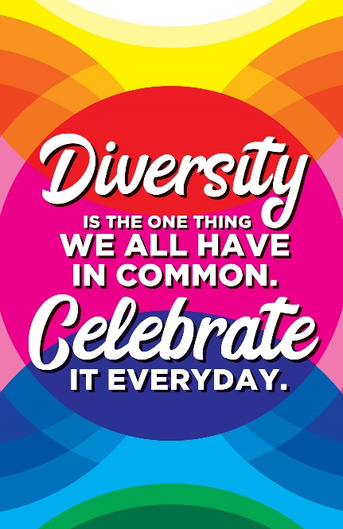
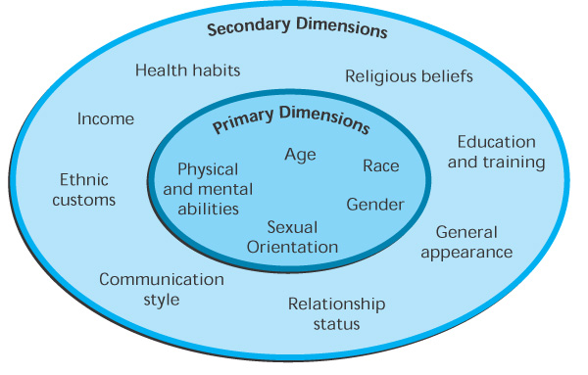
Diversity and Discrimination
Diversity
Differences among individuals/groups based on various characteristics eg race, ethnicity, gender, sexual orientation, age, religion, disability, socioeconomic status, other individual and social identities.
About acceptance, tolerance, Understanding, appreciation, uniqueness, inclusion.
Primary and Secondary Dimensions of Diversity.
Notes:
Diversity explained – concept; a definition.
Pay attention to the words … inclusion of diffeernces, understanding, accepting, valuing …

Slide 7
Diversity and Discrimination (cont.)
Discrimination and Concepts in connection with Diversity
What is discrimination?
  Unjust or prejudicial treatment of different categories of people.
  Biased behaviour; unequal or unfair treatment.
Common Concepts in Relation to Discrimination
  Racism
  Xenophobia
  Prejudice
  Ethnocentric
  Stereotyping
  Misogyny.
Notes:
Racism - the belief that different races possess distinct characteristics, abilities, or qualities, especially so as to distinguish them as inferior or superior to one another.
Xenophobia - dislike of or prejudice against people from other countries. Fear of strangers.
Prejudice - preconceived opinion that is not based on reason or actual experience: "prejudice against people from different backgrounds“
Ethnocentric – hold a belief that our own culture, ethnic group, race, etc. are superior to others. Such a belief develops out of socialization, we tend to believe that what we practice in our own culture is right, as opposed to the practices of the other cultures.
Stereotyping - a generalized belief about a particular category of people.. Stereotypes are sometimes overgeneralized (re behaviour, aptitude, abilities). Often inaccurate. Examples: Asians/Chinese bad drivers. Chinese good in maths. Pasifika good in sports.
Misogyny - is hatred of, contempt for, or prejudice against women. It is a form of sexism that keeps women at a lower social status (inferior status) than men. Misogyny widely practiced for thousands of years. An example of misogyny is violence against women, which includes domestic violence, sexual harassment, coercion, socially excluding women. Misogynistic comments, “a bit of Eurasian fluff” when describing Nadia Lim, a celebratory chef and qualified nutritionist, entrepreneur of My Food Bag. Very successful biz woman.

Slide 8
Discrimination
Denial of
Employment
Promotion
Training
Compensation
Job-related privileges
On the basis of
Primary diversity
Secondary diversity

Slide 9
Diversity and Inclusion in the Workplace
Importance of Diversity AND Inclusion in the Workplace – DuPont’s conviction/view.
https://youtu.be/uHYuDDHvU64
(2:31m)
“At DuPont, we understand that we can only truly fulfil our purpose with the full commitment, participation, creativity, energy, and cooperative spirit of a diverse workforce.”
“Diversity, equity and inclusion are central to our high-performing culture.”
Notes:
DuPont de Nemours, Inc., DuPont for short.
American multinational chemical company first formed in 1802.
Strong history of developing innovative products.
As of December 2014, it had 27,000 global patents, 5 National Medals of Science and Technology, and one Nobel Prize for its innovation.
DuPont is all about gathering great and diverse minds to solve global problems.
Operates in 50 different countries, including New Zealand.

Slide 10
Diversity and Inclusion in the Workplace
Diversity and Inclusion: What does diversity look like without inclusion?
https://youtu.be/64M6NoFM2RI
(2:04m)
Notes:
You can create and maintain an inclusive environment.
Realise that success depends on people taking different views.
Identify components of exclusion (ie discrimination) – ageism, racism, sexism, heterosexism (exclude eg same sex, gays), classism, ableism (exclude/discriminate against PwDisabilities), culturalism
Acceptance, unity, everyone matters.

Slide 11
Benefits of a Diverse and Inclusive Workforce
Different perspectives and ideas
Creativity and innovation
Customers’ needs and wants
Better understanding of the market
Employee satisfaction, engagement, sense of belonging, productivity, and retention.

Slide 12
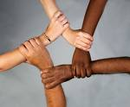
Understanding Diversity
Involves:
Ethics
Attitudes
Values
Trust
Respect
Cultural Intelligence (CQ)
Cross/Intercultural Competence

Slide 13
Cultural Intelligence (CQ)
First, what is Culture?
  abstract, complex, diverse, variable.
  ideas, customs, values, and social behaviour.
  a way of life; familial; generational.
  meaning, purpose, direction.
  socialised into a particular culture, through exposure, experience, and practice; learned (Wood et al. (2004).
  environmental effects; malleable.
Concepts and Definitions:
  Not genetically imprinted but “a learned set of shared perceptions about beliefs, values, norms and standards of behaviour” (Harris & Moran, 1991; Lustig & Koester, 1996).
  Common set of thoughts, beliefs and actions, distinguishing from one culture to another (Berry, 2004; Hofstede, 2001), eg traditions, rituals and practices, taboos (Harris & Moran, 1991).
  Shared values that help people understand which actions are considered acceptable and which are deemed unacceptable in society or organisations (Griffin & Moorhead, 2012).
Notes:
Screeds of research on culture.
Literature attests to the complexities of culture. Eg Griffin & Moorhead (2012).

Slide 14
Cultural Intelligence (CQ)
Cultural intelligence (CQ) is the ability to adapt to various cultural contexts. CQ is a combination of emotional and social intelligence that is acquired through the process of observing, analysing, and understanding how and why people function in different societal situations.
(Kannan, 2018)
At organisation level, CQ is activated through using sensitive and different ways of thinking and problem-solving. Ultimately, …
  improves work effectiveness in multicultural contexts.
  enhances trust between team members.
  requires flexibility in thinking, adaptability.
  leadership, and organisation effectiveness; profitability.
Notes:
This slide helps shed a little light on facets of importance of understanding, acquiring, and applying CQ in social/organisation interactions.
To acquire CQ, one must first understand that culture is multi-faceted; has a strong and enduring influence on one’s behaviour.

Slide 15
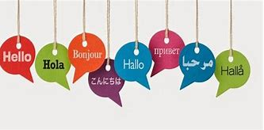
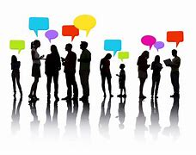
Cross/Intercultural Competence
“….is the ability to communicate effectively in cross-cultural situations and to relate appropriately in a variety of cultural contexts” (Bennett & Bennett, 2004, p. 149)
Communication
  Intrinsic human behaviour; primary social process (Porter & Samovar, 1994)
  Eastern v Western communication patterns
    Eastern (high-context culture)
    Western (low-context culture
Notes:
A large part of acquiring CQ is to understand the important role of communication.
Communication has pitfalls and difficulties even amongst people of the same culture; even amongst friends; family.
Considering the difficulties; think how much more difficult with i/c communication.
Eastern (high-context culture) – subtle, implicit, non-verbal, contextual sensitivity and appropriateness, intuitive. Favours verbal hesitance and ambiguity so not to offend; silence preferred; eloquent verbalisation of affection and compliments viewed with suspicion of authenticity. Feelings are intuitively apparent, need not be articulated.
Western (low-context culture)– primarily direct, explicit, verbal and underscored heavily by logical and rational perception, thinking, and articulation. Individuality expressed by way of verbal articulation and assertiveness. Generally, internal feelings verbalised and discussed clearly rather than comprehended intuitively.

Slide 16
Cultural Intelligence (CQ); Intercultural Competence
Communication - significance
  “the ability to communicate effectively in cross-cultural situations and to relate appropriately in a variety of cultural contexts” (Bennett & Bennett, 2004, p. 149)
  Eastern v Western communication patterns
    Eastern (high-context culture)
      Subtle, implicit, non-verbal, contextual sensitivity and appropriateness, intuitive.
      Favours verbal hesitance, ambiguity so not offensive; silence preferred; eloquent verbalisation of affection, compliments viewed with suspicion of authenticity.
      Feelings are intuitively apparent, need not be articulated.
    Western (low-context culture
      Primarily direct, explicit, verbal, underscored heavily by logical and rational perception, thinking, and articulation.
      Individuality expressed by way of verbal articulation and assertiveness.
      Generally, internal feelings verbalised and discussed clearly, rather than comprehended intuitively.
Notes:
A large part of acquiring CQ is to understand the important role of communication.
Communication has pitfalls and difficulties even amongst people of the same culture; even amongst friends; family.
Considering the difficulties; think how much more difficult with i/c communication.
Eastern (high-context culture) – subtle, implicit, non-verbal, contextual sensitivity and appropriateness, intuitive. Favours verbal hesitance and ambiguity so not to offend; silence preferred; eloquent verbalisation of affection and compliments viewed with suspicion of authenticity. Feelings are intuitively apparent, need not be articulated.
Western (low-context culture)– primarily direct, explicit, verbal and underscored heavily by logical and rational perception, thinking, and articulation. Individuality expressed by way of verbal articulation and assertiveness. Generally, internal feelings verbalised and discussed clearly rather than comprehended intuitively.

Slide 17
Importance of Cross/Intercultural Competence
Key capability for working and living effectively with people.
Establishes effective and positive relations.
Reduces organisational conflict.
Improved community relations.
Improves recruitment and retention rates.
(Hammer, 2012)

Slide 18
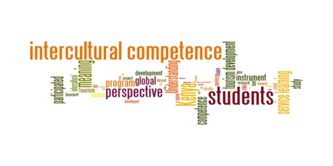
Cross/Intercultural Competence
Cultural Competence
https://youtu.be/2ugzWjl2tv0
(2:21m)
Notes:
Cultural Competence is the ability to understand, communicate and effectively interact with people across cultures.
Self-aware, adopt a positive view of cultural differences.
Acknowledges and acceptances of differences in appearance, behaviour and culture.
Respect. Open to listening and understanding others who are different.
Impossible for us to be an expert; don’t be afraid to acknowledge that.
Things you can do when interacting with people different from you …
Pay attention
Listen
Show interest
Truly understand their perspective
Withhold bias. Bias is linked to prejudice. Preconceived opinion about someone or something, w/o examining facts.

Slide 19
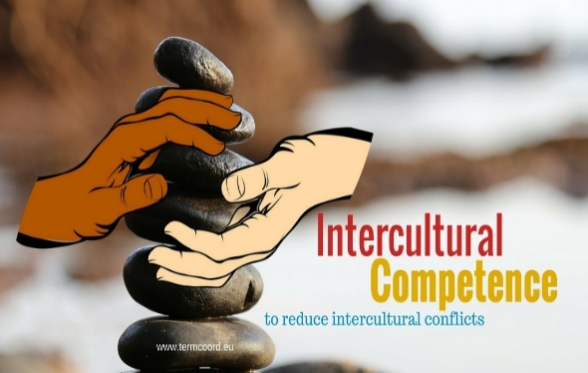
Improving Cultural Competence
Three Components
Knowledge
  Self awareness, grasp of issues/trends, socio-linguistic.
Skills
  Listening, observing, patience, viewing the world from others’ perspective.
Attitudes
  Respect (valuing other cultures), Openness (withholding judgement), Curiosity (viewing difference as a learning opportunity), Discovery (tolerance)
  (Deardorff, 2006)
Notes:
Three main components.

Slide 20
Managing Diversity
Diverse workforce
Organisational commitment
Employment practices
Training and development

Slide 21
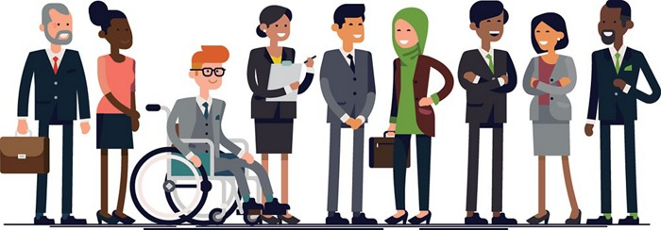
Diversity Management
…. is about:
  appreciating, valuing everyone’s uniqueness
  respecting differences
  encouraging every worker to make full contribution to the organization.
  Diversity management in organisations requires top-down commitment and investment, reflected in valuing diversity through implementing effective policies and practices, and providing training and development for all employees.

Slide 22
Section 8, Reflective Portfolio Part B:
Diversity Statement
Complete the following self-assessment for Section 8 of the Portfolio, Assessment 2.
https://myworldabroad.com/quizzes/gsa/10290
Reflective Questions:
What is my cultural diversity? My cultural perspective?
In what ways can I improve my intercultural competence that will benefit an organisation?
How can organisations create an environment that recognises the value of diversity?

Slide 23
Next Week: Week 9
Leadership Principles, and Power
Notes:
Week # 9 content leads in nicely to next week’s topic on Leadership.

