Slide 1
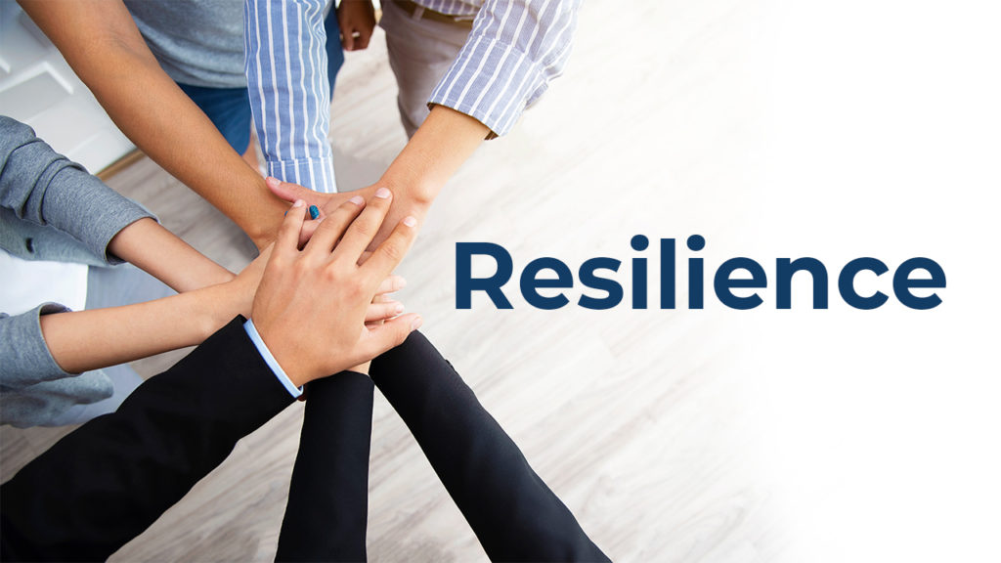
Organisation and Human Behaviour Perspectives
CLSY513
Semester 1, 2026
Week 7 Lecture

Slide 2
Lecture Content
Guest Speaker/s; Resilient People: Some Examples
Resilience?
  Definitions
  Psychological Resilience
  Personal Attributes/Key Characteristics
  Adult Personal Resilience
  Resilience and EQ/EI
  Resilience Training: Organisational Factors
  Resilience: Organisational Change
  Building Resilience in Times of Organisational Change
  Building Employee Resilience in Organisations
  Resilience at Work: Personal Resilience Building Blocks Model
  Resilience Training: A Skills-based Model of Personal Resilience
Secrets of Resilient People: Lucy Hone, Resilient Expert.

Slide 3
Resilient People,
Resilient Students
YKL-McIntyre Award
Brief Background of Award
Guest Speaker Ana Taio

Slide 4
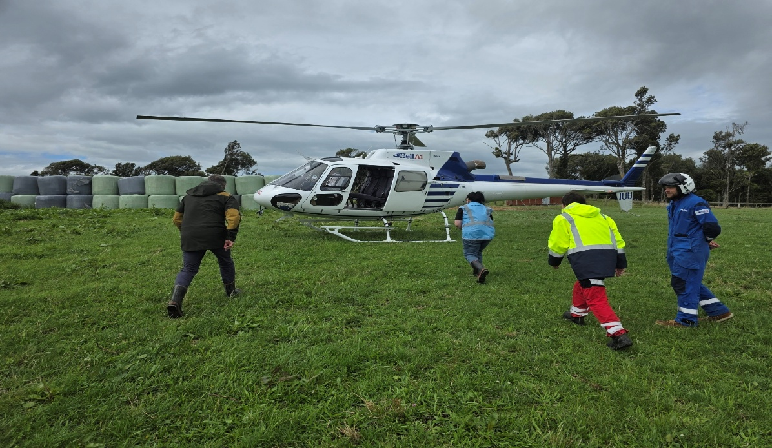
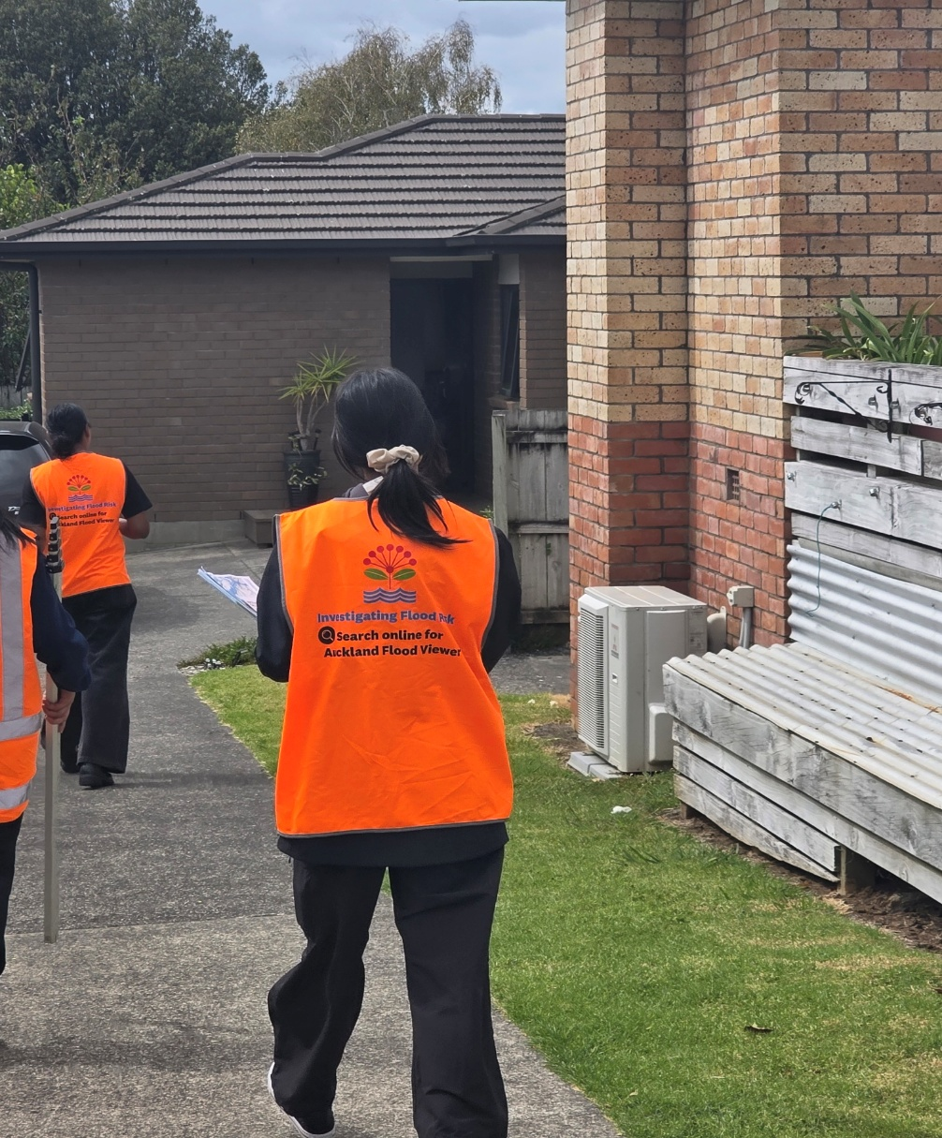
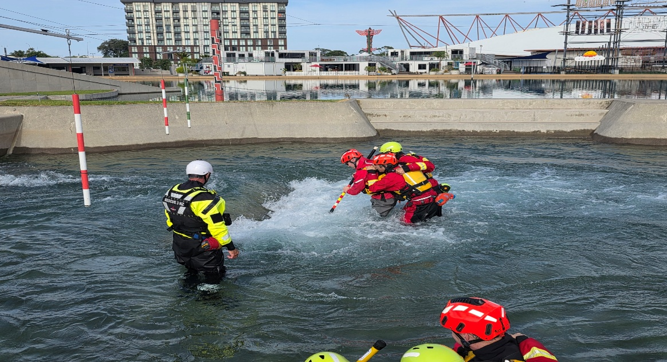
Dean Yee, Manager, Healthy Waters Network Compliance
Wāhanga mō ngā Waiora me te Manawaroa ā-Waipuke / Healthy Waters & Flood Resilience Department

Slide 5
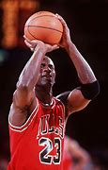
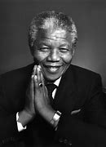


Resilient People: Some Examples
Michael Jordan, Athlete
Nelson Mandela, Leader
Bethany Hamilton, Surfer
Lady Gaga
Notes:
Michael Jordan, Athlete
Failed multiple times; dropped from his team in high school; coaches saw him as a slacker.
Refused to let the negatives get to him; kept practicing harder and harder.
Jordan said, “Never give up. I have failed over and over and over again in my life. [I didn’t give up.] And that is why I succeed.”
Nelson Mandela, Leader
Jailed for 27 years due to political persecution; made him more determined than ever that justice has to prevail.
Continued to oppose apartheid and stand for his beliefs (convictions).
Mandela said, “I am the master of my fate: I am the captain of my soul.”
Bethany Hamilton, Surfer
Born in Hawaii, started surfing at three years old; bitten by a shark at age 13, lost her arm.
Refused to let tragedy break her; winning huge championships and inspiring the world.
2011 film Soul Surfer chronicles her journey, showing her determination and grit.
Lady Gaga, Singer, Songwriter, Performer/Actress
A symbol of resilience;; very open about her many challenges and described how she bounced back
Suffered significant personal, physical and professional hardships.
Lady Gaga defines resilience not just as ‘bouncing back’ but as the disciplined effort to turn pain into art and advocacy.
Early in her career Gaga faced intense bullying, dropped by her first record label just three months after signing.
Gaga suffers from chronic illnesses. Accepts them and use mental toughness.
Early 2025 released Abracadabra is about resilience, about what it means to persevere. Play this song with lyrics?

Slide 6
What is Resilience?
Latin verb “resilire”, or “to leap back” (see Robertson, et al., 2015).
Stress and adversities are a part of human existence (Kaye-Kauderer, et al., 2021).
Research (see Baker, et al., 2021) shows a requirement to develop self-awareness, reflect and manage challenges and adversities.
Successful engagement – resilience – generates confidence in one’s ability to manage future threats and adversity (see Baker, et al., 2021).

Slide 7
What is Resilience? Definitions
Oxford English Dictionary
  Able to withstand or recover quickly from difficult conditions (in relation to people)
Scholarly
  … ability to bounce back from adversity, serious threat, or trauma (Feder, 2019; Kaye-Kauderer, et al., 2021; Southwick, 2018).
  … ‘the role of mental processes and behaviour in promoting personal assets and protecting an individual from the potential negative effect of stressors’ (Fletcher & Sarkar, 2013, p. 16).
  … ‘a combination of assets and resources within the individual and their environment that facilitate the individual’s capacity to adapt in the face of adversity’ (Tonkin et al., 2018, p. 108).

Slide 8
Psychological Resilience
What is Psychological Resilience?
  Ability to cope mentally and emotionally in a crisis, to recover, re-bound, adjust, thrive following misfortune (see Rees, et al., 2015).
Factors fostering/bolstering psychological resilience:
  Personal attributes: Self-efficacy, optimism, self-regulation/discipline, determination, adaptability.
  Social support: Vital role in providing emotional, informational, and tangible support
  Role of coaches: Offer emotional support, guidance, constructive feedback.
  Contribution of teammates: Offer encouragement, sense of belonging, camaraderie.
  Family support: Critical, protective factor. Emotional support, nurturing environment, understanding, encouragement.
  Wellbeing practices eg physical exercises, self-care activities.

Slide 9
Personal Attributes/
Key Characteristics
Mental toughness a protective factor in resilience process.
Self-esteem. Self-worth; buffers against negative impacts of challenging experiences.
Self-efficacy. Significant predictor of personal resilience.
Optimism. Tendency to hold positive expectations. Optimists demonstrate greater persistence.
Adaptability. Capacity to adjust thoughts, behaviours, and emotions in response to uncertainties.
Notes:
Self-efficacy is an individual’s belief that they can perform a selected task (Bandura, 1977, cited in Rees et al., 2015).
People who identify as having self-efficacy have lower levels of anxiety, better coping skills (Saks, 1994, cited in Rees et al., 2015).

Slide 10
Adult Personal Resilience
A definition: “Adult personal resilience is a multifaceted construct that includes a person’s determination and ability to endure, adapt, and recover from adversity.” (Taormina, 2015, p. 36)
Personal Resilience
  Ability to recover from adversities.
  Characteristics within a person, internal, intrapersonal
  Proactivity, persistence, and resourceful (eg seeking out support of others).
  Communication skills, problem-solving ability.
  Positivity, hopefulness.
  Multi-faceted: Four dimensions:
    Determination = willpower and firmness of purpose to persevere.
    Endurance = personal strength and fortitude.
    Adaptability = capacity to be flexible and resourceful, to cope, to adjust oneself in changing conditions.
    Recuperability = ability to recover, physically and cognitively, from harm, setbacks, difficulties.

Slide 11
Resilience and EQ/EI;
Emotional Intelligence (EQ/EI)
  Ability to understand one’s own emotional needs, providing insights ……. (see Jackson et al., 2007).
  Emotions shape a person’s reaction ……. (Salovey et al., 2004; Zajonc, 1998, cited in Schneider, et al., 2013).
  Positive Emotions
    Mitigate negative impact of stress.
    Positive emotions strategies include: (i) Adopt sense of gratitude, (ii) Embrace love; (iii) Savour joy; (iv) Reframe negative circumstances; (v) Spirituality.
  EQ enables people to regulate emotions to
    cope effectively with stress, perform well under pressure, and adjust to organisational change (Lopes et al., 2006, cited in Magnano et al., 2016),
    as they can “accurately perceive and appraise their emotions, know how and when to express their feelings” (Salovey, et al., 1999, p. 161, cited in Magnano et al., 2016).
  EQ is antecedent (prerequisite) to becoming resilient. Accurately perceiving, accessing and regulating emotions enable people to deal better with a stressful work environment, and achieve personal goals (Magnano, et al., 2016).
Notes:
Ability to understand one’s own emotional needs, providing insights into how to cope with stress and adversity, and spawn ideas for different ways of coping (see Jackson et al., 2007).
Emotions shape a person’s reaction to external stimuli, focus their attention, interpret harm or benefits, motivate them to respond to anticipated or actual events (Salovey et al., 2004; Zajonc, 1998, cited in Schneider, et al., 2013).
EQ enables people to regulate emotions to cope effectively with stress, perform well under pressure, and adjust to organisational change (Lopes et a., 2006, cited in Magnano et al., 2016), as they can “accurately perceive and appraise their emotions, know how and when to express their feelings” (Salovey, et al., 1999, p. 161, cited in Magnano et al., 2016).

Slide 12
Resilience Training;
Organisational Factors
Resilience Training (see Baker, et al., 2021)
  Benefits/outcomes – mental health improvements, optimism, self-efficacy, self-esteem, and positive emotions.
  Able to adapt to adversities, workplace pressures and demands; benefitting the individual/organisation.
Training and Organisational Support Factors (see Taormina, 2015)
  Assess employees’ strong or weak dimensions to determine which dimensions to strengthen.
  Increase employees’ affective commitment to enable them to be more resilient to setbacks.
  Organisational support necessary, ie positive treatment of employees increases affective commitment.
  Managers’ support correlates to employees’ resilience - enthusiastic workforce; organisational and individual benefit/s.

Slide 13
Resilience: Organisational Change
In organisational context, resilience refers to the capacity to bounce back from ….
Organisational large-scale change, such as new priorities, new leadership, new directions, new organisational strategies, major change initiatives, new technologies, mergers and acquisitions, and downsizing.
Adverse effects/impact on employees ….
Personal, emotional and psychological demands ….
Notes:
In organisational context, resilience described as the capacity to bounce back from both overwhelming positive and negative adversity/changes, such as increased responsibility.
Adverse effects/impact on employees. People often experience it as a disruption of their status quo, uncomfortable, stress and anxiety, and even threatening.
Personal, emotional and psychological demands: Requires employees to draw on inner strength and resourcefulness to cope with impact.

Slide 14
Building Resilience in Times of Organisational Change
Leadership and management engagement with employees.
Engage employees emotionally:
  Create a sense of urgency for the change.
  Communication transparency: Ensure the rationale and business case for the change is clearly understood.
  Training: Design effective training programmes to enable them to implement the new, or changed, processes and procedures.
Benefits to employees
  Less likely to become mentally or physically ill during adversity.
  Experience overall more hope, optimism, and positivity.
  Better able to cope with job demands, job loss and economic hardship.
  Better able to learn new skills and knowledge when their existing set becomes outdated.
  More able to turn adversity into personal growth, leverage it into new experiences for working and living.
Notes:
Warner, R., & April, K. (2012). Building personal resilience at work. Effective Executive, Vol. XV, No. 4, 53-68.

Slide 15
Building Employee Resilience in Organisations
Legal obligation to provide psychologically and physically safe working conditions under current occupational health and safety laws.
Interventions build resilient employees; experience lower levels of psychological distress. Require provision of resources, e.g. targeted training, guidance, support.
  Time commitment – employees and their supervisors/managers
  Financial commitment
  Deal with stigma
Notes:
Tonkin, et al. (2018). Building employee resilience through wellbeing in organisations. Human Resource Dev Quarterly, 29, 107-124. doi: 10.1002/hrdq.21306.

Slide 16
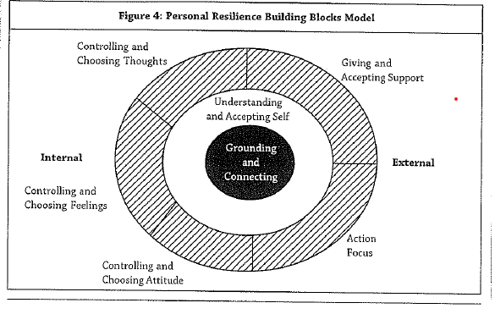
Resilience at Work
Personal Resilience Building Blocks Model
  Figure 4, p. 59, Warner & April (2012).
  Fig 4, p. 59, Warner & April (2012).
  Building personal resilience at work. Effective Executive, Vol. XV, No. 4, 53-68.
Model will be explained in Week 7 Tutorial.
Notes:
Warner, R., & April, K. (2012). Building personal resilience at work. Effective Executive, Vol. XV, No. 4, 53-68.

Slide 17
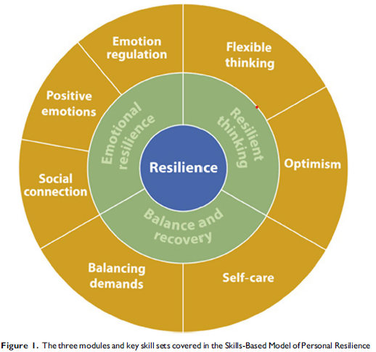
Resilience Training: A Skills-based Model of Personal Resilience
Fig 1, Baker et al. 2021, p. 464
Three Modules: Emotional Resilience, Resilient Thinking, and Resilient Behaviours - Balance and Recovery. Will be covered in tutorial.
Notes:
*Baker, F. R. L., Baker, K. L., & Burrell, J. (2021). Special Issue Paper. Introducing the skills-based model of personal resilience: Drawing on content and process factors to build resilience in the workplace. Journal of Occupational and Organisational Psychology, 94, 458-481. DOI: 10.1111/joop.12340.

Slide 18
Secrets of Resilient People
Lucy Hone: The three secrets of resilient people | TED Talk
Start from 2:22; finish at 14:56
In this powerful and personal talk (2.3 million views to date), Lucy Hone, resilient expert, talks about resilience as an essential survival skill. Lucy shares three strategies which got her through unimaginable tragedy.

Slide 19
Portfolio Part B: Section 7
Resilience Questionnaire
  Link to questionnaire in a tutorial slide.
  Reflective Questions in tutorial slide.
  Time allocated to guide and assist students in questionnaire completion in tutorial.

Slide 20
Next Week: Week 8
Diversity and Inclusion

