Slide 1

Chapter 08
Joints and Movement
Seeley’s
ANATOMY & PHYSIOLOGY Thirteenth Edition
Cinnamon VanPutte, Jennifer Regan, Andrew Russo
© 2023 McGraw Hill, LLC. All rights reserved. Authorized only for instructor use in the classroom.
No reproduction or further distribution permitted without the prior written consent of McGraw Hill, LLC.

Slide 2
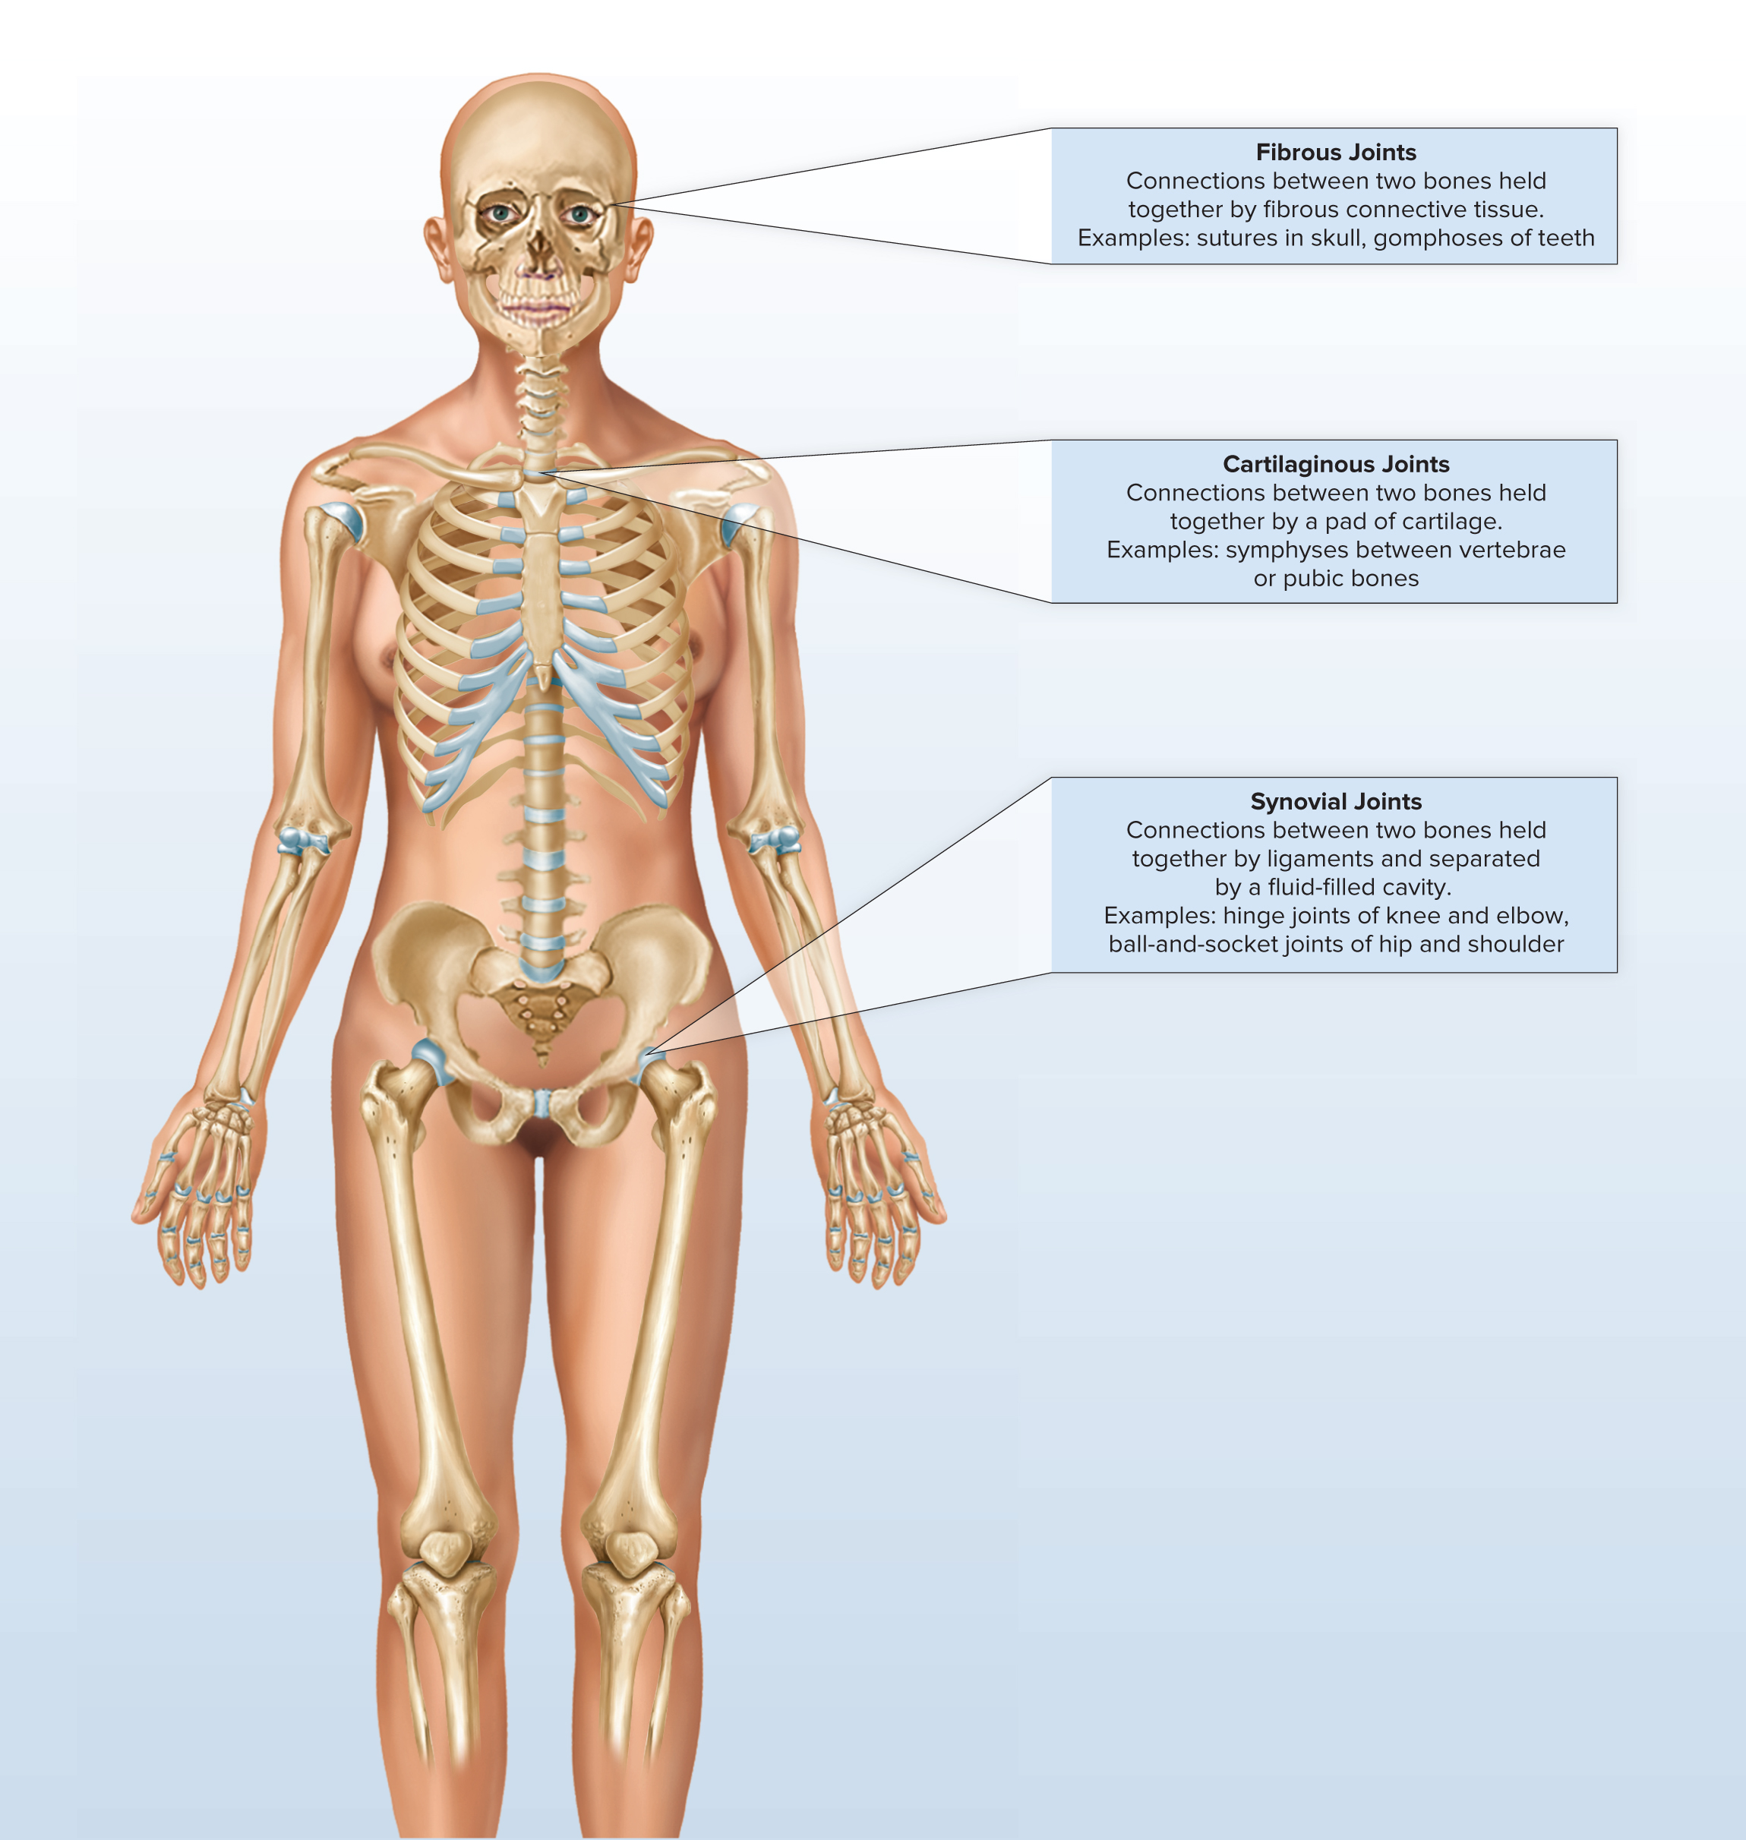
Lecture Outline
Joints are part of the musculoskeletal system and are integral to the body’s structural stability as well as its ability to move.
Access the text alternative for slide images.

Slide 3
8.1 Classes of Joints
Structural: based on major connective tissue type that binds bones.
  Fibrous.
  Cartilaginous.
  Synovial.
Functional: based on degree of motion.
  Synarthrosis: non-movable.
  Amphiarthrosis: slightly movable.
  Diarthrosis: freely movable.

Slide 4
Fibrous Joints
Characteristics.
  United by fibrous connective tissue.
  Have no joint cavity.
  Exhibit little to no movement.
Types: Sutures, Syndesmoses, Gomphoses.

Slide 5
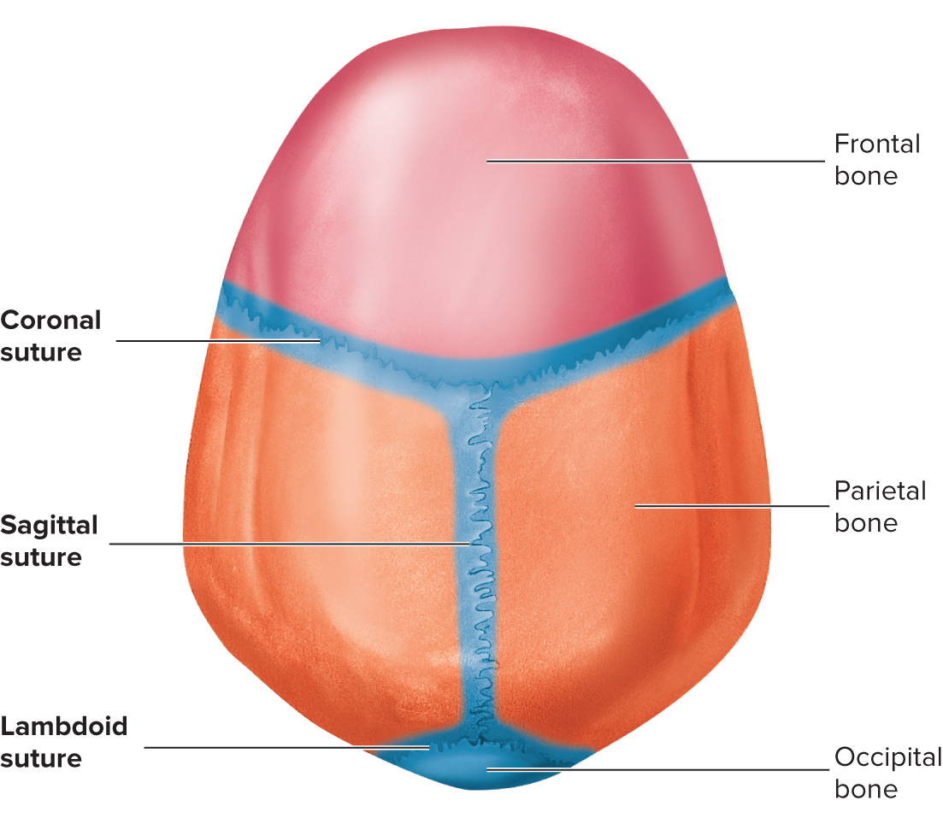
Fibrous Joints: Sutures
Opposing bones of the skull interdigitate.
Periosteum of one bone is continuous with the periosteum of the other.
Sutural ligament: two periostea plus dense, fibrous, connective tissue between.
In adults may ossify completely: synostosis.
Fontanels: membranous areas in the suture between bones. Allow change in shape of head during birth and rapid growth of the brain after birth.

Slide 6
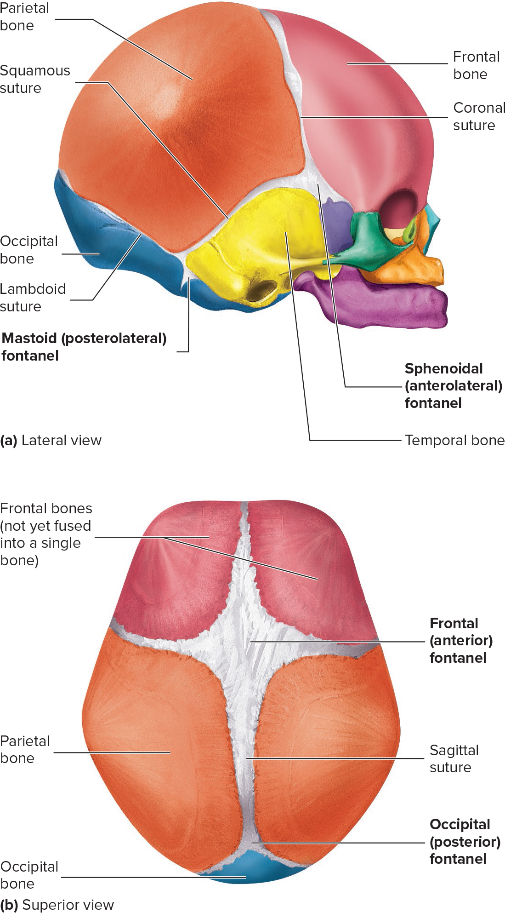
Fetal Skull Showing Fontanels and Sutures
Access the text alternative for slide images.

Slide 7
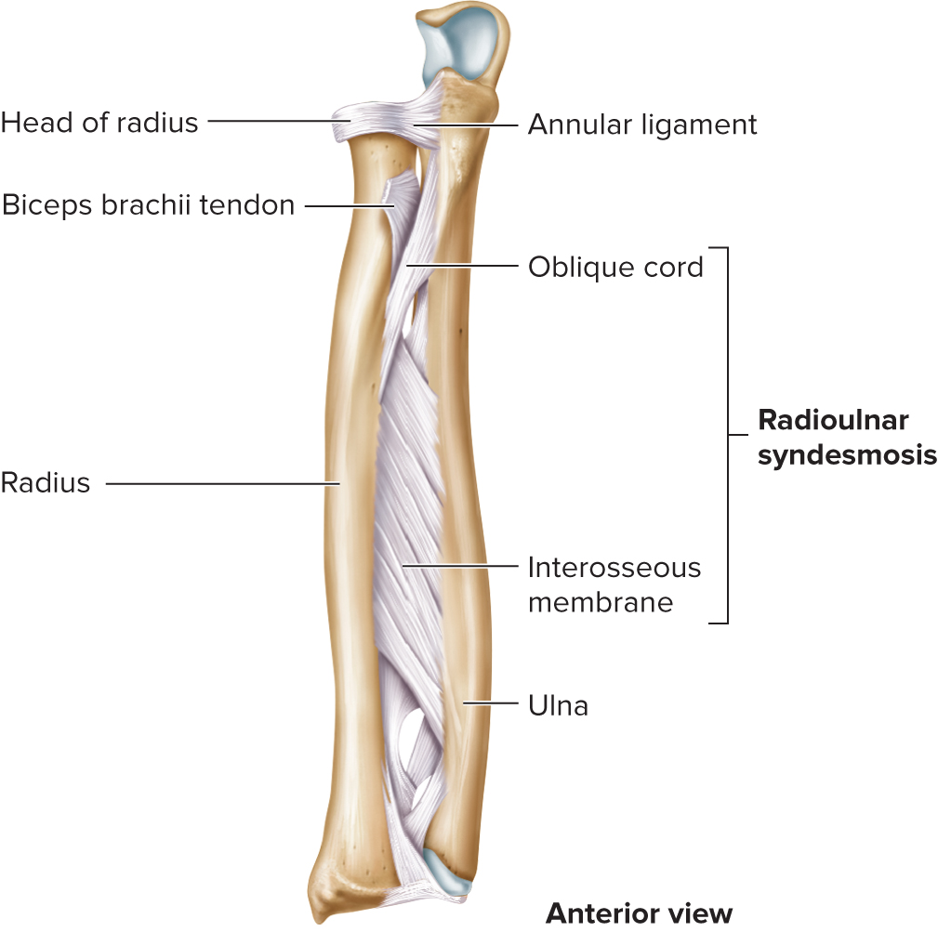
Fibrous Joints: Syndesmoses
Bones farther apart than suture and joined by ligaments.
Some movement may occur.
Example: radioulnar (interosseus membrane).
Access the text alternative for slide images.

Slide 8
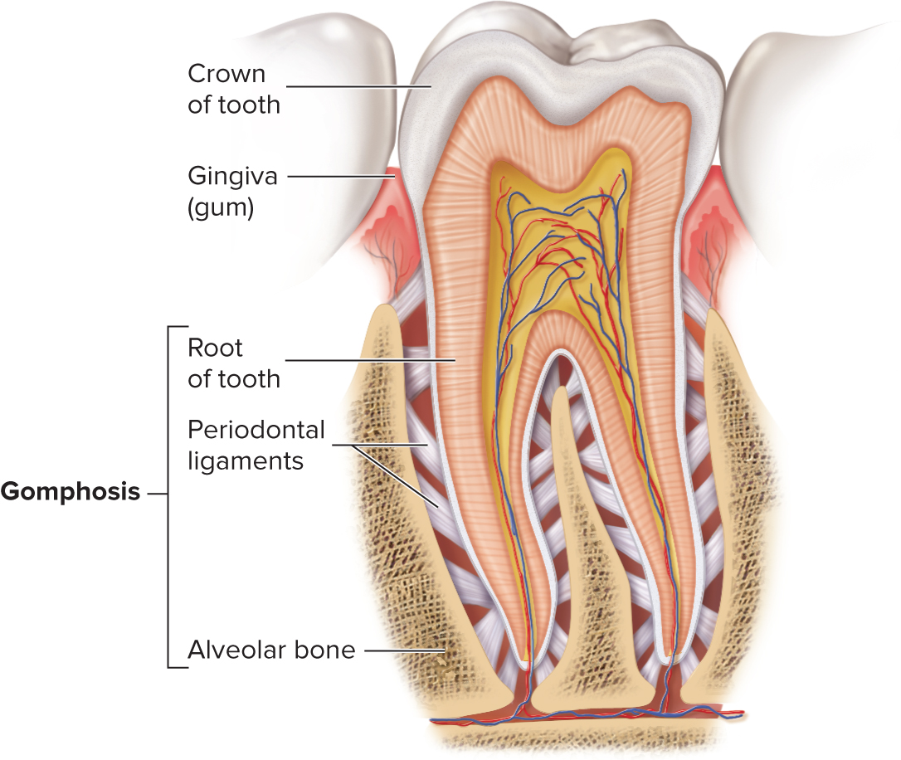
Fibrous Joints: Gomphoses
Specialized joints.
Pegs that fit into sockets.
Periodontal ligaments: hold teeth in place.
Inflammations.
  Gingivitis leads to…
  Periodontal disease.
Access the text alternative for slide images.

Slide 9
Cartilaginous Joints
Unite two bones by pad of cartilage.
Types:
  Synchondroses: contain hyaline cartilage.
  Symphyses: contain fibrocartilage.

Slide 10
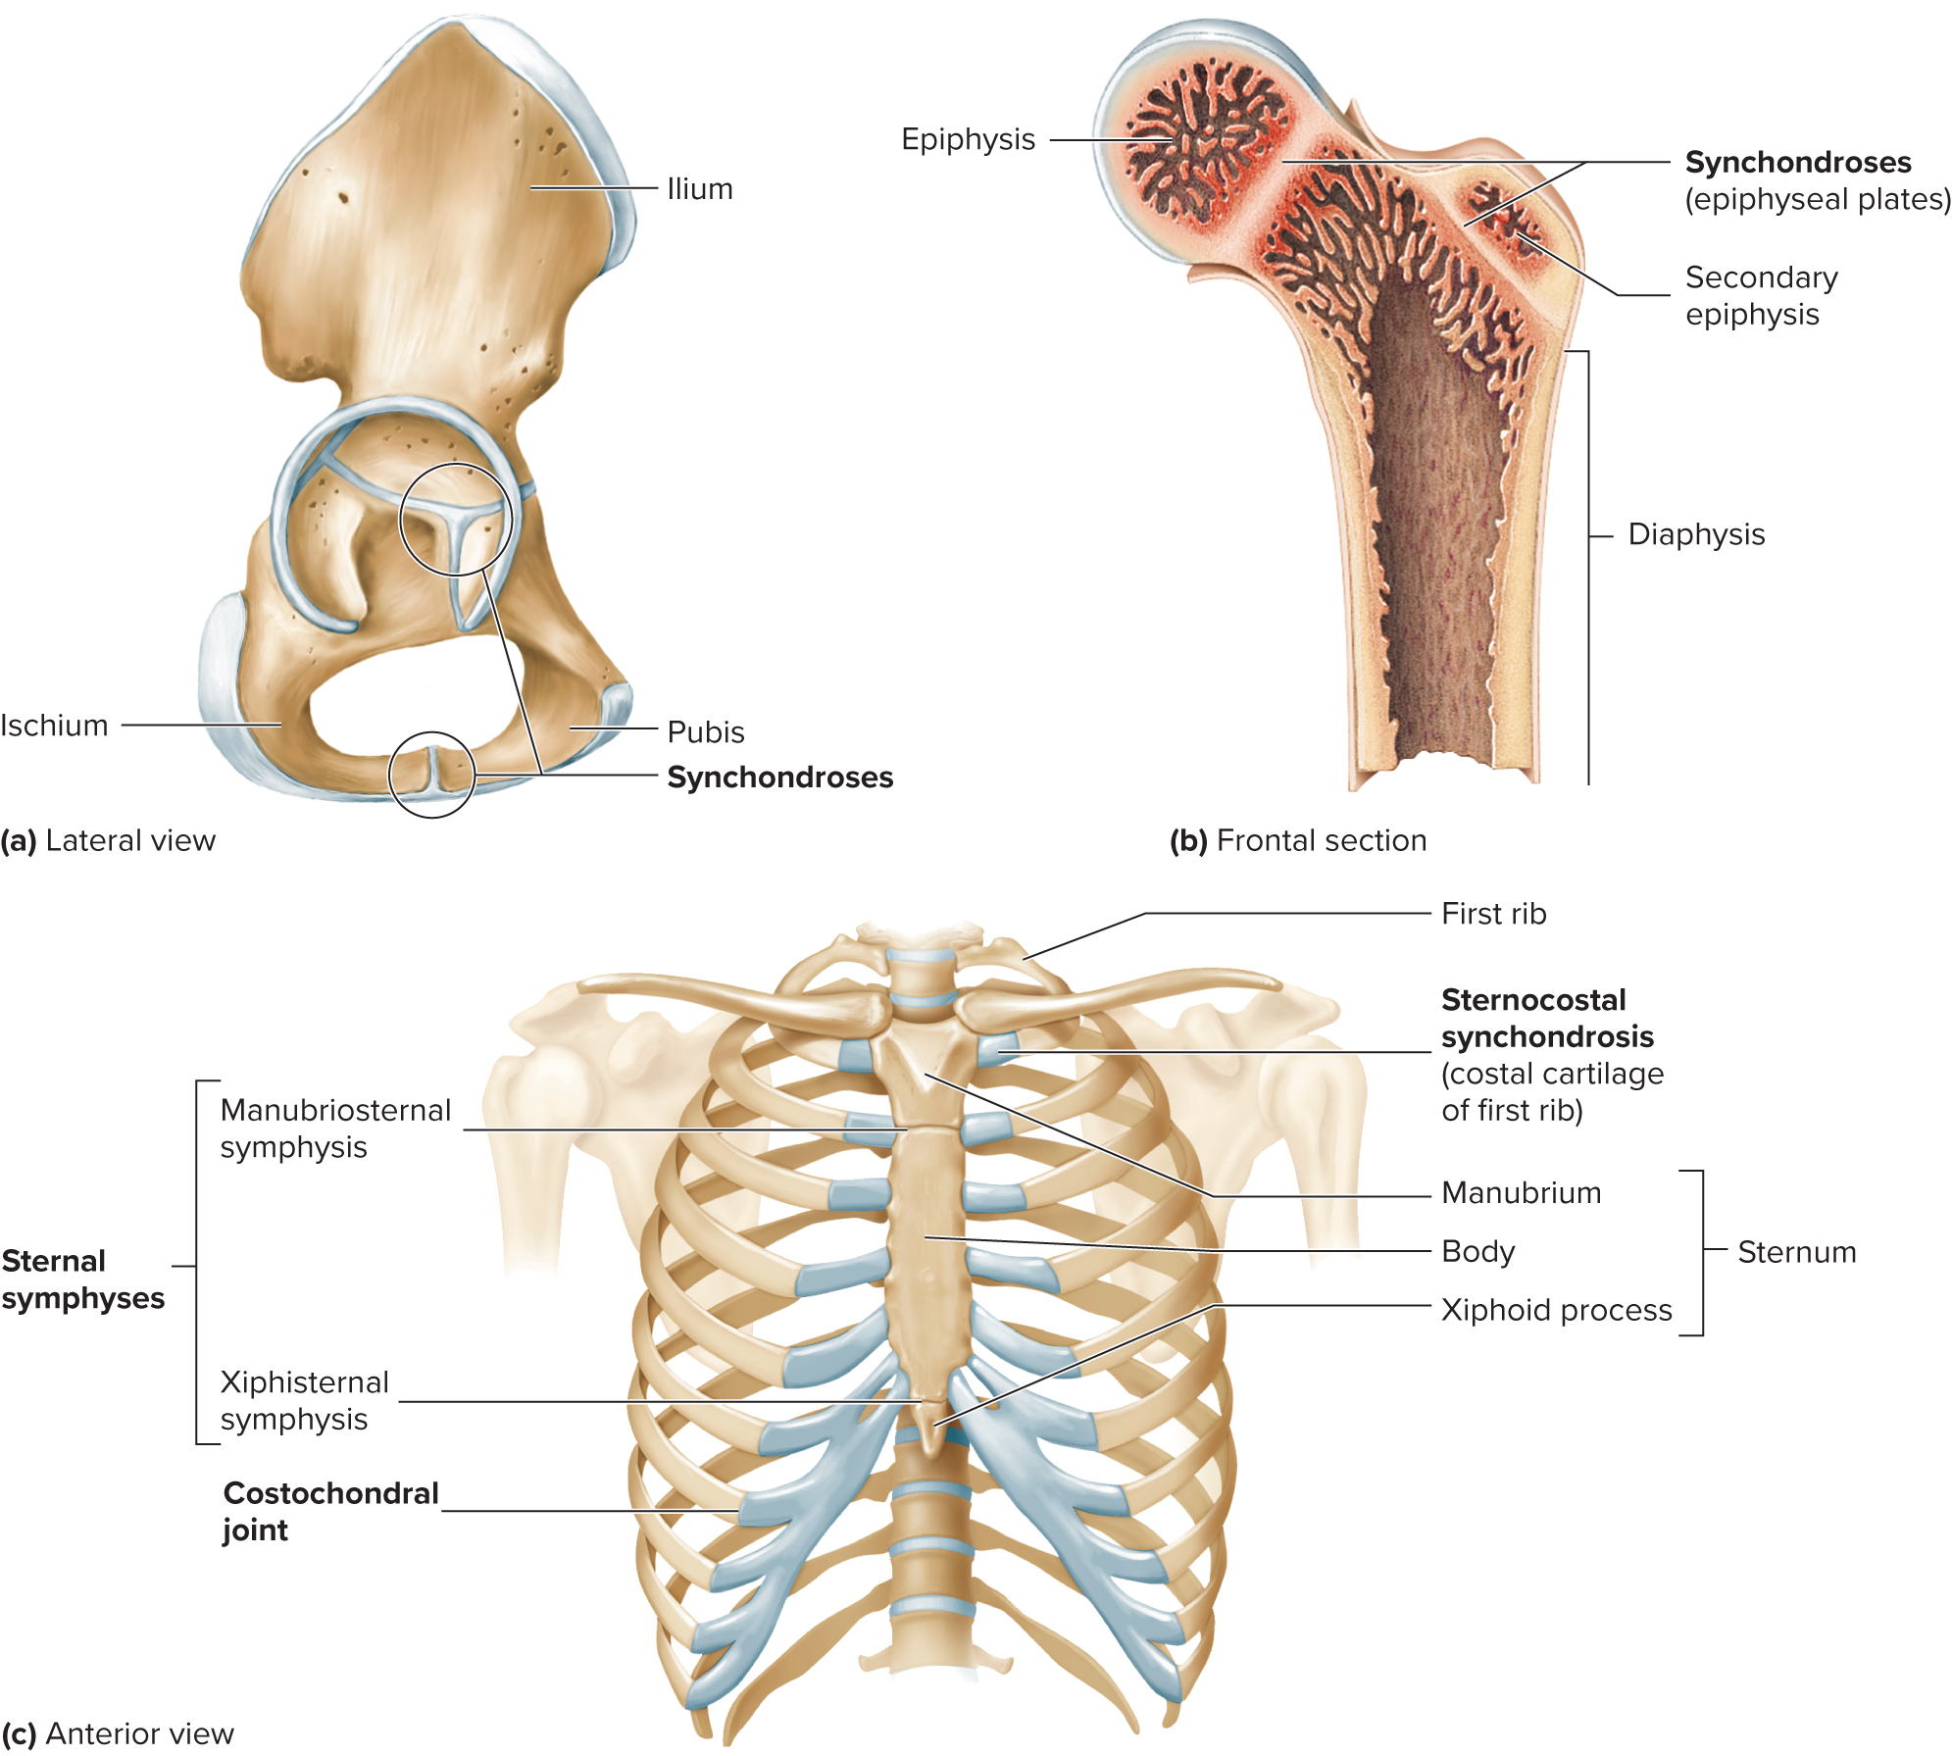
Cartilaginous Joints: Synchondroses
Joined by hyaline cartilage.
Little or no movement.
Some are temporary and are replaced by synostoses.
Some are permanent.
Some like costochondral joints develop into synovial joints.
Examples: Epiphyseal plates, sternocostal, sphenooccipital.
Access the text alternative for slide images.

Slide 11
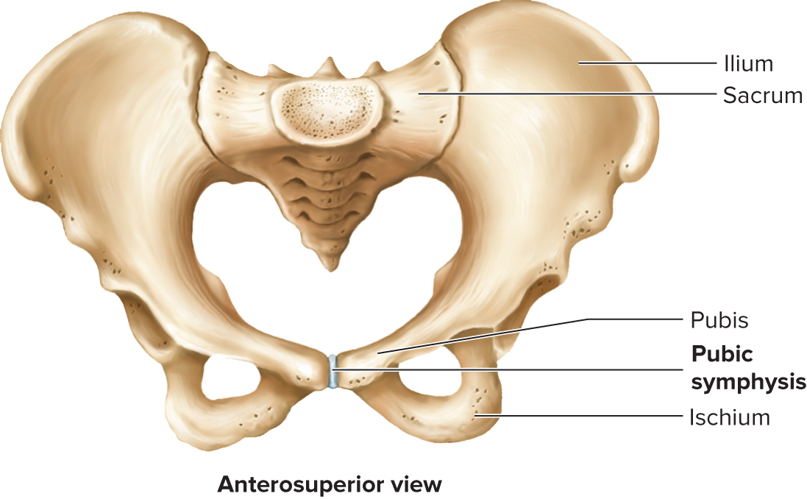
Cartilaginous Joints: Symphyses
Fibrocartilage uniting two bones.
Slightly movable.
Examples: symphysis pubis, between the manubrium sternum and the body of the sternum, intervertebral disks.
Access the text alternative for slide images.

Slide 12
Synovial Joints 1
Contain synovial fluid.
Allow considerable movement.
Most joints that unite bones of appendicular skeleton reflecting greater mobility of appendicular skeleton compared to axial.
Complex compared to other structural joints.

Slide 13
Synovial Joints 2
Articular cartilage: hyaline; provides smooth surface.
Joint cavity: synovial; encloses articular surfaces.
Capsule.
  Fibrous capsule: dense irregular connective tissue, continuous with fibrous layer of the periosteum. Portions may thicken to form ligaments.
  Synovial membrane and fluid: membrane lines inside of joint capsule except at actual articulation of articular cartilages. Thin, delicate. Sometimes separated from fibrous capsule by areolar C.T. and fat, sometimes merged with fibrous.
Synovial fluid: complex mixture of polysaccharides, proteins, fat and cells. Hyaluronic acid- slippery.
No blood vessels or nerves in articular cartilages; nutrients from nearby blood vessels and synovial fluid.
Nerves in capsule help brain know position of joints.

Slide 14
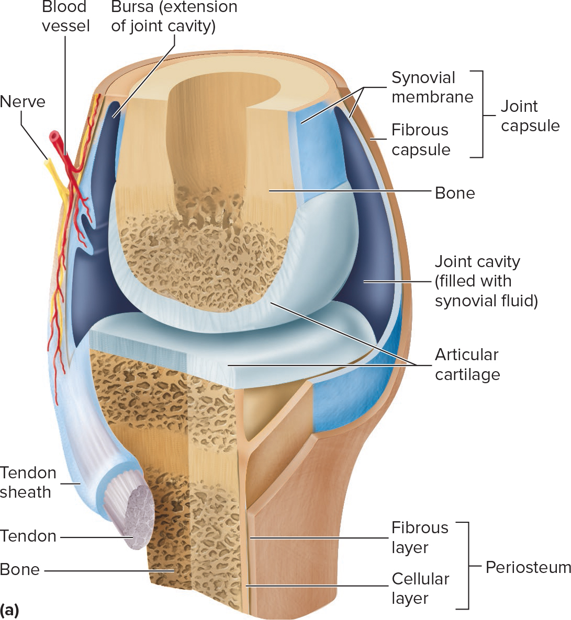
General Structure of a Synovial Joint
Access the text alternative for slide images.

Slide 15
Accessory Structures
Bursae.
  Pockets of synovial membrane and fluid that extend from the joint. Found in areas of friction.
  Bursitis is inflammation of a bursa.
Ligaments and tendons: stabilization.
Articular discs: temperomandibular, sternoclavicular, acromioclavicular.
Menisci: fibrocartilaginous pads in the knee.
Tendon sheaths: synovial sacs that surround tendons as they pass near or over bone.

Slide 16
Types of Synovial joints
Six types:
  Plane, saddle, hinge, pivot, ball-and-socket, ellipsoid.
Movements described as:
  Uniaxial: occurring around one axis.
  Biaxial: occurring around two axes at right angles to each other.
  Multiaxial: occurring around several axes.

Slide 17
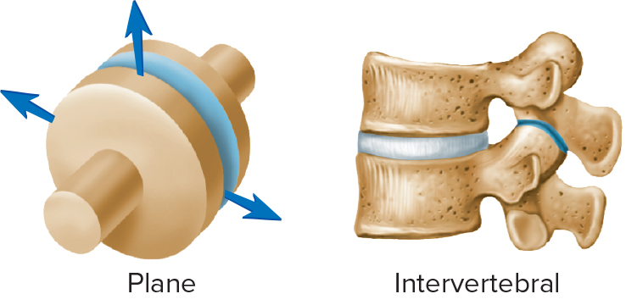
Plane and Saddle Joints 1
TABLE 8.4 Synovial joints
Class and Example of Joint | Bones Joined | Movement
Plane
Intervertebral | Between articular processes of adjacent vertebrae | Uniaxial; slight
Acromioclavicular | Acromion process of scapula and clavicle | Uniaxial; slight
Carpometacarpal | Carpals and metacarpals 2–5 | Uniaxial; slight
Costovertebral | Ribs and vertebrae | Uniaxial; slight
Intercarpal | Between carpal bones | Uniaxial; slight
Intermetatarsal | Between metatarsal bones | Uniaxial; slight
Intertarsal | Between tarsal bones | Uniaxial; slight
Sacroiliac | Between sacrum and hip bone (complex joint with several planes and synchondroses) | Uniaxial; slight
Tarsometatarsal | Tarsal bones and metatarsal bones | Uniaxial; slight
Access the text alternative for slide images.

Slide 18
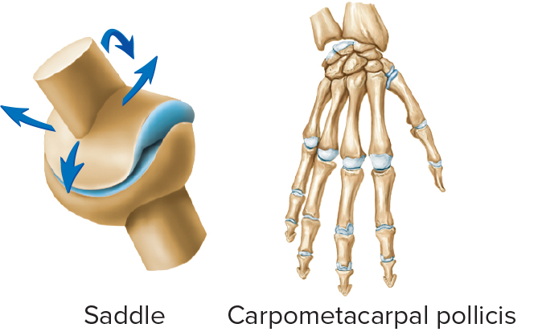
Plane and Saddle Joints 2
TABLE 8.4 Synovial joints
Class and Example of Joint | Bones Joined | Movement
Saddle
Carpometacarpal pollicis | Carpal and metacarpal of thumb | Biaxial
Sternoclavicular | Manubrium of sternum and clavicle | Multiaxial; slight
Access the text alternative for slide images.

Slide 19
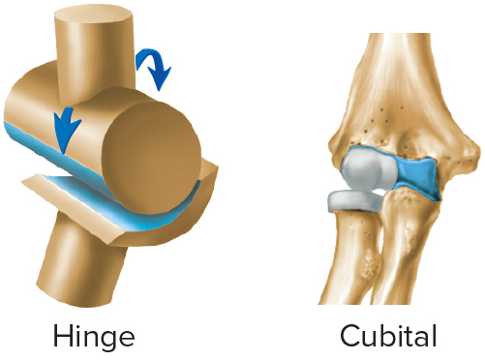
Hinge and Pivot Joints 1
TABLE 8.4 Synovial joints
Class and Example of Joint | Bones Joined | Movement
Hinge
Cubital (elbow) | Humerus, ulna, and radius | Uniaxial
Knee | Femur and tibia | Uniaxial
Interphalangeal | Between phalanges | Uniaxial
Talocrural (ankle) | Talus, tibia, and fibula | Multiaxial; one predominates
Access the text alternative for slide images.

Slide 20
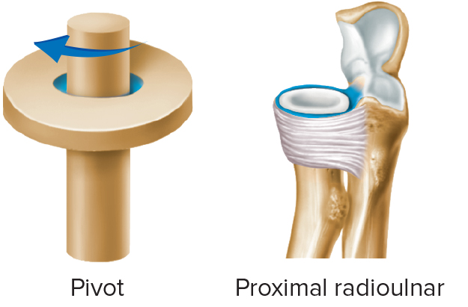
Hinge and Pivot Joints 2
TABLE 8.4 Synovial joints
Class and Example of Joint | Bones Joined | Movement
Pivot
Atlantoaxial | Atlas and axis | Uniaxial rotation
Proximal radioulnar | Radius and ulna | Uniaxial rotation
Distal radioulnar | Radius and ulna | Uniaxial rotation
Access the text alternative for slide images.

Slide 21
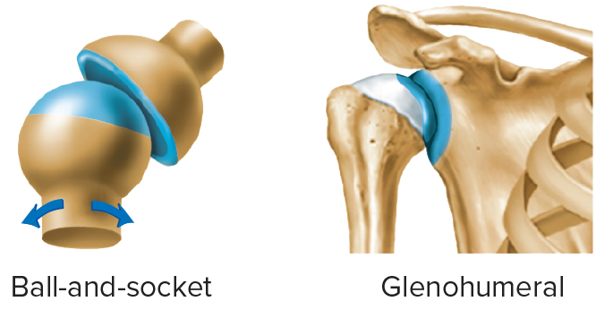
Ball-and-Socket and Ellipsoid Joints 1
TABLE 8.4 Synovial joints
Class and Example of Joint | Bones Joined | Movement
Ball-and-Socket
Glenohumeral (shoulder) | Scapula and humerus | Multiaxial
Hip | Hip bone and femur | Multiaxial
Access the text alternative for slide images.

Slide 22
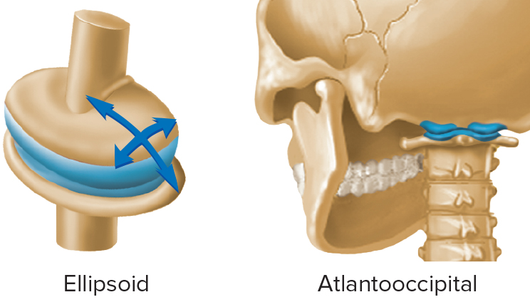
Ball-and-Socket and Ellipsoid Joints 2
TABLE 8.4 Synovial joints
Class and Example of Joint | Bones Joined | Movement
Ellipsoid
Atlantooccipital | Atlas and occipital bone | Biaxial
Metacarpophalangeal (knuckles) | Metacarpal bones and phalanges | Biaxial
Metatarsophalangeal (ball of foot) | Metatarsal bones and phalanges | Biaxial
Radiocarpal (wrist) | Radius and carpal bones | Multiaxial
Temporomandibular | Mandible and temporal bone | Multiaxial; one predominates
Access the text alternative for slide images.

Slide 23
8.2 Types of Movement
Gliding: in plane joints; slight movement.
Angular: angle between bones changes
  Flexion and Extension.
    Hyperextension.
    Plantar flexion and Dorsiflexion.
  Abduction and Adduction: away from or toward the midline.
Circular: rotation around an axis
  Rotation: turning around the long axis
  Pronation and Supination: unique forearm movements
  Circumduction.
Special movements

Slide 24
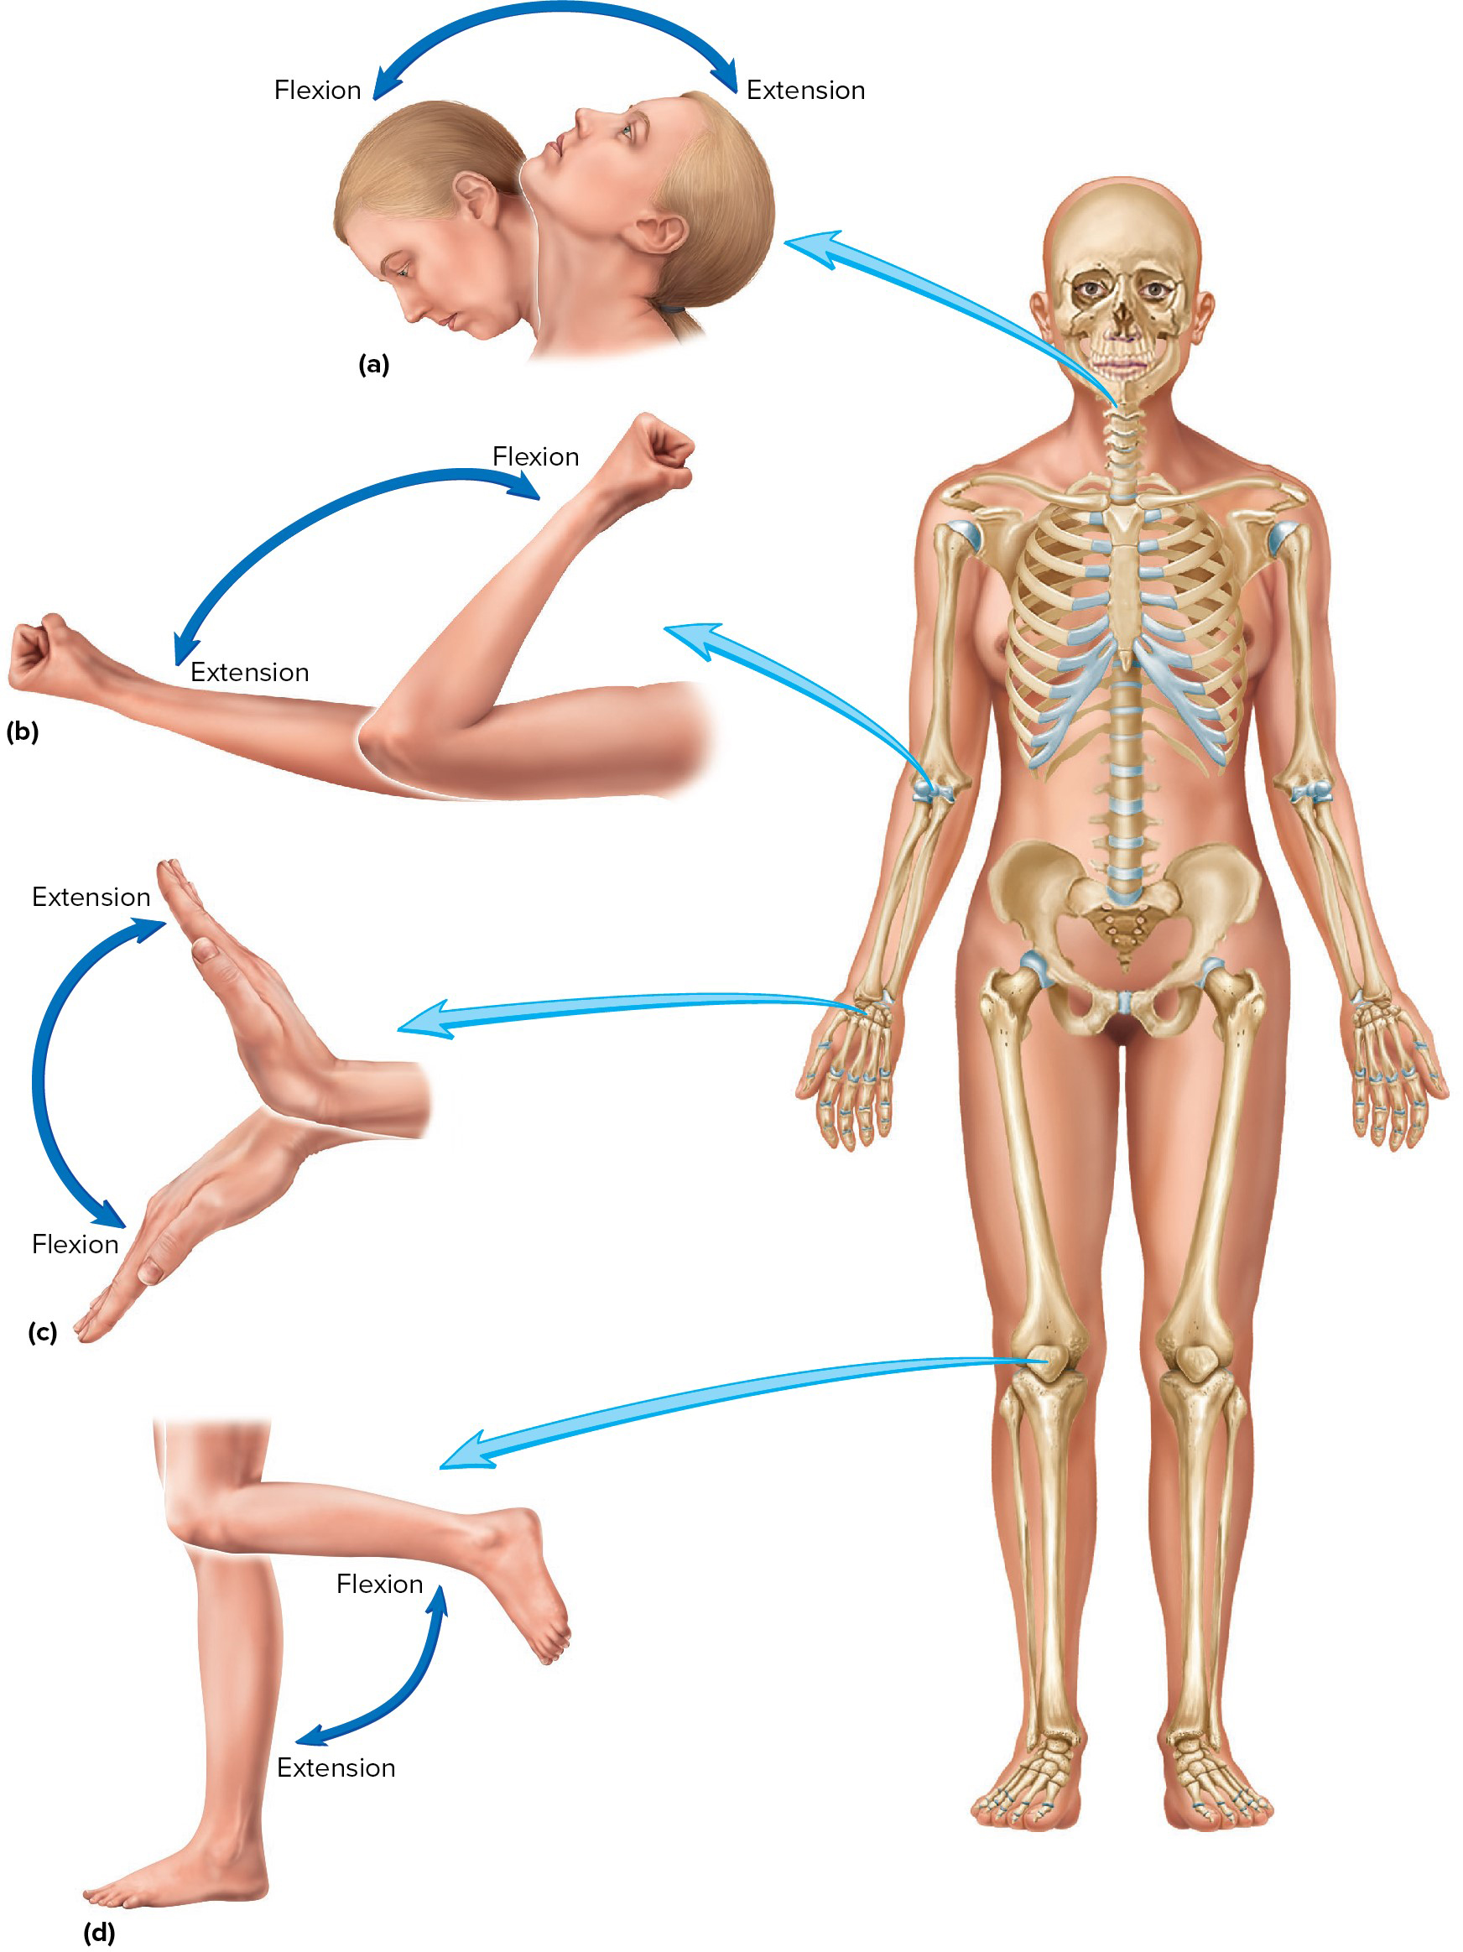
Flexion and Extension
Flexion: movement of a body part anterior to the coronal plane.
Extension: movement of a body part posterior to the coronal plane.
Access the text alternative for slide images.

Slide 25
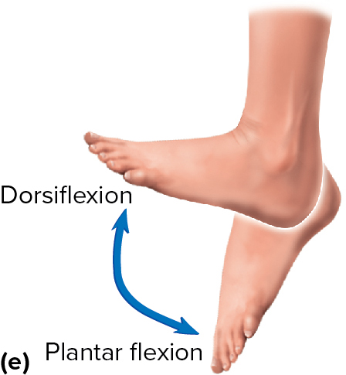
Dorsiflexion and Plantar Flexion of the Foot
Special angular movements of the foot.
Plantar flexion: standing on the toes.
Dorsiflexion: foot lifted toward the shin.

Slide 26
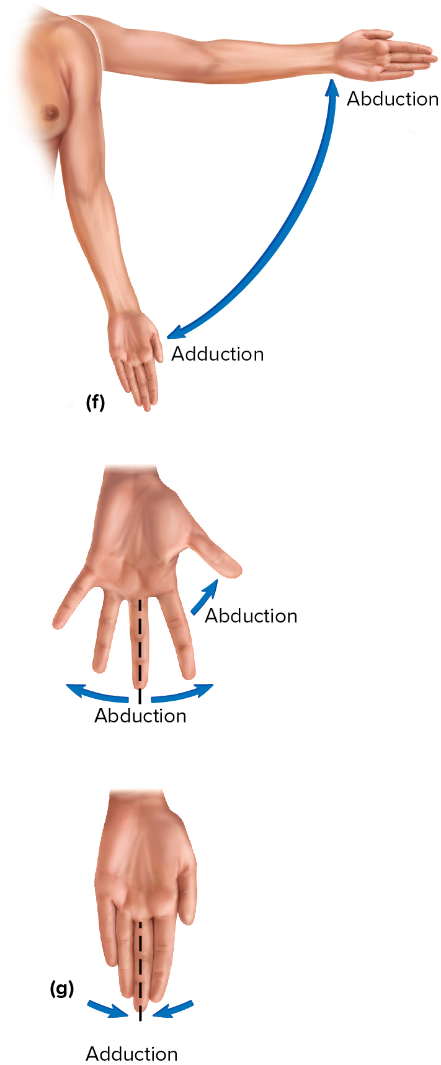
Abduction and Adduction
Abduction: movement away from the median plane.
Adduction: movement toward the median plane.
Access the text alternative for slide images.

Slide 27
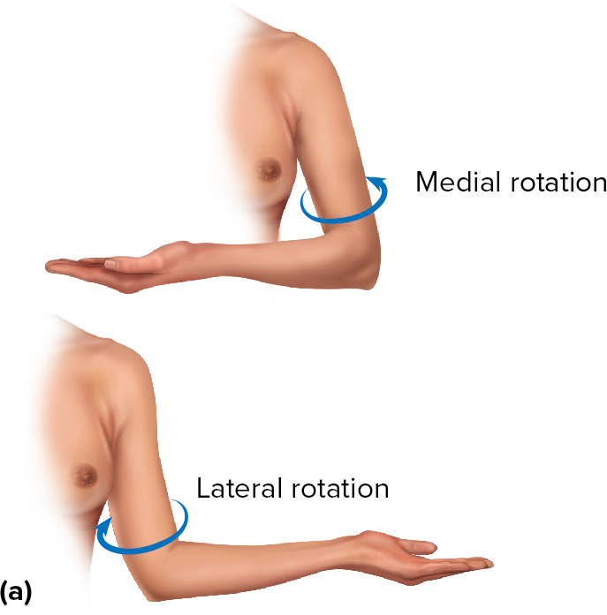
Circular Movements: Rotation
Rotation: turning of a structure on its long axis.
  Examples: rotation of the head, humerus, entire body.
  Medial and lateral rotation; example, the rotation of the arm.

Slide 28
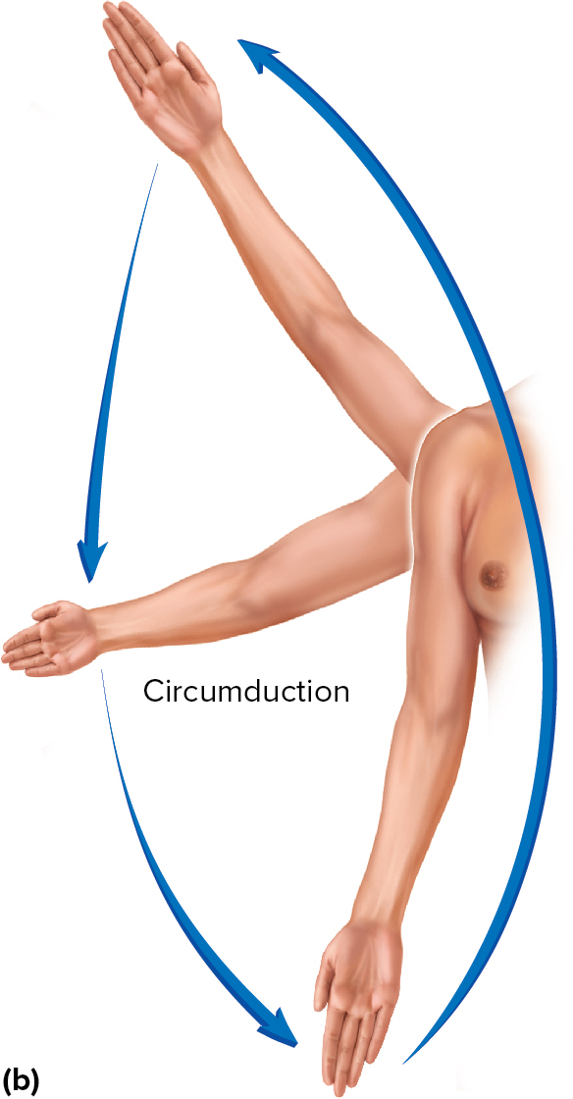
Circular Movements: Circumduction
Circumduction.
  Combination of flexion, extension, abduction, adduction.
  Appendage describes a cone.

Slide 29
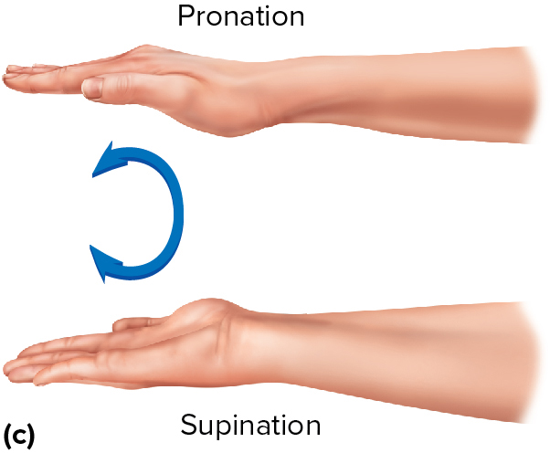
Pronation and Supination of the Forearm
Pronation/Supination: refer to unique rotation of the forearm.
  Pronation: palm faces posteriorly.
  Supination: palm faces anteriorly.

Slide 30
Special Movements
Unique to only one or two joints and don’t fit into other categories.
Types.
  Elevation and Depression.
  Protraction and Retraction.
  Excursion.
  Opposition and Reposition.
  Inversion and Eversion.
  Combination movements.

Slide 31
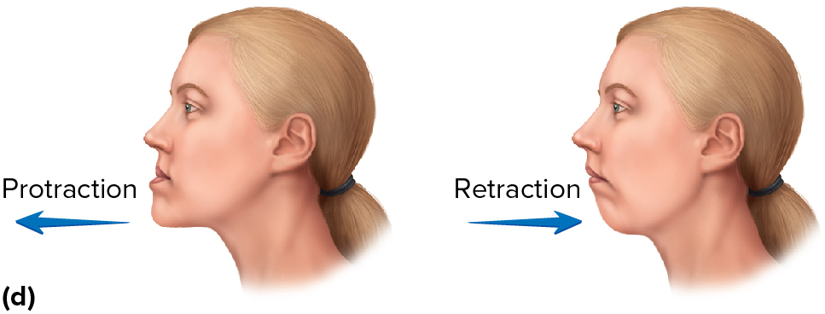
Protraction and Retraction
Protraction: gliding motion anteriorly.
Retraction: moves structure back to anatomic position or even further posteriorly.
Examples: scapulae and mandibles.

Slide 32
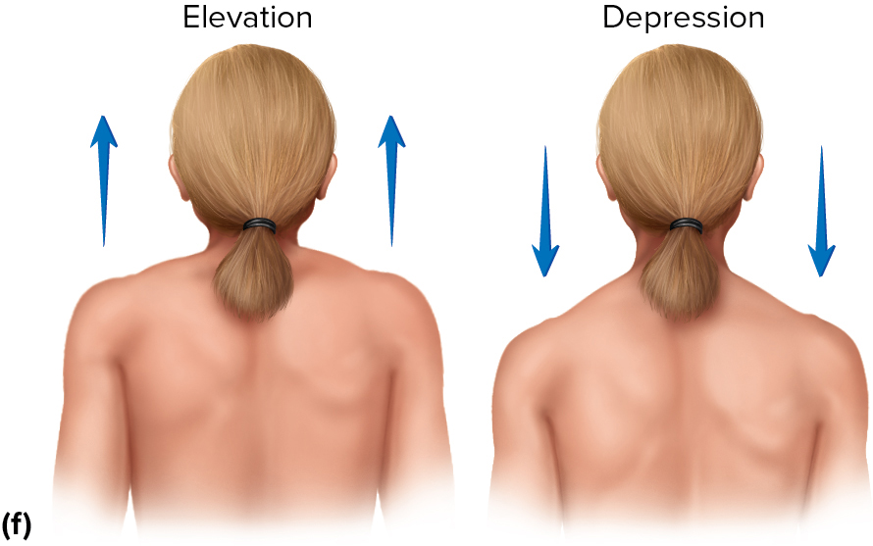
Elevation and Depression
Elevation: moves a structure superior.
Depression: moves a structure inferior.
Examples: shrugging the shoulders, opening and closing the mouth.

Slide 33
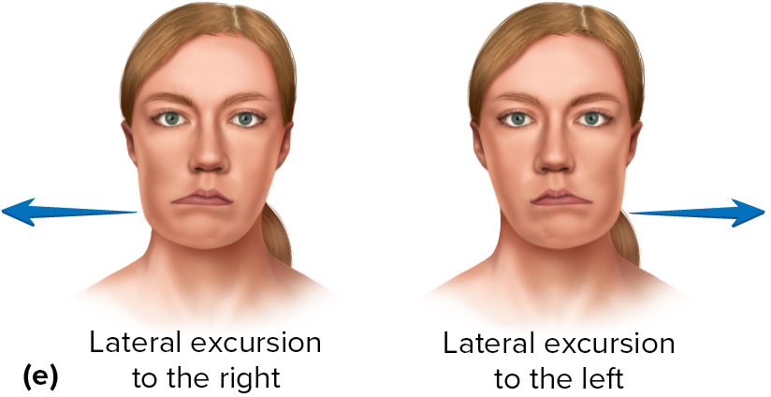
Excursion
Lateral: moving mandible to the right or left of midline.
Medial: return the mandible to the midline.

Slide 34
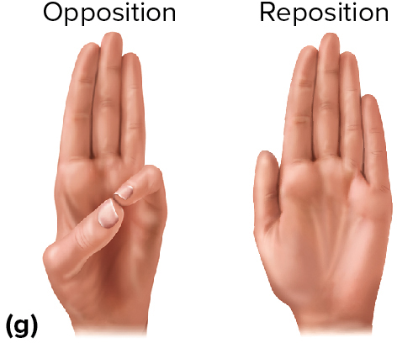
Opposition and Reposition
Opposition: movement of thumb and little finger toward each other.
Reposition: return to anatomical position.

Slide 35
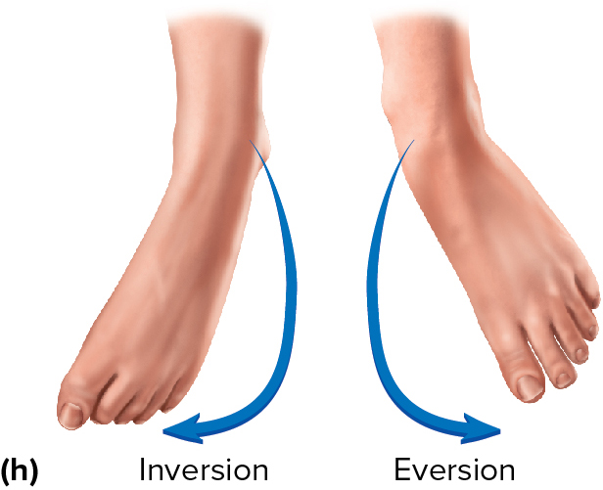
Inversion and Eversion
Inversion: turning the ankle so the plantar surface of foot faces medially.
Eversion: turning the ankle so the plantar surface of foot faces laterally.

Slide 36
8.3 Range of Motion
Amount of mobility demonstrated at a given joint.
Types.
  Active: amount of movement accomplished by muscle contraction.
  Passive: amount of movement accomplished by some outside force.
Both active and passive can be influenced by.
  Shape of articular surfaces forming joint.
  Amount and shape of cartilage covering surfaces.
  Strength and location of ligaments and tendons.
  Bulk of surrounding tissues, such as muscle and adipose tissue.
  Amount of fluid in and around joint.
  Amount of pain in and around joint.
  Amount of use/disuse of joint.

Slide 37
Abnormalities in Range of Motion
Dislocation or luxation: articulating surfaces are moved out of proper alignment.
Subluxation: partial dislocation
Sprain: damaged ligament from stretched to completely torn.

Slide 38
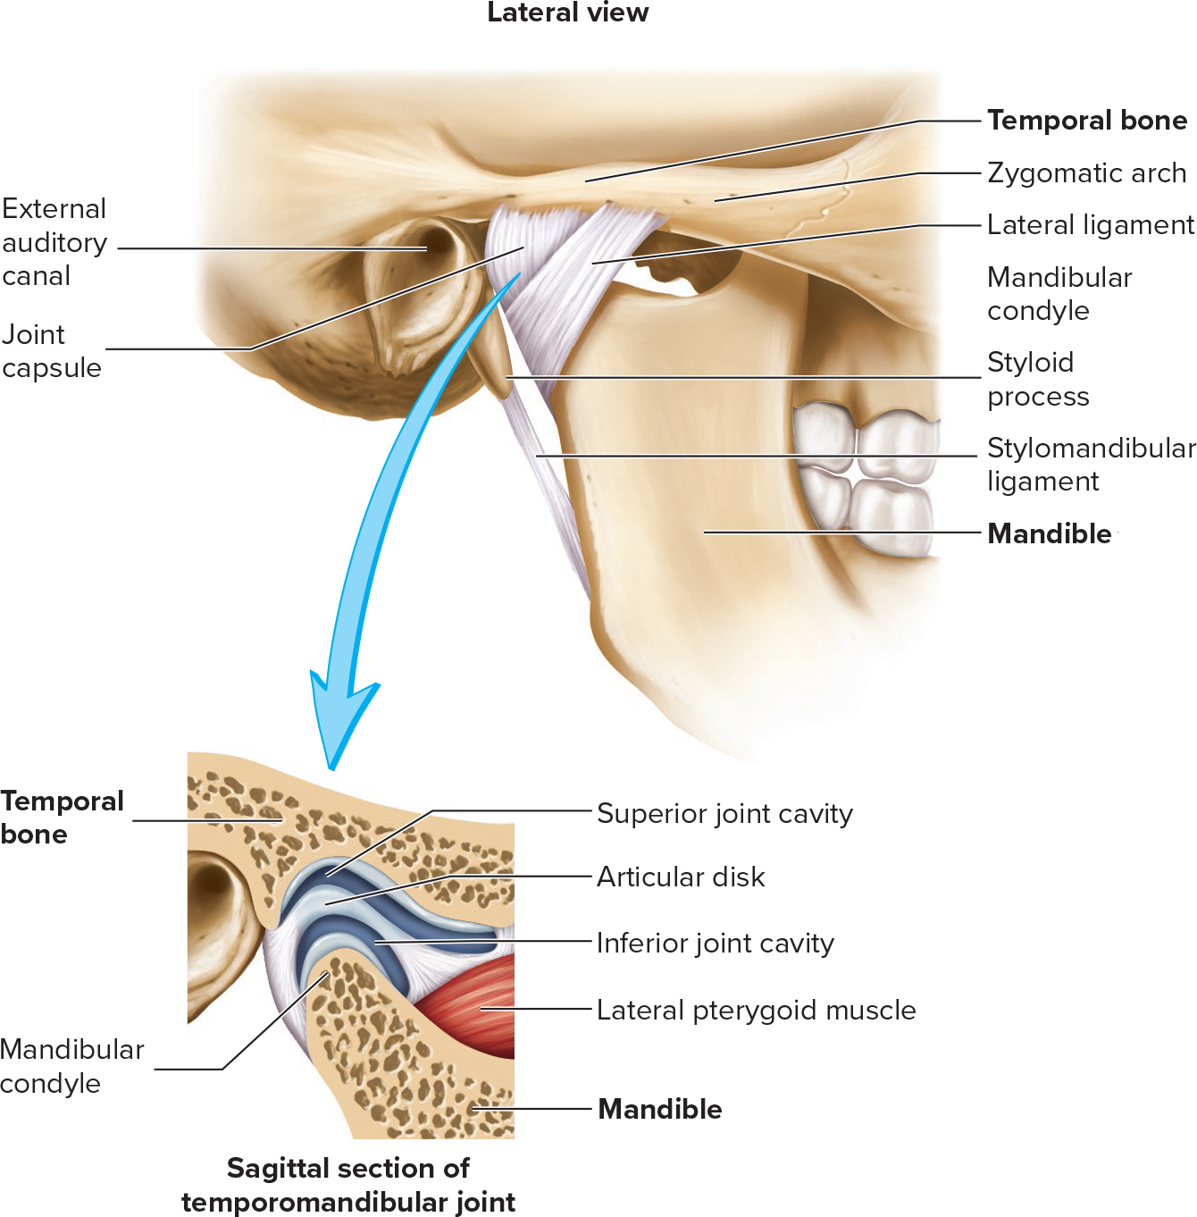
8.4 Description of Selected Joints
Temporomandibular Joint (T M J).
Combination plane and ellipsoid joint.
Fibrocartilage disk divides joint into superior and inferior cavities.
Allows depression/elevation, excursion, protraction/retraction.
T M J Disorders.
  Cause of most chronic orofacial pain.
Access the text alternative for slide images.

Slide 39
Shoulder (Glenohumeral) Joint
Ball-and-socket: stability is reduced, mobility is increased compared to hip.
Flexion/extension, abduction/adduction, rotation, circumduction.
Glenoid labrum: rim of fibrocartilage built up around glenoid cavity; joint capsule attachment.
Bursae: subacromial and subscapular.
Rotator cuff: four muscles that along with ligaments give stability to the joint.
Tendon of biceps brachii passes through the joint capsule.
Most common traumatic disorders are dislocations and torn muscles or tendons.

Slide 40
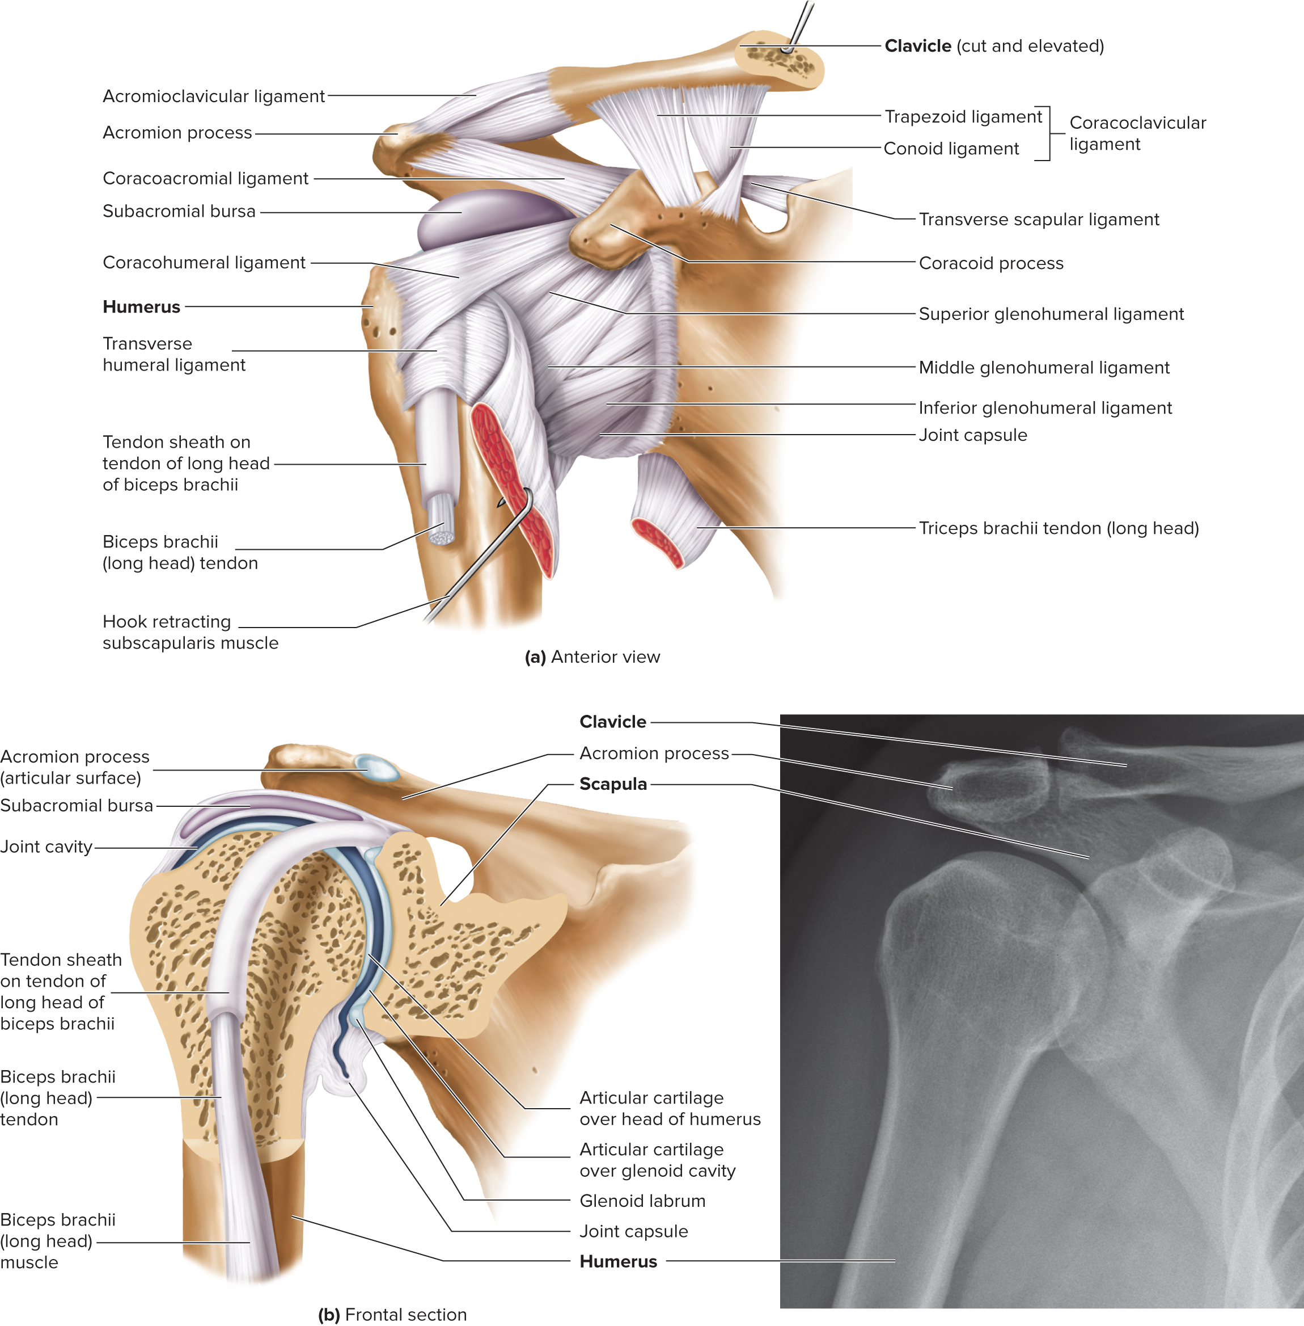
Shoulder Joint
(b) Ivan Smuk/Alamy Stock Photo
Access the text alternative for slide images.

Slide 41
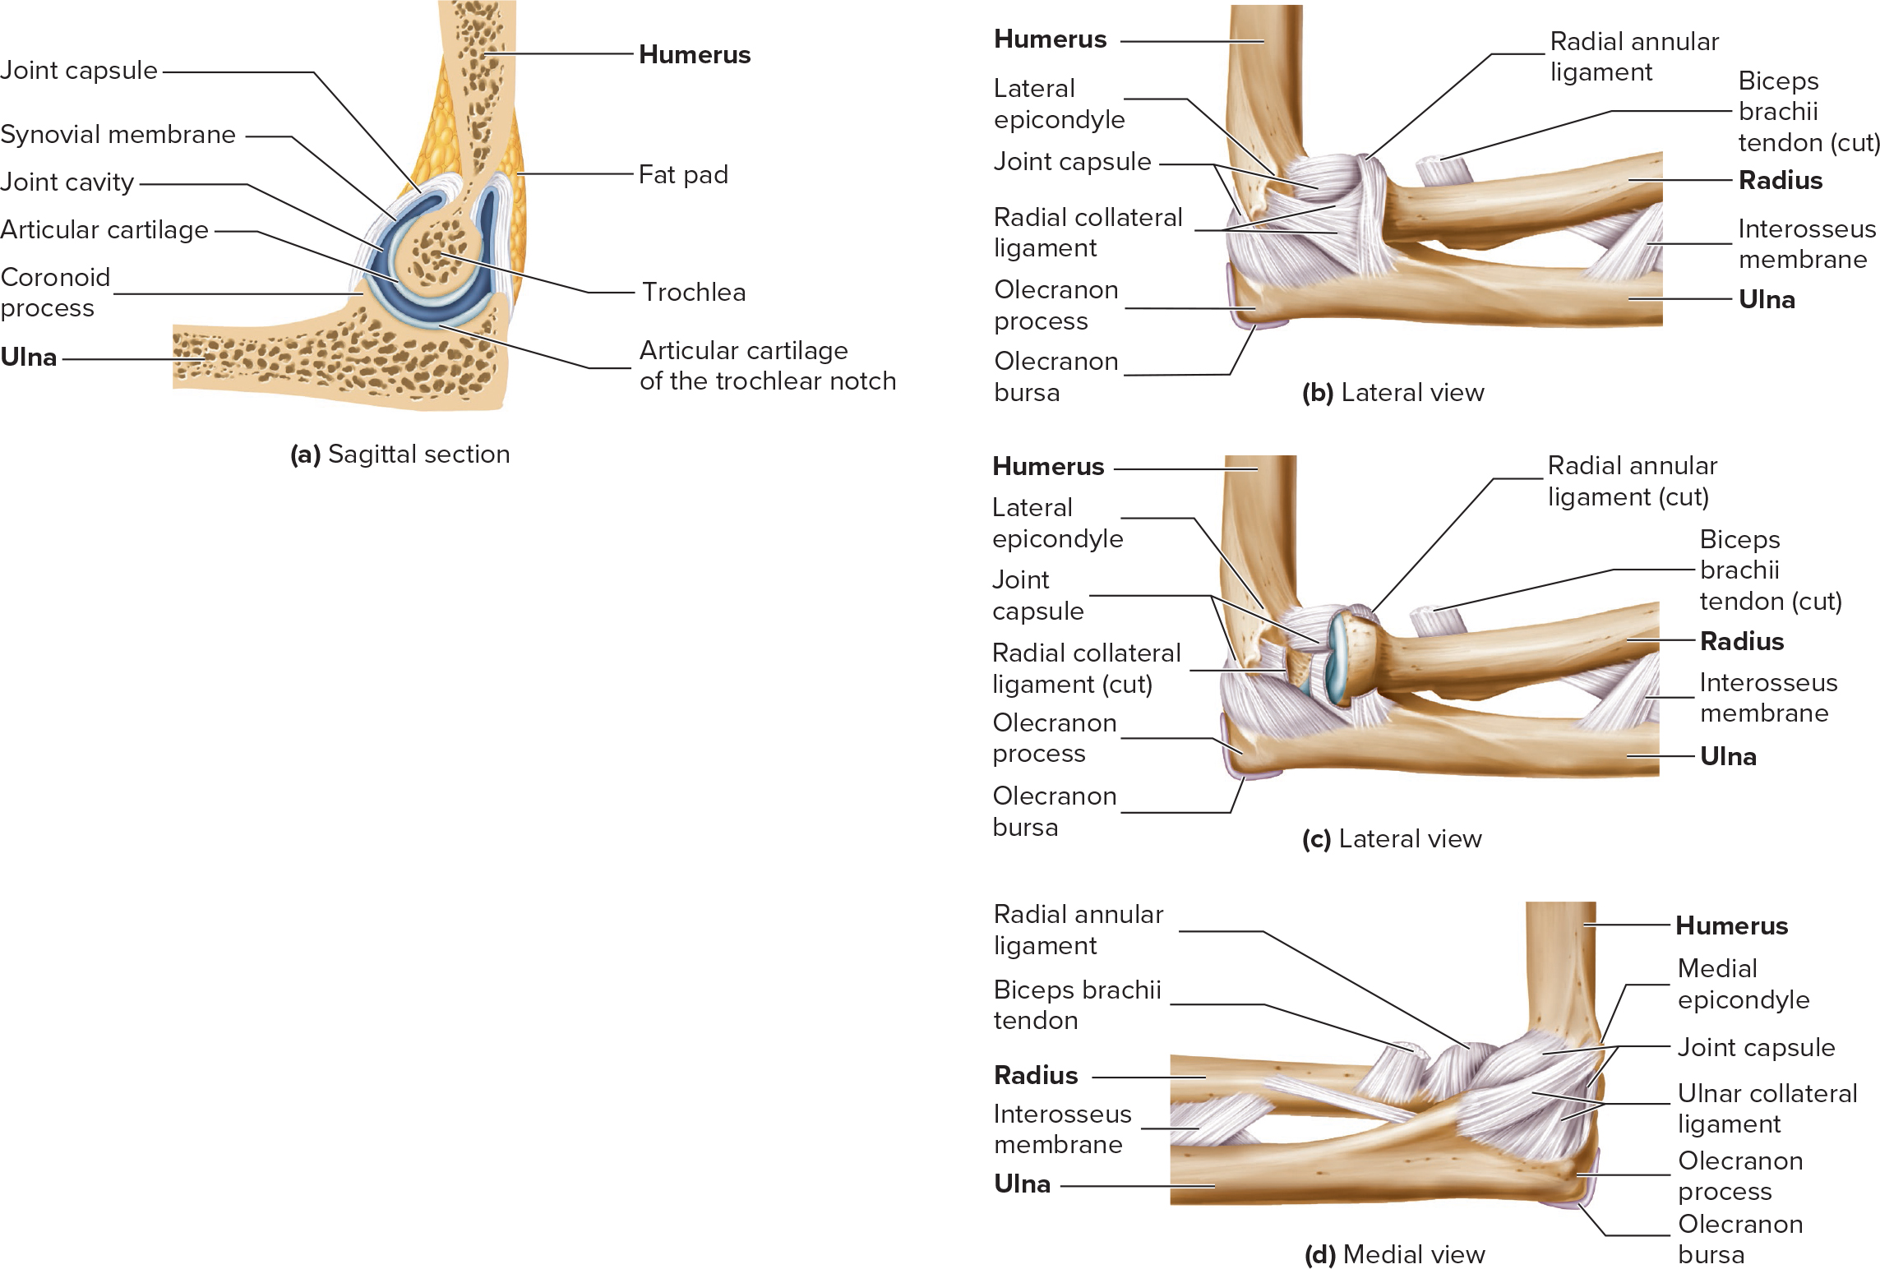
Elbow Joint
Compound hinge joint.
  Humeroulnar joint.
  Humeroradial joint.
  Proximal radioulnar joint.
Shape of trochlear notch and trochlea limit movement to extension and flexion.
Rounded head of radius allows pronation and supination.
Ligaments.
  Ulnar collateral ligament.
  Radial collateral ligament.
  Radial annular ligament.
Subacromial bursa.
(c, d) Puwadol Jaturawutthichai/Alamy Stock Photo
Access the text alternative for slide images.

Slide 42
Hip (Coxal) Joint 1
Ball-and-socket with acetabulum deepened by fibrocartilage acetabular labrum and transverse acetabular ligament.
More stable but less mobile than shoulder joint.
Flexion/extension, abduction/adduction, rotation, circumduction.
Extremely strong joint capsule reinforced by ligaments including the iliofemoral ligament that bears much of the body weight while standing.
Ligament of head of femur (round ligament of femur); often bears nutrient artery.

Slide 43
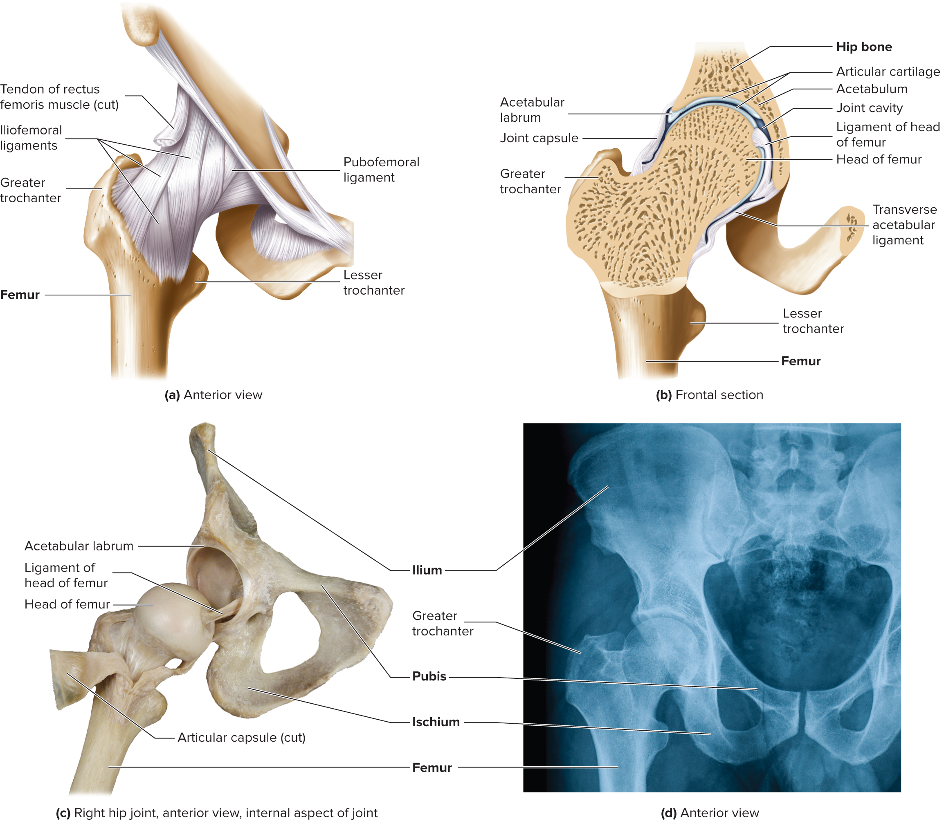
Hip (Coxal) Joint 2
(c) Christine Eckel/McGraw Hill Education; (d) temet/Getty Images
Access the text alternative for slide images.

Slide 44
Knee Joint
Condyloid: allowing flexion/extension, small amount of rotation.
Menisci: fibrocartilage articular disks that build up the margins of the tibia and deepen articular surface.
Cruciate ligaments: extend between intercondylar eminence of tibia and fossa of the femur.
  Anterior cruciate ligament (A C L). Prevents anterior displacement of tibia.
  Posterior cruciate ligament (P C L). Prevents posterior displacement of tibia.
Collateral and popliteal ligaments: along with tendons of thigh muscles strengthen the joint.
Bursae: may result in slow accumulation of fluid in the joint (water on the knee).

Slide 45
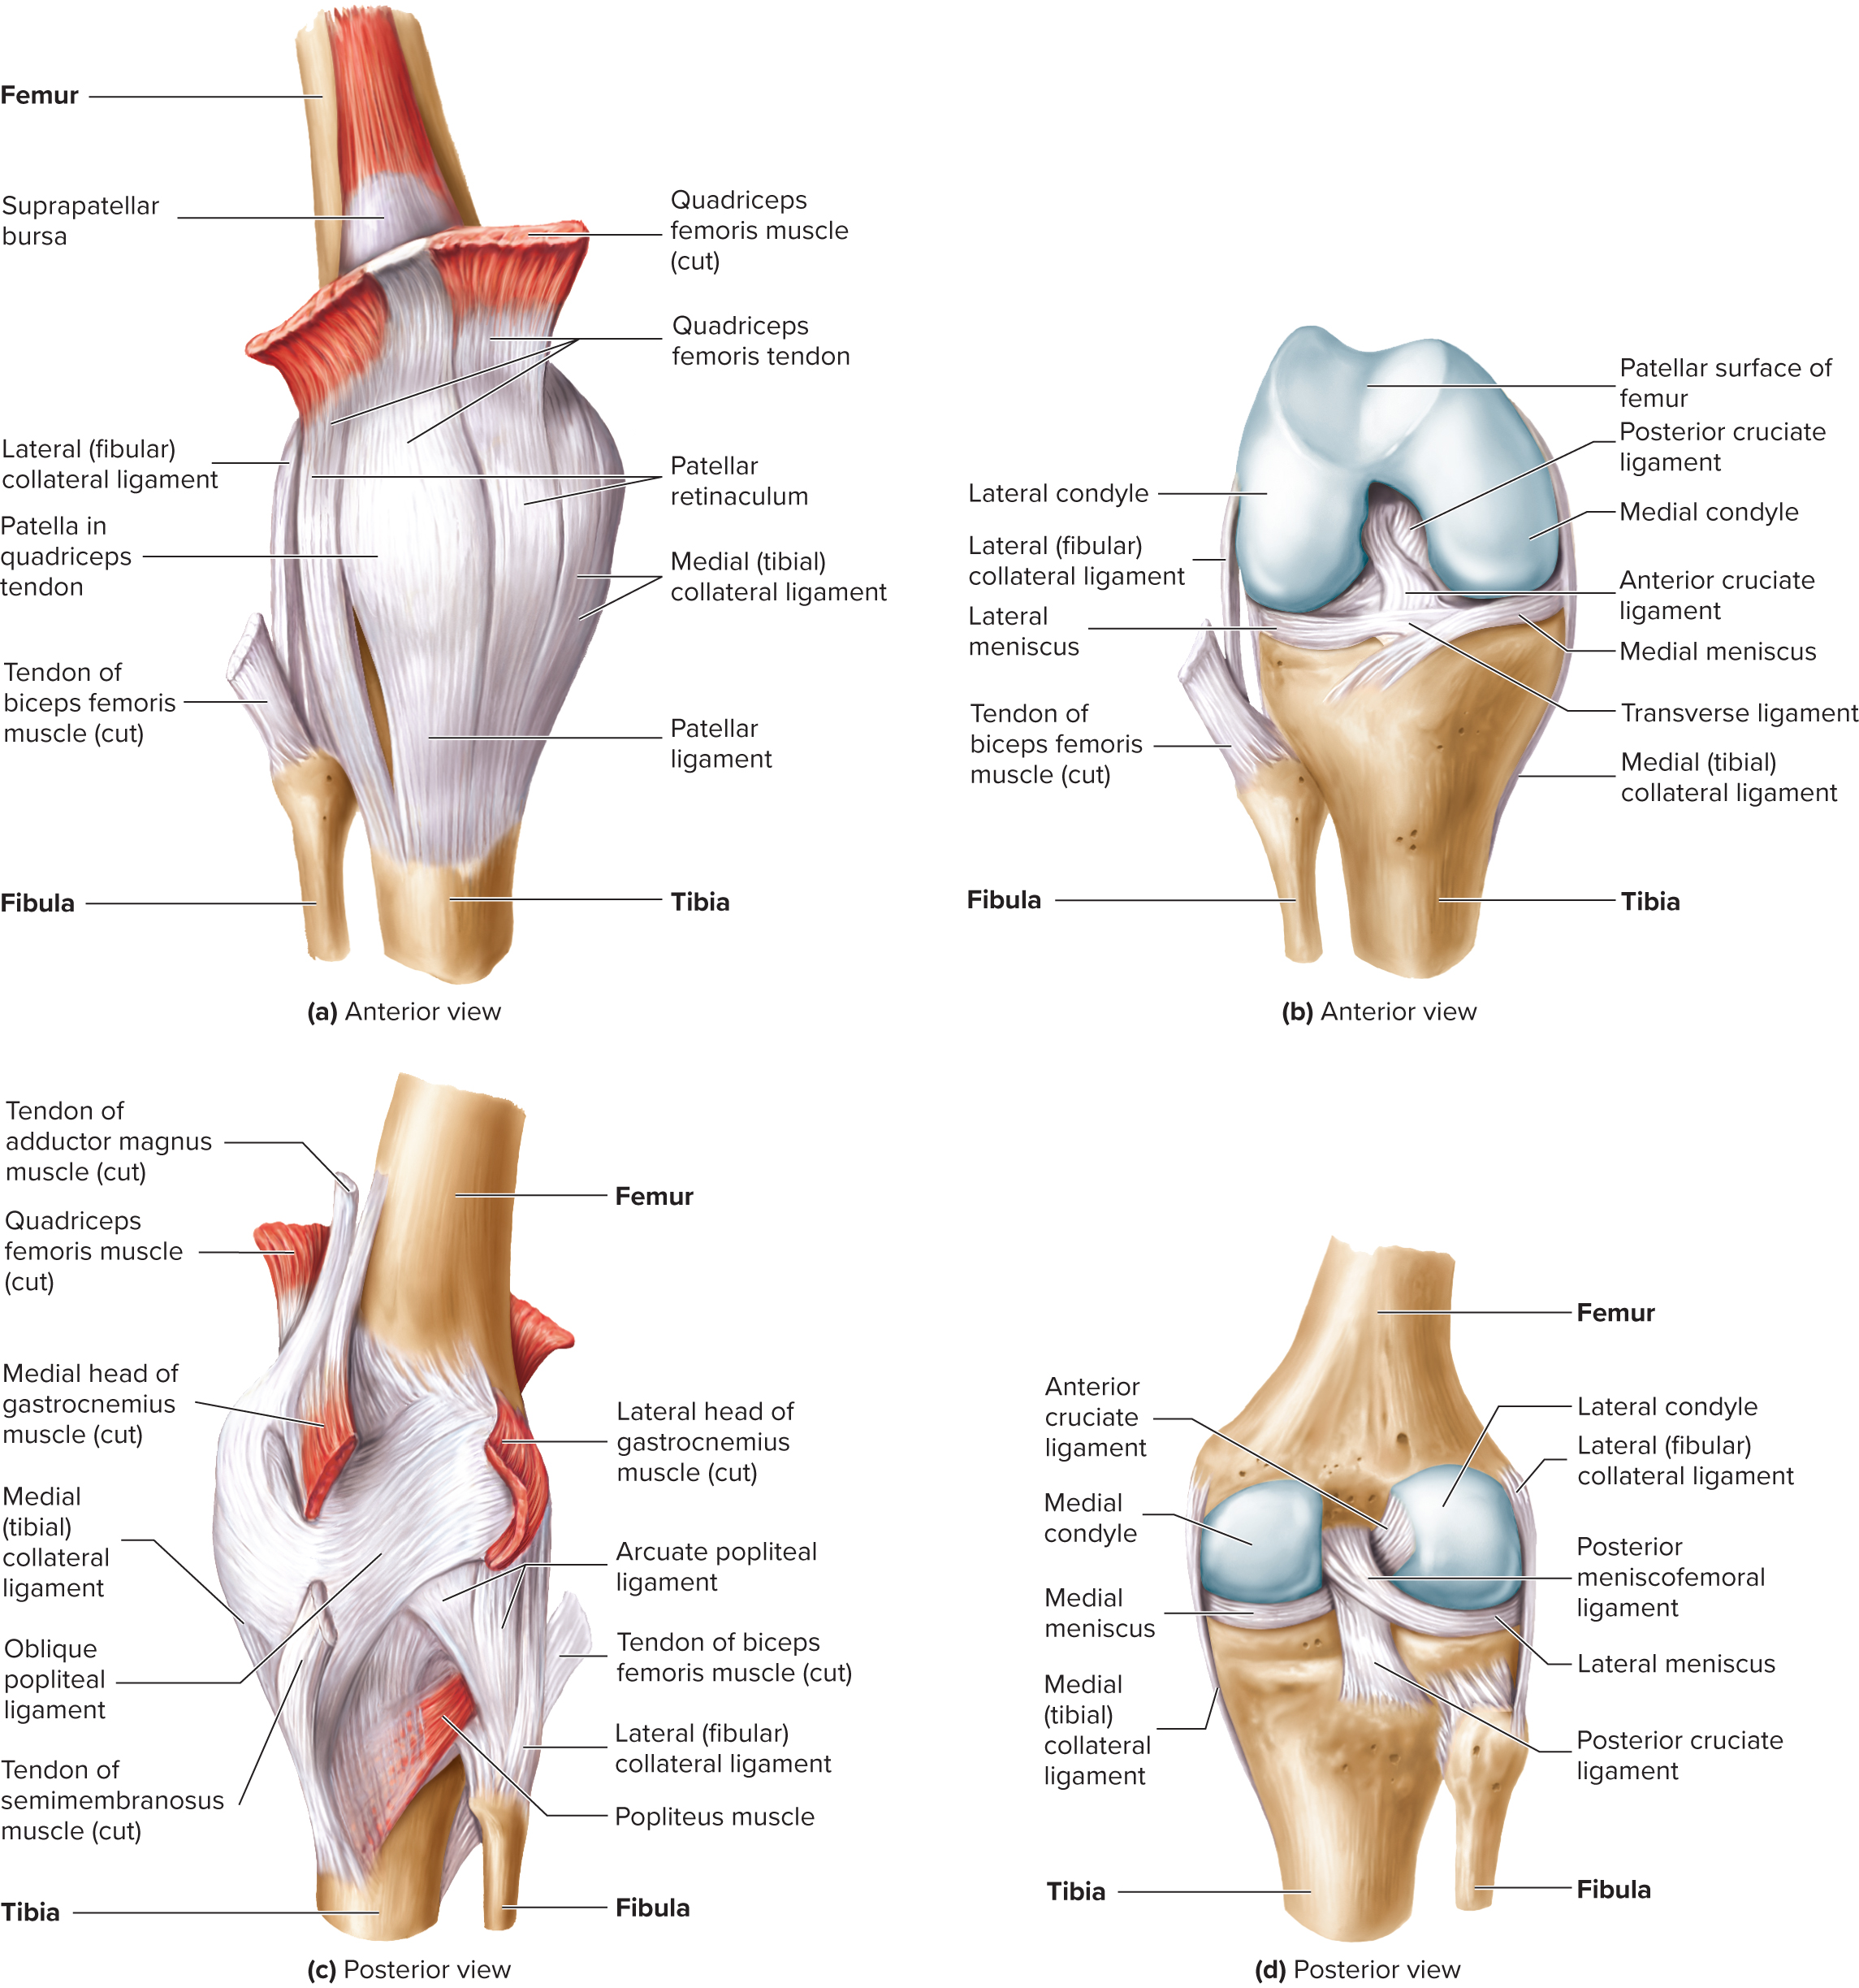
Right Knee Joint 1
Access the text alternative for slide images.

Slide 46
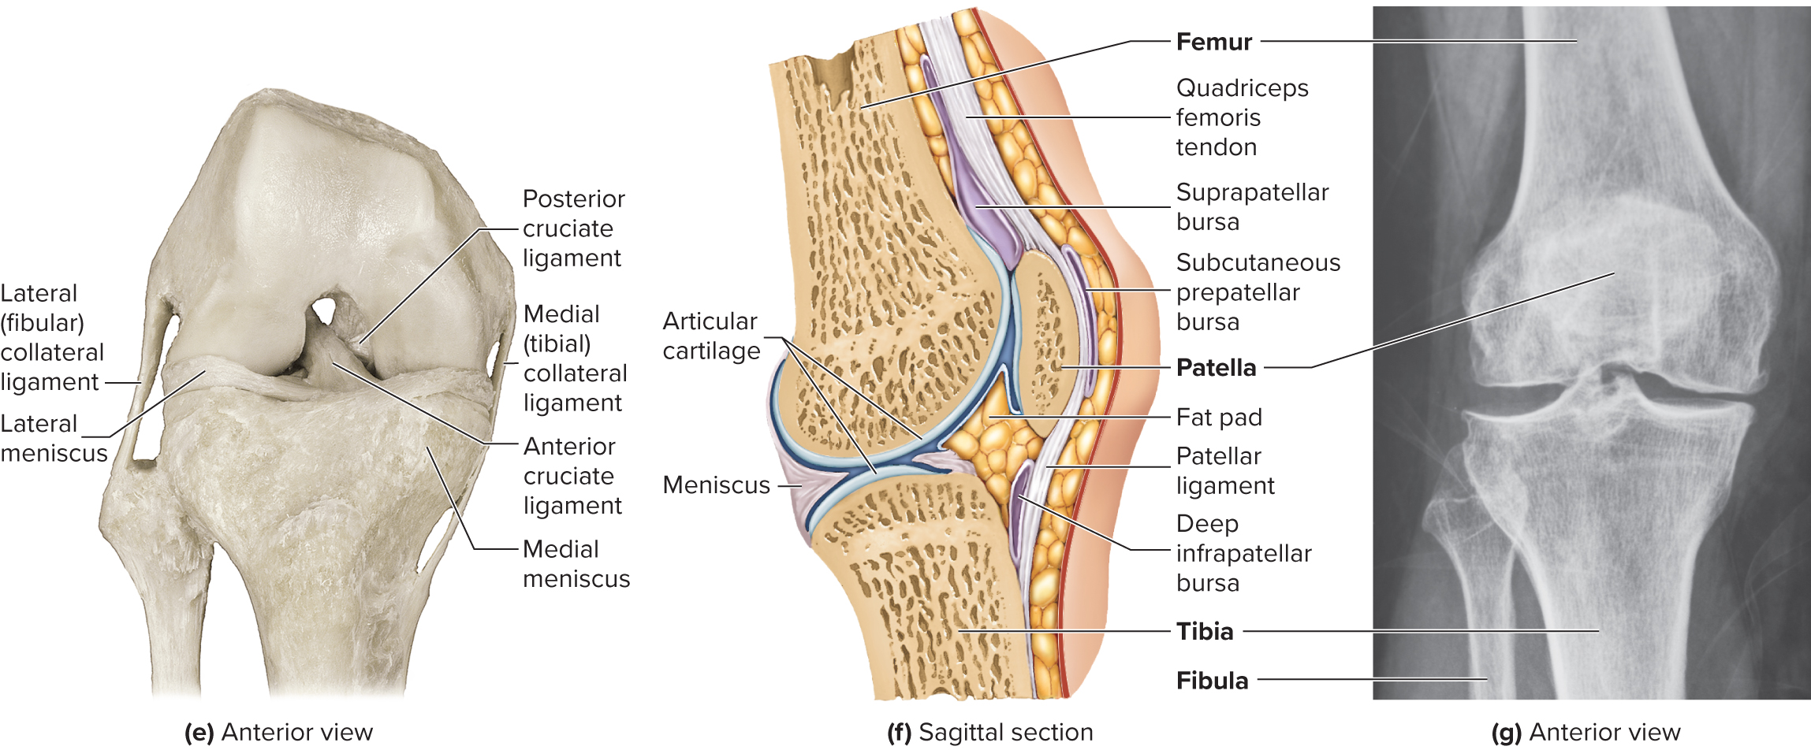
Right Knee Joint 2
(e) Christine Eckel/McGraw Hill Education; (g) zhu difeng/Shutterstock
Access the text alternative for slide images.

Slide 47
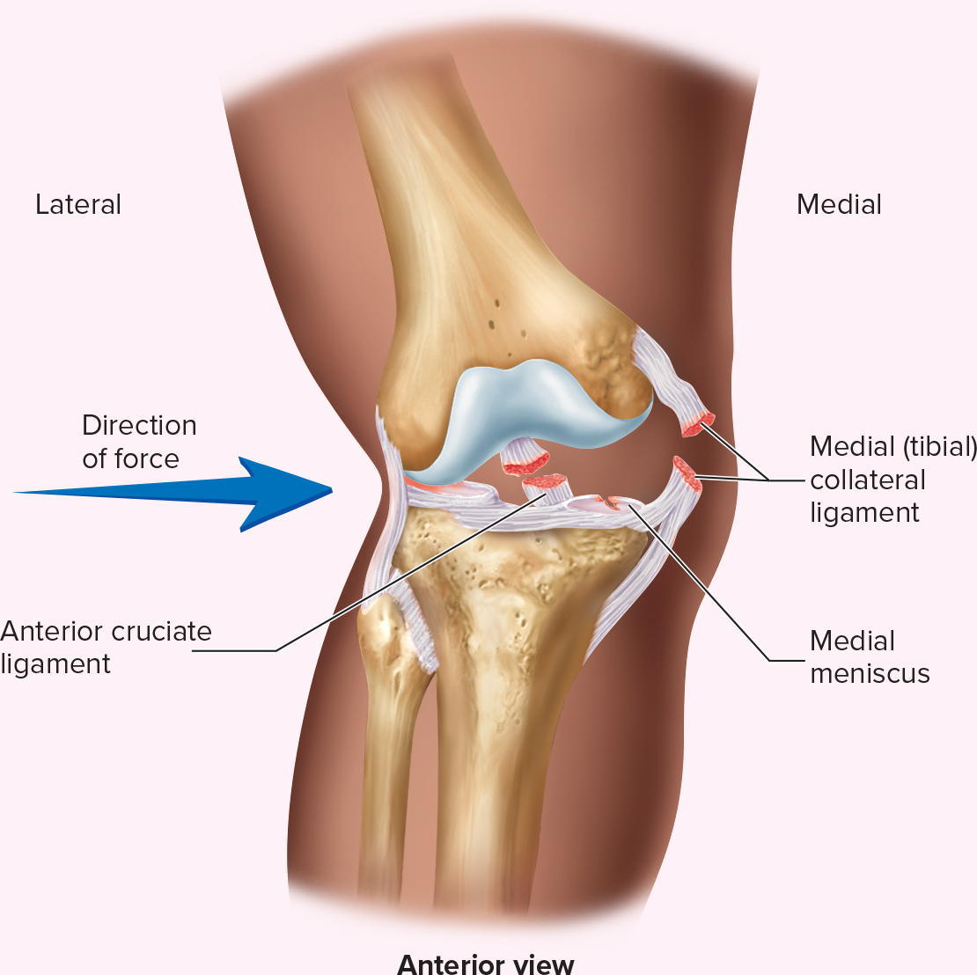
Injury to the Knee
Lateral blows to knee (for example. from a football tackle) often tear the lateral collateral ligament, the anterior cruciate ligament, and damage the medial meniscus.
Access the text alternative for slide images.

Slide 48
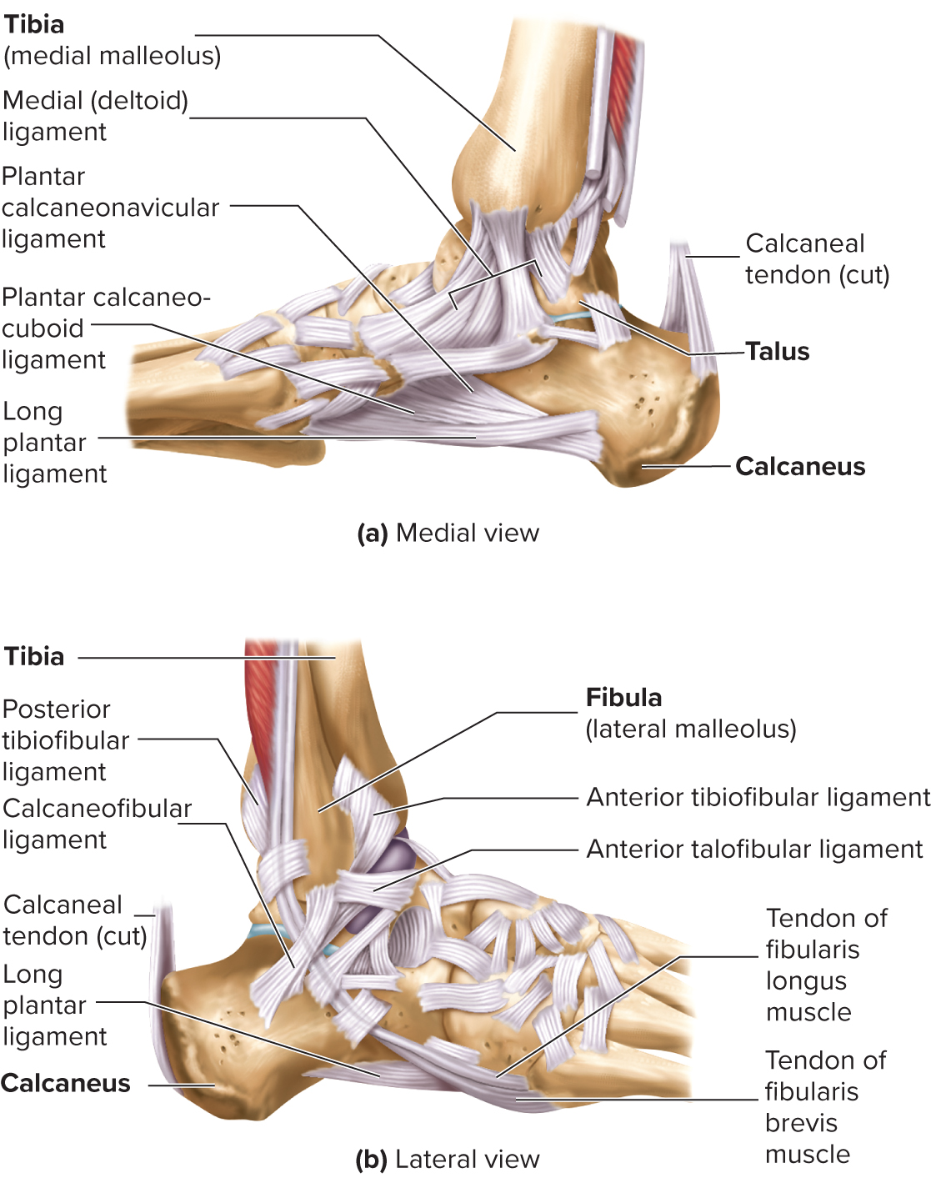
Ankle (Talocrural) Joint
Highly modified hinge joint.
Lateral and medial thickening of articular capsule to prevent side-to-side movement.
Dorsiflexion/plantar flexion, limited inversion and eversion.
Ligaments of arch.
  Hold bones in proper relationship.
  Transfer weight.
Access the text alternative for slide images.

Slide 49
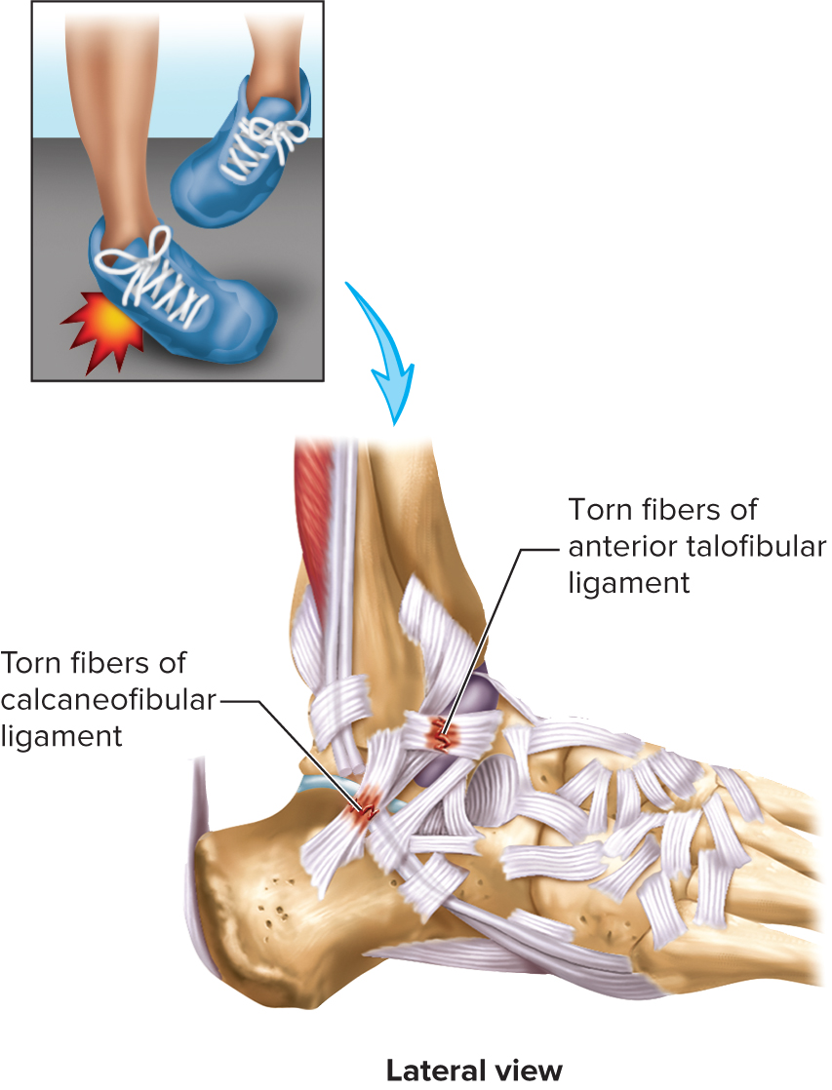
Injury to the Ankle
Access the text alternative for slide images.

Slide 50
Effects of Aging on Joints
Tissue repair slows; rate of new blood vessel development decreases.
Articular cartilages wear down and matrix becomes more rigid.
Production of synovial fluid declines.
Ligaments and tendons become shorter and less flexible: decrease in range of motion (R O M).
Muscles around joints weaken.
A decrease in activity causes less flexibility and decreased ROM.

Slide 51
Representative Joint Disorders ₁
Arthritis.
  Osteoarthritis: wear and tear.
  Rheumatoid: caused by transient infection or autoimmune disease.
Lyme disease. Bacterial infection can result in chronic arthritis.
Gout. Metabolic disorders result in increased uric acid in blood; results in deposition of monosodium urate crystals in joints and kidneys.
Bursitis. Inflammation of a bursa.
Bunion. Deformations in first metatarsal, often caused by ill-fitting shoes.

Slide 52
Representative Joint Disorders ₂
Tendinitis. Inflammation of tendon sheaths, often from overuse.
Dislocation. Movement of bones out of alignment.
Sprain. Stretching or tearing of ligaments in a joint.
Chondromalacia patellae. Inflammation under patella and softening of the cartilage.

Slide 53
End of Main Content
© 2023 McGraw Hill, LLC. All rights reserved. Authorized only for instructor use in the classroom.
No reproduction or further distribution permitted without the prior written consent of McGraw Hill, LLC.

Slide 54
Accessibility Content: Text Alternatives for Images

Slide 55
Lecture Outline - Text Alternative
Return to parent-slide containing images.
The illustration consists of the following joints: 1) Fibrous Joints: Connections between two bones held together by fibrous connective tissue. Examples: Sutures in the skull, gomphosis of teeth. 2) Cartilaginous Joints: Connections between two bones held together by a pad of cartilage. Examples: Symphyses between vertebrae or pubic bones. 3) Synovial Joints: Connections between two bones held together by ligaments and separated by a fluid-filled cavity. Examples: Hinge joints of knee and elbow, ball-and-socket joints of hip and shoulder.
Return to parent-slide containing images.

Slide 56
Fetal Skull Showing Fontanels and Sutures - Text Alternative
Return to parent-slide containing images.
Illustration (a) of the lateral view of the fetal skull shows Parietal bones, two bones in the skull which, when joined together at a fibrous joint, form the sides and roof of the cranium; Squamous suture, the cranial suture between the temporal and parietal bones bilaterally; Occipital bone, the bone which forms the back and base of the skull and encircles the spinal cord; Lambdoid suture, a dense, fibrous connective tissue joint on the posterior aspect of the skull that connects the parietal bones with the occipital bone; Mastoid (posterolateral) fontanel, paired bilateral soft membranous gaps (fontanelles) at the junction of the parietomastoid, occipitomastoid, and lambdoid sutures; Temporal bone, either of a pair of bones that form part of the side of the skull on each side and enclose the middle and inner ear; Sphenoidal (anterolateral) fontanel, paired bilateral soft membranous gaps (fontanelles) at the junction of the coronal, sphenofrontal, sphenoparietal, sphenosquamosal, and squamosal sutures; Coronal suture, the transverse suture in the skull separating the frontal bone from the parietal bones; Frontal bone has two portions, the vertically oriented squamous part, and the horizontally oriented orbital part, making up the bony part of the forehead, part of the bony orbital cavity holding the eye, and part of the bony part of the nose. Illustration (b) of the superior view of the fetal skull shows frontal bones (not yet fused into a single bone), frontal (anterior) fontanel, parietal bone, sagittal suture, occipital bone, and occipital (posterior) fontanel.
Return to parent-slide containing images.

Slide 57
Fibrous Joints: Syndesmoses - Text Alternative
Return to parent-slide containing images.
In the illustration, the radioulnar syndesmoses consist of the oblique cord and the interosseous membrane between the radius and ulna. The Biceps brachii tendon is above the oblique cord and below the head of the radius wrapped by the annular ligament.
Return to parent-slide containing images.

Slide 58
Fibrous Joints: Gomphoses - Text Alternative
Return to parent-slide containing images.
In the illustration, the crown of the tooth is at the top. The gingiva is between the teeth. The gomphosis shows the layers of the tooth as the root of the tooth, periodontal ligaments, and alveolar bone.
Return to parent-slide containing images.

Slide 59
Cartilaginous Joints: Synchondroses - Text Alternative
Return to parent-slide containing images.
In part a, the synchondroses of the hip bone of a fetus are illustrated. The body of the hip bone is labeled Ilium. The bottom of the bone consists of a circular, hollow structure. The right end is labeled the pubis and the left end is labeled Ischium. The part between the pubis and the ischium is labeled the synchondroses. In part b, the frontal section of the femur shows the epiphysis and the secondary epiphysis at the top which is divided by synchondroses (epiphyseal plates). The body of the bone is diaphysis. In part c, the anterior view of the thorax shows the sternum consisting of manubrium, body, and xiphoid process. The sternocostal synchondrosis is the costal cartilage of the first rib.
Return to parent-slide containing images.

Slide 60
Cartilaginous Joints: Symphyses - Text Alternative
Return to parent-slide containing images.
The pelvis shows the sacrum at the top with ilium on either side that extends to pubis with pubis symphysis and ischium at the bottom.
Return to parent-slide containing images.

Slide 61
General Structure of a Synovial Joint - Text Alternative
Return to parent-slide containing images.
In the illustration, the synovial joint is a cup-shaped structure. The capsule that encloses the synovial joint is labeled Fibrous capsule. The outer membrane of the joint is labeled the Synovial joint. The fibrous capsule and the synovial joint together are labeled as Joint capsules. Beneath the joint is a cavity labeled Joint cavity (filled with synovial fluid). The extension of the cavity on the other side is labeled as Bursa (extension of the joint cavity). Blood vessels and nerve fibers can be seen along with the bursa. Beneath the cavity is a U-shaped structure on a flat surface. This structure is labeled as Articular cartilage. The lower end of the articular cartilage leads to a rod-shaped structure labeled Tendon which is covered by a layer called the Tendon sheath. The synovial joint leads to the bone. The bone is enclosed by the Periosteum. The periosteum consists of the fibrous layer and the cellular layer.
Return to parent-slide containing images.

Slide 62
Plane and Saddle Joints 1 - Text Alternative
Return to parent-slide containing images.
In the illustration, the class of the synovial joint is Plane. The example given for this type of joint is the intervertebral disks of the vertebra.
Return to parent-slide containing images.

Slide 63
Plane and Saddle Joints 2 - Text Alternative
Return to parent-slide containing images.
In the illustration, the class of the synovial joint is Saddle. The example given for this type of joint is the carpometacarpal pollicis of the palm.
Return to parent-slide containing images.

Slide 64
Hinge and Pivot Joints 1 - Text Alternative
Return to parent-slide containing images.
In the illustration, the class of the synovial joint is Hinge. The example given for this type of joint is the cubital joint of the elbow.
Return to parent-slide containing images.

Slide 65
Hinge and Pivot Joints 2 - Text Alternative
Return to parent-slide containing images.
In the illustration, the class of the synovial joint is Pivot. The example given for this type of joint is the proximal radioulnar of the radius and ulna.
Return to parent-slide containing images.

Slide 66
Ball-and-Socket and Ellipsoid Joints 1 - Text Alternative
Return to parent-slide containing images.
In the illustration, the class of the synovial joint is Ball-and-socket. The example given for this type of joint is the glenohumeral (shoulder) of the scapula and humerus.
Return to parent-slide containing images.

Slide 67
Ball-and-Socket and Ellipsoid Joints 2 - Text Alternative
Return to parent-slide containing images.
In the illustration, the class of the synovial joint is Ellipsoid. The example given for this type of joint is the atlantooccipital joint of the atlas and occipital bone.
Return to parent-slide containing images.

Slide 68
Flexion and Extension - Text Alternative
Return to parent-slide containing images.
In the illustration, the skeletal system of a body is given in general for all types of movements. In part a, the head of a person moves forward (flexion) and backward (extension). In part b, the hand of a person is stretched forward (extension) and folded (flexion). In part c, the palm of a hand moves downward (flexion) and upward (extension). In part d, the leg of a person is extended and placed on the ground (extension), and folded from the knee (flexion).
Return to parent-slide containing images.

Slide 69
Abduction and Adduction - Text Alternative
Return to parent-slide containing images.
In part f, the arm of a person is extended and moved upward (abduction and adduction). In part g, the fingers of a hand are opened and closed (abduction and adduction).
Return to parent-slide containing images.

Slide 70
8.4 Description of Selected Joints - Text Alternative
Return to parent-slide containing images.
In the illustration of the lateral view of the right temporomandibular joint, parts such as the external auditory canal and joint capsule are located. The parts labeled common to the illustration and the x-ray of the right temporomandibular joint are the temporal bone, zygomatic arch, lateral ligament, mandibular condyle, styloid process, stylomandibular ligament, and the mandible. The parts labeled in the sagittal section of the joint are the temporal bone, mandibular condyle, superior joint cavity, articular disk, inferior joint cavity, lateral pterygoid muscle, and mandible.
Return to parent-slide containing images.

Slide 71
Shoulder Joint - Text Alternative
Return to parent-slide containing images.
In part a, the parts labeled in the anterior view are acromioclavicular ligament, acromion process, coracoacromial process, subacromial bursa, coracohumeral ligament, the humerus, transverse humeral ligament, tendon sheath on the tendon of the long head of biceps brachii, biceps brachii (long head) tendon, hook retracting subscapularis muscle, the clavicle (cut and elevated), coracoclavicular ligament consisting of the trapezoid ligament and the conoid ligament, transverse scapular ligament, coracoid process, superior glenohumeral ligament, middle glenohumeral ligament, inferior glenohumeral ligament, joint capsule, and triceps brachii tendon (long head). In part b, the parts labeled in the frontal section are acromion process (articular surface), subacromial bursa, joint cavity, tendon sheath on the tendon of the long head of biceps brachii, biceps brachii (long head) tendon, and biceps brachii (long head) muscle. The parts common in both the frontal section and the x-ray are as follows: the clavicle, acromion process, scapula, articular cartilage over the head of the humerus, articular cartilage over glenoid cavity, glenoid labrum, joint capsule, and the humerus.
Return to parent-slide containing images.

Slide 72
Elbow Joint - Text Alternative
Return to parent-slide containing images.
Illustration (a) of the sagittal section of the right elbow joint shows the joint capsule attached to the trochlea. The trochlea is connected with the ulna. The trochlea is surrounded by articular cartilage, joint cavity, synovial membrane, the articular cartilage of the trochlear notch, and joint capsule. Below the trochlea is the coronoid process. The fat pad lies above the trochlea and is bordered by the humerus. Illustrations (b) and (c) of the lateral views of the right elbow joint show the following parts: Humerus; Lateral epicondyle; Joint capsule; Radial collateral ligament; Olecranon process; Olecranon bursa; Radial annular ligament; Biceps brachii tendon (cut); Radius; Interosseus membrane, and Ulna. Illustration (d) of the medial view of the elbow joint shows Radial annular ligament; Biceps brachii tendon; Radius; Interosseus membrane; Ulna; Humerus; Medial epicondyle; Joint capsule; Ulnar collateral ligament; Olecranon process, and Olecranon bursa.
Return to parent-slide containing images.

Slide 73
Hip (Coxal) Joint 2 - Text Alternative
Return to parent-slide containing images.
Illustration (a) of an anterior view of the right hip joint shows the Tendon of rectus femoris muscle (cut), rectus femoris arises from two tendons that originate from the anterior inferior iliac spine and the other from the ridge of the acetabulum; Iliofemoral ligaments, a ligament of the hip joint which extends from the ilium to the femur in front of the joint; Greater trochanter, a large, irregular, quadrilateral eminence and a part of the skeletal system; Pubofemoral ligament, a supporting ligament located on the inferior side of the hip joint; Lesser trochanter, projects from the lower and back part of the base of the femur neck; Femur, the largest bone from the hip to the knee. Illustration (b) of the frontal section of the right hip joint shows an Acetabular labrum, Joint capsule, Greater trochanter, Hip bone, Articular cartilage, a Joint cavity, Acetabulum, Ligament of the head of the femur, Head of the femur, Transverse acetabular ligament, Lesser trochanter, and the Femur. Illustration (c) of the anterior view with the internal aspects of the hip joint shows the Acetabular labrum; Ligament of the head of the femur, Head of the femur, Ilium, Pubis, Ischium; Femur, and Articular capsule (cut). Illustration (d) of an x-ray of the anterior view of the hip joint shows Ilium, Greater trochanter, Pubis, Ischium, and the Femur.
Return to parent-slide containing images.

Slide 74
Right Knee Joint 1 - Text Alternative
Return to parent-slide containing images.
illustration A shows an anterior superficial view of the right knee. The femur along with the suprapatellar bursa is connected to the tibia and fibula. Tibia has a patellar ligament that extends as medial (tibial) collateral ligament, patellar retinaculum, patella in the quadriceps tendon, and quadriceps femoris tendon. The fibula has a tendon of the biceps femoris muscle and lateral (fibular) collateral ligament. Above the quadriceps femoris tendon lies the quadriceps femoris muscle. The illustration B shows the anterior deep view that has a patellar surface of the femur with lateral condyle and medial condyle with lateral (fibular) collateral ligament and medial (tibial) collateral ligament respectively. Between the lateral and medial condyle lies the posterior cruciate ligament and the anterior cruciate ligament. The tibia is connected to the lateral meniscus, medial meniscus, and transverse ligament. The Tendon of the biceps femoris muscle is connected to the fibula. The illustration C shows the posterior superficial view of the right knee. The femur and tibia are enveloped in ligaments such as the Oblique popliteal ligament, Medial (tibial) collateral ligament, and Arcuate popliteal ligament. Lateral (fibular) collateral ligament arises from the fibula. The muscles identified are Popliteus muscle, Tendon of semimembranosus muscle, Medial head of gastrocnemius muscle, Tendon of adductor Magnus muscle, Quadriceps femoris muscle, Lateral head of gastrocnemius muscle, and Tendon of biceps femoris muscle. Most of the muscles are cut to reveal the ligaments below. The illustration D shows a posterior view of the right knee. The medial condyle and lateral condyle are separated by posterior meniscofemoral ligament, medial meniscus, and lateral meniscus. Lateral (fibular) collateral ligament and medial (tibial) collateral ligament lie on either side of the joint. The posterior cruciate ligament from the tibia joins the space between the two condyles.
Return to parent-slide containing images.

Slide 75
Right Knee Joint 2 - Text Alternative
Return to parent-slide containing images.
The photo e shows an anterior deep view of the right knee joint. The posterior cruciate ligament and anterior cruciate ligament lie between the lateral (fibular) collateral ligament and medial (tibial) collateral ligament. Between the knee joints lie lateral meniscus and medial meniscus. Illustration B shows the femur, tibia, and patella. The other parts labeled are quadriceps femoris tendon, suprapatellar bursa, subcutaneous prepatellar bursa, fat pad below the patella, patellar ligament, and deep infrapatellar bursa. The meniscus lies between the two bones that have articular cartilage. An X-ray C shows the anterior view of the knee joint that has femur, patella, tibia, and fibula.
Return to parent-slide containing images.

Slide 76
Injury to the Knee - Text Alternative
Return to parent-slide containing images.
The anterior view of injury to the knee shows the direction of force applied to the lateral part of the knee, the anterior cruciate ligament on the lateral side, the Medial (tibial) collateral ligament, and the Medial meniscus on the medial side. The anterior view of torn medial collateral ligament shows the Medial (tibial) collateral ligament and Medial meniscus.
Return to parent-slide containing images.

Slide 77
Ankle (Talocrural) Joint - Text Alternative
Return to parent-slide containing images.
The medial view shows medial ligament connected between tibia and talus. The calcaneus tendon (cut) is above the calcaneus. The arch of the foot shows plantar calcaneonavicular ligament, plantar calcaneocuboid ligament, long plantar ligament. The lateral view shows the calcaneus tendon (cut) above the calcaneus. The arch of the foot shows tendon of fibularis longus muscle, tendon of fibularis brevis muscle, long plantar ligament. The tibia and fibula shows posterior tibiofibular ligament, calcaneofibular ligament, and anterior tibiofibular ligament.
Return to parent-slide containing images.

Slide 78
Injury to the Ankle - Text Alternative
Return to parent-slide containing images.
The illustration shows an injury to the ankle, torn fibers of the anterior talofibular ligament on top of the ankle, and torn fibers of the calcaneofibular ligament behind the ankle. An inset shows a bent ankle of the right foot.
Return to parent-slide containing images.

