Slide 1

Leadership Business Briefings
Transformational Leadership and Servant Leadership
Based on Northouse’s Leadership: Theory and Practice, 10th Edition
Felicity Potter, Kwameisha Daniels, Noah Marshall, Jacari Morgan, Lindsei Newton, Khalil Younger
MGMT615: Leading Organizations
Dr. Rodney McCrowre
10/07/2026

Slide 2

Transformational Leadership

Slide 3
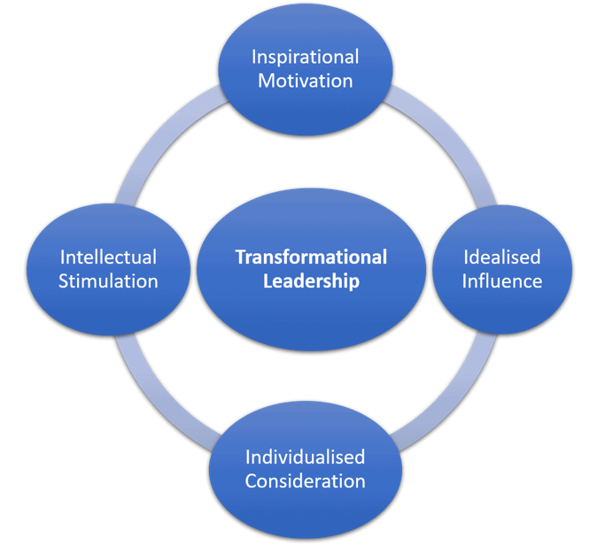
Summary of theory
The transformational theory inspires followers to perform beyond expectations
It Connects individual goals with a shared vision
It encourages growth, motivation, and organizational change
Four core components:
Idealized influence
Inspirational motivation
Intellectual stimulation
Individualized consideration
Emphasizes relationships between leaders and followers
Promotes higher levels of commitment and performance

Slide 4

How it adds to leadership
Transformational leadership has broadened the leadership focus from the characteristics of the leader to formal authority.
The theory has laid the foundation for motivation and follower development as key factors in the effective leadership.
The theory also raise awareness of values, emotions, ethics and organizational vision.
Transformational leadership is about engaging followers in the process of leadership.
Theory offers a framework to understanding leadership in the context of organizational change.
The method has helped to study employee engagement, creativity, innovation and employee performance (Northouse 2025).

Slide 5
Criticisms of the theory
There are some ideas that overlap between the concepts of transformational and charismatic leadership.
It can be challenging to differentiate the four aspects of transformational leadership.
Emphasis is placed on the leader and not followers or organizational systems.
The theory has the potential to develop a “heroic leadership” perspective that relies heavily on one leader in the organization for success.
Assessments of transformational leadership are typically based on the perceptions of followers of their leaders.
Influence is a very powerful force and can be misused by leaders who will strive to achieve unethical objectives.
The impact of transformational leadership may differ depending on the organizational and cultural context (Northouse, 2025).

Slide 6

Recent Research I : Transformational Leadership in Hybrid Work
New studies indicate that transformational leadership is applicable to hybrid working.
Informal leader–employee communication enhances the employee's perception of transformational leadership.
In-office communication generally drops off when staff is not at work.
Decreased informal contact may lead to diminished relationship between leader and followers.
Leaders should do intentional things to allow for informal interaction with remote employees.
Communication outside of formal work conversations is a crucial aspect of effective transformational leadership in hybrid workplaces (Lütjens & Felfe, 2025).

Slide 7
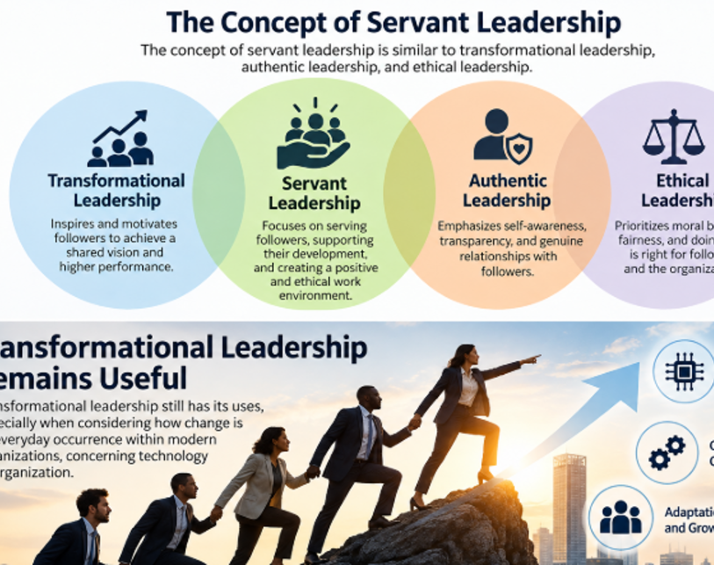
Group assessment of the approach with respect to today's workforce and current global environment
Transformational leadership still has its uses, especially when considering how change is an everyday occurrence within modern organizations, concerning technology or organization.
The approach fosters innovation by allowing employees to question and think outside the box.
Geographically dispersed employees can be connected to a shared purpose with the help of transformational leadership.
Individual consideration assists in providing support for employees who have different professional and developmental needsemployees who have a different professional and developmental need.
§Leaders need to influence followers in a transformative way, and they need to do so in an ethical manner, not by manipulating followers.
§Transformational leadership is practical, relevant and adaptable to the workforce today for our group (Northouse, 2025; Lütjens & Felfe, 2025).

Slide 8

Second briefing: Servant leadership

Slide 9
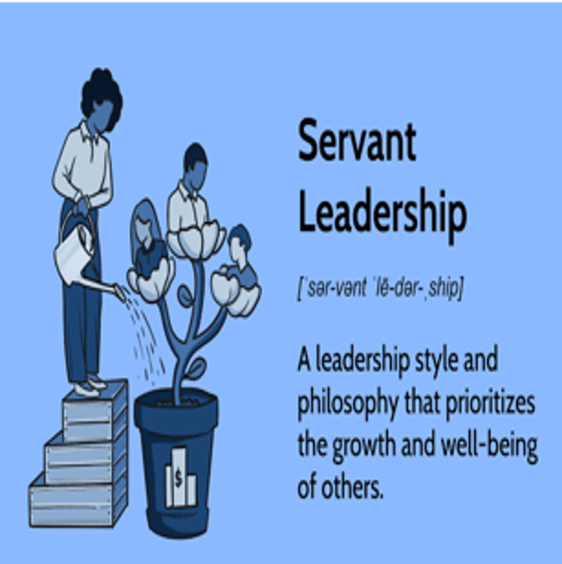
Theory Summary
•In servant leadership, the interest and growth of followers is the focus of leadership.
•Servant leaders start serving others and not seeking authority.
•Servant leaders pay attention to followers and try to grasp what their followers need.
•Servant leadership involves leaders giving others power and keeping followers in the decision making process.
•The emphasis is on ethical conduct, empathy, stewardship and building community.
•Servant leaders want to nurture followers to become efficient and self-reliant participants.
•Followers/communities and organizational results are considered (Northouse, 2025).

Slide 10

How it adds to leadership
•Servant leadership redirected more focus on the welfare and development of followers.
• It was a model that broke away from the traditional one that focused on the power of leadership at the top.
•Servant leadership aligned effective leadership with ethics and service and with social responsibility.
•It is focused on the sharing of power with leaders still being held accountable for organizational performance.
•The addition of servant leadership added follower growth and healthy relationships to the list of leadership outcomes.
•It involves self-awareness, coaching , listening and colleque development
•The approach raised awareness around trust, empowerment, community and employee wellbeing (Northouse, 2025).

Slide 11
Criticisms of Servant Leadership
•The word “servant” might seem to conflict with the word “leader,” since it's about influence, and “service” is about others.
•There have been multiple definitions and measurement tools for servant leadership.
•The concept of servant leadership is similar to transformational leadership, authentic leadership, and ethical leadership.
•Sometimes, followers have preferences that can clash with the needs of the organizations.
•Servant leadership might be challenging to implement in emergencies that call for quick decisions.
•The response to shared leadership power may vary in people from highly hierarchical cultures.
•The servant leader needs to be humble and serve, while also taking responsibility and leading a group (Northouse, 2025).

Slide 12

New material on the theory
The idea of servant leadership is connected to an increase in psychological safety among employees, according to recent research.
Staff may feel more comfortable speaking their own views and opinions.
Psychological safety can help to create a more supportive relationship dynamic within the organization.
Employee participation can be fostered through servant leadership behaviors like listening and respect.
Socially responsible leadership can reinforce the positive experiences that are linked to servant leadership.
Furthermore, servant leadership is shown to be relevant in non-Western organizational contexts in the context of Ugandan public universities (Kyambade et al., 2024).

Slide 13

Group Assessment for Today’s Workforce and Global Environment
•Servant leadership aligns with the values of today's employees with respect, support, participation, and professional growth.
•The approach could enhance the psychological safety in different and collaborative work environments.
•Resilience and P.O.S. can be fostered by servant leadership to contribute to engagement.
•Shared power can motivate more active involvement of employees in organizational decision making.
•Global leaders need to be flexible about servant leadership in various cultural perspectives of authority.
•The dynamics of servant leadership must be counterbalanced with employee support and organizational responsibility and performance.
•We believe servant leadership is relevant, practical and valuable in the current work environment

Slide 14
References
•Cai, M., Wang, M., & Cheng, J. (2024). The effect of servant leadership on work engagement: The role of employee resilience and organizational support. Behavioral Sciences, 14(4), 300. https://doi.org/10.3390/bs14040300
•Kyambade, M., Nkurunziza, G., Sewante, L., Namatovu, A., & Tushabe, M. (2024). Servant leadership and healthy work relationships in university context: A moderated mediation analysis of psychological safety and socially responsible leadership. Cogent Education, 11(1), 2418802. https://doi.org/10.1080/2331186X.2024.2418802
•Lütjens, D., & Felfe, J. (2025). Casual yet crucial: How informal nonwork-related communication shapes transformational leadership in hybrid work environments. European Journal of Work and Organizational Psychology. https://doi.org/10.1080/1359432X.2025.2560496
•Northouse, P. G. (2025). Leadership: Theory and practice (10th ed.). SAGE Publications.

