Slide 1
BRAZIL
CONTENT
History
Population
Regions
Weather
Tourist Attraction Sites
Foods
Culture
Interesting Facts

Slide 2
OVERVIEW
Hello, My name is (Insert name) and today we are going to learn abut the rich history, cultural and interesting facts about brazil. This presentation will be composed of a number of sections namely:
History
Population
Religion
Weather
Culture and facts.
Learning about different countries’ cultures and history helps broaden the scope of knowledge and appreciate how different but the same we all are.
Throughout the presentation, the audience is encouraged to ask questions and offer useful insights.

Slide 3
HISTORY
Brazil was officially "discovered" in 1500.
Discovered by Portuguese diplomat Pedro Álvares Cabral.
Colonized by Portugal.
Gained Independence in 1814.

Slide 4
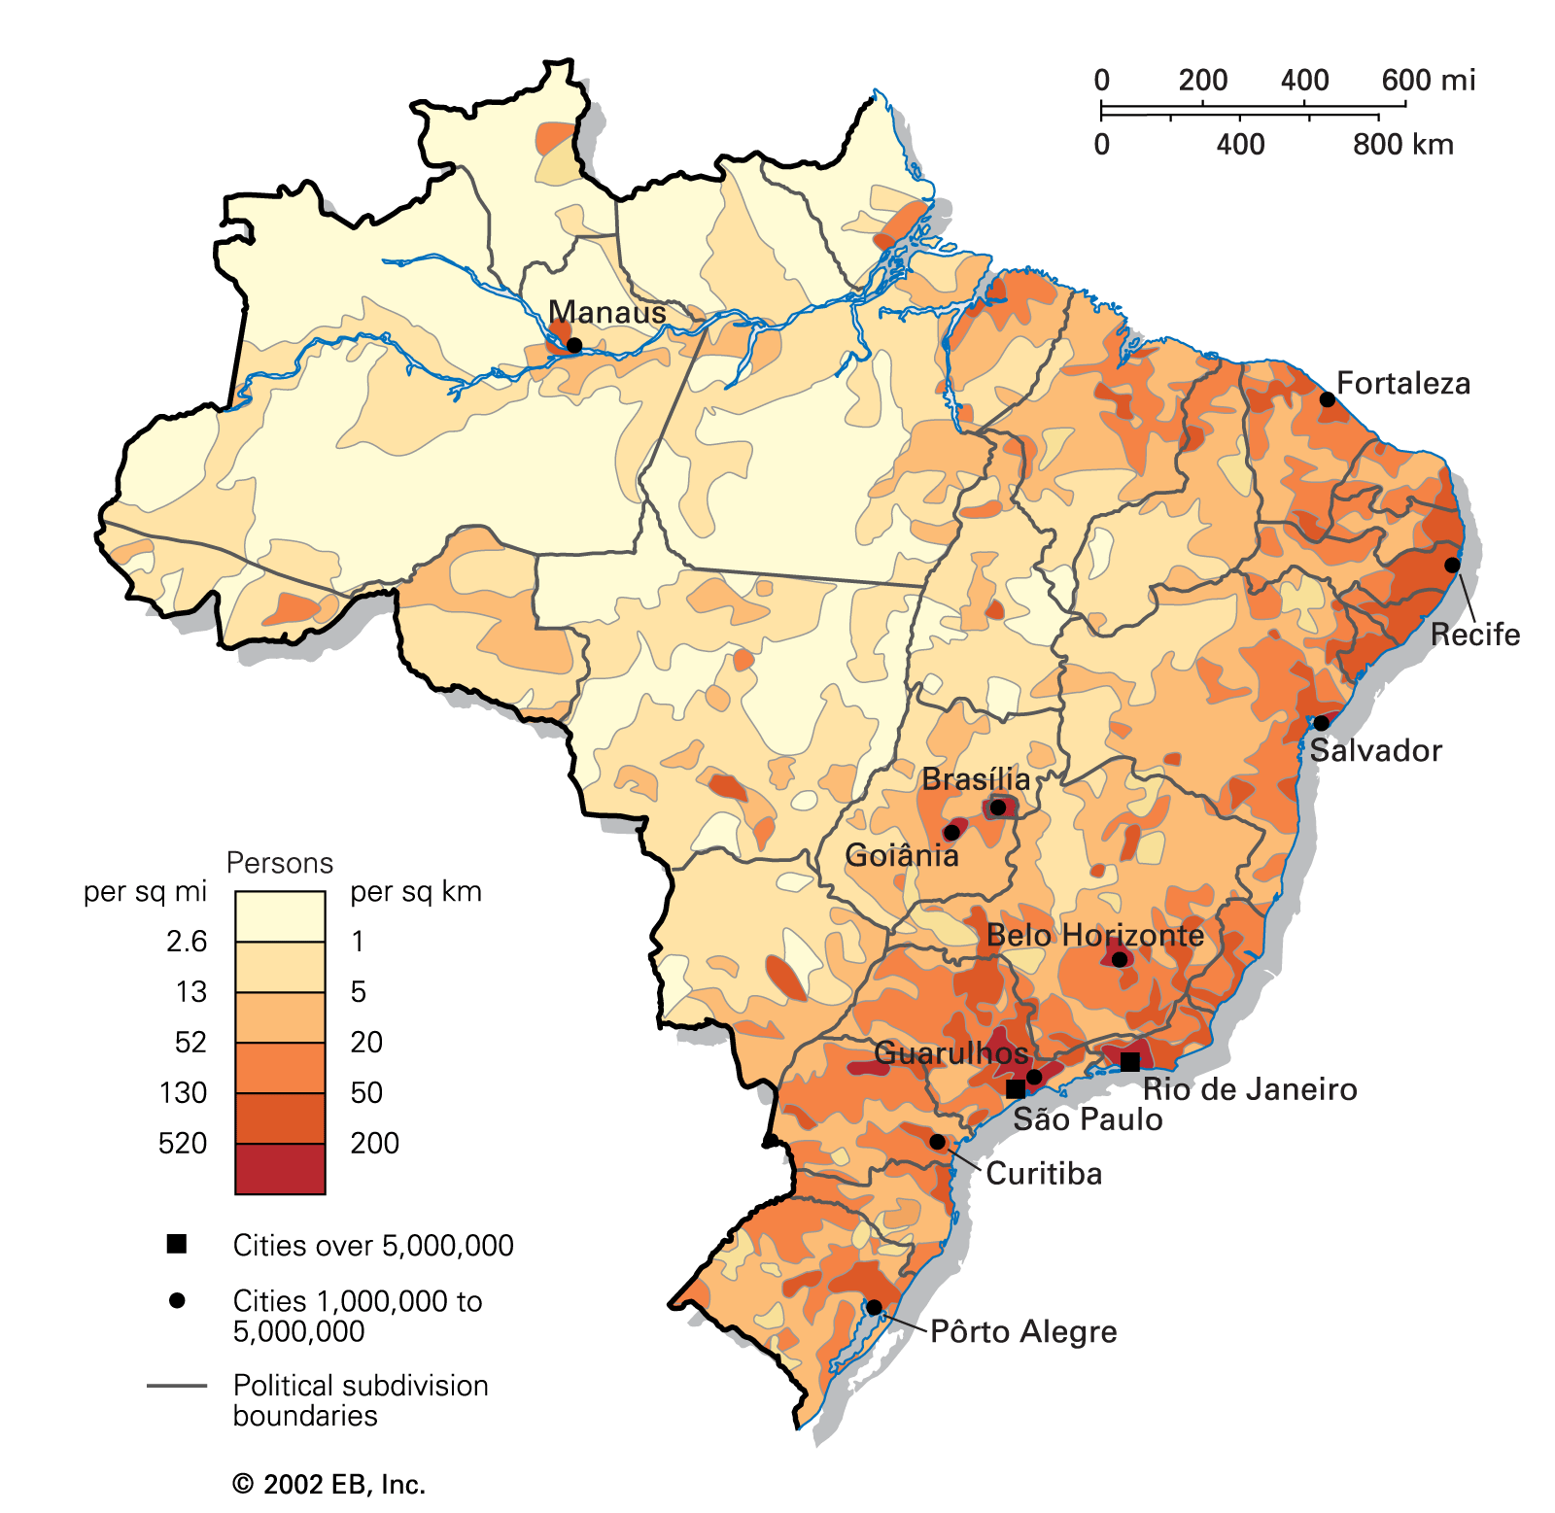
POPULATION
Largest country in South America.
Population of 204,500,000.
World’s fifth largest country.
Largest city Sao Paolo.
Official currency: Real.

Slide 5
REGIONS
Has 26 states and 1 federal district.
States are grouped into regions.
Composed of 5 regions.
North, Central-West, North-East, South-East and South.
Regions In Brazil

Slide 6
WEATHER
Mostly hot.
Average temperature of above 25º.
Cold temperatures in selected areas.
January being the coldest and wettest month.
Humid tropical and subtropical climate.
January
Hottest & Coldest
March
Fairly cold
November
Very cold

Slide 7
TOURIST ATTRACTION SITES
Cristo Redentor and Corcovado, Rio de Janeiro.
Sugar Loaf, Rio de Janeiro.
Iguaçu Falls.
Copacabana, Rio de Janeiro.
Carnaval, Rio de Janeiro.
Amazon Rain Forests.

Slide 8
FOODS
Barbecued meat.
Moqueca (pronounced moo-kek-a).
Cachaça.
Brigadeiros.
Acarajé (pronounced a-ka-ra-zjeh).

Slide 9
CULTURE
Primarily Western.
Derived from European Portuguese culture.
Diverse with a mixture of cultures.
Mostly Indigenous and African people.

Slide 10
INTERESTING FACTS
Number of titles won (1930-2018)
1958 1
1962 1
1970 1
1994 1
2002 1
Biggest annual carnival: Rio Carnaval.
Football team has won 5 world cup titles.
5th largest country in the world.
14 cultural UNESCO World Heritage-designated sites.

Slide 11
CONTACT INFORMATION
Name:
E-mail:
Phone:

