Slide 1
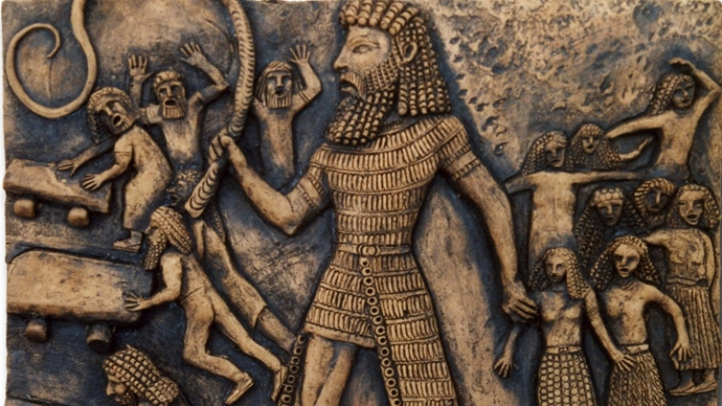
Our Earliest Literature
The Epic of Gilgamesh
and the Babylonian Creation Epic

Slide 2
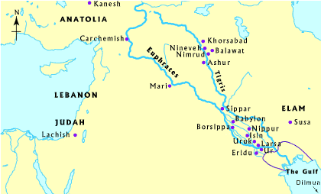
The Beginnings of Civilization
Most accounts of Western history begin with ancient Mesopotamia.
Located in the fertile valley between the Tigris and Euphrates Rivers, in modern day Iraq and Syria
“Mesopotamia” =
“the land between
the rivers”

Slide 3
The Beginnings of Civilization
Mesopotamia had been occupied since the end of the last ice age (~10,000 B.C.)
Advancements in agriculture, irrigation, and animal domestication made surplus harvests possible, raising quality of life
Cities began to form as economic, religious, and cultural hubs
By ~4000 B.C., multiple cultures, often with unique traditions, gods, and languages were sharing this critical region

Slide 4
The Rise of Sumer
Exactly when Sumerians settled in Mesopotamia and where they actually came from is unclear.
Sumerian is an isolate language—it doesn’t seem to have evolved from any other Mesopotamia language.
Sumerian culture might have evolved from earlier North Mesopotamian cultures or migrated from West Asia or East Arabia.
Rose to the power over larger swaths of South Mesopotamia in ~4000 B.C. with the formation of larger urban areas, including Uruk.

Slide 5
The Rise of Sumer
At the height of its use, between 4000 and 2700 B.C., Uruk reached between 50,000 and 80,000 residents—the largest city in the world.
Cities along the river were traditionally led by “priest-kings” and their councils, but by the end of the 3rd millennium B.C., Sumerian culture shifted toward more secular kings.
It is likely that Gilgamesh was an actual historical king of the city-state of Uruk sometime between 2800 B.C. and 2500 B.C.

Slide 6
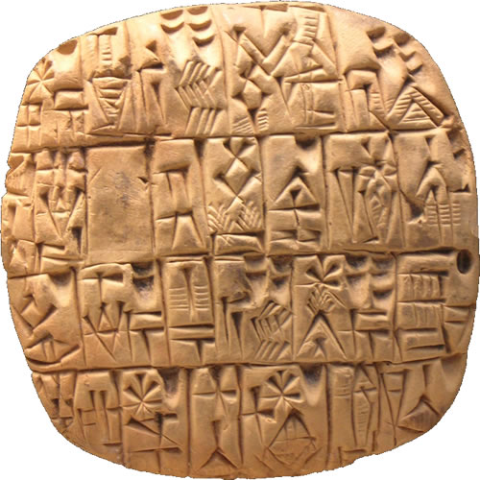
Origins of the Written Word
The oldest known written language, called Cuneiform (“wedge-shaped”), evolved in Sumer sometime around 3100-3000 B.C.
Originally a system of
pictograms (pictures that
had meanings), the writing
became “simplified”
over time, with symbols
coming to stand for
whole words,
consonants,
and syllables.

Slide 7
Origins of the Written Word
Very few people learned to write or read Cuneiform.
It was not originally intended to be used to record literature.
Early Cuneiform examples are typically records of business transactions and government reports.
Cuneiform was primarily learned by scribes to record those business transactions, and by priests and highly educated public figures, who were responsible for teaching the people.

Slide 8
The Oral Tradition
Even though many early civilizations such as ancient Sumer, Babylon, and even ancient Greece had a form of writing, most people in the community could not read or write.
Instead, these cultures shared information following the oral tradition.
Stories and information were expressed orally from person to person, and people memorized the portions of the stories or information that were considered important.
Oftentimes, these cultures were structured so that educated elites at the top of society were able to read and write, which gave them power over what information the rest of society learned.

Slide 9
The Oral Tradition
In most early civilizations, for example, priests, kings, and other government figures could read and write, which gave them the ability to shape religious texts and laws.
People who could not read or write were dependent on the information given to them by these educated, elite members of society.
Information travelled primarily by word of mouth: each person who heard a story or piece of information then passed that information on to others orally, by reciting the information out loud.
This meant that stories were told in two ways: they were either perfectly memorized and told word-for-word—or they were loosely retold, with many variations as they travelled from person to person.

Slide 10
The Oral Tradition
Although most people nowadays are literate (can read and write) in at least one language, the oral tradition has not completely died.
We still love to tell stories out loud!
Teachers read storybooks out loud to their young students; families gather together over dinner to talk about their days; friends might share gossip they overhead about others or summarize a great new movie they just saw.
You might be listening to this PowerPoint out loud right now—because listening to a human voice can sometimes make the information easier to understand (and more interesting) than just trying to read through it by yourself.

Slide 11
The Oral Tradition
Why do we tell stories out loud?
Most people don’t sit down and read their grocery lists or bank records out loud nowadays. But we still tell stories to others.
Telling a story out loud has numerous benefits:
  Easier to remember
  More emotionally engaging
  Allows for information to be quickly shared
  Helps maintain a human connection
  It’s just plain out fun
The oral tradition has existed as long as humanity has existed—our Neanderthal ancestors likely told stories to each other. Gathering together to share the events we’re experienced or the things we think and feel is a uniquely human experience that will likely persist as part of our culture forever.

Slide 12
A Little More History: Akkad and Babylon
Sumer’s dominance over southern Mesopotamia waned with the growing military strength and cultural prominence of the Akkadians.
Prior to this, cultural confluence tied Sumer and Akkad together strongly.
In 2334 B.C., Sargon became king of Akkad and embarked on an expansionist campaign.
By ~2270 B.C., Sargon defeated the last Sumerian king of Uruk, uniting most of Mesopotamia under the banner of the Akkadian Empire. The town of Babylon was formally established.

Slide 13
Akkad and Babylon
But the vast area, with its many conflicting cultures, was impossible to maintain.
A confluence of political and climate related events caused the formal collapse of the Akkadian Empire in 2154 B.C.
Mesopotamia entered a brief “Dark Age,” followed by rapidly shifting powers vying for control.

Slide 14
Akkad and Babylon
In ~1792 B.C. the vacuum of power in South Mesopotamia was filled when the previously small town of Babylon flourished under the reign of Hammurabi.
Under his control, Babylon became an empire that, in relatively short time, assumed control of all of Mesopotamia.
The rise of the Babylonian Empire dramatically changed culture in Mesopotamia, introducing new gods (including Marduk) to the greater pantheon, and transforming political and economic policies. The legal Code of Hammurabi is still studied today.

Slide 15
The Epic of Gilgamesh
A fictionalized poetic account of the life of Sumerian Gilgamesh (“The ancestor is a young man”), who likely reigned as king of Uruk sometime around 2800-2500 B.C.
Numerous Sumerian cuneiform tablets detailing small parts of Gilgamesh’s story have been recovered.
Standard version is translated from 12 tablets in Akkadian cuneiform, compiled in Babylon in 1200 B.C. by Sin-Leqi-Unninni.
The tablets were badly damaged, and some parts of the story may be lost forever.
As with many texts, Gilgamesh was intended to be read out loud to an audience, not silently by a single reader.

Slide 16
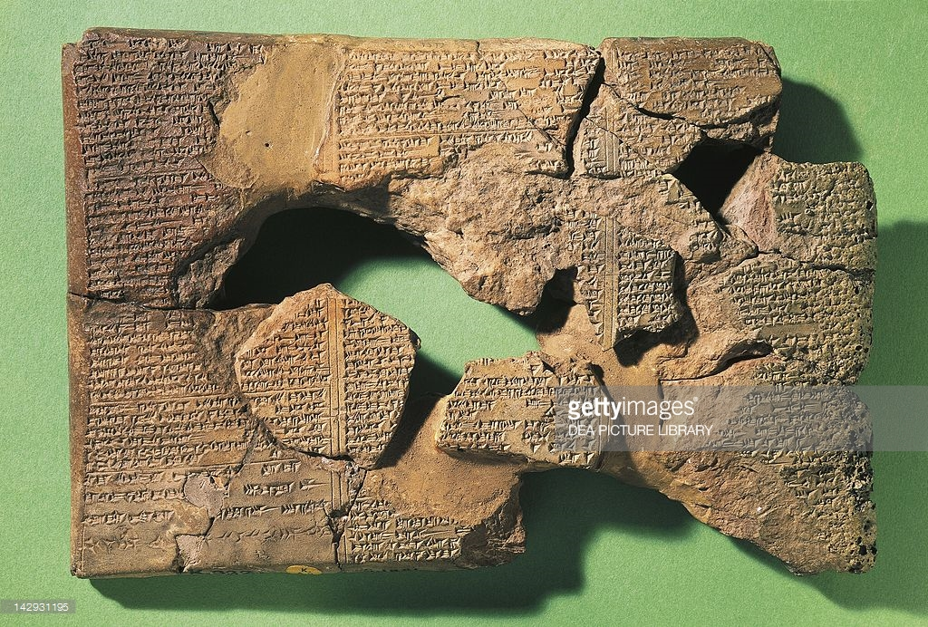
The Epic of Gilgamesh

Slide 17
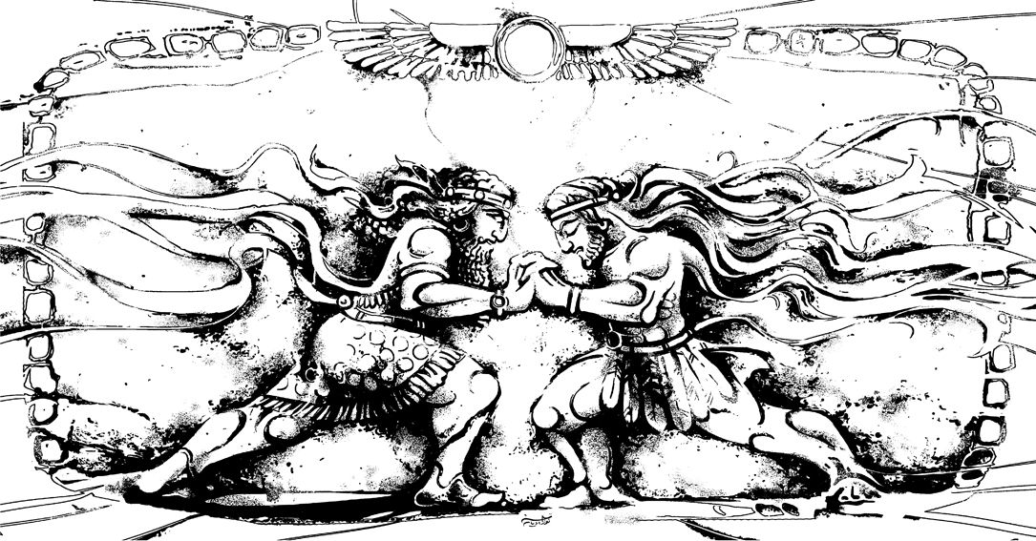
The Epic of Gilgamesh
The tablets that make up our current version of the Epic of Gilgamesh were recovered from excavations at the Library of Ashurbanipal in the ruins of Nineveh, located historically in Assyria.
The story that is available today recounts Gilgamesh’s days as a tyrant in Uruk, which motivates the gods to create an “equal” to distract him. Together, the two friends embark on a quest to slay the monstrous Humbaba and then defeat the Bull of Heaven, which incites the wrath of the gods, resulting in Enkidu’s death. Deeply affected, Gilgamesh undertakes a journey past the ends of the earth seeking immortality.
He fails in this
quest and ultimately
returns to Uruk,
contenting himself with
the architectural legacy
he will leave behind in his
city-kingdom.

Slide 18
The Epic of Gilgamesh
The ambiguity of cuneiform text makes it difficult to determine whether Gilgamesh has many of the elements of style we associate with traditional poetry.
It does not appear to have conventional line breaks, set meter (syllabic rhythm), or rhyme.
However, Gilgamesh is full of plays on words, homophones (words that sound the same but have multiple meanings), and situations unique to the cuneiform script, where a marking might be both a word and part of another simultaneously.
Includes near constant repetition.

Slide 19
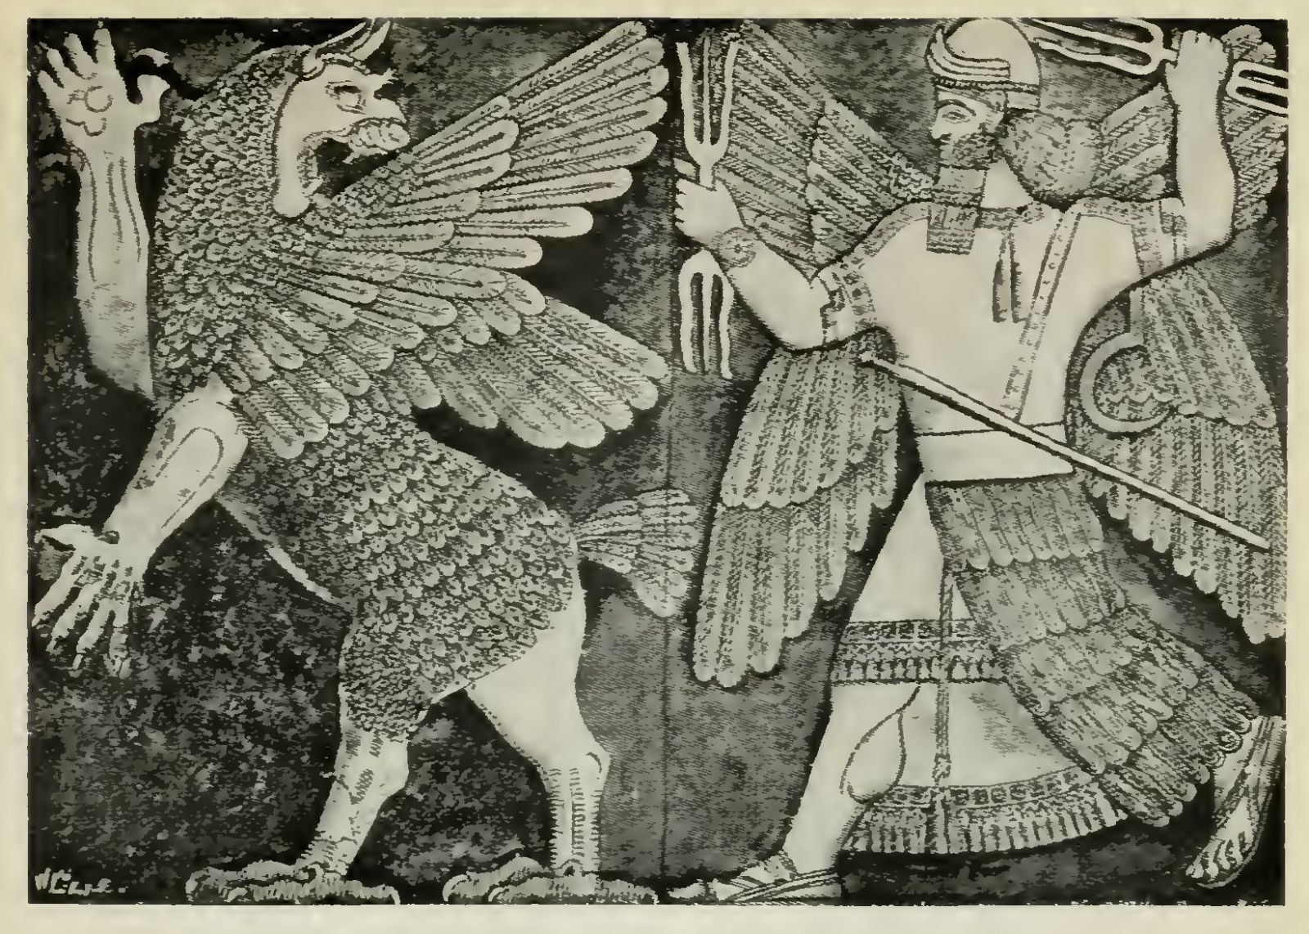
Babylonian Creation Epic
Likely a conglomerate of many older, similar stories from previous cultures, with influences from Sumer, Old Akkadian legends, and West Semitic tribes.
The exact date of its writing is unknown. It may been set in stone prior to the growth of the Babylonian Empire (~1800-1700 B.C.) or it may have been a later inscription summarizing beliefs, possibly recorded between 1100 and 1000 B.C.

Slide 20
Babylonian Creation Epic
Like the Epic of Gilgamesh, it was recorded in Akkadian cuneiform.
Also like Gilgamesh, it was meant to be listened to, not actively read by the masses.
Similarly, it is difficult to determine what identifiable elements of poetic style it would have had for its listeners, although it also heavily features repetition.

Slide 21
Babylonian Creation Epic
The creation epic has a clear goal: to establish Marduk’s, an original Babylonian god’s, prominence in the pantheon over other older gods worshipped across Mesopotamia, and to elevate Babylon to the chosen city of the gods.
The existing fragments of the tale we have explain how Marduk formed the earth (especially the land of Babylon) from the body of the monster-goddess Tiamat, and humans from the blood of her consort, Qingu. The gods build a major temple in Babylon to make a resting place, and Marduk establishes humans as the bearers of the gods’ burdens, allowing them to rest.

Slide 22
What is an “Epic”?
A longer poem, sometimes even book length
A narrative poem, i.e. intending to tell a complete story
Utilizes lofty, elevated, sometimes even archaic (ancient, outdated) language
Often focuses on a central protagonist (the “hero” archetype)
Details the hero’s famous deeds—almost always involves an adventure or battle against a great evil

Slide 23
What is an “Epic”?
Almost always serious in nature, dealing with complex concepts like war, death, loss, and legacy
Typically details events which are central to the culture or nation that produced the epic—often epics address the actions of kings leading their nations to greatness (or ruin)
Most later Western epics utilize set meter and even rhyme.
Other common elements: divine intervention, statements of theme, examinations and changes to the hero’s values, a hero who learns or changes through his experiences

Slide 24
What is an “Epic”?
Some other examples of epics:
  Homer’s The Odyssey and The Iliad
  Virgil’s The Aeneid
  The Mahabharata
  Beowulf
  The Song of Roland
  The Nibelungenlied

Slide 25
Influence on Other Texts
Many of the concepts present in The Epic of Gilgamesh and the Babylonian Creation Epic appear in the texts of other Mesopotamian and Near/Middle Eastern cultures.
Notably, both Gilgamesh and the creation story make reference to a terrible flood, which may be the same flood referenced in the Old Testament.

Slide 26
Influence on Other Texts
Core elements of Gilgamesh appear thematically similar the creation story present in Genesis and Exodus, including a man’s seduction away from nature and ignorance into a state of awareness by a woman, wrestling with a being who is said to be divine, the loss of immortality due to the trickiness of a serpent, and the role of man to live and die on earth.
The Bible mentions Akkad in Genesis, indicating that there was some form of cultural exchange between the Semitic groups and the Akkadians.
Some brief portions of the later Gilgamesh tablets seem to have been utilized almost word-for-word in portions of Ecclesiastes.

Slide 27
Points to Consider
The Epic of Gilgamesh:
  This epic was lost to the world from the fall of the Assyrian Empire in Mesopotamia until the 1850s, when it was rediscovered and translated into English. It gained popularity with readers during World War II. Why?
  Repetition plays a major role in how listeners perceive this poem. How?
  The text is already a compilation of earlier stories and poems—a retelling of a retelling of history. How might it have evolved over time?
  The relationships between gods and humans depicted in Gilgamesh are very different from those in other ancient texts from the region, including the Old Testament. What is different about Gilgamesh?

Slide 28
Points to Consider
The Epic of Gilgamesh:
  Thematically, Gilgamesh is full of binaries: Enkidu’s wild nature versus Gilgamesh’s power over the city and civilization, immortality vs. mortality, love and friendship in comparison to wrath. How do these show up in the text?
  Central to its plot and conclusion is the question of the inevitability of death for humans and how immortality is defined—whether it means living forever, or whether leaving behind a legacy is sufficient to secure it. What do you think? How would you define immortality?
  Parallelism between events and characters is also vital to Gilgamesh’s storytelling. Characters are described similarly, familiar events happen more than once, and the hero’s journey takes a circular route. What does this do for the story?

Slide 29
Points to Consider
The Babylonian Creation Epic:
  This epic served a direct purpose and walked a thin line by revising previous cultures’ creation myths to prioritize the Babylonian creator deity Marduk and to centralize Babylon the city. How the text show the fact that this might be a revision of earlier creation stories?
  The roles the gods play feels different in this epic compared to Gilgamesh. How do gods relate to humans in this myth, compared to Gilgamesh? Can you show some specific differences in the text?
  What, exactly, are the “many needs” of the gods that Marduk creates humans to fulfill? What would your definitions of these many needs be?
  This poem is referred to as an epic. Does it seem to match the definition of an “epic poem” as we just laid it out? What is similar? What might be missing?

