Slide 1

Lab #2
DUE: FRIDAY, SEPTEMBER 7 @ 12:20pm
LAB #2 Assignment Summary
Chapter 2: (7a,b) (10a,b) (11a,b) (21a,c,d)
Chapter 3: (1) (4) (6) (9a,b,c)

Slide 2
Office Hour Reminder
Thursday 9:30-10:30am
606B (inside the Weather Center)
Email me with any questions, especially if you can’t make it to office hours! (kar5469@psu.edu)

Slide 3
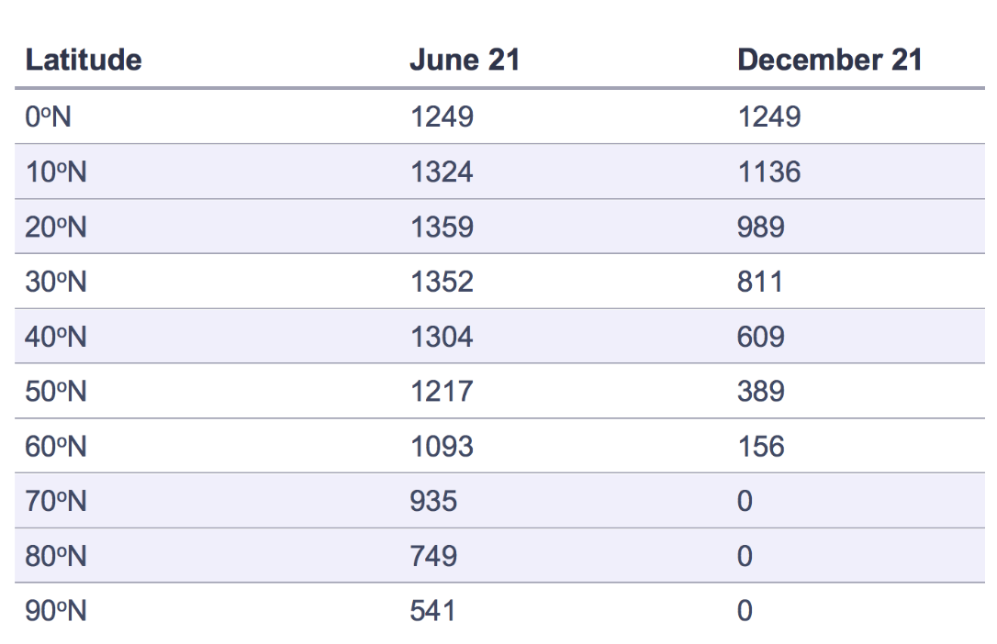
Problem 2.7
Solar radiation (W/m²)
a) Copy and plot the data in Excel or use graph/lined paper, but be neat!
Solar radiation (W/m²)
June 21
Dec 21
0
90
Latitude (ºN)
Print plot and attach to your assignment
Find the latitudes where incoming radiation varies the least and most between the two lines
b) Find latitudes where largest and smallest swing in temperature
Hint- temperature is related to the amount of incoming radiation
Think about what factors affect the climate of a location (At the Beach? Mountains?)

Slide 4
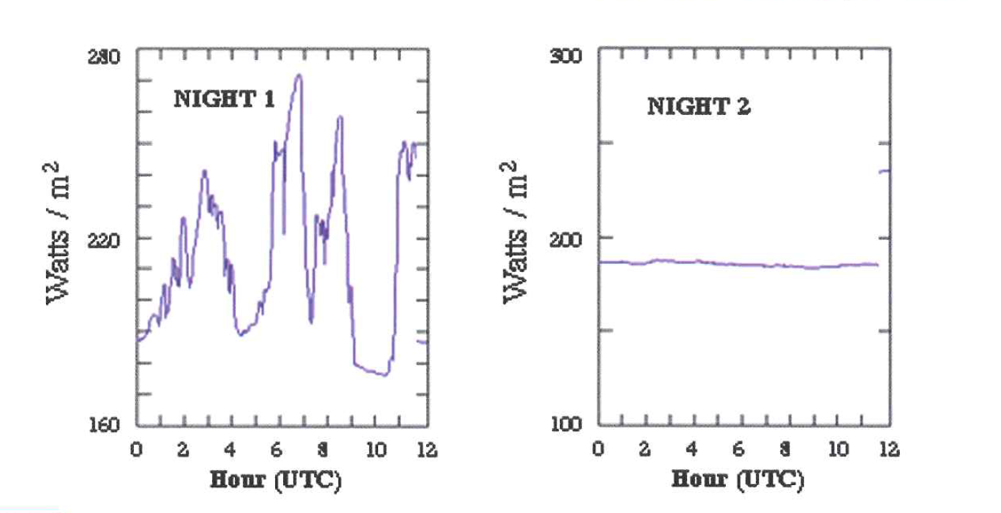
Problem 2.10
Why the difference?
*Note the different scales on the y axis
b) Eyeball the average downwelling radiation for both nights using the graphs
Hint – More downwelling radiation heats up the ground more, so it is warmer
Times shown are 7 pm thru 7 am

Slide 5
Problem 2.10
*Note the different scales on the y axis
“Downwelling infrared radiation”?
Times shown are 7 pm thru 7 am
a) Why the difference?
Hint- What might emit radiation in the sky at night?

Slide 6
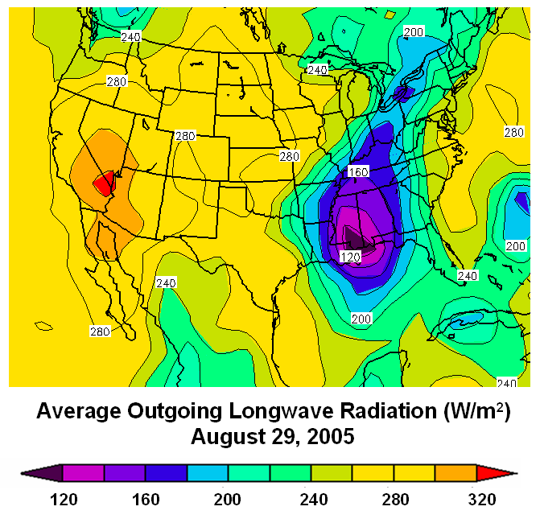
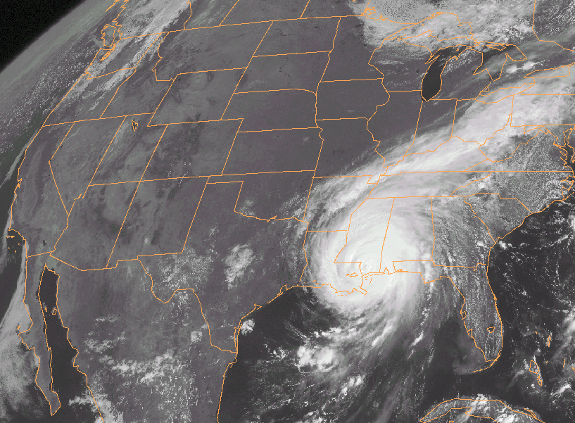
Problem 2.11
Highest values
Lowest values

Slide 7
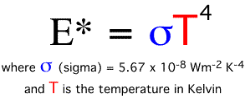
Problem 2.11
a) What is the atmospheric source of the infrared radiation in the Gulf?
Hint - Make connections between the two maps
Was the temperature of the Gulf source higher or lower than the temperature of the desert source?
Hint - Stefan-Boltzmann Law:
The higher the emission, the greater the temperature
b) What is the source in the desert for the radiation?
Hint – Is it atmospheric or terrestrial?

Slide 8
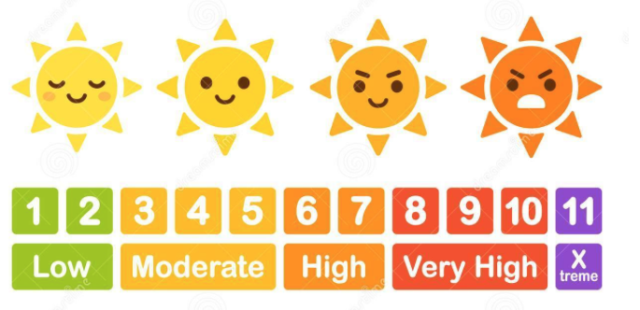
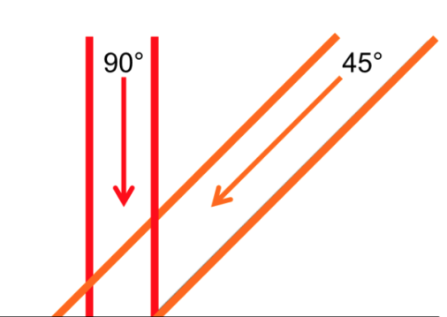

Problem 2.21
Why UV index apply at solar noon?
Hint – think about the sun’s angle and intensity

Slide 9
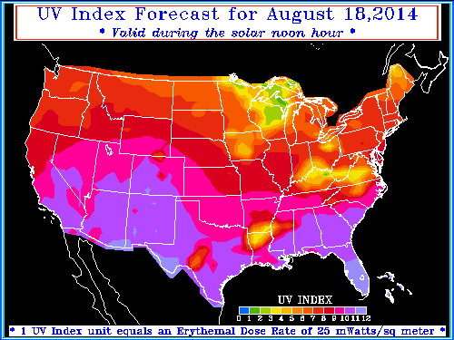
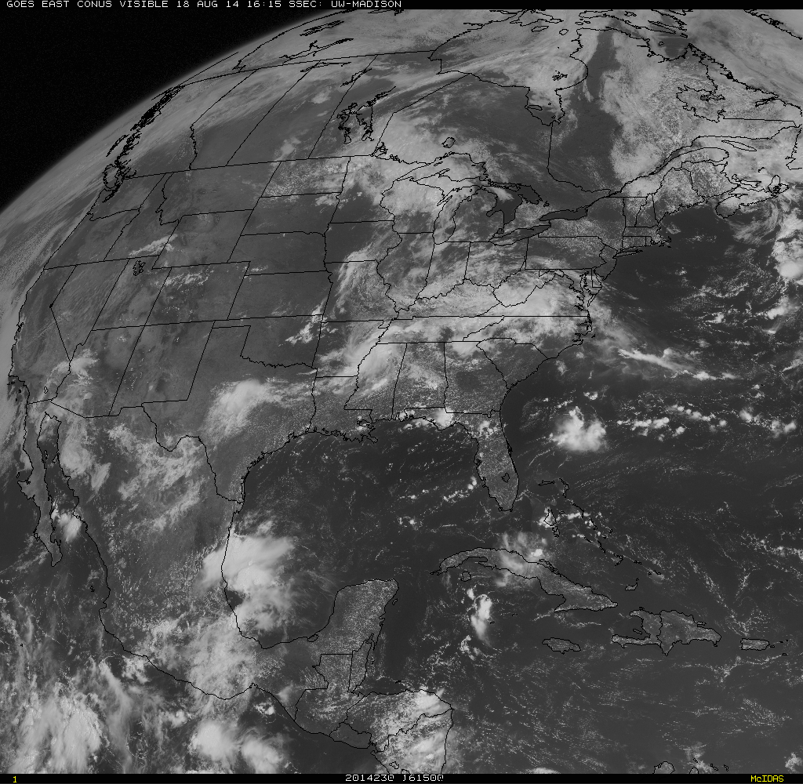
Problem 2.21
UV index related to latitude? Why?
Hint -Think about where the sun is directly above
UV index related to clouds? Why?
Hint - Make a connection between the two maps
Are clouds increasing or decreasing the UV index?

Slide 10
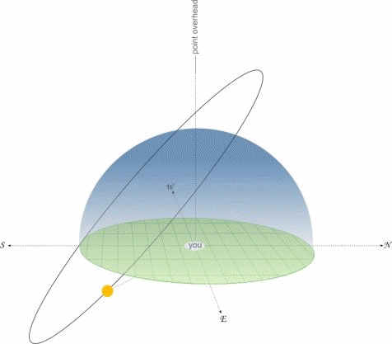
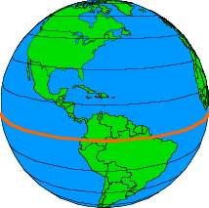
Problem 3.1
Directly above
90º
Maximum altitude of Sun
D
The angle above the horizon where the Sun reaches its maximum for that time of the year
Max Altitude Angle
Horizon
0º
Max Altitude Angle = 90º - D
D is the difference (in degrees) between:
  1.) latitude of your location
  2.) latitude at which Sun is directly overhead at that time of year

Slide 11
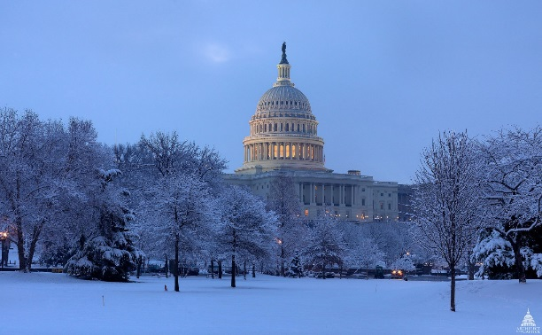
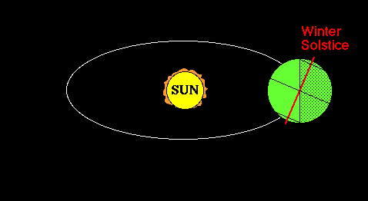
Sun Angle Example
Max Altitude Angle = 90º - D
Washington, DC is located at 39ᵒ N. Determine the maximum altitude of the sun during the winter solstice and fall/spring equinox
  Fall and Spring equinox sun is at equator (0ºN)
  Latitude difference: D = [39° - 0°]= 39°
  Max Altitude: 90° - D = [90° - 39°] = 51°
  Winter solstice sun is overhead
  at 23.5°S latitude (farthest South)
  Latitude difference: D = [39° - (-23.5°)] = 62.5°
  Max Altitude: 90° - D = [90° - 62.5°] = 27.5°
Negative for Southern Latitudes

Slide 12
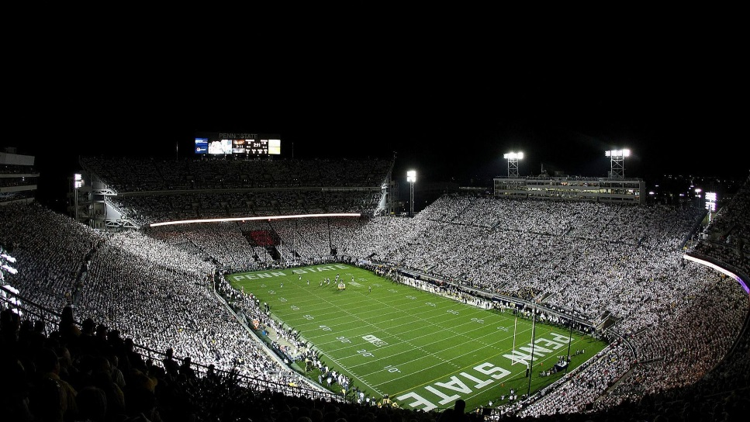
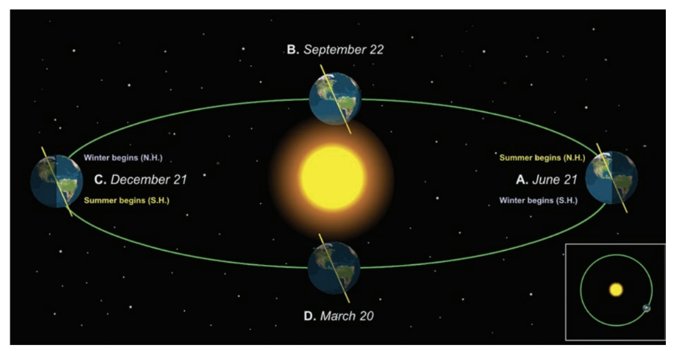
Problem 3.1
What is the max altitude of Sun in State College?
Look up online the nearest whole degree of latitude (ºN) for State College
3 calculations: equinox (spring/fall) , summer solstice, and winter solstice
Hint - where the sun is overhead during the Solstices and Equinoxes?
At the equator? In the southern hemisphere? In the northern hemisphere?
Consider the sign (+/-) of latitude in northern and southern hemispheres

Slide 13
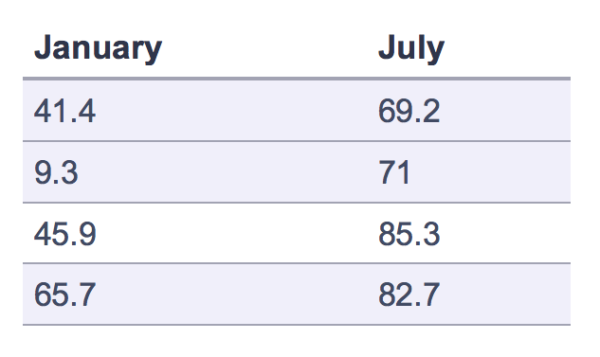
Problem 3.4
Given Jan and July average temperatures (ºF) for 4 cities. Match the cities to the data.
What’s the seasonality and climatology of the cities?
Consider:
  Latitude – warmer locations closer to equator
  Proximity to body of water (or not)
  Elevation – higher elevations tend to be cooler
  Hint - Look at a map of the U.S. and find these cities
Dallas, TX
Fargo, ND
Portland, OR
West Palm Beach, FL
Notes:
Proximity to water - San Francisco is closest to large body of water so it has the least variability. St Louis is far from water, continental location with big temperature swings
West vs East coast - Charleston has more variability than San Diego (San Diego prevailing winds from west off the Pacific)

Slide 14
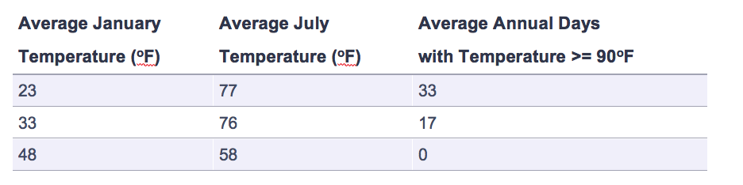
Problem 3.6
Given Jan and July average temperatures (ºF) for 3 cities. Match the cities to the data.
Similar to last question, so use the same considerations
Latitude is no longer an issue (all cities are at same latitude)
Wind direction will play a larger factor
  Hint – is the wind coming off the water or the land (look at a map)
New York, NY
Omaha, NE
Eureka, CA

Slide 15
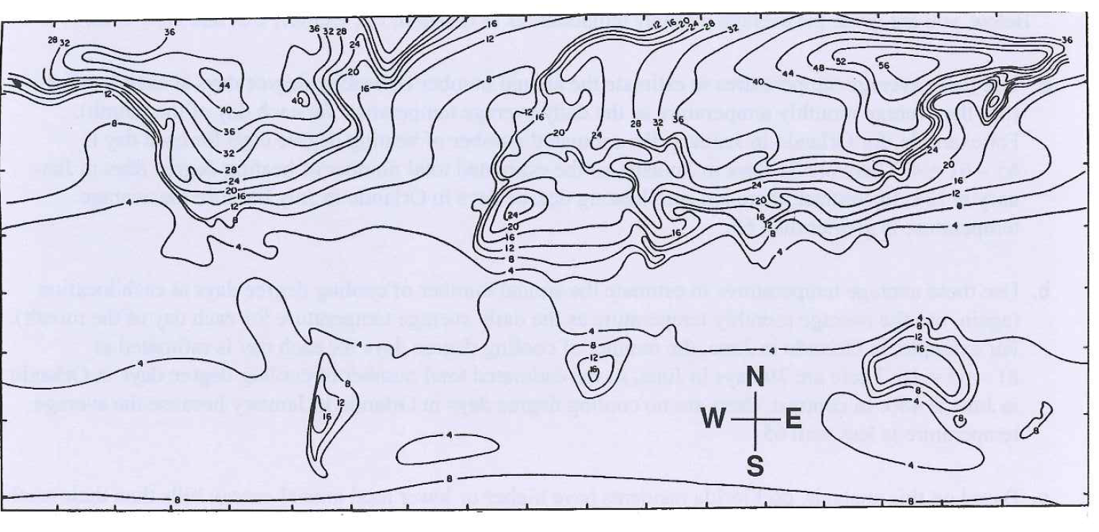
Problem 3.9
Label the continents, oceans, and Sahara Desert
Explain your reasoning for part (a)
Isopleths of the annual range in surface temperature
Think about the same guidelines used in problems 3.4 and 3.6
c.) Look for largest isopleths for the largest seasonality
+2 Bonus points!
Relate your answer to the answer of Problem 2.7
North America
Notes:
More continental, highest seasonality = greatest difference in temperature.

