Slide 1
Lab 3
Due Fri, Sept 14th
Assignment Summary
Chapter 3: (13 a-e), 14, 15, 16
Chapter 4: (1 a,b ), 4, 6, 8

Slide 2
Problem 3.13
Five questions that explore the effect of large bodies of water on surface air temperature
  Water has a high heat capacity
      Lots of energy must be added to water to raise its temperature.
      Change in temperature is therefore slow to respond.
      Large bodies of water moderate temperature (i.e., reduce the seasonality of an area)
Must also consider prevailing wind direction!
  In general, winds blow across the country from west to east

Slide 3
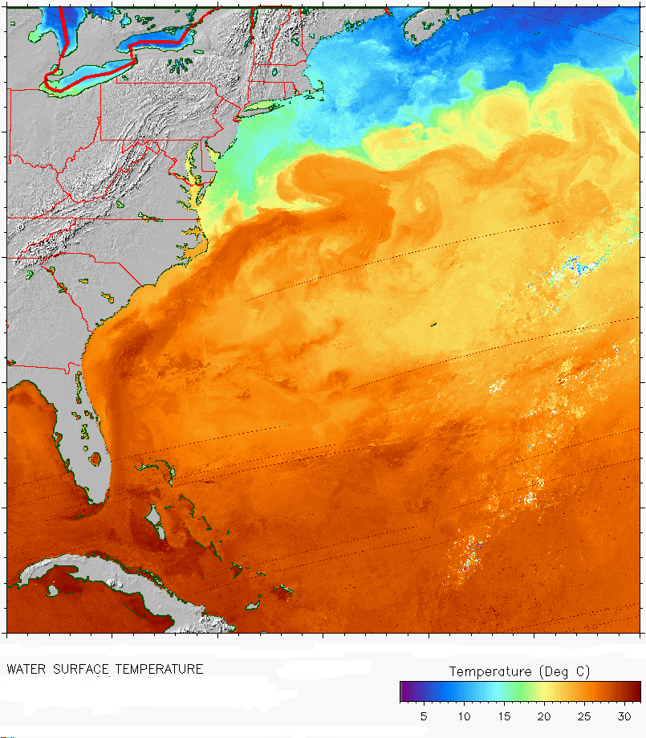
Problem 3.13e
Consider the direction of ocean currents and what water temperature they carry.
Major Ocean Currents
Water Surface Temperature

Slide 4
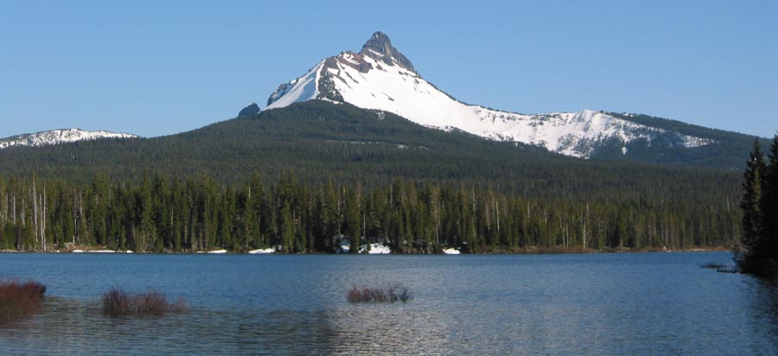
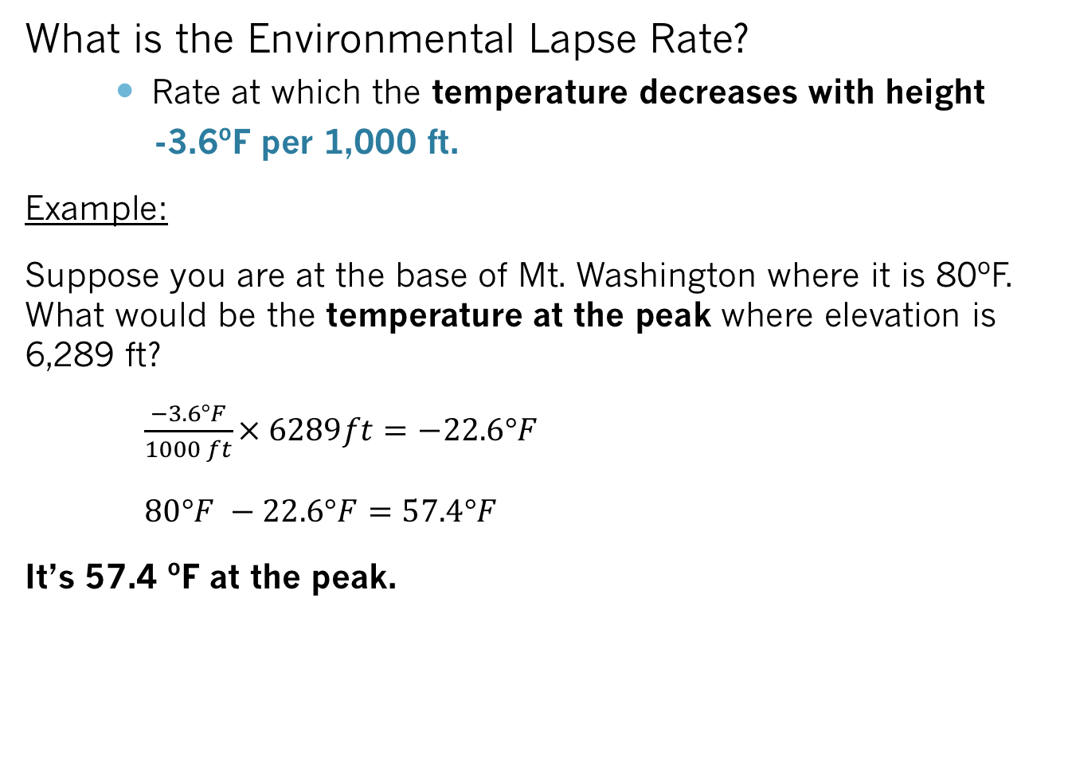
Problem 3.14
What is the Environmental Lapse Rate?
    Rate at which the temperature decreases with height
    -3.6ºF per 1,000 ft.
Example:
Suppose you are at the base of Mt. Washington where it is 80ºF. What would be the temperature at the peak where elevation is 6,289 ft?
$\frac{−3.6°F}{1000 ft}× 6289ft=−22.6°F$
$80°F −22.6°F=57.4°F$
It’s 57.4 ºF at the peak.

Slide 5
Problem 3.15 a,b
 | Albuquerque, NM |  | Atlanta, GA
 | Max | Min | Max | Min
2001 | 91 | 62 | 83 | 66
2002 | 93 | 65 | 85 | 67
2003 | 88 | 61 | 83 | 66
2004 | 89 | 61 | 83 | 68
2005 | 89 | 61 | 84 | 67
2006 | 91 | 65 | 87 | 67
2007 | 90 | 62 | 90 | 69
2008 | 91 | 62 | 90 | 69
2009 | 86 | 61 | 89 | 70
2010 | 92 | 64 | 91 | 72
Compute the average diurnal range for each city.
  1.) Calculate the difference between max and min for each year (this is the diurnal range).
  2.) Take the average of all the differences you calculated.
Which city has more clouds?
  Think about how clouds effect max and min temperatures

Slide 6
Problem 3.16 a
Maximum Temperature (ºF)
Snow Cover (inches)
Isopleth MAP A. (Remember to label)

Slide 7
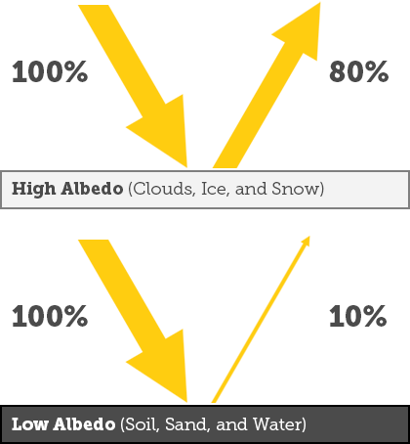
Problem 3.16
Why is there a large temperature gradient?
  Think about the albedo of snow.
Albedo- amount of solar energy reflected

Slide 8
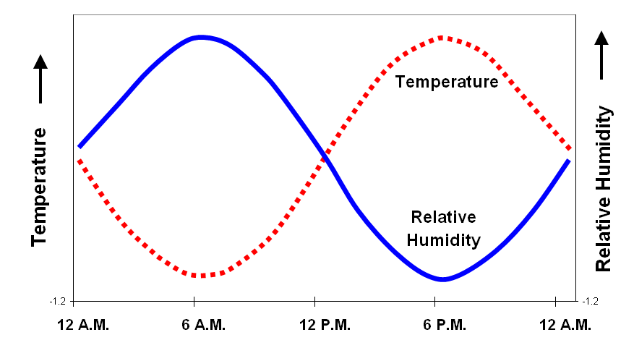

Problem 4.1a: Relative Humidity (RH)
$$RH= \frac{vapor pressure}{equilibrium \left(saturation\right)vapor pressure} x 100\%$$
Vapor Pressure: Pressure resulting from evaporation of a liquid
Equilibrium Vapor Pressure: Pressure when there are equal rates of evaporation and condensation
  Increases as temperature increases (more water vapor can be in the air at higher temperatures).
Relative Humidity depends on the air temperature.
Assume the dew-point is constant (vapor pressure will not change)
Increase temperature → Decrease relative humidity
Notes:
As Temperature Increase, equilibrium vapor pressure becomes larger while vapor pressure remains the same → so RH becomes smaller
As Temperature decreases, equilibrium vapor pressure becomes smaller while vapor pressure remains the same → RH becomes larger

Slide 9
Problem 4.1b: Dew-Point Depression
Dew-Point: Temperature at which air must cool to reach saturation (saturation is when RH = 100%)
Dew-Point Depression: Difference between the air temperature and dew point
DP Depression = Air Temp – DP
b.) What is the relationship between dew-point depression and relative humidity?
As dew-point depression _________, relative humidity ________.
(decreases/increases)
(decreases/increases)

Slide 10
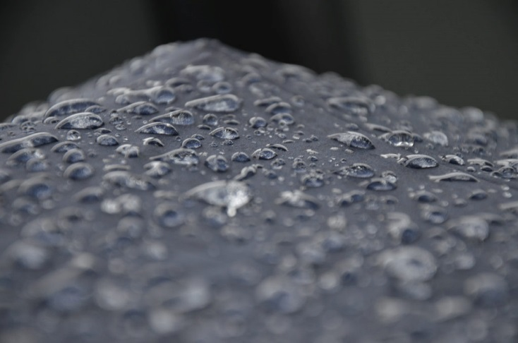
Problem 4.4
Why is the atmosphere to blame for making concrete floors wet in the absence of a climate control system?
  Hints:
  Concrete takes longer to heat up than air.
  Will the concrete have a lower temperature than the dew-point? If so, what happens?

Slide 11
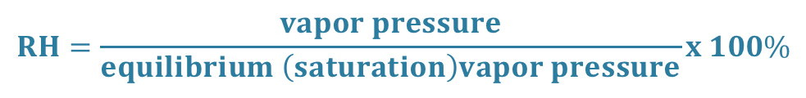

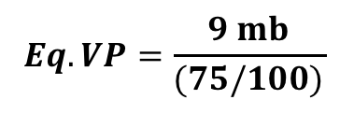
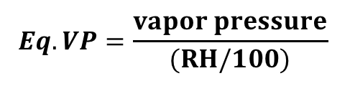
Problem 4.6
Given 2 out of 3 variables (RH, vapor pressure, and equilibrium vapor pressure), you will solve for missing variable.
Example
Given: RH = 75% and Vapor Pressure = 9mb
What’s the Eq. Vapor Pressure = ?
Solution:
1. Rearrange equation for Eq VP.
$$RH=\frac{vapor pressure}{equilibrium \left(saturation\right)vapor pressure}x 100\%$$
$$Eq. VP=\frac{vapor pressure}{(RH/100)}$$
$$Eq. VP=\frac{9 mb}{(75/100)}$$
$$Eq. VP=12 mb$$
Notes:
9mb/0.75 = 12mb

Slide 12

Problem 4.8
Is moist air less dense or more dense than dry air?
Atom (symbol) | Mass (amu)
Oxygen (O) | 16
Nitrogen (N) | 14
Hydrogen (H) | 1
$$Density=\frac{Mass}{Volume}$$
Given two parcels of air with equal volumes (therefore can simply compare their masses)
What is the molecular masses of O₂? N₂? H₂O?
  Ex). Molecular mass of H₂O
      Oxygen = 16 AMU; Hydrogen = 1 AMU
      H₂O = 2 Hydrogen + 1 Oxygen
      (2 x 1 AMU) + (16 AMU) = 18AMU
Find the total mass of the dry & moist parcel, and compare.

