Slide 1
Meteo 003: Lab 5
Chapter 6: (11 a-d) (18 a,b,c) (24 a-b)
Chapter 7: (1 a-c ) (2 b-c) (9 a-b) (10 a-b)
Chapter 8: (2 a-d)

Slide 2
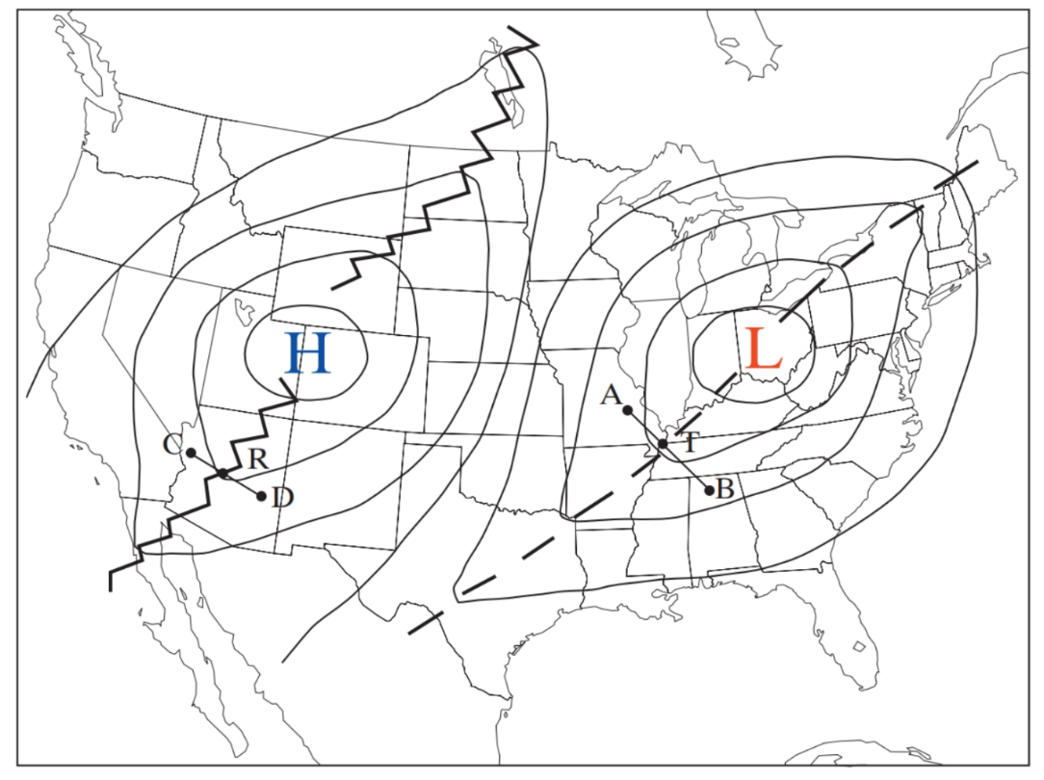
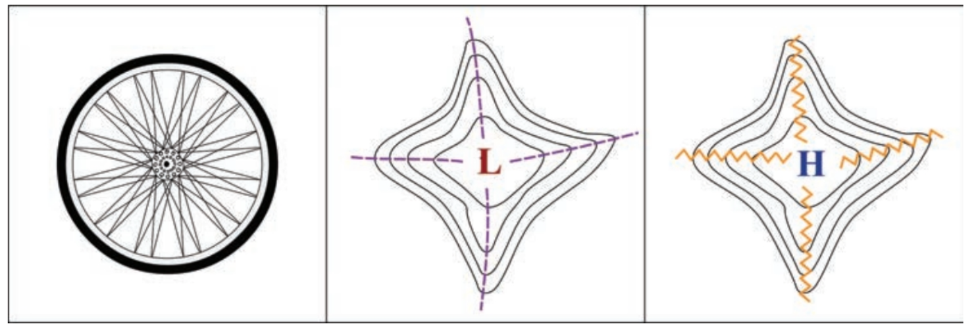
6.11 (a-b) Constant Pressure Maps
a) Centers of high (low) pressure
  pressure decreases (increases) as you go out of the center.
b)
Trough - elongated region of low pressure
Ridge – elongated region of high pressure

Slide 3
6.11 (c-d) Wind Flow
c)
At high altitudes the air flows parallel to isobars with low pressure to its left (see top diagram).
  This is due to the PGF & Coriolis balancing each other. We call this the GEOSTROPHIC WIND.
Closer to the surface there is friction, which slows the wind down & reduces the contribution from Coriolis (see bottom diagram).
  PGF wins out and the air crosses isobars towards low pressure (at roughly 30º)
d) Tighter isobars (greater PGF), create a fast wind. (assuming no change in friction)

Slide 4
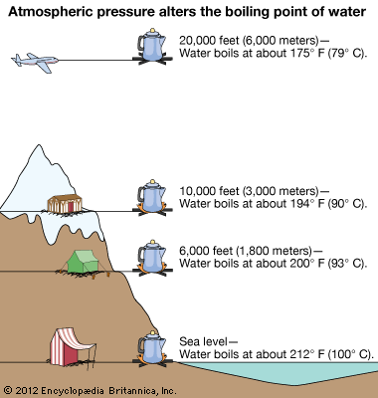
6.18 (a-c) Boiling Point of Water
a) Pressure increases the deeper into the ocean
  How does this affect the boiling point?
  Higher Pressure = Higher Boiling Point
b) Same concept as part a
c) How does pressure change at higher altitudes?
Notes:
Part b - Increasing pressure raises boiling point which allows you to cook at temps higher than 212
Part c – water boils at lower temp, so egg might not be fully cooked

Slide 5
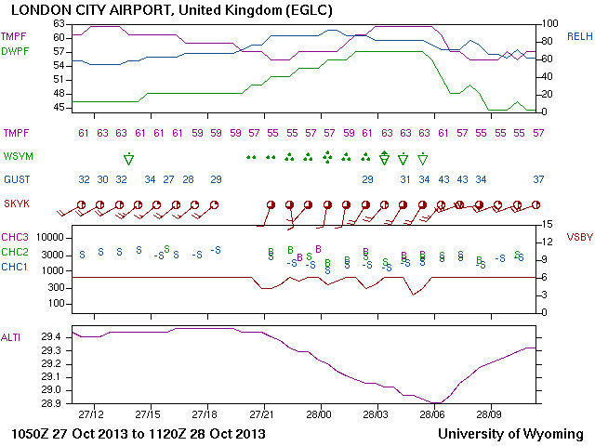
6.24 (a-b) How to Read a Meteogram
Surface Temperature
Dew-Point Temperature
Relative Humidity
Precipitation
Max Wind Gust
Wind Direction/Speed
Cloud Base Height
Visibility
Altimeter Pressure
Date / Time (UTZ)

Slide 6
6.24 (a-b) Meteograms and Fronts
Fronts are associated with:
    A change in pressure
    A shift in the wind direction
    Temperature and dew point changes
    Precipitation (usually precedes the passage of the front)
To determine the type of front, look at the wind direction before & after its passage, as well as, the temperature before & after.
  Is it a cold or warm front?

Slide 7
7.1 (a-c) Height & Constant-Pressure Maps
a) Hint: Pressure decreases with altitude
b) Hint: Be careful because the contour intervals for each map are not the same!
c) Geostrophic winds are parallel to the isobars with lower heights to the left of the wind direction.
How does the spacing of isobars relate to wind speed?

Slide 8
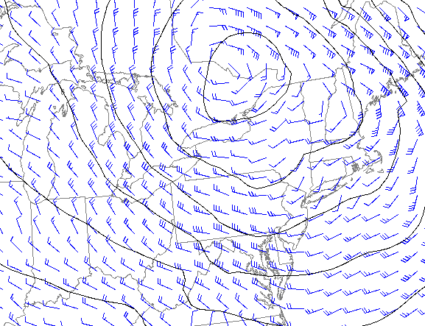
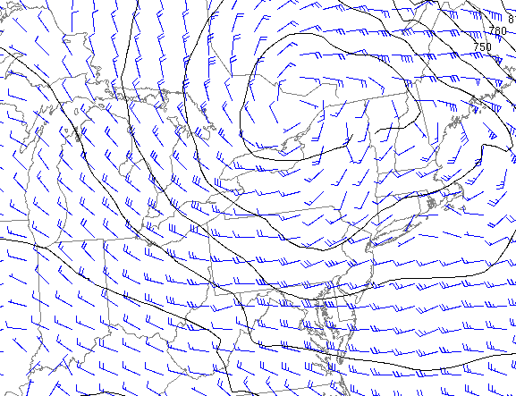
7.2 (b-c) Wind and Height Maps
b) Which pressure level is closer to the ground: 850 mb or 925 mb?
How does wind direction and speed change the higher you go in the atmosphere? Why? Think about one force in particular!
c) Buys-Ballot’s Law: lower heights are to the left of wind (in NH).

Slide 9
7.9 (a-b) Pressure Levels and Temperature
 | Height (m)
Pressure Level (mb) | Location 1 | Location 2 | Location 3
850 | 1570 | 1390 | 1480
500 | 5900 | 5500 | 5750
300 | 9690 | 9050 | 9400
Warm Air
If a column of air is heated, it will expand.
The heights of constant pressure surfaces are directly proportional to the temperature of the column.
Cold Air

Slide 10

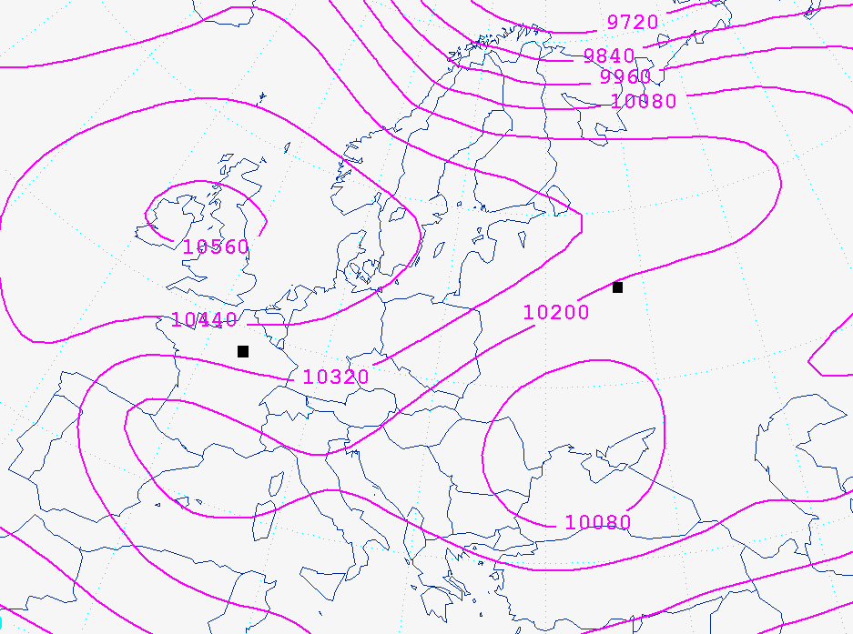
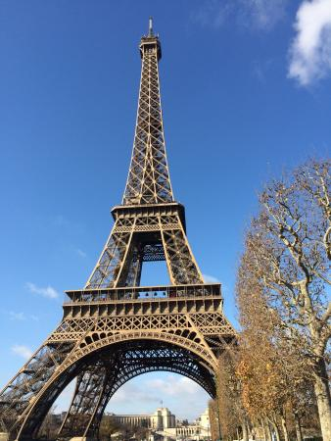
7.10 (a-b) How winds impact flights
a) Mark the centers of Highs and Lows.
  How do the winds blow at the 250mb level? Is there strong/weak friction?
b) Is it faster going from Paris to Moscow or the other direction?
  Use your answer from part (a)
  Consider whether the pilot would have a headwind (flying against the wind) or a tailwind (with the wind).
Moscow
Paris

Slide 11
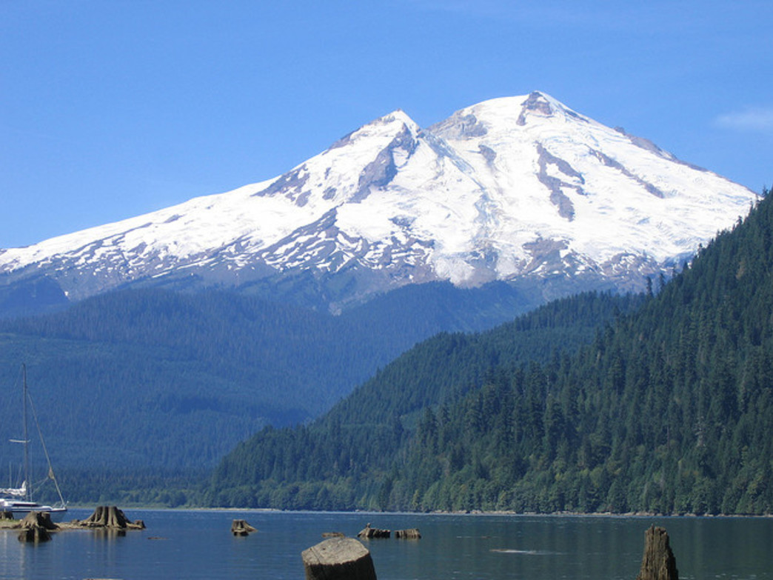
8.2 (a-b) Stability concepts
a) A cloud will form when the parcel temperature has drops to the dew point.
Before the cloud forms, the air is unsaturated.
  Unsaturated air cools at 10°C for each km it rises. (1 km = 1000 m).
  How many kilometers does the parcel need to rise for T_{parcel} = T_{dew}?
b) What’s T_{parcel} at the top of the mountain?
Note that the parcel is already at the height you found in part (a). How much further does it have to rise to reach the top?
Parcel starts at temperature T_{parcel} = 10ºC.
Once the temperature drops to the dew point, the air is now saturated and will only cool 6°C for each km it rises.
T_{env} = 0ºC
2.5 km
? km
T_{parcel} = 16ºC
T_{dew} = 10ºC

Slide 12
8.2 (c-d) Stability concepts
c) Is the parcel negatively or positively buoyant?
An air parcel is negatively buoyant if it is cooler than its surroundings. Negatively buoyant air wants to sink back down.
An air parcel is positively buoyant if it is warmer than its surroundings. Positively buoyant air wants to continue to rise.
d) What is its final temperature if it descends the 2.5km down the mountain?
For this part, start with the temperature you calculated in part b) for the parcel at the top of the mountain.
This air is now unsaturated so it will warm at 10°C for each km it sinks.

Slide 13
Due Friday, October 5th in Class
Office hours: Thursday 9:30-10:30AM in 606B Walker
Email me (kar5469@psu.edu) if you have any questions!
LAB #5 Assignment Summary
Chapter 6: (11 a-d) (18 a,b,c) (24 a-b)
Chapter 7: (1 a-c ) (2 b-c) (9 a-b) (10 a-b)
Chapter 8: (2 a-d)

