Slide 1
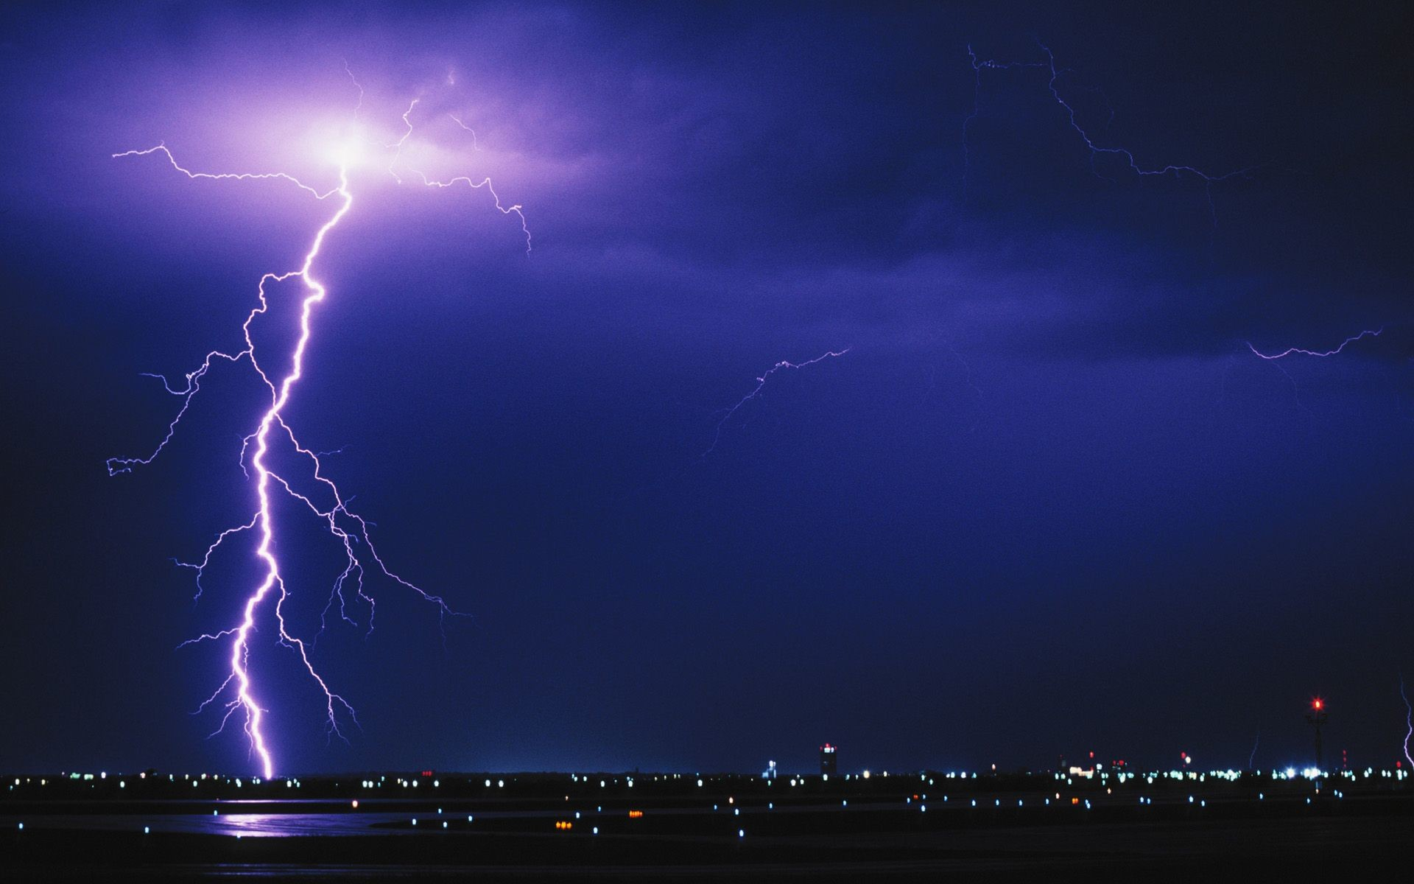
Meteo 003: Lab 6
Chapter 7: 12(a,b)
Chapter 8: 1(a,b,c), 2(a,b), 9(a,b), 11(a,b)
Chapter 9: 2, 6(a,b)
Due: Fri, Oct 12 in Class

Slide 2
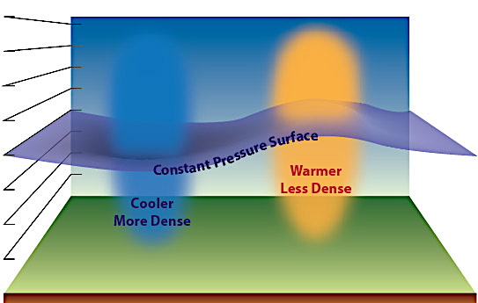
7.12 Heights on Pressure Surfaces
Pressure Surfaces slope downward from low latitudes (equator) to high latitudes (poles) because temperature decreases.
Height (m)
1540 m
1360 m
a.) compute the slope of each pressure surface
← N. Pole
Equator →
70 ºN
25 ºN
Latitude

Slide 3






7.12 Heights on Pressure Surfaces
a.) example for 850-mb level
1540 m
Slope = $\frac{Change in height}{change in distance}$
1360 m
Slope = $\frac{Height at 25o −Height at 70o }{Distance between latitudes}$
70 ºN
25 ºN
We need units of m per 100km
Slope = $\frac{1540m −1360m}{25o−70o}$
1º latitude = 111 km
Slope = $\frac{180 (m)}{−49.95(km∗100) }$
$25o−70o$ = -45$o$
-45$o$ * 111 km = -4,995 km
Slope = -3.6 m per 100 km
-4,995 / 100 = -49.95 (km*100)

Slide 4
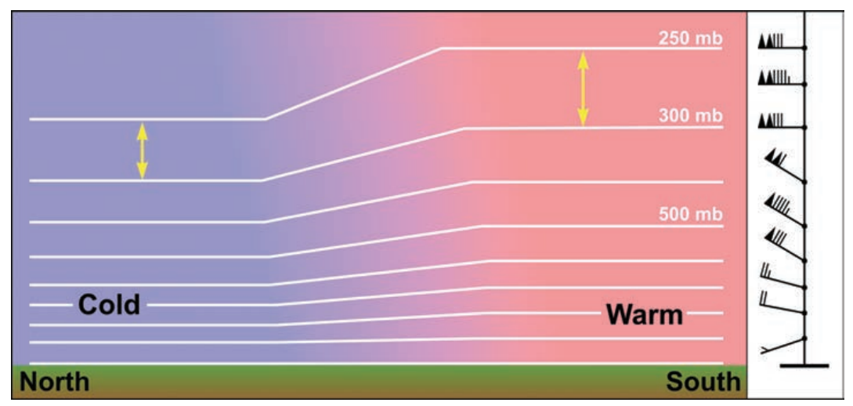
7.12 Heights on Pressure Surfaces
b.) what level does the slope reach at maximum?
Use your answers from part (a) to determine the level with the greatest slope
What about the wind speed at this level?
The bigger the difference in pressure or height (i.e. the bigger the slope), the wind speed is _______
[faster or slower?].
Increasing wind speed →
FASTER

Slide 5
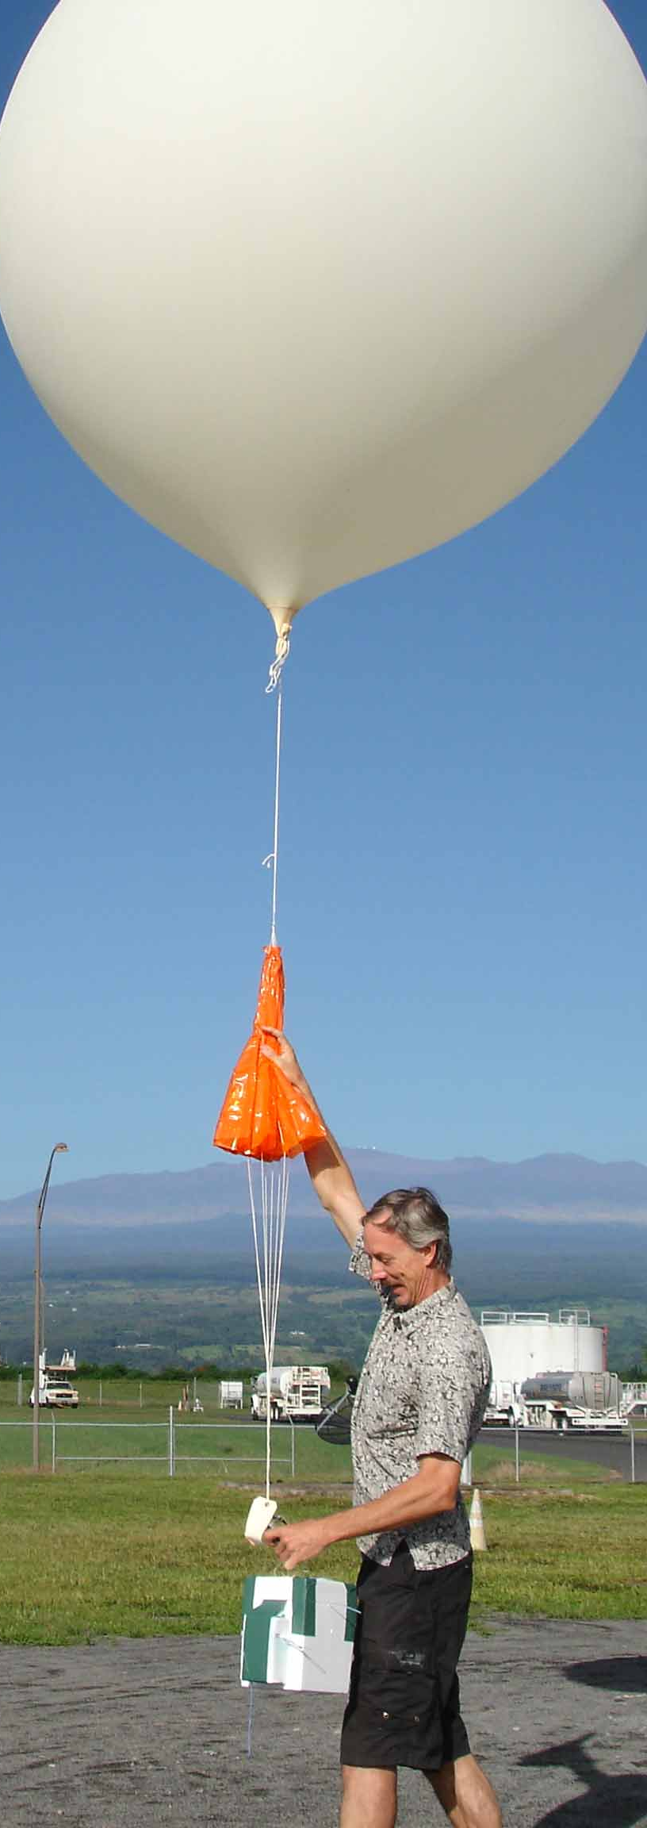



8.1 Environmental Lapse Rate
a.) environmental lapse rate of each layer?
Lapse rate: change in temperature with altitude (units: ºC/m)
Lapse Rate = $\frac{Change in temperature from bottom to top of layer}{thickness of layer}$
Height Above Ground (m) | Temperature (ºC)
2500 m | 13
3000 m | 9
EXAMPLE
Lapse Rate = $\frac{ 13 oC − 9 oC}{|2500 −3000m|}$
= $\frac{ 4 oC}{500 m}$
Convert 1000m = 1km
Lapse Rate = 8 ºC/km

Slide 6
8.1 Environmental Lapse Rate
b.) is the layer stable, unstable, or conditionally unstable?
Compare the environmental lapse rate to the dry adiabatic lapse rate (10 ºC/km) and moist adiabatic lapse rates (6 ºC/km)
Stable | Enviro Lapse Rate < 6ᵒC/km | Parcel will sink (if displaced)
Conditionally Unstable | 6ᵒC/km < Enviro Lapse Rate < 10ᵒC/km | Parcel could rise if it becomes saturated
Unstable | Enviro Lapse Rate > 10ᵒC/km | Parcel will rise (if displaced)
EXAMPLE
6 ºC/km < 8 ºC/km < 10 ºC/km
Conditionally Unstable
Enviro Lapse Rate = 8 ºC/km

Slide 7
8.1 Environmental Lapse Rate
c.) Check stability assuming both dry adiabatic and moist adiabatic ascent
EXAMPLE
Dry Adiabatic Lapse Rate = -10 ºC/km
3000m
Parcel lifted 0.5km, so it cools by -5ºC.
9ºC
Temperature at top of layer is 8ºC. (13-5)
8ºC < 9ºC. Negatively buoyant (sinks)
Moist Adiabatic Lapse Rate = -6 ºC/km
parcel
Parcel lifted 0.5km, so it cools by -3ºC.
2500m
13 ºC
Temperature at top of layer is 10ºC. (13-3)
Assume the parcel starts at 13ºC
10ºC > 9ºC. Positively buoyant (rises)
VERDICT: Conditionally Unstable

Slide 8
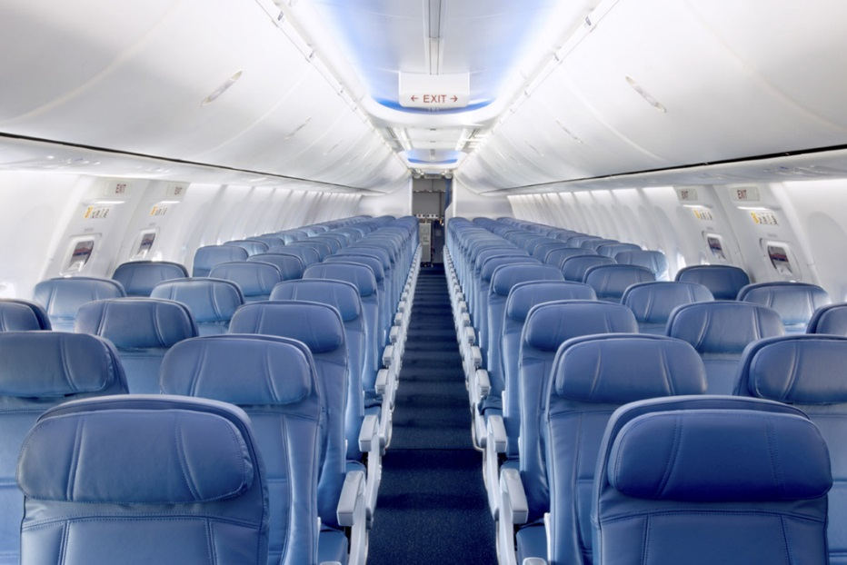
8.7 Environmental Lapse Rate
Cabin air pressure = 820mb, at altitude 1.8 km
You’re on a plane at altitude = 9.5km
Outside Air Pressure = 300mb
Outside Temperature = -40ºC
a.) What is the temperature when the air is pressurized?
  Think of an air parcel descending from 9.5km (at -40ºC) to 1.8km.
  Parcel will warm at dry adiabatic lapse rate (10ºC/km)
  Calculate the temperature change in that descent using the dry adiabatic lapse rate
b.) Would the air need to be heated or cooled to be comfortable?
  Is the temperature from (a) comfortable? Compare to the average room temperature, 20ºC-25ºC [68ºF – 77ºF].

Slide 9
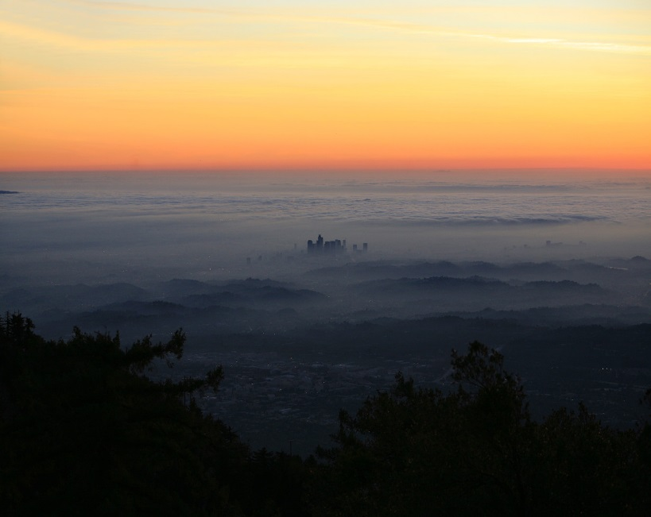
8.9 Stability
a.) Is the Marine Layer stable or unstable?
Look at the image for reference
Cloud appearance gives clues to stability:
  Bubbly (cumulus) = stable or unstable?
  Flat (stratus) = stable or unstable?
Is fog and haze more likely to form in unstable or stable layers?
Marine Layer: shallow deck of low clouds
b.) Is there a temperature inversion?
Temperature inversion: temperature INCREASES with altitude (opposite of normal)
Water Temperature = 60-65ºF
Inland Temperature = 75-80ºF
Check the temperature column of the chart

Slide 10
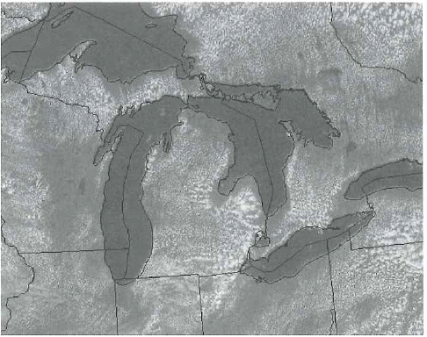
8.11 Satellite Imagery
a.) Describe where there are clouds and no clouds
Clouds show up as white blobs on visible imagery
b.) Time of day (morning/afternoon)? Season?
Think about the temperature difference of the water and land during the seasons. Would temperature impact cloud formation?
The clouds are “convective cumulus”. What does this say about stability? What time of day would these clouds appear?

Slide 11
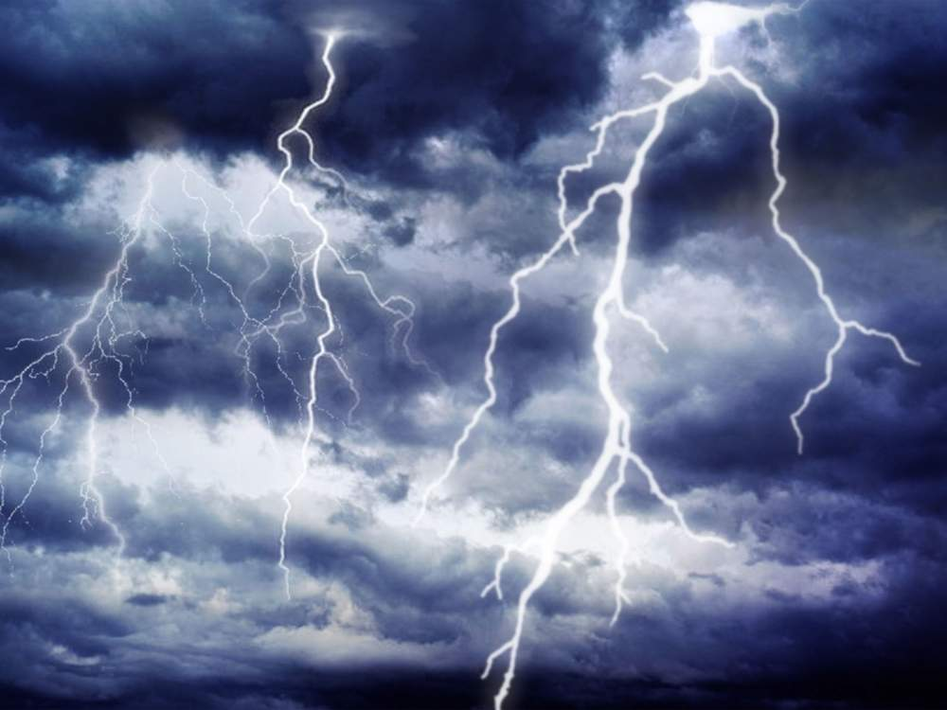
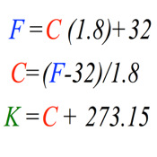


9.2 Speed of Sound
Speed of sound depends, in part, on the air temperature
$$Speed of Sound=20∗\sqrt{T}$$
*this is an approximate equation, so units do not work out
Q: Estimate the amount of time that would elapse between seeing lightning and hearing thunder
First convert from Fahrenheit to Kelvin
  Use the chart to the right →
Plug into equation to solve for speed of light
Time Elapsed = $\frac{Distance}{Speed of Light}$
Notes:
m/s = 20*T (plug in temperature and distance and solve for time (seconds)).

Slide 12
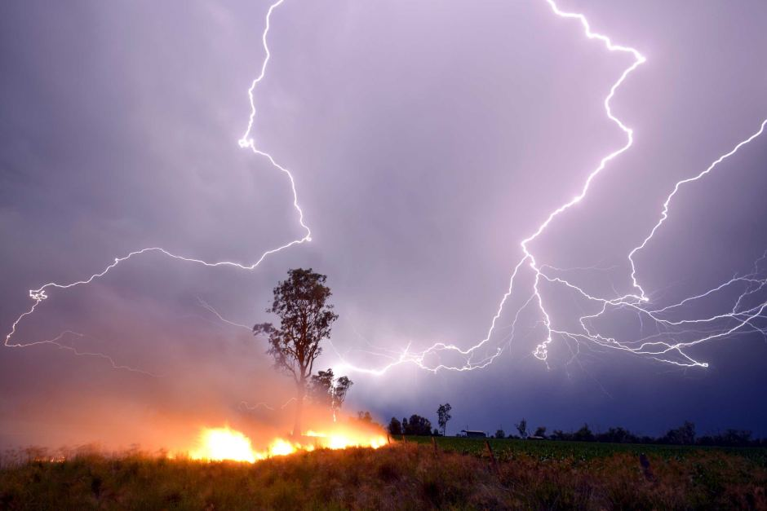
9.6 Thunderstorm Concepts
a.) Calculate the height of the cloud base.
A rising unsaturated parcel cools at the dry adiabatic lapse rate (10ºC/km)
The height of the cloud base is where the parcel temperature falls to the dew point
b.) What 2 cities would have the most forest fires triggered by thunderstorms?
Think about the rainfall that would put out the fires
The relative humidity below the cloud base is <100%, so what will happen to the raindrops as they fall, especially if cloud base is very high and raindrops fall a long way through dry (unsaturated) air?

Slide 13
Lab #6 – Due Friday October 12th
This lab has a lot of calculations. Show your work, always!
Office hours: Thursday 9:30-10:30AM in 606B Walker
Email me (kar5469@psu.edu) if you have any questions!

