Slide 1
Meteo 003 Lab 7
Due Friday, October 19th
9.3(a-c), 9.12, 9.16
10.1(a-b), 10.2b, 10.3, 10.7(a-b)
11.1(a-c)
EXAM NEXT WEEK!

Slide 2
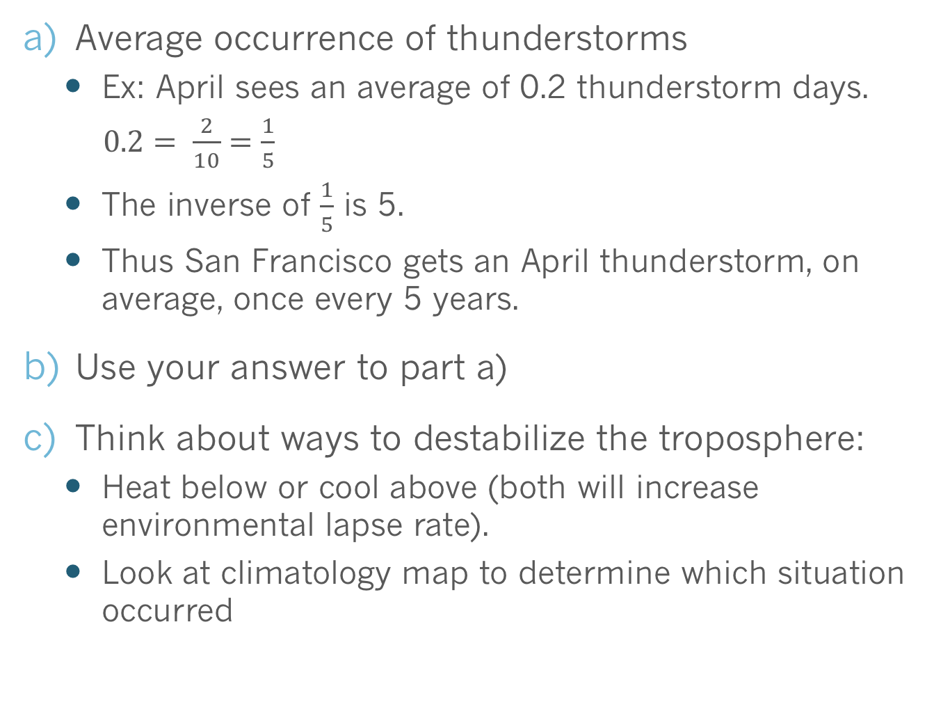
9.3(a-c) -Thunderstorms
Average occurrence of thunderstorms
  Ex: April sees an average of 0.2 thunderstorm days.
  $0.2= \frac{2}{10}=\frac{1}{5}$
  The inverse of $\frac{1}{5}$ is 5.
  Thus San Francisco gets an April thunderstorm, on average, once every 5 years.
Use your answer to part a)
Think about ways to destabilize the troposphere:
  Heat below or cool above (both will increase environmental lapse rate).
  Look at climatology map to determine which situation occurred
Notes:
A) 1/0.4 = 2.5

Slide 3
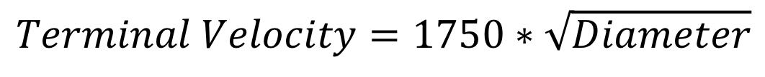
9.12 - Hail
Object | Approximate Diameter (cm)
Pea | 1
Golf ball | 4
Baseball | 7.5
Softball | 9
Large hailstone | 18
$$Terminal Velocity=1750∗\sqrt{Diameter}$$
Units? cm/s
Units? cm
  Use [cm] for the diameter units in your initial calculation
  Units of calculated terminal velocity are [cm/s]
  Don’t forget to convert your answers to mph!
$$\frac{Answer in cm}{ s}×\frac{3600 s}{1 hr}×\frac{1 inch}{2.54 cm}×\frac{1 foot}{12 inches}×\frac{1 mile}{5280 feet}=Answer in \frac{miles}{hour}$$
1 cm/s = 0.02236 mph

Slide 4
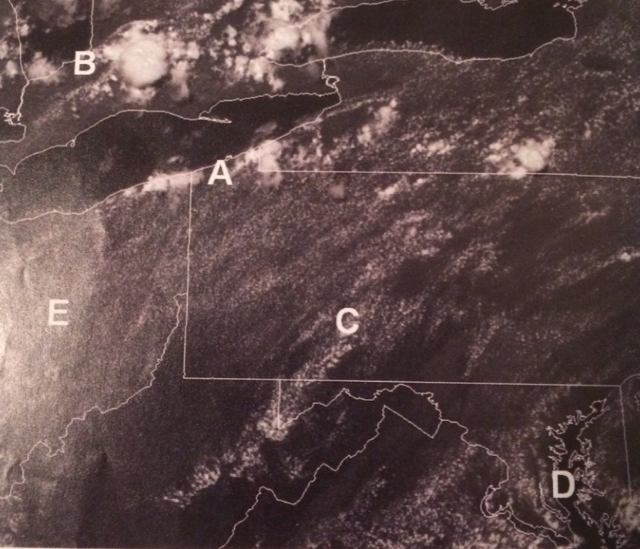
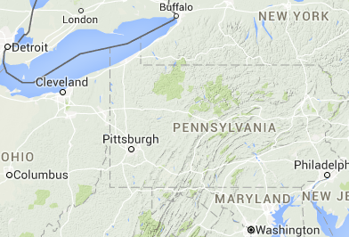
9.16 - Convection
Match locations to descriptions
Visible satellite image, white patches correspond to clouds
Note location of the Appalachian Mountains
Image was taken in July, lakes relatively cool compared to land

Slide 5
10.1(a-b) - ITCZ
ITCZ (Intertropical Convergence Zone): Elongated area that separates the trade winds in the Northern Hemisphere from their counterparts in the southern hemisphere
The ITCZ tends to follow the sun’s direct rays
Land heats more intensely than water, less land means more even distribution of heating.

Slide 6
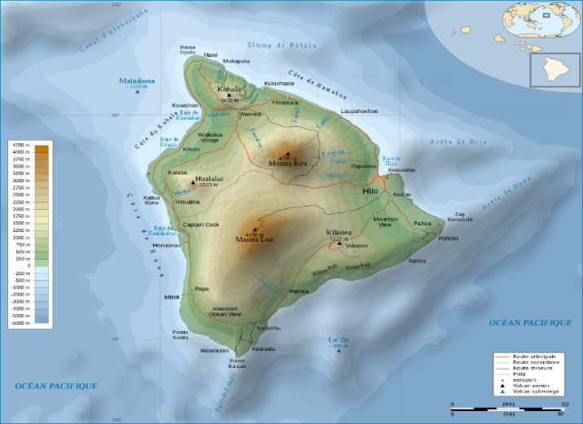
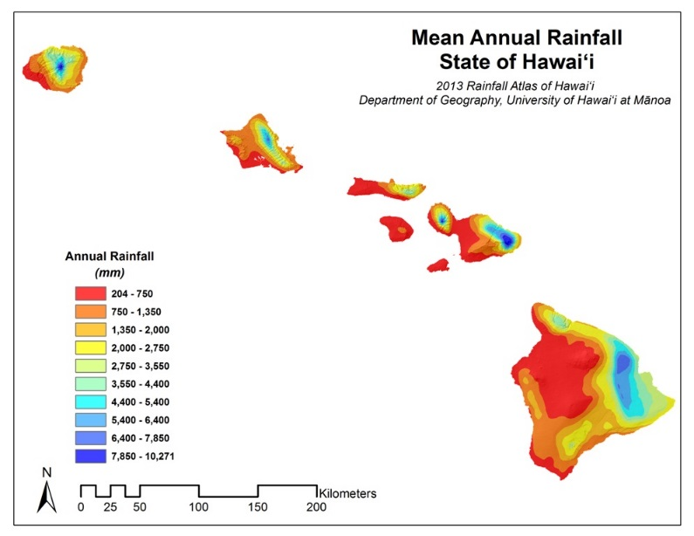
10.2 (b) – Trade Winds
Use the contour map to help explain precipitation pattern
  Prevailing low level winds are from what direction?
  Precipitation pattern of the windward vs leeward side of a mountain

Slide 7
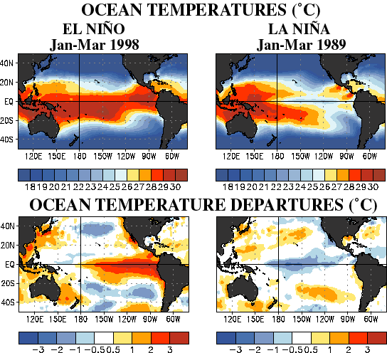
10.3 – El Niño / La Niña
El Niño: Anomalously warm (warmer than normal) waters in the equatorial central and eastern Pacific
La Niña: Anomalously cold waters in the equatorial central and eastern Pacific
Neutral (“La Nada”): Somewhere in between, neutral or average Pacific temperatures

Slide 8
10.7(a-b) – Ekman Spiral
Most of an iceberg is actually underneath the surface of the water.
For this question, consider the concept of Ekman transport:
  Wind, through friction, creates a surface current that flows to the right of the wind (in NH) due to Coriolis Effect.
  This surface current applies a force to the layer of water below it. The moving deeper layer is deflected to the right of the surface current.
  Each subsequent layer of water will be deflected to the right of the layer above it.
  Net result: Water spirals as you go deeper. Net transport of water is 90 degrees to the right of the wind in NH.

Slide 9
11.1 (a)
Let’s consider a hurricane in the Northern Hemisphere …
1) PGF directs the air inward perpendicular to isobars.
952
944
L
948
940
2) Coriolis Effect deflects the air to the right of the moving air, but friction slows the wind & reduces that effect.
Now you try for the Southern Hemisphere …

Slide 10
11.1 (b-c) – Storm Surge
Storm Surge:
  A rise in sea level due to storm winds pushing the water towards the shore. Lower pressure plays a small role.
  The deadliest aspect of a hurricane.

Slide 11
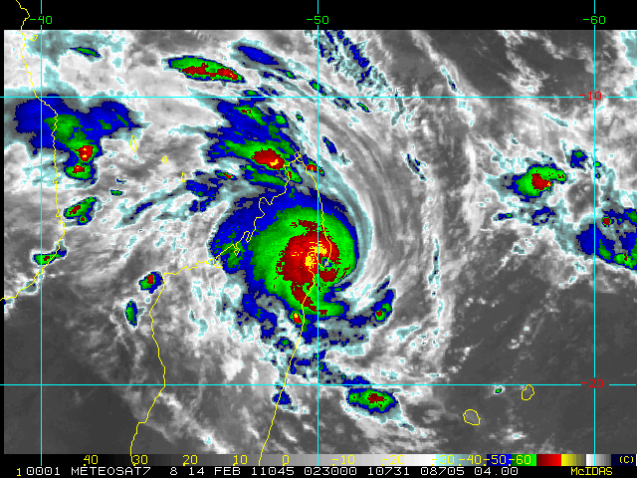
11.1 (b-c)
In which of these 4 quadrants would storm surge be highest?
Consider rotation of storm.
But this question requires you to look at a Southern Hemisphere storm (Cyclone Bingiza, Feb 2011).
Refer to this loop.

Slide 12
Lab 7: Due Fri, October 19th
Office hours: Thursday 9:30 – 10:30am in Walker 606B
Email me (kar5469@psu.edu) if you have questions!
9.3(a-c), 9.12, 9.16
10.1(a-b), 10.2b, 10.3, 10.7(a-b)
11.1(a-c)

