Slide 1
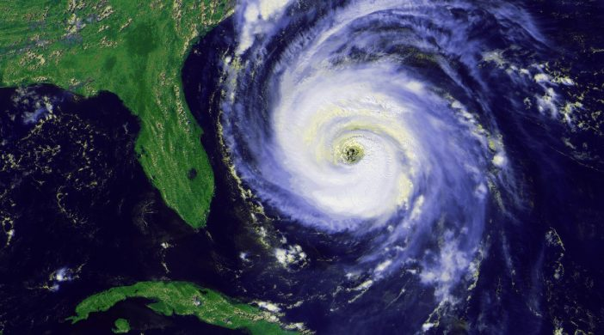
Meteo 003: Lab 8
Due: Friday, Nov. 2
Chapter 11: 4 (a-b), 7, 8 (a-c), 11
Chapter 12: 12 (a-d), 13 (a-b)
Chapter 13: 8 (a-b), 9(a,c), 13 (a-b)

Slide 2
Office Hours Reminder
Thursday 9:30am – 10:30am in 606B Walker Building
Email me (kar5469@psu.edu) questions if you are having trouble understanding a concept.
Remember: late penalty of -10 points if turned in Monday. No points are given after Monday.

Slide 3
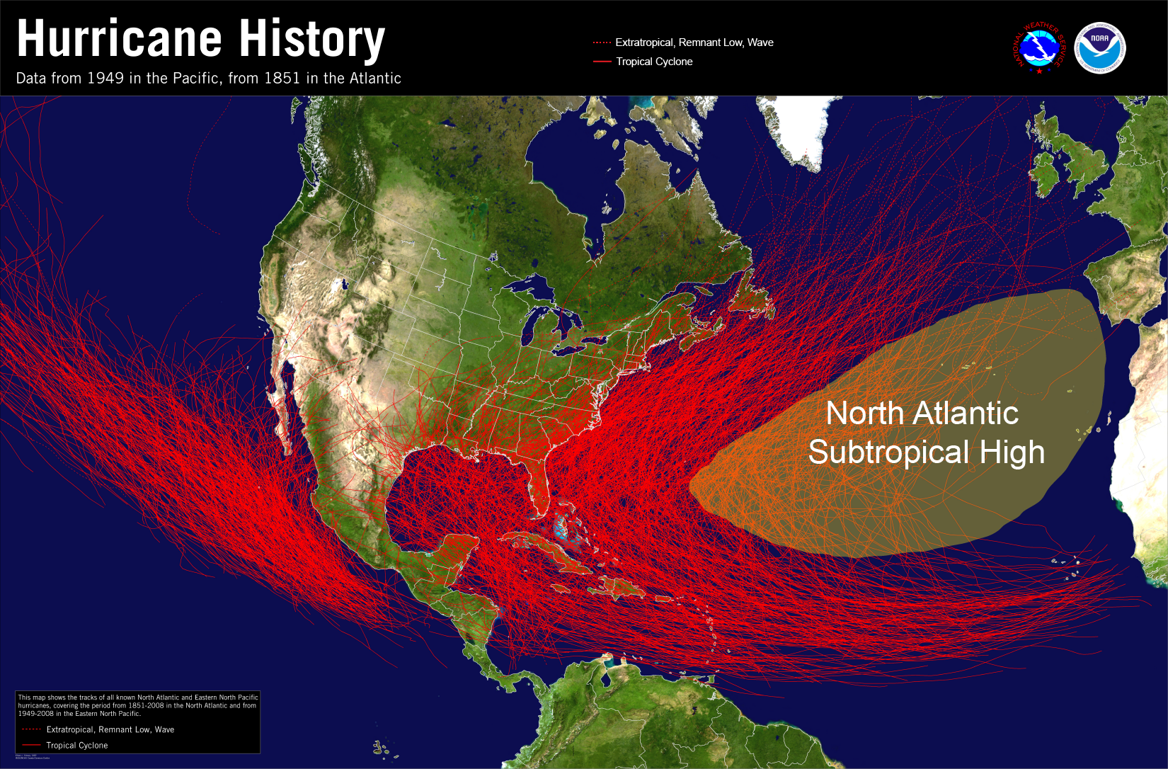
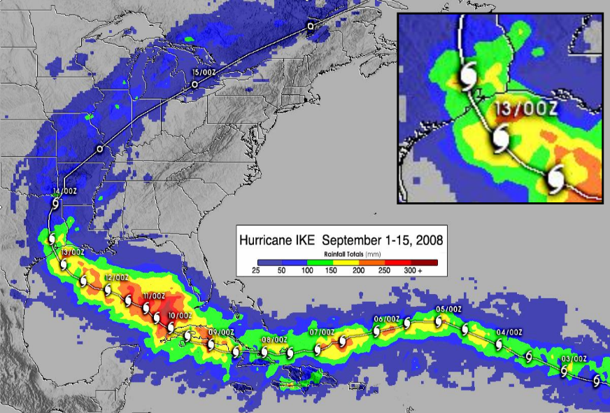
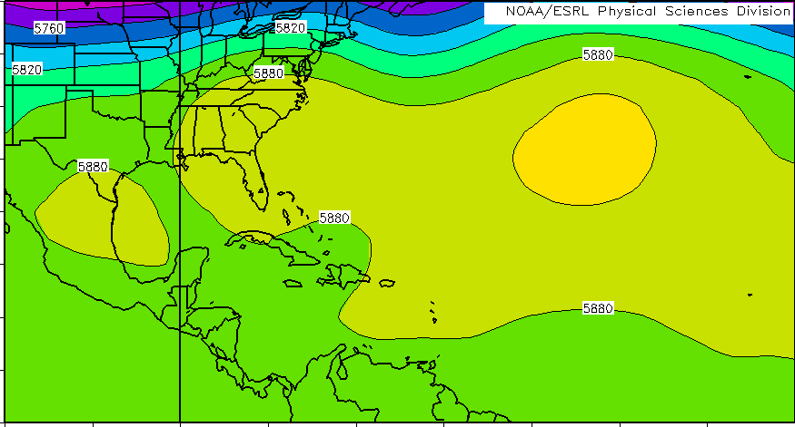
11.4 (a-b) Hurricane track
a.) What is the height of the closed contour (yellow)? Is it a center of high or low? Name this feature.
Note the contour intervals are every 30 m
b.) Discuss the hurricane path
Direction of storm track?
Clockwise or counterclockwise circulation?

Slide 4
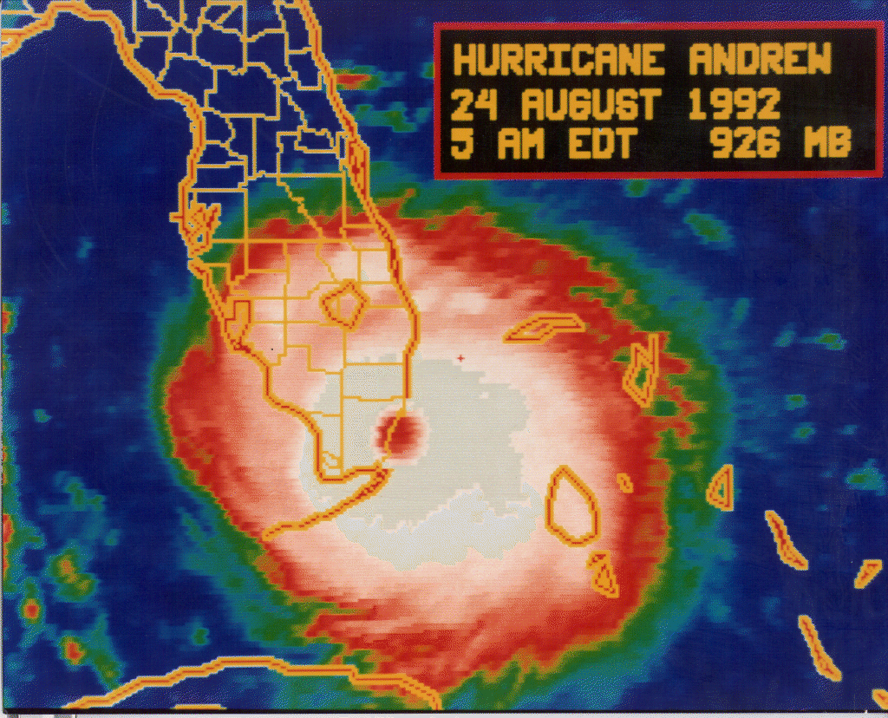
11.7 Storm surge
Graph tide height above sea level (storm surge) vs. distance north of the eye
Q: Why doesn’t the peak storm surge line up with the central point of landfall (i.e. 0.0m) ?
Storm Surge (ft)
Where are winds the strongest in a hurricane?
How do winds move around the eye wall? Clockwise or counterclockwise?
How do winds impact waves coming onshore?
Distance North of Eye (mi)

Slide 5
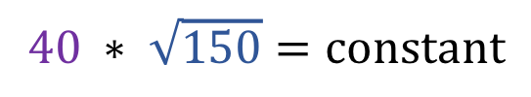
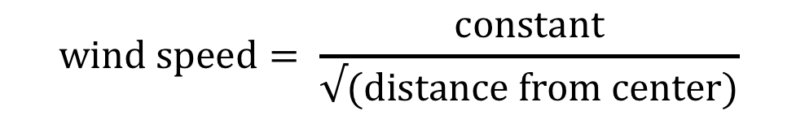
11.8 (a-c) Hurricane winds
Law of Conservation of Angular Momentum
Wind speed *$\sqrt{(distance }from center)$ = constant
(km/hr)
(km)
1.) Solve for the “constant”
Wind speed = 40 km/hr
Distance from center = 150 km
$$40 ∗ \sqrt{150}=constant$$
2.) Rearrange for wind speed
a.) What is the wind speed 75 km from center? 25 km? 2 km?
$$wind speed= \frac{constant}{√(distance from center)}$$

Slide 6
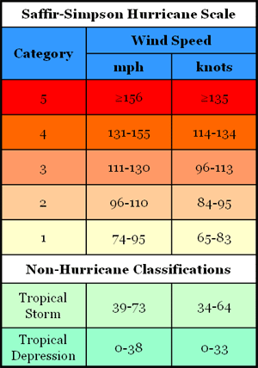
11.8 (a-c) Hurricane winds
Law of Conservation of Angular Momentum
Wind speed *$\sqrt{(distance }from center)$ = constant
(km/hr)
(km)
b.) Wind speed at 12 km from center? What category hurricane?
Follow steps from part (a)
Use the chart to the right to determine the category
1 km/hr = 0.62 mph
c.) What does this relationship improperly represent?
At what distance from center does this relationship fail?
Consider the wind speed near the eye center.

Slide 7
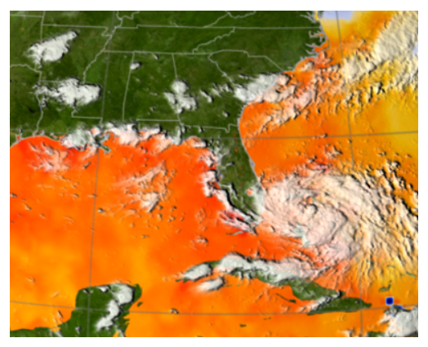
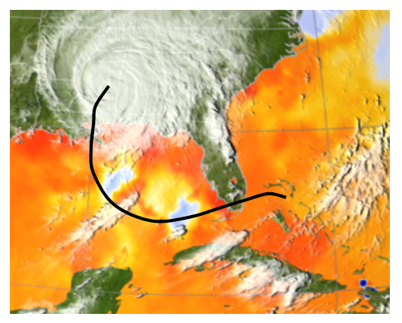
11.11 Energy transfer during a hurricane
Storm Track
AUG 24
Five Days Later
Q: What caused the change in surface water temperature (in context of the hurricane)?
Did waters warm or cool after the hurricane passed?
Think about energy transfer from the hurricane winds to the ocean surface.
How do winds impact mixing below the ocean surface?

Slide 8
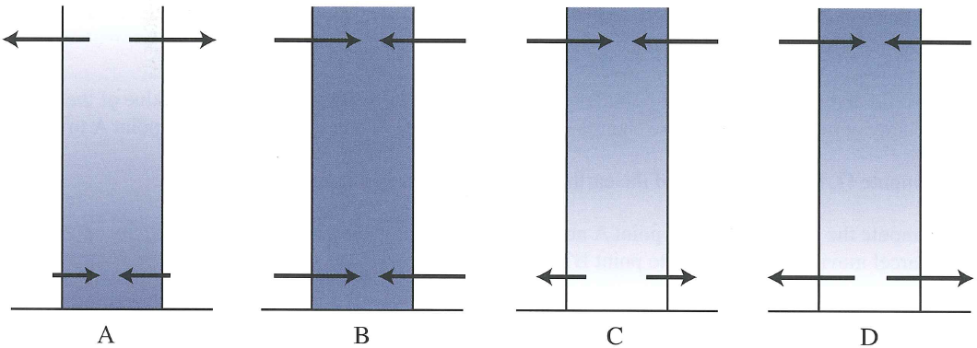
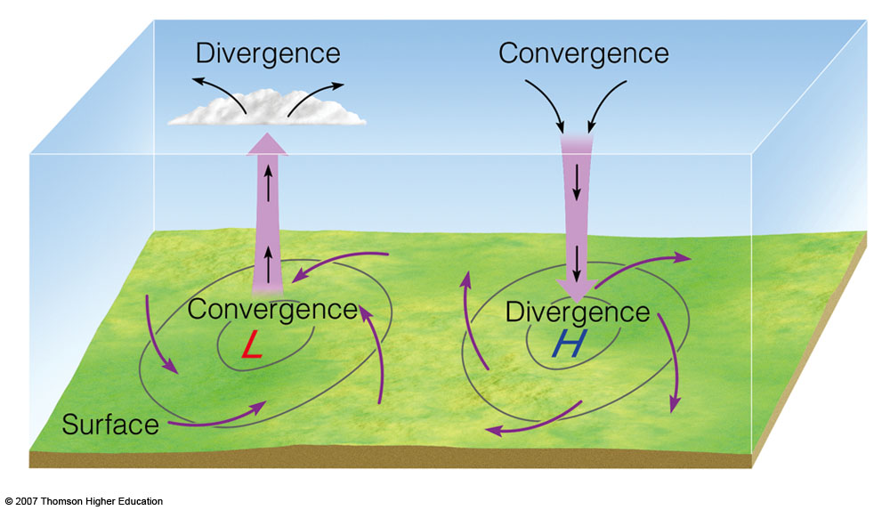
12.12 (a-d) Convergence vs. divergence
divergence
Match A,B,C,D to the description. Explain your answer!
aloft
convergence
surface
Net divergence leads to decrease in pressure -> High
Net convergence leads to increase in pressure -> Low
Convergence/divergence aloft will lead to a strengthening high/low at the surface

Slide 9
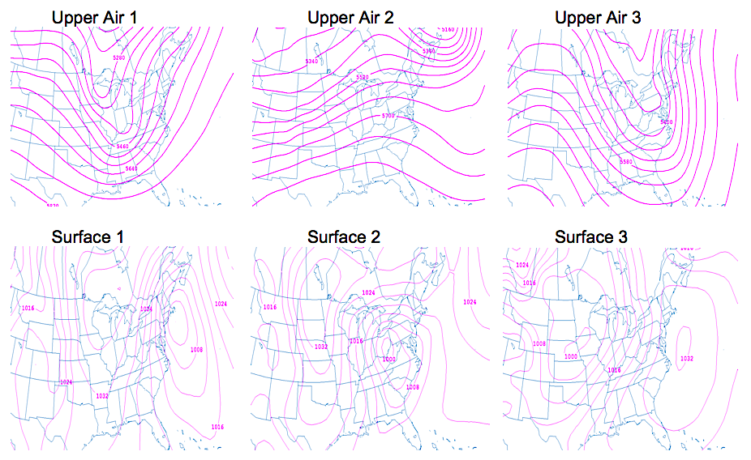
12.13 (a-b) Linking upper air and surface maps
a.) Identify centers of high and low pressure on the surface maps.
ridge
b.) Match surface maps to their corresponding upper air maps.
Locate troughs and ridges in upper air
?
?
?
Surface Highs to the East side of ridges
?
?
?
L
H
Surface Lows to the East side of troughs

Slide 10
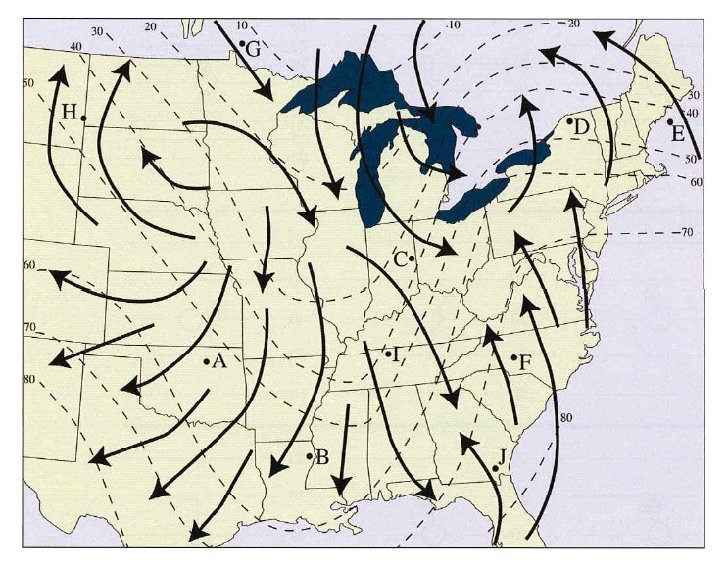
13.8 (a-b) Warm & cold advection
a.) At each letter (A-J): is there warm, cold, or neutral advection?
Isotherms show temperature
Winds blowing from cold /warm air are said to have cold /warm advection
Neutral advection when winds are blowing parallel to isotherms
b.) Find center of low and high. Draw a front. Is it a cold or warm front?
Clockwise or counterclockwise circulation? Use the wind direction to find low and high.
Fronts occur at areas of convergence.
Use the concept of advection to determine if it’s a cold or warm front.
Advection: transport of an atmospheric variable (temperature, moisture, etc.) by the wind

Slide 11
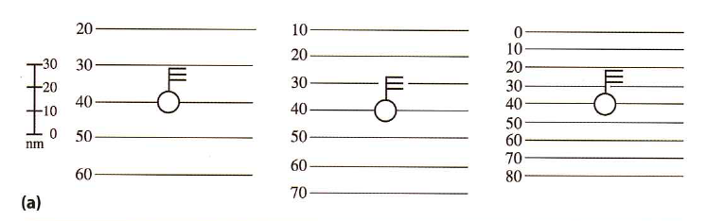
13.9 (a,c) Advection magnitude
a.) At each location, estimate the temperature in one hour.
Advection: transport of an atmospheric variable (temperature, moisture, etc.) by the wind
Isotherms separated by 10 n.m.
EXAMPLE
What is temp at A?
A
Magnitude determined by:
Orientation of wind w.r.t isopleths
Speed of wind
Gradient of isopleths
What is the wind speed?
Is this cold or warm advection?
20
30
40
50
60
70
80
Will temperature decrease or increase over the next hour?
temperature
What will the temperature be in one hour?
Final temp = Initial temp – [(time)*(wind speed)*(gradient)]
Final temp = 50º – [(1hr) * (10n.m./hr) * (10º/10n.m.)]
Final temp = 50º – 10º = 40º
Notes:
1Temp = 50 degrees
Wind speed = 10 knots
Cold advection
Decrease in temperature

Slide 12
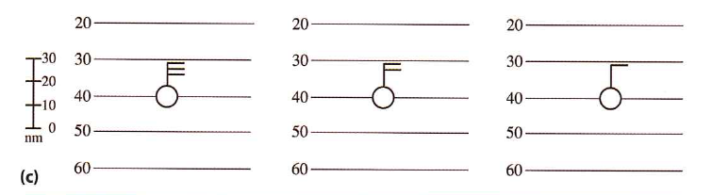
13.9 (a,c) Advection magnitude
a.) At each location, estimate the temperature in one hour.
Advection: transport of an atmospheric variable (temperature, moisture, etc.) by the wind
Note: the only change is the gradient!
The stronger the gradient, the _________ the magnitude of advection.
(smaller?/larger?)
Magnitude determined by:
Orientation of wind w.r.t isopleths
Speed of wind
Gradient of isopleths
c.) The same as Part (a) but now the gradient is the same and the wind speed is changing.
(smaller?/larger?)
The stronger the wind speed, the _________ the magnitude of advection.
Notes:
1Temp = 50 degrees
Wind speed = 10 knots
Cold advection
Decrease in temperature

Slide 13
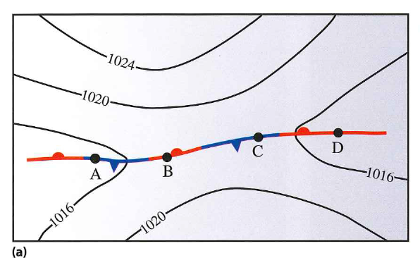
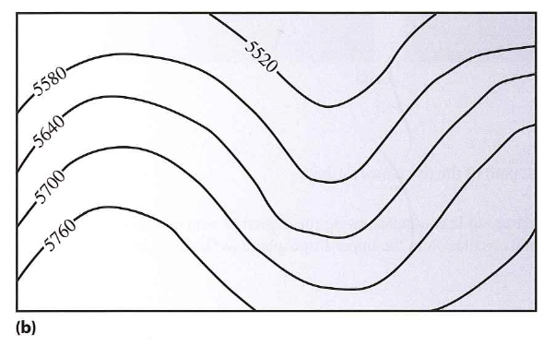
13.13 (a-b) Cyclogenesis
Cyclogenesis: development of a low pressure system (cyclone)
a.) At what letter (A-D) would cyclogenesis be favored?
Surface Lows to the East side of troughs
Does upper air convergence or divergence occur here?
b.) At what letter (A-D) would form an upper level High pressure system?
Surface Highs to the East side of ridges
Does upper air convergence or divergence occur here?

