Slide 1

LEADERSHIP
I AM a Leader

Slide 2
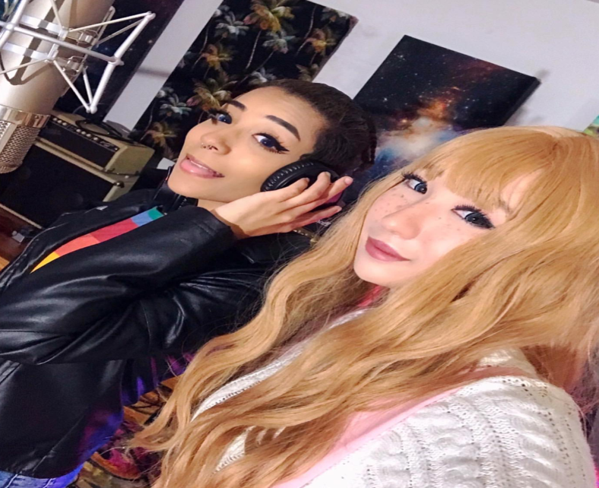
Many situations in my life that seemed impossible
I have had many situations in my life that seemed impossible mainly because I am a very shy individual; an introvert. However, my interests and passions are those of an extrovert’s personality.
During my entire educational career, I have participated in Marching Band, cheer, gymnastics, clubs, dance, and Show Choir. Today, I currently sing at a few places as a side job. Those that know me often share that they can’t believe how much and how often I face my fears.

Slide 3

High School
My high school goal was to graduate from the Health Academy, which is a rigorous magnet program for students interested in the medical field. Many told me it would be too difficult for me especially because I was involved in several extra-curricular activities. Their words motivated me instead discouraged. My goal was to graduate with honors and I did so. Was able to accomplish my goal by taking an online class every summer in order to free up my schedule at school for both band and choir. I also dual enrolled at the community college to earn the science credits at the college level.

Slide 4
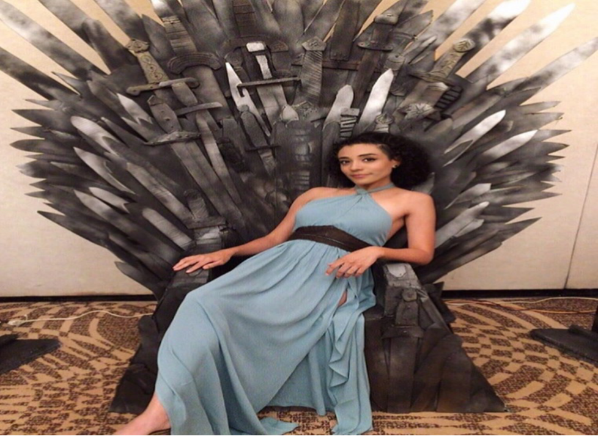
College
My first semester I went to an out of state university that my sister also attended. I was not happy with dorm life and I missed my lifelong friends. Although I have very supportive parents, I did not want to move back home. Again, I heard the voices telling me that it would be very difficult to live on my own, work, and go to college. They were certainly correct, however, I have earned my Associate’s Degree while working a couple of part-time jobs and I only have two classes left to take for my A.A.B!

Slide 5
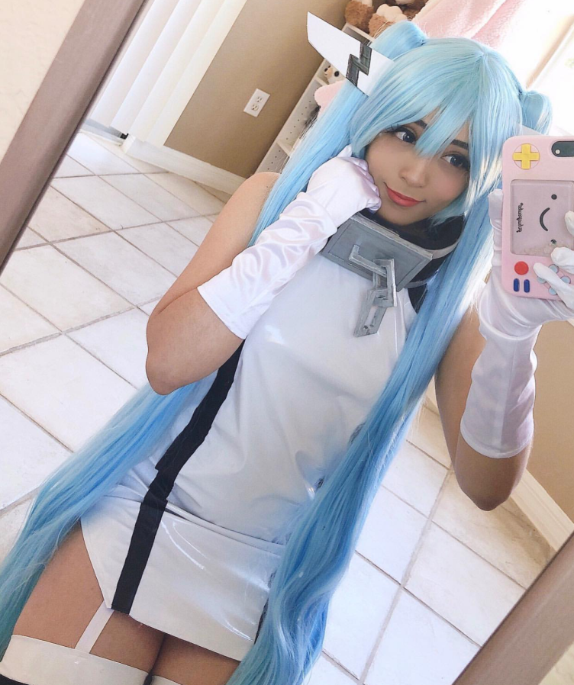
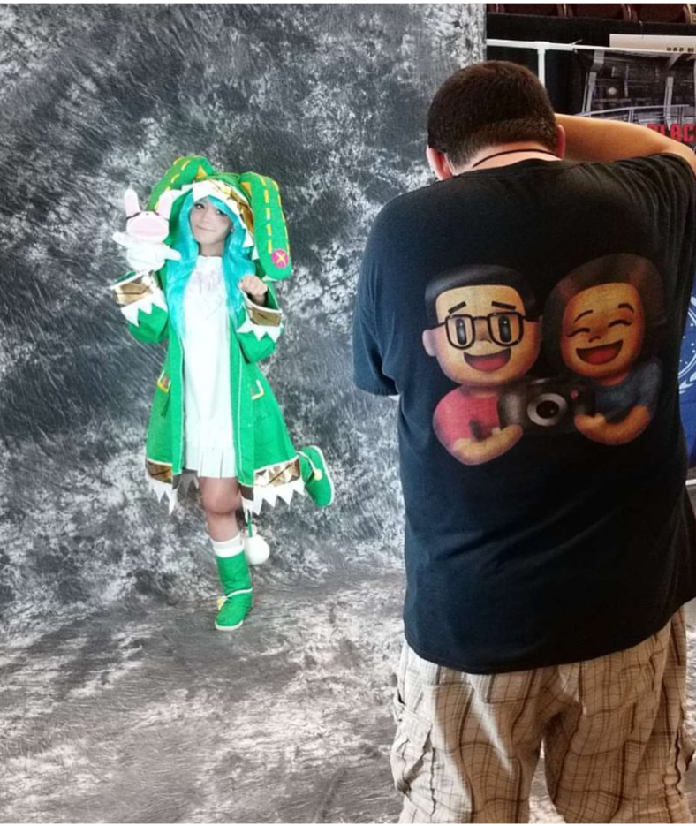
COSPLAY MODEL
One of my passions
One of my jobs

Slide 6
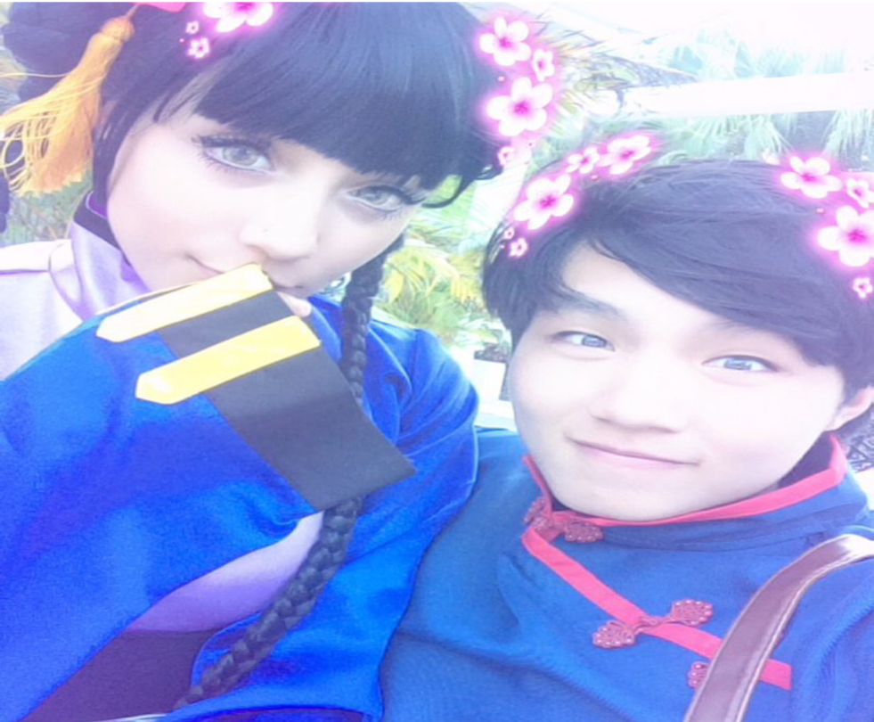
Cosplay helps me accomplish my goals
I am very fortunate that my passion and hobby is also a source of income which allows me to live independently as I continue my college education. I also get to travel and meet from around the world. This enriches my life on so my levels and has given me skills to work with people of diverse cultures.

Slide 7
TWO DEGREES
Another goal I have set for myself is earning two degrees; a degree in Psychology and a degree in Business. Now this is the one goal that I was apprehensive about. Funny, I no longer have doubters. People are now used to me accomplishing what I say I will accomplish. I decided to enroll at EGCC despite my own doubts and to my surprise, I will complete my A.A.B this year and I have a 4.0 GPA! I plan on running my own counseling center one day.

Slide 8

I am a volunteer
I am a PROUD volunteer of WOW Legacy founded by Secily and our Mission is to improve the lives of women transitioning through life's adversities by empowering, encouraging and educating them to reach their true potential mind, body and spirit.
*We provide workshops and trainings on how to get back on track, take control of finances, physical and emotional health, education, and more.
*We host a FALL into FABULOUS event at the completion of the program with a special banquet in their honor for “Falling into Fabulous” instead of falling and staying down.
Working with such wonderful leaders has provided me an immense amount of leadership skills and experiences that I will take with me when I begin building my career.

Slide 9
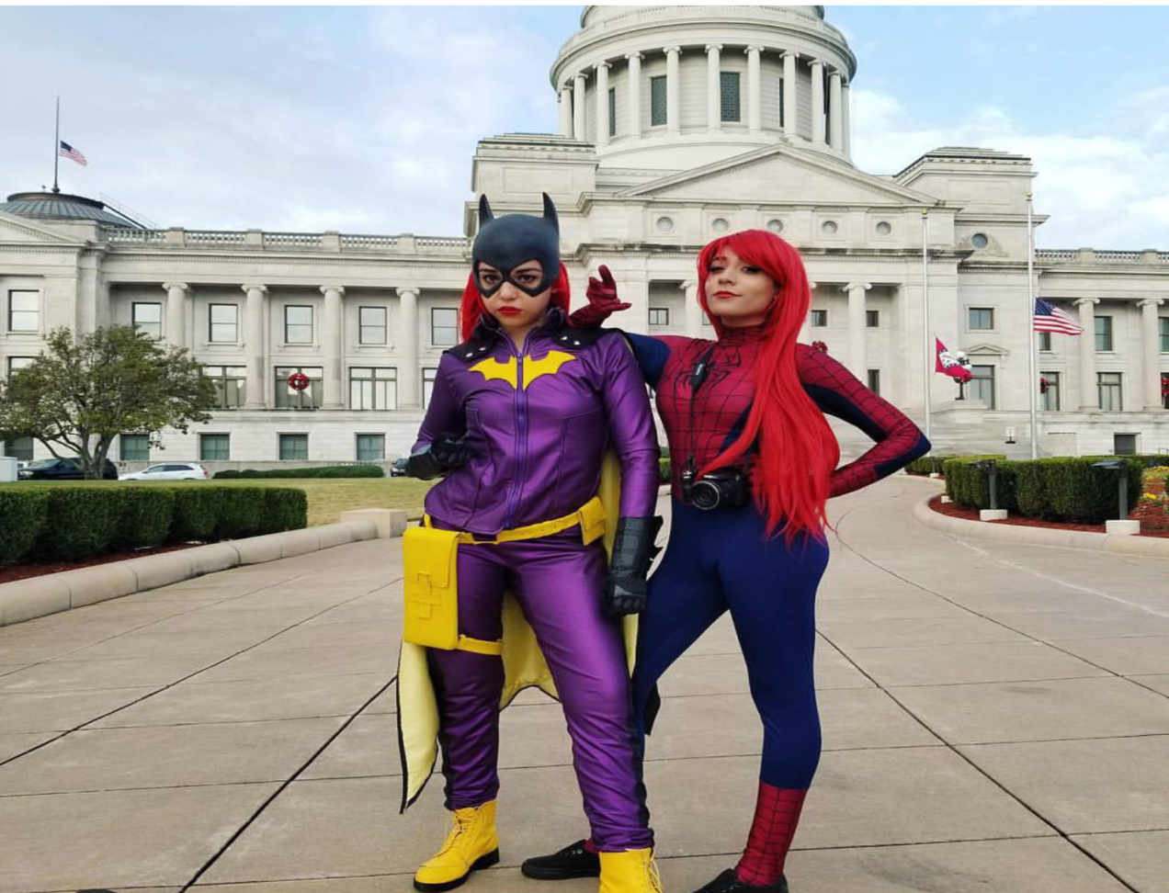
Taking my time
I am aware that I have big goals that are very time consuming, however, I’m in no hurry. Two Associates degrees in my early 20s is perfect for me. I refuse to stress over a time frame not meant for me. I much rather enjoy life, do well in a few classes at a time, and travel with friends doing what we love; Cosplay.

Slide 10
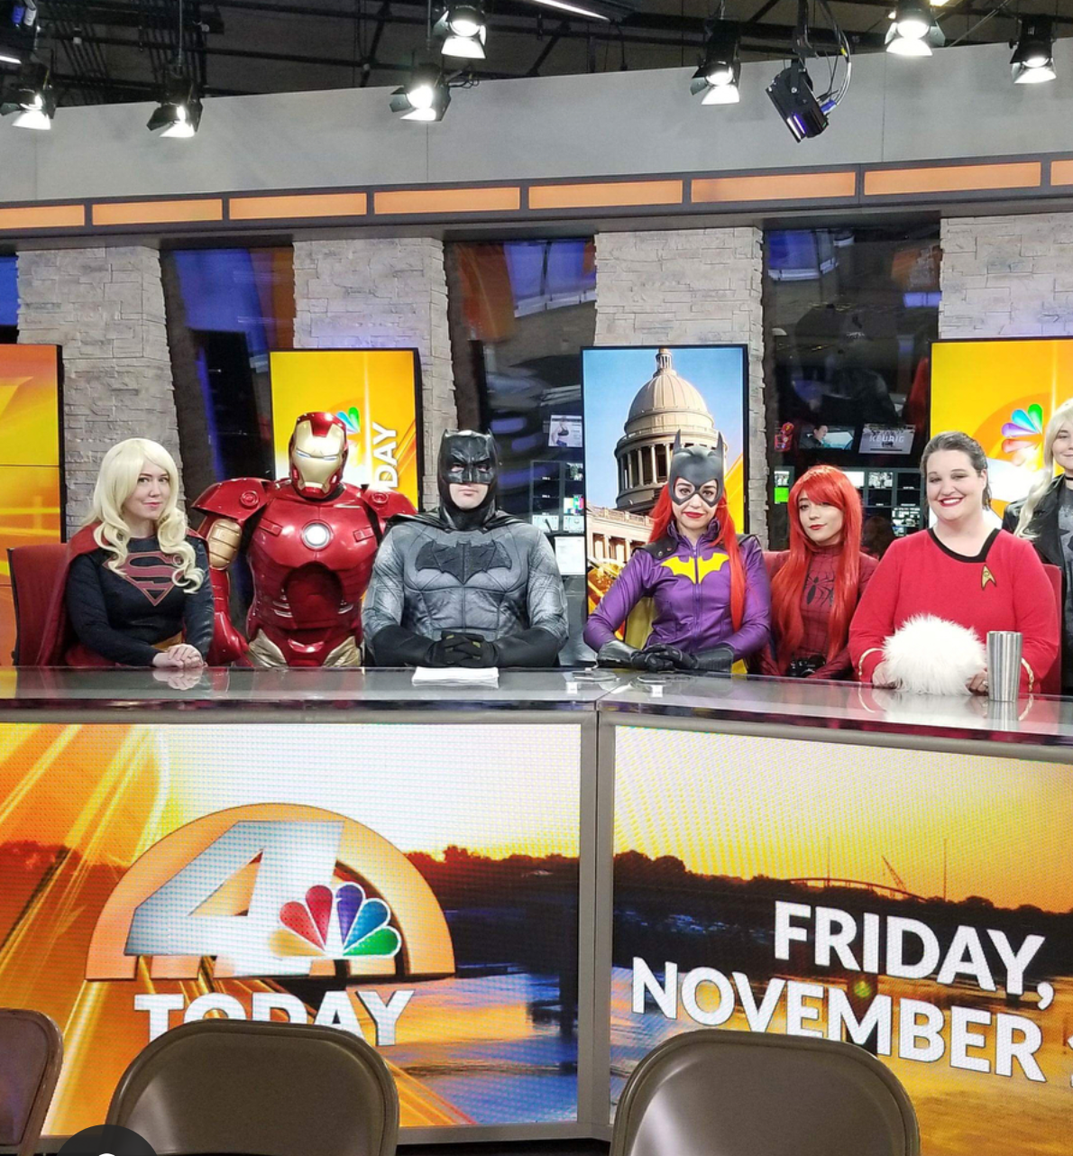
Traveling
Every year I set a goal to visit a different state or country. I am the leader and trip planner in my group of friends. I was very fortunate to have traveled to many countries growing up and now I share my love for traveling with my friends. I start planning a year in advance and of course, save my pennies. One of our favorite trips was to New York because we were on the Today show promoting a Cosplay event.

Slide 11
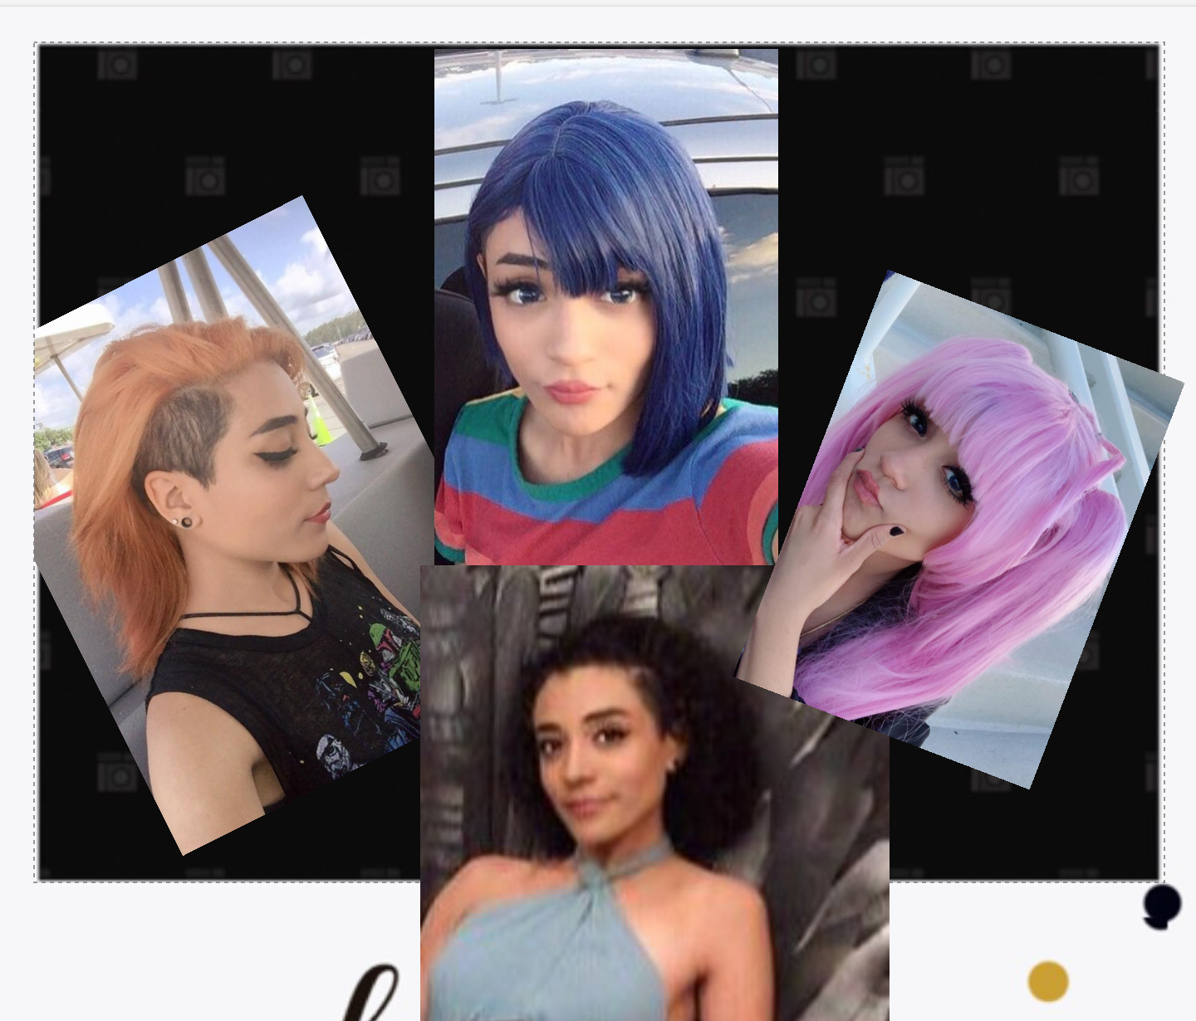
Don’t stand in my way
So how do I overcome situations that may seem impossible for me in order to achieve what I want? I do not let anyone or myself stand in my way…

