Slide 1
Notes:
Activity time! One the screen is a menu for a restaurant. Alone or in small groups, I want you to decide on a meal option (lunch or dinner). Imagine you are in the restaurant and you are picking an entire meal (not just a single entrée). Take a few minutes to do this and then let’s discuss the process of how you arrived at your decision and we’ll take it up together.
Allow anywhere from 5-10 minutes depending on the level of conversation.

Slide 2

Discussion
What did you choose?
What else did you consider?
How did you make your decision?
What are the similarities and differences in your approaches?
Notes:
Ask for volunteers to talk about their choices.
The point here is to set up the idea that decision making is a process, and we want to understand that process as a series of logical steps.

Slide 3
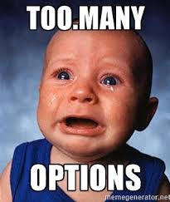
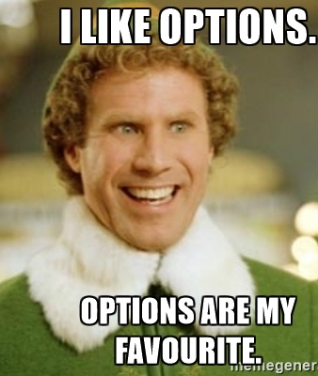
Decision Making
Cornerstone of Marketing
It is also very difficult to understand because:
It is multifaceted.
Consumers are sometimes “irrational”.
Marketplace options are prolific.
Notes:
Ask: did anyone get overwhelmed trying to make the choice because there were so many options? Have you ever had this feeling when trying to make a consumption choice?
Decision making is a cornerstone of marketing, and we know a lot about how people make consumption decisions. But the process is very multifaceted with a lot of influences. Consumers are also not perfectly “rational” when making choices – something that makes marketing the best business discipline because we understand people as people and not robots.
We have developed some systematic understanding of how consumers make decisions.
As well as the factors that influence those decisions. Today, we’re going to go through the process of decision making and then for the rest of the course we’re doing to talk about the complexities of this process and the various things that impact consumer decision making and experiences.

Slide 4
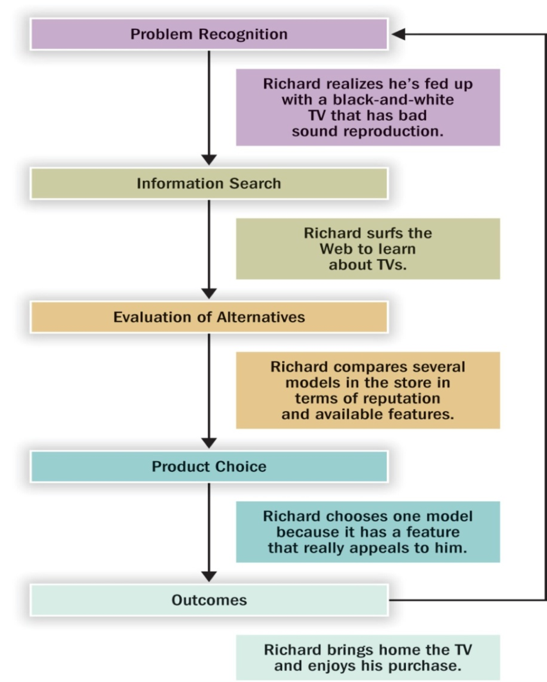
The Traditional Decision-Making Model
Assumes people follow a logical, rational approach to making choices.
Notes:
This is the traditional model of decision making --- it should look familiar as it was covered in your intro to marketing classes.
This model holds true to a certain extent, some of the time. But, assumes a very rational approach to decision making that is derived from an economic view of the world that assumes people are rational.
But, we know that people aren’t always rational. So, today we’ll work through this model because it’s important to understand the various steps, but we’ll also talk about it’s shortcomings.

Slide 5
Problem Recognition
Actual
Ideal
Notes:
What’s happening with actual human beings in this model? Remember, it’s all just people.
The basic idea is that we all have 2 “states” or conditions. One is our actual state at any given moment. The second is what we consider to be our ideal state.

Slide 6
Opportunity Recognition
Ideal
Opportunity
Actual
Notes:
Opportunity recognition: Ideal state moves upward --- example --- get a bonus at work and want to go on vacation.

Slide 7
Need Recognition
Ideal
Actual
Need
Notes:
Need recognition: actual state moves downward – example --- get the flu and need to buy medication.

Slide 8
Ideal
Opportunity
Actual
Ideal
Actual
Need
Notes:
While there are definitely opportunities for marketers to be unethical and try to persuade (or delude) people into thinking they need something or generate an unhealthy degree of wanting for something.
More generally what’s going on here is that marketing can shape the behaviors of consumers in various ways. That’s how you should think of marketing. We can shape behaviors, both in positive pro-social ways, and also in more negative ways.

Slide 9
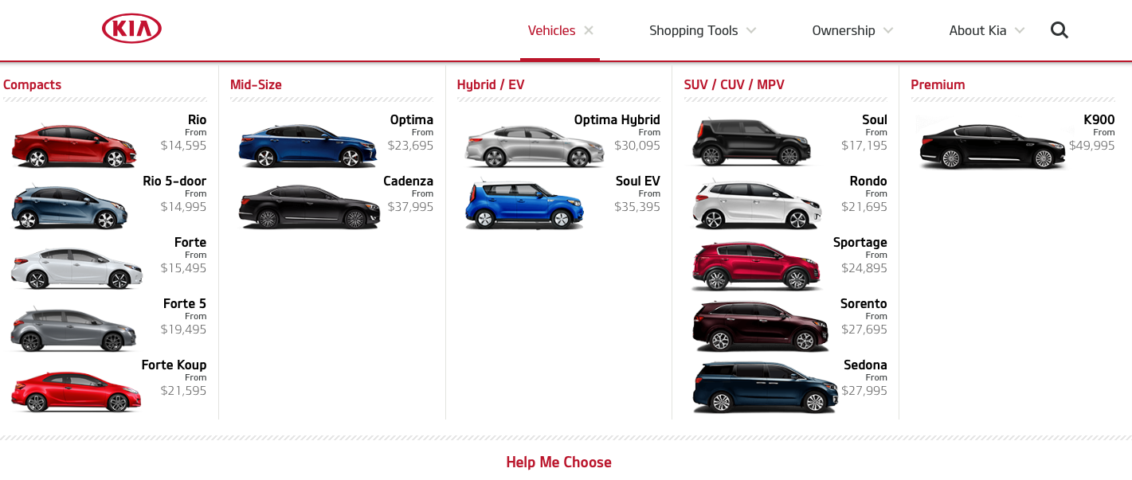
Primary vs. Secondary Demand
Notes:
Primary demand: Encourage consumers to use product category.
Secondary demand: Encourage consumers to use a specific brand.
So here, secondary demand would be for Kia itself whereas primary demand would be for a one of the product categories more specifically (Mid-size, Hybrid etc).

Slide 10
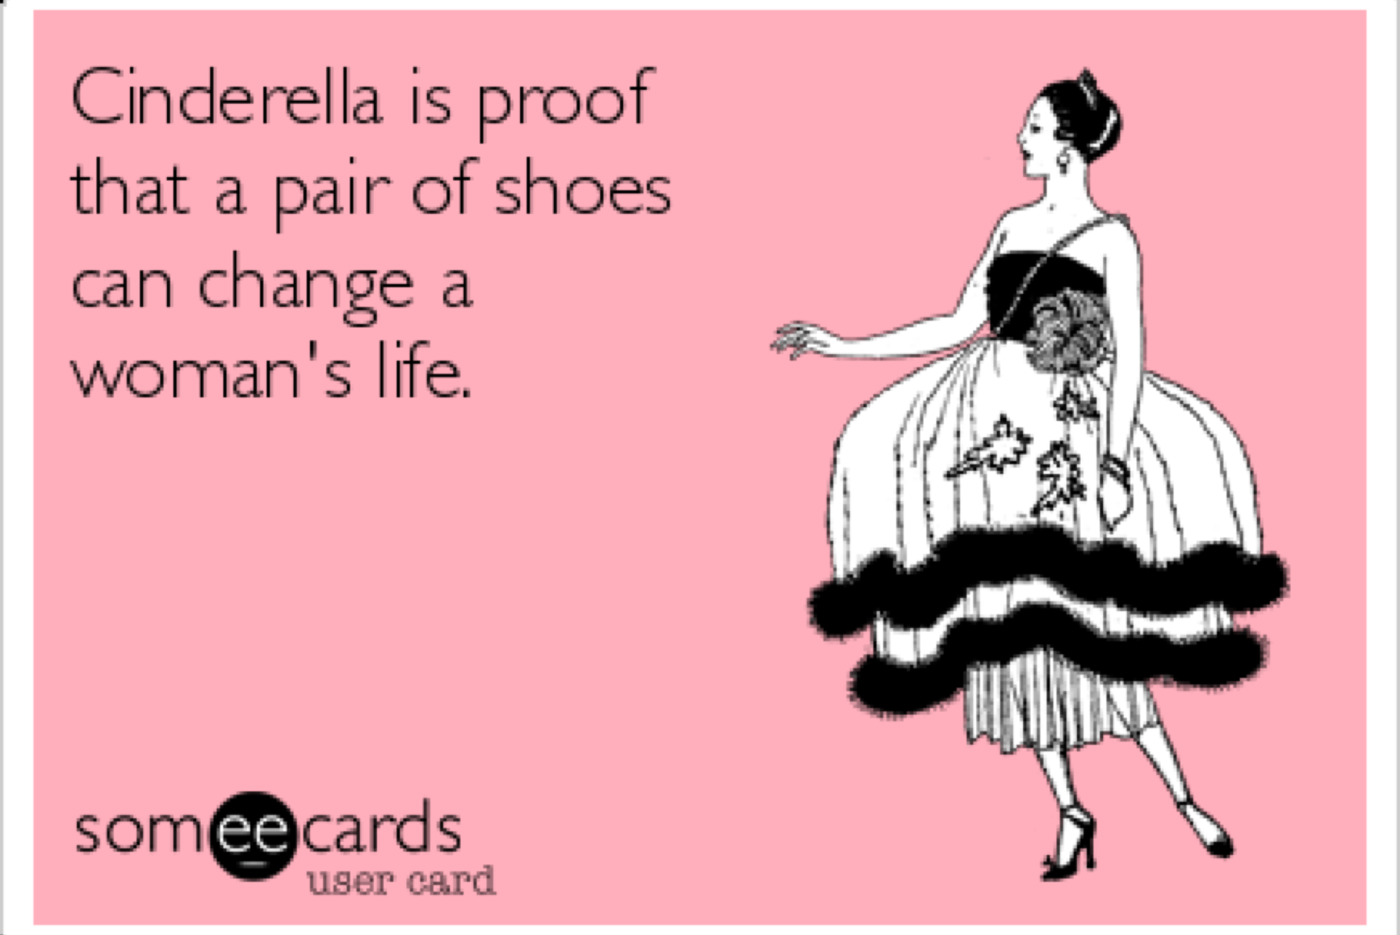
But…
Consumers often cannot identify needs and opportunities (especially innovative ones).
Consumers misidentify problems.
Consumers over and underestimate the degree to which products will solve problems (note: stuff doesn’t make people happy, but experiences do).
Notes:
- people don’t always know what they want or need --- they might be able to identify an end state (e.g., ideal state), but don’t know how to get there.
They also misidentify problems --- someone might think they are overly tired because they are lacking nutrients, so they go see a naturopath and spend hundreds of dollars on vitamins, when really, they just need to watch less Netflix and go to bed earlier.
Products to solve problems --- happiness stuff vs. experiences

Slide 11

Information Search
Process by which consumer surveys the environment for appropriate data to make reasonable decision.
Internal search: scanning memory to assemble product alternative information.
External search: obtaining information from ads, retailers, catalogs, friends, family, people-watching, internet, Consumer Reports, etc.
Notes:
Deliberate vs. Accidental Search:
Directed learning: Existing product knowledge obtained from previous information search or experience of alternatives
Incidental learning: Mere exposure over time to conditioned stimuli and observations of others
Search activity is greater when…
Purchase is important
There is a need to learn more about purchase
Relevant info is easily obtained/utilized
One is younger, is better-educated, and enjoys shopping/fact-finding
One is female (compared to male)
One places greater value on own style/image

Slide 12
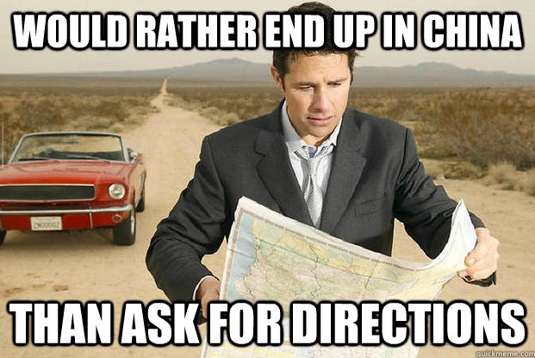
But…
Some consumers avoid external search and don’t do enough research.
Don’t seek out unbiased information (or ignore it).
Satisficing ~ Find adequate, but not best information and solution.

