Slide 1
Satire
an Introduction

Slide 2
Satire Defined
Satire
A technique employed with the intent to expose and criticize foolishness and corruption of individuals, institutions, or societies by using humor, irony, exaggeration, and/or ridicule.

Slide 3
Satire Defined 2
Satire
Satire has been around for a long time; one of the earliest records of Greek satire dates back to 500 B.C.

Slide 4


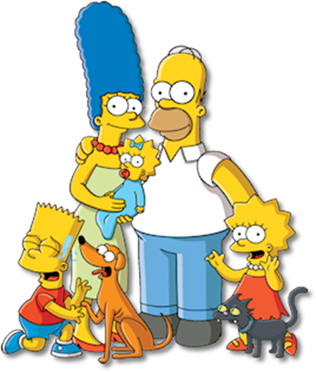
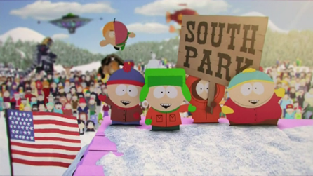
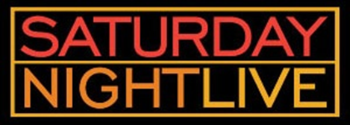
Satire today
Satire is still a popular technique today. Some modern examples of satire include:
The Daily Show
Saturday Night Live
The Colbert Report
The Simpsons
South Park
Political cartoons
Comic strips – Dilbert, The Boondocks
Movies – Scary Movie, Not Another Teen Movie
Internet – Uncyclopedia, The Onion

Slide 5
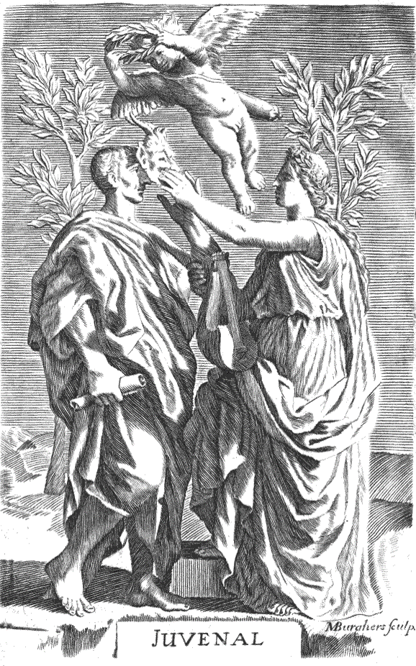
Juvenalian Satire - Harsh
Juvenalian satire is named after Juvenal, a Roman satirist from the 1st -2nd century CE.
Juvenalian satire is a harsh form of satire in which the author/narrator mercilessly ridicules or criticizes certain practices or characters. It generally employs less humor than Horatian satire and often uses some type of metaphor or allegory.
This type of satire is not as popular today as it once was.

Slide 6
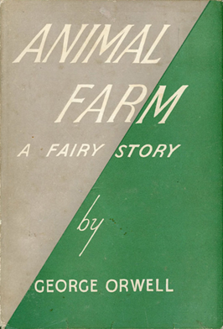
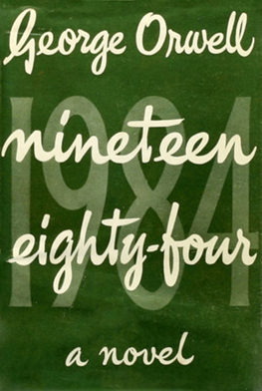
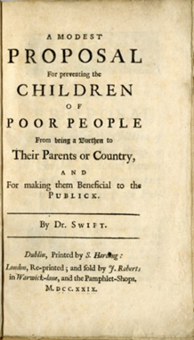
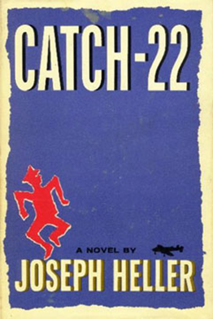
Juvenalian Satire – Harsh 2
Some well-known examples of Juvenalian satiric literature are George Orwell’s Animal Farm and 1984, Jonathan Swift’s famous essay “A Modest Proposal”, and Joseph Heller’s novel Catch-22.

Slide 7
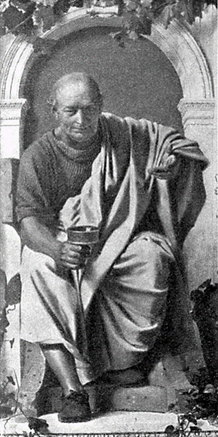
Horatian satire - gentle
Horatian satire is named after Roman satirist Horace (65 BCE).
This is a gentle form of satire in which the author/narrator mildly pokes fun at the subject. It is meant to draw attention to the ridiculousness of a particular concept by exaggerating it to an absurd extreme.
Notes:
Horace: By Anton von Werner - Scan by User:Gabor from the book Bibliothek des allgemeinen und praktischen Wissens. Bd. 5 (1905), Abriß der Weltliteratur, Seite 51., Public Domain, https://commons.wikimedia.org/w/index.php?curid=52353

Slide 8



Horatian satire – gentle 2
Modern examples of Horatian satire include The Simpsons, Southpark, and The Onion (an online “news” source that reports satirical news pieces commenting on political, economic, and social issues).

Slide 9
SATIRE’S PURPOSE
Satire's main purpose is usually political, social, or moral; the purpose of satire is often to point out what the satirist perceives as a need for change. Because of this, the subject matter of satire is often very serious.
Although humor is NOT the main purpose of satire, satire often IS humorous, even when the subject matter is not.

Slide 10
SOME TOOLS OF SATIRE
Overstatement (hyperbole)
Understatement
Sarcasm
Invective
Irony
Parody
Caricature
Notes:
Satire employs a wide variety of tools or literary devices; some of the most common are overstatement, also called hyperbole, understatement, sarcasm, invective, irony, and parody.

Slide 11
Tools of Satire: Overstatement (hyperbole)
Overstatement
Exaggeration used to emphasize a point, also called hyperbole (pronounced hi-PER-bo-lee)

Slide 12
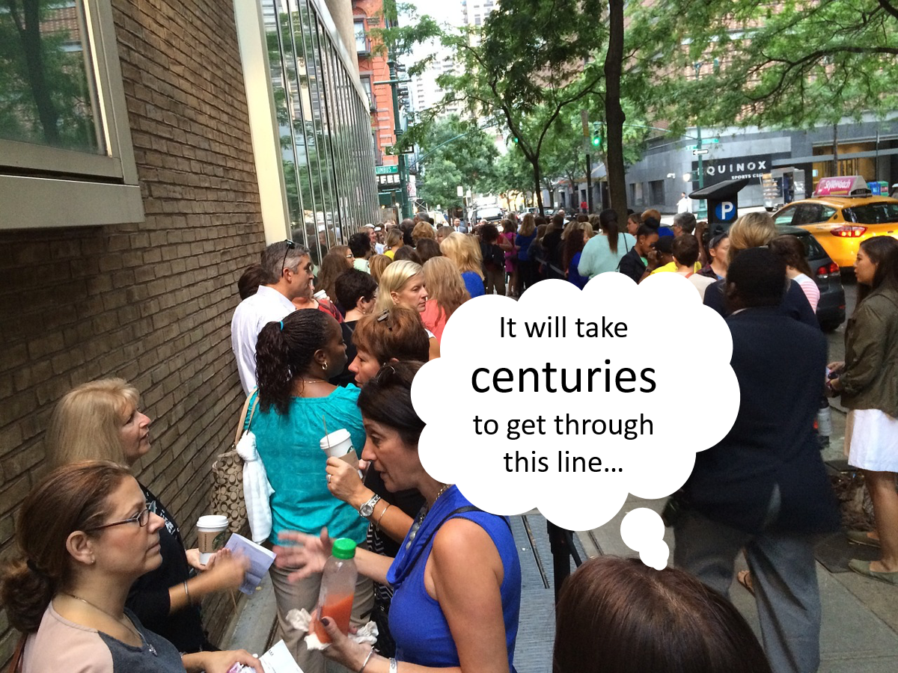
Overstatement (hyperbole)
Although it might feel like it will take centuries to get through the ticket line at a concert, it really won’t; to say that it will is hyperbole.
Notes:
Image: Pixabay

Slide 13
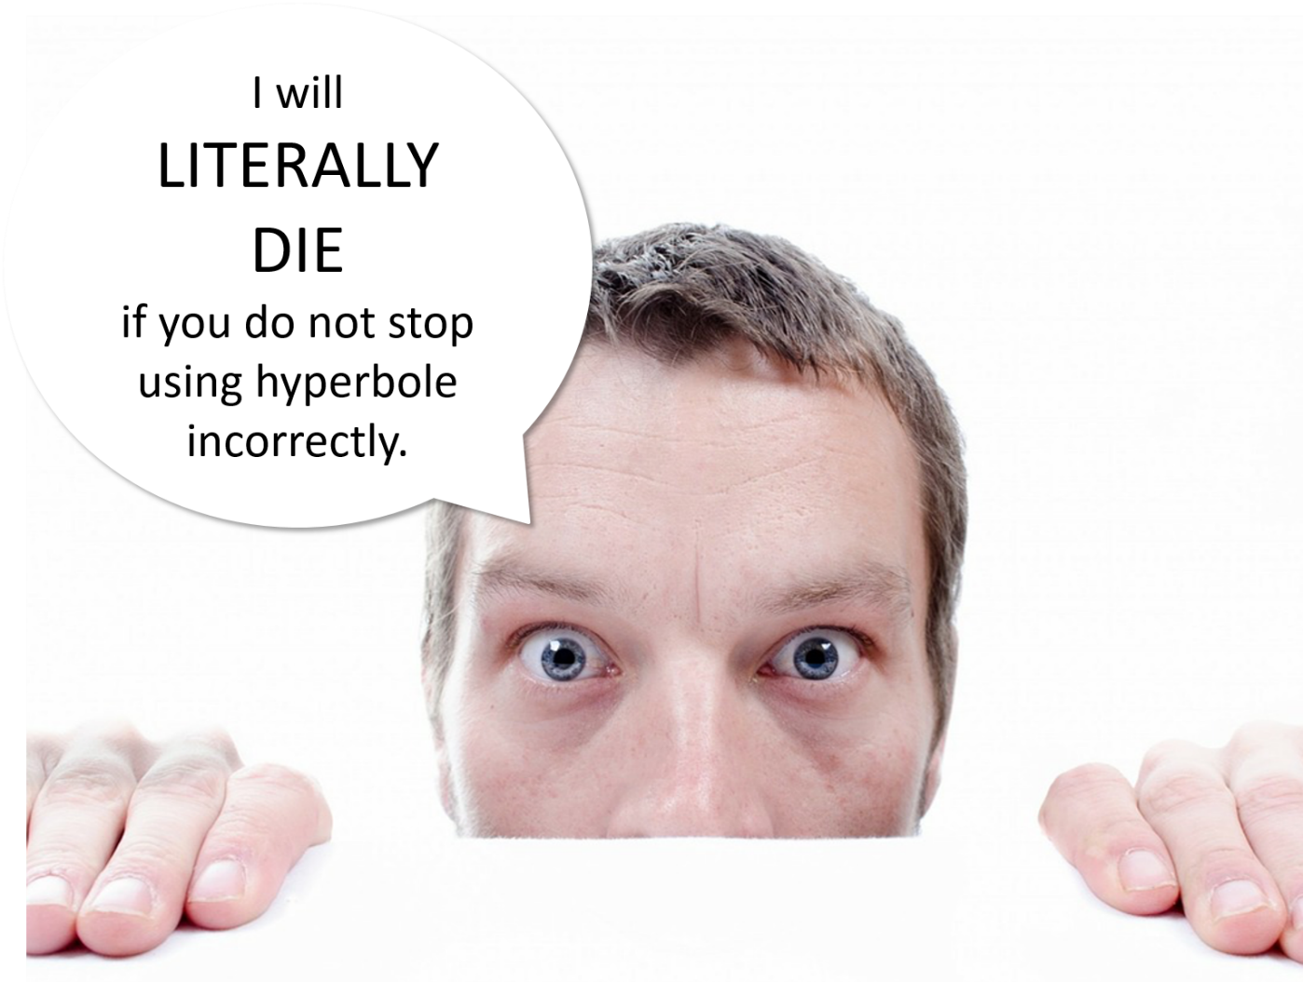
Overstatement (hyperbole)2
No matter how annoying it is for someone to use hyperbole incorrectly, you will not die from it – and neither will this guy. He is overstating his case (or using hyperbole correctly).
Notes:
Image: Pixabay

Slide 14
Satirical Example of Overstatement
From The Onion:
“Stressing the importance of physical and mental preparation for their upcoming game against UNLV, a wild-eyed, frenzied Jim Harbaugh reportedly informed all University of Michigan players Saturday that they would have to kill their pregame meal themselves. ‘You have four hours to track, catch, and slaughter your food before kickoff’” (The Onion).
"Wild-Eyed Jim Harbaugh Informs Players They Must Kill Their Pregame Meal." - The Onion. N.p., 26 Sept. 2015. Web. 26 Sept. 2015. <http://www.theonion.com/article/wild-eyed-jim-harbaugh-informs-players-they-must-k-51397>.

Slide 15
Literary Example of Overstatement
“It’s a slow burg. I spent a couple of weeks there one day.”
From “The People, Yes” by Carl Sandburg

Slide 16
Literary Example of Overstatement 2
“I'll love you, dear, I'll love you
Till China and Africa meet,
And the river jumps over the mountain
And the salmon sing in the street.”
From “As I Walked Out One Evening” by W.H. Auden

Slide 17
Literary Example of Overstatement 3
“Why does a boy who’s fast as a jet take all day and sometimes two to get to school?”
From “Speed Adjustments” by John Ciardi

Slide 18
Tools of Satire: Understatement
Understatement
Minimizing of a fact in order to emphasize it

Slide 19
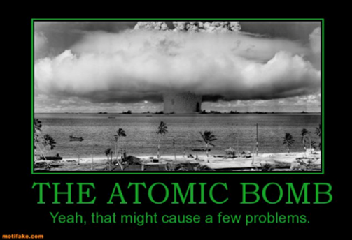
Understatement
An atomic bomb explosion is, of course, likely to cause more than “a few problems.”
Notes:
Such as saying that the atomic bomb might cause a few problems.
Image: Flickr Commons, poster created with Motifake.com

Slide 20
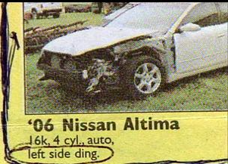
Understatement 2
To have half the left front of your car missing and refer to it as a “left side ding” is most certainly an understatement.

Slide 21
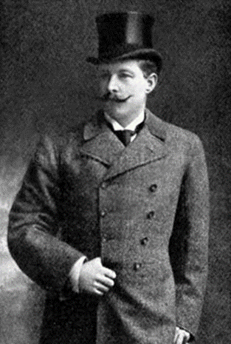
Understatement 3
“It was rather a serious evening, you know.”
Sir Cosmo Duff Gordon, describing
his survival of the sinking
of the Titanic.
Notes:
Image Wikipedia – Public Domain

Slide 22
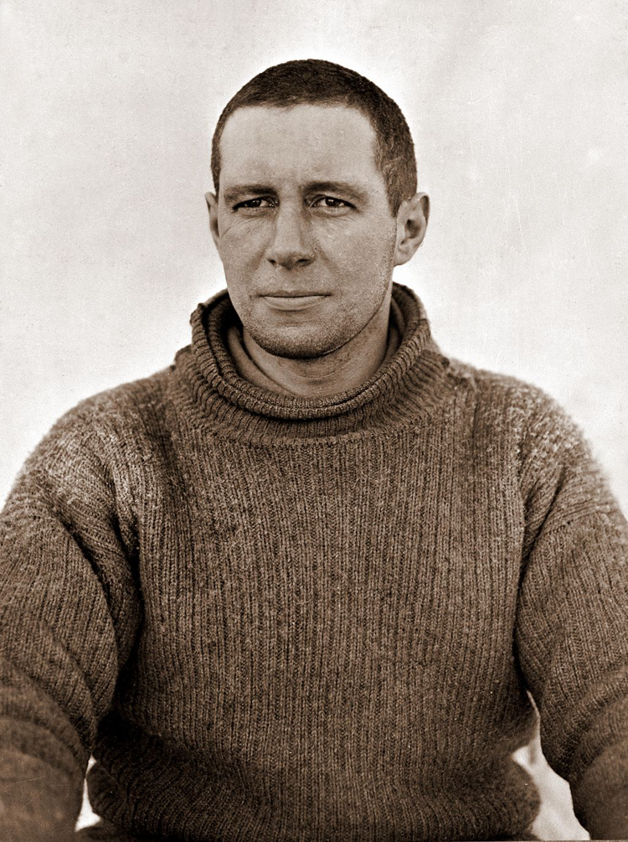
Understatement 4
“I am just going outside and may be some time.”
Antarctic explorer Laurence Oates, before sacrificing himself by walking out into a blizzard to increase his companions’ chances of survival.
Notes:
Image Wikipedia – Public Domain

Slide 23
Literary Example of Understatement in Beowulf
Remember that the epic poem Beowulf was using literary devices over 1,000 years ago? Read the passage and note the last line (in italics) for an example of understatement.
There was Shield Sheafson, scourge of many tribes,
A wrecker of mead-benches, rampaging among foes.
This terror of the hall-troops had come far.
A foundling to start with, he would flourish later on
As his powers waxed and his worth was proved.
In the end each clan on the outlying coasts
Beyond the whale-road had to yield to him
And begin to pay tribute. That was a good king.

Slide 24
Tools of Satire: Invective
Invective
Violent verbal assault; vehement denunciation of something or someone; name-calling, swearing. A long invective is called a DIATRIBE.

Slide 25
Invective: Criticizing Politicians
“I do know a con when I see one. And in politics, I see them all the time.
We are courted by blow-dried, focus-grouped, stage-managed, photo-opped, sloganeering, false-smiling, hand-clasping, back-slapping would-be leaders who say they feel our pain and understand our concerns and maybe sometimes they do, but all too often, it seems they feel little and understand less.
Superficiality gleams in their perfect teeth and scripted lines. They work hard to make style look just like substance.”
- Leonard Pitts, Miami Herald
Notes:
Such as this excerpt from the Miami Herald where Leonard Pitts is criticizing politicians.

Slide 26
Tools of Satire: Irony
Irony
The basis of irony is inversion or reversal, doing or saying the opposite or the unexpected
Irony is perhaps the satirist’s most powerful weapon.
There are three types of irony:
  Verbal
  Situational
  Dramatic

Slide 27
Tools of Satire: Verbal Irony
Verbal Irony
  Irony in which a person says one thing and means another, or words used to convey a meaning opposite of the literal meaning

Slide 28
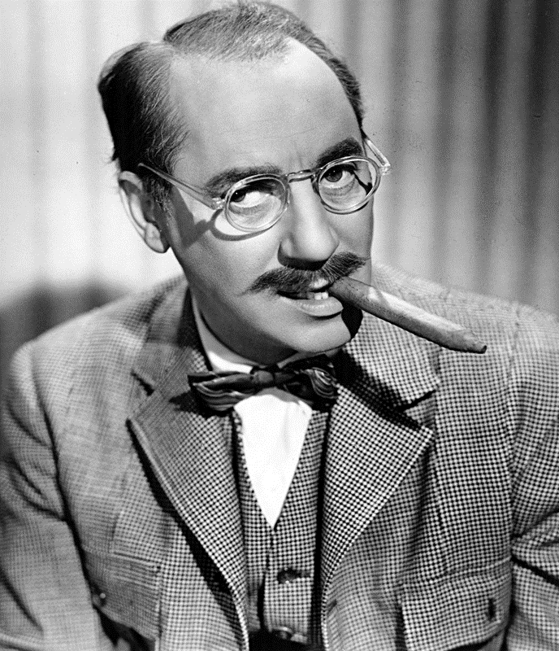
Verbal Irony
“I must say I find television very educational. The minute somebody turns it on I go to the library and read a good book.”
Groucho Marx
Groucho Marx is saying that he thinks television is educational, but it is clear that this is the opposite of what he really thinks.
Notes:
We understand that Groucho Marx means the exact opposite of his statement that television is educational.
Image: By ABC Photo - eBay, Public Domain, https://commons.wikimedia.org/w/index.php?curid=20403474

Slide 29
Tools of Satire: Situational Irony
Situational Irony
  A situation in which the outcome is the opposite of or in sharp contrast to what is expected

Slide 30
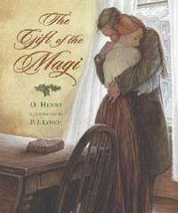
Situational Irony
A classic literary example of situational irony occurs in a short story by O. Henry called “The Gift of the Magi.”

Slide 31

Situational Irony: “The Gift of the Magi”
The young husband and wife, Jim and Della, each sell their most prized possession to buy a Christmas gift for the other.
Notes:
A classic example of situational irony occurs in a short story by O. Henry called “The Gift of the Magi,” where the young husband and wife, Jim and Della, each sell their most prized possession to buy a Christmas gift for the other. Della cuts off and sells her long beautiful hair to buy Jim an expensive chain for his pocket watch, only to discover that Jim sold his watch to buy her an expensive hair clip for her long hair.
Images: Pixabay

Slide 32
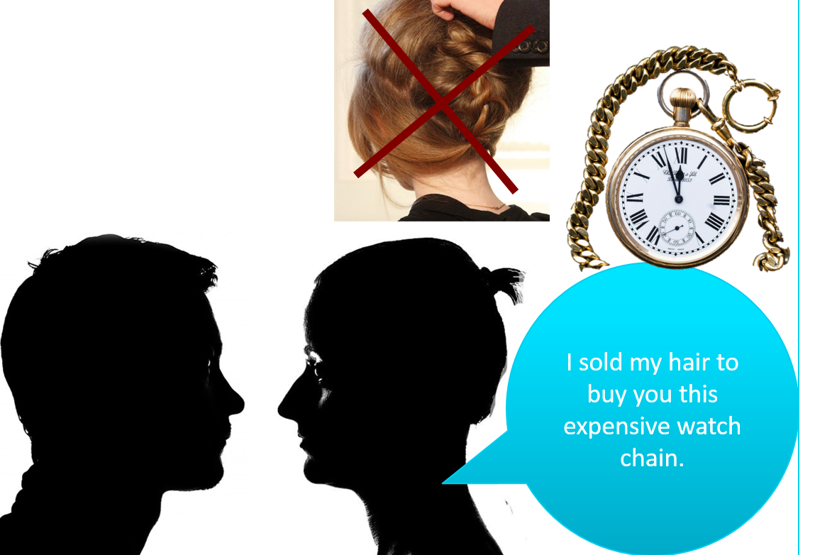
Situational Irony: “The Gift of the Magi” 2
Della cuts off and sells her long beautiful hair to buy Jim an expensive chain for his pocket watch…
Notes:
A classic example of situational irony occurs in a short story by O. Henry called “The Gift of the Magi,” where the young husband and wife, Jim and Della, each sell their most prized possession to buy a Christmas gift for the other. Della cuts off and sells her long beautiful hair to buy Jim an expensive chain for his pocket watch, only to discover that Jim sold his watch to buy her an expensive hair clip for her long hair.
Images: Pixabay

Slide 33
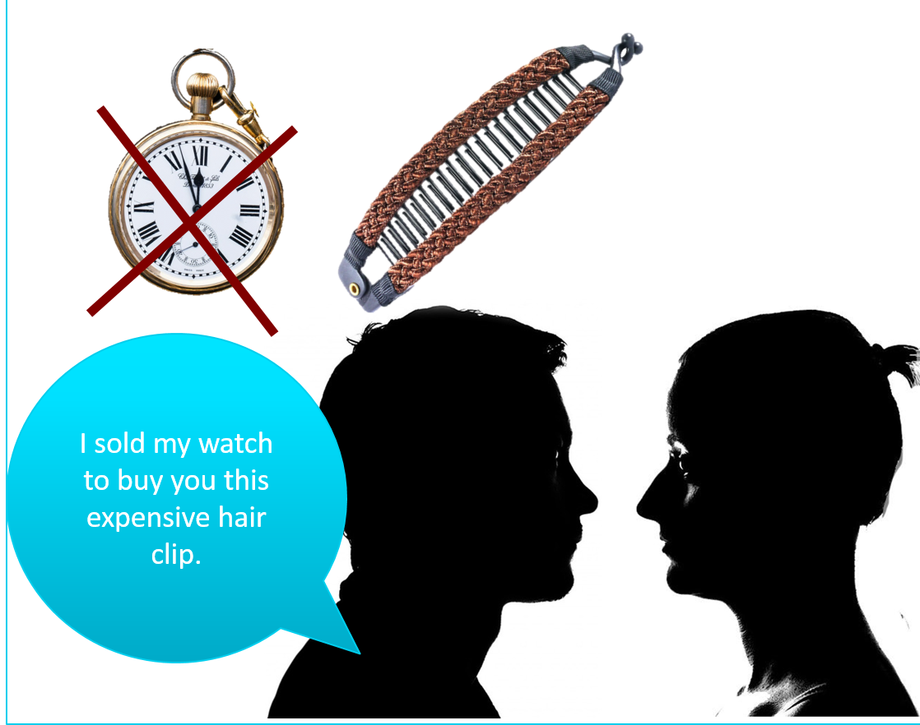
Situational Irony: “The Gift of the Magi” 3
…only to discover that Jim sold his watch to buy her an expensive hair clip for her long hair.
Notes:
A classic example of situational irony occurs in a short story by O. Henry called “The Gift of the Magi,” where the young husband and wife, Jim and Della, each sell their most prized possession to buy a Christmas gift for the other. Della cuts off and sells her long beautiful hair to buy Jim an expensive chain for his pocket watch, only to discover that Jim sold his watch to buy her an expensive hair clip for her long hair.
Images: Pixabay

Slide 34
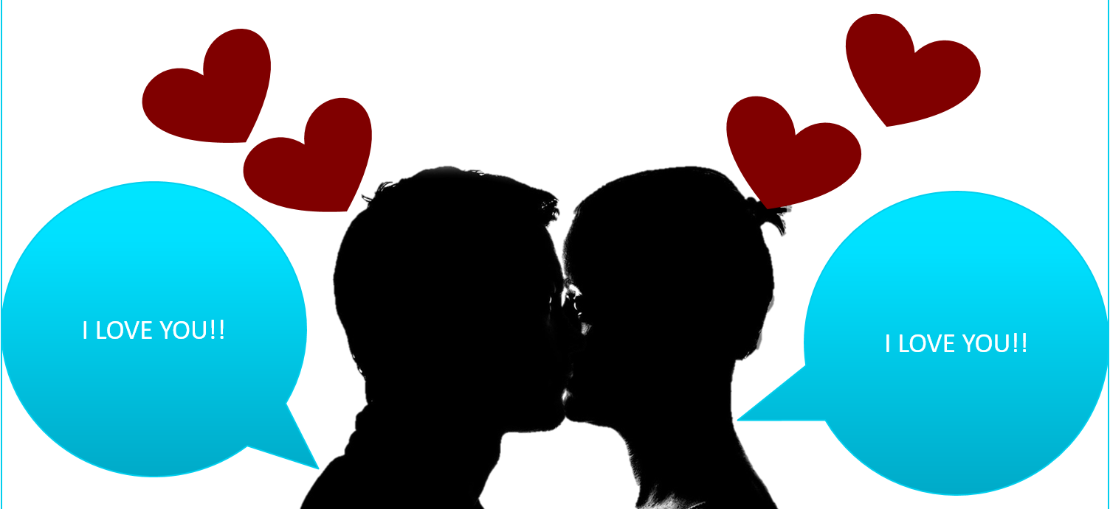
Situational Irony: “The Gift of the Magi” 4
(Spoiler alert: It has a happy ending.)
Notes:
A classic example of situational irony occurs in a short story by O. Henry called “The Gift of the Magi,” where the young husband and wife, Jim and Della, each sell their most prized possession to buy a Christmas gift for the other. Della cuts off and sells her long beautiful hair to buy Jim an expensive chain for his pocket watch, only to discover that Jim sold his watch to buy her an expensive hair clip for her long hair.
Images: Pixabay

Slide 35
Tools of Satire: Dramatic Irony
Dramatic Irony
  When the audience has information that characters in the story do not have

Slide 36
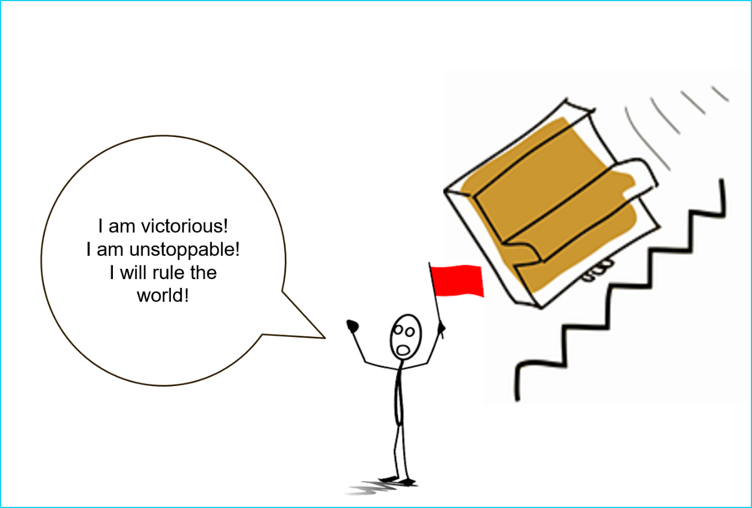
Dramatic Irony
For example, in this situation, this character thinks he is about to take over the world; but we, the audience, know that he’s actually about to be flattened by a piano.

Slide 37
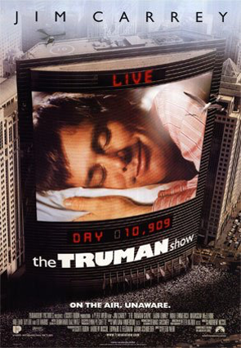
Dramatic Irony 2
In the movie The Truman Show, the main character’s life is the subject of a television show, and everyone knows it except for him.
Notes:
Wikipedia - fair use license, no restrictions - "Trumanshow". Via Wikipedia - https://en.wikipedia.org/wiki/File:Trumanshow.jpg#/media/File:Trumanshow.jpg
https://en.wikipedia.org/wiki/File:Trumanshow.jpg
Fair use in The Truman Show:
This image illustrates the text next to which it appears, which describes the film in question for which it promotes.
It does not limit the copyright owner's rights to market or sell the film in any way.
The image is of lower resolution than the original poster (copies made from it will be of inferior quality).
The image is being used in an informative way and does not detract from the film.
No free or public domain images have been located for this film.

Slide 38
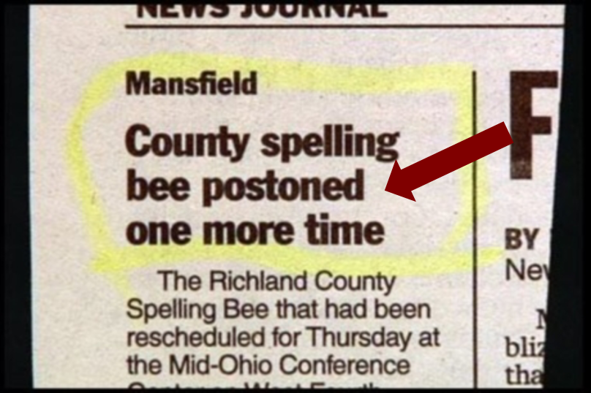
Irony
Irony is often determined by context. For example, misspelling a word isn’t ironic – but misspelling a word on an announcement about a spelling bee is ironic.
Notes:
Irony is often determined by context. For example, misspelling a word isn’t ironic – but misspelling a word on an announcement about a spelling bee is ironic.

Slide 39
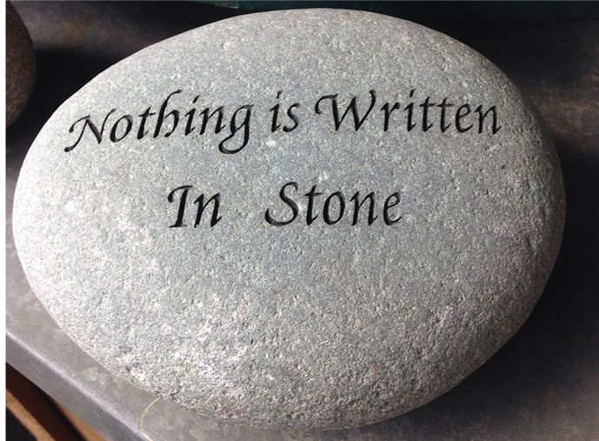
Irony 2
The saying “nothing is written in stone” (meaning that nothing is permanent) isn’t ironic – UNLESS the saying itself is, in fact, written in stone.
Notes:
Irony is often determined by context. For example, misspelling a word isn’t ironic – but misspelling a word on an announcement about a spelling bee is ironic.
Image courtesy of Pixabay

Slide 40
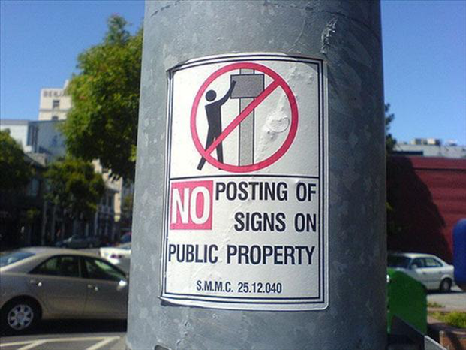
Irony 3
It’s ironic to post a sign on public property that tells people not to post signs on public property.
Notes:
Irony is often determined by context. For example, misspelling a word isn’t ironic – but misspelling a word on an announcement about a spelling bee is ironic.
Image courtesy of Pixabay

Slide 41
Tools of Satire: Sarcasm
Sarcasm
Often a cutting personal remark; from the Greek sarkazein, “to tear flesh”
Usually sarcasm comes in the form of saying something that sounds like praise or concern while meaning the opposite.
Sarcasm is a form of verbal irony.

Slide 42
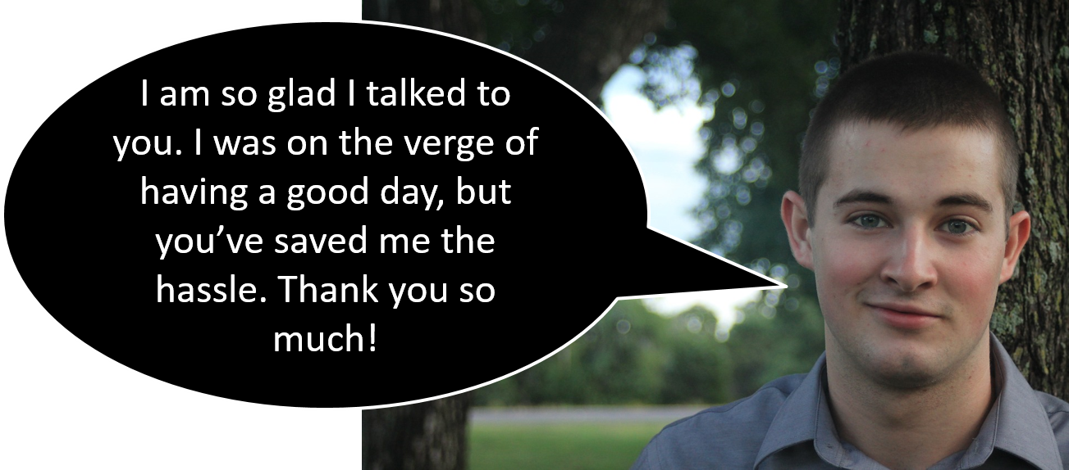
Sarcasm
Sarcasm is a familiar tool in modern situational comedies (as well as in real life).

Slide 43
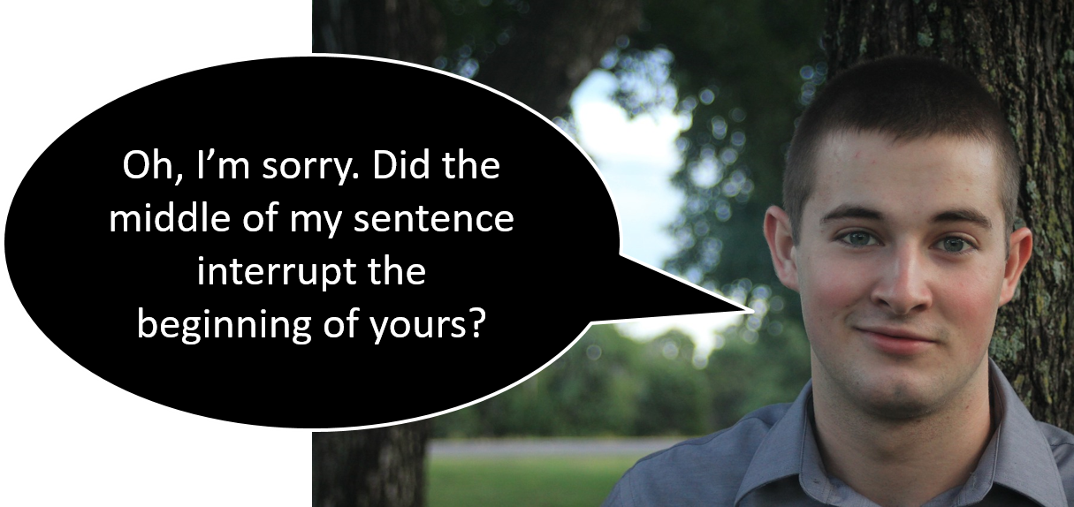
Sarcasm 2
Although sarcasm is a form of verbal irony, sarcasm is distinguished by its intent: sarcasm is meant to mock or attack; it’s at least a little mean.

Slide 44
Tools of Satire: Parody
Parody
A form of satire that imitates a specific piece of work or a specific person, often for the purpose of ridicule (or at least humor)

Slide 45
Tools of Satire: Parody 2
Parody
Unlike other forms of satire, the main purpose of a parody is frequently just to be humorous.

Slide 46
Tools of Satire: Parody 3
Parody
Parody can be part of larger work of satire: for example, a satire about consumerism in America can include a parody of a specific person (like Steve Jobs) or a specific product (like the iPhone).

Slide 47

Parody
The Harvard Lampoon’s The Hunger Pains is a parody of the best-selling novel The Hunger Games.

Slide 48
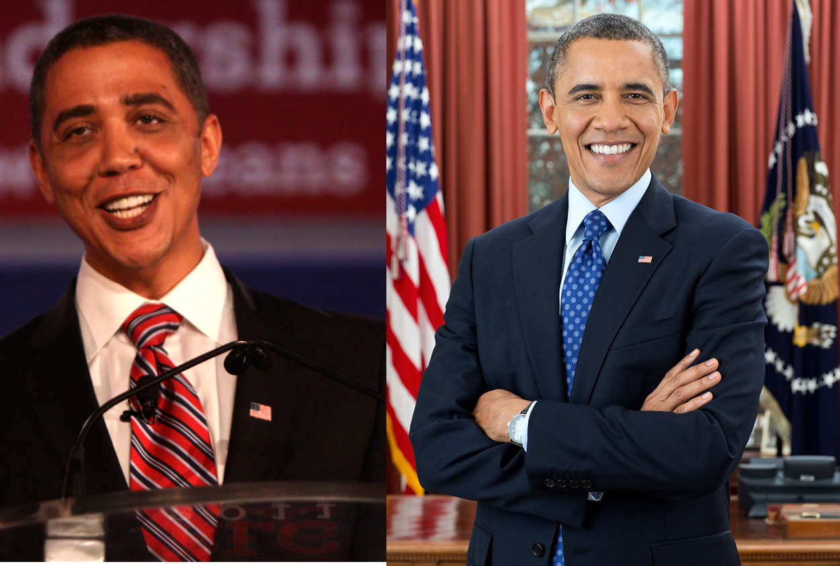
Parody 2
Comedian Reggie Brown impersonating President Barack Obama is an example of parody.
Notes:
Comedian Reggie Brown impersonating President Barack Obama.
Image Reggie Brown, a voice actor and Barack Obama impersonator: attribute: "Reggie Brown by Gage Skidmore 2" by Gage Skidmore. Licensed under CC BY-SA 3.0 via Commons - https://commons.wikimedia.org/wiki/File:Reggie_Brown_by_Gage_Skidmore_2.jpg#/media/File:Reggie_Brown_by_Gage_Skidmore_2.jpg
Image Barack Obama – Wikipedia – public domain: "President Barack Obama" by Official White House Photo by Pete Souza - P120612PS-0463 (direct link). Licensed under Public Domain via Commons - https://commons.wikimedia.org/wiki/File:President_Barack_Obama.jpg#/media/File:President_Barack_Obama.jpg

Slide 49
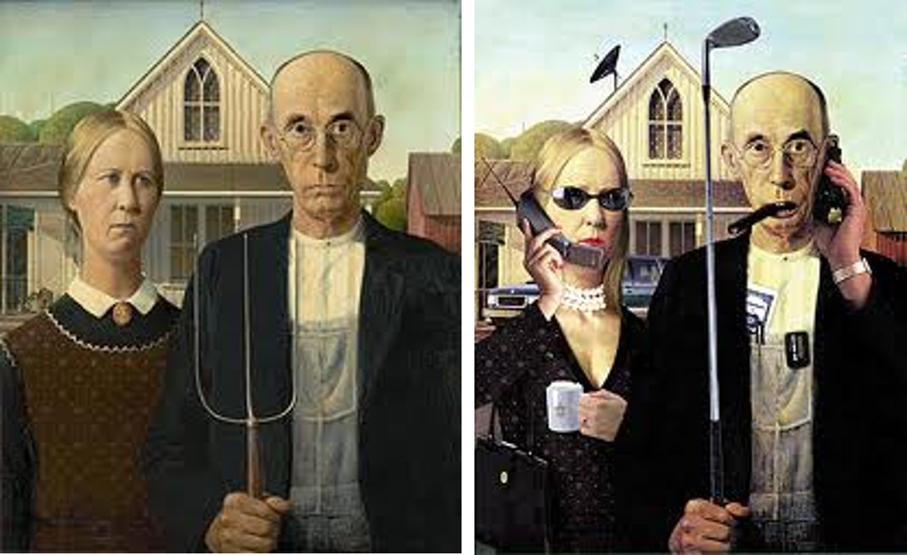
Parody 3
A parody of artist Grant Wood’s iconic painting American Gothic

Slide 50
Tools of Satire: Caricature
Caricature
Exaggerating, for comic effect, a particular characteristic or characteristics of the target

Slide 51
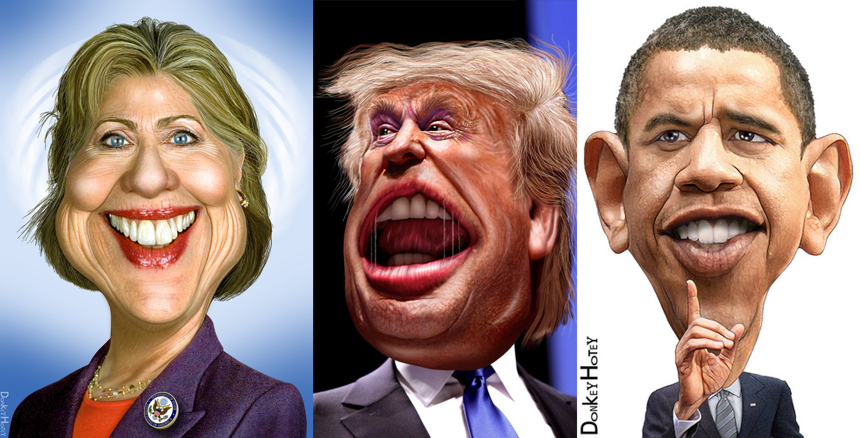
Caricature - artwork
Political figures are often the subject of caricature.
Notes:
http://public-domain.pictures -
Donald Trump: Photo By <a target='_blank' href='http://www.flickr.com/photos/47422005@N04/11360500826/'>DonkeyHotey</a> via <a href="http://public-domain.pictures/" target="_blank">http://public-domain.pictures/</a>
Hillary Clinton: Photo By <a target='_blank' href='http://www.flickr.com/photos/47422005@N04/5621847849/'>DonkeyHotey</a> via <a href="http://public-domain.pictures/" target="_blank">http://public-domain.pictures/</a>
Barack Obama Photo By <a target='_blank' href='http://www.flickr.com/photos/47422005@N04/5548467691/'>DonkeyHotey</a> via <a href="http://public-domain.pictures/" target="_blank">http://public-domain.pictures/</a>

Slide 52
Caricature - verbal
"They wear down-filled coats in public. Out on the ski slopes they look like hand grenades. They have 'audio systems' in their homes and know the names of hit albums. They drive two-door cars with instrument panels like an F-16's. They like High-Tech furniture, track lighting, glass, and brass. They actually go to plays in New York and follow professional sports. The down-filled men wear turtleneck sweaters and Gucci belts and loafers and cover parts of their ears with their hair. The down-filled women still wear cowl-necked sweaters and carry Louis Vuitton handbags. The down-filled people strip wood and have interior walls removed. They put on old clothes before the workmen come over."
(Tom Wolfe, "The Down-Filled People." In Our Time, Farrar Straus Giroux, 1980)
Notice how particular characteristics of the people in this passage are emphasized and exaggerated for the purpose of ridicule, just like in the caricature artwork.

