Slide 1
EDS/SOC 126
Week 2, Monday

Slide 2
Early America 1700’s and 1800’s
A young nation, still forming after the American Revolution.
Steady waves of millions of European immigrants; many didn’t speak English, were illiterate and had few job skills.
The Industrial Revolution transformed and expanded agricultural, textile, and metal industries. The economic system transitioned from rural and local to urban and large-scale manufacturing.

Slide 3
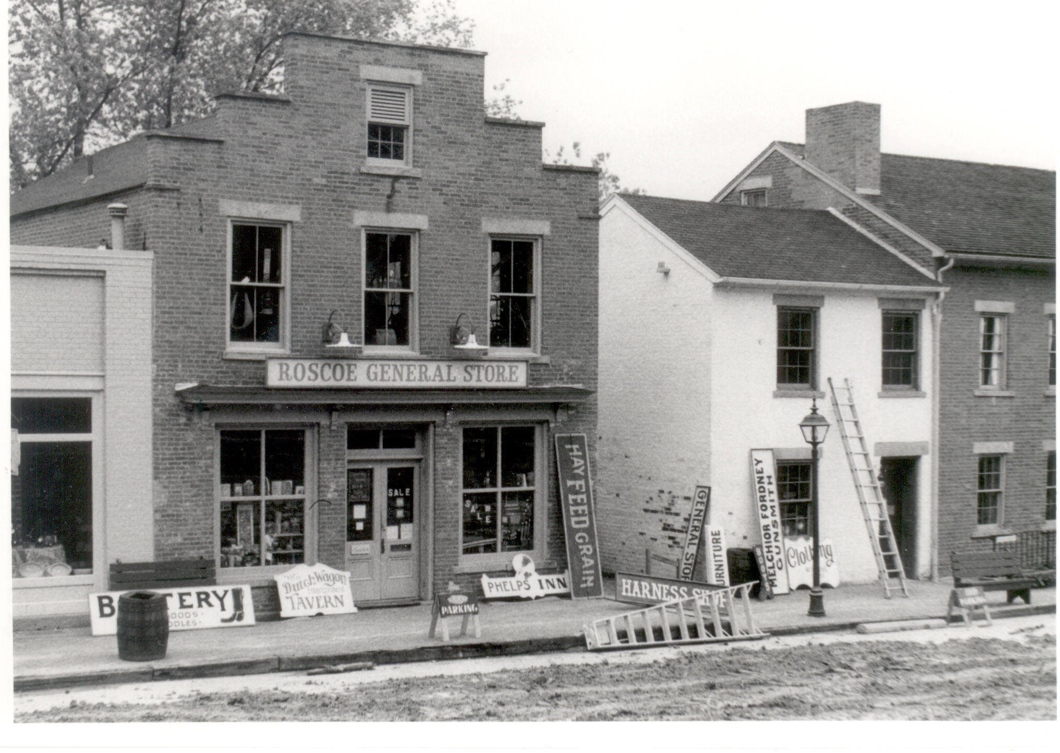
Notes:
19th century General Store in Colorado

Slide 4
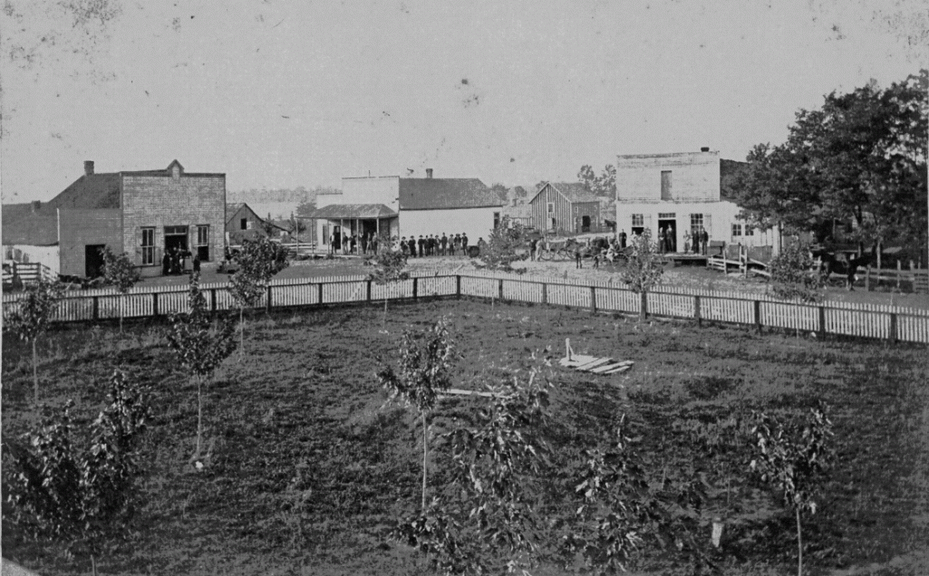
Notes:
Missouri town 1885

Slide 5
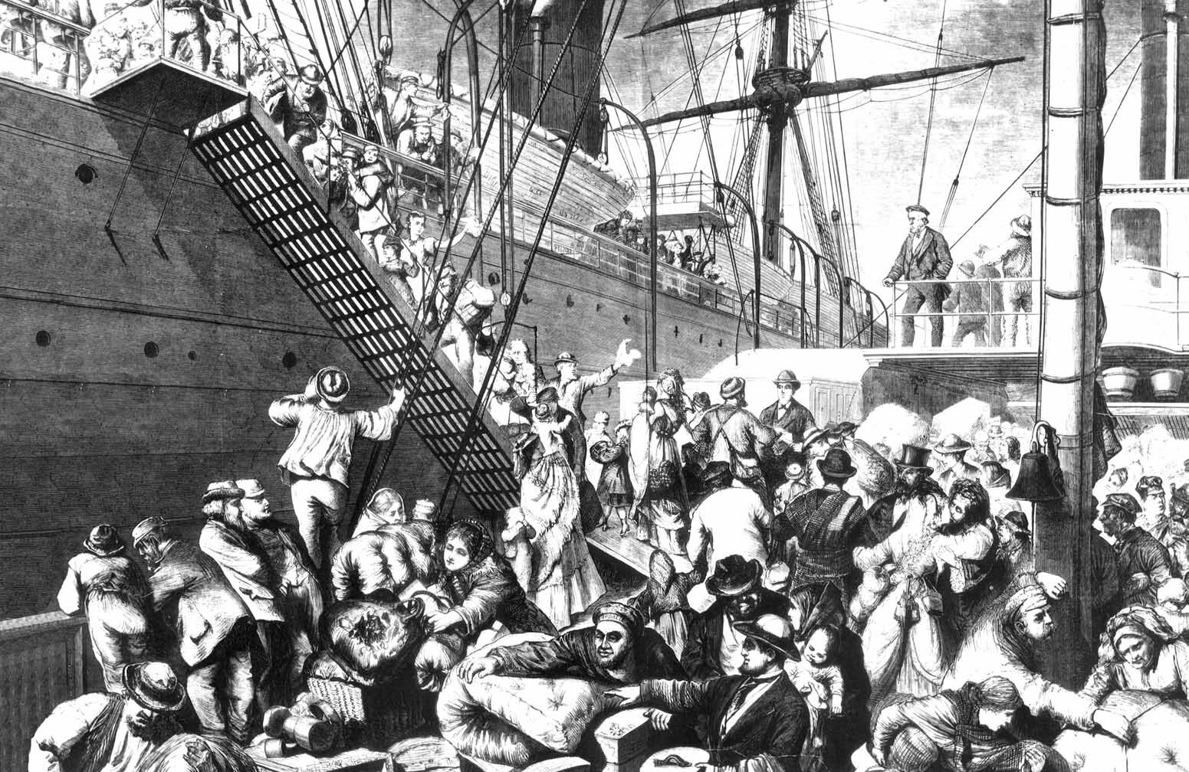
Notes:
German emigration 1874

Slide 6
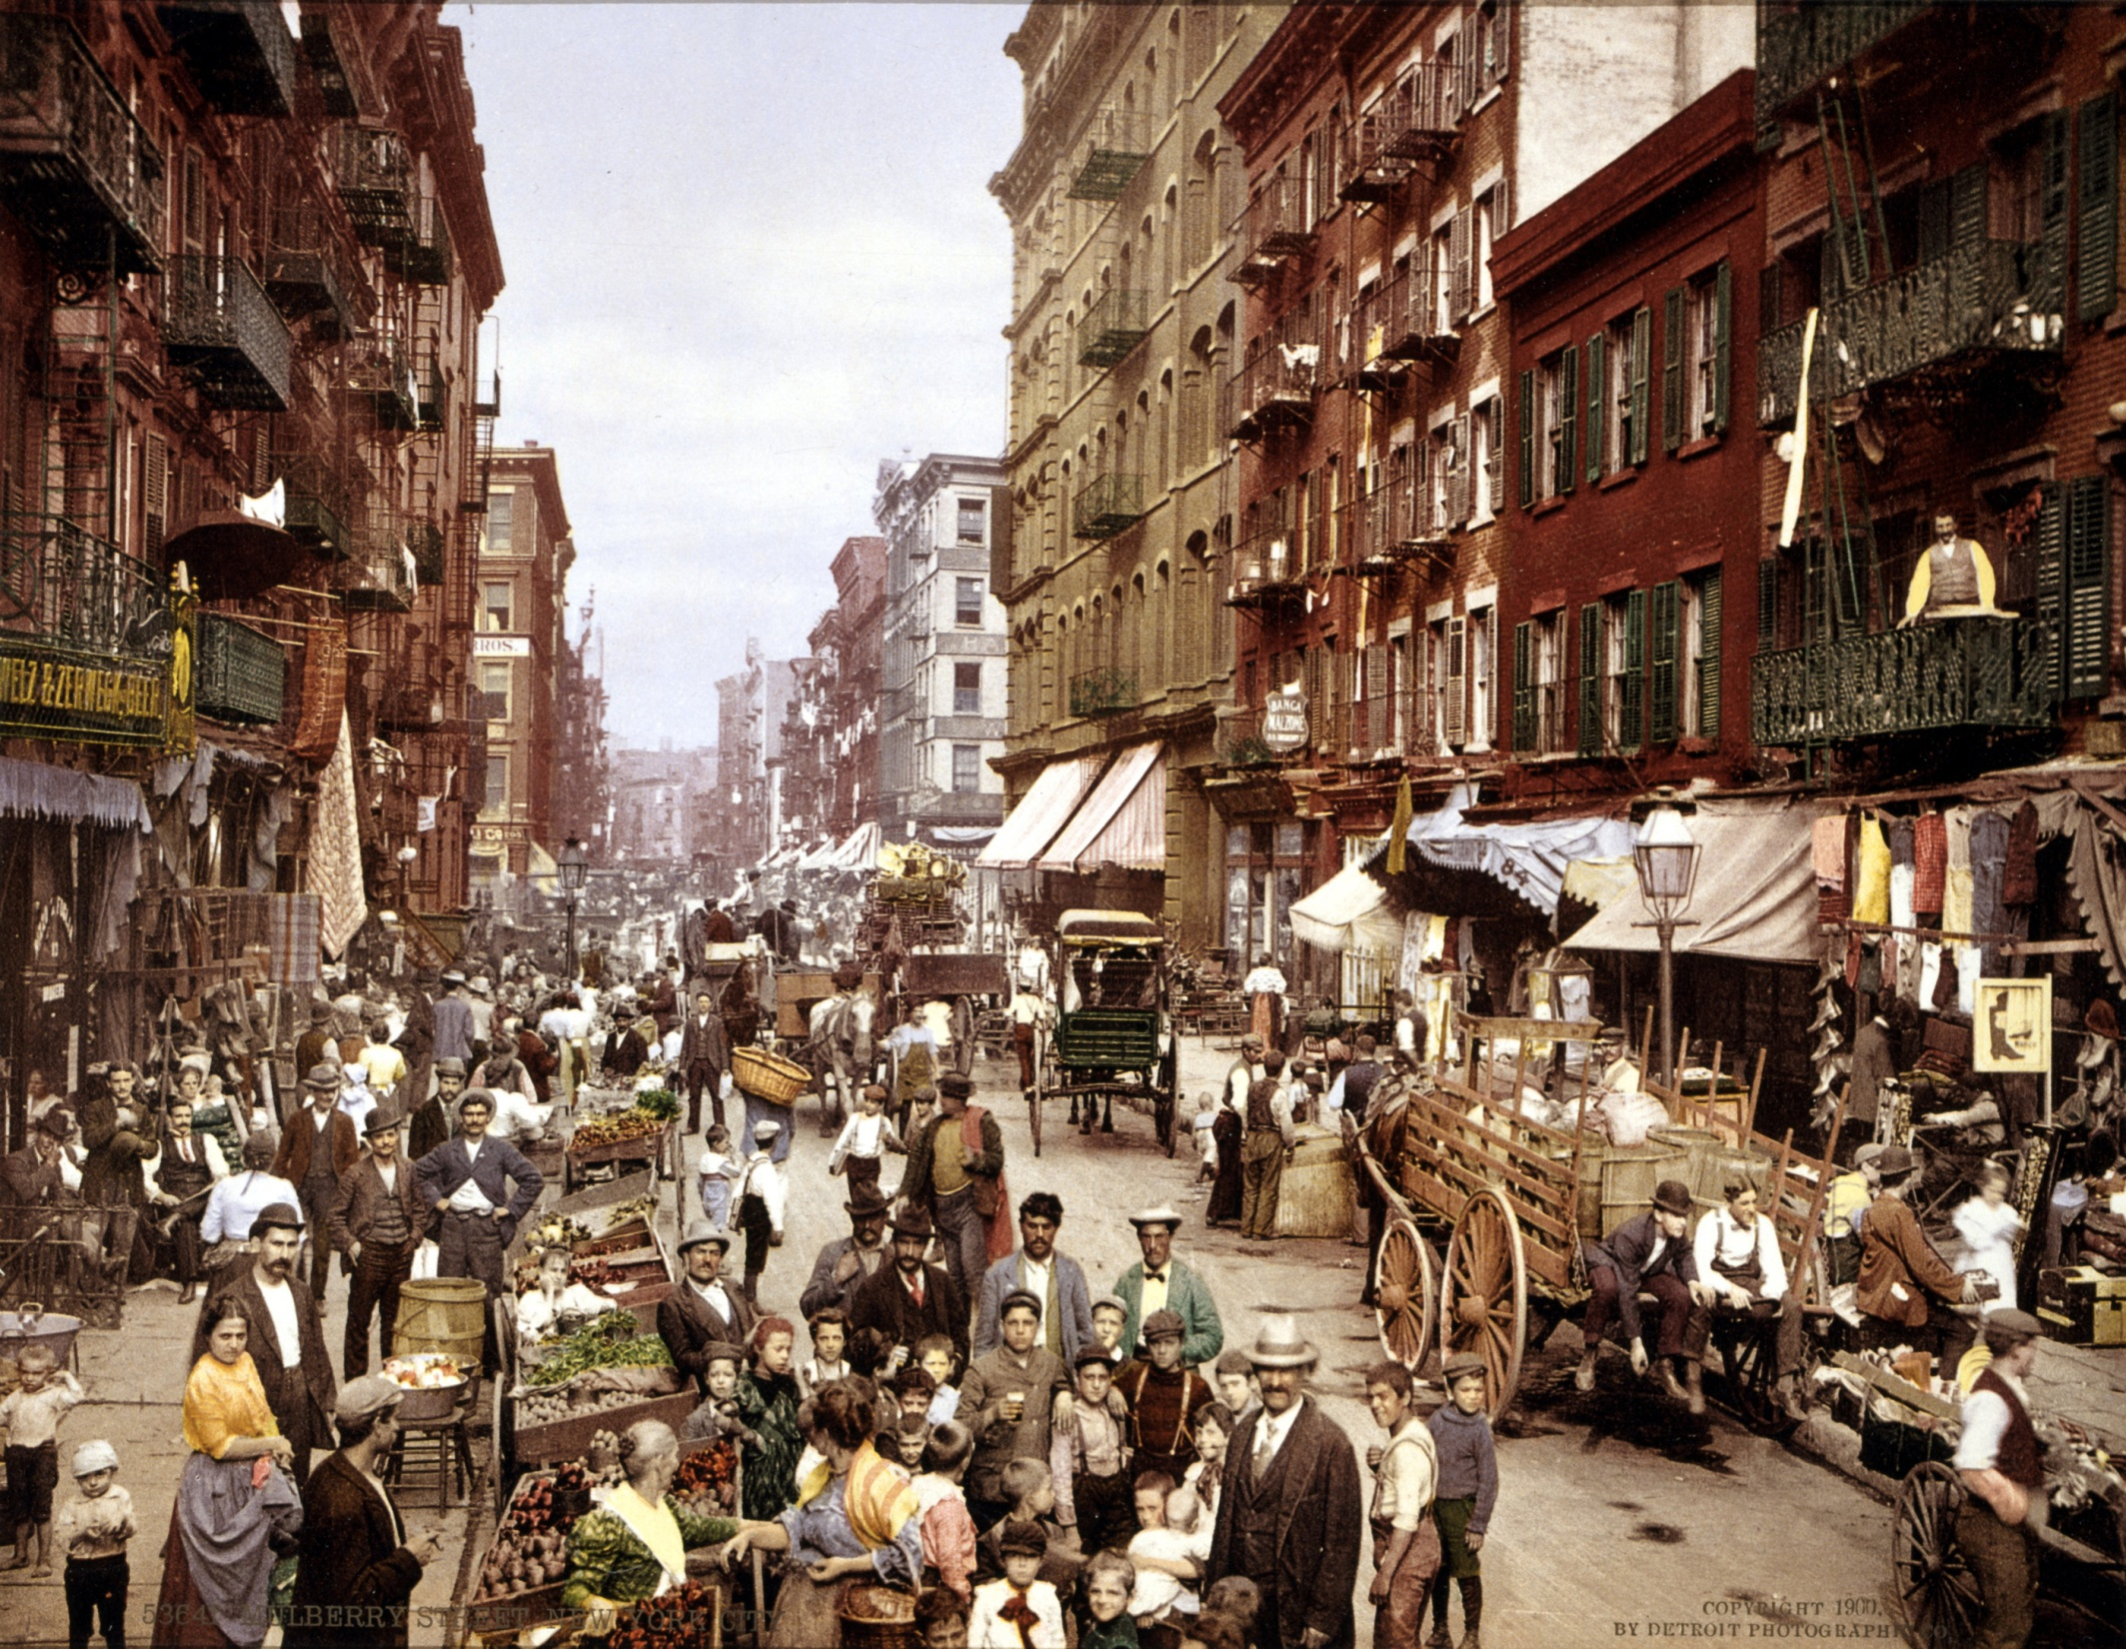
Notes:
Little Italy, New York City c. 1900

Slide 7
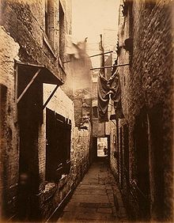
Notes:
18th century urban city

Slide 8
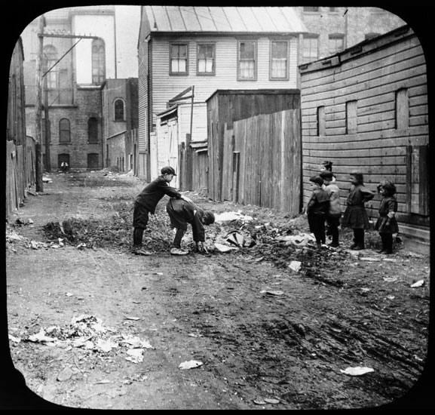
Notes:
1880’s Chicago

Slide 9
Thomas Jefferson’s letters from On Democracy, compiled by Saul Padover (1947)
“Only popular education can safeguard democracy”
In every government on earth is some trace of human weakness, some germ of corruption and degeneracy, which cunning will discover, and wickedness insensibly open, cultivate and improve. Every government degenerates when trusted to the rulers of the people alone. The people themselves are its only safe depositories. And to render even them safe, their minds must be improved to a certain degree…An amendment of our constitution must here come in aid of the public education. The influence over government must be shared among all the people. If every individual participates in the ultimate authority, the government will be safe. (pg. 87)

Slide 10
Thomas Jefferson’s letters from On Democracy, compiled by Saul Padover (1947)
“Ignorant people can not maintain their freedom”
If a nation expects to be ignorant and free, in a state of civilization, it expects what never was and never will be. The functionaries of every government have propensities to command at will the liberty and property of their constituents. There is no safe deposit for these but with the people themselves; nor can they be safe with them without information. Where the press is free, and every man able to read, all is safe. (pg. 89)

Slide 11
Thomas Jefferson’s letters from On Democracy, compiled by Saul Padover (1947)
“Happiness of man lies in popular education”
I look to the diffusion of light and education as the resource most to be relied on for ameliorating the condition, promoting the virtue, and advancing the happiness of man….And I do hope that, in the present spirit of extending to the great mass of mankind blessings of instruction, I see a prospect of great advancement in the happiness of the human race; and that this may proceed to an indefinite, although not to an infinite degree. (pg. 92)

Slide 12
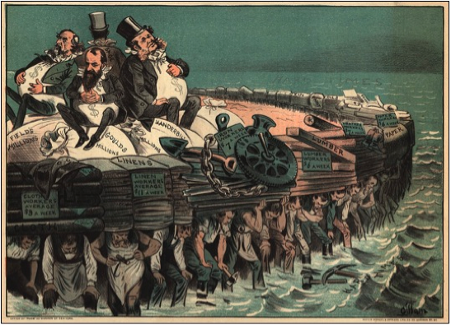
Notes:
“on the backs of Irish”

Slide 13
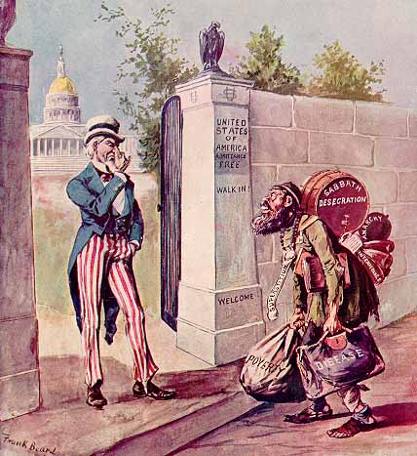
Notes:
Anti-immigration sentiment 1896

Slide 14
Contradictions in early ideas on democracy and education
During Jefferson’s writing, one-fifth of the nation’s people were enslaved. Africans were not considered human, only property.
Freedom and equality were reserved for white men and men with property (land, animals, slaves). Disparities in wealth were commonly accepted.
Jefferson made sure citizenship and civic participation excluded women and all people of African descent.

Slide 15
Early America: 1700’s and 1800’s
The concept of education was generally linked to parental obligation to raise children “properly.” Child-rearing activities were considered informal schooling.
In places with more formal education, religious and charitable organizations often organized and ran the schools.
Schooling rarely went beyond elementary years. Secondary schools were rare and a very small percentage of the population attended college. The wealthy commonly sent children to European schools.

Slide 16
J. Spring reading – The Ideology and Politics of the Common School
Distinct aspect of the common school:
Educating children from diverse religious, social class and ethnic backgrounds in the same schoolhouse
Opposition:
Upper-classes were afraid of the social and economic changes brought by immigration

Slide 17
J. Spring reading – The Ideology and Politics of the Common School
Other reasons for the opposition: fear that common schools would eliminate “desirable” social class differences among groups and educate people out of their “proper place” in society
One of most significant ideas from common school movement was the idea that “human nature can be formed, shaped, and given direction by training within formally organized institutions” (pg. 72)

Slide 18
J. Spring reading – The Ideology and Politics of the Common School
Competing interpretations of the common school:
Politicians and business leaders wanted to reduce/prevent crime, prepare boys for the workforce, assimilate immigrants into American culture.
The working class or “blue collar” workers wanted to maintain and protect individual rights
Blacks wanted to advance in society

Slide 19
Oakes et. al. reading –
History and Culture…
Before the 1900’s, education was not necessarily seen as connected to the national economy
Manufacturers and labor union appealed to schools to take on the role of developing “human capital”
Sorting students into curriculum “tracks” became common practice to educate students for different roles in the economy

Slide 20
Schools support the nation’s workforce, economy, global competitiveness
Since the early 1900’s, education has been the primary mechanism to improve the economy.
National attention on improving education when the U.S. fears it’s losing its competitive edge.

Slide 21
Persistent Inequities in American Education
Persistent achievement gaps between White students and their Black and Latino counterparts
Over 75% of Black and Latinx students attend schools that are predominantly non-White
Schools with the largest numbers of poor students have the greatest shortages of textbooks, the lowest numbers of qualified teachers, and attend the state's most overcrowded and run-down schools

Slide 22
Funding Inequities
California ranks close to the bottom in per pupil funding compared to other states in the country
Districts located in wealthier areas, serving mostly white students, receive more money (from local, state, and federal sources combined) than districts in other areas

Slide 23
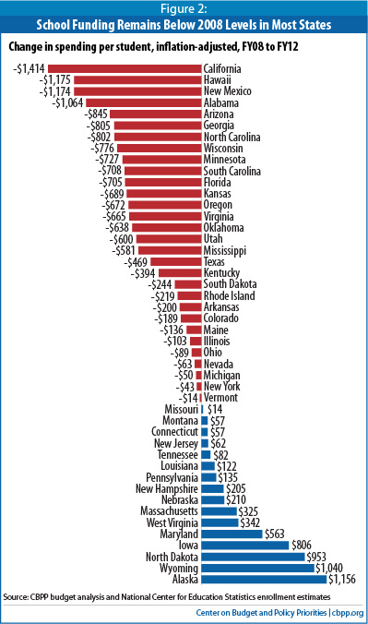

Slide 24
Inequities for English Language Learners (ELLs)
Approximately 1.5 million students in CA schools are ELLs
ELLs are highly segregated among CA schools, are more likely to be taught by un-credentialed teachers, and have less access to high quality materials
ELLs are disproportionately placed in special education and remedial courses when their special language needs are misidentified as learning disabilities

Slide 25
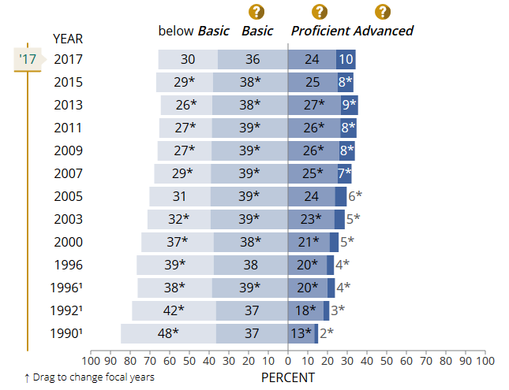
2017 Trends in eighth-grade mathematics achievement

Slide 26
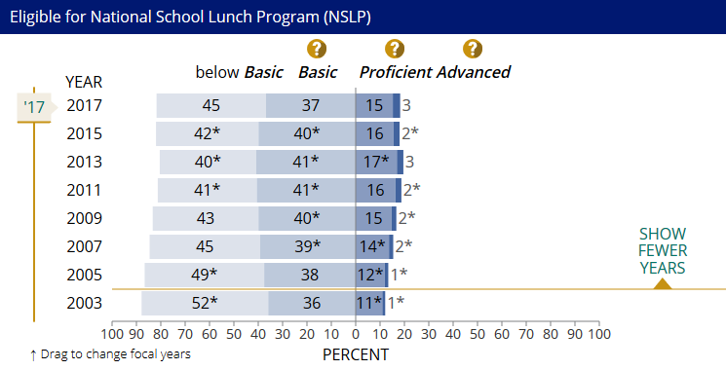
2017 Trend in eighth-grade NAEP mathematics – Eligible for National School Lunch Program

Slide 27
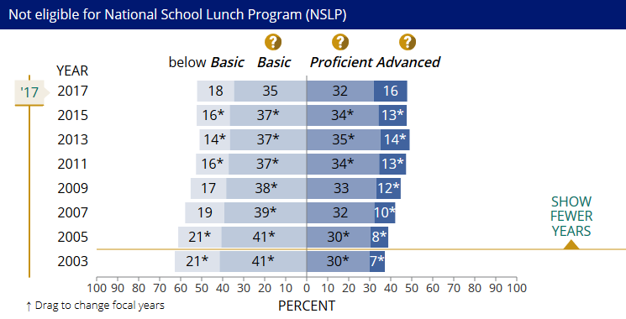
2017 Trend in eighth-grade NAEP mathematics – NOT Eligible for National School Lunch Program

Slide 28
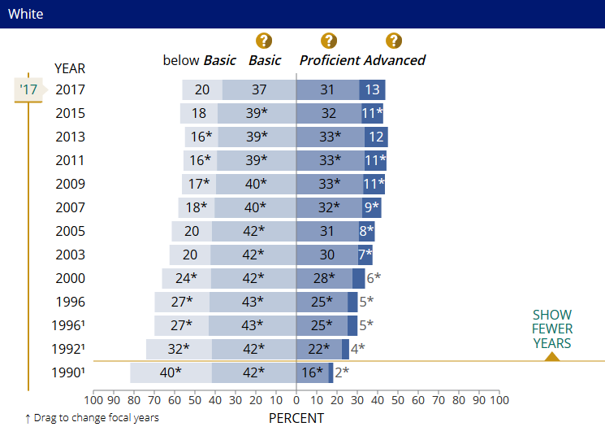
2017 Trend in eighth-grade NAEP mathematics - White

Slide 29
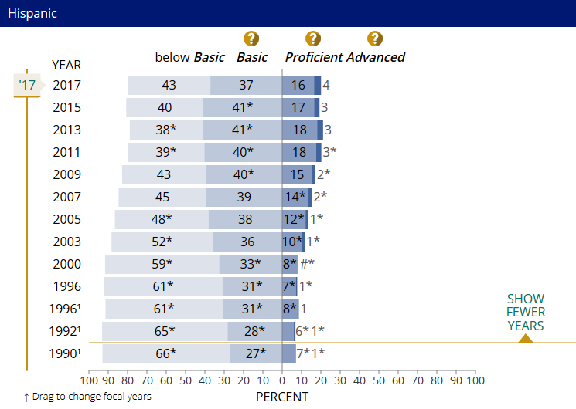
2017 Trend in eighth-grade NAEP mathematics - Latinx

Slide 30
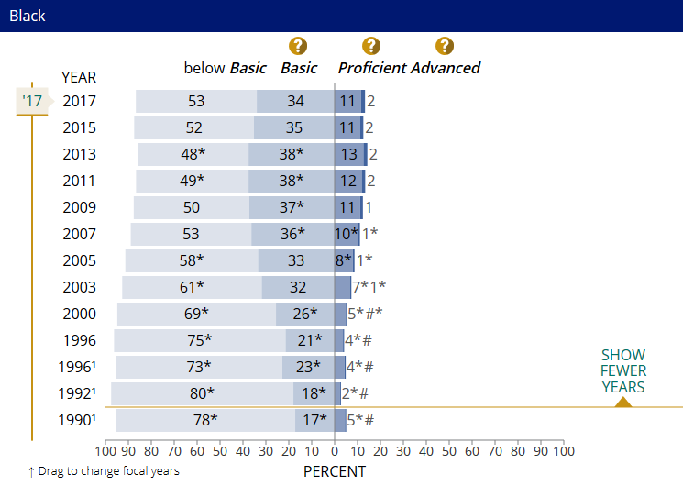
2017 Trend in eighth-grade NAEP mathematics - Black

Slide 31
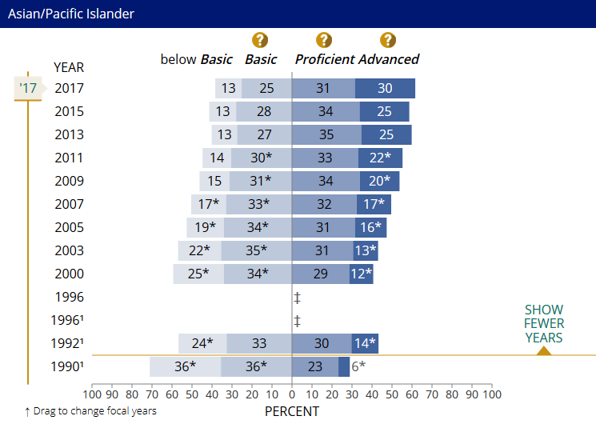
2017 Trend in eighth-grade NAEP mathematics – Asian/Pacific Islander

Slide 32
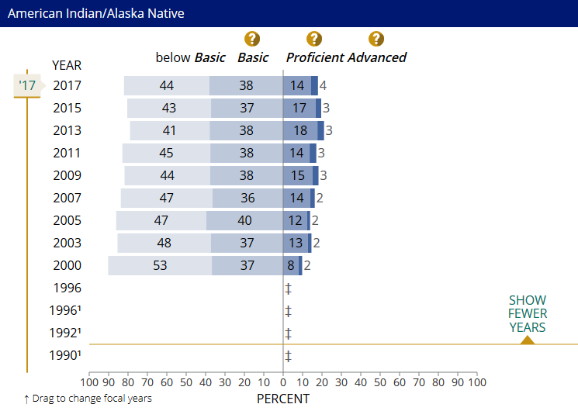
2017 Trend in eighth-grade NAEP mathematics – Native American Indian

Slide 33
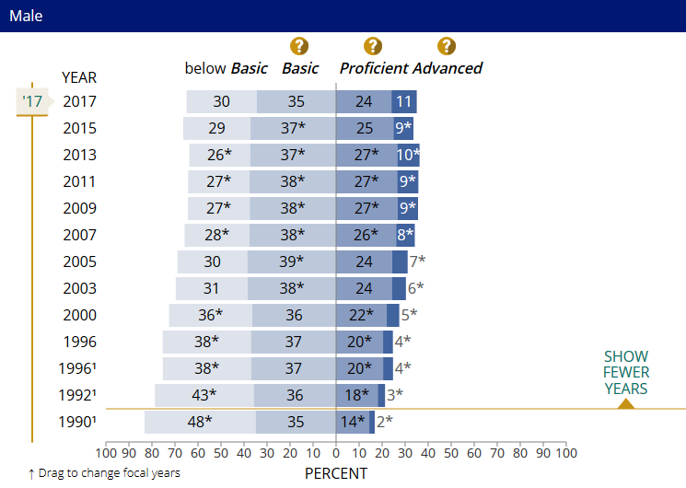
2017 Trend in eighth-grade NAEP mathematics – Males

Slide 34
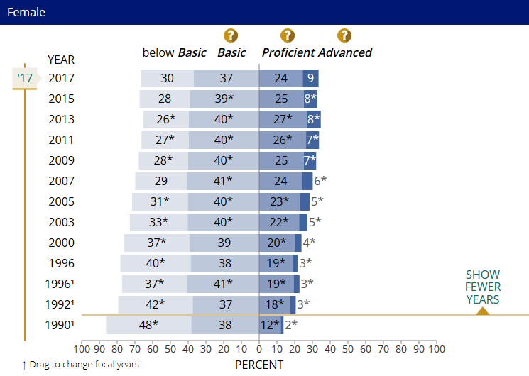
2017 Trend in eighth-grade NAEP mathematics –Females

Slide 35
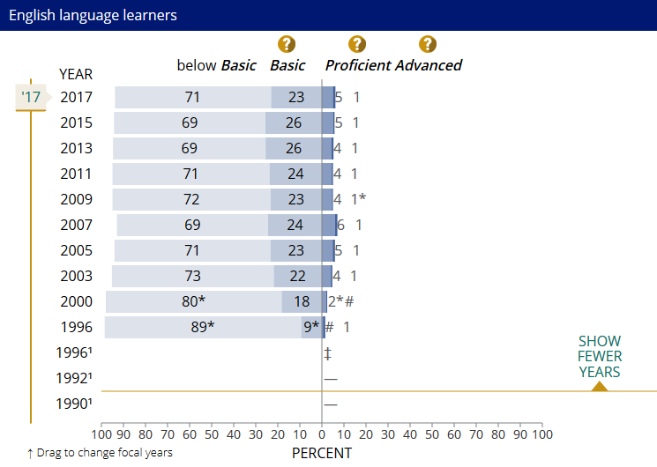
2017 Trend in eighth-grade NAEP mathematics – English Language Learners

Slide 36
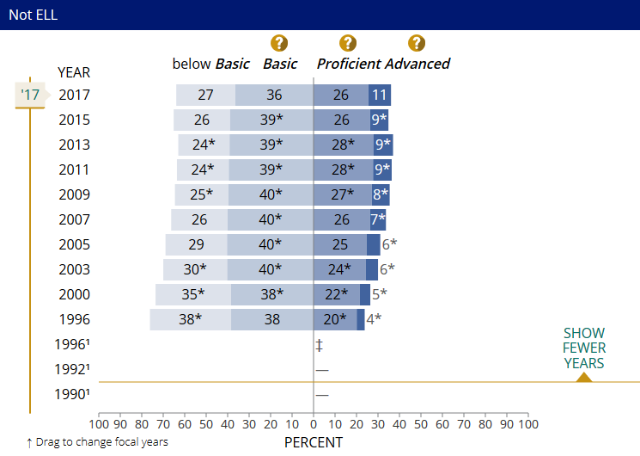
2017 Trend in eighth-grade NAEP mathematics – NON-English Language Learners

Slide 37
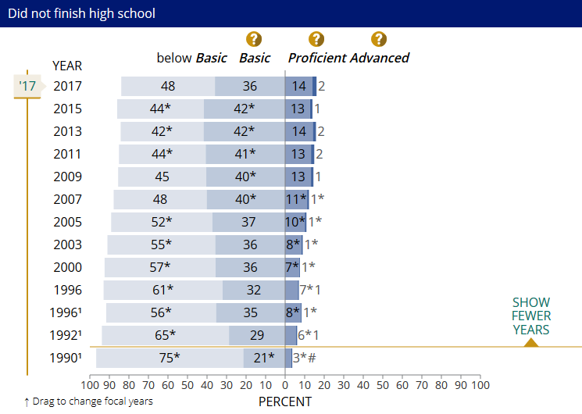
2017 Trend in eighth-grade NAEP mathematics – Parent Education Level – No High School Diploma

Slide 38
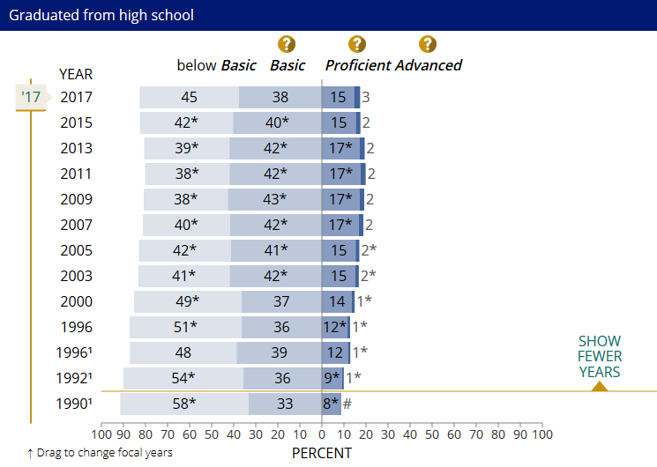
2017 Trend in eighth-grade NAEP mathematics – Parent Education Level – Graduated from High School

Slide 39
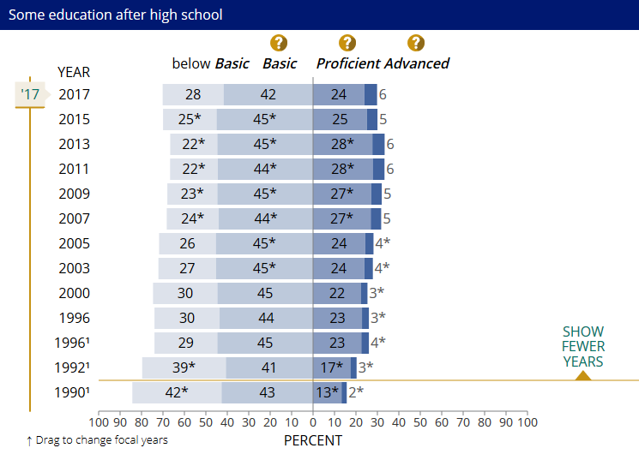
2017 Trend in eighth-grade NAEP mathematics – Parent Education Level – Some Education After High School

Slide 40
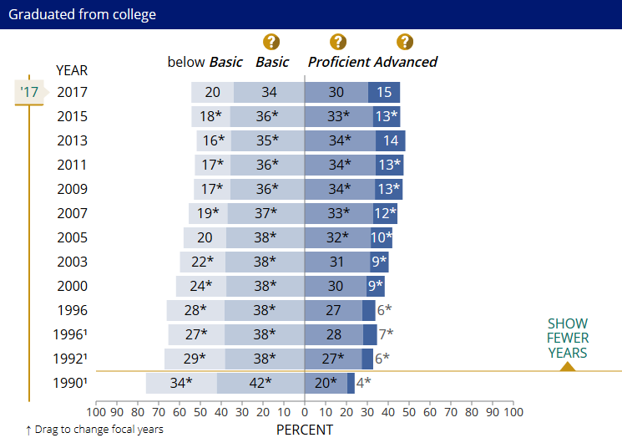
2017 Trend in eighth-grade NAEP mathematics – Parent Education Level – College Graduate

Slide 41
In sum…
8th Grade Demographics | Below Basic | Proficient
All | +1 | -1 24%
Low-income | No change | +1 18%
Middle/High income | -4 | No change 32%
White | +2 | -1 31%
Latinx | -2 | +2 16%
Black | No change | +1 11%
Asian/Pacific Islander | -4 | -1 31%
Native American | -3 | No change 14%
Males | +2 | -2 24%
Females | +1 | No change 24%
ELL | +2 | -1 5%
Non-ELL | +1 | No change 26%
Parent –HS diploma | +5 | -2 15%
Parent - College Degree | +1 | -3 30%

Slide 42
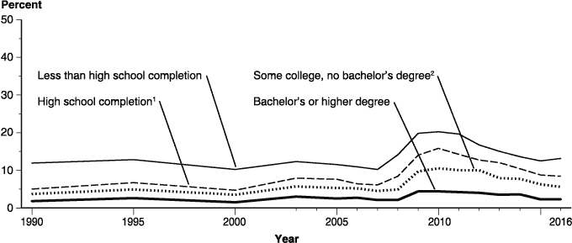
Unemployment rates of persons 25 to 34 years old, by highest level of educational attainment: 1990 - 2016

Slide 43
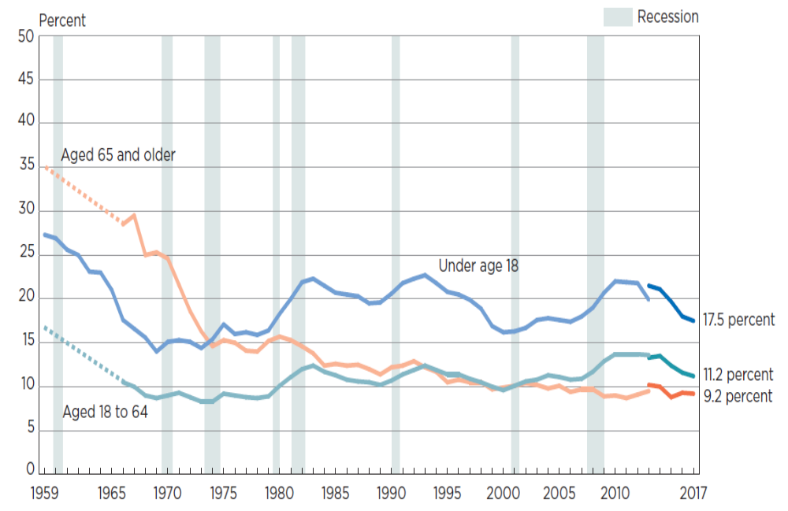
Poverty Rates by Age: 1959-2017

Slide 44
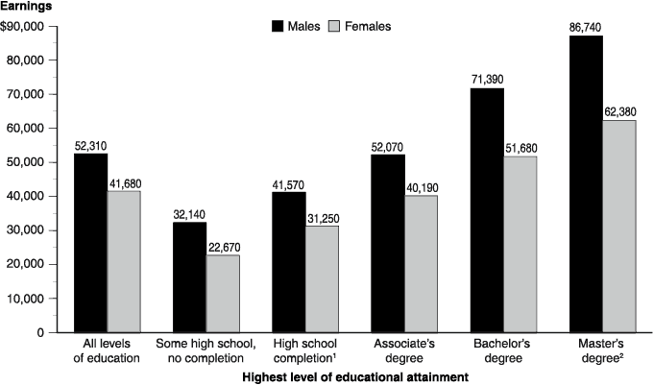
 | Median annual earnings of full-time workers 25 years old and over, by highest level of education and gender: 2015

Slide 45
The consequences of these inequities for U.S. society
Many students, particularly low-income, Latinx, Native American Indian, African American and Asian immigrant students, are being left behind in the educational system
Lack of education affects the quality of the workforce, engaged and informed citizens, and the overall public good

Slide 46
PBS Documentary –
Chicano! Taking Back the Schools
Chicano student movement in East Los Angeles, 1968
https://www.youtube.com/watch?v=xY6cytReBm8

Slide 47
For Wednesday
Be ready to discuss the Sonia Nieto reading.
Pay attention to the theory that stands out to you the most
Bring a copy to class (electronic or hard copy)

