Slide 1
Microbiology genetics
The topic defines the following terms as used widely in the topic.
Throughout the topic I have been able to learn the following terms;
Viruses: these are obligate intracellular parasites found in various components.
In many cases virus are found in the bacteria and the plasmid which forms after a series of co-evolution and transposon.

Slide 2
Definition cont.’
Viroid: these can be defined as the infectious RNA molecules that can cause infection in living bodies.
The Gene: they can be defined as series of DNA or RNA within a molecule that has molecular code with a distinct function.
Mutation: can be defined as permanent alteration of the nucleotide with a set of genome and extra chromosomal for either DNA or their genetically made elements.

Slide 3
The virus structure
The virus is formed from small particles called the virion.
There is a nucleic acid that is surrounded by a protein layer coat that consists of the capsid and the capsomers.
I learnt that the virus have different shapes that includes,
The isometric shapes
The helical shapes
The complex shapes

Slide 4
Virions
The virions consists of two types;
The naked, these types of virions have no envelope that covers them.
Enveloped virions have a lipid membrane that surrounds them and hence protected from severe environmental caused mutation.
Virions have different shapes including, the helical, icosahedral, spherical, tubular, filamentous and the complex.

Slide 5
Microbial genetics
The topic analyzed the basic structure of the bacteria genome, the structure exhibited is, the circular single DNA molecule.
The nucleoid: this is the region that contains the bacterial DNA
DNA: this is the actual polymer that molecule that is mainly composed of the nucleic acids with a strong genetic information.
Under the structure, the gene and the RNA are highlighted as the essential components in a bacteria,

Slide 6
The Central dogma
This can be defined as the path followed by the DNA and the RNA to process their genetic information.
The central dogma allows the following processes to take place in the following molecules;
DNA: this allows for a transcription process for the protein substances.
RNA: this allows the translation process of the protein substances.

Slide 7
Mutation process
As defined in slide III, the term mutation can has been defined as the rapid replication and changing process that molecules go through leading to a compete change of the internal and the external structure.
I have learnt that there are several types of mutations;
The spontaneous mutations: this type of mutation occur under the natural conditions including the environment.

Slide 8
Mutation Cont.’
The genetic mutation: this type of mutation is affected by the DNA sequence and the accidental alteration of the DNA.
The rate of mutation is defined as the probability of mutation that can be observed in any gene.
The rate is represented as to be between one and ten thousands and one trillion. Some genes record low rate due to the cellular mechanisms.

Slide 9
The viruses structure in animals
Animal viruses classification is based on the taxonomic criteria which dictates either the use of DNA or the RNA.
The viruses are classified as either single stranded or double stranded depending on the various taxonomy unit.
Secondly, in animal the viruses are classified as either isometric, pleomorphic and the helical.
The last classification is based on the presence of the envelope or the absence and hence the full classification of the viruses in the animal cells.

Slide 10
The infectious properties
There are various infectious properties that are exhibited in viruses, these properties includes,
The viral hostage: these are spectrum of host that can be infected by the virus.
Viral specificity: this is the probability on whether the virus can affect the host or not.
Viral eco-role: this the ease in which the genes can be transferred.

Slide 11
Additional concepts learnt
The transformation process: from the knowledge of the microbiology, the natural transformation occurs in four main stages;
The DNA entry
The process of the integration of the Donor DNA
The mismatch pair: removing the donor DNA that does not match.
The cell multiplication: multiplication of the transformed cells.

Slide 12
Transduction
From microbiology, the term transduction can be defined as the process of mis-packaging of the DNA while the viral replication is taking place.
Transduction process affects the new bacterial already been formed.
The mis-packaged DNA combines with the donor DNA to form a mis-matched par.

Slide 13
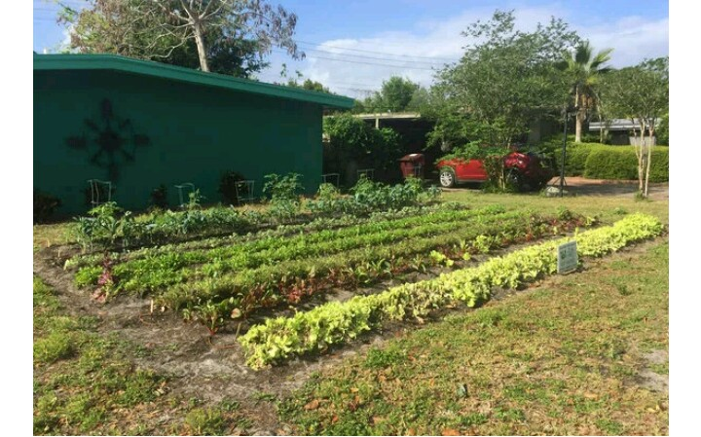
Growing food on microbe soil
(pictorial description)
The picture was taken to show how microbe can be great disaster to soil and to the crop being grown.
The microbe have the potential of lowering the soil fertility and hence reduced yield

Slide 14
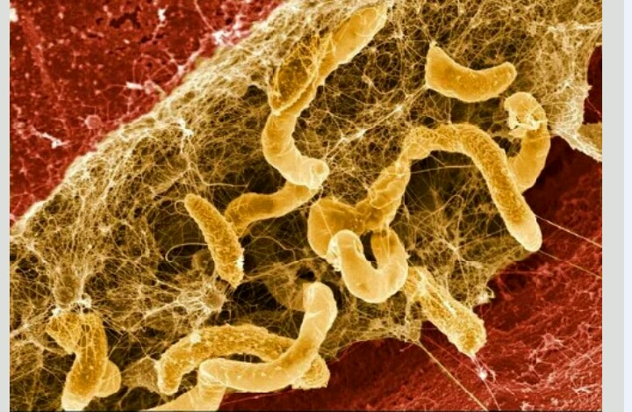
Pictorial two
The picture shown on the left, is a sample of soil structure which has been affected by the microbes. The soil does not have the capacity to support crops.

Slide 15
Summary
At the end of the course I learned fundamental concepts in genetics, microbiology, viruses and the replication process.
The course is essential to students attracted to nature as well as those who would wish to advance in biological courses.
The course had a lot of practical applications, that were crucial in understanding each and every concept exhibited in the course.

