Slide 1


Wines of the Old World

Slide 2
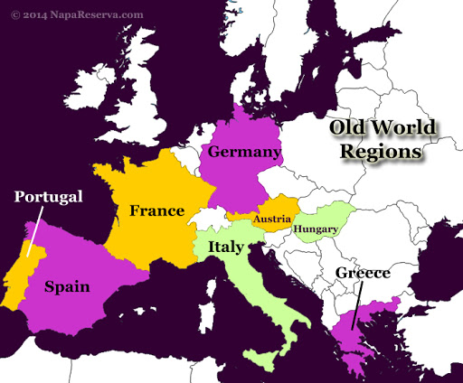
Old World Wine Countries

Slide 3
Controlling Authenticity of Old World Wines
Permitted grapes
Permitted boundaries
Maximum yield
Minimum alcohol content
Viticulture practices
Vinification

Slide 4
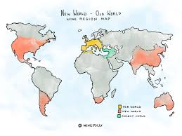
Old World vs New World

