Slide 1

Chapter 12
What Lies Beyond the Current State of HIS and Technology?

Slide 2
Introduction
Understanding the future of HIS and technology
As world transforms due to technology revolution, health care does so – at the speed of health care
Eric Topol - The Creative Destruction of Medicine
6 major disruptive technologies over past 40 years
Cell phones, smart phones, personal computers, the Internet, digital/mobile sensors and medical devices, genomic sequencing, and social media or networks

Slide 3
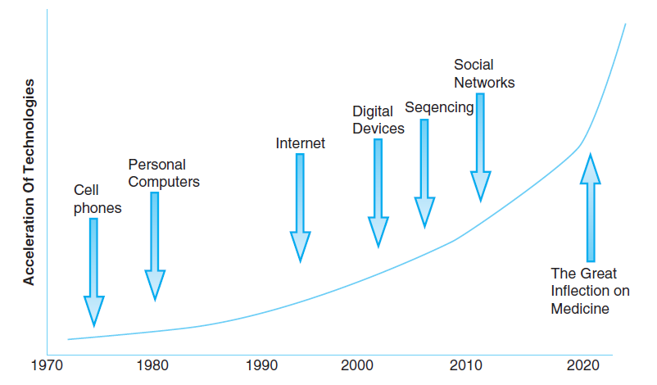
Figure 12.1: HIS Transformative Technologies and their Application to Health Care
Reproduced from Eric Topol. The Creative Destruction of Medicine: How the Digital Revolution Will Create Better Health Care.© Nov 5, 2013, Eric Topol. Reprinted by permission of Basic Books, a member of the Perseus Books Group.

Slide 4
Ubiquitous Available Data
New technologies’ pervasiveness = ubiquitous
Inflection point, hockey stick, tipping point, convergence
This is a game-changer in health care
Increased access to health information
Such access no longer strictly dependent on insurance coverage
Empowered consumers

Slide 5
Ubiquitous Available Data
To achieve lasting behavior change, individuals must complete each task in each successive stage
Intervention programs should begin “where people are” and move them one step (one stage) closer to lasting behavior change
“Stage-matched or stage-targeted intervention”

Slide 6
Ubiquitous Available Data
Opportunity to integrate and share data, be freed from silos
Better HIS planning essential to make sense of exploding volumes of healthcare data
Today, health data disconnected and disorganized
“Big Data” and cloud computing = new norm
Beyond BI/CI, “personal health intelligence” emerging through “quantified self” and digital health movements

Slide 7
Ubiquitous Available Data
Future goal of HIS
Appropriate access to ubiquitous, personalized, specific information relevant to situation, available to those who should have access to it, while honoring privacy, security, and confidentiality of those whose information it is
Includes, builds upon EHR systems
Organizations must exert their will to change traditional ways

Slide 8
Ubiquitous Available Data
Uneven fits and starts of adoption
This phase of technology change will happen over period of years, not decades
Caveats
Professionals must learn to work in new ways
Organizations, regulations, institutions some of slowest entities to change

Slide 9
eHealth Definition, Progress, and Development
Comprises technologies enabling methods, attitudes, actions in health/wellness or Health 2.0
Transfer of health resources and health care by electronic means in three areas
Delivery of health information for professionals and consumers Improve public health services
Use of e-commerce practices in managing health systems: World Health Organization (WHO)

Slide 10
eHealth Definition, Progress, and Development
WHO definition focus:
Health for people world-wide
Emphasizes Importance of education and training
eHealth = broad electronic capabilities
EHR systems, HIS and technology, research collaboration spaces, mHealth, social media, telemedicine, telehealth
“Digital health” another term for eHealth

Slide 11
eHealth Definition, Progress, and Development
Focus on wellness and health, in addition to sickness
eHealth advancing steadily but carefully
Through maze of regulations
Barriers removed one by one, e.g., overturned privacy regulation prohibiting direct patient access to lab results
Restrictions using EHR systems to train medical, nursing students due to privacy

Slide 12
mHealth
Use of mobile technologies
Smart phones, mobile applications, the Internet, machine-to-machine (M2M) wireless capabilities, personal computing devices, sensors and mobile devices, social media, personalized health dashboards, applications connecting clinicians and people/patients
“Taking geography out of the healthcare equation”
Patients and physicians favor adoption of mobile technologies in health care

Slide 13
mHealth
Additional drivers of mHealth adoption
Aging of the population/changing demographics
Greater potential role for mHealth
Increasing implementation of HIS, EHR systems
“Quantified self” movement
mHealth technologies multiplicity of uses across healthcare continuum

Slide 14
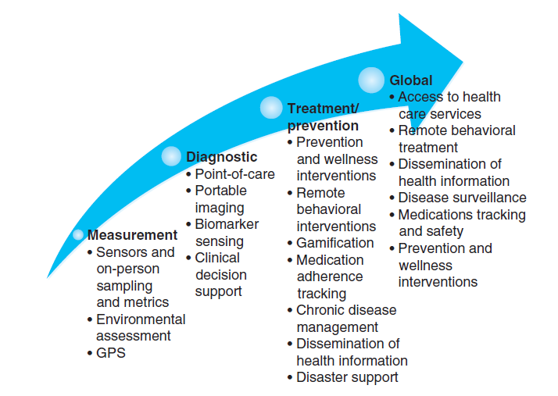
Figure 12.3: Continuum of mHealth tools
Reprinted from Kumar, S., Nilsen, W. J., Abernethy, A., et al. (2013). Mobile health technology evaluation: The mHealth evidence workshop. American Journal of Preventive Medicine, 45(2), 228–236. Copyright 2013 with permission from Elsevier.

Slide 15
Social Media and HIS
Wide open, trial-and-error period
Use of social media embraced, major change from earlier years
Healthcare organizations charged with preserving privacy, confidentiality and security of protected health information (PHI)
Partly technology, partly human behavior-related

Slide 16
Social Media and HIS
Uses include marketing and education, reviews, information gathering, building support communities
Clinicians and patient groups engage one another through social media platforms
Patients discuss topics, gain support online
Enhance experience for healthy, young, older, or individuals with specific conditions

Slide 17
Social Media and HIS
Key governance policies and practical considerations for use of social media
Balance between HIPAA compliance and access to social media
Protection of PHI paramount
Productivity can be concern
Use of technology can enhance but should not interfere with doing one’s work
Ultimately, anything posted on social media is not private
Education/training regarding protecting PHI is key

Slide 18
Telemedicine and Telehealth
Telemedicine is remote, technology-enabled delivery of clinical services
Includes clinical support, overcome geographic barriers, connect users in different locations, improve health outcomes
Telehealth is exchange of valid clinical information in situations where geographic distance a factor (WHO)
Includes diagnosis, treatment, prevention of disease and injury; research; continuing education

Slide 19
Telemedicine and Telehealth
Barriers to adoption of telemedicine and telehealth
Complexity of human and cultural factors
Cost of sustaining telemedicine and telehealth
Shortage of studies evaluating costs and benefits
Legal issues in crossing transregional boundaries
Technical challenges integrating various technologies

Slide 20
Telemedicine and Telehealth
Examples of telemedicine and telehealth
Remote radiology interpretations
Intensive care monitoring for remote, smaller hospitals
Clinician-patient on-line consults
Remote patient monitoring for heart disease, diabetes, or other chronic conditions
Education and networking for professionals
Patient on-line support and education groups

Slide 21
Emerging HIS Technologies and the Human-Machine Relationship
Only as useful as practical application and demonstrated value
Priority areas for research (IOM)
Medication management; outreach care for vulnerable populations; hypertension; diabetes; heart disease; case coordination; major depression; frailty; immunization; pregnancy and childbirth; and tobacco cessation
Ambulatory care outcomes improvement

Slide 22
Emerging HIS Technologies and the Human-Machine Relationship
Uses technologies coupled with streamlined processes
Three main trends
Human work augmented by technology
Machines replacing work of humans
Humans and machines working together (e.g., mobile surgical robot used by surgeon in performing procedure)
Gartner Group identified Hype Cycle for 2013 describing phased continuum of adoption

Slide 23
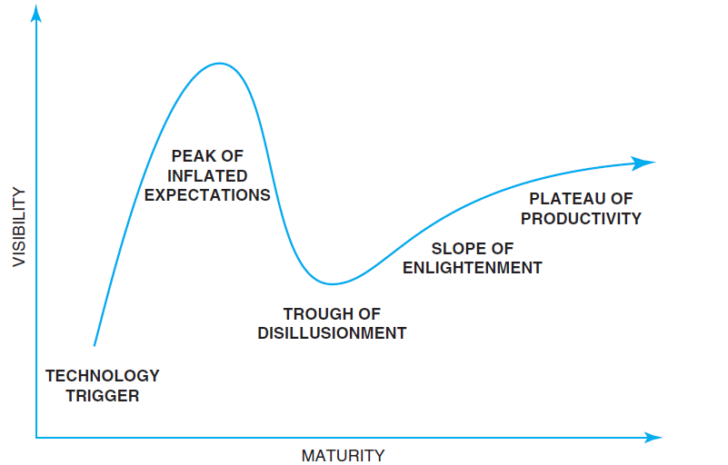
Figure 12.4: Hype Cycle for Emerging Technologies
Each Hype Cycle drills down into the five key phases of a technology’s life cycle. Modified from Gartner’s 2013 Hype Cycle for Emerging Technologies, which maps out evolving relationships between humans and machines. http://www.gartner.com/technology/research/methodologies/hype-cycle.jsp

Slide 24
Future Directions in Informatics, Data, and Analytics
Informatics
Creating new ways to streamline and improve the human-computer interface and workflows
Limited only by our ingenuity, technical prowess, and boundaries of appropriate care
Improvements to initial, basic implementation of new systems
Creating new care delivery innovations, e.g., hybrid exam room where patient stays during entire visit and all providers and specialists come to the patient in that room

Slide 25
Future Directions in Informatics, Data, and Analytics
Data and Analytics
Greater data availability both helpful and challenging today
Technologies will supplant/enhance clinical and business analytics, e.g., voice activated data inquiries
Data analytics skills will be requisite skill for healthcare professionals, both clinical and business

Slide 26
The Effect of New Technologies on Public Health
mHealth’s impact on public health
Vast opportunities to connect isolated individuals and populations to care, education, information, and professionals
Provider-to-patient
Provider-to-provider
Digital support of health and chronic illness management
Essential elements as populations age and

Slide 27
The Effect of New Technologies on Public Health
Prevention trumps cure
Technology revolution allowing a “getting back to basics”
Focus on preventing disease vs. curing illness
Not only efficient, effective, but preemptive, preventive health care
Empower people with access to their own health data
Reestablishing primary relationship between people/patients and providers vs. insurance/payer domination of access to care and health data

Slide 28
Alignment Between HIS and Future Challenges in Health Care/Public Health
Issues to track HIS’ impact
Overall cost and quality of health care
Meaningful Use adoption
Unintended consequences of HIS
HIS marketplace dynamic
Competitive processes weed out low-quality products
Innovators introduce new technology solutions
HIS-related job opportunities in health care and public health

Slide 29
Issues and Ethics to Consider as Future of HIS and Technology Unfolds
Finding the balance: Security and privacy vs. access to health information
Significant issue with increased availability of HIS and access to data
Increase appropriate access
Prevent inappropriate uses of data/breaches
Interoperability between systems a high priority goal
Challenged with security vs. access issues
Answer is both technology and behavioral

Slide 30
Issues and Ethics to Consider as Future of HIS and Technology Unfolds
Ethical Considerations Sharing Patient Data in EHRs and HIEs
Patients give permission to use their data for purposes of their care
HIPAA intended to protect patient data, but breaches occur
Infeasible to turn back
Major MU incentives for EHRs and HIEs
Personal genomic data: who and how to use?
How do payers vs. providers use these data?

Slide 31
Claims vs. Care: What Is Your Priority?
Practical and philosophical issue related to HIS and EHR construction
To meet financial objectives for populating insurance claims and patient bills or
To support and improve patient care?
Software may emphasize “claim” or “care”
These objectives not mutually exclusive
Mission of health care organizations is clinical
EHRs should improve care and documentation to achieve better clinical and financial performance

Slide 32
Getting Through the Current State of Flux: Moving from Paper to Electronic Processes
Will we ever be paperless in health?
40 years effort to implement HIS and technology
Most EHR systems don’t completely replace paper
A gradual process, taking years unless in a completely new facility and organization
Paperless health care a distant future
Many processes use forms EHRs don’t support
Emphasize process redesign to alter workflow to use the system vs. emulate paper process electronically

Slide 33
Future Impact of HIS and Technology on Research, Policy, and Public Health
Data emanate from numerous new electronic sources for research, policy, public health
E.g., EHR systems, mobile devices, HIEs
Challenges extracting and normalizing data
Applying lessons from other industries
Create data “sandboxes” for analytics
Predictive analytics through access to Big Data
Adopt population health management perspective

Slide 34
Summary
Future of HIS and technology limitless
Technology infrastructure now ubiquitous
Vast opportunities to share data, requiring data stewardship and normalizing
mHealth, eHealth, social media, telemedicine, and telehealth offer connectedness and active engagement of people in managing their health
Informatics evolving in sync with Hype Cycle
Entrepreneurs and innovators creating new future
Unintended consequences, ethical issues abound
Opportunity to improve health care, public health

