Slide 1
Hypertension and you

Slide 2
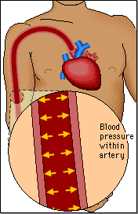
What is Hypertension ?
Hypertension is the medical term for repeated elevated Blood Pressure
Force from the heart muscle transfers to the blood with each heartbeat
Blood pressure is the force blood presses against artery walls
Notes:
Blood pressure is defined as force against the wall of a blood vessel. This is created while the heart contracts, forcing blood out of it into the circulatory system. As illustrated above.
Hypertension (HTN) is commonly known as High Blood Pressure (HBP), which is a repeatedly higher than normal blood pressure reading.
Hypertension is often referred to as “the silent killer”, as individuals suffering from it often are unaware of it. If this condition is not controlled it can lead to long term consequences.

Slide 3
Ranges of Blood Pressure Readings
Classification | Systolic | Diastolic
Normal | 120 or less | 80 or less
Pre-Hypertension | 120 to 139 | 80 to 89
Stage 1 Hypertension | 140 to 159 | 90 to 99
Stage 2 Hypertension | 160 to 179 | 100 to 119
Hypertensive Emergency | 180 or more | 120 or more
Notes:
A blood pressure is represented by two numeral values separated by a slash. The top number is the Systolic (Sys) number representing the pressure blood is enforcing to the blood vessel walls while the heart is contracting and forcing blood out. The bottom number is the Diastolic (Dys) number, representing the pressure while the heart is relaxed and filling with blood.

Slide 4
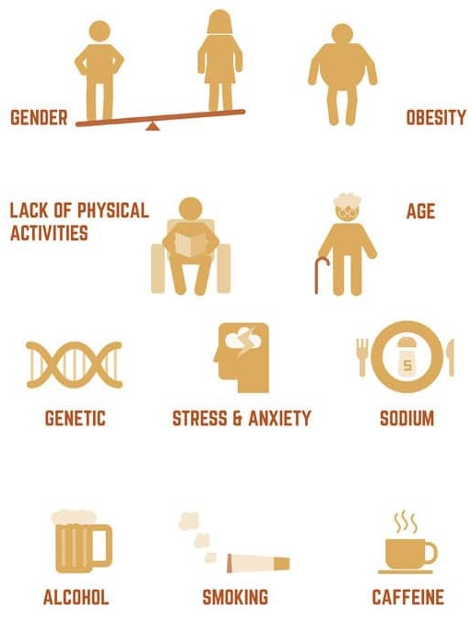
Causes of Hypertension
Notes:
A variety of risk factors are named in relationship with hypertension. Non modifiable risk factors are:
Age – flexibility of vessels decreases and built up increases in age
Family history – it tends to run in the family, often due to race/ethnicity and family diet
Race – high blood pressure is common in people of African heritage
Modifiable factors are:
Tobacco use – damages vessel walls, temporarily increases blood pressure and causes vessel constriction
High sodium diet – causes fluid retention, resulting in high blood pressure
Overweight – excess weight places stress on the heart muscle by increasing its workload
Not being active – the heart is a muscle, if it gets neglected it easily gets over worked
Low Potassium – potassium balances the salt in the body
Heavy alcohol consumption – can damage organs such as the heart
Stress and caffeine – increase blood pressure temporarily

Slide 5
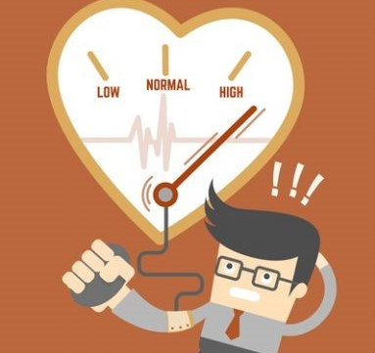
Signs to look out for:
Repeated high blood pressure readings
Headache and Dizziness – constricted blood vessels lead to oxygen deficient in the brain
Blurred Vision – reduced blood flow to eye
Chest Pain – due to decreased oxygen levels
Notes:
Hypertension is frequently referred to as “The Silent Killer” due to the fact that until it’s later stage it has no noticeable symptoms.

Slide 6
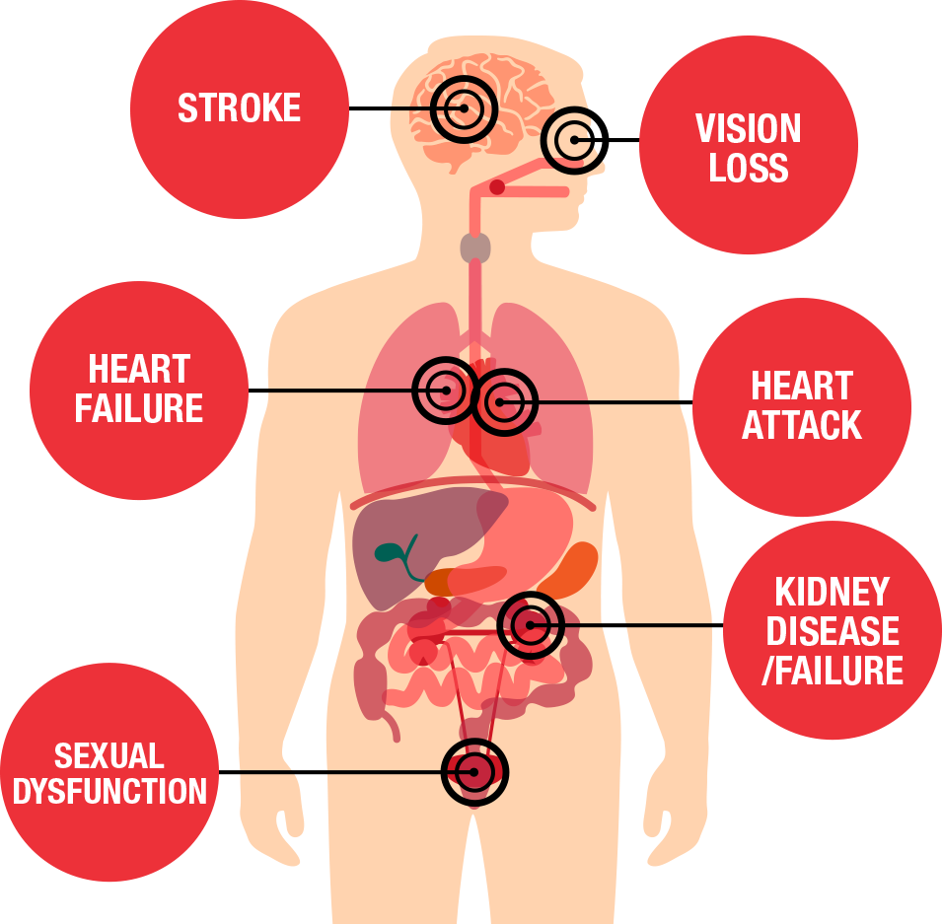
Danger of Uncontrolled Hypertension
Stroke
Vision loss
Heart attack
Kidney disease
Erectile Dysfunction
Blood clots
Heart Failure
Thickening and narrowing of Blood Vessel Walls
Notes:
Uncontrolled, meaning untreated, HBP can damage vessel walls and cause clogging of arteries. That can escalate to tissue damage, blood clots, leading to strokes, heart attacks, blindness and death.

Slide 7
Adjustments to make
Weight loss
Low Sodium Diet
Regular aerobic activity
Moderate alcohol consumption
Stop smoking
Limit caffeine intake
Moderate potassium intake
Stress relieving activity
Notes:
It is important to maintain a healthy lifestyle, to limit the risk of developing HTN especially as an African descending male with a family history of HTN. Sustaining a balanced, low salt diet is very impactful. A person can reduce stress by warm baths, going long walks, and mediation to relax the body, thus helping to relieve stress. Stress reduction and this can be achieved by learning to manage or avoid stress as this helps to control blood pressure. Aerobic exercise should be done three times a week for at least 30minutes each. Studies have shown that decreasing the salt in one's diet can have an immense impact on blood pressure, it’s recommended to lower the intake to 5grams per day.

Slide 8
Pharmaceutical treatments
Calcium-channel Blockers
Beta-blockers
Vasodilators
Diuretics
ACE inhibitors
Angiotensin II receptor blockers
Notes:
If the blood pressure cannot be controlled by lifestyle adjustments, the medical provider might introduce a pharmaceutical treatment. ACE inhibitors, Calcium Channel Blockers and Vasodilators work by relaxing the blood vessels, decreasing resistant and therefor lowering the blood pressure.
Beta Blockers slow the heartbeat down which lowers the force blood gets ejected from the heart. Diuretics and Angiotensin II receptor blockers influence the fluid retention of the body, the lower the amount of fluid in the body the lower the pressure is.

Slide 9
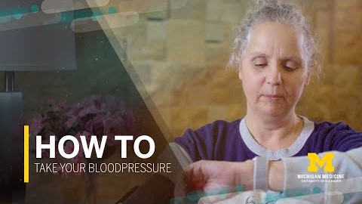
Monitor your Blood pressure
Notes:
The blood pressure should be assessed at least once a day, preferably at the same day. One should sit straight up; legs uncrossed and stay still while the reading is done. The result should be noted in a log to monitor the blood pressure trends. If the blood pressure is elevated, try breathing exercises and unwind. If the blood pressure does not come down, contact your health care provider or seek treatment.

Slide 10
References
(n.d.). Retrieved September 19, 2020, from http://www.heart.org/HEARTORG/Conditions/HighBloodPressure/GettheFactsAboutHighBloodPressureFinal Recommendation Statement: High Blood Pressure in Adults: Screening: United States
Preventive Services Taskforce. (2015, October 12). Retrieved September 19, 2020, from http://www.uspreventiveservicestaskforce.org/Page/Document/RecommendationStatementFinal/high-blood-pressure-in-adults-screeningHigh Blood Pressure and African Americans. (n.d.).
Retrieved September 19, 2020, from http://www.heart.org/HEARTORG/Conditions/HighBloodPressure/UnderstandSymptomsRisks/High-Blood-Pressure-and-African-Americans_UCM_301832_Article.jspKnow Your Risk Factors for High

Slide 11
References
Blood Pressure. (n.d.). Retrieved September 19, 2020, from http://www.heart.org/HEARTORG/Conditions/HighBloodPressure/UnderstandSymptomsRisks/Know-Your-Risk-Factors-for-High-Blood-Pressure_UCM_002052_Article.jspMark Stibich, P. (n.d.). Why
Hypertension Develops. Retrieved September 19, 2020, from https://www.verywellhealth.com/hypertension-causes-risk-factors-2224338Understanding Blood
Pressure Readings. (n.d.). Retrieved September 19, 2020, from http://www.heart.org/HEARTORG/Conditions/HighBloodPressure/KnowYourNumbers/Understanding-Blood-Pressure-Readings_UCM_301764_Article.jsp

