Slide 1

Data Entry and Coding
Holli Slater, PhD
School of Social Work

Slide 2
Basics of Data Analysis
Cases – The individual unit of analysis.
  Example: Surveys, Interviews
Variables – Generally, any characteristics of the populations that varies.
  Example: Gender (in a population that is represented by more than one gender)
  Gender is not a variable at an all-girls school where gender is restricted to females.

Slide 3
Data Entry and Coding
Data coding
  “[T]he process of organizing data through the creation and assignment of numerical values for nominal and ordinal data” (Patterson & Basham, 2005, p. 18)
Codebooks or Code Dictionary
  Records used to “document information about a data set” (Patterson & Basham, 2005, p. 19)
Data entry
  Rows = cases
  Columns = variables

Slide 4
Sample Code Book in Excel

Slide 5
Sample Codebook in Excel

Slide 6
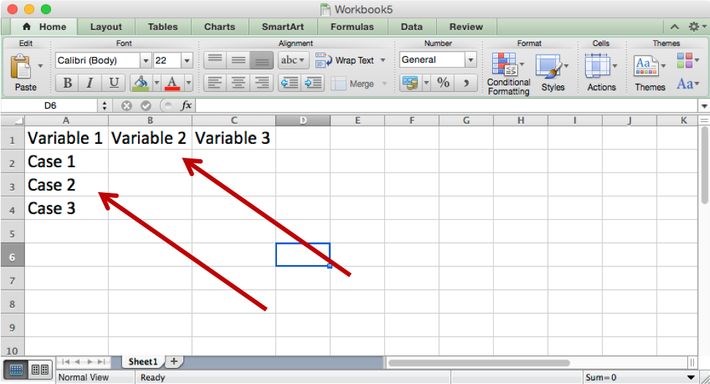
How to Create a Dataset in Excel
Open a new Excel spreadsheet
In this spreadsheet, each column represents an item on the questionnaire, or a variable
Each row represents a case, or an individual survey

Slide 7
How to Create a Dataset in Excel
Step 1: Enter the variables names for each survey item.
  The survey ID should be the first variable named CaseID
  Variable names should use the naming convention of Q1, Q2, Q3.
  If a question has sub-questions – these should be named Q8a, Q8b, Q8c, etc.
Step 2: Enter data for each case across the columns.
  You will have a total of 11 rows when you are in your final spreadsheet
    1 variable name row
    10 rows representing cases
    Missing data (if a participant skips a question) it should be entered as 99.

Slide 8
Create Coding Key in Excel
Step 3: Create a coding key.
  Create a new tab and rename Codebook
  Create headings for three columns named Variable, Value, and Question
  Each row represents a separate question on the survey with the applicable information in each column.

Slide 9
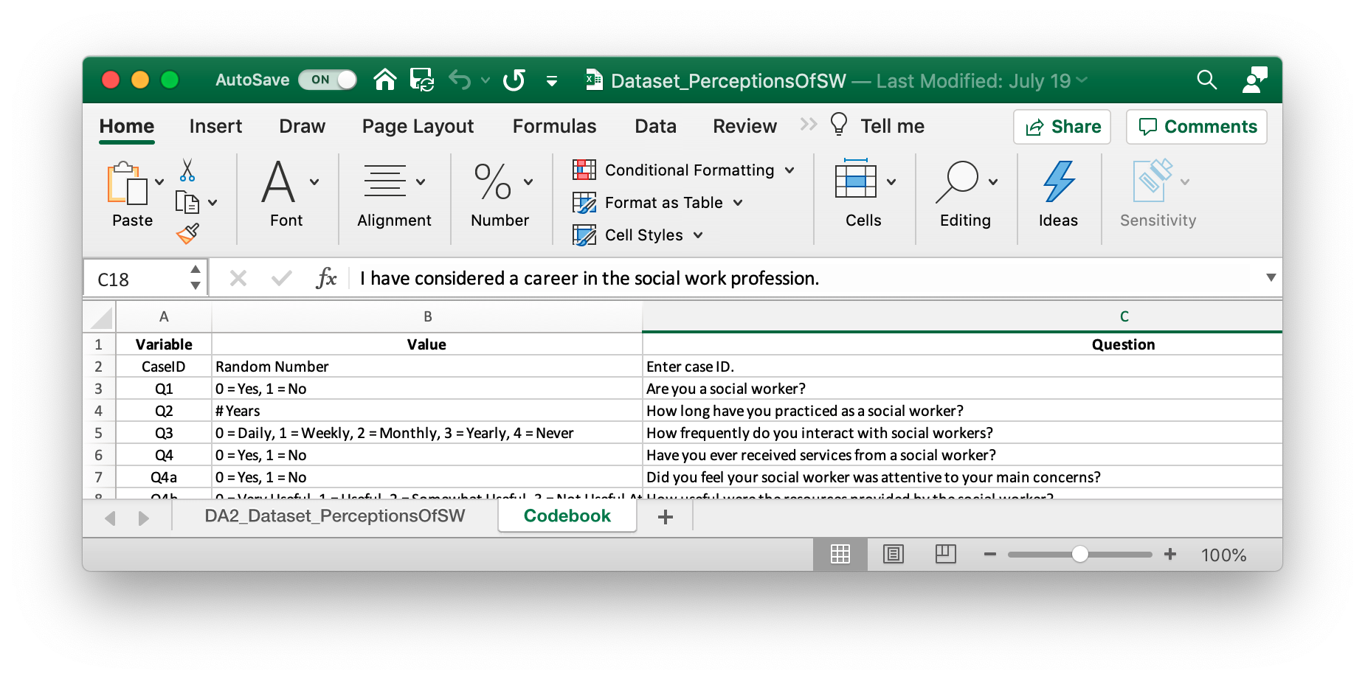
Create Coding Key in Excel

Slide 10
Create Coding Key in Excel
Use the following conventions:
  Always start with zero (0)
  Each response option is a variable category
Examples:
  Categorical – Gender
    0 = Female
    1 = Male
  Ordinal - How do you rate your experience?
    0 = Very Bad
    1 = Bad
    2 = Average
    3 = Good
    4 = Very Good

