Slide 1
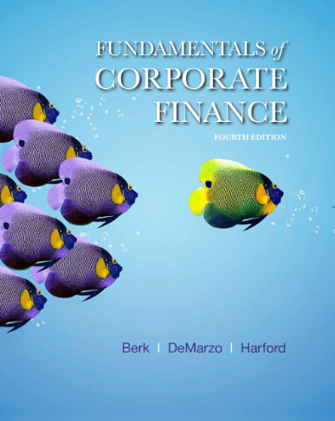
Fundamentals of Corporate Finance
Fourth Edition
Chapter 6
Bonds
Copyright © 2018, 2015, 2012 Pearson Education, Inc. All Rights Reserved.
Notes:
If this PowerPoint presentation contains mathematical equations, you may need to check that your computer has the following installed:
1) MathType Plugin
2) Math Player (free versions available)
3) NVDA Reader (free versions available)

Slide 2
Chapter Outline
6.1 Bond Terminology
6.2 Zero-Coupon Bonds
6.3 Coupon Bonds
6.4 Why Bond Prices Change
6.5 Corporate Bonds

Slide 3
Learning Objectives
Understand bond terminology
Compute the price and yield to maturity of a zero-coupon bond
Compute the price and yield to maturity of a coupon bond
Analyze why bond prices change over time
Know how credit risk affects the expected return from holding a corporate bond

Slide 4
6.1 Bond Terminology (1 of 3)
Bond
Bond certificate
  Terms of the bond
  Amounts and dates of all payments to be made.
Payments
Maturity date
Term

Slide 5
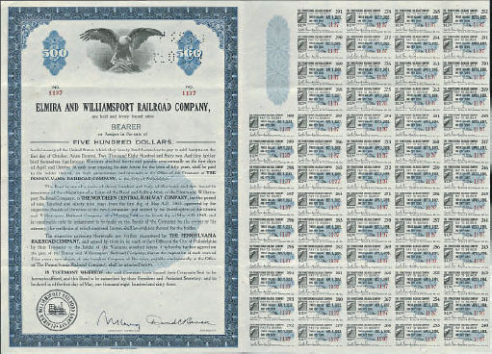
Figure 6.1 A Bearer Bond and Its Unclipped Coupons Issued by the Elmira and Williamsport Railroad Company for $500
Source : Courtesy Heritage Auctions, Inc. © 1999–2006.

Slide 6
6.1 Bond Terminology (2 of 3)
Face value (aka par value or principal amount)
  Notional amount used to compute interest payments
  Usually standard increments, such as $1000
  Typically repaid at maturity
Coupons

Slide 7
6.1 Bond Terminology (3 of 3)
Coupon rate
  Set by the issuer and stated on the bond certificate
  By convention, expressed as an APR, so the amount of each coupon payment, CPN, is

Slide 8
Table 6.1 Review of Bond Terminology
Bond Certificate | States the terms of a bond as well as the amounts and dates of all payments to be made.
Coupons | The promised interest payments of a bond. Usually paid semiannually, but the frequency is specified in the bond certificate. They are determined by the coupon rate, which is stated on the bond certificate. The amount paid is equal to:
Maturity Date | Final repayment date of the bond. Payments continue until this date.
Principal or Face Value | The notional amount used to compute the interest payment. It is usually repaid on the maturity date. Also called par value.
Term | The time remaining until the repayment date.

Slide 9
6.2 Zero-Coupon Bonds (1 of 5)
Zero-Coupon Bonds
  Only two cash flows
    The bond’s market price at the time of purchase
    The bond’s face value at maturity
  Treasury bills are zero-coupon U.S. government bonds with maturity of up to one year

Slide 10
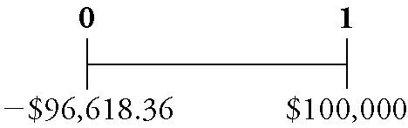
6.2 Zero-Coupon Bonds (2 of 5)
A one-year, risk-free, zero-coupon bond with a $100,000 face value has an initial price of $96,618.36
  If you purchased this bond and held it to maturity, you would have the following cash flows:

Slide 11
6.2 Zero-Coupon Bonds (3 of 5)
Yield to Maturity of a Zero-Coupon Bond
  The discount rate that sets the present value of the promised bond payments equal to the current market price of the bond
  Yield to Maturity of an n-Year Zero-Coupon Bond:

Slide 12
Example 6.1 Yields for Different Maturities (1 of 4)
Problem
Suppose the following zero-coupon bonds are trading at the prices shown below per $100 face value.
Determine the corresponding yield to maturity for each bond.
Maturity | 1 year | 2 years | 3 years | 4 years
Price | $96.62 | $92.45 | $87.63 | $83.06

Slide 13
Example 6.1 Yields for Different Maturities (2 of 4)
Solution
Plan
We can use Eq. 6.2 to solve for the YTM of the bonds. The table gives the prices and number of years to
maturity and the face value is $100 per bond.

Slide 14
Example 6.1 Yields for Different Maturities (3 of 4)
Execute
Using Eq. 6.2, we have

Slide 15
Example 6.1 Yields for Different Maturities (4 of 4)
Evaluate
Solving for the YTM of a zero-coupon bond is the same process we used to solve for the rate of return in
Chapter 4. Indeed, the YTM is the rate of return of buying the bond.

Slide 16
Example 6.1a Yields for Different Maturities (1 of 4)
Problem:
Suppose the following zero-coupon bonds are trading at the prices shown below per $100 face value. Determine the corresponding yield to maturity for each bond.
Maturity | 1 year | 2 years | 3 years | 4 years
Price | $98.52 | $96.59 | $94.23 | $91.48

Slide 17
Example 6.1a Yields for Different Maturities (2 of 4)
Solution:
Plan:
We can use Eq. 6.2 to solve for the YTM of the bonds. The table gives the prices and number of years to maturity and the face value is $100 per bond.

Slide 18
Example 6.1a Yields for Different Maturities (3 of 4)
Execute:
Using Eq. 6.2, we have:

Slide 19
Example 6.1a Yields for Different Maturities (4 of 4)
Evaluate:
Solving for the YTM of a zero-coupon bond is the same process we used to solve for the rate of return in Chapter 4. Indeed, the YTM is the rate of return of buying the bond.

Slide 20
6.2 Zero-Coupon Bonds (4 of 5)
Risk-Free Interest Rates
  Because a default-free zero-coupon bond that matures on date n provides a risk-free return over that period, the Law of One Price guarantees that the risk-free interest rate equals the yield to maturity on such a bond
  We often refer to this as the risk-free interest rate for that period (n)

Slide 21
6.2 Zero-Coupon Bonds (5 of 5)
Spot interest rates
  Default-free, zero-coupon yields
In Chapter 5, we introduced the yield curve, which plots the risk-free interest rate for different maturities
  These rates are the yields of risk-free zero-coupon bonds
  Thus the yield curve in Chapter 5 is also called the zero-coupon yield curve

Slide 22
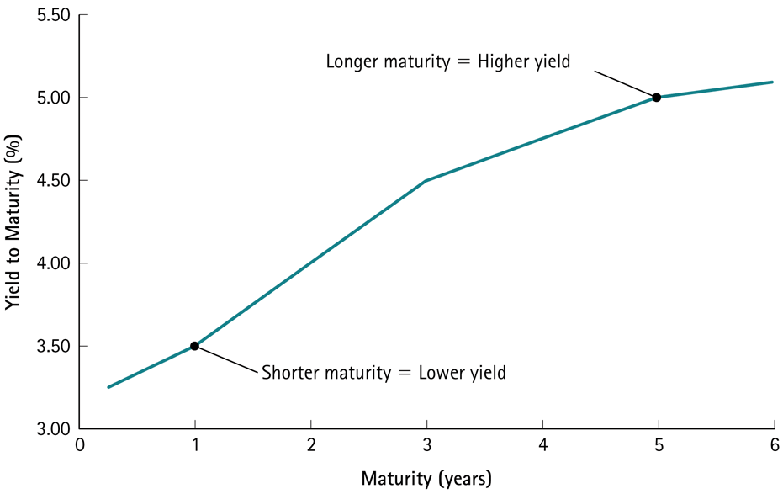
Figure 6.2 Zero-Coupon Yield Curve Consistent with the Bond Prices in Example 6.1

Slide 23
Example 6.2 Computing the Price of a Zero-Coupon Bond (1 of 3)
Problem
Given the yield curve shown in Figure 6.2, what is the price of a five-year risk-free zero-coupon bond with a face value of $100?

Slide 24
Example 6.2 Computing the Price of a Zero-Coupon Bond (2 of 3)
Solution
Plan
We can compute the bond’s price as the present value of its face amount, where the discount rate is the bond’s yield to maturity. From the yield curve, the yield to maturity for five-year risk-free zero-coupon bonds is 5.0%.

Slide 25
Example 6.2 Computing the Price of a Zero-Coupon Bond (3 of 3)
Execute
Evaluate
We can compute the price of a zero-coupon bond simply by computing the present value of the face amount using the bond’s yield to maturity. Note that the price of the five-year zero-coupon bond is even lower than the price of the other zero-coupon bonds in Example 6.1, because the face amount is the same but we must wait longer to receive it.

Slide 26
Example 6.2a Computing the Price of a Zero-Coupon Bond (1 of 4)
Problem:
Given the yield curve in Figure 6.2, what is the price of a 3-year risk-free zero-coupon bond with a face value of $900?

Slide 27
Example 6.2a Computing the Price of a Zero-Coupon Bond (2 of 4)
Solution:
Plan:
We can use the bond’s yield to maturity to compute the bond’s price as the present value of its face amount, where the discount rate is the bond’s yield to maturity.
From the yield curve, the yield to maturity for 3-year risk-free zero-coupon bonds is 4.50%.

Slide 28
Example 6.2a Computing the Price of a Zero-Coupon Bond (3 of 4)
Execute:
Also note that the price given in Example 6.1a is $94.23 per $100 face value, which is a standard format for bond price quotes. We can answer the problem using that information: $94.23×9=$848.09.

Slide 29
Example 6.2a Computing the Price of a Zero-Coupon Bond (4 of 4)
Evaluate:
We can compute the price of a zero-coupon bond simply by computing the present value of the face amount using the bond’s yield to maturity.

Slide 30
6.3 Coupon Bonds (1 of 5)
Coupon bonds
  Pay face value at maturity
  Also make regular coupon interest payments
  Two types of U.S. Treasury coupon securities are currently traded in financial markets:
    Treasury notes
      original maturities from one to ten years
    Treasury bonds
      original maturities of more than ten years

Slide 31
Table 6.2 Existing U.S. Treasury Securities
Treasury Security | Type | Original Maturity
Bills | Discount | 4, 13, 26, and 52 weeks
Notes | Coupon | 2, 3, 5, and 10 year
Bonds | Coupon | 20 and 30 year

Slide 32
6.3 Coupon Bonds (2 of 5)
Return on a coupon bond comes from:
  The difference between the purchase price and the principal value
  Periodic coupon payments
To compute the yield to maturity of a coupon bond, we need to know the coupon interest payments, and when they are paid

Slide 33
Example 6.3 The Cash Flows of a Coupon Bond or Note (1 of 4)
Problem
Assume that it is May 15, 2010, and the U.S. Treasury has just issued securities with a May 2015 maturity, $1000 par value, and a 2.2% coupon rate with semiannual coupons. Since the original maturity is only five years, these would be called “notes” as opposed to “bonds.” The first coupon payment will be paid on November 15, 2010. What cash flows will you receive if you hold this note until maturity?

Slide 34
Example 6.3 The Cash Flows of a Coupon Bond or Note (2 of 4)
Solution
Plan
The description of the note should be sufficient to determine all of its cash flows. The phrase “May 2015 maturity, $1000 par value” tells us that this is a note with a face value of $1000 and five years to maturity. The phrase “2.2% coupon rate with semiannual coupons” tells us that the note pays a total of 2.2% of its face value each year in two equal semiannual installments. Finally, we know that the first coupon is paid on November 15, 2010.

Slide 35
Example 6.3 The Cash Flows of a Coupon Bond or Note (3 of 4)
Execute
The face value of this note is $1000. Because this note pays coupons semiannually, using Eq. 6.1 you can compute that you will receive a coupon payment every six months of
Here is the timeline based on a six-month period and there are a total of 10 cash flows:

Slide 36
Example 6.3 The Cash Flows of a Coupon Bond or Note (4 of 4)
Note that the last payment occurs five years (10 six-month periods) from now and is composed of both a coupon payment of $11 and the face value payment of $1000.
Evaluate
Since a note is just a package of cash flows, we need to know those cash flows in order to value the note. That’s why the description of the note contains all of the information we would need to construct its cash flow timeline.

Slide 37
Example 6.3a The Cash Flows of a Coupon Bond or Note (1 of 4)
Problem:
Assume that it is January 15th, 2010 and the U.S. Treasury has just issued securities with January 15th, 2019 maturity, $1000 par value and a 3% coupon rate with semiannual coupons. Since the original maturity is only 9 years, these would be called “notes” as opposed to “bonds”. The first coupon payment will be paid on July 15th, 2010.
What cash flows will you receive if you hold this note until maturity?

Slide 38
Example 6.3a The Cash Flows of a Coupon Bond or Note (2 of 4)
Solution:
Plan:
The description of the note should be sufficient to determine all of its cash flows.
The phrase “January 2019 maturity, $1000 par value” tells us that this is a note with a face value of $1000 and nine years to maturity.
The phrase “3% coupon rate and semiannual coupons” tells us that the note pays a total of 3% of its face value each year in two equal semiannual installments.
Finally, we know that the first coupon is paid on July 15th, 2010.

Slide 39
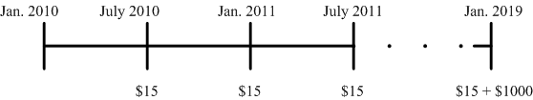
Example 6.3a The Cash Flows of a Coupon Bond or Note (3 of 4)
Execute:
The face value of this note is $1000. Because this note pays coupons semiannually, from Eq.(6.1) you will receive a coupon
payment every six months of
Here is the timeline based on a six-month period and there are a total of 18 cash flows:
Note that the last payment occurs nine years (eighteen six-month periods) from now and is composed of both a coupon payment of $15 and the face value payment of $1000.

Slide 40
Example 6.3a The Cash Flows of a Coupon Bond or Note (4 of 4)
Evaluate:
Since a note is just a package of cash flows, we need to know those cash flows in order to value the note.
That’s why the description of the note contains all of the information we would need to construct its cash flow timeline.

Slide 41
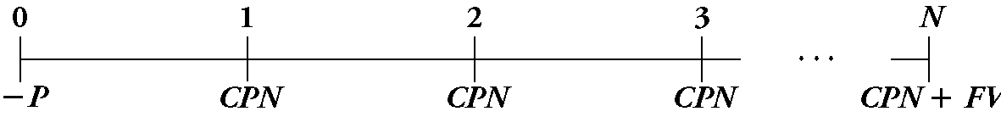
6.3 Coupon Bonds (3 of 5)
Yield to Maturity of a Coupon Bond:
  Cash flows shown in the timeline below:
  Coupon bonds have many cash flows, complicating the yield to maturity calculation
  The coupon payments are an annuity, so the yield to maturity is the interest rate y that solves the following equation:

Slide 42
6.3 Coupon Bonds (4 of 5)
Yield to Maturity of a Coupon Bond

Slide 43
Example 6.4 Computing the Yield to Maturity of a Coupon Bond (1 of 5)
Problem
Consider the five-year, $1000 bond with a 2.2% coupon rate and semiannual coupons described in Example 6.3. If this bond is currently trading for a price of $963.11, what is the bond’s yield to maturity?

Slide 44
Example 6.4 Computing the Yield to Maturity of a Coupon Bond (2 of 5)
Solution
Plan
We worked out the bond’s cash flows in Example 6.3. From the cash flow timeline, we can see that the bond consists of an annuity of 10 payments of $11, paid every six months, and one lump-sum payment of $1000 in five years (in 10 six-month periods). We can use Eq. 6.3 to solve for the yield to maturity. However, we must use six-month intervals consistently throughout the equation.

Slide 45
Example 6.4 Computing the Yield to Maturity of a Coupon Bond (3 of 5)
Execute
Because the bond has 10 remaining coupon payments, we compute its yield y by solving Eq. 6.3 for this bond:
We can solve it by trial and error, a financial calculator, or a spreadsheet. To use a financial calculator, we enter the price we pay as a negative number for the PV (it is a cash outflow), the coupon payments as the PMT, and the bond’s par value as its FV. Finally, we enter the number of coupon payments remaining (10) as N.

Slide 46
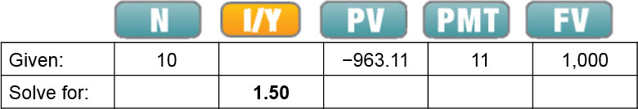
Example 6.4 Computing the Yield to Maturity of a Coupon Bond (4 of 5)
Excel Formula: RATE(NPER,PMT,PV,FV) = RATE(10,11,−963.11,1000)
Therefore, y = 1.5%. Because the bond pays coupons semiannually, this yield is for a six-month period. We convert it to an APR by multiplying by the number of coupon payments per year. Thus, the bond has a yield to maturity equal to a 3% APR with semiannual compounding.

Slide 47
Example 6.4 Computing the Yield to Maturity of a Coupon Bond (5 of 5)
Evaluate
As the equation shows, the yield to maturity is the discount rate that equates the present value of the bond’s cash flows with its price. Note that the YTM is higher than the coupon rate and the price is lower than the par value. We will discuss why in the next section.

Slide 48
Example 6.4a Computing the Yield to Maturity of a Coupon Bond (1 of 6)
Problem:
Consider the nine-year, $1000 note with a 3% coupon rate and semiannual coupons described in Example 6.3a.
If this bond is currently trading for a price of $1,038.32, what is the bond’s yield to maturity?

Slide 49
Example 6.4a Computing the Yield to Maturity of a Coupon Bond (2 of 6)
Solution:
Plan:
We worked out the bond’s cash flows in Example 6.3a.
From the cash flow timeline, we can see that the bond consists of an annuity of 18 payments of $15, paid every 6 months, and one lump-sum payment of $1000 in 9 years (eighteen 6-month periods).
We can use Eq. 6.3a to solve for the yield to maturity.
However, we must use 6-month intervals consistently throughout the equation.

Slide 50
Example 6.4a Computing the Yield to Maturity of a Coupon Bond (3 of 6)
Execute:
Because the bond has eighteen remaining coupon payments, we compute its yield y by solving Eq.(6.3) for this bond:

Slide 51
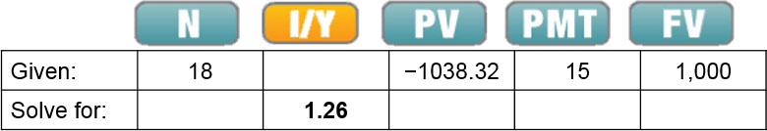
Example 6.4a Computing the Yield to Maturity of a Coupon Bond (4 of 6)
Execute:
We can solve it by trial-and-error, financial calculator, or a spreadsheet. To use a financial calculator, we enter the price we pay as a negative number for the PV (it is a cash outflow), the coupon payments as the PMT, and the bond’s par value as its FV. Finally, we enter the number of coupon payments remaining (10) as N.
Excel Formula: =RATE(NPER,PMT,PV,FV) = RATE(18,15,−1038.32,1000)

Slide 52
Example 6.4a Computing the Yield to Maturity of a Coupon Bond (5 of 6)
Execute:
Therefore, y = 1.26%.
Because the bond pays coupons semiannually, this yield is for a six-month period.
We convert it to an APR by multiplying by the number of coupon payments per year.
Thus the bond has a yield to maturity equal to a 2.52% APR with semiannual compounding.

Slide 53
Example 6.4a Computing the Yield to Maturity of a Coupon Bond (6 of 6)
Evaluate:
As the equation shows, the yield to maturity is the discount rate that equates the present value of the bond’s cash flows with its price.

Slide 54
Example 6.5 Computing a Bond Price from Its Yield to Maturity (1 of 5)
Problem
Consider again the five-year, $1000 bond with a 2.2% coupon rate and semiannual coupons in Example 6.4. Suppose interest rates drop and the bond’s yield to maturity decreases to 2% (expressed as an APR with semiannual compounding). What price is the bond trading for now? And what is the effective annual yield on this bond?

Slide 55
Example 6.5 Computing a Bond Price from Its Yield to Maturity (2 of 5)
Solution
Plan
Given the yield, we can compute the price using Eq. 6.3. First, note that a 2% APR is equivalent to a semiannual rate of 1%. Also, recall that the cash flows of this bond are an annuity of 10 payments of $11, paid every six months, and one lump-sum cash flow of $1000 (the face value), paid in five years (10 six-month periods). In Chapter 5, we learned how to compute an effective annual rate from an APR using Eq. 5.3. We do the same here to compute the effective annual yield from the bond’s yield to maturity expressed as an APR.

Slide 56
Example 6.5 Computing a Bond Price from Its Yield to Maturity (3 of 5)
Execute
Using Eq. 6.3 and the six-month yield of 1%, the bond price must be:
We can also use a financial calculator or spreadsheet:

Slide 57
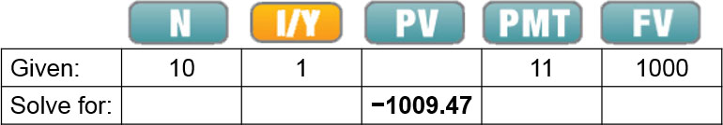
Example 6.5 Computing a Bond Price from Its Yield to Maturity (4 of 5)
Excel Formula: PV(RATE,NPER,PMT,FV) = PV(.01,10,11,1000)
The effective annual yield corresponding to 1% every six months is:
or 2.01%

Slide 58
Example 6.5 Computing a Bond Price from Its Yield to Maturity (5 of 5)
Evaluate
The bond’s price has risen to $1009.47, lowering the return from investing in it from 1.5% to 1% per six-month period. Interest rates have dropped, so the lower return brings the bond’s yield into line with the lower competitive rates being offered for similar risk and maturity elsewhere in the market.

Slide 59
Example 6.5a Computing a Bond Price from Its Yield to Maturity (1 of 5)
Problem:
Consider again the nine-year, $1000 bond with a 3% coupon rate and semiannual coupons in Example 6.4a.
Suppose interest rates increase and the bond’s yield to maturity increases to 4.0% (expressed as an APR with semiannual compounding).
What price is the bond trading for now?

Slide 60
Example 6.5a Computing a Bond Price from Its Yield to Maturity (2 of 5)
Solution:
Plan:
Given the yield, we can compute the price using Eq.6.3.
First, note that a 4.0% APR is equivalent to a semiannual rate of 2.0%.
Also, recall that the cash flows of this bond are an annuity of 18 payments of $15, paid every 6 months, and one lump-sum cash flow of $1000 (the face value), paid in 9 years (eighteen 6-month periods).

Slide 61
Example 6.5a Computing a Bond Price from Its Yield to Maturity (3 of 5)
Execute:
Using Eq. 6.3 and the 6-month yield of 2.0%, the bond price must be

Slide 62
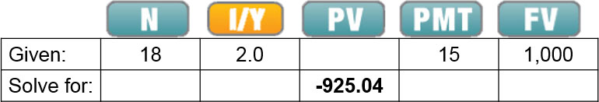
Example 6.5a Computing a Bond Price from Its Yield to Maturity (4 of 5)
Execute:
We can also use a financial calculator:
Excel Formula: = PV(RATE,NPER,PMT,FV) = PV(0.02,18,15,1000)
The effective annual yield corresponding to 2.0% every six months is
or 4.04%

Slide 63
Example 6.5a Computing a Bond Price from Its Yield to Maturity (5 of 5)
Evaluate:
The bond’s price has declined to $925.04, increasing the return from investing in it from 1.26% to 2.0% per 6-month period.
Interest rates have increased, so the higher return brings the bond’s yield into line with the higher competitive rates being offered for similar risk and maturity elsewhere in the Market.

Slide 64
6.3 Coupon Bonds (5 of 5)
Coupon Bond Price Quotes
  Prices and yields are often used interchangeably
  Bond traders usually quote yields rather than prices
  One advantage is that the yield is independent of the face value of the bond
  When prices are quoted in the bond market, they are conventionally quoted per $100 face value

Slide 65
6.4 Why Bond Prices Change (1 of 4)
Zero-coupon bonds always trade for a discount
Coupon bonds may trade at a discount or at a premium
Most issuers of coupon bonds choose a coupon rate so that the bonds will initially trade at, or very close to, par
After the issue date, the market price of a bond changes over time

Slide 66
6.4 Why Bond Prices Change (2 of 4)
Interest Rate Changes and Bond Prices
  If a bond sells at par the only return investors will earn is from the coupons that the bond pays
  Therefore, the bond’s coupon rate will exactly equal its yield to maturity
  As interest rates in the economy fluctuate, the yields that investors demand will also change

Slide 67
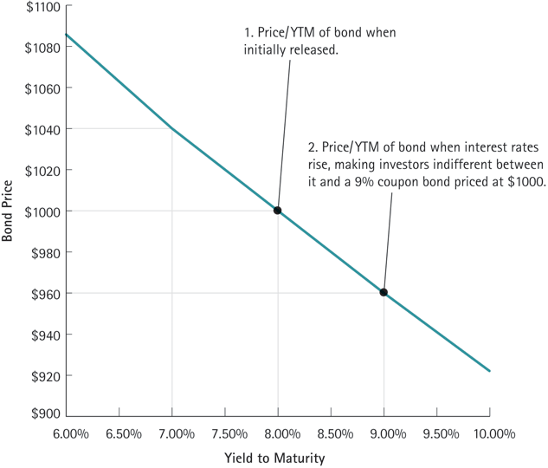
Figure 6.3 A Bond’s Price vs. Its Yield to Maturity

Slide 68
Table 6.3 Bond Prices Immediately After a Coupon Payment
When the bond price is . . . | greater than the face value | equal to the face value | less than the face value
We say the bond trades . . . | “above par” or “at a premium” | “at par” | “below par” or “at a discount”
This occurs when . . . | Coupon Rate > Yield to Maturity | Coupon Rate = Yield to Maturity | Coupon Rate < Yield to Maturity

Slide 69
Example 6.6 Determining the Discount or Premium of a Coupon Bond (1 of 4)
Problem
Consider three 30-year bonds with annual coupon payments. One bond has a 10% coupon rate, one has a 5% coupon rate, and one has a 3% coupon rate. If the yield to maturity of each bond is 5%, what is the price of each bond per $100 face value? Which bond trades at a premium, which trades at a discount, and which trades at par?

Slide 70
Example 6.6 Determining the Discount or Premium of a Coupon Bond (2 of 4)
Solution
Plan
From the description of the bonds, we can determine their cash flows. Each bond has 30 years to maturity and pays its coupons annually. Therefore, each bond has an annuity of coupon payments, paid annually for 30 years, and then the face value paid as a lump sum in 30 years. They are all priced so that their yield to maturity is 5%, meaning that 5% is the discount rate that equates the present value of the cash flows to the price of the bond. Therefore, we can use Eq. 6.3 to compute the price of each bond as the PV of its cash flows, discounted at 5%.

Slide 71
Example 6.6 Determining the Discount or Premium of a Coupon Bond (3 of 4)
Execute
For the 10% coupon bond, the annuity cash flows are $10 per year (10% of each $100 face value). Similarly, the annuity cash flows for the 5% and 3% bonds are $5 and $3 per year. We use a $100 face value for all of the bonds.
Using Eq. 6.3 and these cash flows, the bond prices are:

Slide 72
Example 6.6 Determining the Discount or Premium of a Coupon Bond (4 of 4)
Evaluate
The prices reveal that when the coupon rate of the bond is higher than its yield to maturity, it trades at a premium. When its coupon rate equals its yield to maturity, it trades at par. When its coupon rate is lower than its yield to maturity, it trades at a discount.

Slide 73
Example 6.6a Determining the Discount or Premium of a Coupon Bond (1 of 5)
Problem:
Consider three 30-year bonds with annual coupon payments.
One bond has a 12% coupon rate, one has a 6% coupon rate, and one has a 2% coupon rate.
If the yield to maturity of each bond is 6%, what is the price of each bond per $100 face value?
Which bond trades at a premium, which trades at a discount, and which trades at par?

Slide 74
Example 6.6a Determining the Discount or Premium of a Coupon Bond (2 of 5)
Solution:
Plan:
From the description of the bonds, we can determine their cash flows.
Each bond has 30 years to maturity and pays its coupons annually.
Therefore, each bond has an annuity of coupon payments, paid annually for 30 years, and then the face value paid as a lump sum in 30 years.

Slide 75
Example 6.6a Determining the Discount or Premium of a Coupon Bond (3 of 5)
Solution:
Plan:
They are all priced so that their yield to maturity is 6%, meaning that 6% is the discount rate that equates the present value of the cash flows to the price of the bond.
Therefore, we can use Eq. 6.3 to compute the price of each bond as the PV of its cash flows, discounted at 6%.

Slide 76
Example 6.6a Determining the Discount or Premium of a Coupon Bond (4 of 5)
Execute:
For the 12% coupon bond, the annuity cash flows are $12 per year (12% of each $100 face value). Similarly, the annuity cash flows for the 6% and 2% bonds are $6 and $2 per year. We use a $100 face value for all of the bonds.
Using Eq. 6.3 and these cash flows, the bond prices are:

Slide 77
Example 6.6a Determining the Discount or Premium of a Coupon Bond (5 of 5)
Evaluate:
The prices reveal that when the coupon rate of the bond is higher than its yield to maturity, it trades at a premium.
When its coupon rate equals its yield to maturity, it trades at par.
When its coupon rate is lower than its yield to maturity, it trades at a discount.

Slide 78
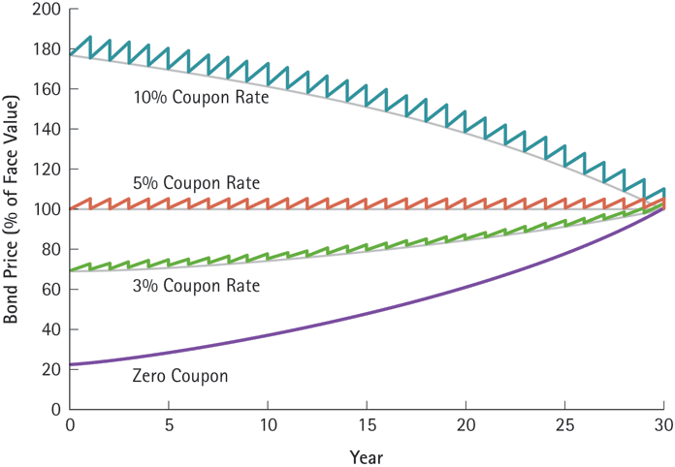
Figure 6.4 The Effect of Time on Bond Prices

Slide 79
Example 6.7 The Effect of Time on the Price of a Bond (1 of 4)
Problem
Suppose you purchase a 30-year, zero-coupon bond with a yield to maturity of 5%. For a face value of $100, the bond will initially trade for:
If the bond’s yield to maturity remains at 5%, what will its price be five years later? If you purchased the bond at $23.14 and sold it five years later, what would the rate of return of your investment be?

Slide 80
Example 6.7 The Effect of Time on the Price of a Bond (2 of 4)
Solution
Plan
If the bond was originally a 30-year bond and five years have passed, then it has 25 years left to maturity. If the yield to maturity does not change, then you can compute the price of the bond with 25 years left exactly as we did for 30 years, but using 25 years of discounting instead of 30. Once you have the price in five years, you can compute the rate of return of your investment just as we did in Chapter 4. The FV is the price in five years, the PV is the initial price ($23.14), and the number of years is five.

Slide 81
Example 6.7 The Effect of Time on the Price of a Bond (3 of 4)
Execute
If you purchased the bond for $23.14 and then sold it after five years for $29.53, the rate of return of your investment would be
That is, your return is the same as the yield to maturity of the bond.

Slide 82
Example 6.7 The Effect of Time on the Price of a Bond (4 of 4)
Evaluate
Note that the bond price is higher, and hence the discount from its face value is smaller, when there is less time to maturity. The discount shrinks because the yield has not changed, but there is less time until the face value will be received. This example illustrates a more general property for bonds: If a bond’s yield to maturity does not change, then the rate of return of an investment in the bond equals its yield to maturity even if you sell the bond early.

Slide 83
Example 6.7a The Effect of Time on the Price of a Bond (1 of 5)
Problem:
Suppose you purchase a 20-year, zero-coupon bond with a yield to maturity of 10%. For a face value of $800, the bond will initially trade for
If the bond’s yield to maturity remains at 10%, what will its price be five years later?
If you purchased the bond at $118.91 and sold it 5 years later, what would the rate of return of your investment be?

Slide 84
Example 6.7a The Effect of Time on the Price of a Bond (2 of 5)
Solution:
Plan:
If the bond was originally a 20-year bond and 5 years have passed, then it has 15 years left to maturity.
If the yield to maturity does not change, then you can compute the price of the bond with 15 years left exactly as we did for 20 years, but using 15 years of discounting instead of 20.

Slide 85
Example 6.7a The Effect of Time on the Price of a Bond (3 of 5)
Solution:
Plan:
Once you have the price in 5 years, you can compute the rate of return of your investment just as we did in Chapter 4.
The FV is the price in 5 years, the PV is the initial price ($118.91), and the number of years is 5.

Slide 86
Example 6.7a The Effect of Time on the Price of a Bond (4 of 5)
Execute:
If you purchased the bond for $118.91 and then sold it after five years for $191.51, the rate of return of your investment would be
That is, your return is the same as the yield to maturity of the bond.

Slide 87
Example 6.7a The Effect of Time on the Price of a Bond (5 of 5)
Evaluate:
Note that the bond price is higher, and hence the discount from its face value is smaller, when there is less time to maturity.
The discount shrinks because the yield has not changed, but there is less time until the face value will be received.
This example illustrates a more general property for bonds.
If a bond’s yield to maturity does not change, then the rate of return of an investment in the bond equals its yield to maturity even if you sell the bond early.

Slide 88
6.4 Why Bond Prices Change (3 of 4)
Interest Rate Risk and Bond Prices
  Effect of time on bond prices is predictable, but unpredictable changes in rates also affect prices
  Bonds with different characteristics will respond differently to changes in interest rates
  Investors view long-term bonds to be riskier than short-term bonds

Slide 89
Example 6.8 The Interest Rate Sensitivity of Bonds (1 of 4)
Problem
Consider a 10-year coupon bond and a 30-year coupon bond, both with 10% annual coupons. By what percentage will the price of each bond change if its yield to maturity increases from 5% to 6%?

Slide 90
Example 6.8 The Interest Rate Sensitivity of Bonds (2 of 4)
Solution
Plan
We need to compute the price of each bond for each yield to maturity and then calculate the percentage change in the prices. For both bonds, the cash flows are $10 per year for $100 in face value and then the $100 face value repaid at maturity. The only difference is the maturity: 10 years and 30 years. With those cash flows, we can use Eq. 6.3 to compute the prices.

Slide 91
Example 6.8 The Interest Rate Sensitivity of Bonds (3 of 4)
Execute
Yield to Maturity | 10-year, 10% Annual Coupon Bond | 30-year, 10% Annual Coupon Bond
5% | A table with 2 rows, coupon rate and Y T M. Columns for coupon rate are 0%, 5%, and 10%. Corresponding columns for Y T M are 4.50%, 4.47%, and 4.44%. | A formula: 10 times, 1 over 0.05, times quantity, 1 minus, 1 over 1.05 raised to the 30 power, end quantity, plus 100 over 1.05 raised to the 30 power = $176.86.
6% | A formula: 10 times, 1 over 0.06, times quantity, 1 minus, 1 over 1.06 raised to the 10 power, end quantity, plus 100 over 1.06 raised to the 10 power = $129.44. | A formula: 10 times, 1 over 0.06, times quantity, 1 minus, 1 over 1.06 raised to the 30 power, end quantity, plus 100 over 1.06 raised to the 30 power = $155.06.
The price of the 10-year bond changes by
if its yield to maturity increases from 5% to 6%.
For the 30-year bond, the price change is

Slide 92
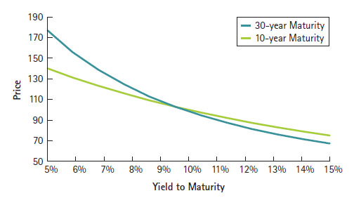
Example 6.8 The Interest Rate Sensitivity of Bonds (4 of 4)
Evaluate
The 30-year bond is almost twice as sensitive to a change in the yield than is the 10-year bond. In fact, if we graph the price and yields of the two bonds, we can see that the line for the 30-year bond, shown in blue, is steeper throughout than the green line for the 10-year bond, reflecting its heightened sensitivity to interest rate changes.

Slide 93
Example 6.8a The Interest Rate Sensitivity of Bonds (1 of 5)
Problem:
Consider a 5-year coupon bond and a 40-year coupon bond, both with 5% annual coupons.
By what percentage will the price of each bond change if its yield to maturity increases from 5% to 6%?

Slide 94
Example 6.8a The Interest Rate Sensitivity of Bonds (2 of 5)
Solution:
Plan:
We need to compute the price of each bond for each yield to maturity and then calculate the percentage change in the prices.
For both bonds, the cash flows are $5 per year for $100 in face value and then the $100 face value repaid at maturity.
The only difference is the maturity: 5 years and 40 years.
With those cash flows, we can use Eq. 6.3 to compute the prices.

Slide 95
Example 6.8a The Interest Rate Sensitivity of Bonds (3 of 5)
Execute:
Yield to Maturity | 5-year, 5% Annual Coupon Bond | 40-year, 5% Annual Coupon Bond
5% | A formula: 5 times, 1 over 0.05, times quantity, 1 minus, 1 over 1.05 raised to the 5 power, end quantity, plus 100 over 1.05 raised to the 5 power = $100 | A formula: 5 times, 1 over 0.05, times quantity, 1 minus, 1 over 1.05 raised to the 40 power, end quantity, plus 100 over 1.05 raised to the 40 power = $100.
6% | A formula: 5 times, 1 over 0.06, times quantity, 1 minus, 1 over 1.06 raised to the 5 power, end quantity, plus 100 over 1.06 raised to the 5 power = $95.79 | A formula: 5 times, 1 over 0.06, times quantity, 1 minus, 1 over 1.06 raised to the 40 power, end quantity, plus 100 over 1.06 raised to the 40 power = $84.95

Slide 96
Example 6.8a The Interest Rate Sensitivity of Bonds (4 of 5)
The price of the 5-year bond changes by
if its yield to maturity increases from 5% to 6%.
For the 40-year bond, the price change is

Slide 97
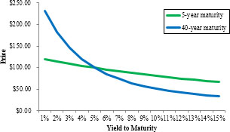
Example 6.8a The Interest Rate Sensitivity of Bonds (5 of 5)
Evaluate:
The 40-year bond is 3.6 times as sensitive to a change in the yield than is the 5-year bond.
In fact, if we graph the price and yields of the two bonds, we can see that the line for the 40-year bond, shown in blue, is steeper throughout than the green line for the 5-year bond, reflecting its heightened sensitivity to interest rate changes.

Slide 98
Table 6.4 Bond Prices and Interest Rates
Bond Characteristic | Effect on Interest Rate Risk
Longer term to maturity | Increase
Higher coupon payments | Decrease

Slide 99
Example 6.9 Coupons and Interest Rate Sensitivity (1 of 5)
Problem
Consider two bonds, each of which pays semiannual coupons and has five years left until maturity. One has a coupon rate of 5% and the other has a coupon rate of 10%, but both currently have a yield to maturity of 8%. By what percentage will the price of each bond change if its yield to maturity decreases from 8% to 7%?

Slide 100
Example 6.9 Coupons and Interest Rate Sensitivity (2 of 5)
Solution
Plan
As in Example 6.8, we need to compute the price of each bond at 8% and 7% yield to maturities and then compute the percentage change in price. Each bond has 10 semiannual coupon payments remaining along with the repayment of par value at maturity. The cash flows per $100 of face value for the first bond are $2.50 every six months and then $100 at maturity. The cash flows per $100 of face value for the second bond are $5 every six months and then $100 at maturity. Since the cash flows are semiannual, the yield to maturity is quoted as a semiannually compounded APR, so we convert the yields to match the frequency of the cash flows by dividing by two. With semiannual rates of 4% and 3.5%, we can use Eq. 6.3 to compute the prices.

Slide 101
Example 6.9 Coupons and Interest Rate Sensitivity (3 of 5)
Execute
Yield to Maturity | 5-year, 5% Coupon Bond | 5-year, 10% Coupon Bond
8% | A formula: 2.50 times, 1 over 0.04, times quantity, 1 minus, 1 over 1.04 raised to the 10 power, end quantity, plus 100 over 1.04 raised to the 10 power = $87.83 | A formula: 5 times, 1 over 0.04, times quantity, 1 minus, 1 over 1.04 raised to the 10 power, end quantity, plus 100 over 1.04 raised to the 10 power = $108.11.
7% | A formula: 2.50 times, 1 over 0.035, times quantity, 1 minus, 1 over 1.035 raised to the 10 power, end quantity, plus 100 over 1.035 raised to the 10 power = $91.68 | A formula: 5 times, 1 over 0.035, times quantity, 1 minus, 1 over 1.035 raised to the 10 power, end quantity, plus 100 over 1.035 raised to the 10 power = $112.47.
The 5% coupon bond’s price changed from $87.83 to $91.68, or 4.4%, but the 10% coupon bond’s price changed from $108.11 to $112.47, or 4.0%. You can calculate the price change very quickly with a financial calculator or spreadsheet. For example, take the 5% coupon bond at 8% YTM (4% per 6 months):

Slide 102
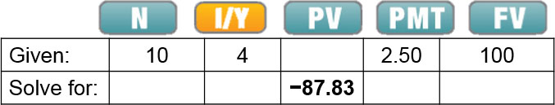
Example 6.9 Coupons and Interest Rate Sensitivity (4 of 5)
Excel Formula: PV(RATE,NPER,PMT,FV) = PV(.04,10,2.5,100)
With all of the basic bond information entered, you can simply change the I/Y by entering 3.5 and pressing I/Y and then solve for PV again. So, with just a few keystrokes, you will have the new price of $91.68.

Slide 103
Example 6.9 Coupons and Interest Rate Sensitivity (5 of 5)
Evaluate
The bond with the smaller coupon payments is more sensitive to changes in interest rates. Because its coupons are smaller relative to its par value, a larger fraction of its cash flows are received later. As we learned in Example 6.8, later cash flows are affected more greatly by changes in interest rates, so compared to the 10% coupon bond, the effect of the interest change is greater for the cash flows of the 5% coupon bond.

Slide 104
Example 6.9a Coupons and Interest Rate Sensitivity (1 of 7)
Problem:
Consider two bonds, each pays semi-annual coupons and 5 years left until maturity.
One has a coupon rate of 4% and the other has a coupon rate of 12%, but both currently have a yield to maturity of 8%.
How much will the price of each bond change if its yield to maturity decreases from 8% to 7%?

Slide 105
Example 6.9a Coupons and Interest Rate Sensitivity (2 of 7)
Solution:
Plan:
As in Example 6.8a, we need to compute the price of each bond at 8% and 7% yield to maturities and then compute the percentage change in price.
Each bond has 10 semi-annual coupon payments remaining along with the repayment of par value at maturity.
The cash flows per $100 of face value for the first bond are $2.00 every 6 months and then $100 at maturity.

Slide 106
Example 6.9a Coupons and Interest Rate Sensitivity (3 of 7)
Solution
Plan:
The cash flows per $100 of face value for the second bond are $6 every 6 months and then $100 at maturity.
Since the cash flows are semi-annual, the yield to maturity is quoted as a semi-annually compounded APR, so we convert the yields to match the frequency of the cash flows by dividing by 2.
With semi-annual rates of 3.5% and 4%, we can use Eq.(6.3) to compute the prices.

Slide 107
Example 6.9a Coupons and Interest Rate Sensitivity (4 of 7)
Execute:
The 4% coupon bond’s price changed from $83.78 to 87.53, or 4.5%, but the 12% coupon bond’s price changed from $116.22 to $120.79, or 3.9%.
You can calculate the price change very quickly with a financial calculator. Taking the 12% coupon bond for example:

Slide 108
Example 6.9a Coupons and Interest Rate Sensitivity (5 of 7)
Yield to Maturity | 5-year, 5% Annual Coupon Bond | 40-year, 5% Annual Coupon Bond
8% | A formula: 2 times, 1 over 0.04, times quantity, 1 minus, 1 over 1.04 raised to the 10 power, end quantity, plus 100 over 1.04 raised to the 10 power = $83.78. | A formula: 6 times, 1 over 0.04, times quantity, 1 minus, 1 over 1.04 raised to the 10 power, end quantity, plus 100 over 1.04 raised to the 10 power = $116.22.
7% | A formula: 2 times, 1 over 0.035, times quantity, 1 minus, 1 over 1.035 raised to the 10 power, end quantity, plus 100 over 1.035 raised to the 10 power = $87.53. | A formula: 6 times, 1 over 0.035, times quantity, 1 minus, 1 over 1.035 raised to the 10 power, end quantity, plus 100 over 1.035 raised to the 10 power = $120.79.

Slide 109
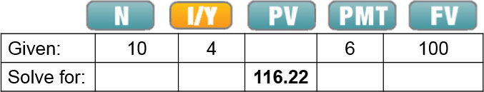
Example 6.9a Coupons and Interest Rate Sensitivity (6 of 7)
Excel Formula: = PV(RATE,NPER,PMT,FV)=PV(0.04,10,6,100)

Slide 110
Example 6.9a Coupons and Interest Rate Sensitivity (7 of 7)
Evaluate:
The bond with the smaller coupon payments is more sensitive to changes in interest rates.
Because its coupons are smaller relative to its par value, a larger fraction of its cash flows are received later.
As we learned in Example 6.8a, later cash flows are affected more greatly by changes in interest rates, so compared to the 12% coupon bond, the effect of the interest change is greater for the cash flows of the 4% bond.

Slide 111
6.4 Why Bond Prices Change (4 of 4)
Bond Prices in Practice
  Bond prices are subject to the effects of both passage of time and changes in interest rates
  Prices converge to face value due to the time effect, but move up and down because of changes in yields

Slide 112
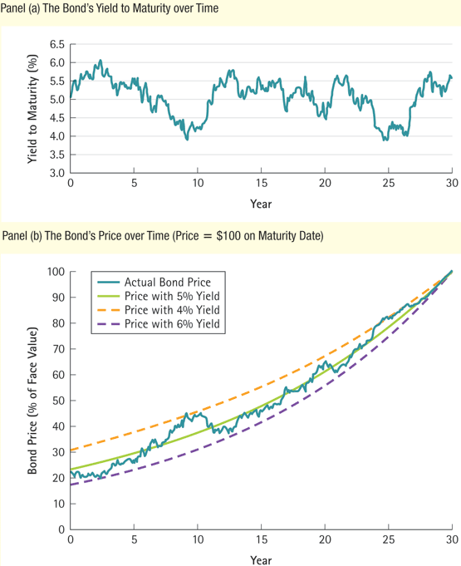
Figure 6.5 Yield to Maturity and Bond Price Fluctuations over Time

Slide 113
6.5 Corporate Bonds (1 of 5)
Credit Risk
  U.S. Treasury securities are widely regarded to be risk-free
  Credit risk is the risk of default, so that the bond’s cash flows are not known with certainty
Corporations with higher default risk will need to pay higher coupons to attract buyers to their bonds

Slide 114
6.5 Corporate Bonds (2 of 5)
Corporate Bond Yields
  Yield to maturity of a defaultable bond is not equal to the expected return of investing in the bond
  A higher yield to maturity does not necessarily imply that a bond’s expected return is higher

Slide 115
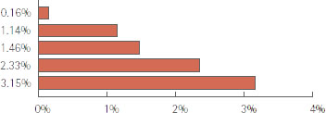
Interest Rates on Five-Year Bonds for Various Borrowers, December 2015
Table 6.5 Interest Rates on Five-Year Bonds for Various Borrowers, December 2015
Borrower | Interest Rate | Credit Spread
U.S. Government (Treasury Notes) | 1.70% | A graph with horizontal bars graph the x-axis is percent from 0 to 4. The bars extend to 0.16%, 1.14%, 1.46%, 2.33%, and 3.15%.
Johnson & Johnson | 1.86%
McDonalds Corp. | 2.84%
Baidu, Inc. | 3.16%
Xerox Corp. | 4.03%
Gap, Inc. | 4.85%

Slide 116
6.5 Corporate Bonds (3 of 5)
Bond Ratings
  Several companies rate the creditworthiness of bonds
    Two best-known are Standard & Poor’s and Moody’s
  These ratings help investors assess creditworthiness

Slide 117
Bond Ratings and the Number of U.S. Public Firms with those Ratings in March 2016 (1 of 2)
Table 6.6 Bond Ratings and the Number of U.S. Public Firms with Those Ratings in March 2016
Moody’s | Standard & Poor’s | Number of Public Firms | Description (Moody’s)
Investment Grade Debt | blank | blank | blank
Aaa | AAA | 3* | Judged to be of the best quality. They carry the smallest degree of investment risk and are generally referred to as “gilt edged.”
Aa | AA | 29 | Judged to be of high quality by all standards. Together with the Aaa group, they constitute what are generally known as high-grade bonds.
A | A | 221 | Possess many favorable investment attributes and are considered as upper-medium-grade obligations. Factors giving security to principal and interest are considered adequate at present, but may not remain that way.
Baa | BBB | 515 | Are considered as medium-grade obligations (i.e., they are neither highly protected nor poorly secured).

Slide 118
Bond Ratings and the Number of U.S. Public Firms with those Ratings in March 2016 (2 of 2)
Table 6.6 [Continued]
Moody’s | Standard & Poor’s | Number of Public Firms | Description (Moody’s)
Ba | BB | 363 | Judged to have speculative elements; their future cannot be considered as well assured.
B | B | 255 | Generally lack characteristics of the desirable investment. Assurance of interest and principal payments over any long period may be small.
Caa | CCC | 41 | Are of poor standing. Such issues may be in default or there may be present elements of danger with respect to principal or interest.
Ca | CC | 5 | Are speculative to a high degree. Such issues are often in default or have other marked shortcomings.
C | C, D | 10 | Lowest-rated class of bonds, and issues so rated can be regarded as having extremely poor prospects of ever attaining any real investment standing.
*The three AAA-rated companies were Microsoft, Johnson & Johnson, and ExxonMobil. However, ExxonMobil was downgraded at the end of April, 2016.Source : www.moodys.com and S&P Compustat.

Slide 119
6.5 Corporate Bonds (4 of 5)
Bond Ratings
  Investment-grade bonds
  Speculative bonds
    junk bonds
    high-yield bonds
  The rating depends on
    the risk of bankruptcy
    bondholders’ claim to assets in the event of bankruptcy

Slide 120
6.5 Corporate Bonds (5 of 5)
Corporate Yield Curves
  We can plot a yield curve for corporate bonds just as we can for Treasuries
  The credit (or default) spread is the difference between the yields of corporate bonds and Treasuries

Slide 121
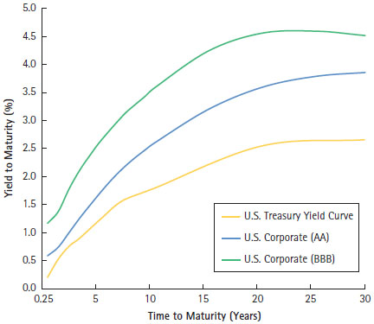
Figure 6.6 Corporate Yield Curves for Various Ratings, May 2016
Corporate Yield Curves for Various Ratings, May 2016
This figure shows the yield curve for U.S. Treasury securities (in yellow) and yield curves for corporate securities with ratings AA (in blue), and BBB (in green). Note how the yield to maturity is higher for the corporate bonds, which have a higher probability of default than the U.S. Treasury securities.
Source : Bloomberg.

Slide 122
Example 6.10 Credit Spreads and Bond Prices (1 of 4)
Problem
Your firm has a credit rating of AA. You notice that the credit spread for 10-year maturity AA debt is 90 basis points (0.90%). Your firm’s 10-year debt has a coupon rate of 5%. You see that new 10-year Treasury notes are being issued at par with a coupon rate of 4.5%. What should be the price of your outstanding 10-year bonds?

Slide 123
Example 6.10 Credit Spreads and Bond Prices (2 of 4)
Solution
Plan
If the credit spread is 90 basis points, then the yield to maturity (YTM) on your debt should be the YTM on similar Treasuries plus 0.9%. The fact that new 10-year Treasuries are being issued at par with coupons of 4.5% means that with a coupon rate of 4.5%, these notes are selling for $100 per $100 face value. Thus, their YTM is 4.5% and your debt’s YTM should be 4.5% + 0.9% = 5.4%. The cash flows on your bonds are $5 per year for every $100 face value, paid as $2.50 every six months. The six-month rate corresponding to a 5.4% yield is
Armed with this information, you can use Eq. 6.3 to compute the price of your bonds.

Slide 124
Example 6.10 Credit Spreads and Bond Prices (3 of 4)
Execute

Slide 125
Example 6.10 Credit Spreads and Bond Prices (4 of 4)
Evaluate
Your bonds offer a higher coupon (5% vs. 4.5%) than Treasuries of the same maturity, but sell for a lower price ($96.94 vs. $100). The reason is the credit spread. Your firm’s higher probability of default leads investors to demand a higher YTM on your debt. To provide a higher YTM, the purchase price for the debt must be lower. If your debt paid 5.4% coupons, it would sell at $100, the same as the Treasuries. But to get that price, you would have to offer coupons that are 90 basis points higher than those on the Treasuries—exactly enough to offset the credit spread.

Slide 126
Example 6.10a Credit Spreads and Bond Prices (1 of 6)
Problem:
Your firm has a credit rating of AAA.
You notice that the credit spread for 10-year maturity debt is 60 basis points (0.60%).
Your firm’s ten-year debt has a coupon rate of 4%.
You see that new 10-year Treasury notes are being issued at par with a coupon rate of 3.65%.
What should the price of your outstanding 10-year bonds be?

Slide 127
Example 6.10a Credit Spreads and Bond Prices (2 of 6)
Solution:
Plan:
If the credit spread is 60 basis points, then the yield to maturity (YTM) on your debt should be the YTM on similar treasuries plus 0.6%.
The fact that new 10-year treasuries are being issued at par with coupons of 3.65% means that with a coupon rate of 3.65%, these notes are selling for $100 per $100 face value.
Thus their YTM is 3.65% and your debt’s YTM should be 3.65% + 0.6% = 4.25%.

Slide 128
Example 6.10a Credit Spreads and Bond Prices (3 of 6)
Solution:
Plan:
The cash flows on your bonds are $4 per year for every $100 face value, paid as $2.00 every 6 months.
The 6-month rate corresponding to a 4.25% yield is
Armed with this information, you can use Eq.(6.3) to compute the price of your bonds.

Slide 129
Example 6.10a Credit Spreads and Bond Prices (4 of 6)
Execute:

Slide 130
Example 6.10a Credit Spreads and Bond Prices (5 of 6)
Evaluate:
Your bonds offer a higher coupon (4% vs. 3.65%) than treasuries of the same maturity, but sell for a lower price ($97.98 vs. $100).
The reason is the credit spread.
Your firm’s higher probability of default leads investors to demand a higher YTM on your debt.
To provide a higher YTM, the purchase price for the debt must be lower.

Slide 131
Example 6.10a Credit Spreads and Bond Prices (6 of 6)
Evaluate:
If your debt paid 4.25% coupons, it would sell at $100, the same as the treasuries.
But to get that price, you would have to offer coupons that are 60 basis points higher than those on the treasuries—exactly enough to offset the credit spread.

Slide 132
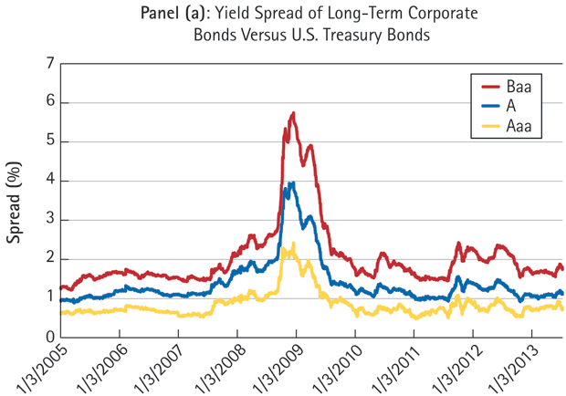
Figure 6.7 Yield Spreads and the Financial Crisis (1 of 2)

Slide 133
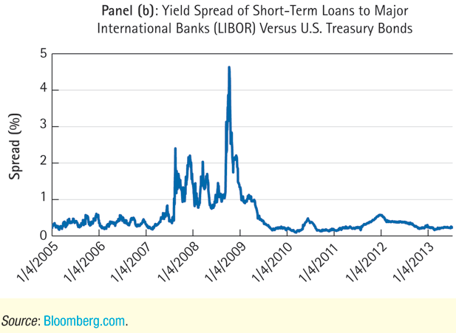
Figure 6.7 Yield Spreads and the Financial Crisis (2 of 2)

Slide 134
Chapter Quiz (1 of 2)
What types of cash flows does a bond buyer receive?
How are the periodic coupon payments on a bond determined?
Why would you want to know the yield to maturity of a bond?
What is the relationship between a bond’s price and its yield to maturity?
What cash flows does a company pay to investors holding its coupon bonds?
What do we need in order to value a coupon bond?

Slide 135
Chapter Quiz (2 of 2)
Why do interest rates and bond prices move in opposite directions?
If a bond’s yield to maturity does not change, how does its cash price change between coupon payments?
What is a junk bond?
How will the yield to maturity of a bond vary with the bond’s risk of default?

Slide 136
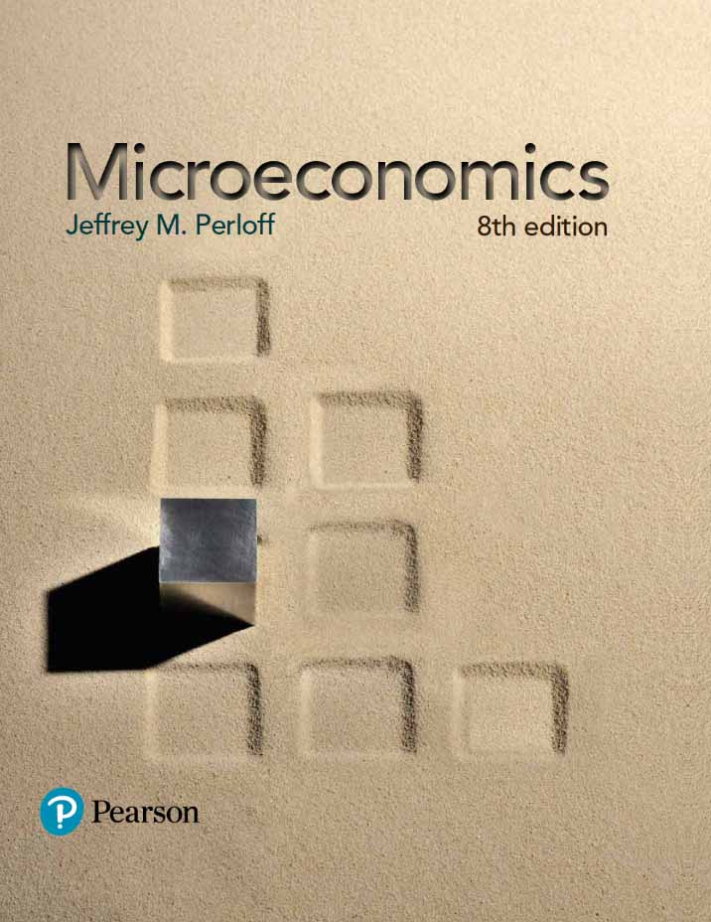
Microeconomics
Eighth Edition
Chapter 6:
Appendix B
The Yield Curve and the Law of One Price
Copyright © 2015, 2012, 2009 Pearson Education, Inc. All Rights Reserved
Notes:
If this PowerPoint presentation contains mathematical equations, you may need to check that your computer has the following installed:
1) MathType Plugin
2) Math Player (free versions available)
3) NVDA Reader (free versions available)

Slide 137
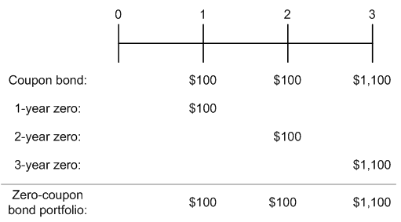
Valuing a Coupon Bond with Zero-Coupon Prices (1 of 4)
It is possible to replicate the cash flows of a coupon bond using zero-coupon bonds using the Law of One Price.
For example, a three-year, $1000 bond that pays 10% annual coupons:

Slide 138
Valuing a Coupon Bond with Zero-Coupon Prices (2 of 4)
We can calculate the cost of the zero-coupon bond portfolio that replicates the three-year coupon bond as follows:
Zero-Coupon Bond | Face Value Required | Cost
1 Year | 100 | 96.62
2 Years | 100 | 92.45
3 Years | 1100 | 11 × 87.63=963.93
blank | blank | Total Cost: $1153.00
By the Law of One Price, the three-year coupon bond must trade for a price of $1153.00

Slide 139
Table 6.7 Yields and Prices (per $100 Face Value) for Zero-Coupon Bonds
Maturity | 1 Year | 2 Years | 3 Years | 4 Years
YTM | 3.50% | 4.00% | 4.50% | 4.75%
Price | $96.62 | $92.45 | $87.63 | $83.06

Slide 140
Valuing a Coupon Bond Using Zero-Coupon Yields (3 of 4)
We can also use the zero-coupon yields to value a coupon bond.

Slide 141
Valuing a Coupon Bond Using Zero-Coupon Yields (4 of 4)
For the three-year, $1000 bond with 10% annual coupons considered earlier, we can use Eq. 6.4 to calculate its price using the zero-coupon yields in Table 6.7:
The price is identical to the price computed earlier by replicating the bond.

Slide 142
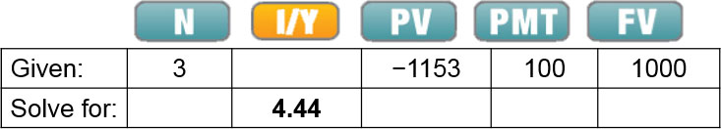
Coupon Bond Yields (1 of 3)
From Eq. 6.3, the yield to maturity of the three-year, $1000 bond with 10% annual coupons satisfies:
Excel Formula: =RATE(NPER,PMT,PV,FV) = RATE(3,100,1153,1000)

Slide 143
Coupon Bond Yields (2 of 3)
Therefore, the yield to maturity of the bond is 4.44%.
We can check this directly:
The yield to maturity is the weighted average of the yields of the zero-coupon bonds of equal and shorter maturities.

Slide 144
Example 6.11 Yields on Bonds with the Same Maturity (1 of 5)
Problem
Given the following zero-coupon yields, compare the yield to maturity for a three-year zero-coupon bond, a three-year coupon bond with 4% annual coupons, and a three-year coupon bond with 10% annual coupons. All of these bonds are default free.
Maturity | 1 Year | 2 Years | 3 Years | 4 Years
Zero-Coupon YTM | 3.50% | 4.00% | 4.50% | 4.75%

Slide 145
Example 6.11 Yields on Bonds with the Same Maturity (2 of 5)
Solution
Plan
From the information provided, the yield to maturity of the three-year zero-coupon bond is 4.50%. Also, because the yields match those in Table 6.7, we already calculated the yield to maturity for the 10% coupon bond as 4.44%. To compute the yield for the 4% coupon bond, we first need to calculate its price, which we can do using Eq. 6.4. Since the coupons are 4%, paid annually, they are $40 per year for three years. The $1000 face value will be repaid at that time. Once we have the price, we can use Eq. 6.3 to compute the yield to maturity.

Slide 146
Example 6.11 Yields on Bonds with the Same Maturity (3 of 5)
Execute
Using Eq. 6.4, we have:
The price of the bond with a 4% coupon is $986.98. From Eq. 6.4:

Slide 147
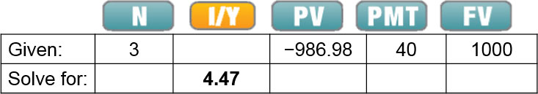
Example 6.11 Yields on Bonds with the Same Maturity (4 of 5)
We can calculate the yield to maturity using a financial calculator or spreadsheet:
Excel Formula = RATE(NPER,PMT,PV,FV) = RATE(3,40,−986.98,1000)
To summarize, for the three-year bonds considered:
Coupon Rate | 0% | 4% | 10%
YTM | 4.50% | 4.47% | 4.44%

Slide 148
Example 6.11 Yields on Bonds with the Same Maturity (5 of 5)
Evaluate
Note that even though the bonds all have the same maturity, they have different yields. In fact, holding constant the maturity, the yield decreases as the coupon rate increases. We discuss why below.

Slide 149
Coupon Bond Yields (3 of 3)
As example 6.11 shows, as the coupon increases, earlier cash flows become more important in the PV calculation.
The shape of the yield curve keys us in on trends with the yield to maturity:
  If the yield curve is upward sloping, the yield to maturity decreases with the coupon rate of the bond.
  If the yield curve is downward sloping, the yield to maturity increases with the coupon rate of the bond.
  If the yield curve is flat, all zero-coupon and coupon-paying bonds will have the same yield, independent of maturities and coupon rates.

Slide 150
Treasury Yield Curves
The plot of the yields of coupon bonds of different maturities is called the coupon-paying yield curve.
When bond traders refer to “the yield curve” they are often referring to the coupon-paying Treasury yield curve.
We can apply the Law of One Price to determine the zero-coupon bond yields using the coupon-paying yield curve.
Thus, either type of yield curve provides enough information to value all other risk-free bonds.

Slide 151
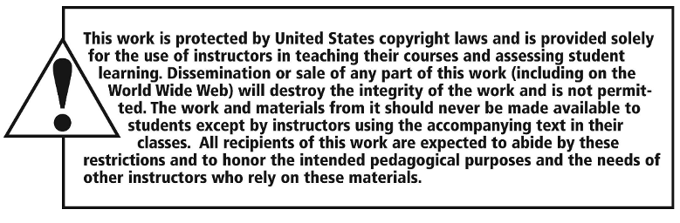
Copyright

