Slide 1
Lecture 6 Schedule
Power Points
Professor V. A. Greiman
Copyright © 2020

Slide 2
Questions or Concerns???
Ask your Facilitator for Guidance
Email or schedule a call with your Professor one on one
Reach out to your Classmates
Post your Questions on the Discussion Board
Raise questions during the Live Class
Send an email to all concerned
Ironically, some of my most successful students professionally never received an A in the course. Instead, they took the concepts and ideas from the course and applied them to their future endeavors.
Never waste time worrying about something that can be resolved quickly!

Slide 3
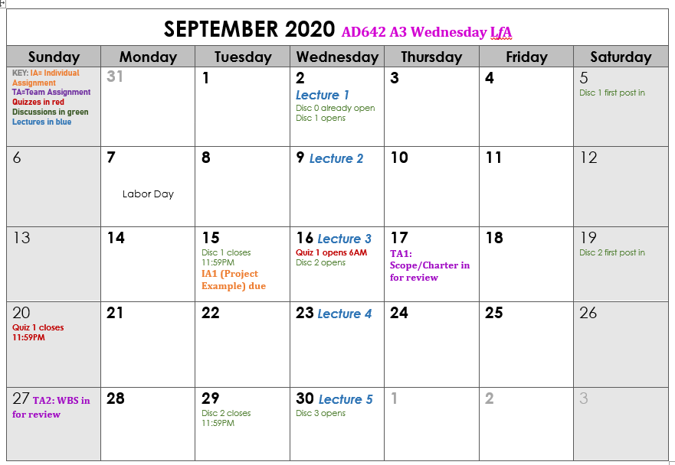
Upcoming Due Dates: Mark your Calendar

Slide 4
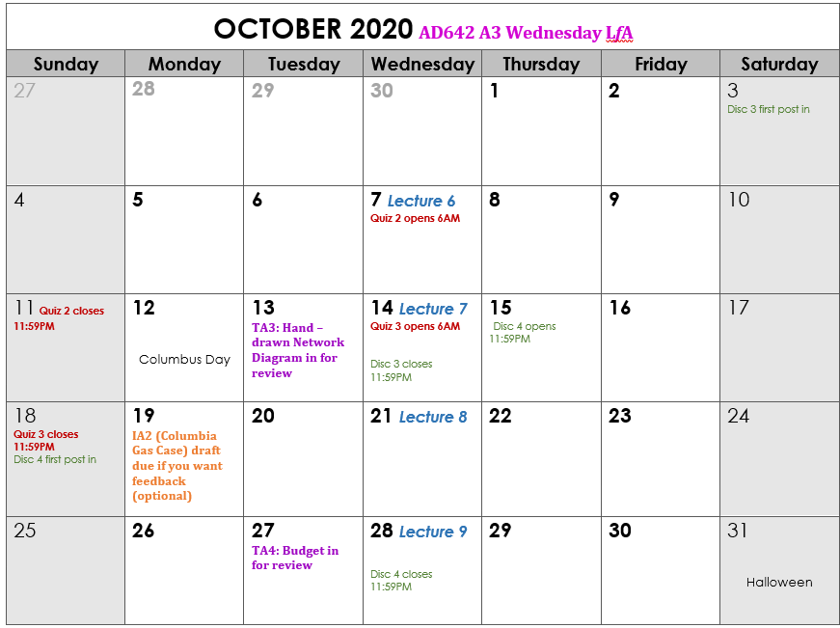
Looking Ahead: October Calendar

Slide 5
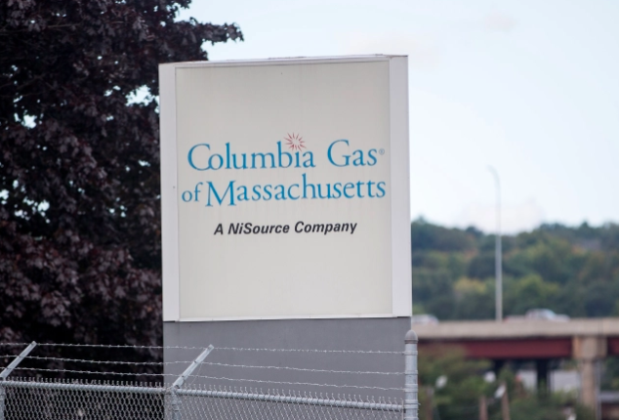
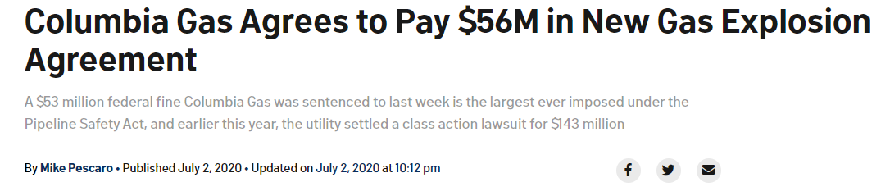
The Case Analysis
Individual Assignment 2
The idea is simple: Read the case material, analyze, create Solution Ideas, pick the best solution

Slide 6

Logic for the Case Study Analysis – Individual Assignment 2
Step 3
Solution1
Step 0: Read the Case!
Minimum 2
Maximum 4
Step 2
Solution 2
Step 1
Identify solutions to the issues.
Some issues may have more than one solution, some solutions may solve more than one issue.
Find three key issues
Solution 3
Solution 4
For each solution, use a table to show the pros and cons
(difficulty in doing it… chance of effectiveness…secondary positive and negative effects)

Slide 7
Team Leaders in this Class - A3
Team 1 - Anna Gabriela Garcia Esquivel
Team 2 – Xiumen Zhang
Team 3 – Xueyang Long
Team 4 – Danlin Wang
Team 5 – Jiaxin Zhao
Team 6 – Amish Shah Nishil
Team 7 – Chih Chun Chen
Team 8 – Jiaming Li

Slide 8
Preparation for Quiz 2
Purpose and Components of Project Scope – milestones, description, constraints, assumptions, risks, deliverables, exclusions, stakeholders, project team, statement of work…..
Purpose and Characteristics of the WBS – levels, activities, hierarchy, process v. product breakdown
Scope Creep – Causes and Prevention

Slide 9
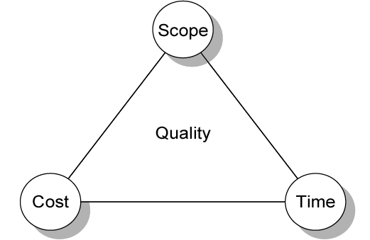
TRADITIONAL: IRON TRIANGLE
Spec
Design, Risk, Safety and Quality Decisions!! Virginia A. Greiman © Copyright 2013

Slide 10
The hierarchy of the constraints
Schedule
Cost
Right up front you should be aware of – and share – the relative importance of the constraints!
Scope
Example: Panama Canal
Identify: The “Fixed”: Met at all costs.
The “Flexible Constraint”: More flexibility than “Driver”,
but less than Weak Constraint
The “Accept Constraint”: Here you have the most flexibility

Slide 11
The Work Breakdown Structure
  An hierarchical outline (map) that identifies the products and work elements involved in a project.
  Defines the relationship of the final deliverable (the project) to its sub-deliverables, and in turn, their relationships to work packages.
  Best suited for design and build projects that have tangible outcomes rather than process-oriented projects.
Remember: the WBS will include the scope related to the project’s product (outcome) but it will also contain work packages that will not be visible in the outcome.
Example from telecom: workers on a fiber optic installation route alongside train tracks must take railway safety training by law. That’s work required of the project that you won’t notice when you binge-watch A Handmaid’s Tale on Hulu.

Slide 12
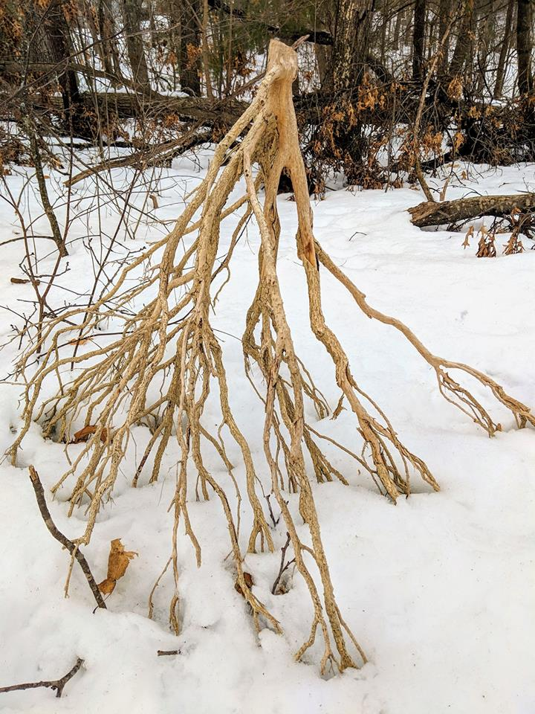
Work Packages
  Discrete tasks with definable end results
  Typically the “leaves” on the tree
  Basis for monitoring and reporting progress
  Can be tied to budget items (charge numbers)
  Resources (personnel) assigned
  Ideally shorter rather than longer
  Longer makes in-progress estimates needed
  These are more subjective than “done”
  2-3 weeks maximum for software projects
  1 day minimum (occasionally a half day)
  Not so small as to micro-manage

Slide 13
Key Points to remember
The WBS is a deliverable-oriented decomposition of the scope.
The WBS should be clear and easy to understand.
WBS Activities require verbs to clarify them
All activities listed in the WBS should produce a deliverable.

Slide 14
Key Points to remember
Deliverables listed in the WBS should be tangible, making it easy to recognize when thy are complete.
The lowest levels of the WBS tree are the work packages, whose size is 1-2 people for 1-2 weeks.
Work Packages should be assignable to responsible individuals.
Each work package should be a direct subset of a summary deliverable, and each summary deliverable should be a direct subset of a high-level deliverable.

Slide 15
The Work Breakdown Structure
  An hierarchical outline (map) that identifies the products and work elements involved in a project.
  Defines the relationship of the final deliverable (the project) to its sub-deliverables, and in turn, their relationships to work packages.
  Best suited for design and build projects that have tangible outcomes rather than process-oriented projects.
Remember: the WBS will include the scope related to the project’s product (outcome) but it will also contain work packages that will not be visible in the outcome.
Example from telecom: workers on a fiber optic installation route alongside train tracks must take railway safety training by law. That’s work required of the project that you won’t notice when you binge-watch A Handmaid’s Tale on Hulu.

Slide 16
Network Diagram Sequencing
Determine the order of activities
The network diagram flows from left to right
Remember Parallel Activities take Different Paths
The Critical Path is the longest path without free float time
All noncritical paths have float time
Every network diagram should have a start and an end node
All paths begin at the start node and come together at the end node.

Slide 17
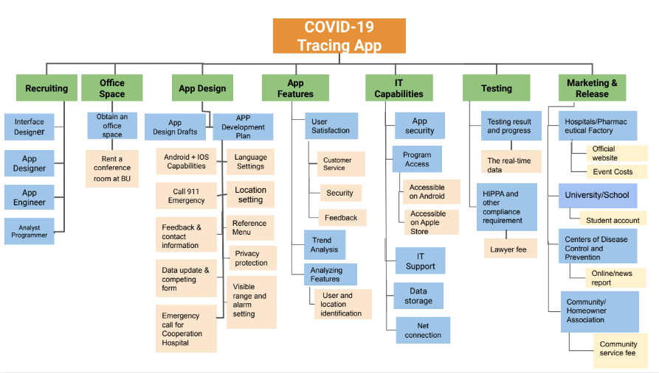
Team 6 – Tracing App
Product Focused

Slide 18
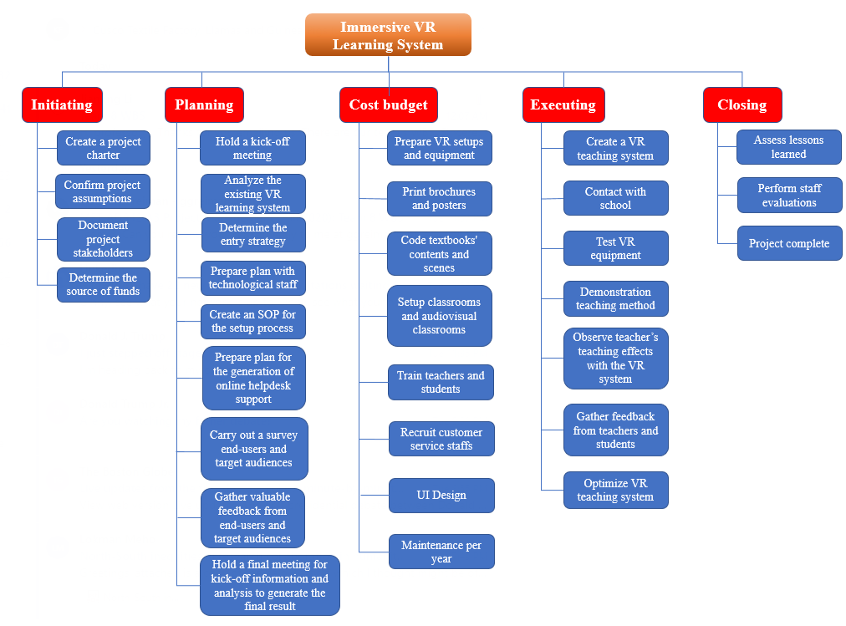
Team 8 – Immersive VR Learning System
Process Focused

Slide 19
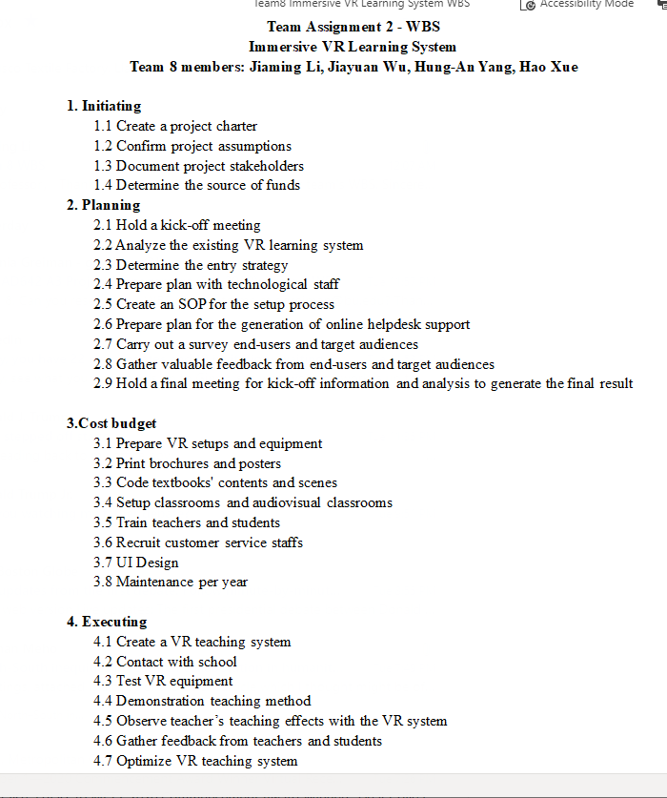
Team 8: Outline

Slide 20
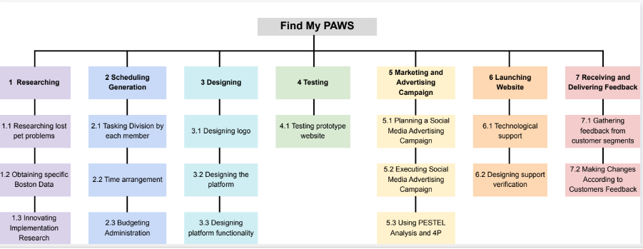
Team 1 – Find My Paws: Product Focused

Slide 21
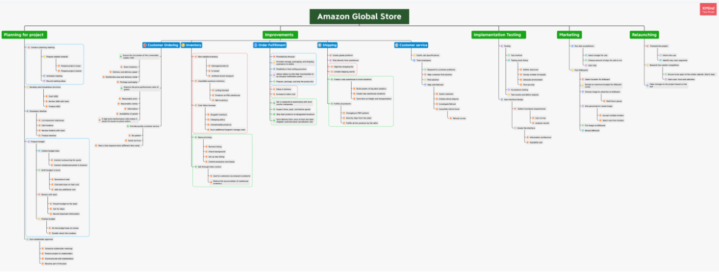
Team 2: Amazon Global Store: Product and Process Focused

Slide 22
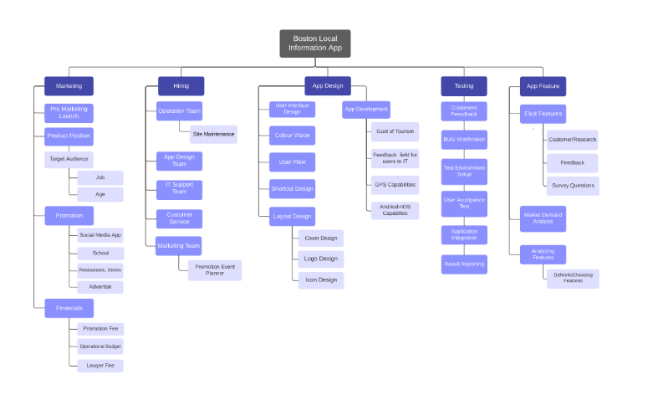
Team 4 – Boston Local Information App: Product Focused

Slide 23
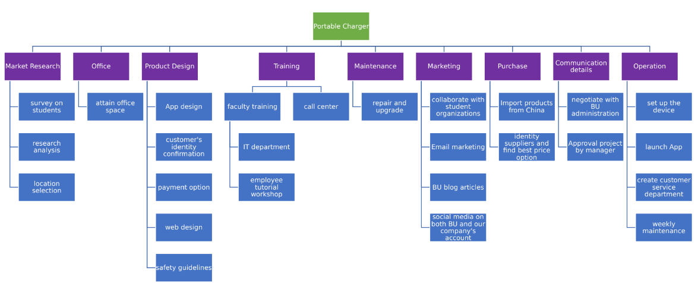
Team 5 – Portable Charger: Product Focused

Slide 24
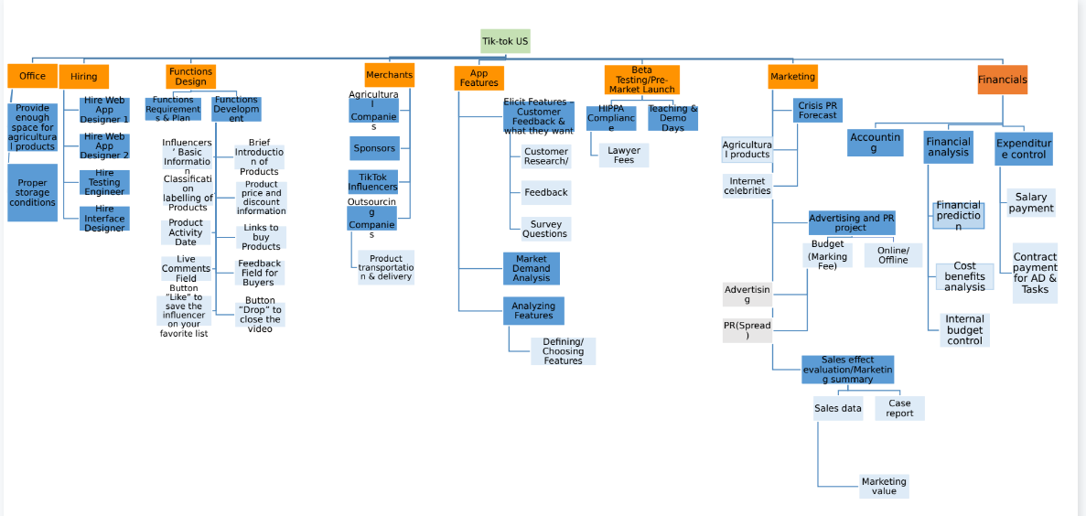
Team 7 – Tik Tok: Product Focused

Slide 25
Network Computation Process
Forward Pass Yields the Earliest Times
  How soon can the activity start?
    Earliest start — ES
  How soon can the activity finish?
    Earliest finish — EF

Slide 26
Network Computation Process
Backward Pass — yields the Latest Times
  How late can the activity start?
    Latest start — LS
  How late can the activity finish?
    Latest finish — LF
  Which activities represent the critical path?
  How long can the task be delayed?
    Slack or float — F

Slide 27
A common notation for labeling tasks with detail
Early Start
Duration
Early Finish
ES
DUR
EF
Task Name
LS
F
LF
Late Start
Float/Slack
Late Finish

Slide 28
Forward Pass Computation*
Add activity times along each path in the network (ES + Duration = EF).
Carry the early finish (EF) to the next activity where it becomes its early start (ES) unless…
The next succeeding activity is a merge activity, in which case the largest EF of all preceding activities is selected.
*In the “1” method I will show you , instead of starting at “Day 0” or “Week 0” we start with Day 1 or week 1, so we’ll subtract 1 from this total in the forward pass. This will become clearer in the upcoming animation.

Slide 29
Backward Pass Computation
Subtract activity times along each path in the network (LF - Duration = LS).
Carry the late start (LS) to the next activity where it becomes its late finish (LF) unless
The next succeeding activity is a burst activity, in which case the smallest LF of all preceding activities is selected.
*In the “1” method I will show you , instead of starting at “Day 0” or “Week 0” we start with Day 1 or week 1, so we’ll add 1 from this total in the backward pass. This will become clearer in the upcoming animation.

Slide 30
Determining Slack (or Float)
Slack (or Float)
  The amount of time an activity can be delayed after the start of a longer parallel activity or activities.
Total slack
  The amount of time an activity can be delayed without delaying the entire project.

Slide 31
Dependencies
Usually are “finish to start”
Show how the tasks relate
i.e. First coat must be dry before second coat is applied
(finish)
(start)

Slide 32


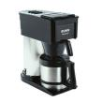





Precedence Relationships
(Dependencies)
FS: You finish opening the milk carton before you start pouring it.
FF: Your main course must finish cooking at the same time as the side dish finishes.
SS: You start your coffee at the same time you start your toast.
SF: (very rare): I won’t finish eating the donut until you start pouring the coffee.

Slide 33
List of Tasks – creating the network diagram
Task Name | Duration | Predecessors
Start | 0 | None
A | 6 | Start
B | 4 | Start
C | 7 | A and B
D | 8 | B
E | 5 | C and D
End | 0 | E

Slide 34
Leads in project networks
Define Requirements
Code Module 1A
Timescale
Halfway through “Define Requirements” we have enough information to begin coding module 1A, so there is a Lead of the Code task on the Define task.

Slide 35
Leads in project networks
Take Yearbook Photos
Begin Editing Yearbook Photo Section
Timescale
Maybe we have 200 students: Aaronson through Zussman. We only got through McIntyre, but we have enough photos to start the layout of the photo section.

Slide 36
Checking in with the PMBOK® Guide, 6th Edition
We covered the following key Schedule Management processes in this chapter
Knowledge Area: Project Schedule Management
Define Activities
Sequence Activities
Estimate Activity Durations
Estimate Activity Resources
Develop Schedule
These are all in the Planning process group

Slide 37

Schedule Compression

Slide 38
What causes schedule compression?
Newly-imposed earlier finish date
  Customer or senior manager demands early completion
Critical path task extends past its deadline and finish date is not negotiable (due to contract or Mother Nature)
Notes:
Instructor Note:
Each schedule compression area will be explored in following slides.

Slide 39
Duration Compression Techniques
Add Resources (Crashing, which adds cost and threat)
Do things all at once (Fast Tracking, which introduces threat)
Reduce Scope (take out features and functionality of end product or of project scope, any of which reduce quality)
Notes:
Instructor Note:
Each schedule compression area will be explored in following slides.

Slide 40
Schedule Compression by Managing the Critical Path
Move resources from non-critical path tasks to critical path tasks
Assign experts to the difficult critical tasks.
Add additional resources to the critical path tasks (not previously assigned ton the project)
Use overtime on the most critical tasks or procure hire/lease experts from outside the company
This might involve further decomposition of activities on the critical path.
Notes:
Instructor Note:
Discuss what the effects may be when resources of a different skill mix than originally planned are added for the tasks.
Discuss the effects of extensive overtime on the workforce.
Ask the students if they have used outside help and what the results were.

Slide 41
Schedule Compression Techniques for Duration
Important Topic!
Fast tracking (doing things in parallel)
  Overlapping tasks that are now sequential
  Change FS to SS or FF; or use lag and lead
Crashing the network (throwing resources at critical path tasks)
  Develop a cost/schedule trade-off table
  Apply resources to least costly compression task
Notes:
Instructor Note:
Ask the students for examples of decomposing tasks into smaller tasks and what could be accomplished.
Ask the students if decomposition could be used in conjunction with fast tracking or crashing the schedule.

Slide 42

Fast-Tracking
Take tasks that are traditionally (and sometimes for good reason) done in sequence and do them in parallel.
Example: Begin construction of a building before the design is complete
Advantage: can decrease schedule by as much as 40%
Disadvantage: GUESS (answer on next slide)

Slide 43
Terminology
Path:
A sequence of connected, dependent activities.
Parallel (Concurrent) Activities:
Activities that can occur at the same time. (If desired)
C
A
B
D

Slide 44
Event
A point in time when an activity is started or completed
It does not consume time
Milestones are events

Slide 45
Burst Activity
An activity that has more than one activity immediately following it (more than one dependency arrow flowing from it).
B
A
C
D

Slide 46
Merge Activity
An activity that has more than one activity immediately following it (more than one dependency arrow flowing from it).
B
C
A
D

Slide 47
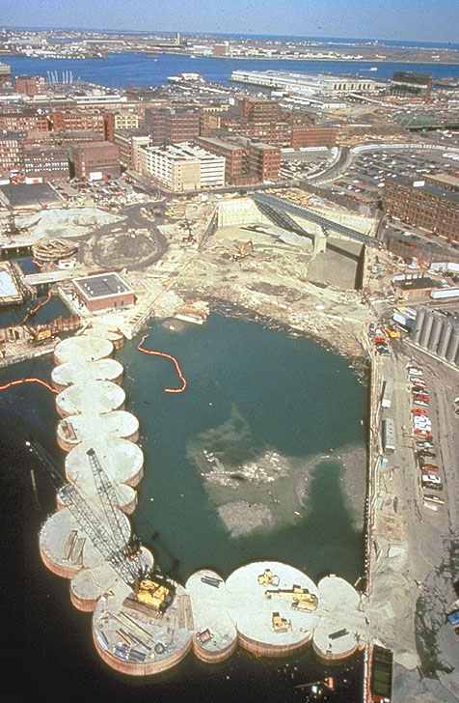
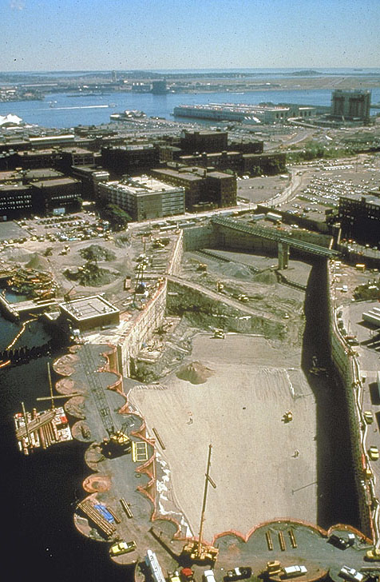

Slide 48
Critical Path
The critical path is the network path(s) that has (have) the least slack in common.

Slide 49
Critical Path
  the longest path through the network that allows for the completion of all activities
  the shortest expected time in which the entire project can be completed. Delays on the critical path will delay completion of the entire project.
T=3
C
A
B
D
T=5

Slide 50
Critical Path ~ 10%
  Assign best people to critical activities
  Prioritize (and eliminate) critical activities
  Risk assessment on critical activities
  Visit people working on critical activities
  Can I borrow Joe?
  Overtime, technology
  Schedule changes ±
  Roll up non criticals
T=3
C
A
B
D
T=5

Slide 51
Simple Example:
6) Free Slack
Difference between EF and ES that follows it
5 | B | 20
0 |  | 0
5 | 15 | 20
EF – ES
0 | A | 5
0 |  | 0
0 | 5 | 5
20 | D | 50
0 |  | 0
20 | 30 | 50
5
0
5 | C1 | 10
5 |  | 5
10 | 5 | 15
10 | C2 | 15
5 |  | 5
15 | 5 | 20
Useful!

Slide 52
Basic Network Rules
Networks typically flow from left to right.
An activity cannot begin until all of its predecessor activities are complete.
Arrows indicate precedence and flow and can cross over each other.
Identify each activity with a unique number; this number must be greater than its predecessors.
Looping is not allowed.
Conditional statements are not allowed.
Use common start and stop nodes.

Slide 53
Lags
The minimum amount of time a dependent activity must be delayed to begin or end.
  Lengthy activities are broken down to reduce the delay in the start of successor activities.

Slide 54
What’s the disadvantage of Fast-Tracking?
Increased Risk

Slide 55
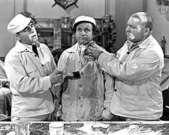
Crashing
Compress the tasks on the critical path –typically by adding more resources
Example: put 2 more developers on the project to get the time down from 3 months to 2 months
Advantage: can decrease schedule
Disadvantage: Guess (answer on next slide)

Slide 56

Disadvantages of Crashing
Increased cost
  Overtime, premium vendors, sheer volume
May not provide the benefit expected – could even cause the opposite!
  ‘the Mythical Man Month” – adding staff to a late software project makes it later

Slide 57
Crashing the Network
- Often results in greater project costs
- Look for least expensive reduction in time
Please read:
http://www.pmi.org/learning/PM-Network/2014/when-and-how-crash-schedule.aspx
Notes:
Instructor Note:
Describe how crashing is basically the project manager’s way of “buying time.”

Slide 58
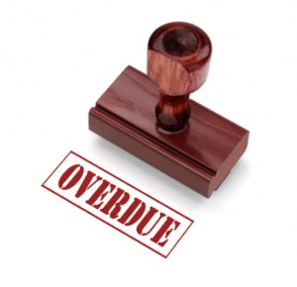
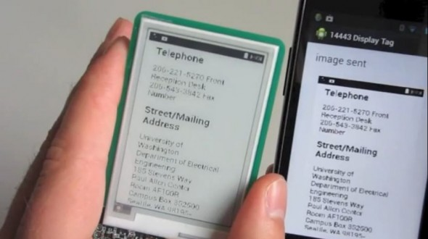
Exercise: Fast Track or Crash, and Why? Scenario 1
Scenario 1: A display prototype is due for delivery to a key customer per your contract - next Wednesday. That’s 8 days. Usually you have at least 15 days for Tim, your quality control expert, to inspect and certify the prototype samples.
For this scenario, pick A or B, justify your logic for the choice, state whether it is fast-tracking or crashing, and identify any threats you’ve introduced with the choice.
A. Tim usually inspects by system, sequentially checking the mechanical, then basic electrical and electronic, and then usability functions. To speed things up, have him do at least some of the tests together.
B. Add Karen and Todd, two other inspectors, to work with Tim to get this done faster.

Slide 59

Exercise: Fast Track or Crash, and Why? Scenario 2
Scenario 2: Your home improvement project includes refinishing a small ¾ bathroom. Special plumbing fixtures you selected have come in late, leaving Trish, your plumber, only one day to do what she knows needs two or three days to do properly.
For this scenario, pick A or B, justify your logic for the choice, state whether it is fast-tracking or crashing, and identify any threats you’ve introduced.
She brings in her cousin Shawn, newly-trained and who has passed his plumbing exam but hasn’t received his license, and they would work together.
She expedites the work by multi-tasking between sink, toilet, and shower installation.

Slide 60
Don’t Forget The Reserves
Schedule Reserve: Amount of time between the scheduled end of the project and the needed completion date
  Can be used to buffer or absorb unplanned slips in the schedule before the project is considered late
Management Reserve: Extra funds (or time) that can be used to pay for additional resources
  Funds/time are applied to trouble areas in an attempt to maintain schedule
Notes:
Instructor Note:
Ask if any of them have used either schedule or management reserve and how it is done at their company.

Slide 61

Something to think about for next class
When you see a square on a Network Diagram, like this:
…and it says “5 days”….
Is it really representing 5.00000000000 days?
5 days

Slide 62
Simple Example:
6) Free Slack
Difference between EF and ES that follows it
Forward Pass – Use the Higher
Number at the Merge
Backward Pass – Use the Lower Number
5 | B | 20
0 |  | 0
5 | 15 | 20
EF – ES
0 | A | 5
0 |  | 0
0 | 5 | 5
20 | D | 50
0 |  | 0
20 | 30 | 50
5
0
5 | C1 | 10
5 |  | 5
10 | 5 | 15
10 | C2 | 15
5 |  | 5
15 | 5 | 20
Useful!

Slide 63
Basic Network Rules
Networks typically flow from left to right.
An activity cannot begin until all of its predecessor activities are complete.
Arrows indicate precedence and flow and can cross over each other.
Identify each activity with a unique number; this number must be greater than its predecessors.
Looping is not allowed.
Conditional statements are not allowed.
Use common start and stop nodes.

Slide 64
Lags
The minimum amount of time a dependent activity must be delayed to begin or end.
  Lengthy activities are broken down to reduce the delay in the start of successor activities.

Slide 65
Simple Example:
6) Free Slack
Difference between EF and ES that follows it
5 | B | 20
0 |  | 0
5 | 15 | 20
EF – ES
0 | A | 5
0 |  | 0
0 | 5 | 5
20 | D | 50
0 |  | 0
20 | 30 | 50
5
0
5 | C1 | 10
5 |  | 5
10 | 5 | 15
10 | C2 | 15
5 |  | 5
15 | 5 | 20
Useful!

Slide 66
Simple Example:
1) Forward Pass (Earliest)
 | B
 | 15
 | A
 | 5
 | D
 | 30
 | C
 | 10
ES | ID | EF
SL | Des | SL
LS | Dur | LF

Slide 67
Simple Example:
1) Forward Pass (Earliest)
5 | B | 20
 | 15
0 | A | 5
 | 5
20 | D | 50
 | 30
5 | C | 15
 | 10
ES | ID | EF
SL | Des | Cr
LS | Dur | LF

Slide 68
Simple Example:
2) Backward Pass (Latest)
 | B
5 | 15 | 20
0 | A | 5
0 | 5 | 5
 | D
20 | 30 | 50
 | C
5 | 10 | 15
ES | ID | EF
SL | Des | SL
LS | Dur | LF
Delivery Date
= 50

Slide 69
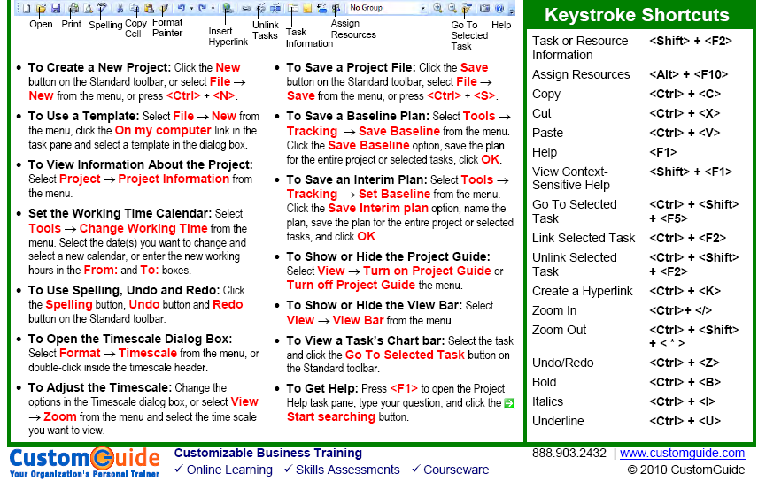
MS Project
http://www.customguide.com/pdf/project-quick-reference-2007.pdf

Slide 70
Questions and Team Zoom Meetings
In your Team meetings tonight you should finish your Network Diagram.
Please meet in your Zoom rooms and record the meeting
The Zoom recording will be posted automatically after your class
Your facilitators, Mira and Merigual and I will be dropping into your meetings to see if you have any questions.
Most important – Speak English!
Your Hand Drawn Diagram is due by October 13 at 11:59 ET!

