Slide 1
ADVERTISING.
RADIO ADVERTISING.

Slide 2
Introduction.
Advertising is producing adverts to promote commercial products or services.
Advertising is market targeted and is designed to influence a specific market segment.
Gender stereotypes have taken root in advertising.
Some adverts promote gender bias unintentionally.
Radio advertising involves audio adverts only.
Notes:
Advertising is the activity of producing adverts to promote a certain product or service in the market. It is a form of product promotion that uses audio or visual content geared towards influencing the market to purchase a product. Some adverts promote gender stereotypes that advance biasness against women and sometimes even violence. Radio advertising is adverts that are only recorded as audio and may promote gender bias through the language.

Slide 3
Gender stereotyping in radio advertising.
Terms used show that women's role is in the kitchen and not the professional world.
Women only do adverts for kitchen wares.
Gender displays in adverts are more explicit on women (Nixon, 2003).
Feminism has been promoted using advertising.
Notes:
The concern of how adverts are being produced has been raised due to its insensitivity towards women's issues. Adverts promote a culture of gender stereotyping through its display and language use. The language used towards women is to depict them as dependents or subjects of the male gender. Adverts will be designed to show that women's role is only in the kitchen when women do all adverts involving kitchenware while men do other professional commercials. There are explicit depicture of women on the billboards in various adverts, indicating the gender gap in advertising.

Slide 4

Gender issues in advertising.
Sexists advertisements for various products.
The portrayal of gender roles via various adverts.
Household hierarchy being featured in adverts.
The remuneration of advertisers is influenced by gender.
Notes:
Several gender issues have been raised in recent times. There is an increase in oversexualizing women to increase the sale of a product through advertising. Adverts involving are made explicit compared to those men. The gender roles have also been portrayed differently in adverts as most of the adverts use women playing characters of household chores while men appeared in the electronics or other technical adverts. The household hierarchy has been evident through the various adverts where the man is portrayed as the head of the family and the women or wife as the subject. The remuneration of advertisers depends on the gender of the individual, where men are highly renumerated compared to women.

Slide 5
Oppression and violence against women through adverts.
Adverts that portray women as subjects to men exposes to oppression.
Advertising based on gender roles is stereotyping (Zotos et al, 2018).
The appearance of women on household chores is discriminative.
Oppression is advanced through uneven opportunities in advertising.
Notes:
This vice against women or the female gender has been fought through various programs such as women empowerment, and strides have been made. However, it has been promoted through advertising in a way that stereotypes one gender against the other. Oppression on women is promoted only in household chores while others appear in more prestigious duties. This kind of advertising is discriminatory. There is uneven remuneration or compensation for women in advertising compared to their male counterparts.

Slide 6
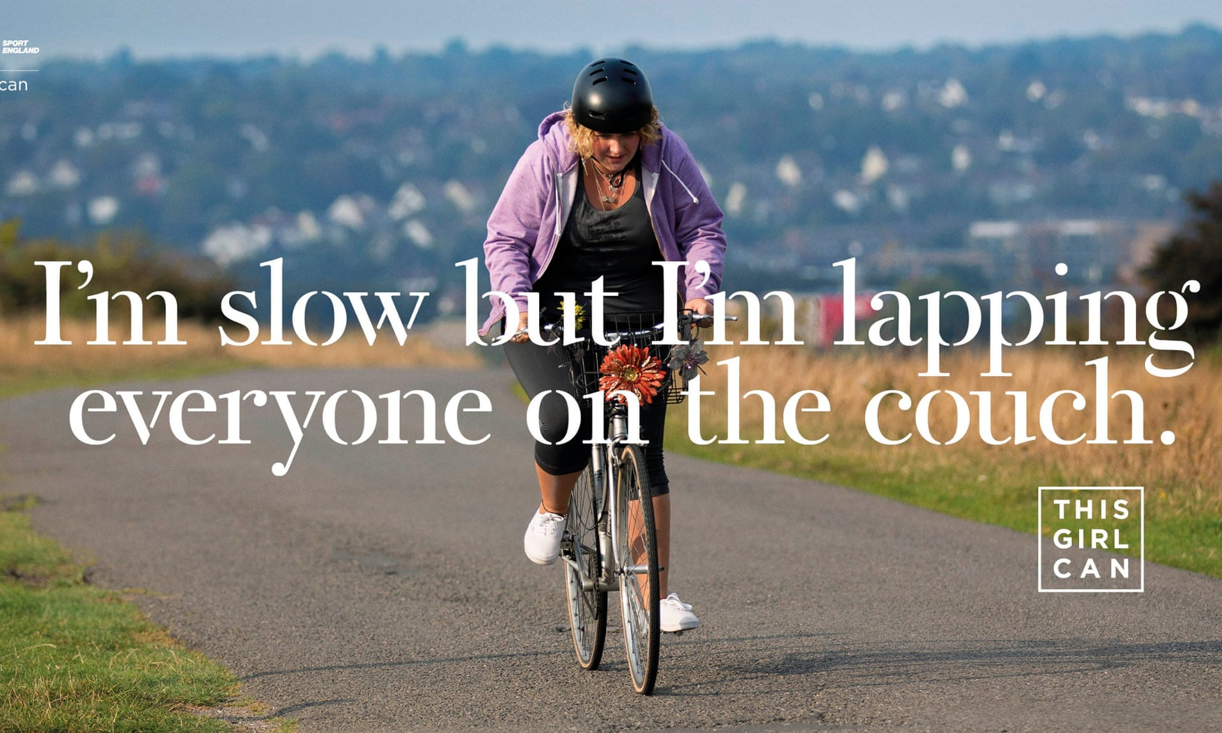
Promoting gender equity through advertising.
Alternate of roles based on merit and not gender.
Creation of content that is against gender inequality.
Ensure ethical consideration in advertising (Zotos et al, 2018).
Create an equal platform for the advertisement industry.
Notes:
There are various ways that the adverts can promote a safe environment or conditions for the women in the society. The adverts can be done to call out practices such as stereotyping against women or any other gender. There should be alternating roles or appearances based on merit and not the gender of the participants. There should be ethical considerations for the advertisements to ensure that adverts are sensitive to gender issues. The advertisement industry should be favorable for all genders to thrive in.

Slide 7
conclusion.
Adverts may promote violence against women.
Adverts can be used to promote gender equity.
Stereotyping in adverts is discriminatory.
Every gender is equal to the other.
Notes:
There are various in which adverts are abused and thereby promote animosity between women and men in society. The adverts should be sensitive not to be oppressive or promote gender inequality in its content or delivery. Stereotyping in advertising is discriminatory and should be called out by the stakeholders. Every gender should be treated equally in the industry.

Slide 8
references.
Zotos, Y., Grau, S., & Taylor, C. R. (Eds.). (2018). Current Research on Gender Issues in Advertising. Routledge.
Nixon, S. (2003). Advertising cultures: gender, commerce, creativity. Sage.

