Slide 1

AEC 258 Construction Planning and Scheduling
AEC 258 Construction Planning and Scheduling
Spring 2019
Review for Final Exam
4/30/2019

Slide 2
AEC 258 Construction Planning and Scheduling
Announcement
Your grade for this course will be determined by total points, not percentage. If you have more than 900 points, you will get an A; 800-899 is B; 700-799 is C, etc.
10 points are added to everyone for attendance, so that the total for attendance is 100.
No class this Thursday. Good luck on your final exams.

Slide 3
AEC 258 Construction Planning and Scheduling
Final Exam
30 questions, 200 points, 60 minutes, closed book closed notes, calculator and scratch paper allowed.
Scope: lecture 1 – lecture 13, assignment 1 – 4.
If you need special accommodation, email me in advance at fan.zhang@usm.edu
Final Exam: May 7, Tuesday, 12:30 pm, TEC 252. For online students, May 7 whole day.

Slide 4
AEC 258 Construction Planning and Scheduling
Topics
Lecture 1 Introduction
  Different types of schedules
Lecture 2 Network models
  Draw the network diagram
  Similar to Midterm exam questions

Slide 5
AEC 258 Construction Planning and Scheduling
Topics
Lecture 3 & 4 Precedence diagrams
  Network calculation
  Project duration
  Critical path
  Total float
  Lecture 3 & 4 in-class exercises

Slide 6
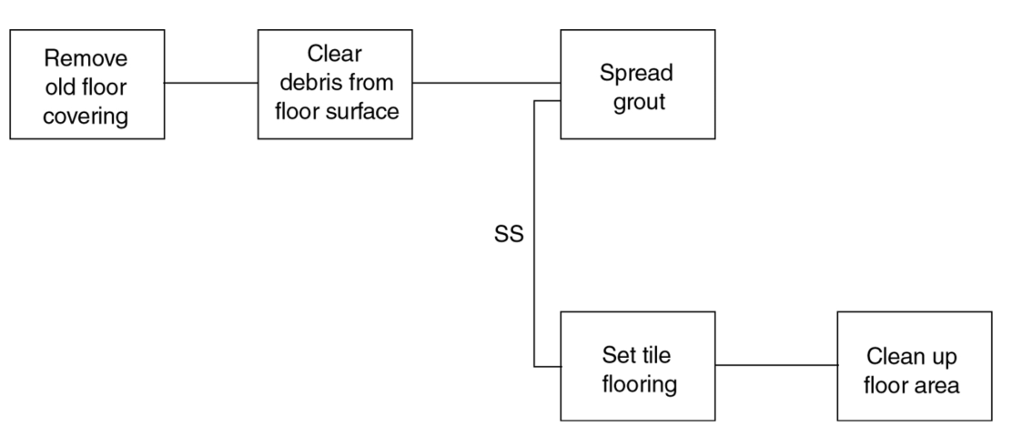
AEC 258 Construction Planning and Scheduling
Topics
Lecture 5 Activity relationships
  SS, FF, SF, FS with delay

Slide 7
AEC 258 Construction Planning and Scheduling
Topics
Lecture 6 activity durations and time in contract
  Activity duration calculation; in-class exercise 6
  Notice to proceed; substantial completion
  Working days vs calendar days

Slide 8
AEC 258 Construction Planning and Scheduling
Topics
Lecture 7 & 8 resource allocation and resource leveling
  In-class exercise 7 & 8; assignment 2
  Series method – order of priorities
  Less complicated network than examples and exercises
  Similar to Midterm exam questions

Slide 9
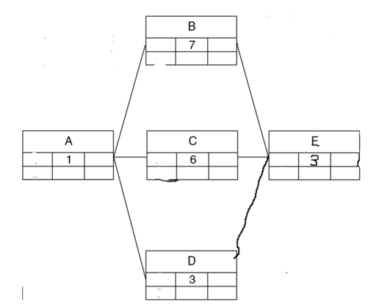
AEC 258 Construction Planning and Scheduling
Topics
Lecture 9, 10, 11 time cost trade-off
  Lecture 9 example;
  assignment 3 question 1 & 2

Slide 10
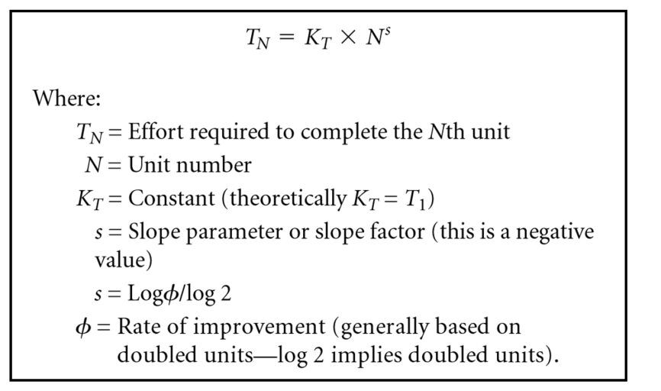
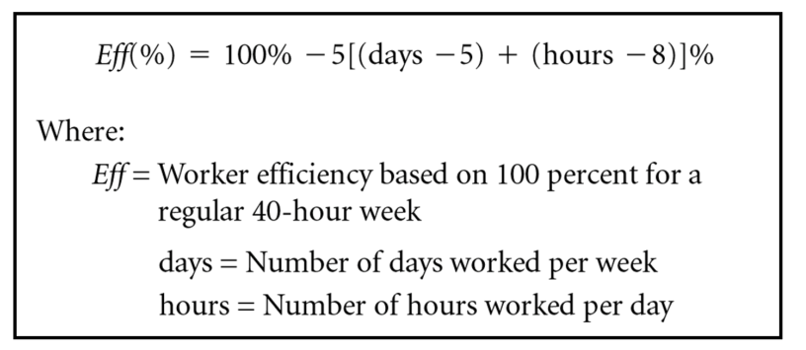
AEC 258 Construction Planning and Scheduling
Topics
Lecture 12 productivity and short interval scheduling
  Given the formula, calculate effective hours for working overtime (assignment 4 question 2, without the table)
  Learning curve (lecture 12 example and assignment 4 question 5)
  Short-interval (assignment 4 question 3)

Slide 11
AEC 258 Construction Planning and Scheduling
Topics
Lecture 13 linear scheduling and PERT
  What type of projects can use linear scheduling.
  Develop a linear schedule for a project with 3 activities
  What is PERT
  Given the equations, calculate mean, standard deviation for activities and project duration
  Given the standard normal curve, find the probability
  In-class exercise 13; assignment 4

