Slide 1
AGILE ORGANIZATIONS
BUSINESS MANAGEMENT

Slide 2
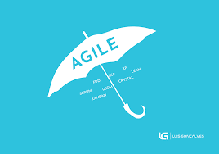
DEFINITION
AN AGILE ORGANIZATION QUICKLY ADAPTS TO MARKETS CHANGES TO ENSURE IT MAINTAINS OPTIMAL OPERATION
AN ORGANIZATION HAS THE ABILITY TO NOTICE NEW COMPETITORS AND STRATEGIZE ON NEW BUSINESS TACTICS

Slide 3

AGILITY GOALS
LEADERSHIP EFFECTIVENESS
PRODUCT INNOVATION
QUALITY AND TIMELY DELIVERY
ORGANIZATIONAL ADAPTABILITY
Notes:
There are numerous challenges that businesses face before they change their operation processes or improve the way they develop their products to reach new markets or retain their market share. This activity is influenced by time in the sense that customer preference evolve and hence businesses have to adjust there systems lest they succumb to competition that lead to reduction of market shares and revenues, some of the immediate goals include enhancing leadership effectiveness, spurring product or service innovation to suit the tastes and preferences of customers, improving the delivery time of products and services to customers and adaptability to increase the survival rate of a company.

Slide 4

BENEFITS
ACHIEVE MARKET SUCCESS
INCREASE WORKER EFFICIENCY AND PRODUCTIVITY
ENHANCES COLLABORATION
INCREASES CUSTOMER SATISFACTION
REDUCES MARKET COMPETITION
MOTIVATES ADAPTIVE LEADERSHIP
Notes:
There are benefits of agility that each company wants and there are the same in all industries. The end goal of any business is getting profits, hence the role of the management or the stakeholders is to actualize the process towards this goal. Increasing the market share is the ultimate objective and a successful agility plan always leads here. Through formation of worker groups to foster teamwork, the benefit is increasing worker efficiency and productivity. When employees realize that the organization prioritizes their development they become loyal and this factor enhances collaboration. Its customers will get quality products and excellent services the company will reduce external competition.

Slide 5

AGILITY VALUES
ADAPTABILITY
TRANSPARENCY
SIMPLICITY
UNITY
COLLABORATION
Notes:
Agility is an intricate matter that requires proper planning lest the company suffers devastating consequences due to complications. Adaptability is the most important value and it ensure that the company can adjust its systems whenever there is a complication in the original plan. The company through it leadership must practice accountability by ensuring that the employees understand the essence of the whole process and the risk it poses to the company survival. The whole process must be simple for the whole team of employees to understand implement without supervision. Complicated systems take a lot of time to implement and they increases the likelihood of failure.

Slide 6

TRANSFORMATION STEPS
DEFINE AND PLAN
ANALYZE AND DESIGN
BUILD AND TEST
DEPLOY
ANALYZE
Notes:
There are specific steps that an agility plan should follow for it to become complete and increase the chances of success. The most important point is that the agility plan should conform to the mission, vision and values of the company. When this factor is not considered it brings confusion to the employees and the customers. Change can be implemented but in gradual way to give the stakeholders time to adjust to the new development. The plan should be defined and analyzed by a the management team in collaboration with the employees. The design should be drawn, built and tested to ensure that it withstands the test of the market. After affirmation, the plan can be deployed then the results tested over a timeframe.

Slide 7

IMPLEMENTATION STEPS
CONCEPT
INCEPTION
CONSTRUCTION ITERATION
TRANSITION
PRODUCTION
Notes:
For every plan to work in business there must be clear steps to be followed. Most of the time the steps can be adjusted but this factor may introduce unforeseen risks that may take significant time and financial resources to mitigate. In the agility plan, conception of the agility idea is the first step. The management and the workers are the team that conceptualizes the idea. Inception is the development of the agility prototype. At this stage the plan can be adjusted to fit new trends in the market. Construction iteration is the alteration of the original plan to allow it to conform to new dynamic in the market. After confirmation of the plan the company can move to the transition stage before the last step of production.

Slide 8
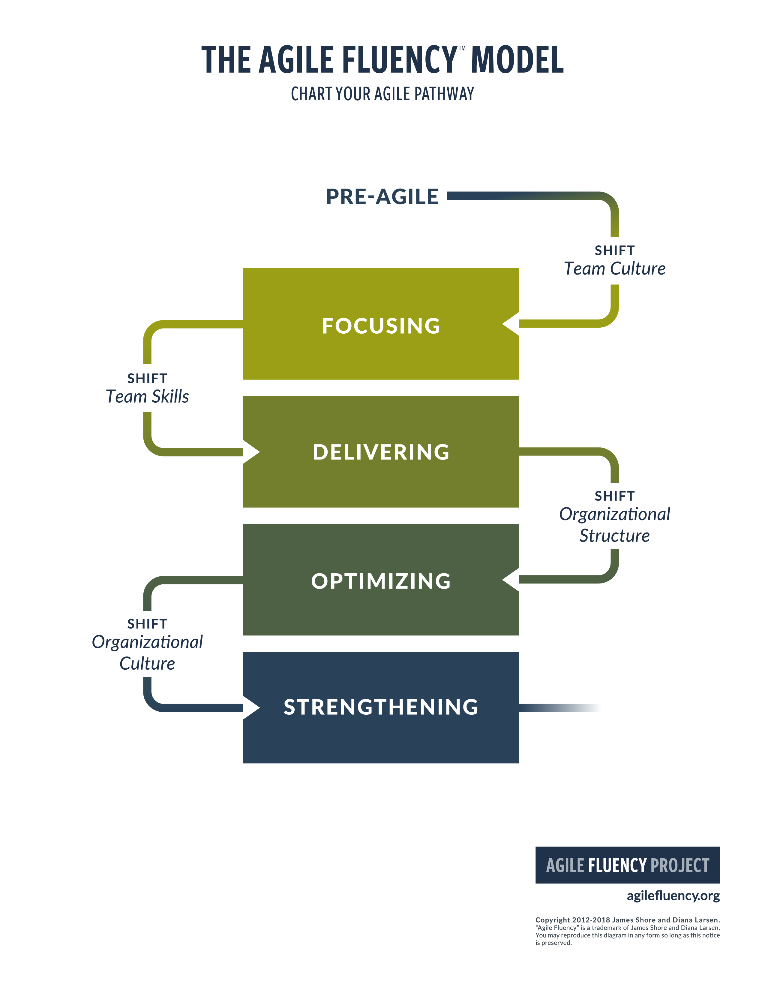
AGILE FLUENCY MODEL
Notes:
Apart from the identified steps of agility that can be customized to suit the processes and operations of any business, there is an agility fluency models that ensures the customized steps are implemented smoothly without disrupting daily operations. Pre-agile step refers to the communication step that the management involves all the employees. They must be aware that process will shift to a team culture and they will need to collaborate with each other. All employees have to focus towards this objective and this will enable them to change their delivery tactics and processes. Through this internal change the whole organization structure shifts to optimization. The last shift is directed towards the customers to enable them adjust and strengthen the company by increasing sales

Slide 9
CHALLENGES
COMPLEXITY OF SYSTEMS
POOR LEADERSHIP
UNCLEAR DEADLINES
LACK OF PERFORMANCE INDICATORS
IMPERFERCT INFORMATION
LACK OF THE NEEDED SKILLS
WORKER BURNOUT

Slide 10

SOLUTIONS
CLEAR COMMUNICATION
COMPREHENSIVE MARKET RESEARCH
FORMATION OF TEAMS
USING MOTIVATION SKILLS
OFFERING OF SUFFICIENT RESOURCES
STIPULATION OF DEADLINES
TEAM BUILDING EXCERCISES

Slide 11
AGILITY EXAMPLES
ALLOWING CUSTOMERS TO PICK THEIR MEALS THROUGH TABLE SCREENS IN A HOTEL
ACCEPT DIFFERENT FORMS OF PAYMENT e.g. CREDIT CARD, CASH OR DEBIT CARD
LETTING CUSTOMERS PICK THE DELIVERY TIME OF THEIR PACKAGES AND NOT CONFINE THEM TO COMPANY WORKING HOURS
CUSTOMIZATION PRODUCTS AND SERVICES DEPENDING ON SUGGESTIONS OF EXISTING CUSTOMERS.

Slide 12
REFERENCES
Lengnick-Hall, C. A., & Beck, T. E. (2016). Resilience capacity and strategic agility: Prerequisites for thriving in a dynamic environment. In Resilience Engineering Perspectives, Volume 2 (pp. 61-92). CRC Press.
Kim, G., Humble, J., Debois, P., & Willis, J. (2016). The DevOps Handbook:: How to Create World-Class Agility, Reliability, and Security in Technology Organizations. IT Revolution.
Prange, C., & Heracleous, L. (Eds.). (2018). Agility. X: How Organizations Thrive in Unpredictable Times. Cambridge University Press
Wlodarkiewicz-Klimek, H. (2017, July). Human capital in the development of mechanisms improving the agility of organizations. In International Conference on Applied Human Factors and Ergonomics (pp. 97-105). Springer, Cham.

