Slide 1
Formal Analysis Essay
Practice Session

Slide 2
Extremely important: follow all directions of the assignment (criterion “Fulfillment of Assignment” on the Grading Rubric)!
For the essay: Write a concise formal analysis of the work. In a first paragraph, introduce the painting’s subject and clearly state your thesis about how you think the artist characterizes the subject (what qualities of the subject the artist reveals).
In subsequent paragraphs, support your thesis with evidence of how the artist uses formal elements to that end.
This is not a research assignment. I deduct points for writing about irrelevant matters.

Slide 3
A major mistake to avoid (because it will ruin your entire essay, leading to a D or F) is organizing your paper around a thesis irrelevant to the assignment.
Examples of thesis types to avoid:
  How excellent the work is
  How abstract or naturalistic the work is
  How well the work represents a particular period style
  Assertions you can’t prove by formal analysis. Formal elements can only communicate about subjects represented in the artwork.
    Example of a thesis that formal analysis can’t prove: the artist’s primitivist outlook. (To establish that requires historical context.)
    Example of a thesis that formal analysis might prove instead: harmony between man and nature (as long as man and nature appear in the work)

Slide 4
In your analysis, focus just on those formal elements that have the most impact in your case. You should, however, address no fewer than three.
Organize your paper so that you discuss one formal element per paragraph after your initial, thesis, paragraph.
  If you discuss more than one aspect of a formal element (e.g., actual line + implied line), and each contributes something different to the total effect, discuss each element aspect in a separate paragraph. Each paragraph should make a single point.
Find more thorough instructions in the posted assignment. Read it thoroughly and carefully. (This PPT won’t substitute.)

Slide 5
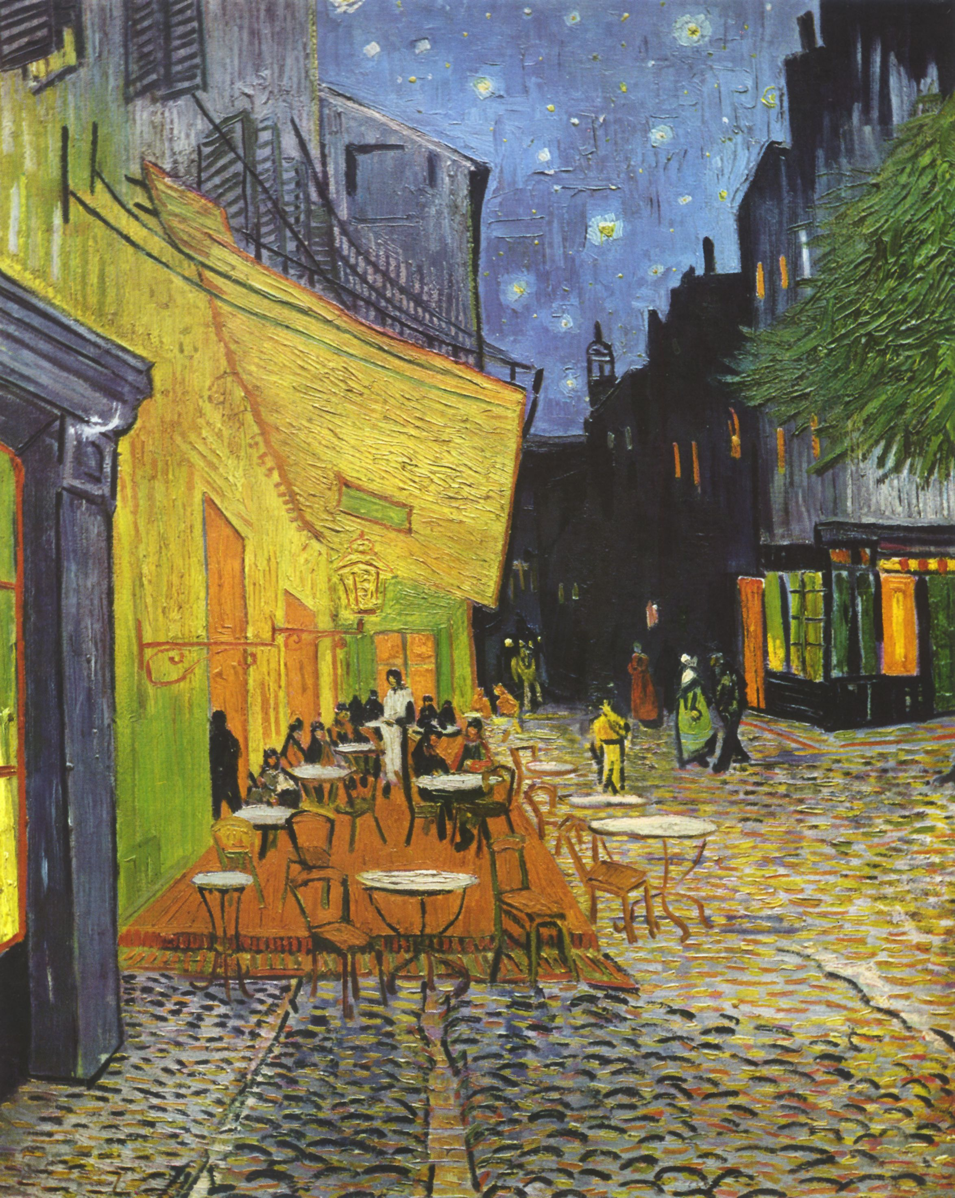
Vincent Van Gogh, Café Terrace at Night, 1888. Oil on canvas. 31.8 x 25.7 in. Kröller-Müller Museum, Ottterlo.

Slide 6
Vincent Van Gogh, Café Terrace at Night, 1888. Oil on canvas. 31.8 x 25.7 in. Kröller-Müller Museum, Ottterlo.
Notes:
-I advise taking notes first on value, especially on whether you find one or more areas where contrast of value is greatest. The presence or lack of emphasis lets you know whether or not the artist wants you to pay special attention to particular subject matter.

Slide 7
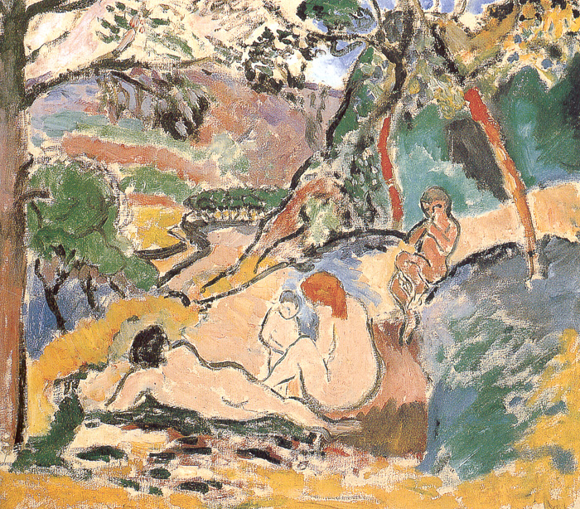
Henri Matisse, Pastoral, 1905. Oil on canvas. 46 x 55 cm. Musée d’Art Moderne de la Ville de Paris.

Slide 8
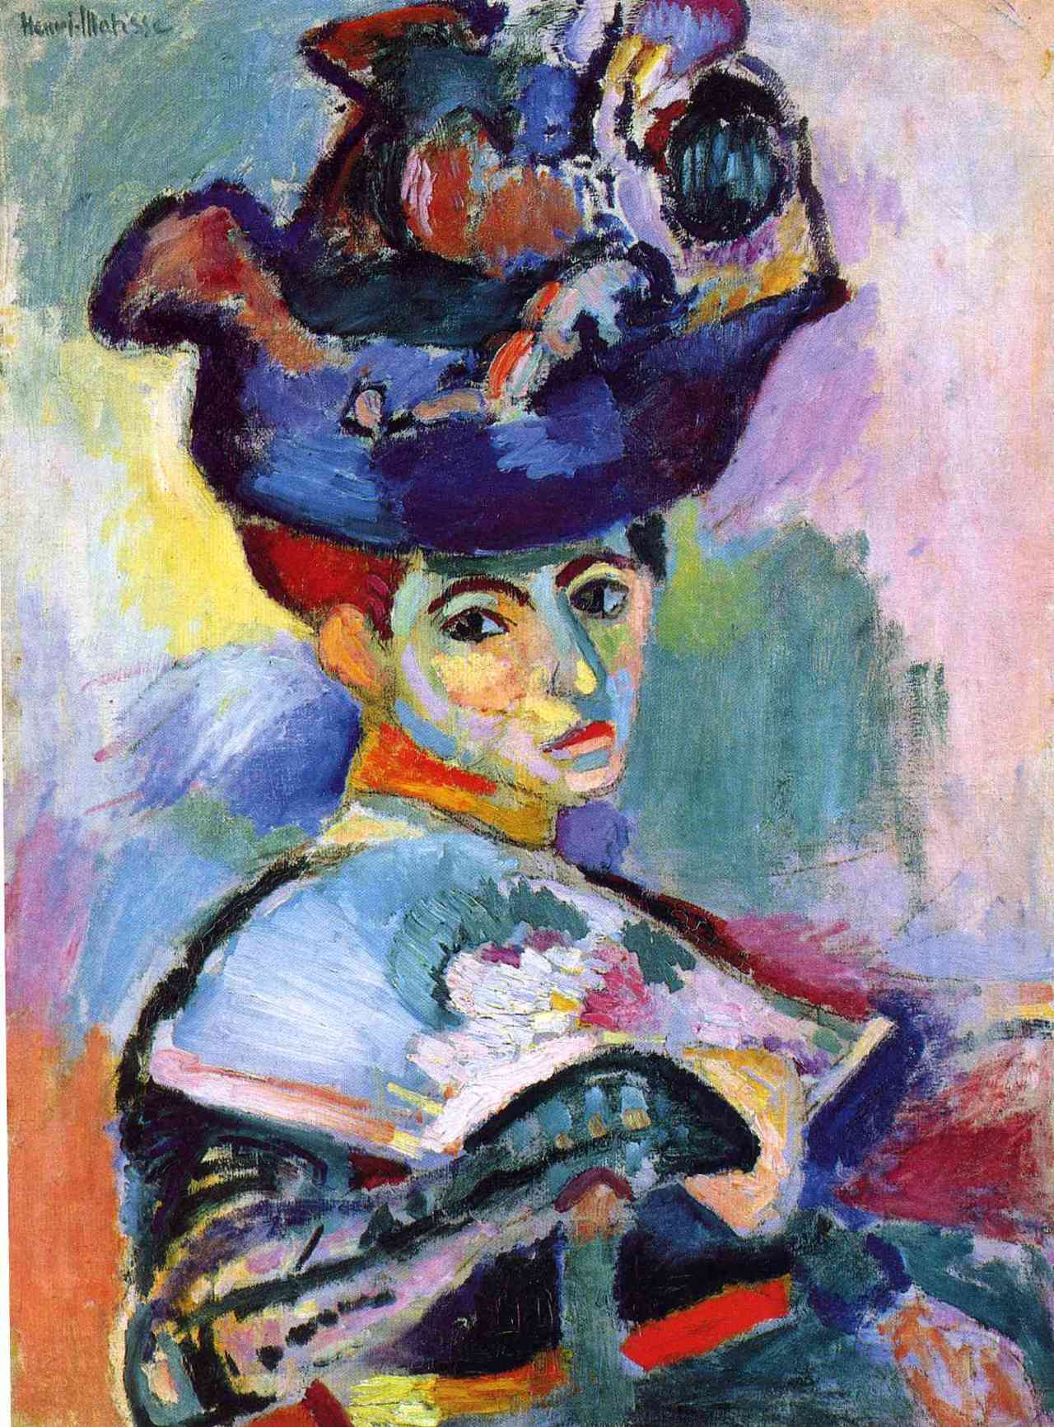
Henri Matisse, Woman with a Hat, 1905. Oil on canvas. 31 3/4” x 23 1/2”. SFMOMA.

Slide 9
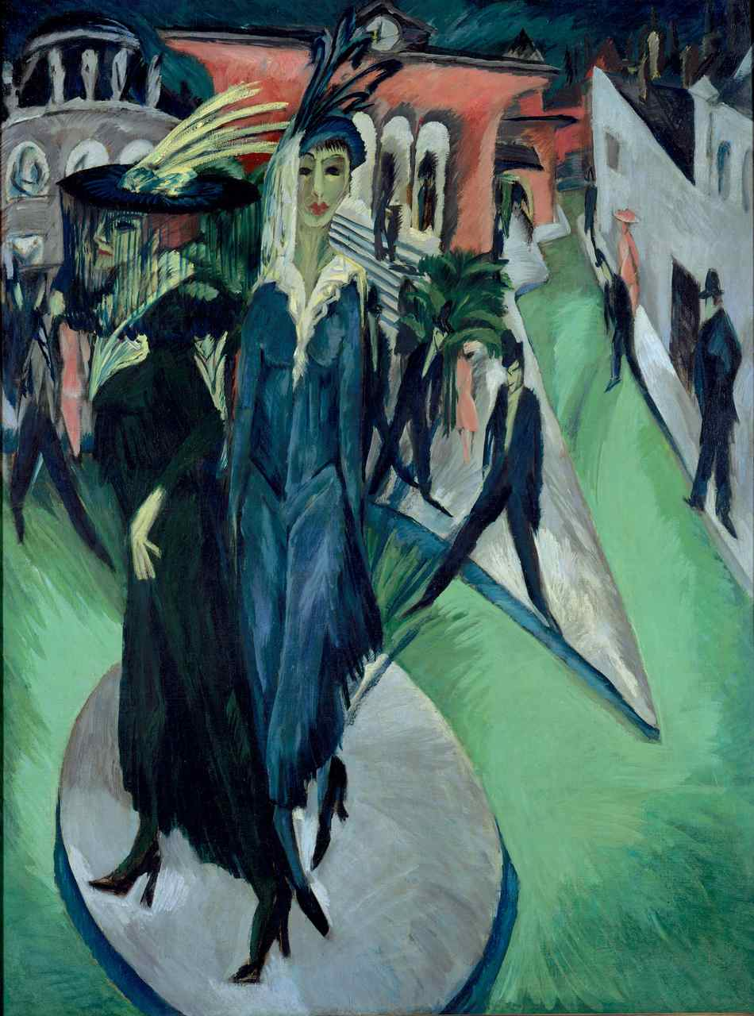
Ernst Ludwig Kirchner, Potsdamer Platz, 1914. Oil on canvas. 66 ¾ x 59 1/16 in., 200 x 150 cm. Nationalgalerie, Berlin.
Notes:
-Potsdamer Platz was a prostitution-rich area and a busy, hectic street in Berlin. There is a younger woman and an older one, the one wearing a black widow’s veil.

Slide 10
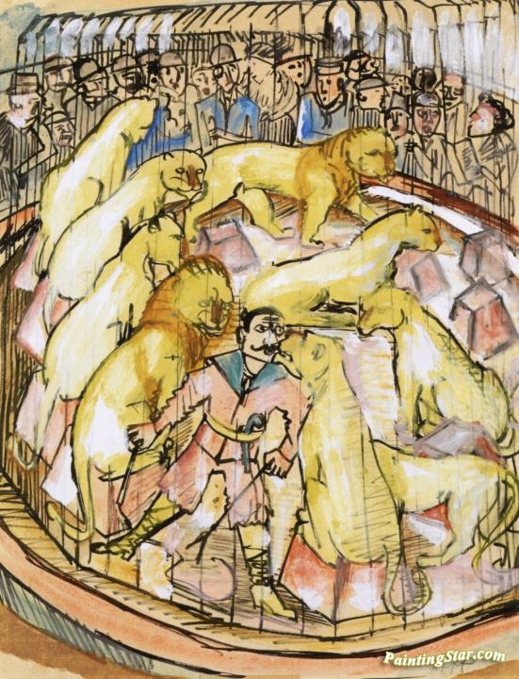
Hermann Max Pechstein (German, 1881-1955), The Lion Tamer, c. 1920. Gouache, watercolor, India ink on paper. 20 5/8 x 16 1/8 in. Private collection.

Slide 11
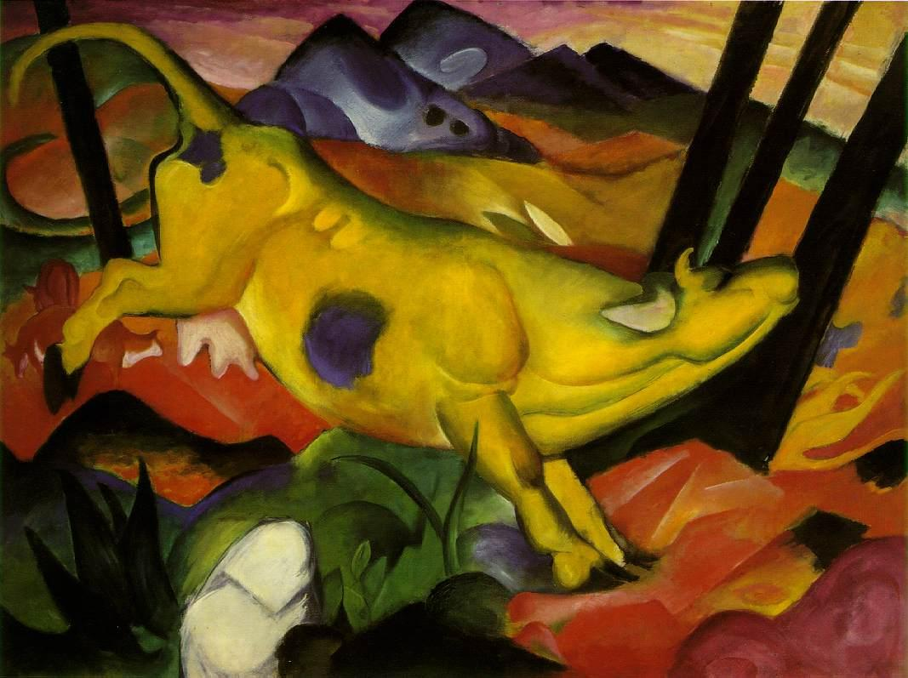
Franz Marc, Yellow Cow, 1911. Oil on canvas. 55 3/8” x 74 ½”. Solomon R. Guggenheim Museum, NYC.

Slide 14
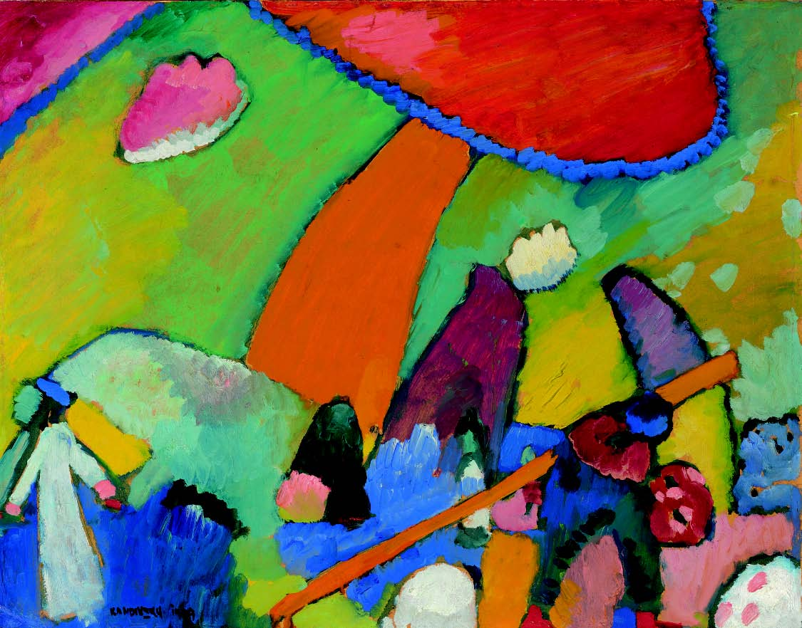
Wassily Kandinsky, River Scene (1909). Oil on board. 20 3/4” x 26 3/8”. Private collection.

Slide 15
Wassily Kandinsky, River Scene (1909). Oil on board. 20 3/4” x 26 3/8”. Private collection.

